Slide 1
U8 Safe and sound
Reading
The Highfield earthquake

Slide 2
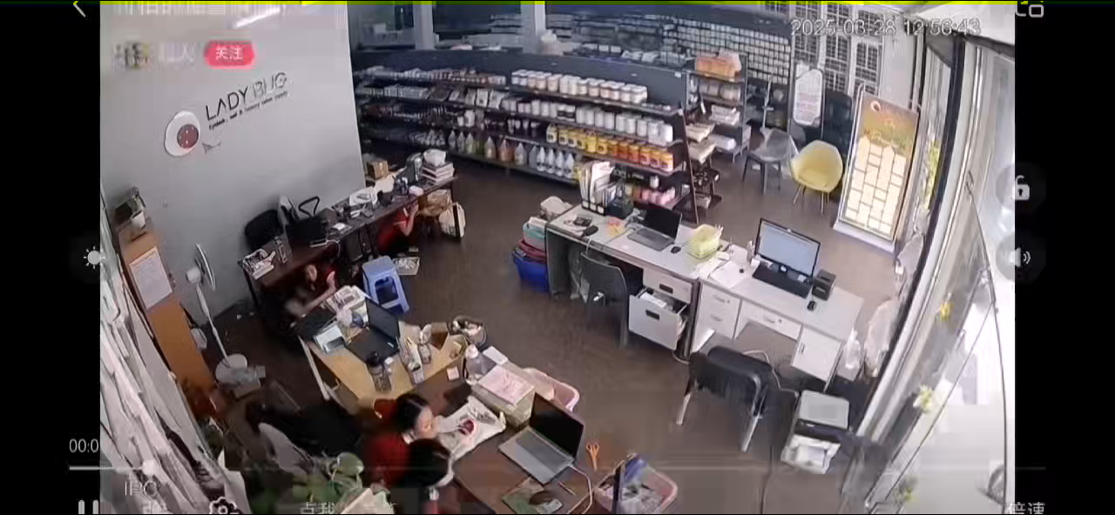
Lead-in
What’s the natural disaster in the video?
It’s an earthquake.

Slide 3
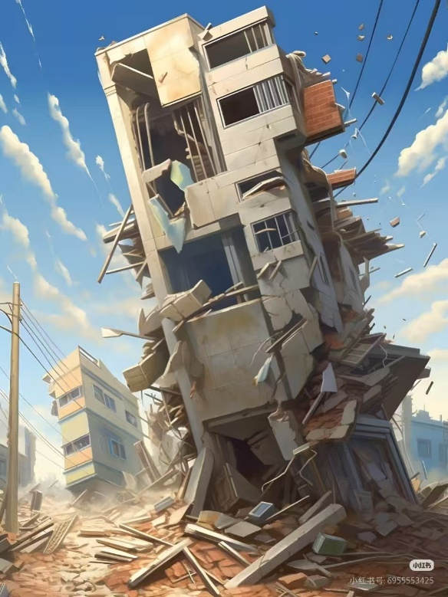
Pre-reading:
What would you see if you were in an earthquake?
The buildings were shaking（摇晃）.
Pieces of glass and bricks（砖块）
were raining down（倾盆而下）.

Slide 4
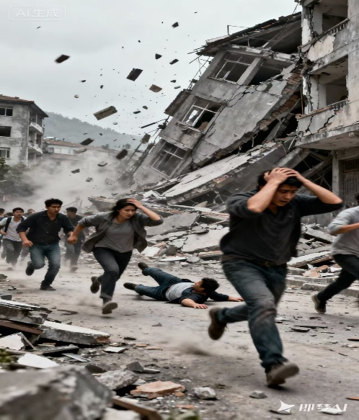
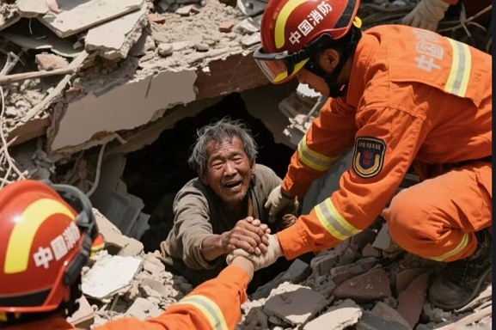
Pre-reading:
What would you see if you were in an earthquake?
People were running in all directions
（四处逃散）.
Some people were trapped（受困的）.

Slide 5
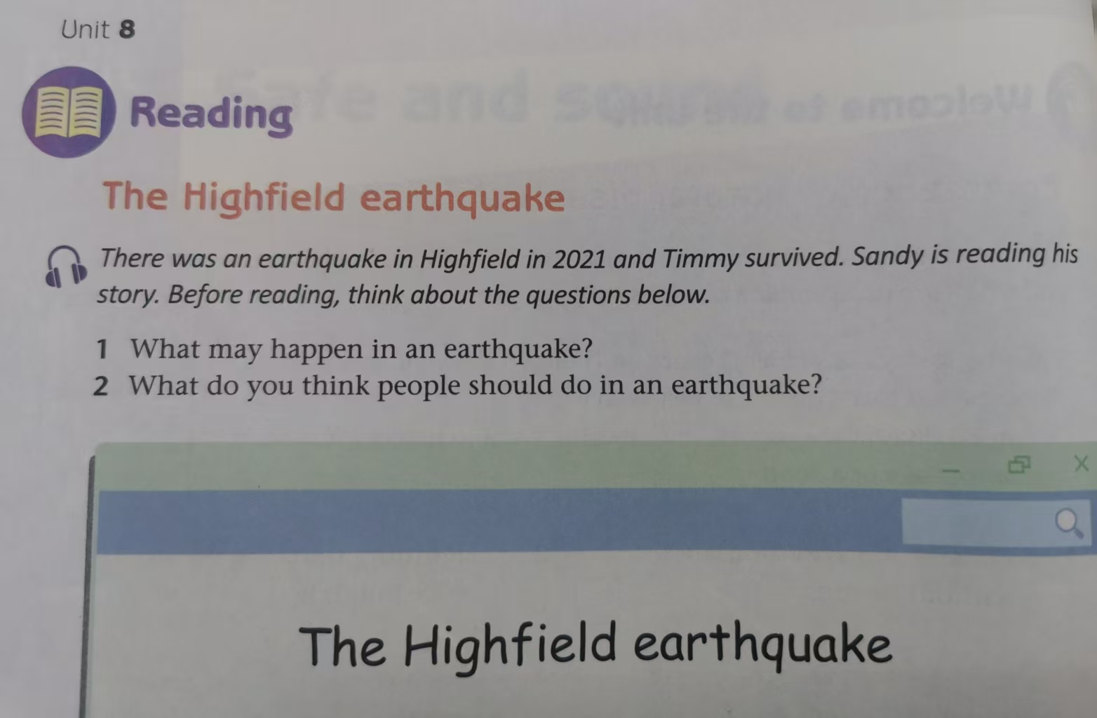
Pre-reading: read rubrics（标题提示） and answer

Slide 6
Pre-reading: read rubrics（标题提示） and answer
Where did the earthquake happen?
In which year did it happen?
Who is in the story?
Was he safe at last?
In Highfield.
In 2021.
Timmy.
Yes. Because he survived.

Slide 7
Fast reading:
1. What’s the type of this article?
A
Narrative writing（记叙文）
Argumentative writing（议论文）
Expository writing（说明文）
2. What’s the order of this article?
A
A. Time order B. Space order
It was about two o’clock in the afternoon.
Soon the real noise came.
Finally, the noise and shaking ended.
Hours later, I suddenly heard some noise above me.

Slide 8
Fast reading:
Write the correct paragraph number next to each main idea
Paragraph number | Main idea
 | Timmy found himself trapped in the building.
 | The earthquake started when Timmy was working.
 | A group of people helped Timmy out.
 | People were scared and tried to run out of the building.
 | Timmy tried to get help
Para 3
Para 1
Para 5
Para 2
Para 4

Slide 9
Fast reading: 1. Divide them into three parts.
2. Match the main idea with each part.
Part 1:
Para 1
After the earthquake
Part 2:
Para 2
Before the earthquake
Part 3:
Para 3-5
During the earthquake

Slide 10
Detailed reading: (Para 1) Before the earthquake
When?
Two o’clock in the afternoon.
What was he doing?
He was working.
The earthquake started
How did he feel?
He felt a slight
（轻微的） shake.
What did he hear?
He heard a loud noise like thunder（雷声）.

Slide 11
Detailed reading: (Para 1) Before the earthquake
Then I heard a loud noise like thunder.
Soon the real noise came, like bombs（炸弹） under the ground.
What rhetorical device（修辞手法） is used?
is used to show how loud the noise is.
Metaphor（比喻）

Slide 12
Detailed reading: (Para 2) During the earthquake
What did Timmy…?
hear | The like bombs Some people .
see | People the building People ran . Pieces of raining down The walls began to .
do | Tried his best to .
real noise
shouted in fear（害怕）
ran out of
in all directions
glass and bricks
come down
run out
Did he succeed?

Slide 13
Detailed reading: (Para 3) After the earthquake
What was it like around Timmy when the earthquake ended?
It was dark and silent.

Slide 14
Detailed reading: (Para 3) After the earthquake
How did Timmy feel when the earthquake ended?
Find out some sentences to show Timmy’s feelings.
Sentences:
I felt nervous （紧张不安的） and my heart was beating（跳动） really fast.
nervous
A moment of fear went through my mind.
fearful（害怕的）
I told myself to calm down since I was still alive.
hopeful/ optimistic（乐观的）/ brave

Slide 15
Detailed reading: (Para 4-5) After the earthquake
How did Timmy save himself？
shouted for help
He .
But no one came
He didn’t any more（不再）.
shout
Because
save energy and wait for help
He knew he had to .
Hours later
He in a weak voice after hearing the noise.
cried out
find his way out
He had been trying to .

Slide 16
Detailed reading: (Para 4-5) After the earthquake
Discuss with each other about:
What do you think of Timmy?
What saved his life?
strong mind
cleverness
self-help
（自救）
other’s help
bravery
People outside quickly moved away the bricks after hearing Timmy’s shouts.

Slide 17
Post-reading: think further and discuss with each other
If you are trapped（被困） in the earthquake, how will you save yourself?
Stay calm and check the environment to keep away from dangerous areas.
Hide under the solid（坚固的）things to protect the head and body.
Save energy to wait for help.

Slide 18
Post-reading: Work in a group of four to make a report about how to survive the earthquake.
Student A: What is it like when the earthquake starts?
Student B: What should you do during the earthquake?
Student C: How will you save yourself if you are trapped in the earthquake?
Student D: Give a report in front of the whole class on behalf of（代表） your partners.

Slide 19
Dear classmates:
I’m glad to be here to give you a report about how to survive the earthquake on behalf of my partners.
When the earthquake starts, .
.
During the earthquake, you should .
.
If it’s unlucky for you to be trapped in the earthquake, don’t panic（惊慌）. You had better .
.
.
.
I hope it will be of great help to you. Thanks for your attention.

Slide 20
feel a slight shake
hear the loud noise like the thunder
run fast
run to the open spaces
take the stairs（楼梯）
stay away from dangerous things
keep calm
never give up
check the environment
hide under the solid（坚固的）things
protect the head and body
save energy and wait for help

Slide 21
Why do we need to learn about these emergency（应急） actions?
Hope you will never experience:
A book is known in time of need.（书到用时方恨少）
Hope you will do:
Save for a rainy day.
Hope you will realize:
Be safe and sound.

Slide 22
Homework:
Must do: Search online to learn more about what to do to be safe if you are trapped in the earthquake.
Choose to do: Search online to learn about how to prepare for the possible earthquakes.

Slide 23
Thank you for your time

