Slide 1

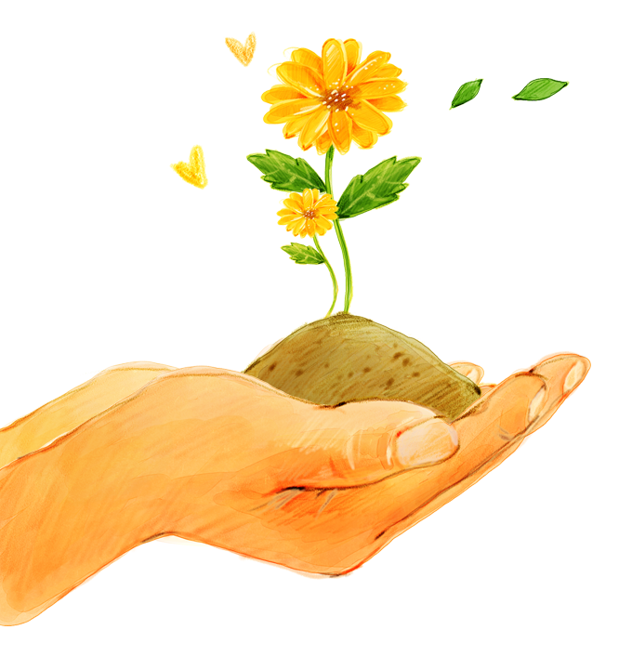
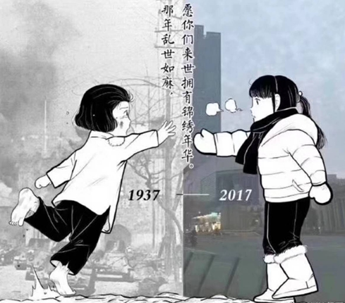
Unit 4 Growing up
Integrated skills
1929-
-2025

Slide 2
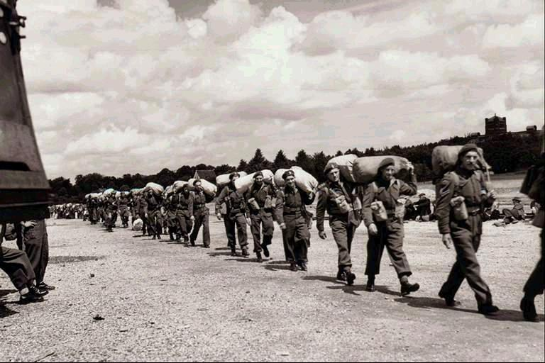
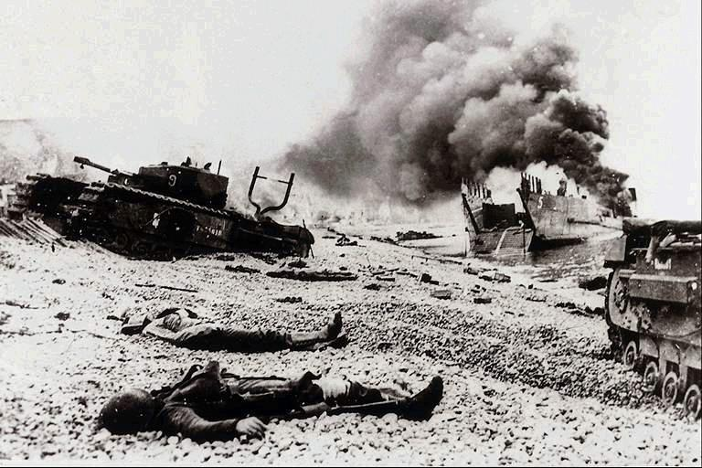
Lead-in
World War II
broke out
World War II started suddenly in Europe in 1939.

Slide 3
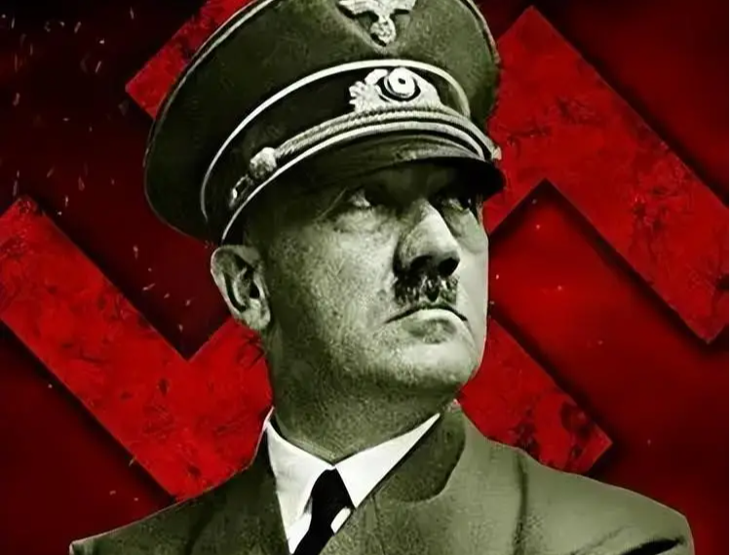
Lead-in
World War II
was the leader of ______________.
Hitler
German Nazis
/'na:tsi/ n. 纳粹

Slide 4
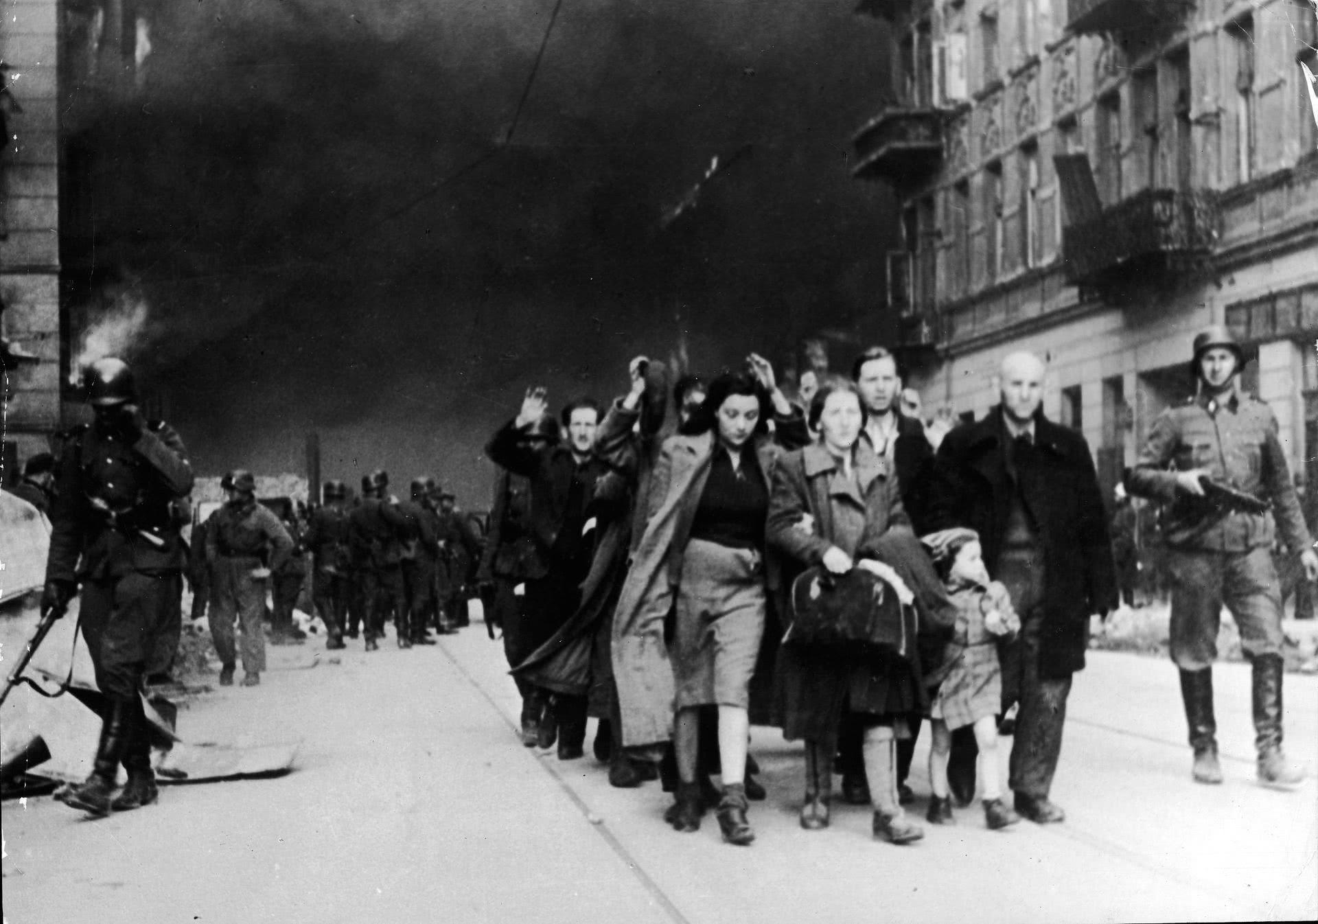
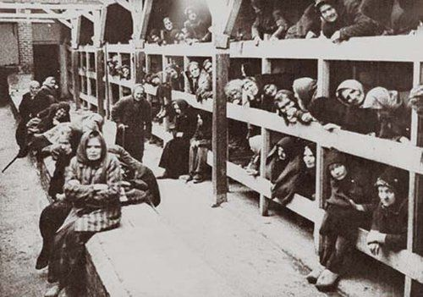
Lead-in
/dʒu:/ n. 犹太人
纳粹集中营
Jews
Nazi camp
Many died in the .

Slide 5
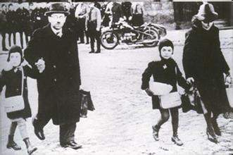
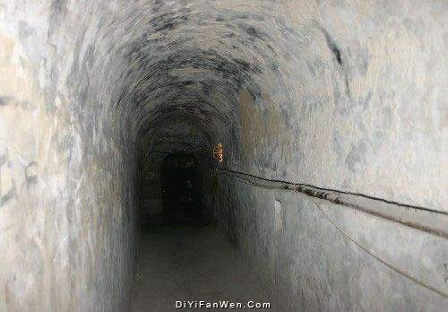
Lead-in
Life changed for everybody.
went into hiding （hid in safe places）
lived in fear of their lives （were afraid of dying）

Slide 6

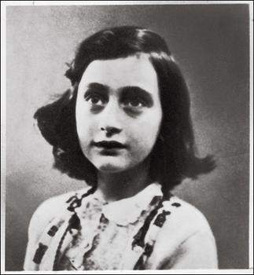
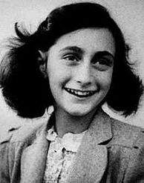
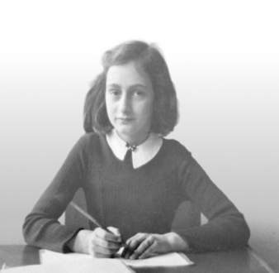
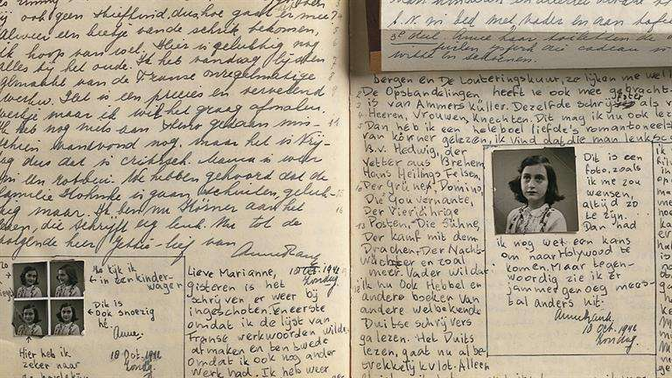
Lead-in
Anne Frank
The Diary of a Young Girl
Published after the war
Imaginary friend: Kitty
（1929.6—1945.3）

Slide 7

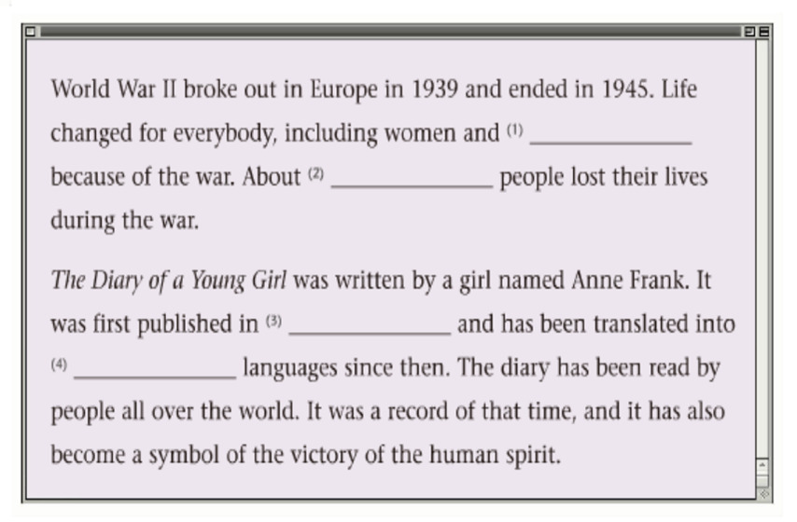
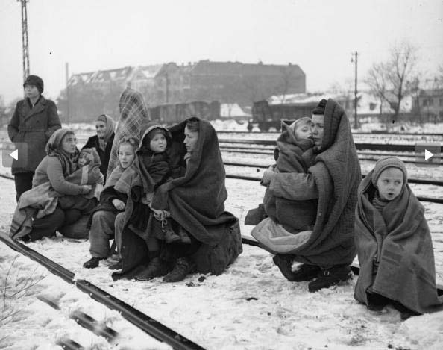
While-listening
Millie is listening to a radio programme about a book and World War II. Listen and fill in the missing words.
Anne Frank and World War Ⅱ
Tips：
1.Predict before listening.
2.Find the key words and circle them.
sb.
number
time
number

Slide 8
While-listening
Millie is listening to a radio programme about a book and World War II. Listen and fill in the missing words.
Anne Frank and World War Ⅱ
Why has the book been read by people all over the world?
children
72 million
72,000,000
World War Ⅱ is terrible.
What makes the victory of human spirit?
The victory of the human spirit.
1947
67
The book is popular among the world.

Slide 9
Pair work: Check your answer with your partner.
Anne Frank’s life
1929
Germany
born in .
1942
In July, they went into hiding in her father’s
Tip:Pay attention to the time order.
office
1944
In August, they were caught and sent to a Nazi camp.
1945
Anne’s died. and in March, Anne and her elder died of illness.
mother
sister
1947
Her had her diary published.
father

Slide 10

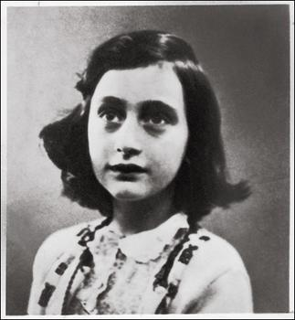
Retell Anne Frank’s life
1. When was she born?
2. How old was she in 1942/1944?
3. When did she die?
1929
Germany
born in .
13 years old
In July, they went into hiding in her father’s
1942
office
1944
In August, they were caught and sent to a Nazi camp.
15 years old
（1929.6-1945.3）
16 years old
1945
Anne’s died. and in March, Anne and her elder died of illness.
mother
sister
She lived a life.
short
1947
Her had her diary published.
father

Slide 11
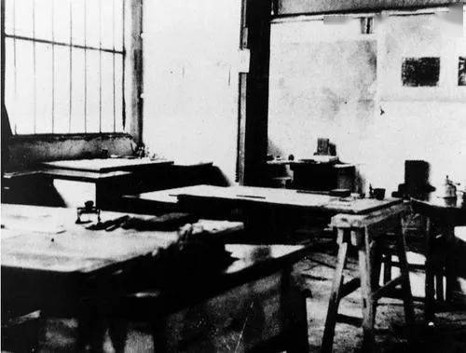
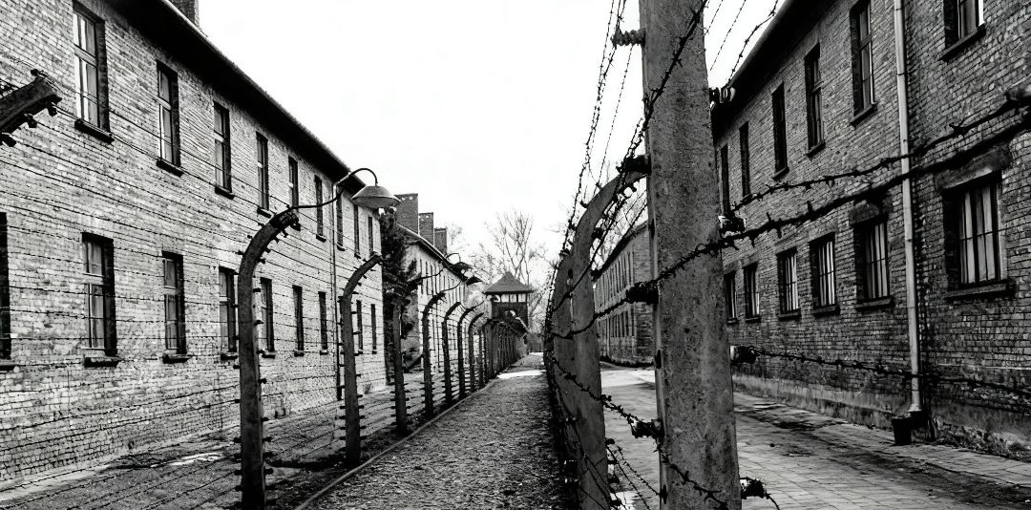
Try to imagine Anne Frank’s life during the war.
13 years old
went in hiding in her father’s office
15 years old
were caught and sent to a Nazi camp
Could she go outdoors?
Could she run and shout and jump?
Could she breath fresh air?
difficult
She lived a short and life.

Slide 12
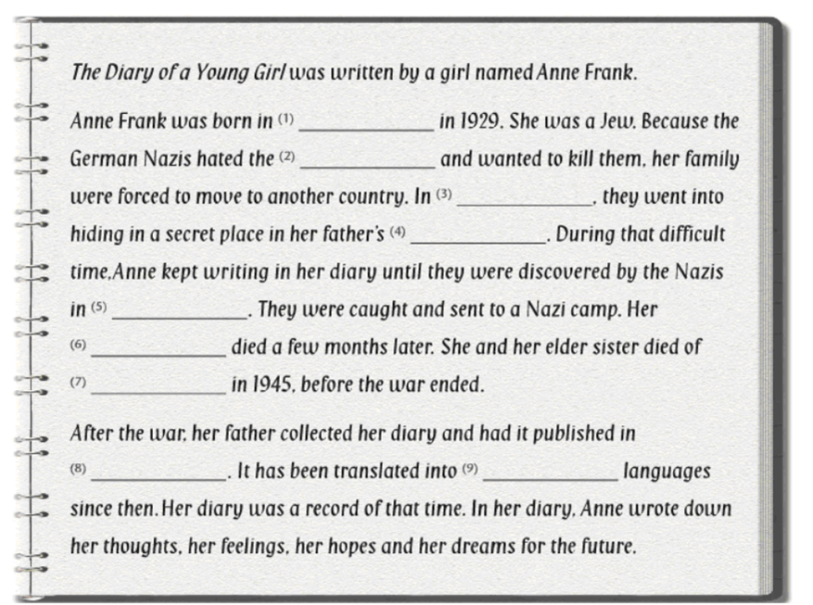
A3
Help Mille complete the article with the information on page 57.
Group work: Check your answer in group of 4 and report it one by one.
What did Anne do during the difficult time?
What did Anne keep writing during that time?
Germany
Jews
July. 1942
office
August. 1944
mother
illness
1947
67

Slide 13
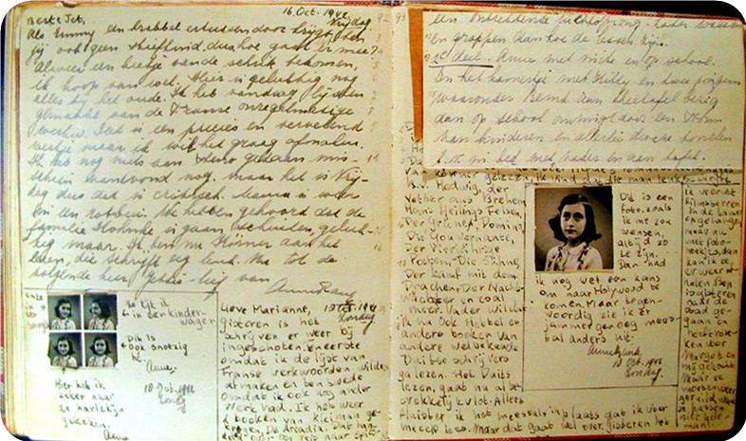
Further thinking
It’s hard for us to live in this mad world.
生活在这个疯狂的世界里很痛苦。
Work and hope.
努力就有希望。
I feel the beauty of nature and the goodness of the people around us.
我感受到了自然的美丽和我身边人的闪光点。
Being hopeful and positive
Read and find your favourite sentence.
makes the victory of human spirit.
I want to go on living, even after I died.我想让生命延续，就算我死了。
What was Anne’s life during the war?
She lived a short, difficult but
life.
hopeful and positive(积极的)

Slide 14

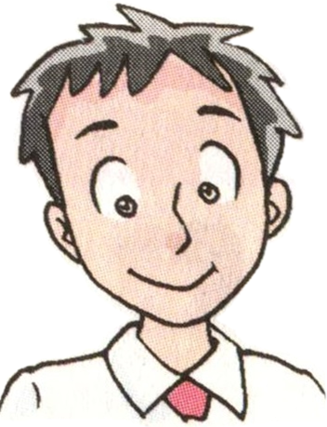


Speak up
some other stories about children in the war.
What books do they read?
What are the books about?
A 12-year-old boy and his journey to Copenhagen /kəʊpən'heiɡən/ after he got away from a Nazi camp.
I admire these children for their courage.
I’m David
Simon
Being brave
makes the victory of human spirit.
A young homeless boy and how he survived the war with his friends.
A Small Free Kiss in the Dark
Millie

Slide 15
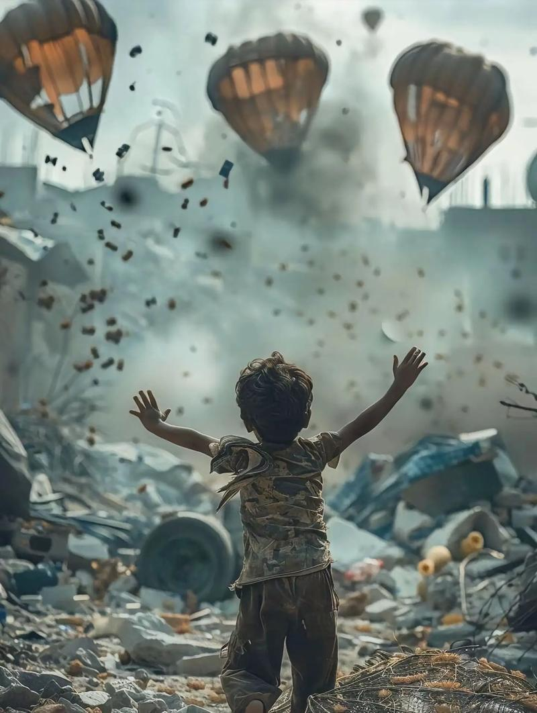
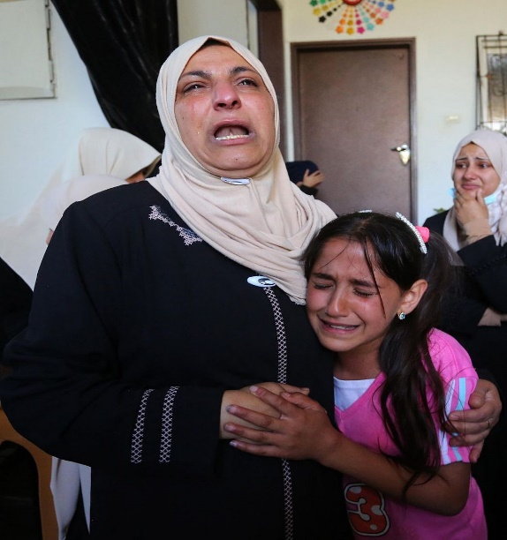
war happens
still
never
I hope again.
If you were Anne, what will you say to them?
Although we may lose our lives, human spirit will all the time.
win

Slide 16
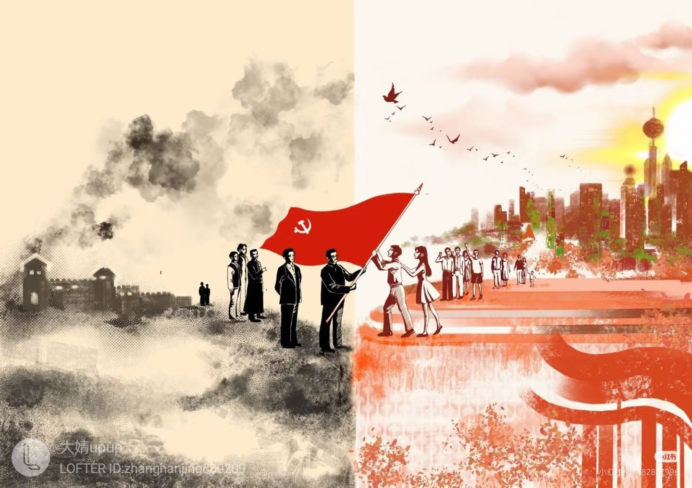
Group Work
President Xi said,‘China will
always be the builder of the world peace.’
A speech contest
What can students do for the world peace?

Slide 17
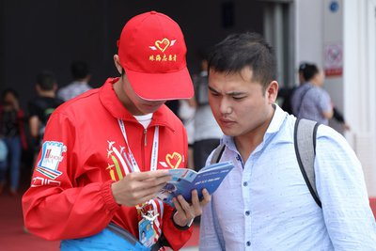
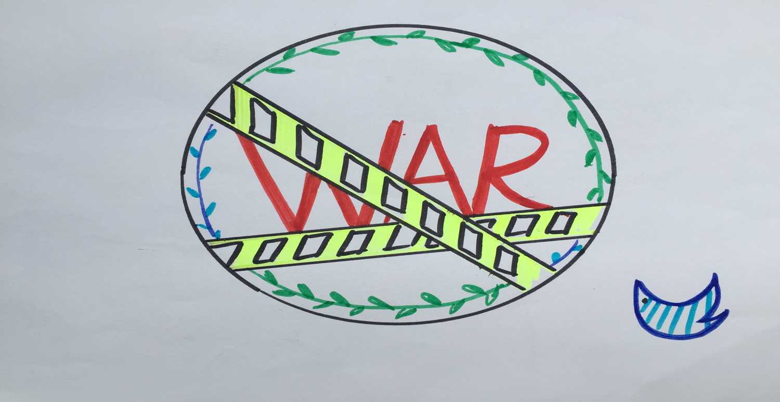
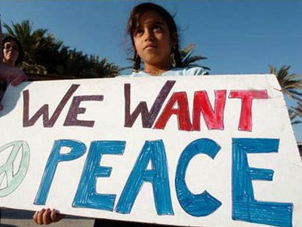
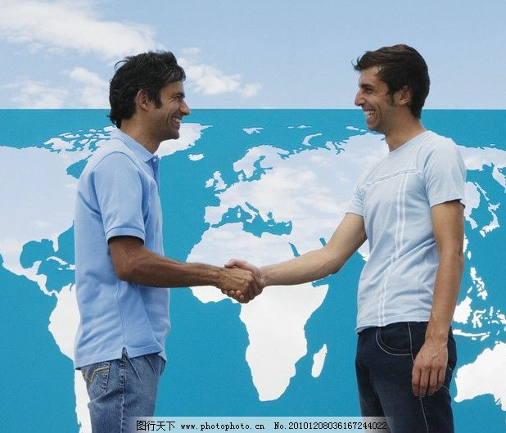
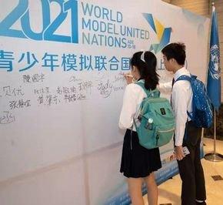
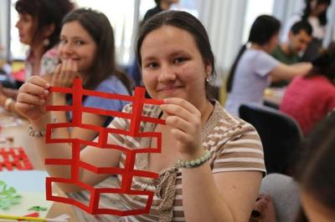
A Speech on Keeping World Peace
We are now living in a peaceful country, and we take the responsibility(责任) for peace. As for we students, There’s a lot we can do.
First of all, we_____________________________________________.
Moreover, it is necessary for us to______________________________.
What matters is that_________________________________________.
Last but not least,___________________________________________.
Peace is not achievement but responsibility. It’s high time we should take action to make a difference!

Slide 18
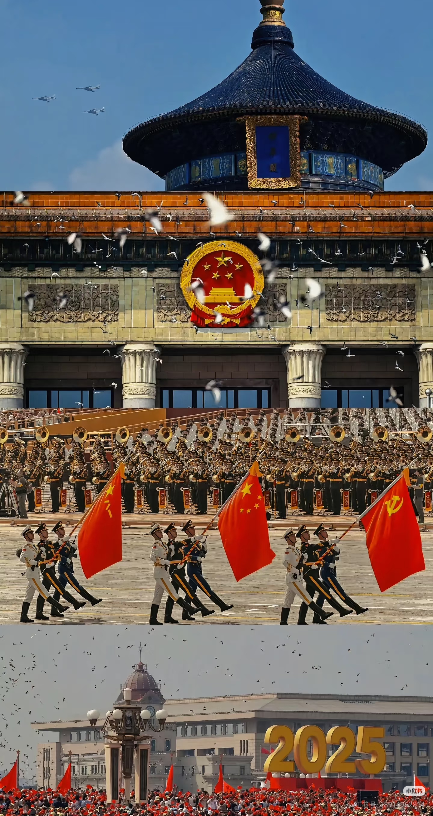
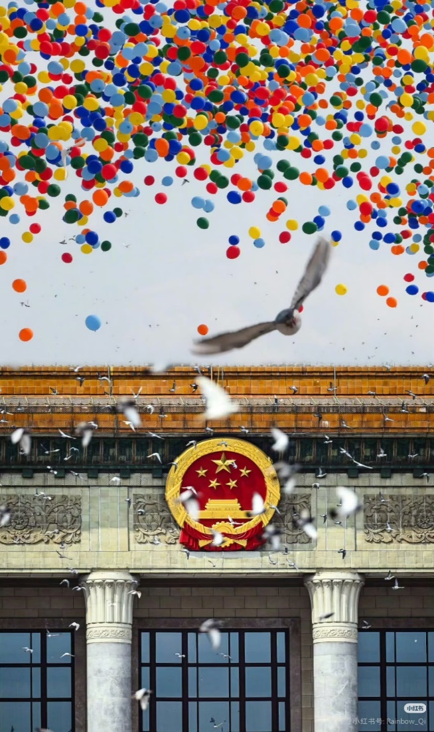
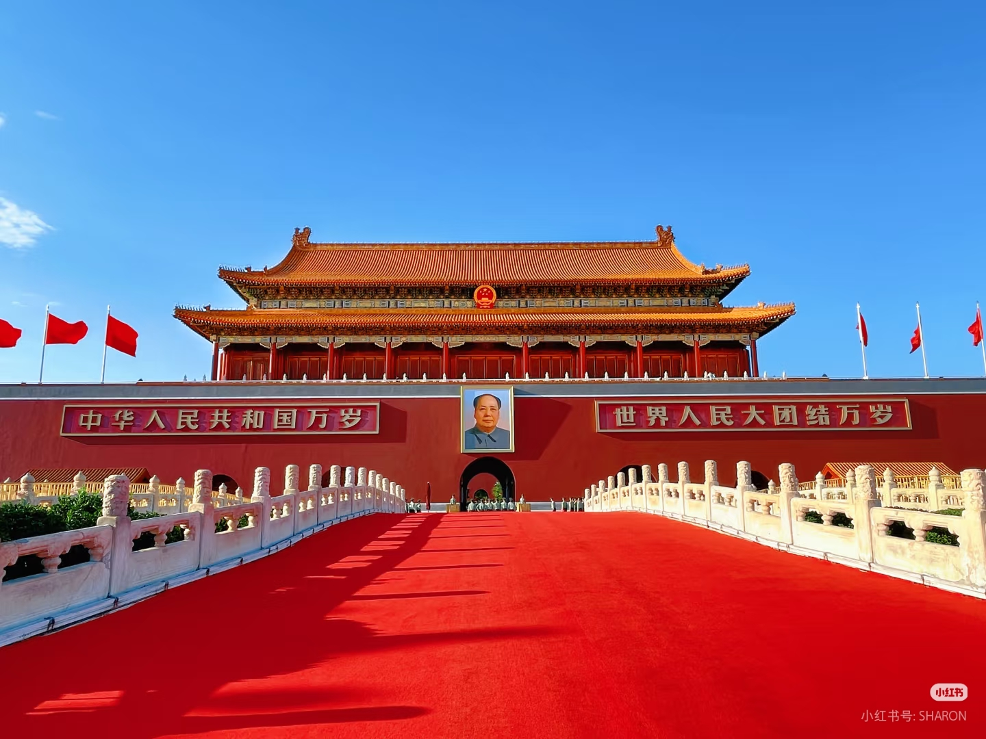
Summary
We are lucky to live in a peaceful country.
Cherish hard-won peace we have now.
Work hard to make our country more beautiful and peaceful.
Grow up to be a better person.

Slide 19

Homework
1. Search for more information about WWII,
Anne Frank and The Diary of a Young Girl.
2. Share with your classmates or friends.
Notes:
Try to think further and share what you’ve learned after reading.

Slide 20
Language points
1. World War II broke out in Europe in 1939 and ended in 1945.
break out意为“突然发生；爆发”，常指战争、灾难、疾病或者争吵等事件的发生。
e.g. The big fire broke out during the night.
那场大火晚上发生的。

Slide 21
break的短语：
break the rule 违反规则；
break off 突然中止；中断；
break down 停止运转；出故障
break up 打碎，分裂
break into 闯入，破门而入

Slide 22
2. It was a record of that time...
keep a record of... 记下......
e.g. You should keep a record of your expense.
你应该记下你的开支。
[名词] (尤指体育运动中的)纪录：
hold/keep a record 保持记录
world record世界纪录
set/break a record 创造/打破纪录

Slide 23
3. She and her elder sister died of illness in 1945.
die of / from… 死于……
e.g. More and more people die of/ from cancer.
越来越多的人死于癌症。
die的短语：
die out 灭绝；逐渐消失
die off 相继死亡

Slide 24
die of 死于疾病、衰老等自身的原因…
die from死于外部的原因，如事故、意外等...
die out常指家族、观念、习俗等的逐渐消失或(动植物)物种的灭绝
We no longer see this animal, probably because it has died out.
In a cold winter, some animals can die from lack of food.
Her grandfather died of heart trouble last year.

Slide 25
4. Her father had her diary published.
have sth done 让/使某事被做
表示“让（他人）为你做（某事）”，相当于get/make sth done。过去分词表示被动，与sth.构成动宾关系。
e.g. I had my hair cut yesterday.
昨天我理发了。

Slide 26
have sth to do 有某事要做
e.g. I have an important task to finish.
我有一项重要的任务要完成。
have sb do sth 让某人做某事，相当于get sb to do sth
e.g. I had Mary clean my bedroom yesterday.
昨天我让玛丽打扫了我的卧室。

Slide 27
5.German adj.德国(人) 的, 德语的;
n. 德国人,其复数形式为Germans.
Germany n. 德国

Slide 28
6.keep (on) doing 继续/重复做某事
keep sb doing sth 让某人一直做某事
Keep sb from doing sth 阻止某人做某事
e.g. Keep on practicing and you’ll make progress. 继续练习，你会取得进步的。
e.g. I keep them waiting at the gate.
我让他们一直在门口等候。
The heavy rain kept them from going out.
大雨阻止了他们外出。

Slide 29
7.thought n.想法, 看法, 主意;v. 想, 认为,think的过去式及过去分词 thought作 “思想; 思维活动” 讲时指经过推理与思考而产生的看法, 也指较全面, 较系统的思想。
Please let me have your___________ (think) on the matter.
thoughtful adj. 深思的；体贴的
thoughts
e.g. 我母亲是一个很体贴的人。
My mother is a very thoughtful woman.

Slide 30
8. survive v.幸存，生存
e.g. Did anyone survive the earthquake?有人在地震中活下来吗？
survivior n. 幸存者
9. admire v.钦佩某人/某事
admire ab/sth 钦佩某人/某事
admire ab for (doing) sth 因(做)某事而钦佩某人
e.g. I admire the scientists like Yuan Longping.
我钦佩像袁隆平那样的科学家。

Slide 31
10.courage n. 勇气
e.g. It takes courage to do that.
做那件事需要勇气。
encourage vt. 鼓励
e.g. It takes courage to do that.
做那件事需要勇气。
Mr. Wu often___________ (courage) us to speak English aloud in class.
encourages

Slide 32
11. It is a pity that...很遗憾......
e.g. It is a pity that he has to leave.
很遗憾他必须要走了。
What a pity! 多么遗憾！
pity n. 同情；怜悯
have/take pity on ... 同情/怜悯......
e.g. I always have pity on beggars.
我总是对乞丐心怀怜悯。

Slide 33
12. in fear of one’s life 表示 “为生命安全担扰” ,其中的fear表示 “担心, 害怕”, life表示 “生命”。
e.g. We walked quietly, in fear of being discovered. 我们悄悄地走，害怕被发现。

