Slide 1
7BU6 Beautiful landscapes
Reading I
刘铭

Slide 2

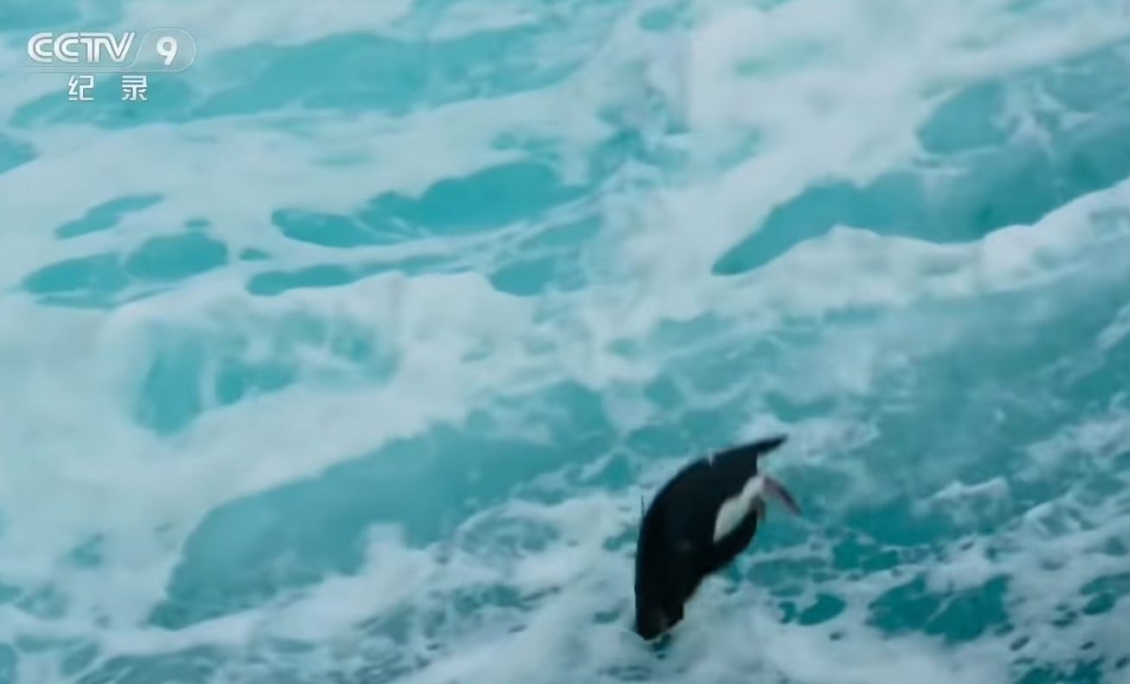
Watch and answer

Slide 3
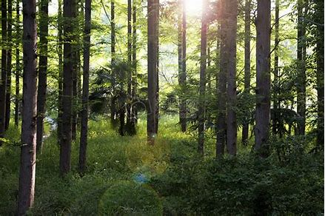
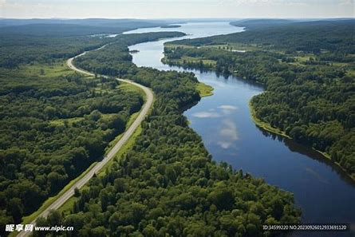
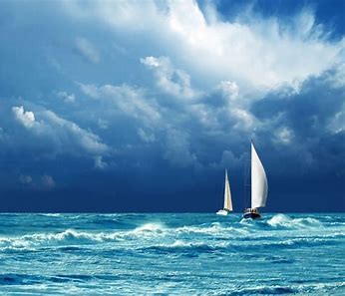
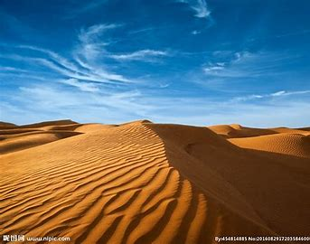
Watch and answer
What landscapes can you see?
Let’s say together!
forest
river
ocean
desert
beautiful
The landscapes are _________.

Slide 4
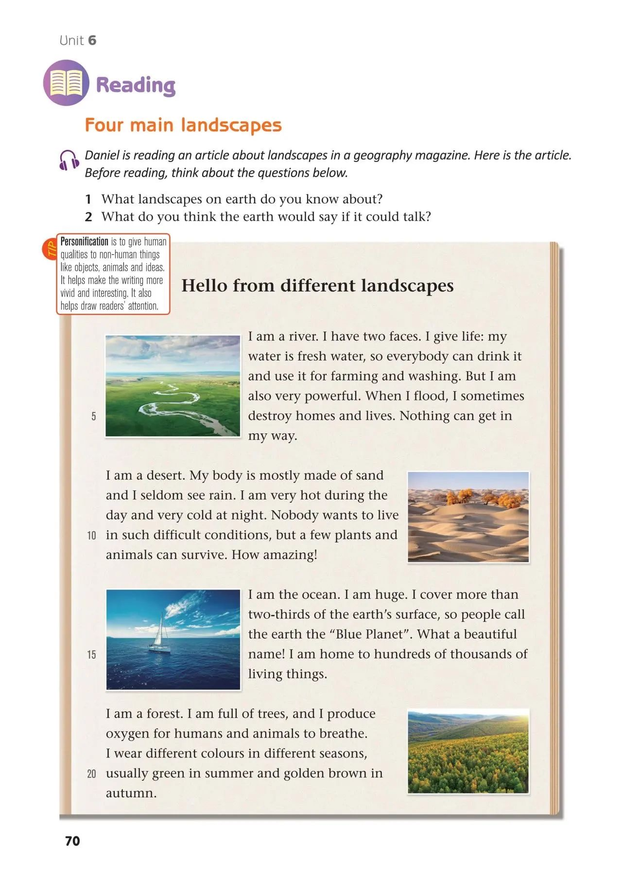
Look and answer
1.What is the article about?
2.Where can we read the article?
Who?

Slide 5
Skim and answer
1.Who are they?
2. Which rhetoric(修辞) is used?
A. Metaphor （比喻）
B. Personification (拟人)
✔
What may the different landscapes say?
makes the writing more vivid and interesting

Slide 6



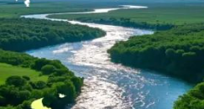
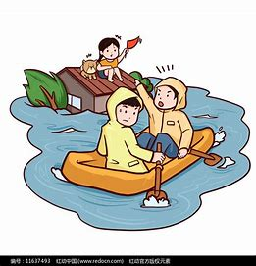
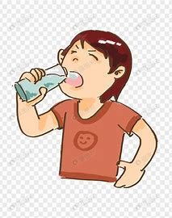
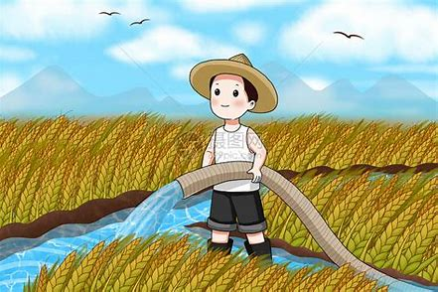
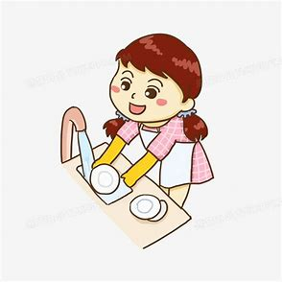
River
Beauty of power
What is the river like? Find the topic sentence.
great power
“I have two faces.”
What can the river do?
useful
Nothing can get in my way!
important
powerful
______ life
give
when I ______
flood
fresh
______ water
destroy
_____
destroy
_____
______
______
______
drinking
farming
washing
homes
lives
Further thinking:
What do you think of rivers?

Slide 7
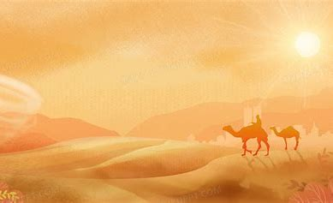

Desert
Listen and fill in the table.
Desert
How : | 1._______conditions
What : | mostly made of 2.______ 3.________ see rain 4._____ during the day and 5._____ at night
Who : | 6.________ wants to live here.
difficult
sand
seldom
hot
cold
Nobody

Slide 8

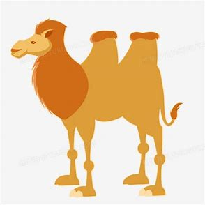
Desert
Beauty of challenge
cactus
camel
Read and think
1. Are there any living things here?
A. lose their lives
B. continue to live
... but a few plants and animals can survive.
✔
2. What are they like?
Which one is better?
strong, amazing...
They are amazing.
v.s.
How amazing!
Tip: We can use HOW to express strong feelings.

Slide 9
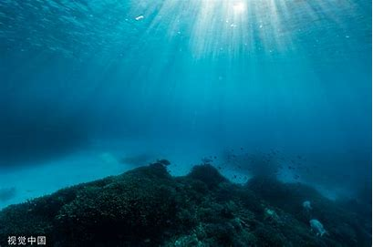
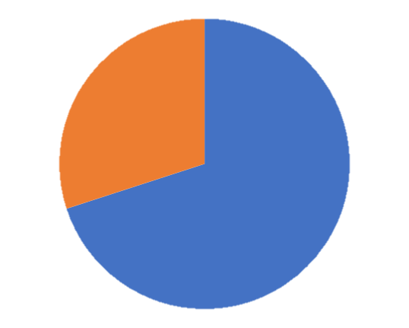






Ocean
Beauty of vastness (广阔)
Find the numbers and what they stand for(代表)
Tip: We can use What to express strong feelings.
land
ocean
What a beautiful name!
stand for
two-thirds
area
_______
the ____ of the ocean
Blue Planet
huge
hundreds of thousands of
stand for
number
_______
the _______ of the living things
The writer uses the two numbers to show the ocean is ________.
The ocean is home to hundreds of thousands of living things.
seagrass
coral
shark
dolphin
crab

Slide 10
Ocean
Beauty of vastness (广阔)
Use “What” and “How” in sentences to show your strong feelings.
Q: What do you think of the ocean and the living things?
I think the ocean is...
How ______ the ocean is!
I think the living things are...
What______ living things!
seagrass
coral
shark
dolphin
crab

Slide 11


Forest
1.Fill in the three blanks;
2. put the pictures in the right circle
Beauty of life
different colors
different seasons
wear _______in _________
2. ;;;;;
A
summer
autumn
1. ;;;;;
lively
important
CO2
（二氧化碳）
full of ____
trees
/ˈɒksɪdʒən/
spring
winter
B
I am a forest. I am full of trees, and I produce oxygen for humans and animals to breathe.
the cycle of ____
life
/briːð/

Slide 12
Appreciate the beauty of language
Which one do you like better? Why?
I am a forest. I am full of trees, and I produce oxygen for humans and animals to breathe. I wear different colours in different seasons, usually green in summer and golden brown in autumn.
A forest is full of trees and produces oxygen for humans and animals to breathe. It has different colors in different seasons, usually green in summer and golden brown in autumn.
Tip: Personification makes the writing more vivid and interesting.

Slide 13
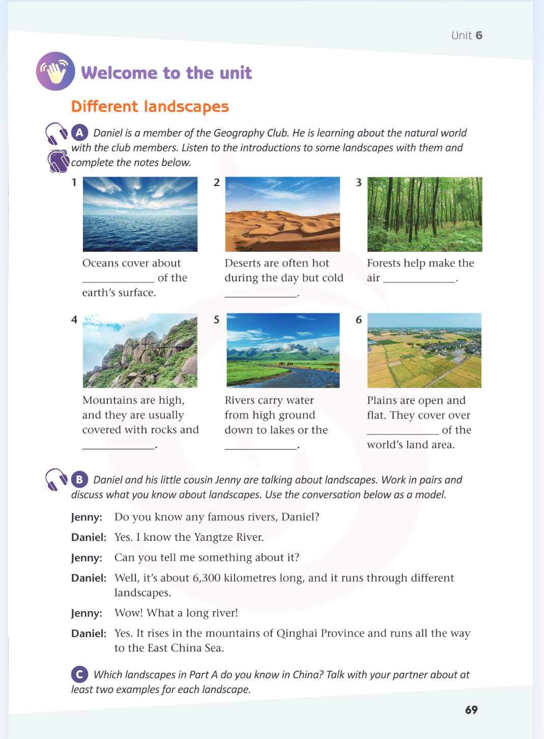
Appreciate the beauty of language
Have a try: Please introduce the other two landscapes by using personification. Practice in pairs.
I am a forest. I am full of trees, and I produce oxygen for humans and animals to breathe. I wear different colours in different seasons, usually green in summer and golden brown in autumn.
Mountains are high, and they are usually covered with rocks and earth.
Plains are open and flat. They cover over one-third of the world’s land area.
Tip: Personification makes the writing more vivid and interesting.

Slide 14
Find
the beauty of power
the beauty of challenge
Enjoy
the beauty of vastness
the beauty of life

Slide 15
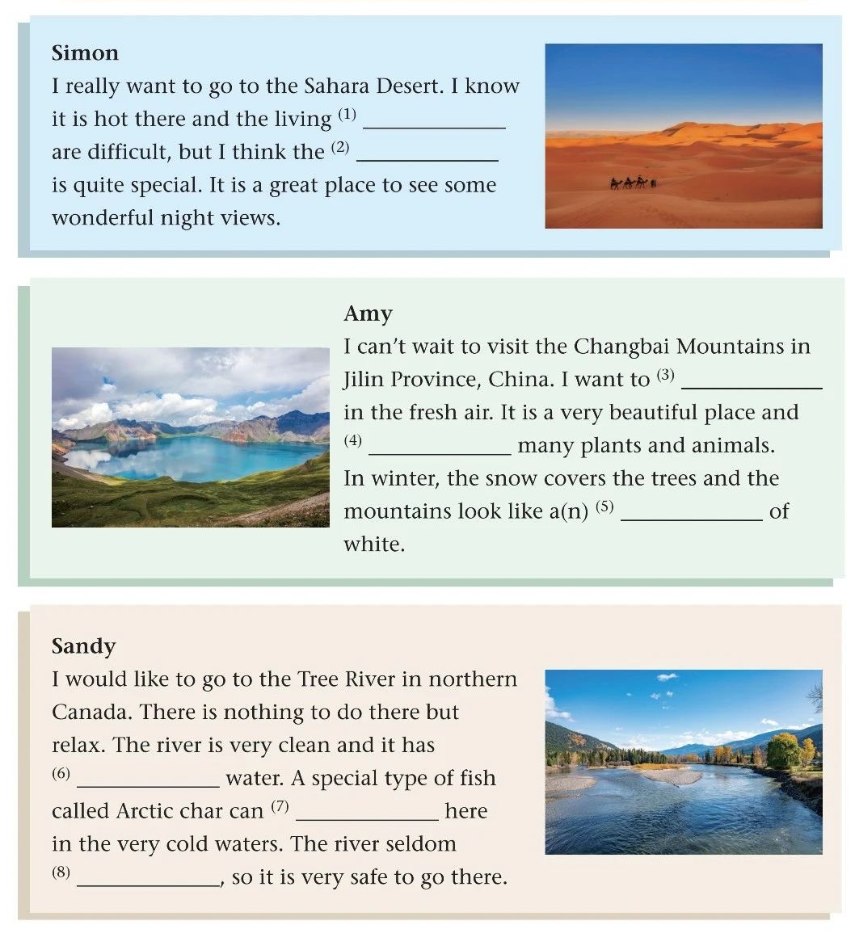
Enjoy the beauty
conditions
landscape
1. Complete the articles with the correct forms of the words.
2. Think about why they want to visit these places.
Talk about places that you want to visit. Ask and answer in turns. 【Pair work】
A: What places do you want to visit?
B: I want to visit _______ because it is _______. And I can ____________here.
breathe
conditions flood breathe
ocean survive landscape
be home to fresh
is home to
ocean
fresh
survive
floods

Slide 16
Find
the beauty of power
But in some places,
the beauty of challenge
Enjoy
water is polluted (污染)，
the beauty of vastness
Keep
the beauty of life
trees are cut down，
and animals are in danger.

Slide 17
Keep the beauty
Discuss in groups
What can we do to keep the landscapes beautiful?
What we should do
What we shouldn’t do
plant more trees
cut down trees
save water
use too many plastic bags
protect animals
throw rubbish everywhere
share knowledge and work together

Slide 18
Role play
Work in groups of 4: Each of the group members play the role of one landscape and introduce yourself.
e.g. I am a mountain! I am tall and I’m usually covered with rocks and earth. I am home to many plants and animals. Don’t litter on me- keep me clean and protect my forest!
name
features
importantce（重要性)
actions to protect you
I’m a river. I’m ________. I can __________. Please________
Student A:
Student B:
I’m a desert. I ________. I __________. Don’t________
Student C:
I’m the ocean. I’m ________. I __________. Don’t/Please________
I’m a forest. I’m ________. I __________. Don’t/Please________
Student D:

Slide 19
Find
the beauty of power
the beauty of challenge
Enjoy
the beauty of vastness
Keep
the beauty of life
The beauty of the natural world lies in ________.
landscapes

Slide 20
Homework
Need to do
Choose to do
1. Make a poster to introduce your favourite landscape.
2. Find more information about landscapes on the internet.
Make a one-minute video to introduce your favourite landscape and give people advice how to get along well with it.

