Slide 1

七年级上册
Unit 4 School days
Welcome to the unit

Slide 2

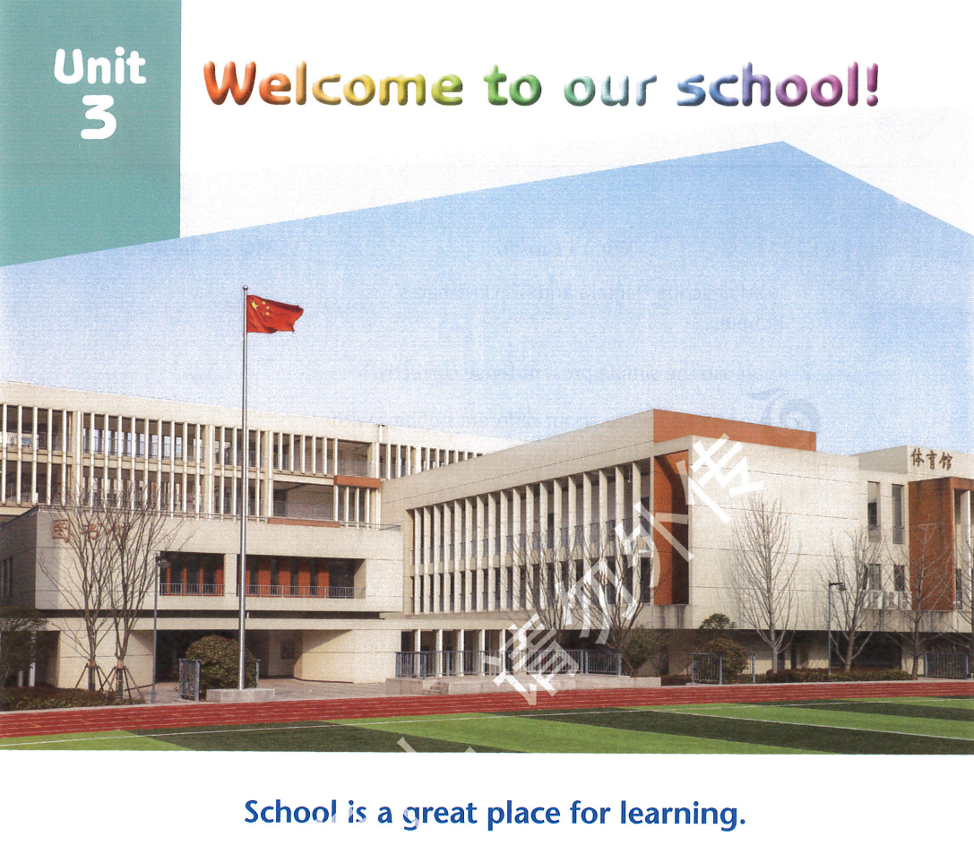
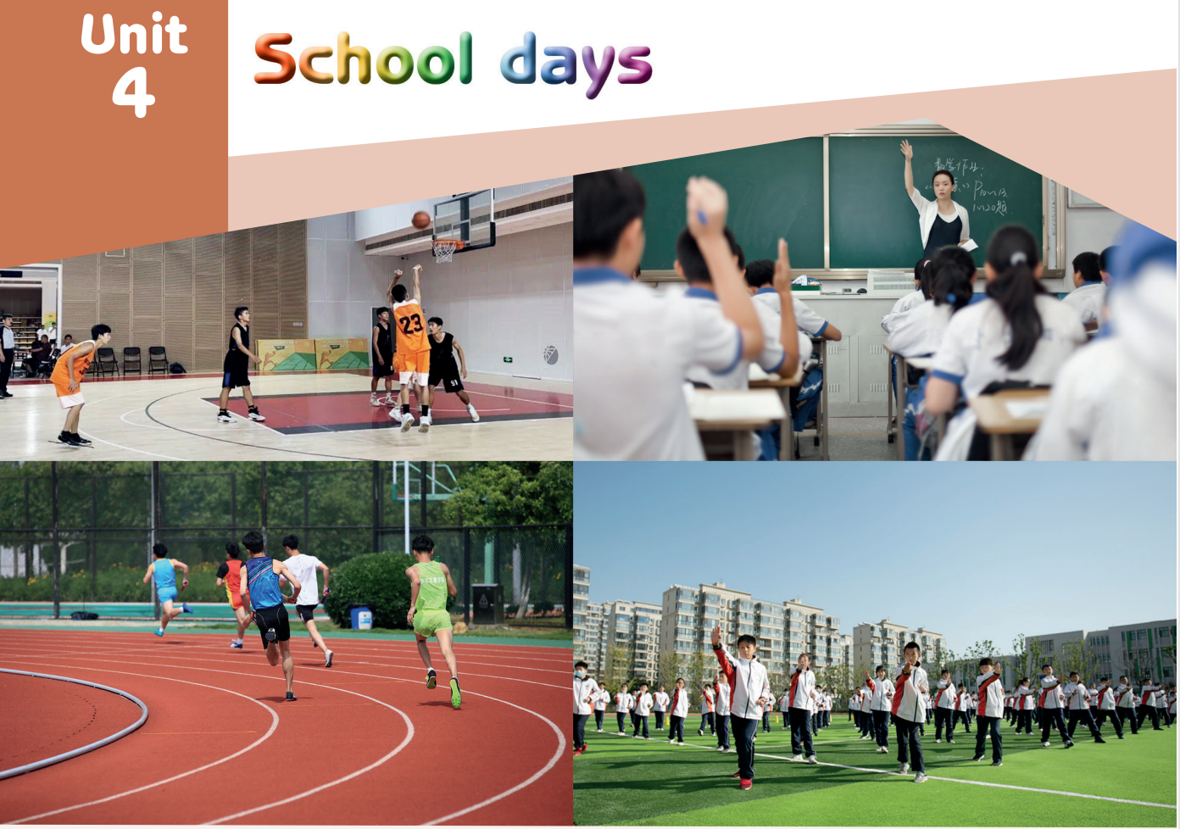
School is a great place for learning.
Learning is the key to unlocking the world.

Slide 3
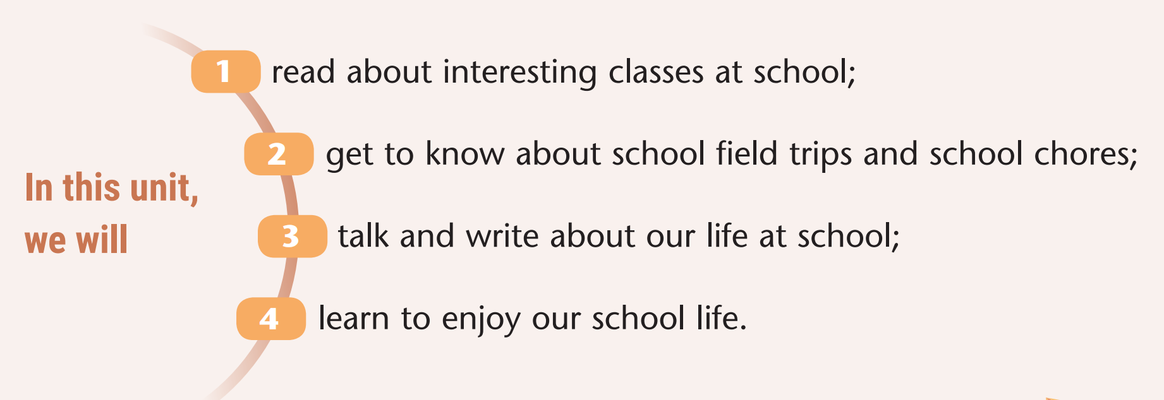
Learning objectives

Slide 4
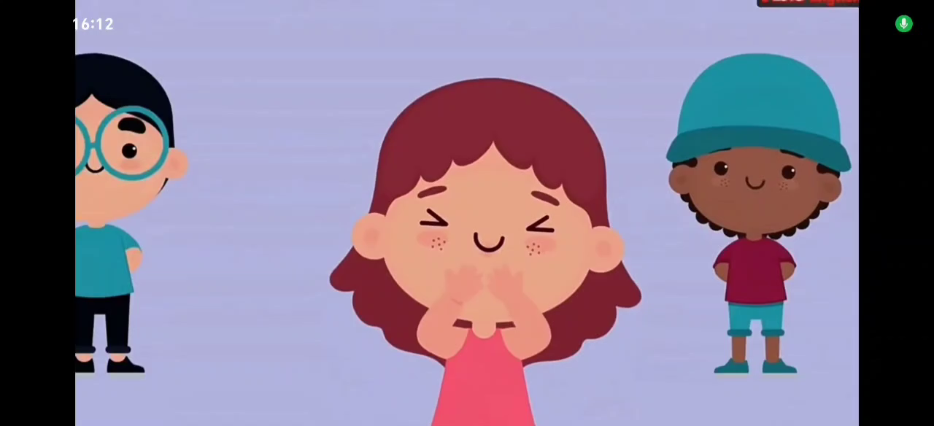
Lead-in
Watch and think about what the video is about?

Slide 5
Lead-in
play basketball
have lessons
do morning exercises
do sport
school days
weekday
weekend

Slide 6
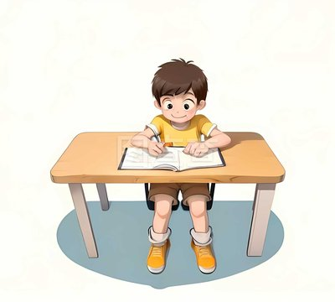
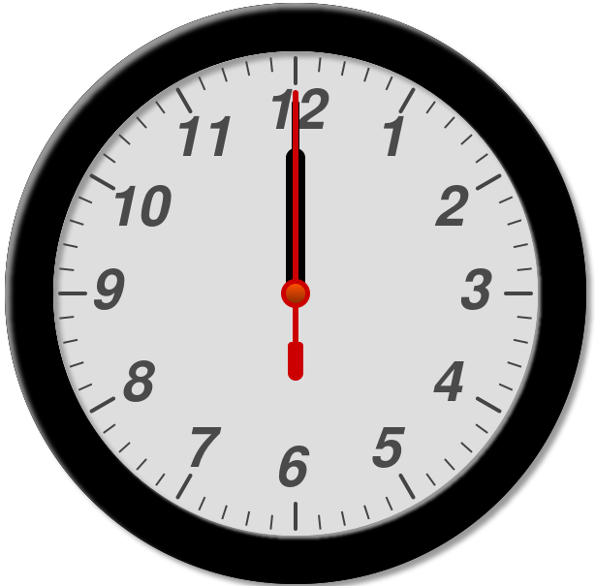
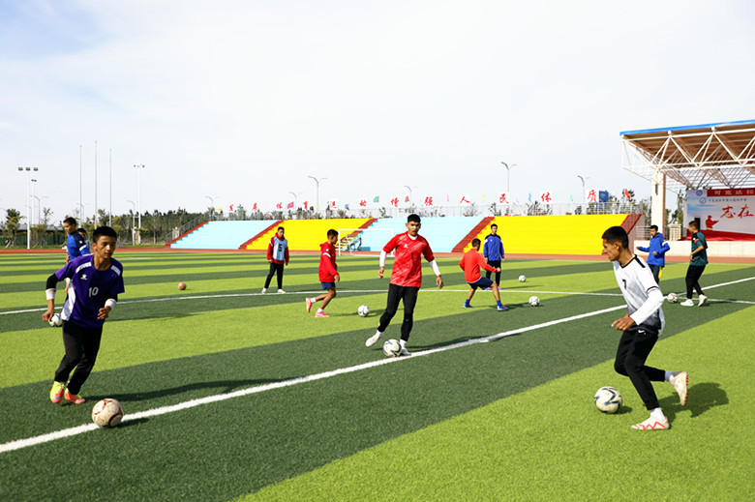
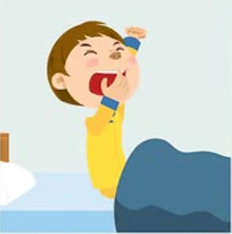
When do you usually
do these activities?
have lessons
at 8:00a.m.
at eight (o’clock)
do homework
do after-school
activities
at 4:50p.m.
at ten to five
at 4:05p.m.
at five past four
get up
at 6:45a.m.
at a quarter to seven
do mornig exercises
I usually... at ... a.m./p.m..
at 9:30a.m.
at half past nine

Slide 7
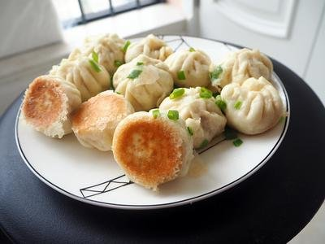
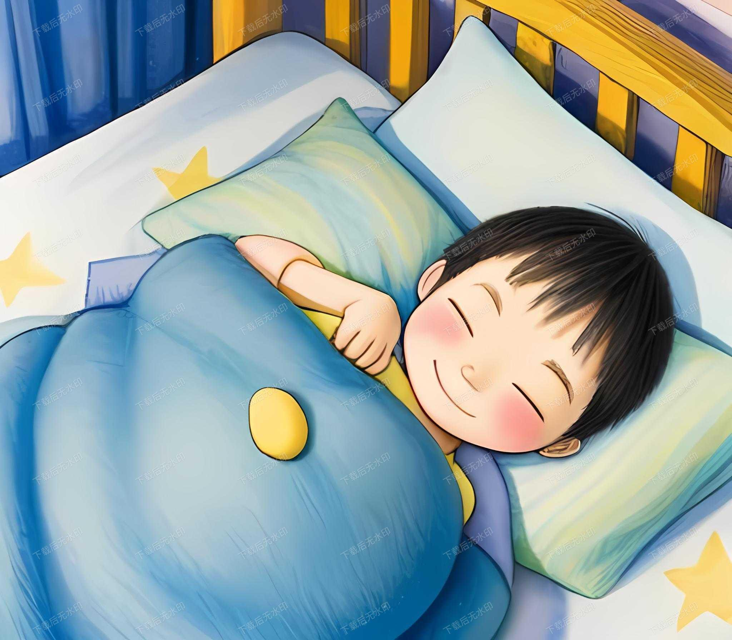
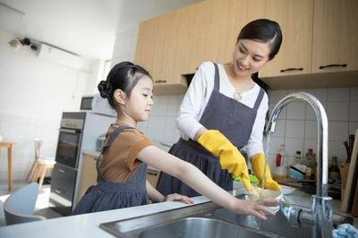
A: When do you ... ?
B: I ... at ... a.m./p.m..
o’clock
past
to
have breakfast
go to bed
half
help with housework

Slide 8

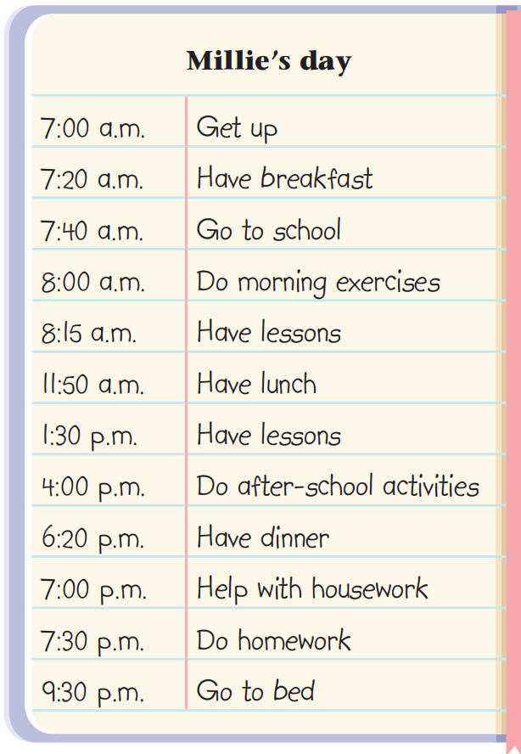
Talking about school days
Activity：Read Millie’s day and answer
1. What does she do at 4:00 p.m.?
She does after-school activities at 4 p.m.
2.How long does Millie have lessons every day?
From 8:15a.m to 11:50a.m, from1:30p.m.to 4:00p.m.
About Six hours.
3.How many hours does Millie sleep every day?
For about nine and a half hours.
≥ 6 hours’ learning every day
enough sleep
Notes:
加地点

Slide 9
Talking about school days
What does Millie do at 7 p.m. after school?
She helps with housework.
Hands-on Learning (skills)
Knowledge Learning
What do you think of Millie’s day?
busy but wondeful,
meaningful, perfect ...
Do you ？
Notes:
加地点

Slide 10
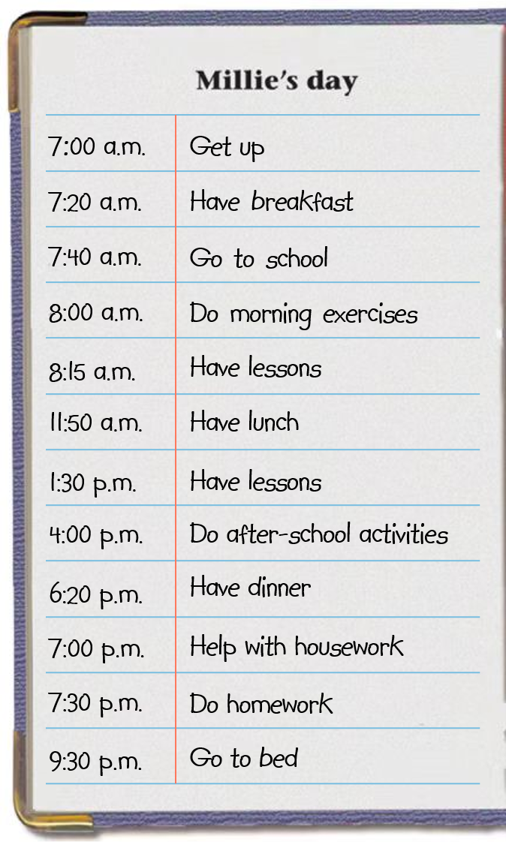
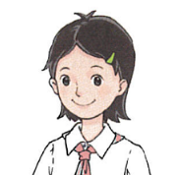
Millie’s day
Millie gets up at 7:00 a.m. She has breakfast at 7:20 a.m. Then she goes to school. At 8:00 a.m., she ____________________________ . She has lessons _____________ a.m.
Millie has lunch at __________ a.m. At 1:30 p.m., she has lessons again. At 4:00 p.m., she _______________________________. She has dinner at 6:20 p.m.
Millie __________________________ at 7:00 p.m. At 7:30 p.m., she does homework. At 9:30 p.m., she goes to bed.
I think her day is ____________________________.
does morning exercises
at 8:15
at 11:50
does after-school activities
helps with housework
busy but colourful.
Notes:
Look at the table of Millie’s day. Read and fill the blanks.

Slide 11

Sharing school days
Activity：Share your day with your partner.
A: When do you ...?
B: I ...at... .What about you?
A: I usually ... at... . How long do you have lesssons?
A: I spend about ... a day learning. It is really ...
B: I think so. What else do you ... after school?
A: I often... at .... . You know hands-on learning is ....
for us.
B: Sure. I’m sure we both have ... school days.
?
Notes:
具体科目，星期几的课表，编对话！！！

Slide 12
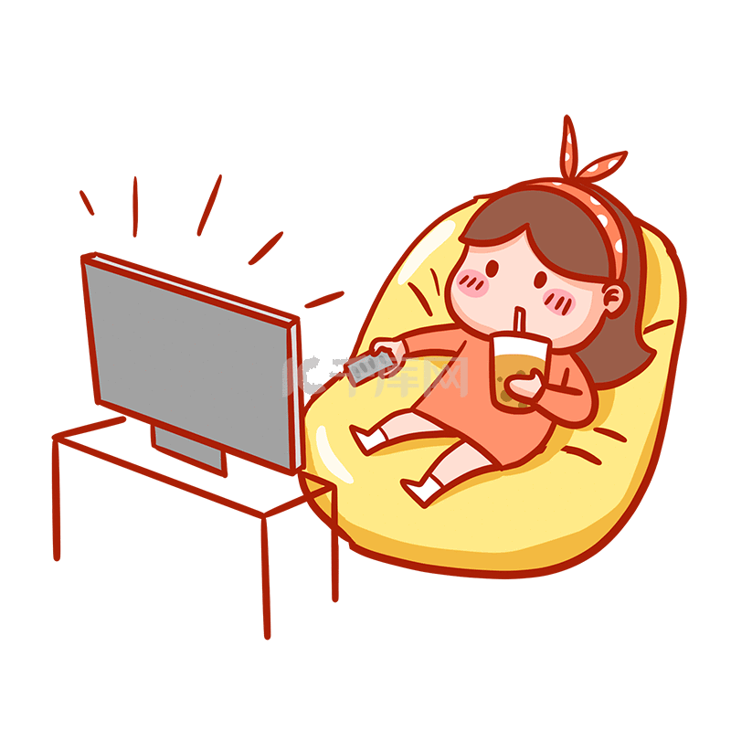
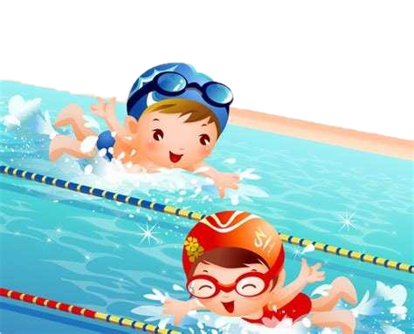
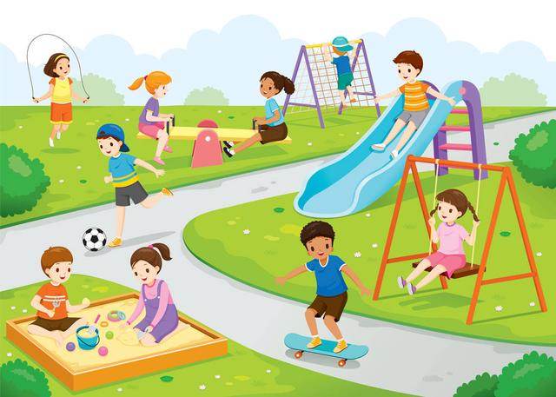
Discussion: How do you plan your time after school?
-Besides homework, I always/sometimes/seldom...because...
Reasons:
a way to have fun
relax after a busy day
learn new life skills
keep healthy
make good / new friends

Slide 13
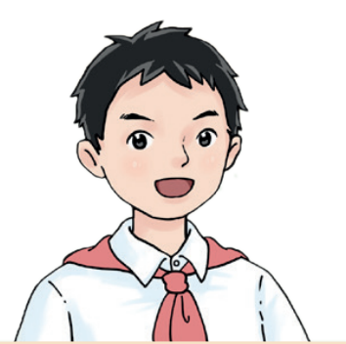
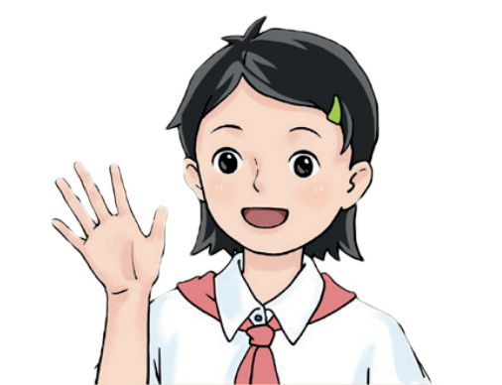


Sharing school days
Listen carefully and fill in the blanks.
Get up: _____________ a.m
After getting up: _____________
Get up: _____________ a.m
After getting up: _____________
6:45
7:00
go for a short jog
read a little
Thinking: Do you do anything special after getting up?
Why do you do so?
An hour in the morning is worth than two in the evening!
一日之际在于晨。

Slide 14
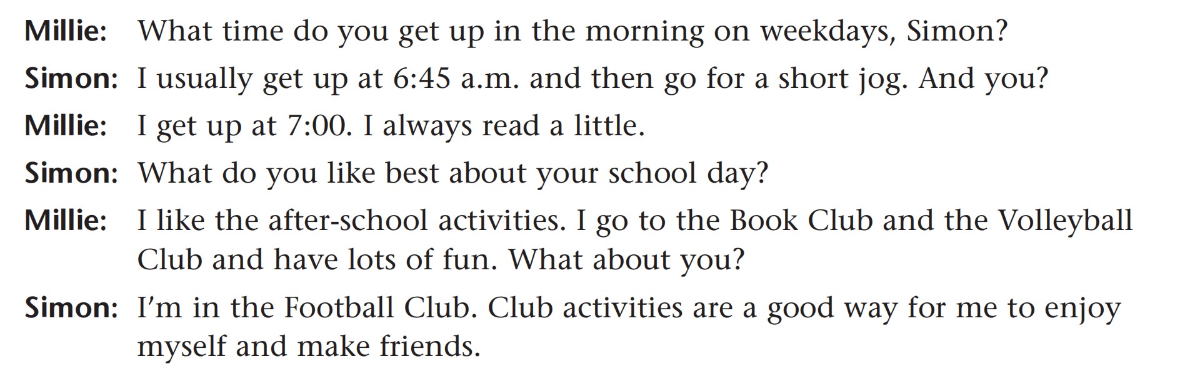
Sharing school days
Read their dialogue again and find out more.
What do Millie and Simon like best about their school days? Why?
Reading is to the mind, what exercise is to the body. (读书健脑，运动健身。)
Discussion: What do you like best about your school day? Why?
I like ... because ...

Slide 15
Introducing school days
...
Hello, I am Millie, a Grade 7 student from Sunshine Middle school. Today I would like to share my school day with you.
I usually get up... at... in the morning on weekdays.
Then I ... because I think...
I like ......most because it... and my friend Simon also thinks it...
After school，I usually... because it’s a good way to...
What about your school day?
...
Introduction
Activities
It’s your turn!
...
Favorite
part
After-school
Plan

Slide 16
Homework
Must do:
1. Share your school day with your friends.
2. Finish Exercise books.
Choose to do：
1. Write about your school days.

Slide 17
Thank you！

Slide 18
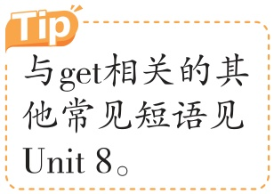



Language Points
1 Get up 起床（教材P43）
get up 起床
其对应词组为go to bed“上床睡觉”。
I usually go to bed at 9:30 p.m. and get up at 6:30 a.m.我
通常晚上9:30上床睡觉，早上6:30起床。
get up站起来 相当于stand up。
Please get up from your seat.请从你的座位上站起来。

Slide 19
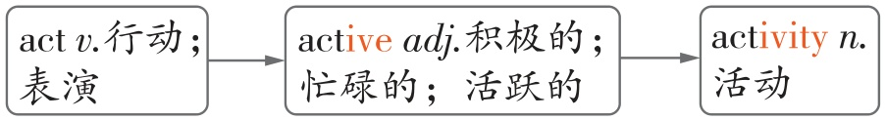
Language Points
2 Do after-school activities 做课外活动（教材P43）
activity/ækˈtɪvəti/ n.活动
其前的不定冠词要用an
［可数名词］其复数形式为变y为i再加-es，即activities。
outdoor/classroom activities户外/课堂活动
Students should take part in many outdoor activities.
学生应该参加许多户外活动。
与activity相关的词：

Slide 20
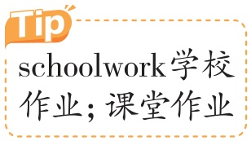
Language Points
3 Help with housework 帮忙做家务（教材P43）
Do homework 做家庭作业（教材P43）
housework/ˈhaʊswɜ:k/ n.家务劳动，家务事
homework/ˈhəʊmwɜ:k/ n.家庭作业
［不可数名词］是由“house/home+work”构成的合成词。
do housework/homework做家务/家庭作业
前面可加the、some、much、a lot of、little等限定词
Teenagers should do some housework after they finish their
homework.青少年应该在完成家庭作业后做一些家务。

Slide 21

Language Points
4. What time do you get up in the morning on weekdays，Simon?
你在上学日早上几点起床?（教材P43）
what time 几点
what time与when
what time | 通常用来询问钟点的时间，只能用时刻来 回答。
when | 可用来询问事情发生的年份、月份、日期等，也可用来询问某事发生的具体时间（此时可与what time互换）。

Slide 22
Language Points
—What time/When does your mother go to work? 你妈妈
什么时候去上班？
—She goes to work at seven.她七点钟去上班。
—What time is it now?现在几点了？
—It’s ten to ten.九点五十。
—When （不能用What time）is Teachers’ Day?
教师节是什么时候？
—It’s on September 10th. 9月10日。

Slide 23
Language Points
5. I always read a little .我总是会读一点书。（教材P43）
此处修饰动词read
a little 一点，少量；少量的；一些
（1）表示程度，可修饰形容词、副词或动词。
She’s a little afraid of the dog.她有点儿害怕狗。
（修饰形容词）
Can you run a little..fast?你能跑得稍微快点吗？（修饰副词）
Please turn down the radio a little.请把收音机音量调小一点儿。
（修饰动词）

Slide 24
Language Points
（2）修饰不可数名词。
There is a little juice in the fridge. You don’t need to buy any.
冰箱里有一些果汁，你不需要买一些。
a little, little, a few与few
四者均可修饰名词，区别如下：
a little | 表示肯定含义，意为“一些；少量的”。 | 修饰 不可 数名 词 | I know a little French.我懂一点儿法语。
little | 表示否定含义，意为“少得几乎没有”。 |  | I have little free time.我几乎没有空闲时间。

Slide 25
Language Points
a few | 表示肯定含义，意为“几个； 一些”。 | 修饰 可数 名词 复数 | His mother works a few hours a day.他妈妈一天工作几个小时。
few | 表示否定含义，意为“几乎 没有”。 |  | There are few eggs in the fridge.冰箱里几乎没有鸡蛋了。

Slide 26
Language Points
典例 [淮安市淮阴区期中]
There is only ___ milk in the refrigerator. Let’s go to the
supermarket to buy some.
D
A.few B.little C.a few D.a little
[解析] 句意：冰箱里只有一点牛奶了，咱们去超市买一
些吧。根据“only”及“Let’s go to the supermarket to buy
some”可知，此处指的是冰箱里只有一点牛奶，表示肯定
意义，且空后的milk为不可数名词，应用a little。故选D。

Slide 27
Language Points
6. I’m in the Football Club. 我加入了足球俱乐部。
（教材P43）
be in 加入；成为……的一员
相当于join。但一般来说，be in强调状态，join强调
动作。
You can be in our school basketball team.你可以加入我们
校篮球队。
When did you join the basketball team?你是什么时候加入
这支篮球队的？

Slide 28
Language Points
7. Club activities are a good way for me to enjoy myself
and make friends. （参加）俱乐部活动是我玩得愉快并
结交朋友的好方法。（教材P43）
enjoy oneself 玩得痛快，得到乐趣
同义短语有have a good/great/wonderful time、
have fun等。
We enjoyed ourselves（=had fun=had a good/great/
wonderful time） at the party yesterday.昨天，我们在聚会
上玩得很愉快。

Slide 29
Language Points
典例 [上海中考]
I had a good time in the ocean park the day before yesterday.
（保持句意基本不变）
I ___ ___ in the ocean park the day before yesterday.
[答案] enjoyed myself/had fun

Slide 30
Sharing school days
hobby
club
activities
because...
play football
go for a short jog
in the Football Club
Club activities are a good way for him
to enjoy himself and make friends.

Slide 31
Talking about school days
When do you usually do these activities?
get up
have lessons
do mornig exercises
6:45a.m.
8:00a.m.
9:30a.m.
a quarter to seven
eight (o’clock)
half past nine
do after-school activities
do homework
4:05p.m.
4:50p.m.
five past four
ten to five

Slide 32
Make a similar dialogue
A : What time do you get up in the morning on weekdays?
B : I usually …and then ... And you?
A : I …. I always ...
B : What do you like best about your school day?
A : I like …. I go to ... and ... . What about you?
B: I … because I think ....

