Slide 1
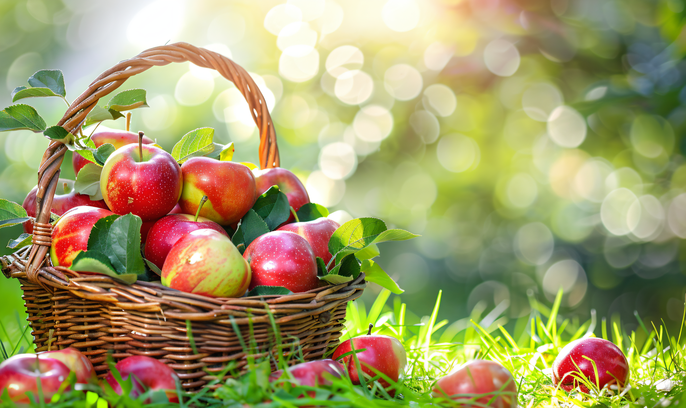
7AU4 School Days
Integration 1

Slide 2

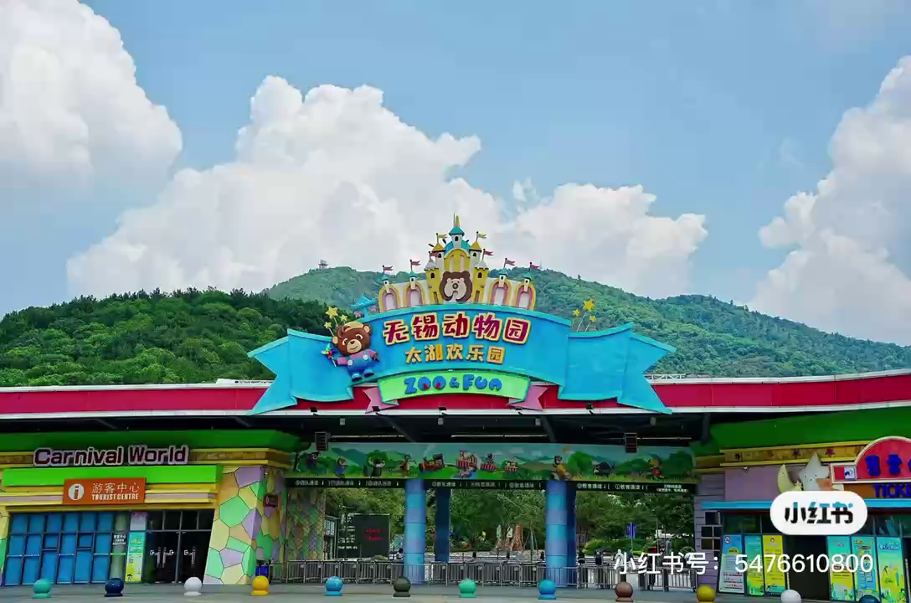
Watch and answer: What is this video about?
school field trips
校园实践活动

Slide 3
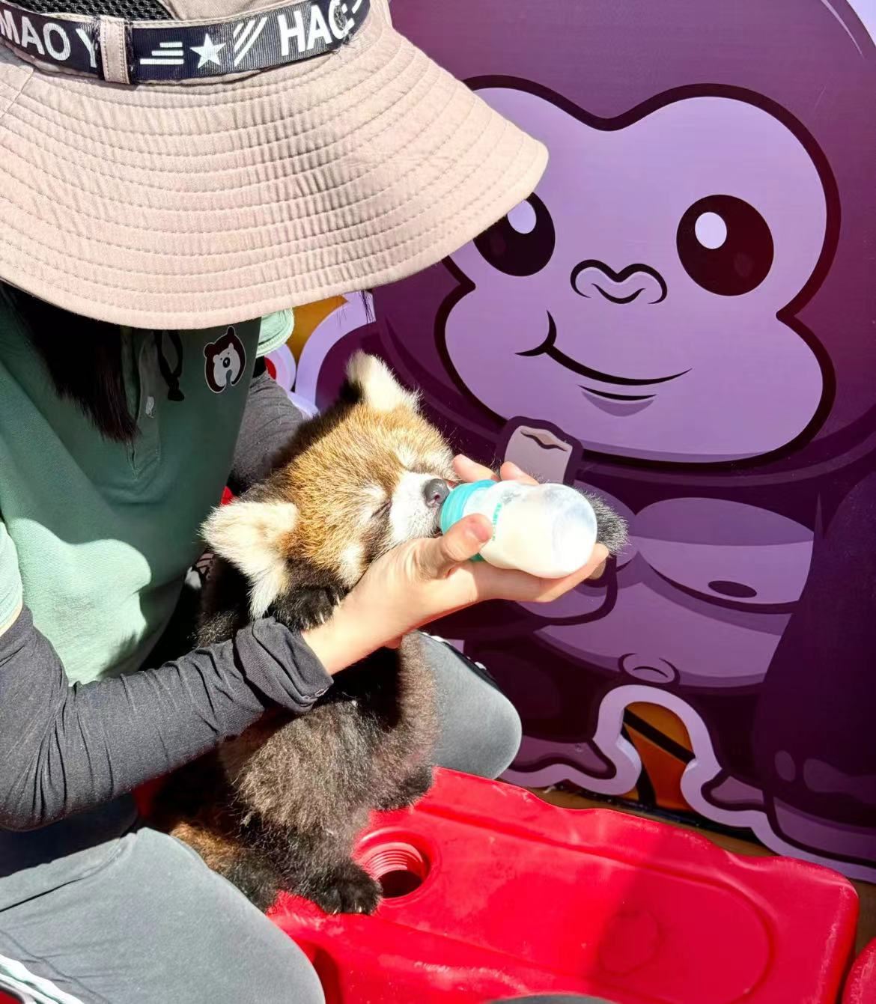
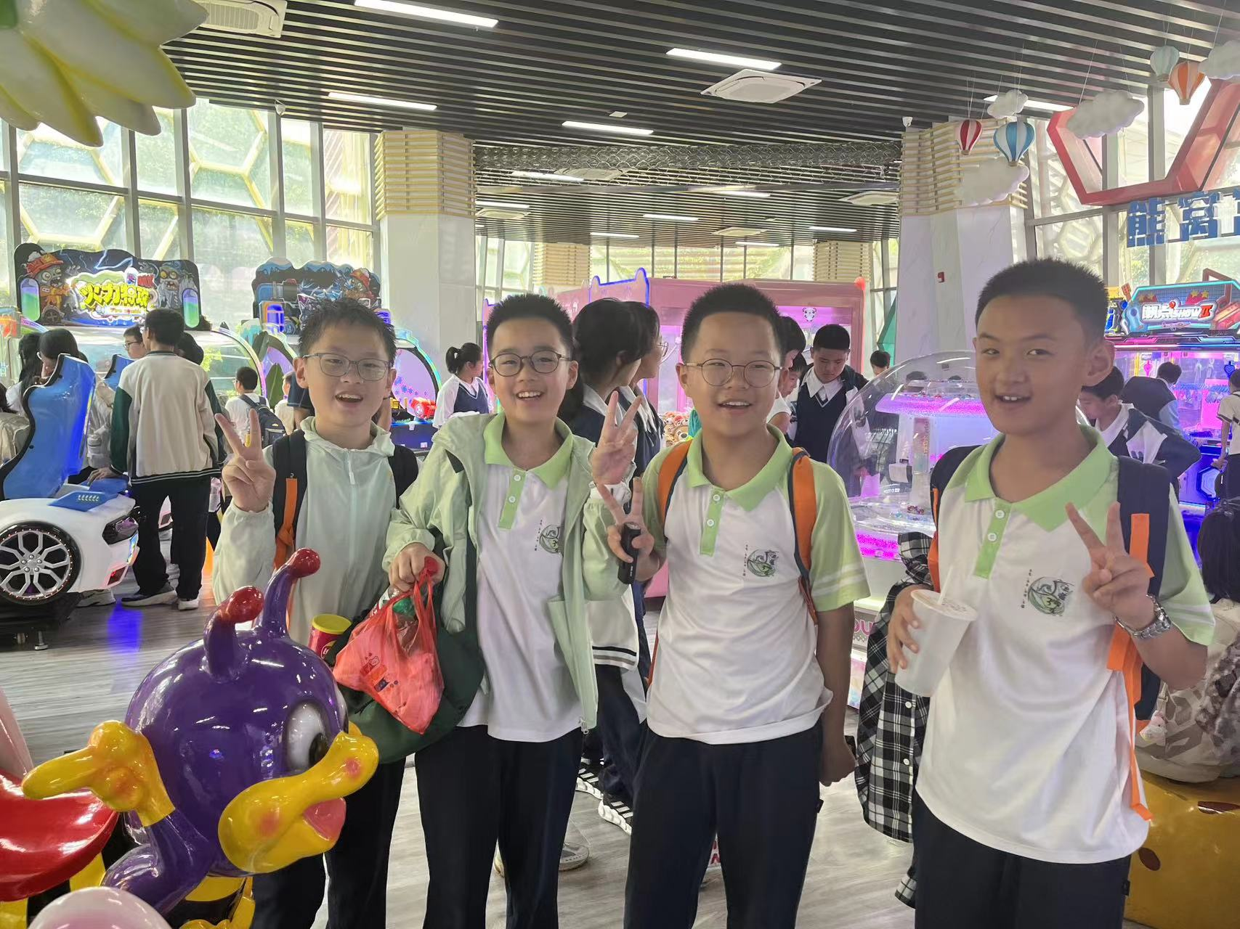
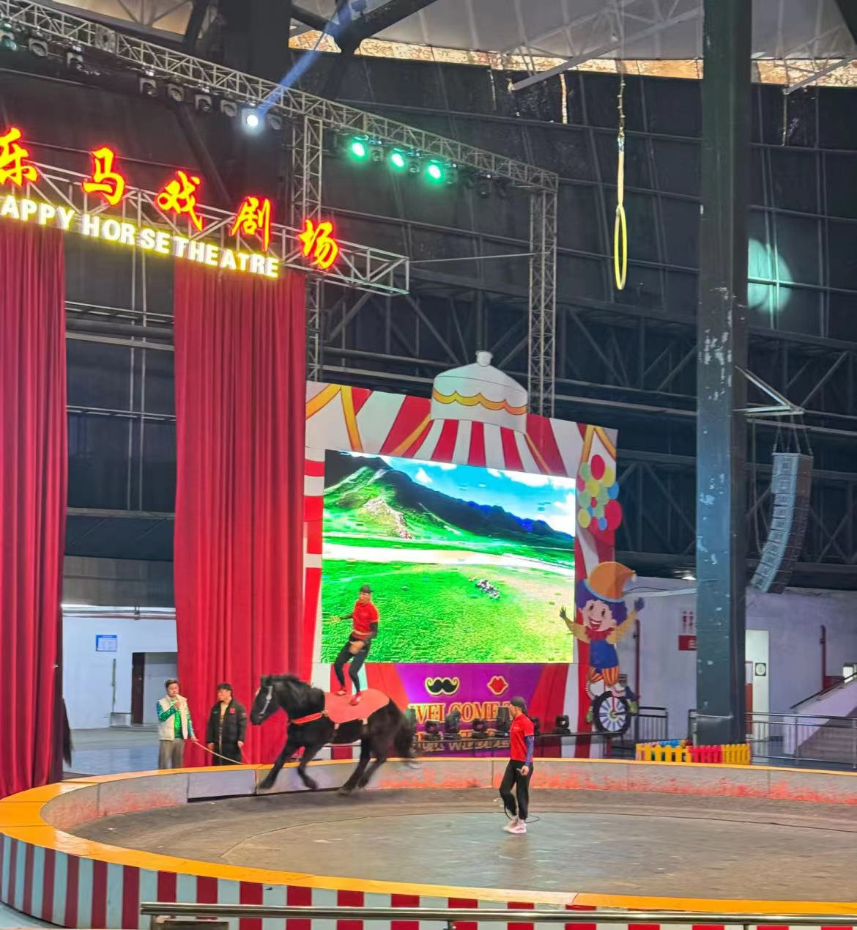
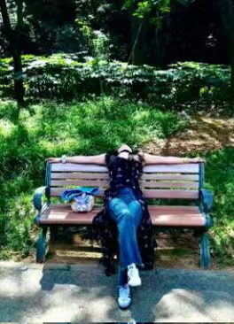
What do you like best about your field trip to Wuxi? Why?
What do you do on your field trip to Wuxi?
What do you think of the field trip?
Feed Animals
Have fun with
friends
Enjoy the show
Get close to
nature
special
wonderful
colourful
meaningful
perfect......
I like ......because......

Slide 4

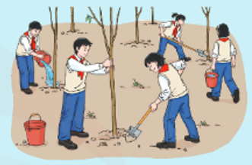
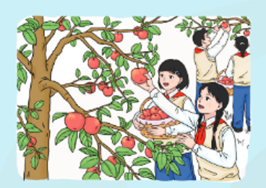
Look and answer
Tip 1:
Pictures tell us a lot of information.
water the trees
fill the holes
straighten the trees
pick the apples
collect the apples

Slide 5
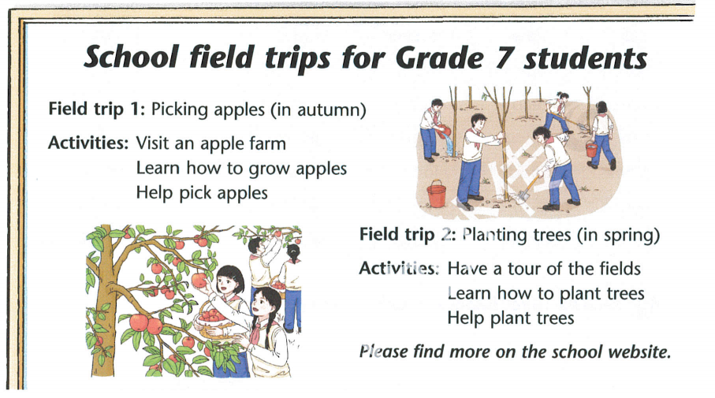
Read and answer
1. What can the Grade 7 students do on the autumn field trip?
Visit an apple farm; Learn how to grow apples, Help pick apples
2. What can the Grade 7 students do on the spring field trip?
Have a tour of the fields; Learn how to plant trees; Help plant trees

Slide 6

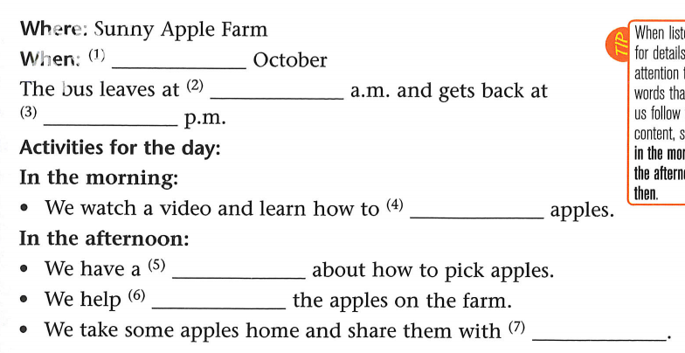
Tip 2:
We can write down the given information before listening.
Listen and fill
grow
pick

Slide 7

Listen and fill
Before listening, what should we do?
Tip 3:
The key words can help us better understand the field trip.
grow
pick

Slide 8
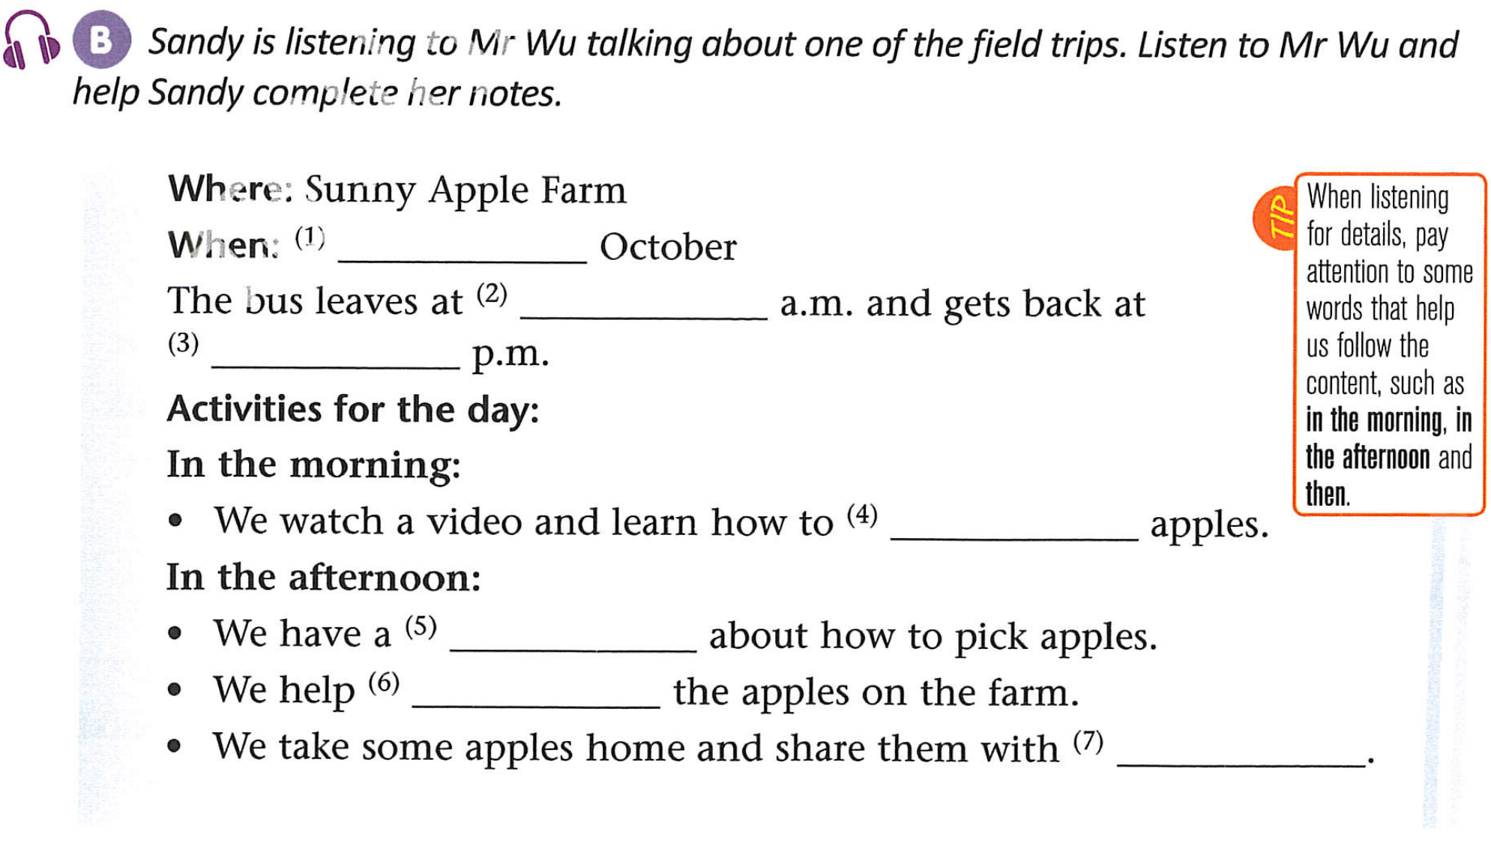
Tip 4:
Before listening, we can predict what kind of information is needed.
Sandy’s note
number
time
time
grow
noun
pick
somebody

Slide 9

Listen and fill
14
8：30
5：30
What can we learn from it?
grow
lesson
pick
our family
teamwork
Where food is shared, happiness is doubled.

Slide 10


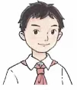


Listen and answer
Students | Likes | Reasons
Amy
Simon
being outside
It’s nice to get close to nature , and she can enjoy the peace and quiet.
teamwork
Everybody tries their best to make things better.
Many hands make light work.
众人拾柴火焰高。

Slide 11
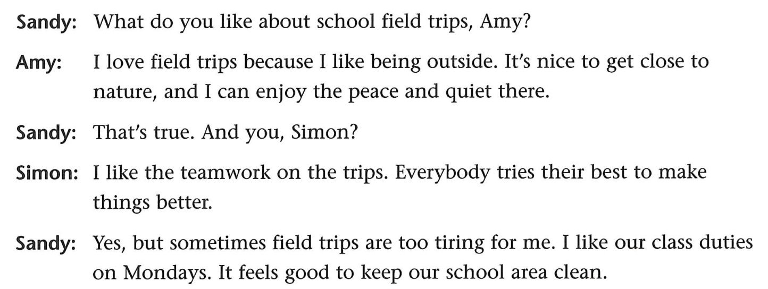
Does Sandy agree（同意） with them?
Expressions to show agreement:
You’re so right.
你说得太对了。
I couldn’t agree more.
我完全同意。
I agree with you. 我同意你。
Exactly. 正是如此

Slide 12

Does Sandy like field trips? Why?
Why does she like her class duties?
Hands- on learning
（实践学习）
We can use “but” to introduce our different/same ideas.

Slide 13

Pairwork
A: What is Sandy’s school field trip?
B: They go to......
A: When and where does the trip take place?
B: It takes place on......and we go to......
A: What do they do there?
B: In the morning......In the afternoon......Then......
A: What do they like about the field trip?
B: Amy likes...... because......Simon likes...... because......
A: Does Sandy like.......why?
B: ......because......
She likes...... because....
What can you learn from

Slide 14
Make a report in group of four
S1:Hello, everyone. Let me tell you about...... The trip takes place on ...... All the students travel to ......
S2:We have lots to do......In the morning......In the afternoon......Then......When we leave ...... we can......
S3:I like......best on the trip because I learn.....
S4:I am happy to take part in school field trips because they are quite ......!
Feed Animals
Have fun with friends
Enjoy the show
Get close to nature

Slide 15
Knowledge
know about the world.
Learning
helps us
Hands-on
get along with(与...相处） the world.
Unlock the world!
Tell me and I forget, teach me and I may remember, involve me and I learn.
——Franklin
告诉我，我会遗忘;教给我，我仅能记住；让我参与，我方能学会。

Slide 16

Homework
Must do:1. Talk with your classmates about your school field trips.
2. Finish some exercises on workbook.
Choose to do:3. Make a poster about your school field trips.

