Slide 1
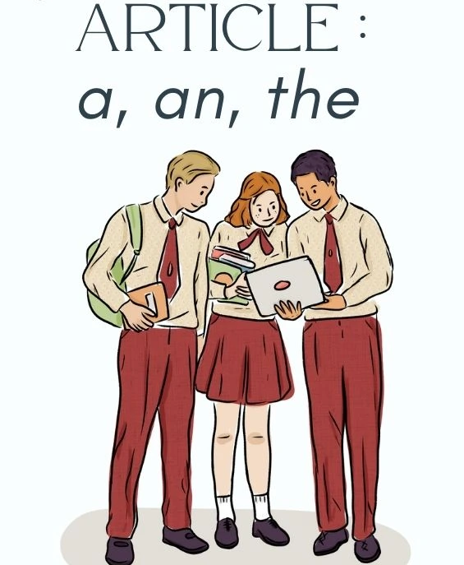
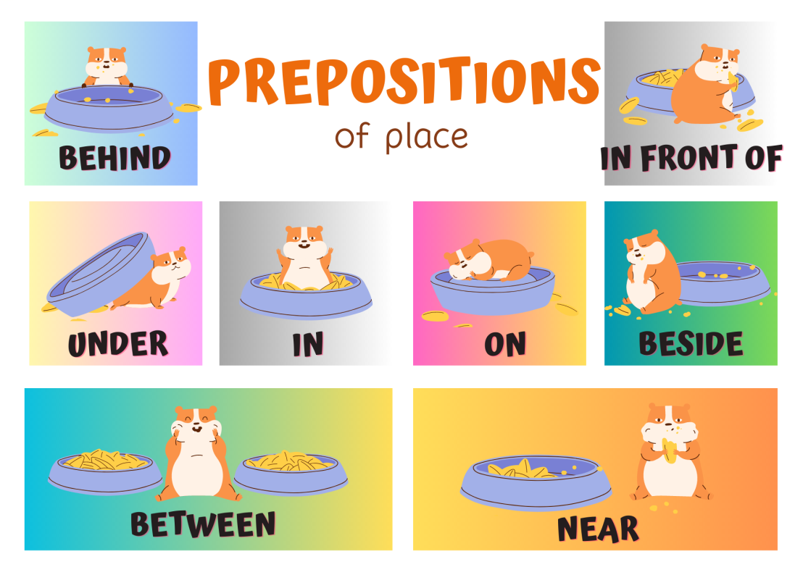
Unit 3 Hometown
P3 Grammar

Slide 2
1. “南京有许多名胜古迹值得游览. /南京有许多值得游览的名胜古迹。”
There are__________________________ in Nanjing.
2. “许多乘客，游客喜欢在清晨在天安门广场观看升国旗。”
________________________________in the early morning in Tiananmen Square.
many places of interest (worth visiting)
Many visitors like watching the raising of the national flag

Slide 3



冠词,不能独立使用，只能放在_____前。分为不定冠词_____和定冠词_____。
名词
冠词
a/an
Fill in the blanks.
the
Beijing is _______ capital of China. Tian'anmen Square is _____ square in ______ centre of ____ city. In _______ square, there are always people from all over ______ country. There is also _______ Summer Palace, ______ amazing traditional Chinese garden. Kunming Lake, ______ big lake in it, is very famous.
the
a
the
the
the
the
the
an
a

Slide 4

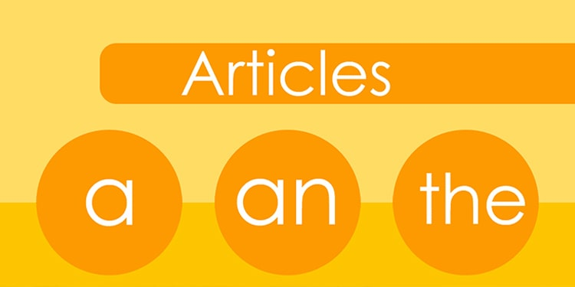
Focus on
用法
Article
1. 不定冠词的用法
2. 定冠词的用法
3. 零冠词的用法

Slide 5

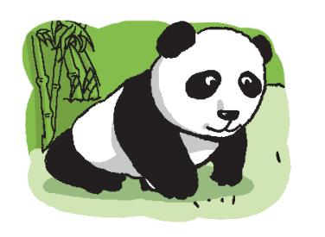
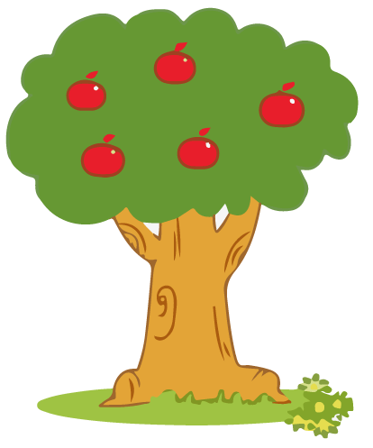
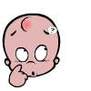
一、不定冠词的用法
1.不定冠词a与an常用来泛指某人或某物。在第一次提到某人或者某物时，如果是可数名词单数，常在其前加不定冠词a/an。
Do you know the differences between a and an?
There is an apple tree over there.
Look! Here is a panda.

Slide 6

不定冠词a和an的区别
辅音音素
如果名词以_________开头，则用冠词a。
a boy a teacher a computer
a unit a football team a house
[bɔɪ]
[ˈti:tʃə(r)]
[kəmˈpju:tə(r)]
[ˈju:nɪt]
[ˈfʊtbɔ:l]
[haʊs]
元音音素
如果名词以_________开头，则用冠词an。
an apple an art teacher an egg
an hour an elder brother an engineer
[ˈæpl]
[ɑ:t]
[eg]
[ˈaʊə(r)]
[ˈeldə(r)]
[ˌendʒɪˈnɪə(r)]

Slide 7
二、定冠词的用法
_____ usual day _____ useful key _____ one-way street
以上以元音字母开头，发音为辅音
_____ hour _______ honest boy
以上以辅音字母开头，发音为元音
a
a
a
an
an

Slide 8
Vowel sound
元音 (20个)
/ɑ:/ /ɔ:/ / ɜ:/ /i:/ /u:/ / ʌ/ /ɒ/ /ə/ /ɪ/ /ʊ/ /e/ /æ/ /eɪ/ /aɪ/ /ɔɪ/ /ɪə/ /eə/ /ʊə/ /əʊ/ /aʊ/
/p/ / t/ / k/ /f/ /θ/ /s/
/b/ /d/ /g/ /v/ /ð/ /z/
/ʃ/ /h/ /ts /tʃ/ /tr/
/ʒ/ / r/ /dz/ /dʒ /dr/
/m/ /n/ /ŋ/
/j/ /w/ / ǀ/
Consonant sound
辅音(28个)

Slide 9
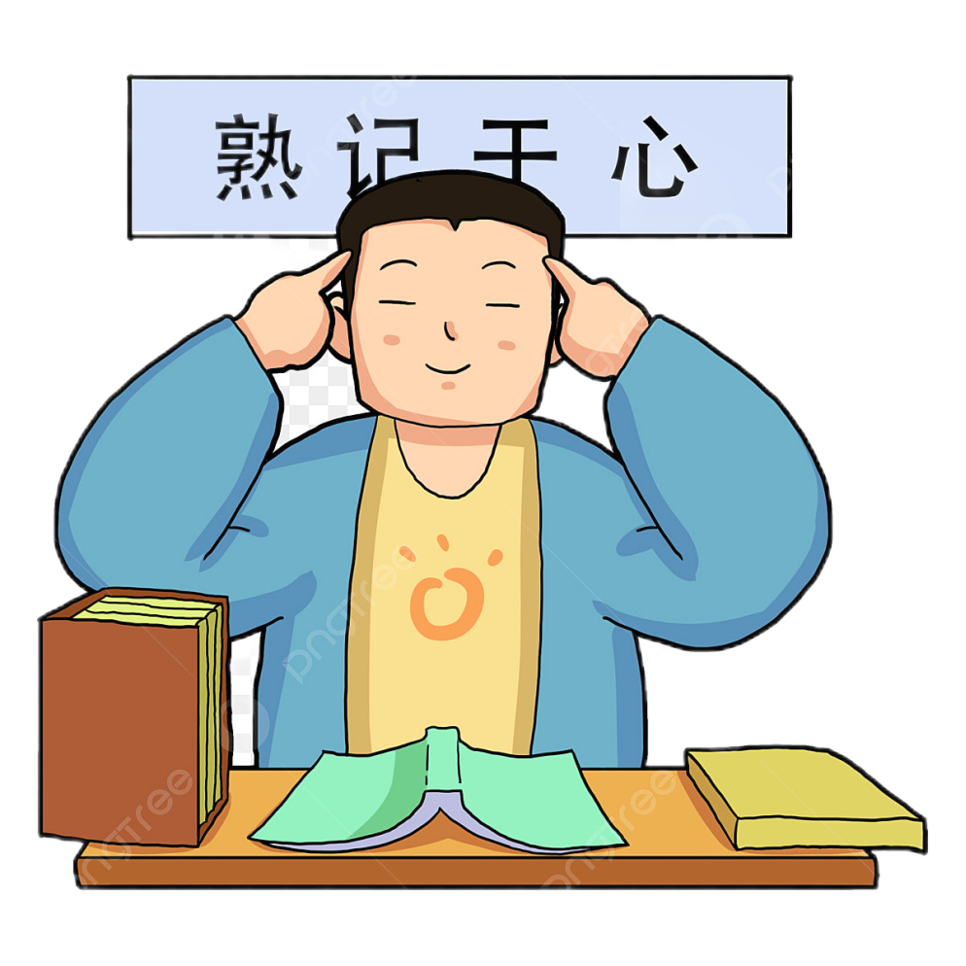
2. 在一些固定词组中。
• have a good time
• a piece of
• a lot of
• a few
• a little
• have a cold
• have a rest
• go for a walk
• have a picnic
...
玩得开心
一块，一片
许多，大量
一些，几个
一点，少量
感冒
休息
去散步
去野餐

Slide 10
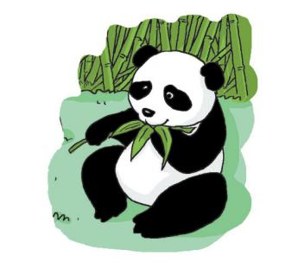
二、定冠词的用法
1. 用于上文中已经提及过的人或物之前。
Look! Here is a panda.
The panda is eating bamboo.

Slide 11
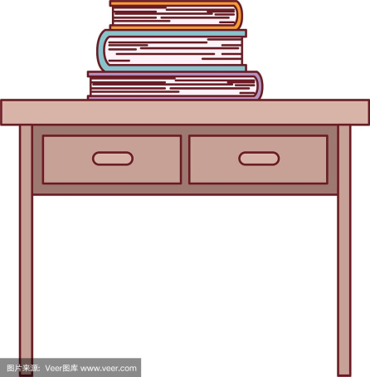
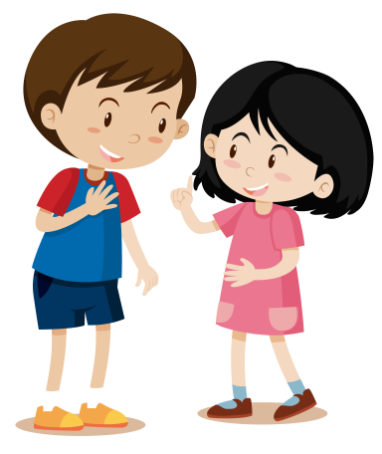
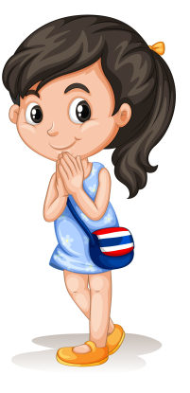
2. 用于谈及特定的人或物。
① The book on the desk is Lily's.
② Tom is talking to the girl on his right.
桌子上的书是莉莉的。
汤姆在跟他右边的女生说话。

Slide 12




3. 用于世界上独一无二的事物前。
地球上独一无二的事物
① The sun rises in the east.
② There were lots of stars in the sky last night.
太阳从东方升起。
昨晚夜空中很多星星。
the moon
the earth
the world
the universe (宇宙)
the Mars (火星)
Do you know
other words
like these?

Slide 13
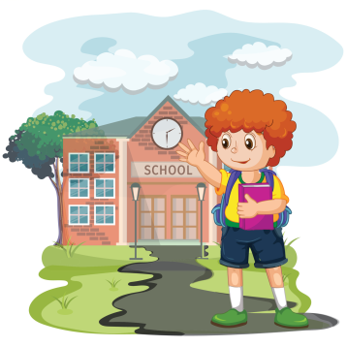
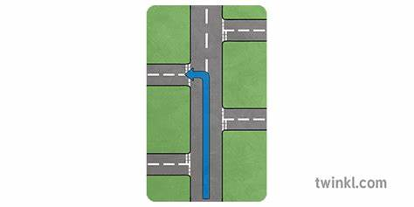
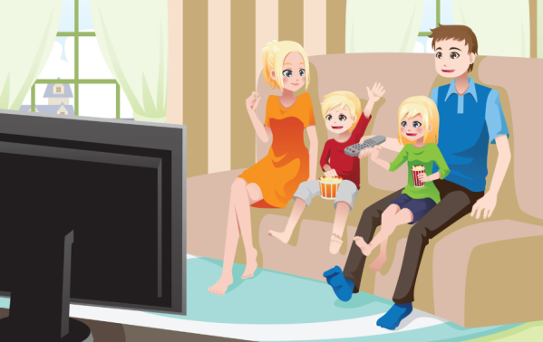
4. 在序数词之前使用。
① Sam is always the first to get to school.
② Take the second road on the right.
山姆总是第一个到校。
第二个路口向右拐。
5. 用于姓氏复数前，表示“某某一家人”。
The Greens are watching TV.
格林一家正在看电视。

Slide 14
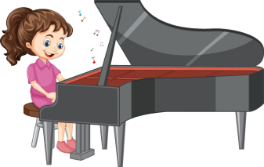
6. 用于一些习惯用语。
in the morning / afternoon / evening
在早晨/下午/晚上
7. 用于一些表示乐器的名词前。
弹钢琴
play the piano
注意：一般在乐器名称前加定冠词，在球类运动前不加冠词。
play football, play basketball
8. 用于由普通名词构成的专有名词前。
the USA the Great wall the Summer Palace
美国
长城
颐和园

Slide 15
三、零冠词的用法
有些名词前没有使用冠词a/an/the，这种现象我们称为零冠词。主要出现在以下场合：
1. Shall we invite them to have lunch with us?
一日三餐
我们邀请他们和我们一起吃午饭好吗？
2. It's about 40 minutes by train.
by与交通工具名词连用时
坐火车大约需要40分钟。
在一些节假日前
3. Children's Day is on the first of June.
6月1日是儿童节。
星期
月份
4. He was born on Sunday, 19 January.
他出生于1月19日，星期日。

Slide 16
24. ______ word “unusual” begins with ______ “u”.
A．A; a B．A; an C．The; an D．The; a
解析：第一空特指单词“unusual”，用 the；"u"发音为/juː/，以辅音音素开头，用 a。
答案：C. The; a
30. We all know that ________ apple a day keeps ________ doctor away.
A．an; a B．an; the C．a; the D．a; a
解析：an apple（以元音音素开头）；the doctor（特指“医生”）。
答案：B. an; the

Slide 17
16. Richard has played ________ football for five years. Now he wants to learn to play ________ trombone.
A．/; the B．the; the C．the; / D．/; /
解析：球类前不加冠词（play football）；乐器前加 the（play the trombone）。
答案：A. /; the
18. —Do you know ________ man in a black suit over there?
—Yes. He is ________ master of music. His name is Lang Lang.
A．the; the B．a; the C．a; an D．the; a
解析：第一空特指“穿黑西装的男人”，用 the；第二空泛指“一位音乐大师”，用 a。
答案：D. the; a

Slide 18
11. —Do you want to learn how to play football?
—Yes, but I don’t have ________ football.
A．a B．an C．the D．/
解析：此处表示“拥有一个足球”（可数名词），用 a。答案：A. a
13. —Look! ________ orange volleyball on the table is for you.
—Really? It is so beautiful. I like it very much.
A．An B．/ C．The D．A
解析：特指桌上的排球，用 the。答案：C. The
14. The girl with _________ new phone HUAWEI Mate 60 Pro in her hand is my elder sister.
A．/ B．a C．an D．the
B

Slide 19
9. —Do you like playing ________ piano?
—Yes. And I have ________ piano at home.
A．/, a B．a, the C．the, a D．the, /
解析：乐器前加 the（play the piano）；第二空表示“拥有一台钢琴”，用 a。
答案：C. the; a
10. —Do you usually have ________ dinner at home?
—Yes. But I had ________ big dinner with my family in the restaurant yesterday.
A．a, a B．a, / C．/, a D．the, a
解析：三餐（如dinner）前不加冠词；have a big dinner（固定搭配，表示“吃大餐”）。
答案：C. /; a

Slide 20
5. This road looks like ________ endless road, but it's only 2,000 metres long ________.
A．a; in the future B．an; in all C．an; together D．a; around
解析："endless"以元音音素/e/开头，用 an；in all（固定短语，意为“总共”）。
答案：B. an; in all
19. I’d like to play ________ chess with my brother, but he wants to play ________ piano.
A．/; the B．the; the C．the; a D．/; a
解析：棋类前不加冠词（play chess）；乐器前加 the（play the piano）。
答案：A. /; the

Slide 21
1. There is ________ “u” and ________ “m” in the word “number”.
A．a, a B．an, a C．an, an D．a, an
解析："u"发音为/juː/，以辅音音素开头，用 a；
"m"发音为/em/，以元音音素开头，用 an。
答案：D. a; an
2. You spent ________ day doing homework. You should have ________ now.
A．the whole; rest B．the whole; a rest C．whole; rest D．whole; a rest
解析：the whole day（固定搭配，强调“一整天”）；have a rest（固定短语，表示“休息一下”）。
答案：B. the whole; a rest
3. Amy is shy and quiet. She is interested in _________.
A．playing chess B．reading book C．dance D．playing the ping-pong
解析：be interested in + 动名词（动词需加-ing）；
"playing chess"（棋类前不加冠词）。
错误选项：B（应为books）、C（需加-ing）、D（ping-pong前不加the）。
答案：A. playing chess

Slide 22

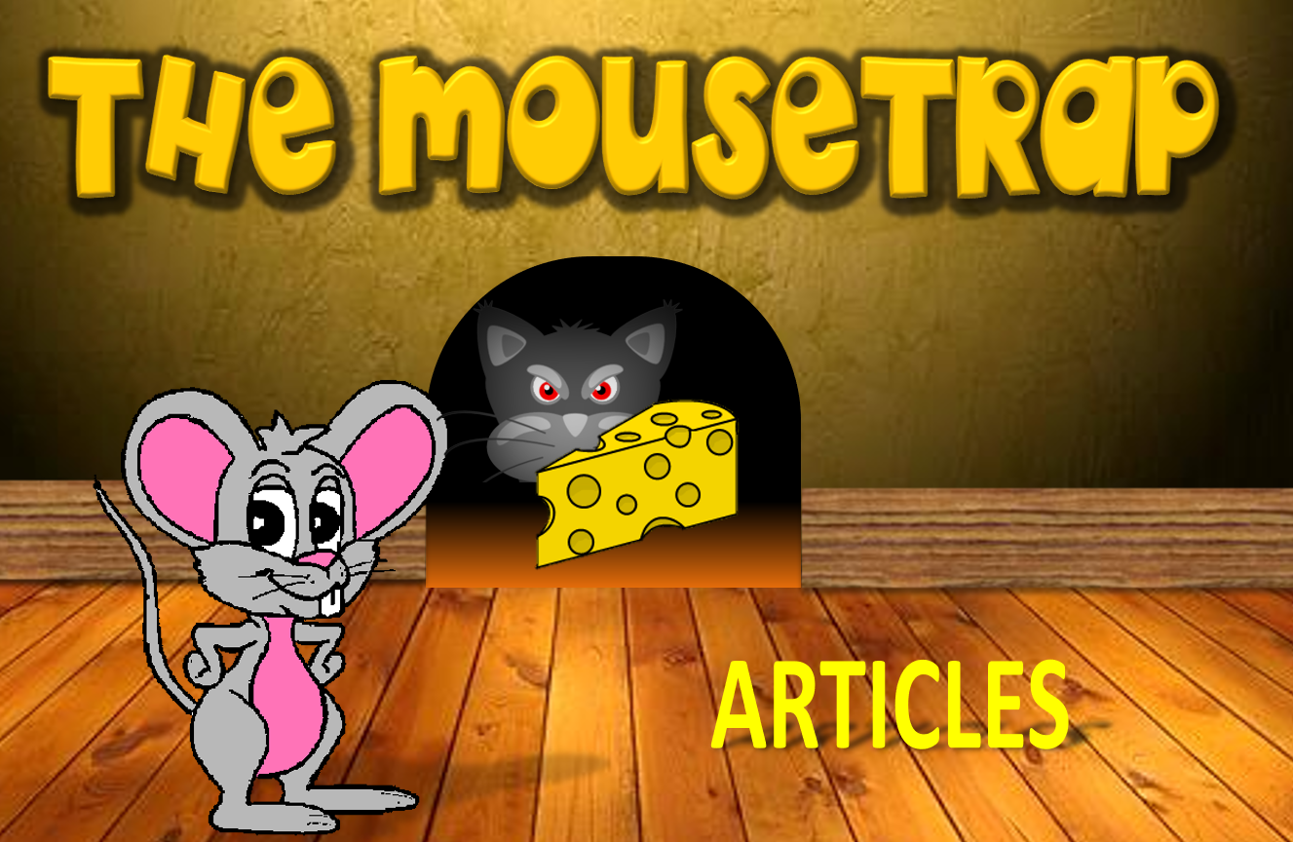

Click on the right article to complete the sentence.

Slide 23
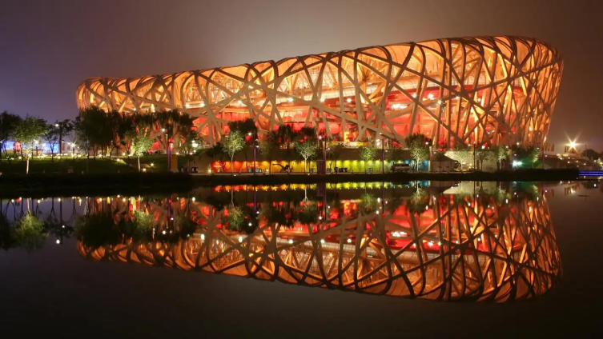
Daniel is reading a short text about Beijing National Stadium. Read the text below and fill in the blanks with a, an, the or /.
A1
Look at this wonderful building. It is the National Stadium, also called (1)_________ Bird's Nest. It is (2)_________ modern stadium in the north of Beijing. It dates from (3)________ 2008 and is (4)__________ important building in (5)________ city. It is big enough for 91,000 people and is now (6)________ popular place for sports and music events.
the
a
/
an
the
a
P35
A1

Slide 24
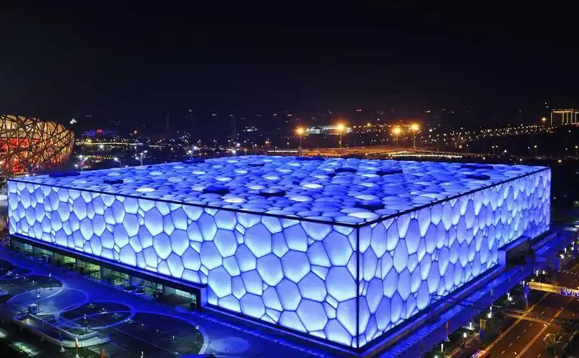

The Water Cube is another place of interest in Beijing. Talk with your partner about it, using a, an and the. The words below may help you.
A2
Amazing building
2008 Olympic Games
Open to visitors
Great place
Enjoy swimming and sports
P35
A2

Slide 25

★ 不定冠词a、an的用法
表示数量“一”，常用于泛指某类人或物。a用于以辅音音素开头的可数名词单数前；an用于以元音音素开头的可数名词单数前。
用于某些固定搭配中。
★ 定冠词the的用法
★ 零冠词the的用法
1. 用于上文中已经提及过的人或物之前；
2. 用于谈及特定的人或物；
3. 用于世界上独一无二的事物前；
4. 在序数词之前使用；
5. 用于姓氏复数前，表示“某某一家人”；
6. 用于一些习惯用语；
7. 用于一些表示乐器的名词前；
8. 用于由普通名词构成的专有名词前。
1. 一日三餐
2. by与交通工具名词连用时
3. 在一些节假日前
4. 表示月份、星期的名词前

Slide 26
Focus on
用法
Prepositions of place
方位介词
in front of behind
inside outside
above below
over under
on in at
beside next to between

Slide 27
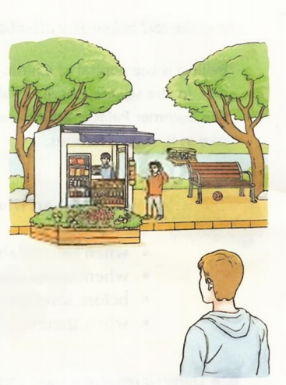
The exchange students are now in Beihai Park. Look at the picture below and find out the prepositions of place.
We are now in Beihai Park. Here is a small shop. There are some flowers in front of the shop. Behind the shop, there is a big tree.
A boy is coming. He is standing outside the shop. The shopkeeper inside the shop is smiling at him.
The shop sells food and drinks. On the left, there are some drinks below the snacks. On the right, there is some bread and sandwiches above the drinks.
Beside the boy, there is a bench. You can see a ball under it. Next to the bench is a big tree. The tree leaves over the bench are waving in the wind.
We use prepositions of place to say where things or people are.

Slide 28
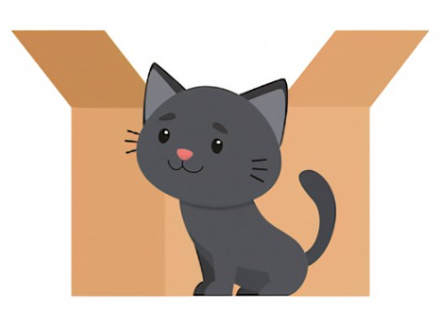

in front of & behind
in front of表示“在……前面”；
behind表示“在……后面”。两者含义相反。
The cat is in front of the box.
The cat is behind the box.
猫在盒子的前面。
猫在盒子后面。

Slide 29
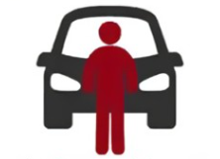
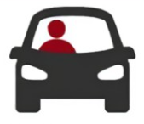
拓展
in front of & in the front of
in front of表示“在……（外部的）前面”；
in the front of表示“在……（内部的）前面”。
The man is in front of the car.
The man is in the front of the car.
这个人在汽车前面。
这个人在汽车的前部。

Slide 30
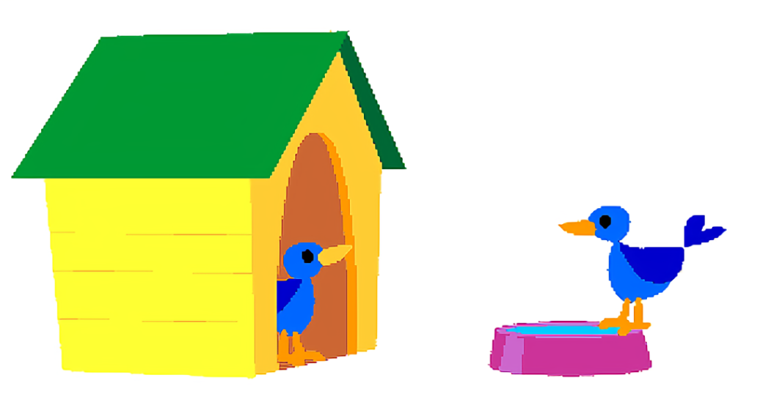
inside & outside
inside 表示“在……里面”。
outside 表示“在……外面”。
The bird is inside the house.
The bird is outside the house.
鸟在房子里。
鸟在房子外面。

Slide 31


above & below
above意为“在……之上”，表示高于；
below意为“在……下方”表示低于。
The airplane flew above the clouds.
The fish is swimming below the surface(表面) of the water.
飞机在云层上飞行。
鱼在水面以下游。

Slide 32
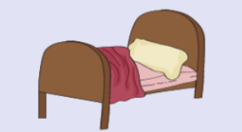
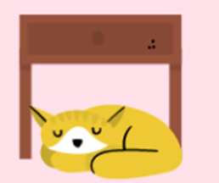
over & under
over 表示“在……（垂直的）正上方”；
under 表示“在……（垂直的正下方）”且互不接触。
The blanket is over the bed.
The cat is sleeping under the table.
毯子盖在床上。
猫在桌子下面睡觉。

Slide 33
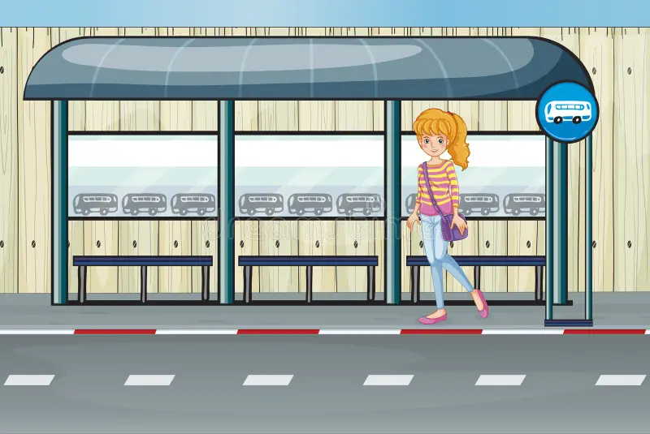

at & in
over 表示“在……处”，一般指较小的比较具体的地点；
in 表示“在……处”,相对于at常用于较大的地方。
There are many books in the library.
She is at the bus stop.
她在公共汽车站。
图书馆里有很多书。

Slide 34

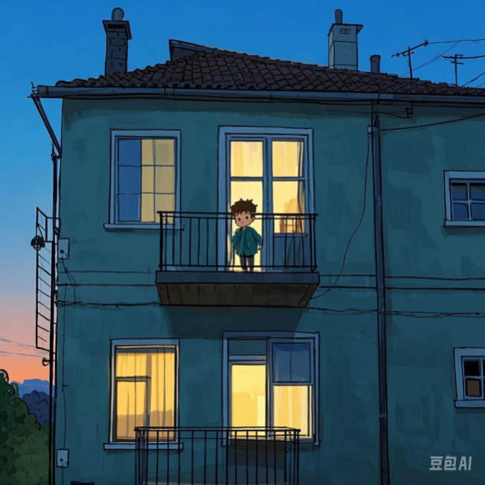
on
on 表示“在……上”，强调在某一平面上。
The book is on the table.
The boy is on the second floor.
书在桌子上。
这个男孩在二楼。

Slide 35


next to & beside
next to与beside都为“在……旁边”。
The teacher stands beside the blackboard.
He sits next to me.
他坐在我旁边。
老师站在黑板旁边。

Slide 36
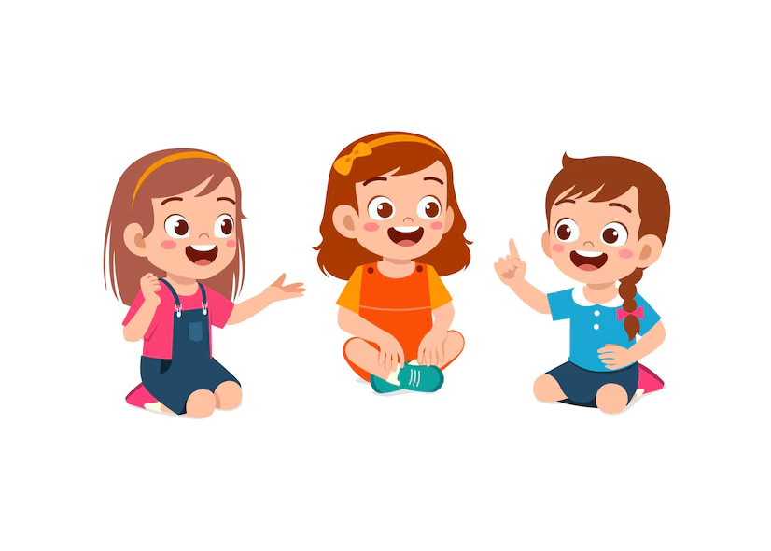
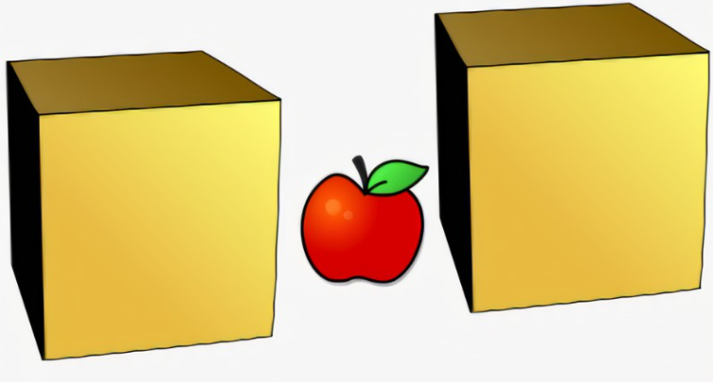
between
between表示“在……之间”，指两者之间。常用固定搭配为between ... and ...。
The apple is between the two boxes.
I sat down between Jo and Diana.
苹果在两个盒子之间。
我坐在了琼和黛安娜之间。

Slide 37
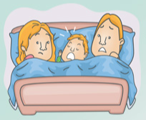
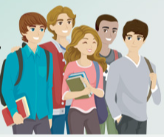
拓展
between & among
between 表示“在……（两者）之间”；
among表示“在……（三者以上）之间，之中”。
The baby is between his parents.
The teacher is among her students.
这个婴儿夹在他父母中间。
老师在她的学生中间。

Slide 38
32. There is a bridge ________ the river and there are many boats ________ the river.
A．on; on B．over; over C．on; over D．over; on
解析；桥在河上方用 over；船在河面上用 on。答案：D. over; on
33. The Chinese Dinosaur Park lies ________ the north of Changzhou and ________ the north-east of our school.
A．in; in B．in; to C．to; in D．to; to
解析：恐龙公园在常州市内，用 in；位于学校东北方向（外部），用 to。答案：B. in; to
34. The old man likes sitting ________ some children to tell interesting stories when he is free.
A．between B．among C．through D．across
解析：among（在三个及以上的人或物之间）。答案：B. among

Slide 39
36. —Why are you standing there, Mary?
—I can’t see the blackboard clearly. Two tall boys are sitting ________ me.
A．behind B．in front of C．beside D．by
解析：in front of（在某人前方，阻挡视线）。答案：B. in front of
37. —Mum, how can I protect my new computer?
—Let’s put a cloth ________ the computer.
A．above B．over C．across D．below
解析：over（覆盖在物体表面）。答案：B. over
38. —I live on the third floor. How about you, May? —On the fifth floor.
—Oh, I live two floors ________ you.
A．under B．below C．over D．above
解析：above（表示垂直方向的上方）。答案：D. above

Slide 40
39. Take a map with you, Jason. It can help you walk ________ the forest.
A．away B．across C．through D．over
解析：through（穿过内部空间，如森林）。答案：C. through
40. The Slender West Lake is famous ________ a place of interest. And it is ________ our school.
A．as; in the west of B．for; to the west of C．for; in the west of D．as; west of
解析：be famous for（以某物闻名）；to the west of（位于外部）。
答案：B. for; to the west of
41. Look! A boy is drawing ________ the bridge, and it is ________ the Hao River.
A．over; on B．over; above C．on; over D．on; on
解析：在桥上用 on；桥横跨河流用 over。答案：C. on; over
42. The bookshelf is a metre __________ my head. I have to stand on a chair to get the books.
A．above B．under C．behind D．in front of
解析：above（表示垂直上方）。答案：A. above

Slide 41
44. The sun is so bright ________ our heads but it is ________ 15℃.
A．on; below B．above; under C．over; below D．over; under
解析：over（正上方）；below（温度低于）。答案：C. over; below
45. I live ________ of Tai Lake, so I can see birds fly ________ my window every morning.
A．the east; past B．east; past C．to the east; pass D．in the east; pass
解析：east of（不加冠词）；past（经过）。答案：B. east; past
46. The book shelf is a metre ________ my head. I have to stand on the chair to get the books.
A．on B．above C．under D．below
解析：above（垂直上方）。答案：B. above
47. Jiangsu is ________ the east of China, but Japan is ________ the east of China.
A．to, to B．in, to C．in, on D．to, on
解析：江苏在中国内部用 in；日本在外部用 to。答案：B. in; to

Slide 42
48. China is ________ east of Asia and ________ north of Australia.
A．in the; to the B．in the; on the C．/; to the D．to the; /
解析：in the east of（在内部）；to the north of（在外部）。
答案：A. in the; to the
49. Xinjiang is ________ the west of China and is famous ________ the delicious food and its top quality cotton.
A．to; as B．in; for C．on; as D．in; as
解析：in the west of（在内部）；be famous for（以某物闻名）。
答案：B. in; for
35. The great man sat __________ the whole class and listened to the teacher carefully.
A．among B．around C．across D．between
解析：among（在群体中）。答案：A. among

Slide 43
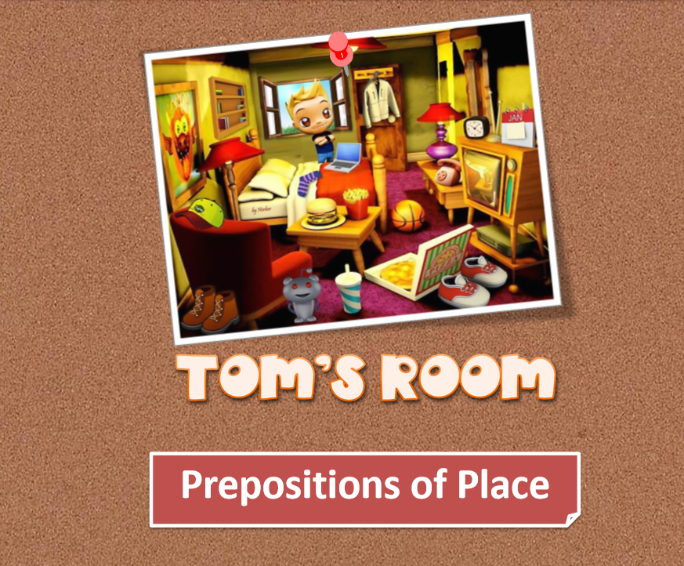
Click on the right answer to complete the sentence.

Slide 44
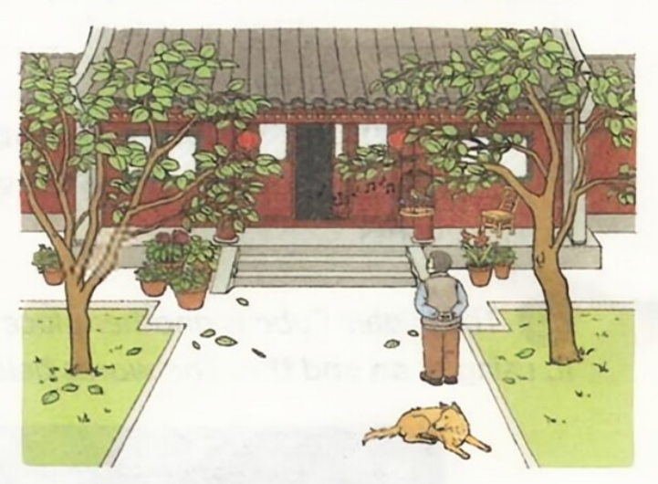
Daniel is showing the exchange students a picture of a siheyuan. Complete his description with the correct prepositions of place.
B1
Look at the house in a siheyuan. There are two lanterns just (1)___________ the roof. (2)___________ the house, there are two trees. An old man is standing (3)___________ a tree. There is a bird cage (4)__________ his head. A bird is singing (5)____________ the cage. (6)______________ the old man lies a dog.
under
In front of
under
above/over
in
Behind/Beside
P36
B1

Slide 45
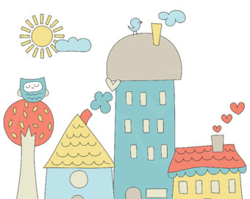
Take a picture of a place in your hometown. Write a short text about the place, using a, an, the and prepositions of place.
B2
P36
B2

Slide 46
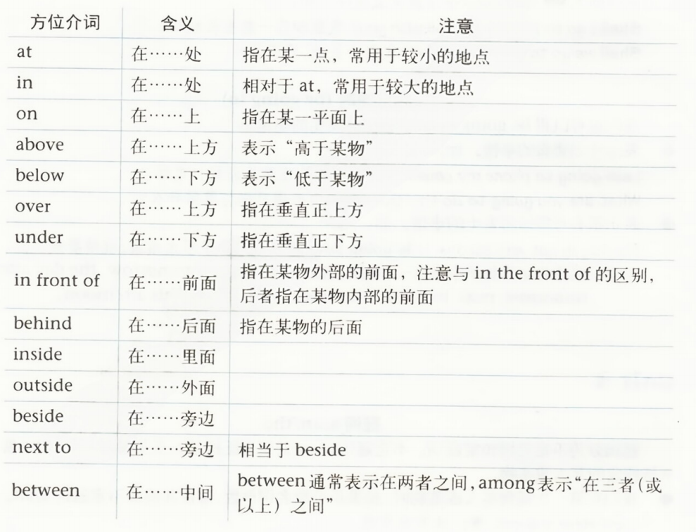

Slide 47

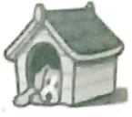
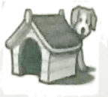
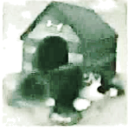
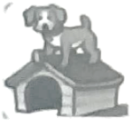
Ⅰ. 实战中考。
1. I bought a new computer last weekend. ________ computer is made in China. (2024甘肃白银)
A. A B. An C. The D. /
2. I want to be _______ scientist like Qian Xuesen when I grow up. (2024江苏宿迁)
A. a B. an C. the D. /
3. Which picture shows the dog is behind the house? (2024甘肃临夏)
A. B. C. D.

Slide 48
ⅠI. 单项选择。
1. Paris is _____ beautiful city and it is ______ capital of France.
A. a; / B. a; a C. a; the D. the; the
2. The Mid-Autumn Festival is ______ important day in China. It is on ______ 15th day of the eighth lunar (阴历的) month.
A. a; / B. an; / C. the; the D. an; the
3. Look at _______ hill over there! We often have _________ picnic on it.
A. a; a B. the; a C. a; an D. the; the

Slide 49

4. I have two new friends. One is from ___________ UK, and the other comes from ______ USA.
A. /; / B. a; a
C. an; an D. the; the
5. — Is there ________ underground station near your home?
— No, but there is _______ bus stop.
A. an; a B. a; an
C. /; / D. the; the

Slide 50
III. 从方框中选择合适的介词填空。
beside, below, outside, above, in, on
outside
1. Millie’s little dog is ________ the cage, so it can run around in the garden.
2. The girl _______ me is my elder sister Tina in the family photo.
3. When Lily is sad, she likes looking up at the clouds ___________ her head.
4. When Tina opens the fridge, she finds only a few tomatoes _______ it.
5. Don’t sit _____ the ground, Kate. It is dirty and cold.
6. Tom lives __________ most neighbours because his flat is on the ground floor.
beside
above
in
on
below

Slide 51


1. Can you use article(a/an, the) properly?
2. Can you use the prepositions of place (in / on / at / below / above / over / under / in front of / behind / inside / outside / next to / beside / between) properly?

Slide 52

1. Write a passage to describe(描写) one of the places of interest in your hometown, using a, an, the and prepositions of place.
2. Preview Pronunciation on page 37.

