Slide 1
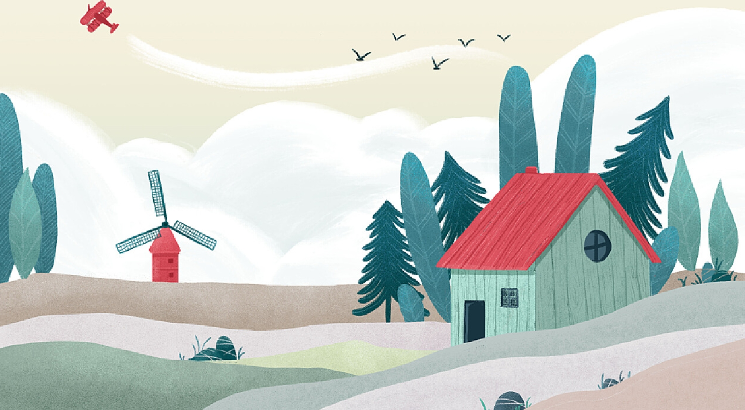
Unit 3
My hometown
Integration(A-C)

Slide 2
Learning objectives
In this lesson, we will be able to:
1. get information about the different places through Daniel’s plan;
2. get basic information about the three main halls of the Palace Museum from the tour guide's introduction by listening;
3. introduce their favourite places in their hometowns to others;
4. explore the deep feelings about their hometown.

Slide 3
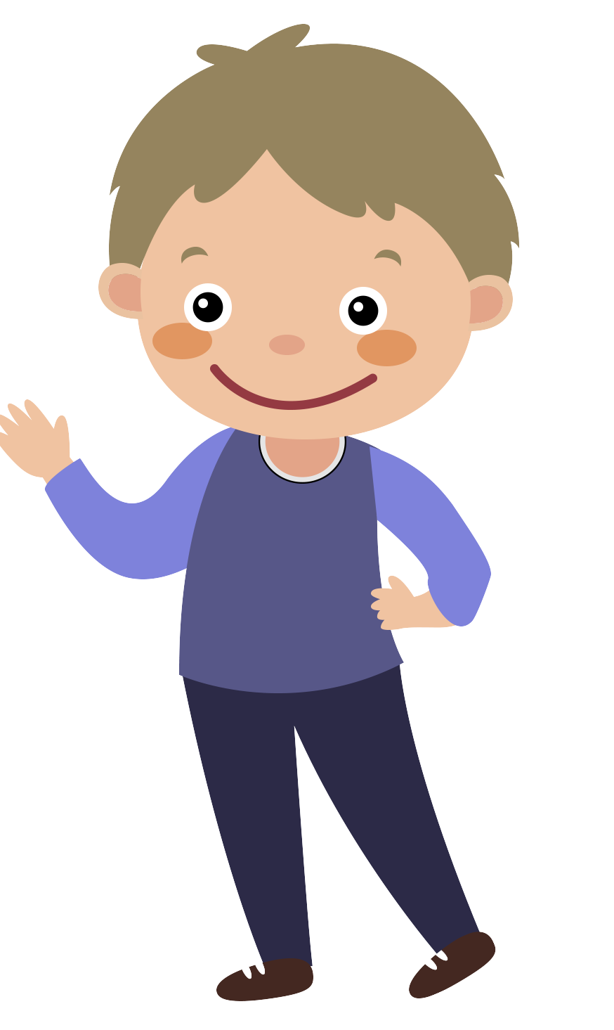
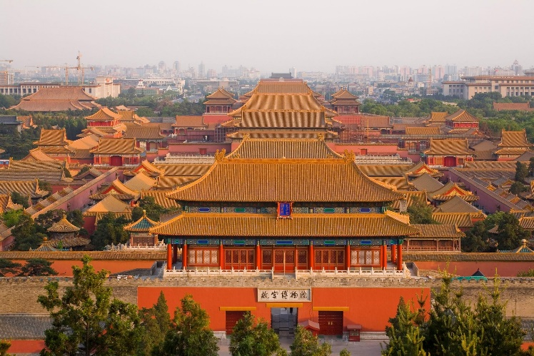
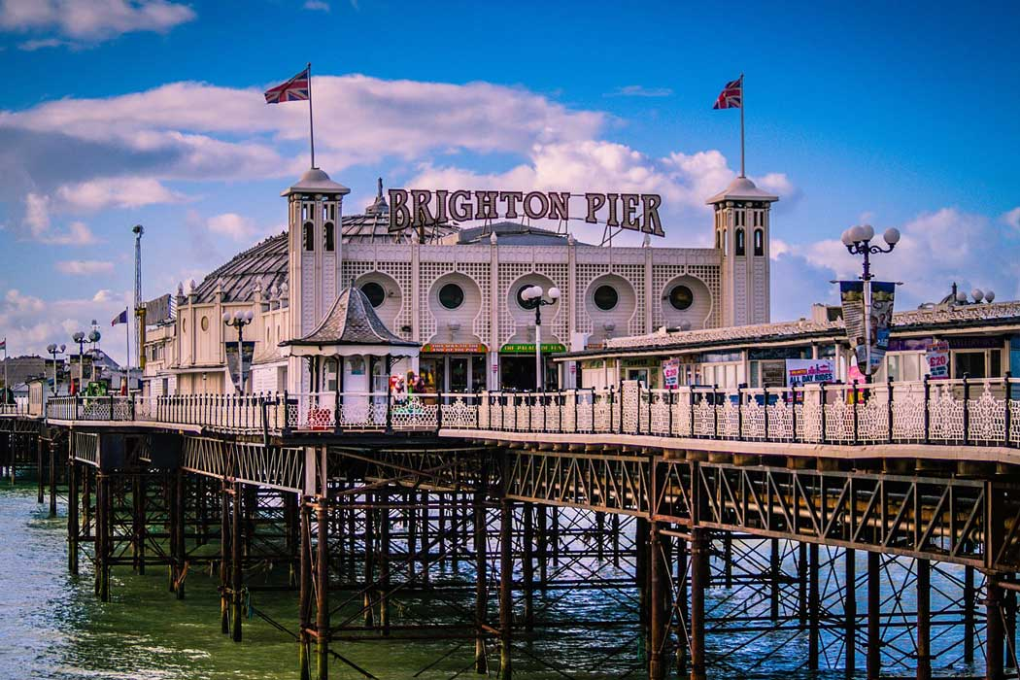
Hometown Square
Beijing
Brighton
Daniel
We have visited some cities in the hometown square.
Today, there is a special guest（特别嘉宾）Daniel is
planning a day out for exchange students visiting Beijing.

Slide 4
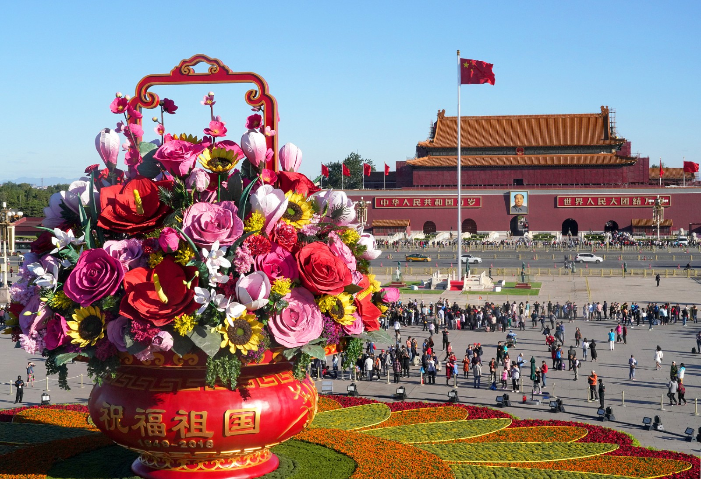
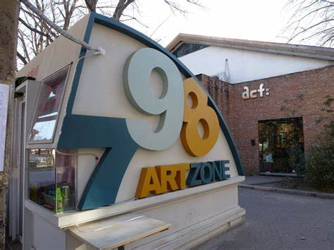
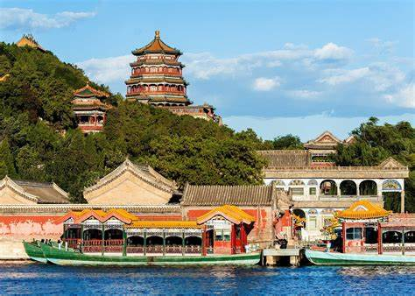
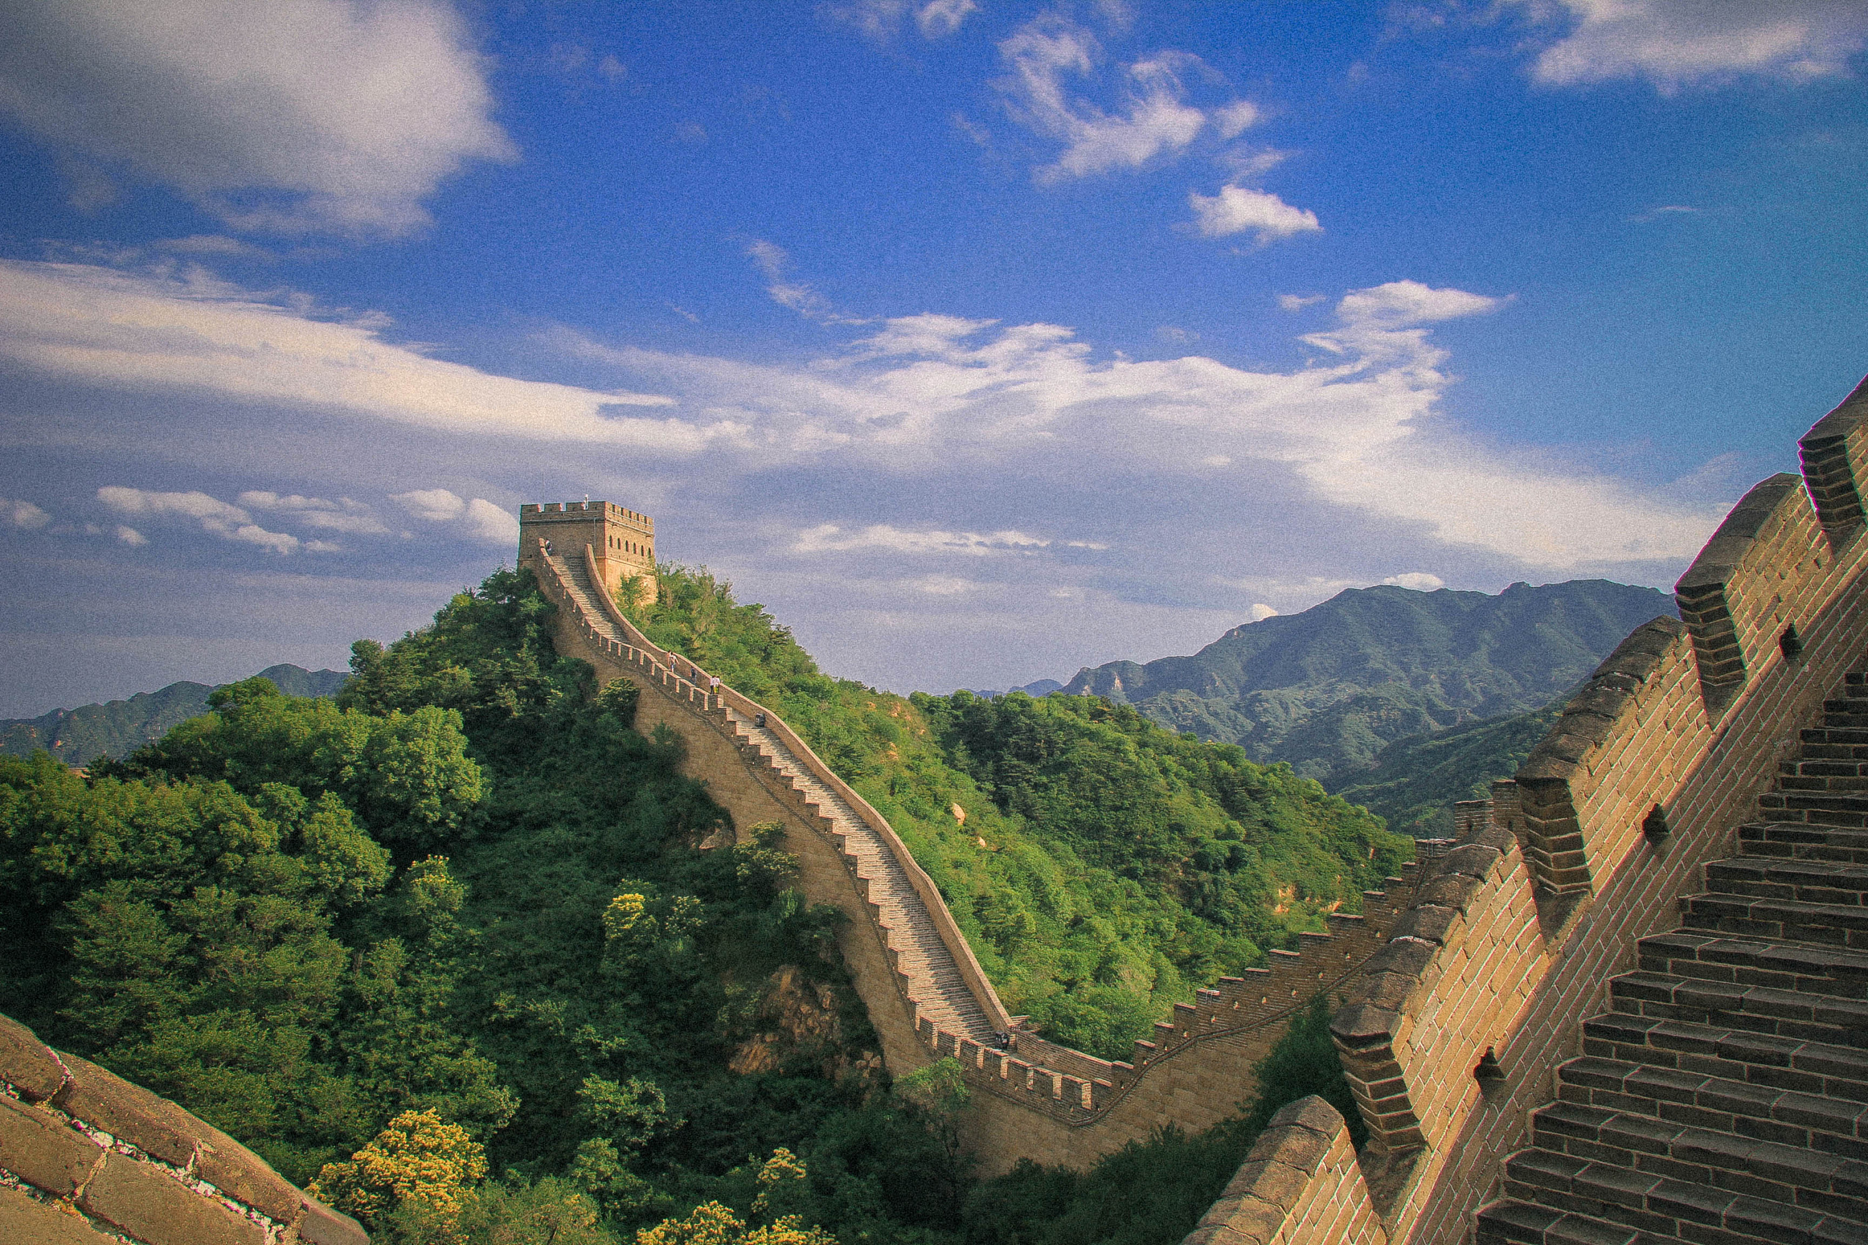

Look and say
Can you guess what are these places?
Tian’anmen Square
798 Art Zone
The Summer Palace
The Great Wall

Slide 5
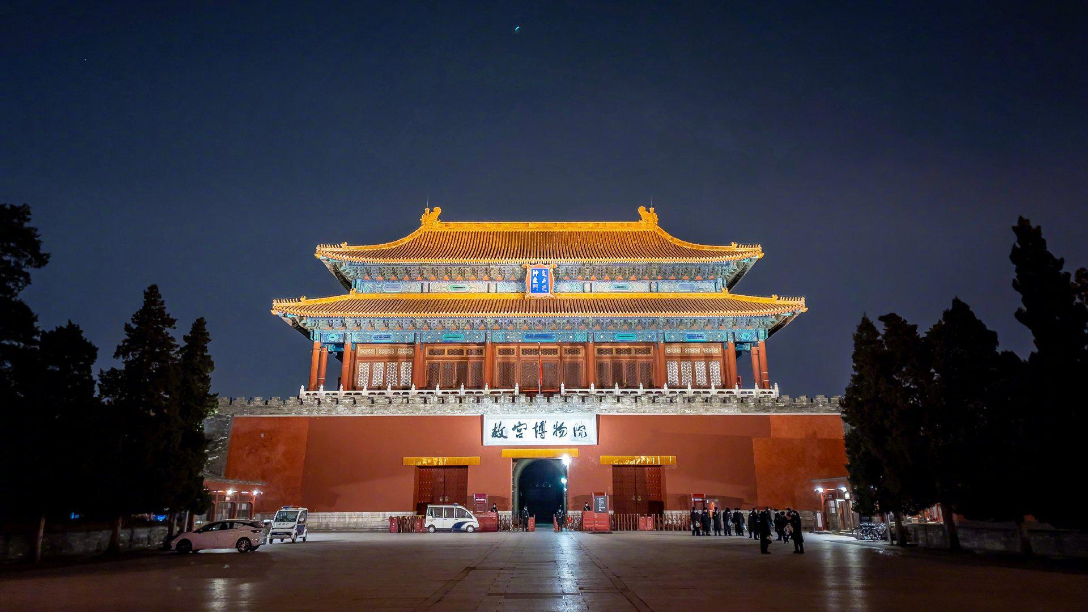
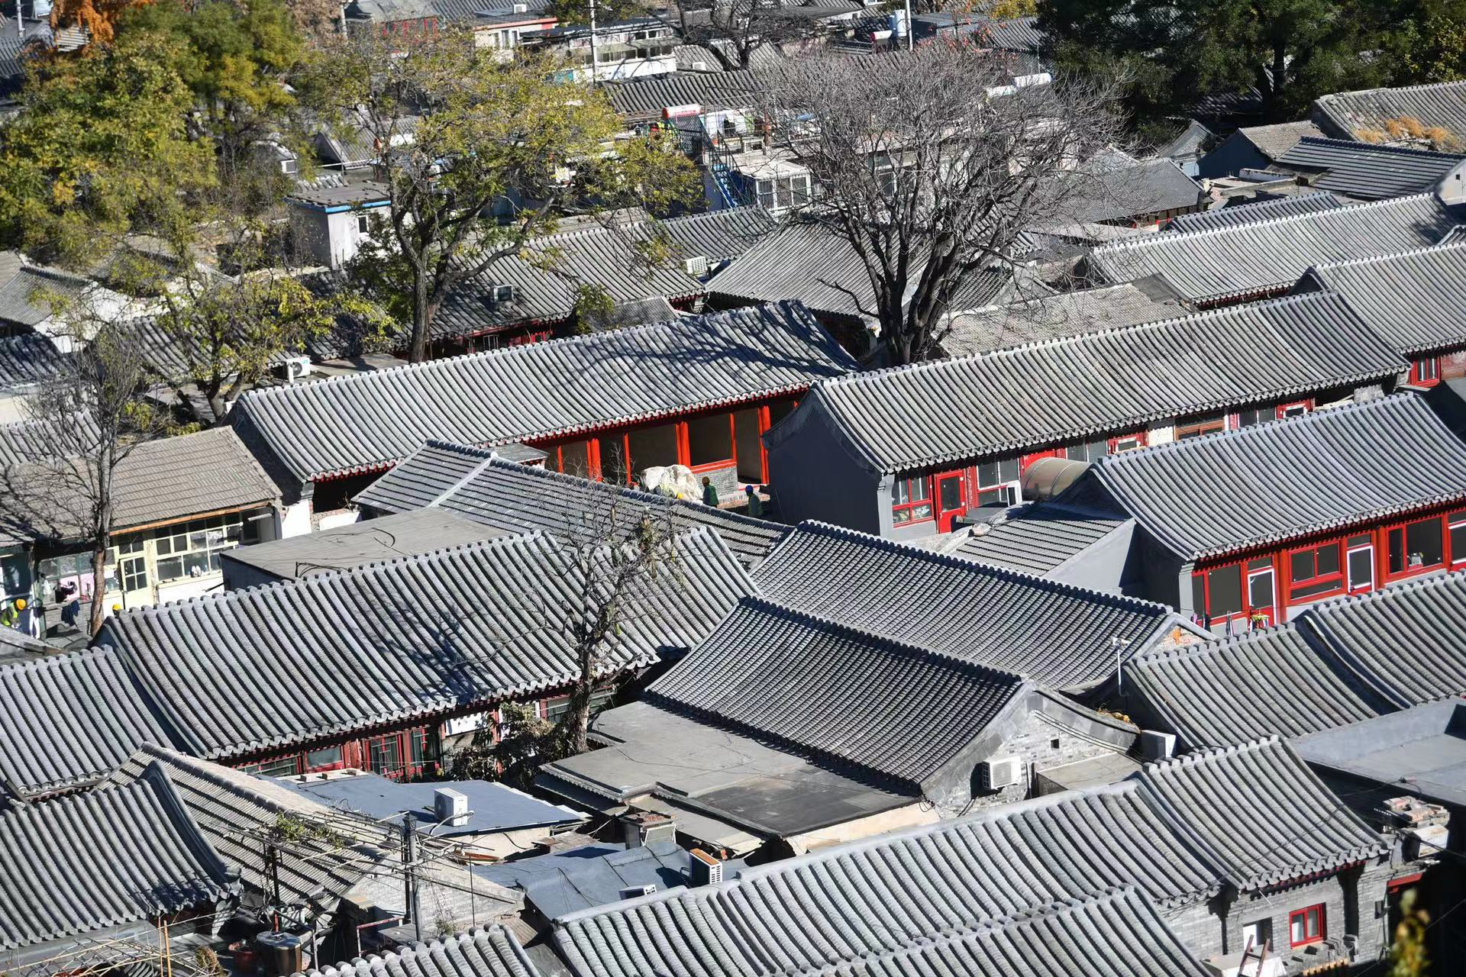
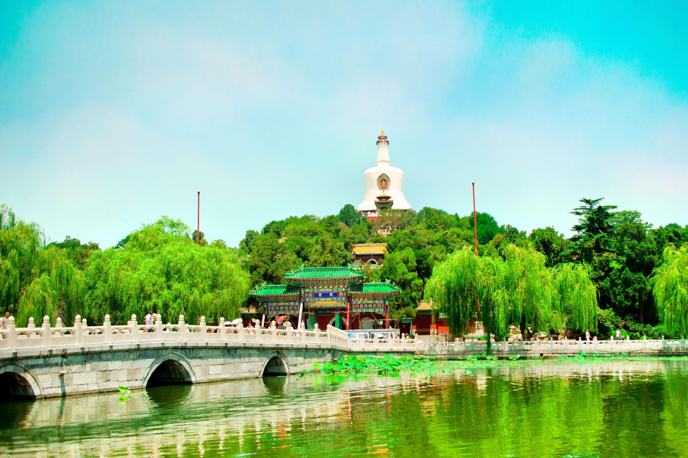
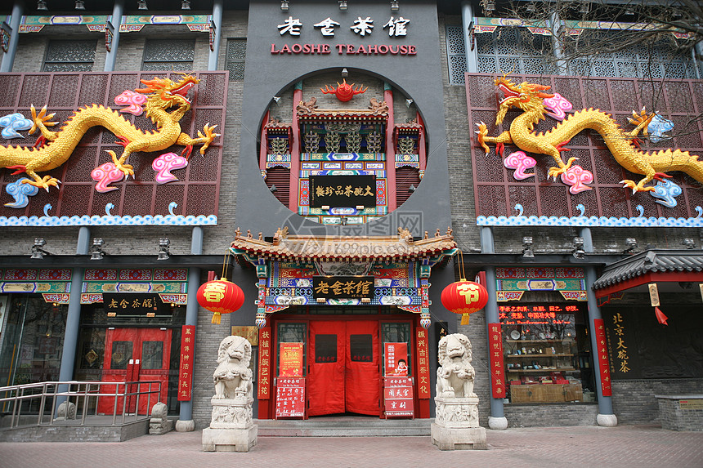
Look and say
Can you guess what are these places?
The Palace Museum
Siheyuan and hutong
Beihai Park
Lao She Teahouse

Slide 6
Different hometowns, same feelings
A
Daniel is planning activities for the exchange students in Beijing. Read his plan and answer the questions below.
Day | Place | Activity
1 | Tian'anmen Square | Walk around the square and watch the raising of the national flag
 | The Palace Museum | See the beautiful buildings and art treasures
2 | Siheyuan and hutong | Take a city walk
 | Beihai Park | Walk around the park and row a boat
 | Lao She Teahouse | Try some traditional Chinese tea and enjoy Beijing opera
3 | 798 Art Zone | Enjoy the museums and works of art, and meet local artists
4 | The Summer Palace | Visit the garden and enjoy beautiful views
5 | The Great Wall | Climb part of this famous wall
1 The exchange students want to enjoy some lake views. Where can they go?
2 Which of these places do you think is the most interesting? Why?

Slide 7
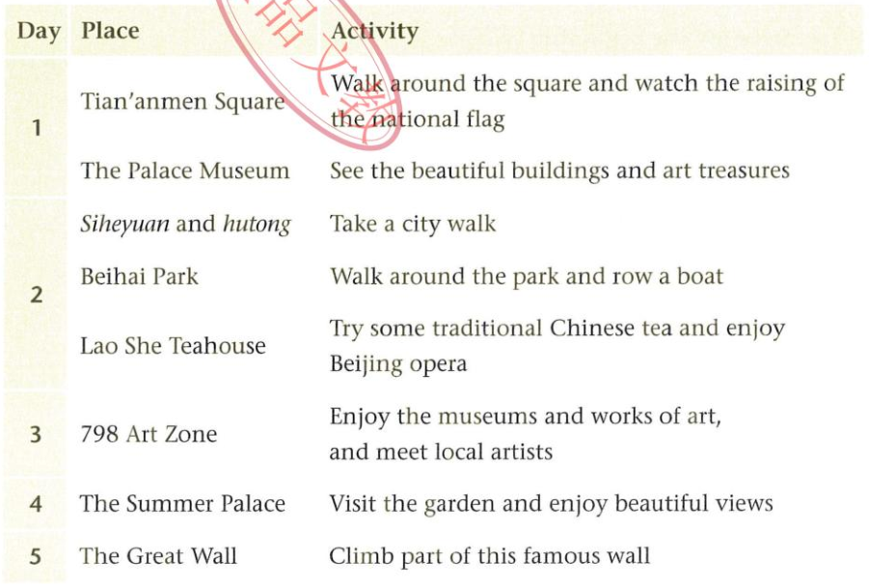
A
Read and answer
Daniel is planning activities for the exchange students in Beijing. Read his plan and answer the questions.
1 .The exchange students want to enjoy some lake views. Where can they go?
Beihai Park
2. Which of these places do you think is the most interesting? Why?
I think…Because…

Slide 8
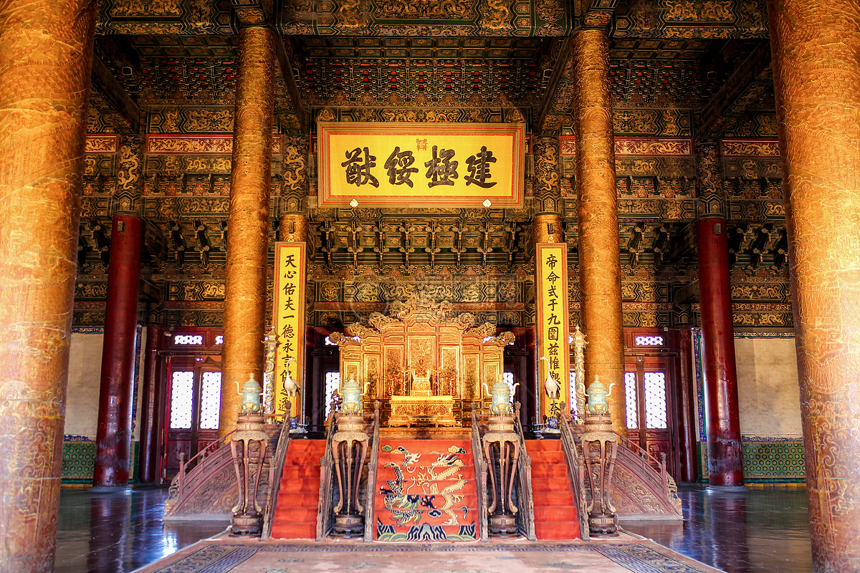
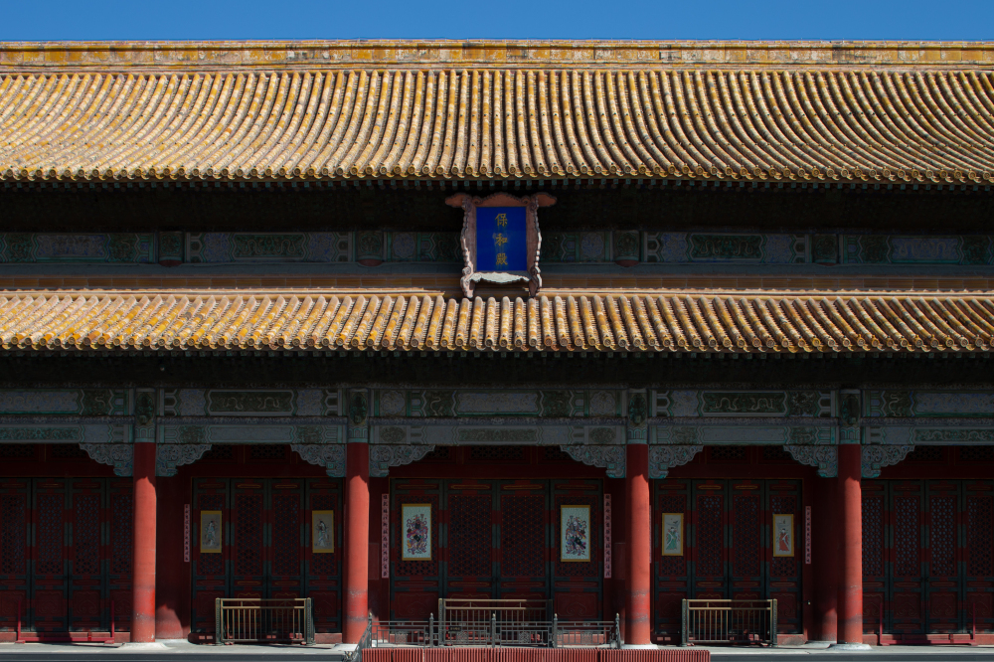
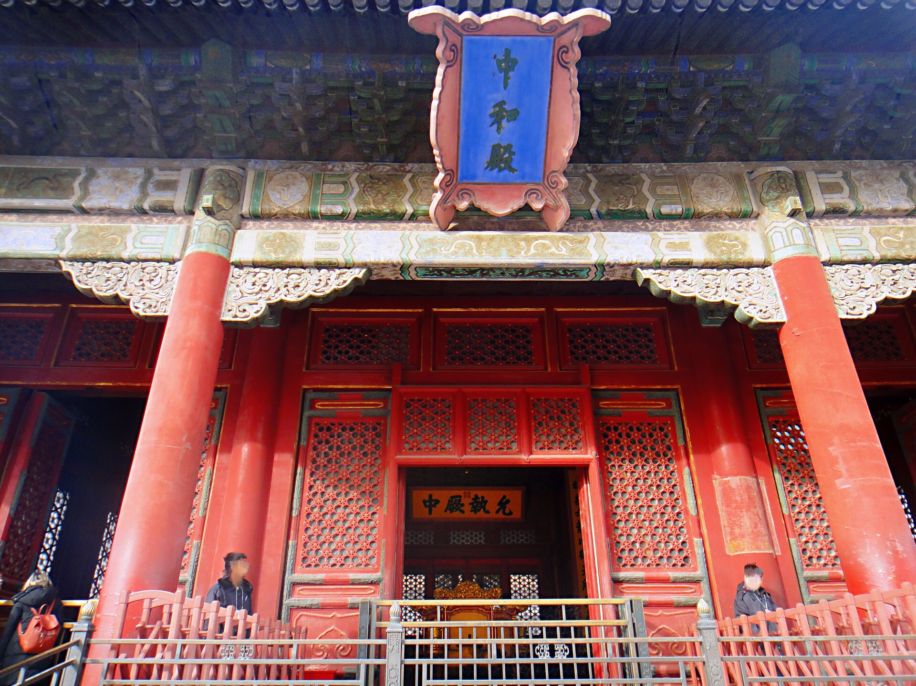
B
Daniel and the exchange students are visiting
the Palace Museum.
Taihe Hall
Zhonghe Hall
Baohe Hall

Slide 9

B
Daniel and the exchange students are visiting
the Palace Museum. Listen to the tour guide and complete the table below.
Tips:
When listening about a place, it is important to listen carefully for the names of its parts, its location, etc.
在听地点时，主要仔细听内部的名称、位置等。
Hall | What it is like
Taihe Hall | About ⁽¹⁾ __________ high A golden ⁽²⁾ __________ in the large hall
Zhonghe Hall | A building in the shape of a ⁽³⁾ __________ ⁽⁴⁾ ___________on four sides
Baohe Hall | A yellow roof with ⁽⁵⁾ ___________ on it Beautiful (6) ___________outside

Slide 10

B
Hall | What it is like
Taihe Hall | About ⁽¹⁾ __________ high A golden ⁽²⁾ __________ in the large hall
Zhonghe Hall | A building in the shape of a ⁽³⁾ __________ ⁽⁴⁾ ___________on four sides
Baohe Hall | A yellow roof with ⁽⁵⁾ ___________ on it Beautiful (6) ___________outside
Hall | What it is like
Taihe Hall | About ⁽¹⁾ 27__________ high A golden ⁽²⁾ ____chair_____in the large hall
Zhonghe Hall | A building in the shape of a ⁽³⁾ _square__ ⁽⁴⁾ __Windows____on four sides
Baohe Hall | A yellow roof with ⁽⁵⁾ __dragons_____ on it Beautiful (6) steps______outside
Thinking:
1. Have you been to the Palace Museum?
2. What did you like the most?

Slide 11
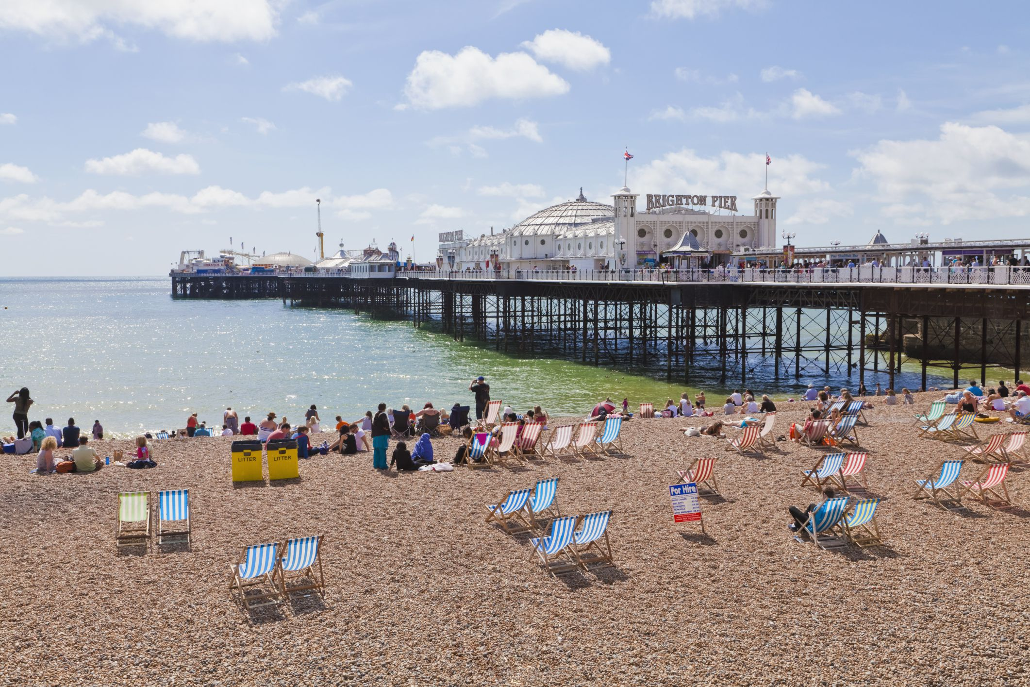
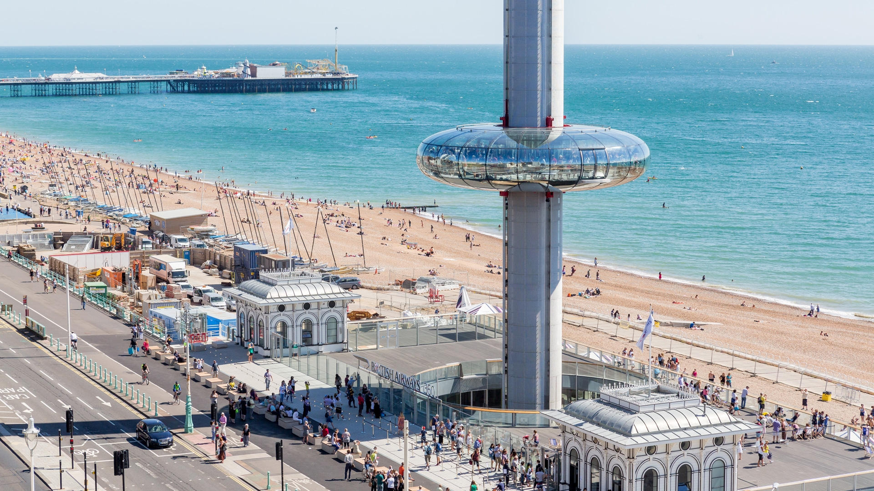
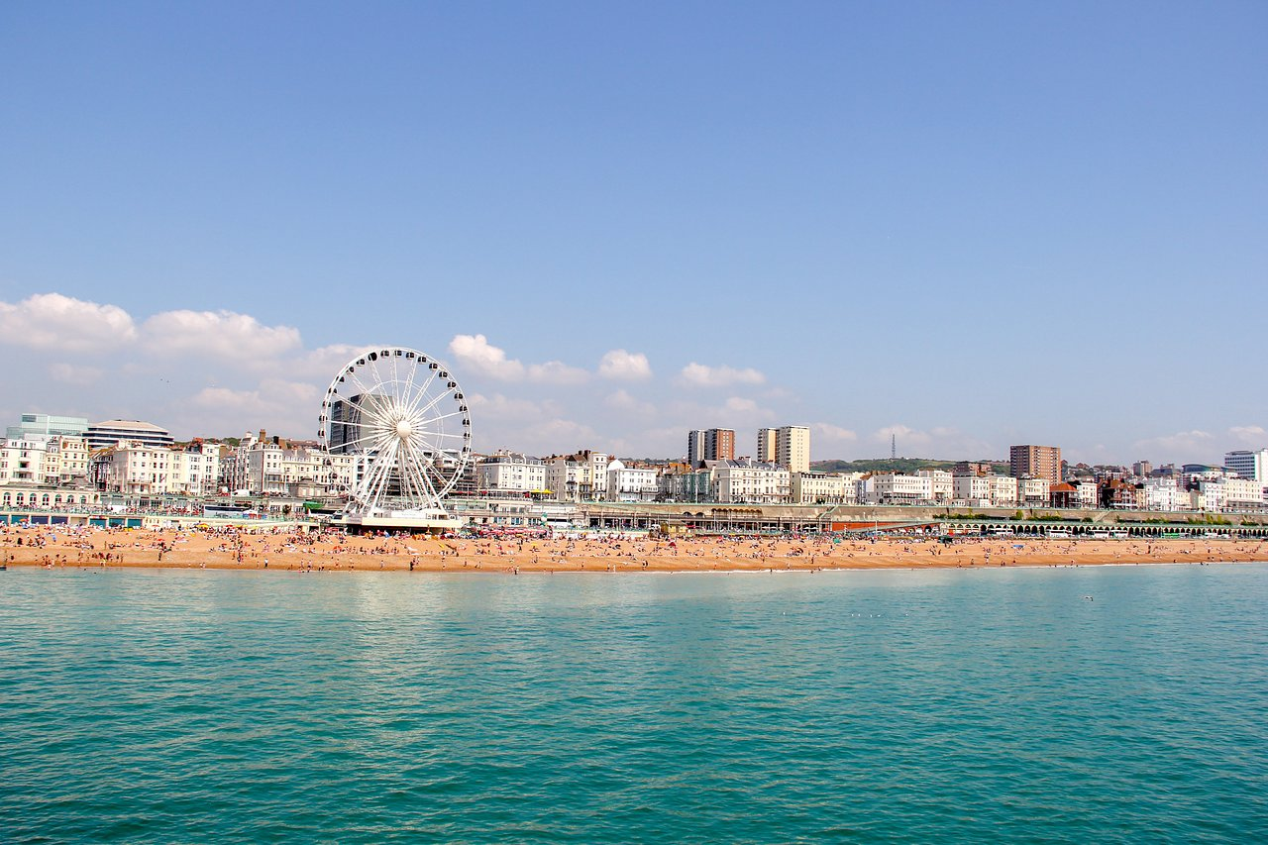
C
Sharing Hometowns - Brighton
Ben, one of the exchange students, is telling Daniel about his hometown Brighton, in the south of the UK.
beach and sea
Brighton 1360 Tower

Slide 12
Listen and imitate. Pay attention to pronunciation and intonation.
Daniel: What places of interest are there in Brighton?
Ben: Hmm…I recommend the Brighton i360 tower. It's 162 metres tall. You can go up and see some amazing views of the city and the sea.
Daniel: Sounds great! What's your favourite place in Brighton?
Ben: I love going to the beach. It's full of stones. It's nice to walk along the beach and take in the sea air. I also like to sit on the stones and watch the sea. The view at sunset is fantastic too.
Pay attention to the intonation (语调)。
1.陈述句读降调。
2.一般疑问句读升调。
3.特殊疑问句读降调。
4.感叹句读降调。
5.选择疑问句前升后降。

Slide 13
C
Read the conversation and answer the questions.
What does Ben recommend? Why?
2. What’s Ben’s favourite place in Brighton? Why?
3. What does the view in Brighton look like?
He recommends the Brighton 1360 tower. It's 162 metres tall.
Because you can go up and see some amazing views of the city and the sea.
He loves going to the beach. Because it's full of stones. It's nice to walk along the beach and take in the sea air. He also likes to sit on the stones and watch the sea.
The view is amazing and fantastic.

Slide 14
Work in pairs and find expressions about the hometown, place and activities.
Daniel: What places of interest are there in Brighton?
Ben: Hmm…I recommend the Brighton 1360 tower. It's 162 metres tall. You can go up and see some amazing views of the city and the sea.
Daniel: Sounds great! What's your favourite place in Brighton?
Ben: I love going to the beach. It's full of stones. It's nice to walk along the beach and take in the sea air. I also like to sit on the stones and watch the sea. The view at sunset is fantastic too.
Feelings
Places

Slide 15
Work in pairs and talk about things to see and do in
your hometown. Use the expressions and sentences below as a model
Expressions
places of interest
favourite place
amazing
fantastic
Sounds great!
Daniel: What places of interest are there in Brighton?
Ben: Hmm…I recommend the Brighton 1360 tower. It's 162 metres tall. You can go up and see some amazing views of the city and the sea.
Daniel: Sounds great! What's your favourite place in Brighton?
Ben: I love going to the beach. It's full of stones. It's nice to walk along the beach and take in the sea air. I also like to sit on the stones and watch the sea. The view at sunset is fantastic too.
Sentences
I recommend …
I love doing...
It's nice to...
I also like…

Slide 16


C
Introducing Your Favourite Place in Your Hometown.
Group work - Tourist of your hometown
Tip :
Four students in a group.
Where is your hometown?
What’s your favourite place in your hometown?
Why do you like this place? Describe your feelings about this place.
What activities can you do in this place?
Use the expressions and sentences below
You may begin like this:
My hometown is...My favourite place is…
I recommend…Because… I love doing…
I also like…It's nice to... It’s amazing…
I feel truly comfortable to...
I love my hometown.

Slide 17


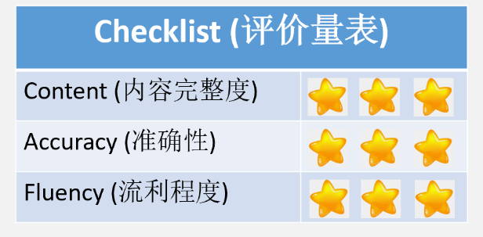
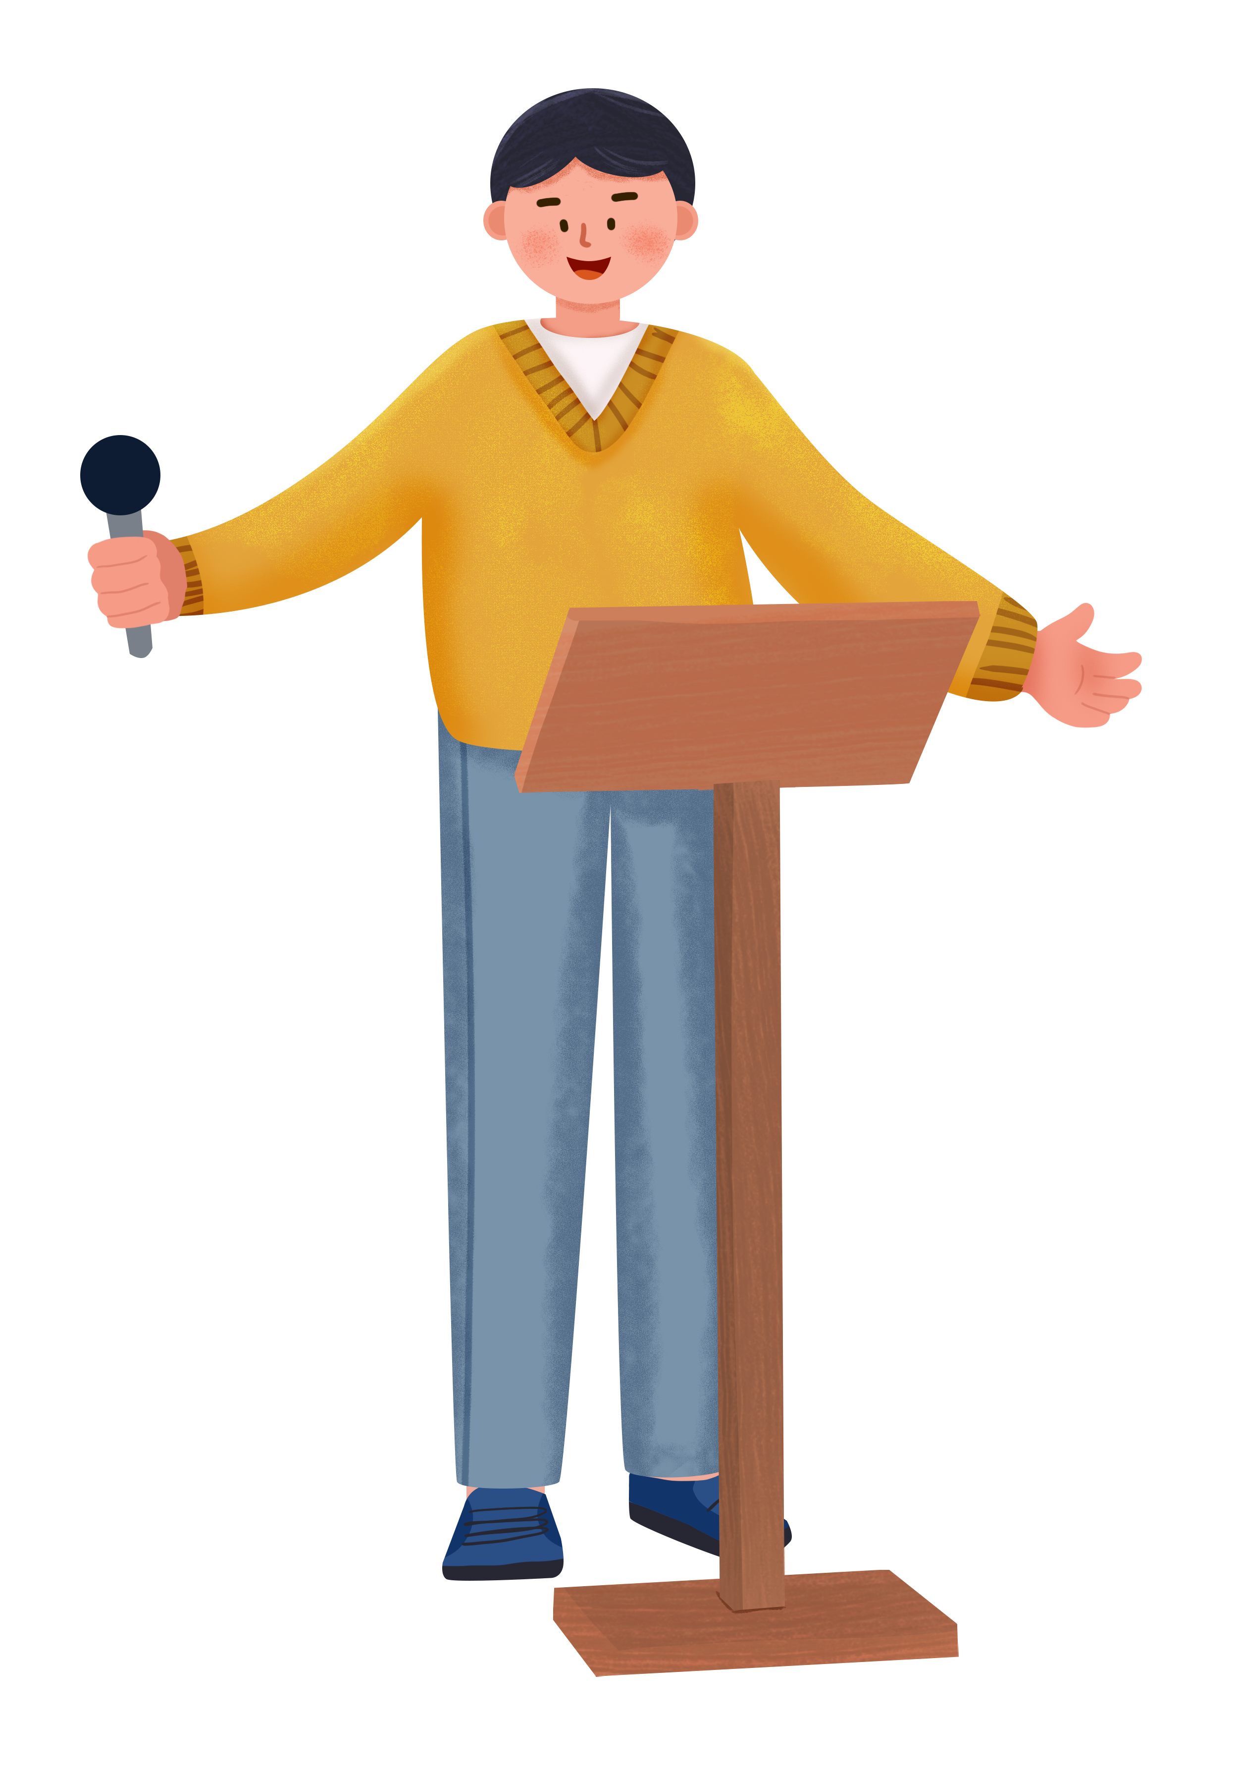
Show time

Slide 18
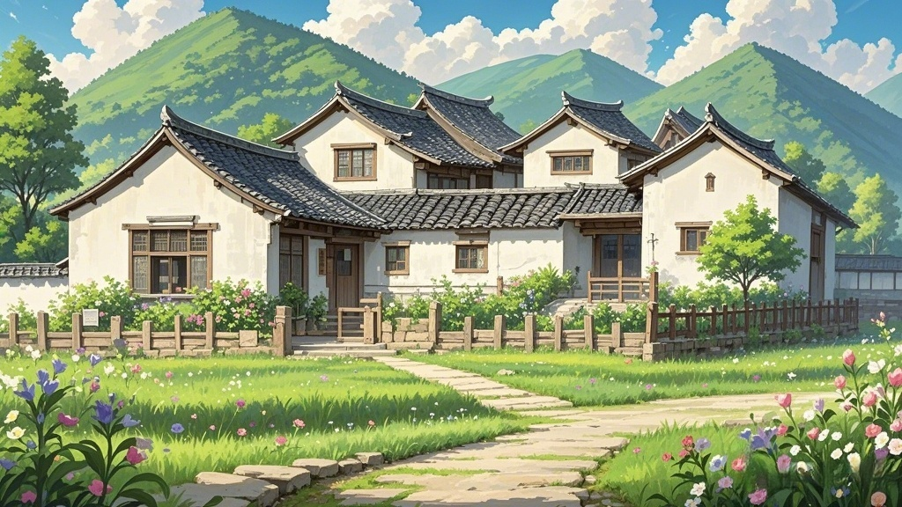


刘刘老师原创，更多精品课件联系V：LLlaoshi7
How do you feel about your hometown?
Do you love your hometown?
My Hometown,
My Love
Cherish the memories in the hometown.
Different hometowns, same feelings.
Feel proud of the hometown.
__________
Miss the hometown.
刘刘老师原创，更多精品课件联系V：LLlaoshi7

Slide 19


Homework

Slide 20

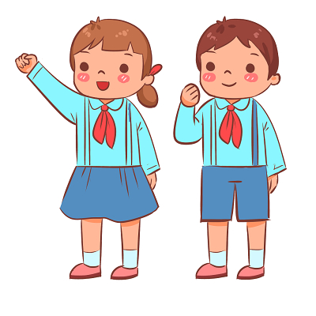
Required（必做）
Write a short passage to introduce your hometown or your favourite place to
your classmates.
Optional（选做）
Draw a picture of doing activities with family members in your hometown and write a brief English introduction.

