Slide 1


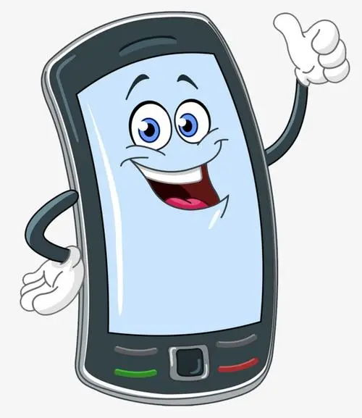
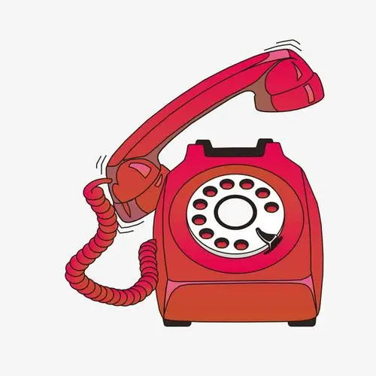
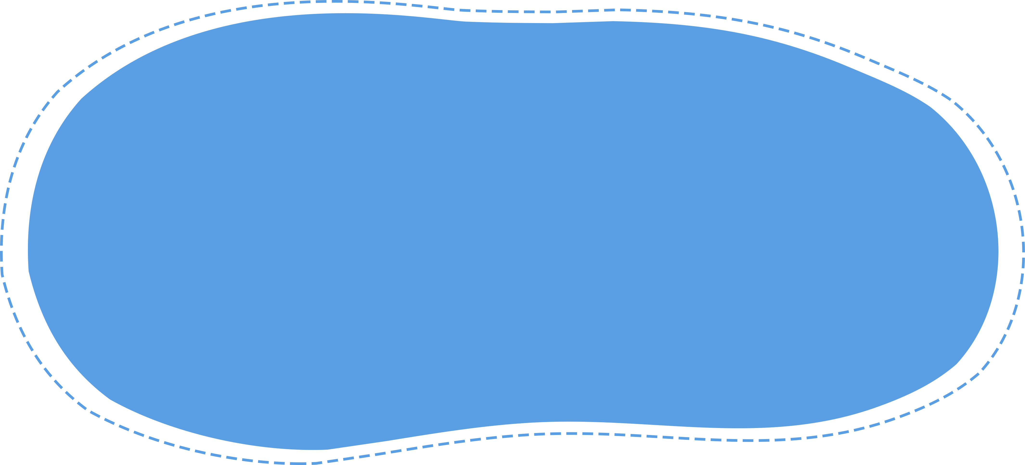



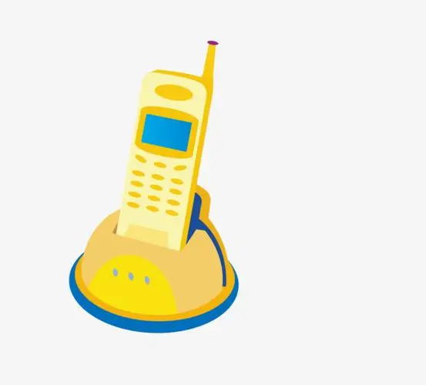



Wow！
That’s communication!
常州市滨江中学 吴春霞 2024.04.20

Slide 2
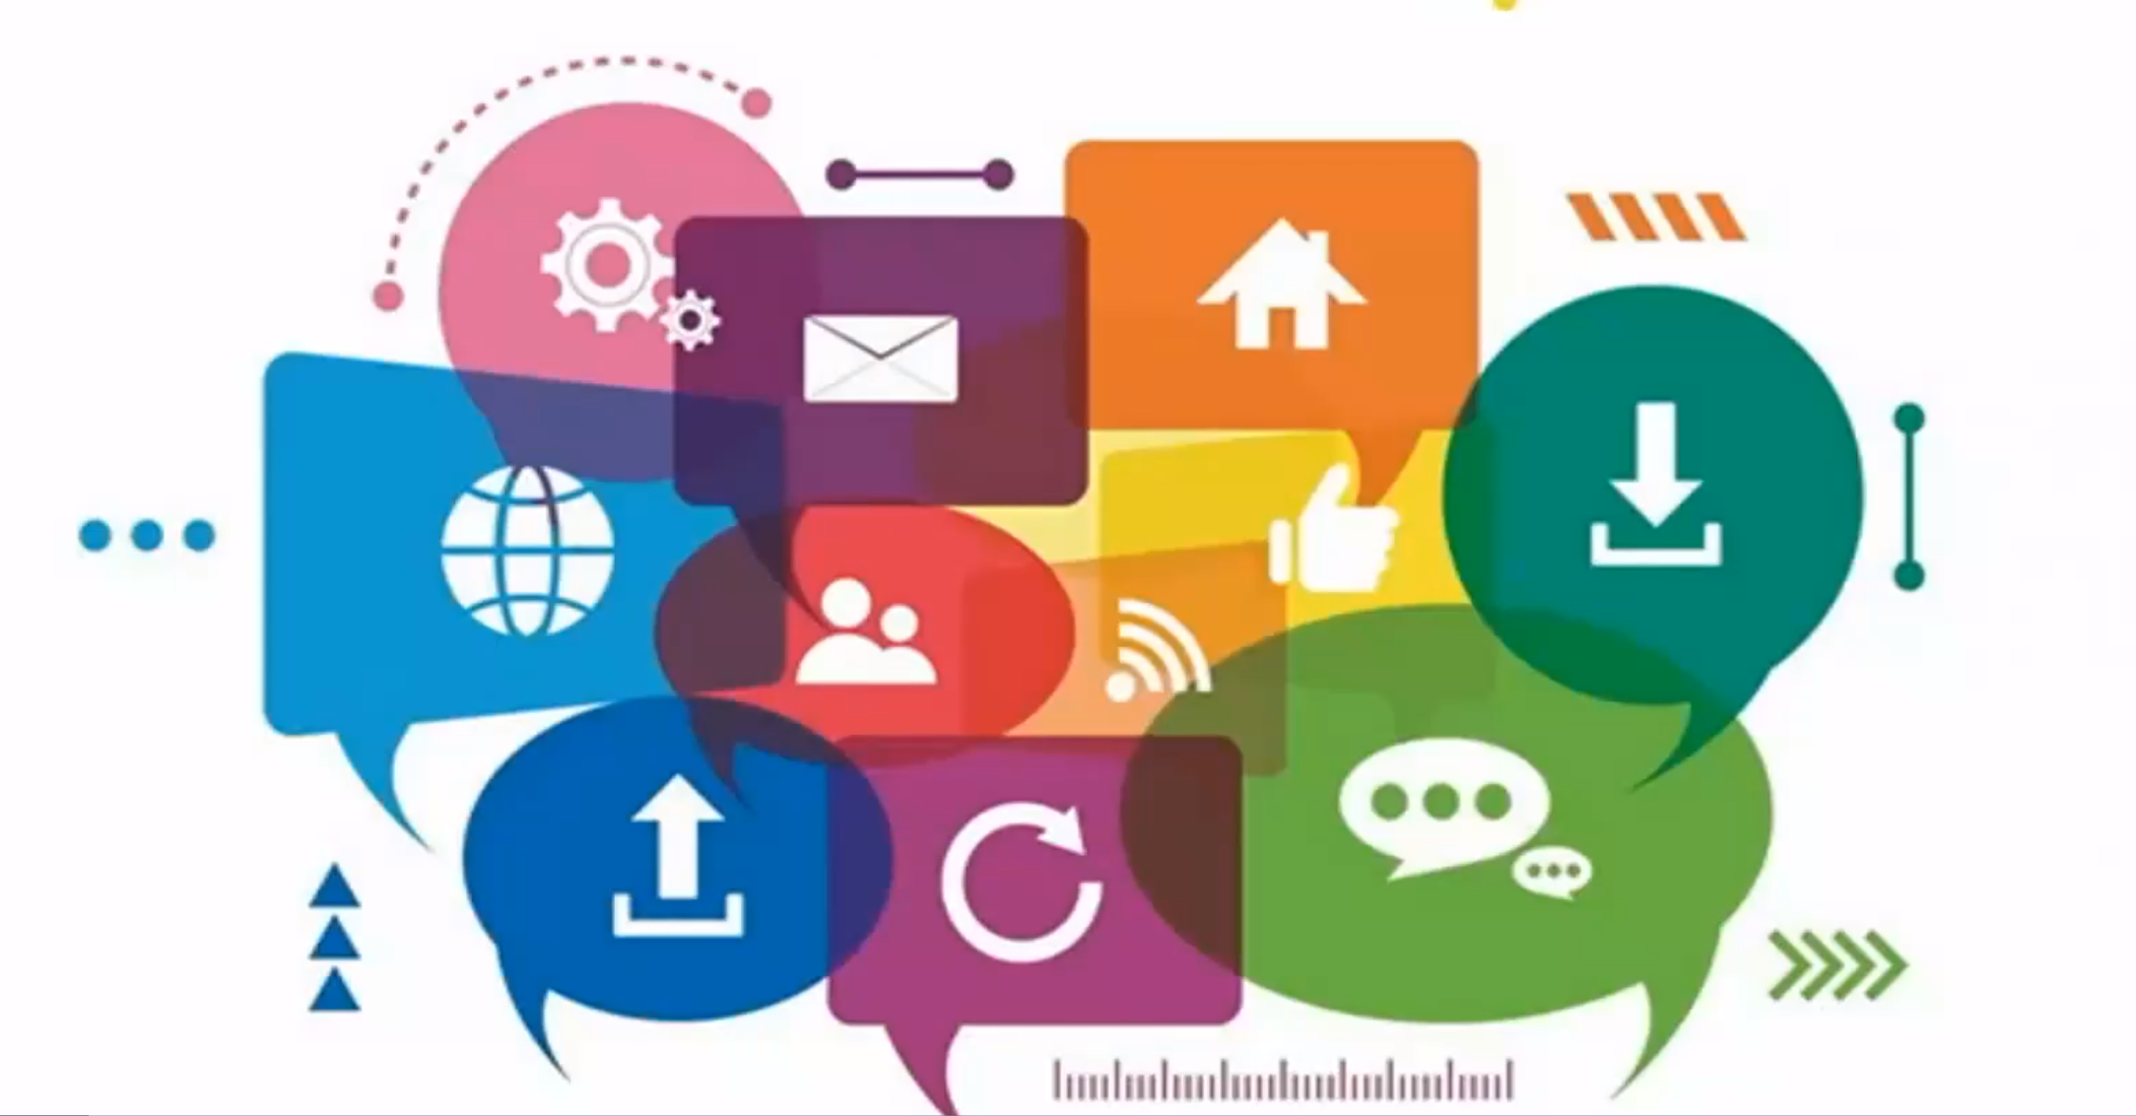
Communication song

Slide 3
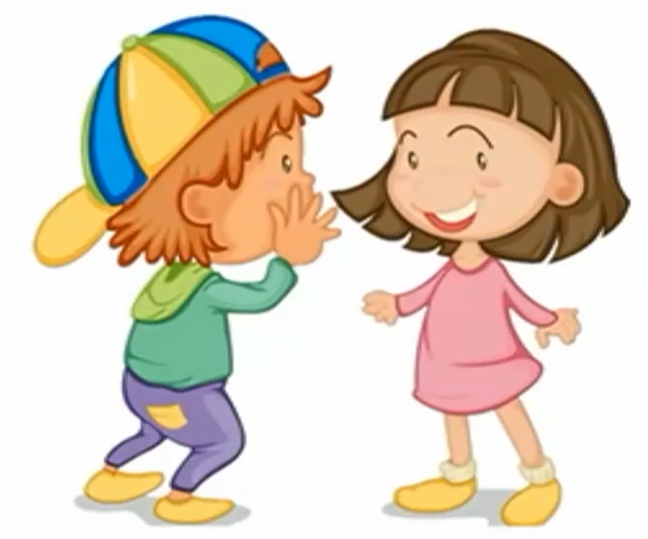
I wanna talk to you.
You wanna talk to me.
We can communicate quite frequently（经常）.

Slide 4
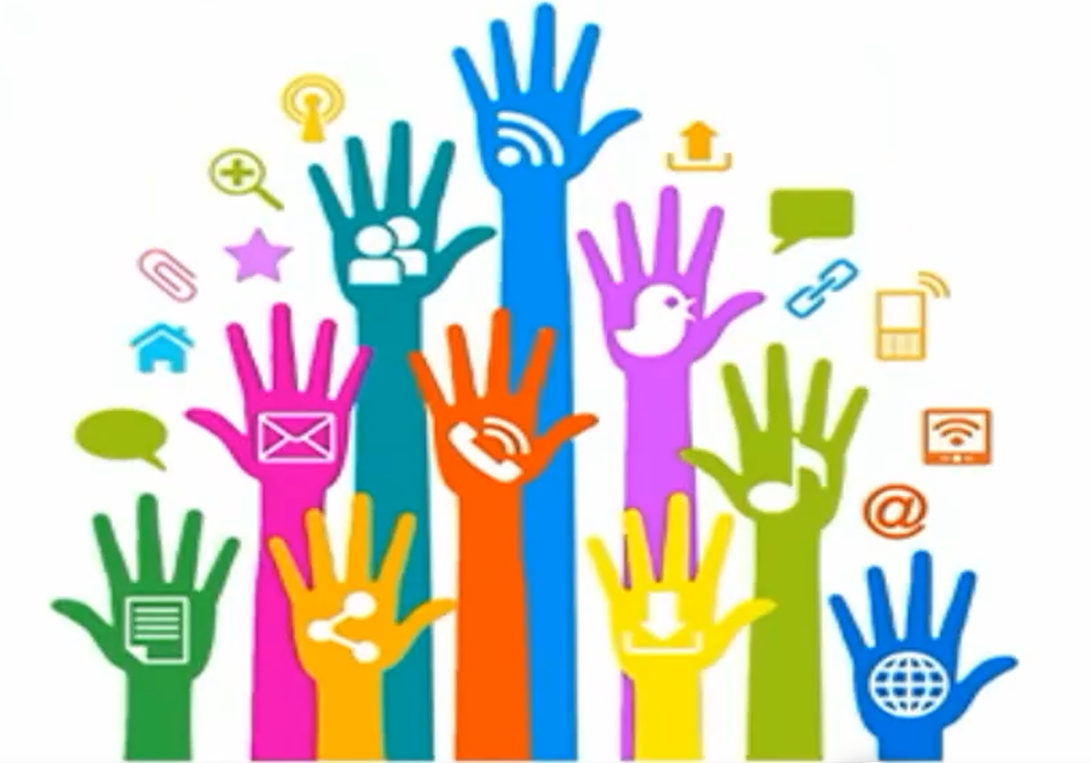
To get in touch with each other in a whole lot of ways.
Communication is a way to go.
Don’t you know communication is a way to go.

Slide 5
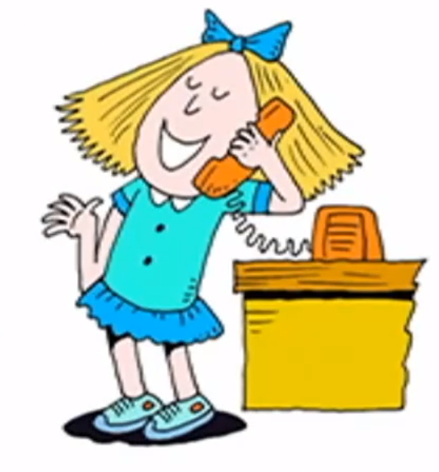
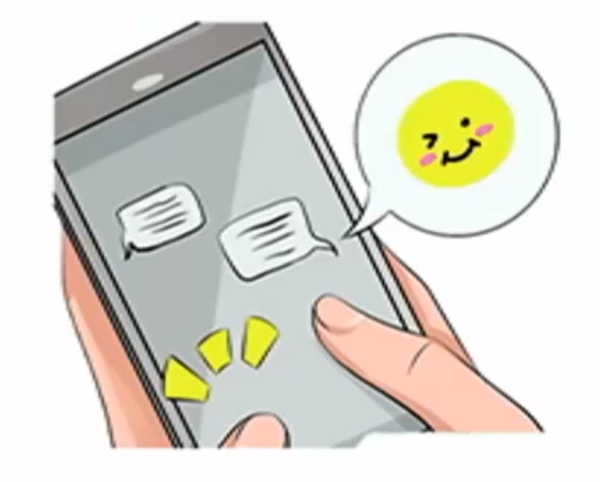
You can call me.
You can text me.

Slide 6
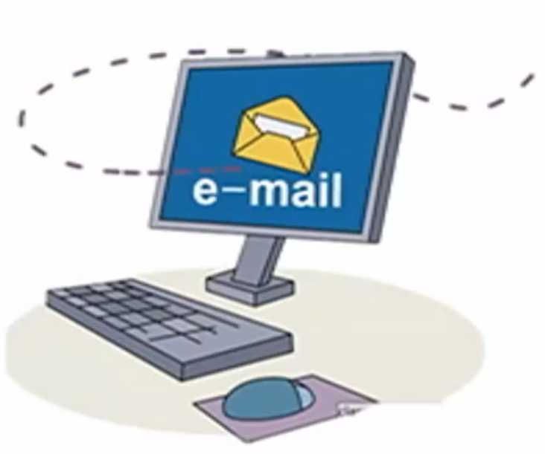
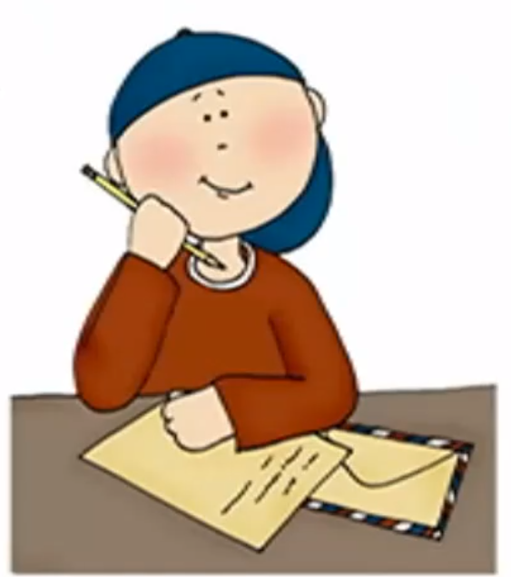
You can email me.
Or you can write me a letter.

Slide 7

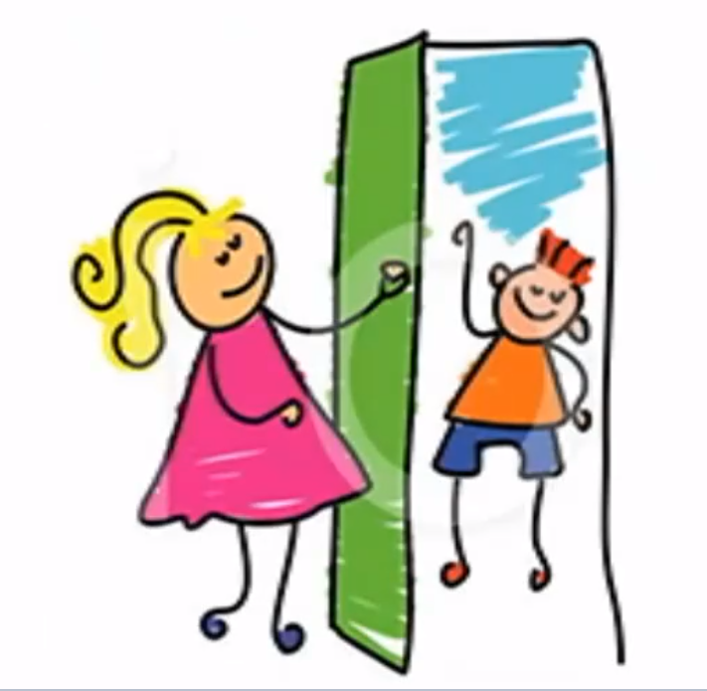
We can talk to each other
face to face.
Or I can simply come around
to see at your place.

Slide 8
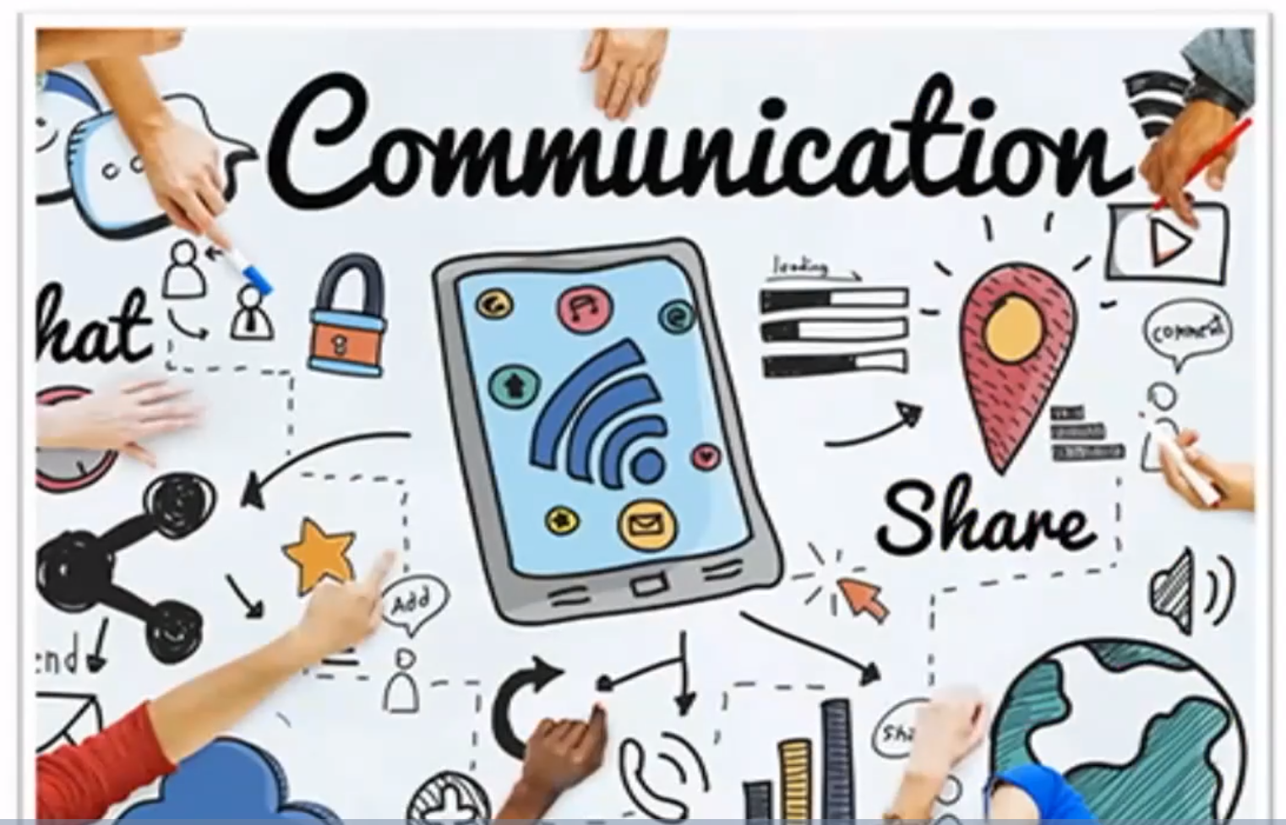
Communication is a way to go.
Don’t you know communication is a way to go.

Slide 9
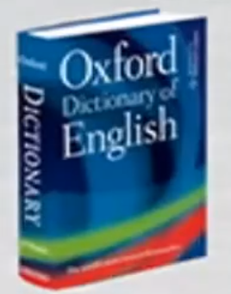
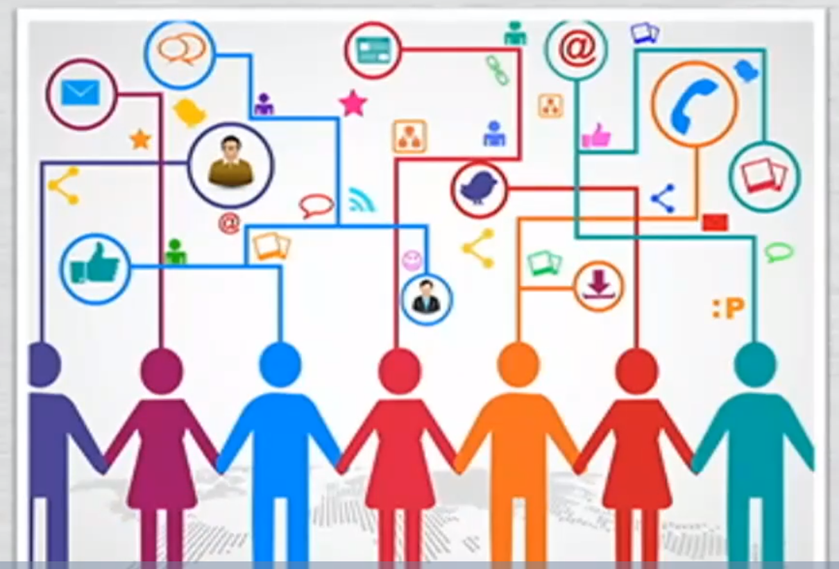
Communication is the activity of
expressing(表达) ideas and feelings
or giving people information .

Slide 10

How do we communicate
with our friends and family members?
01
make a phone call
02
chat online
03
write a letter
04
meet up
... ...

Slide 11

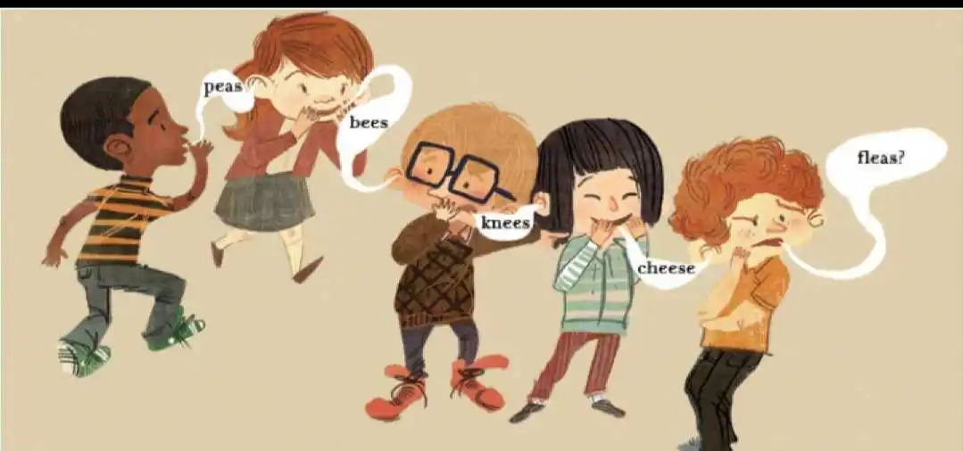

Warming up
游戏规则：
每一竖列为一个小组，老师将写有密码的纸条发给最后面的同学，密码是一个5个字母的单词 。
同学从后往前依次传递，后面的同学在前面的同学后背写出密码，不能说话、比划，前面同学不能回头。
最后由第一排的同学在黑板上写出密码。看看哪组传递的又快又准确。
Guessing game

Slide 12
The development of
communication methods

Slide 13
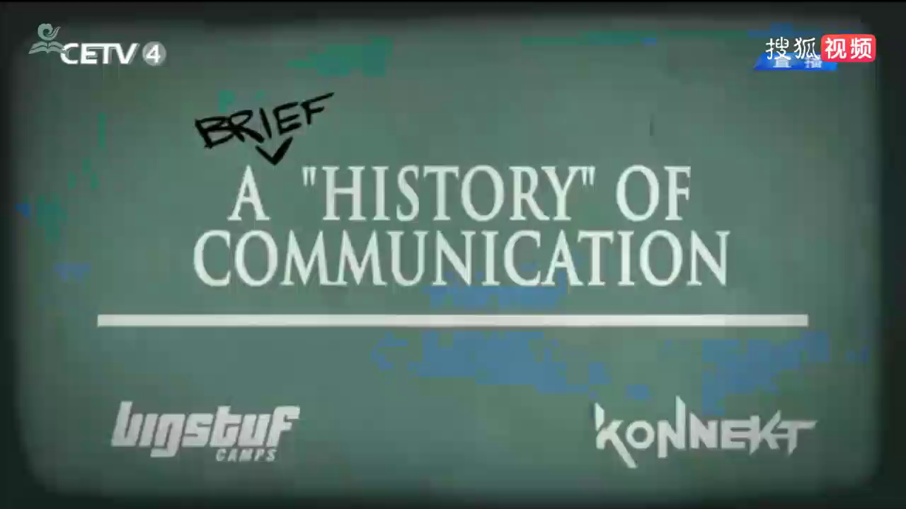

Slide 14
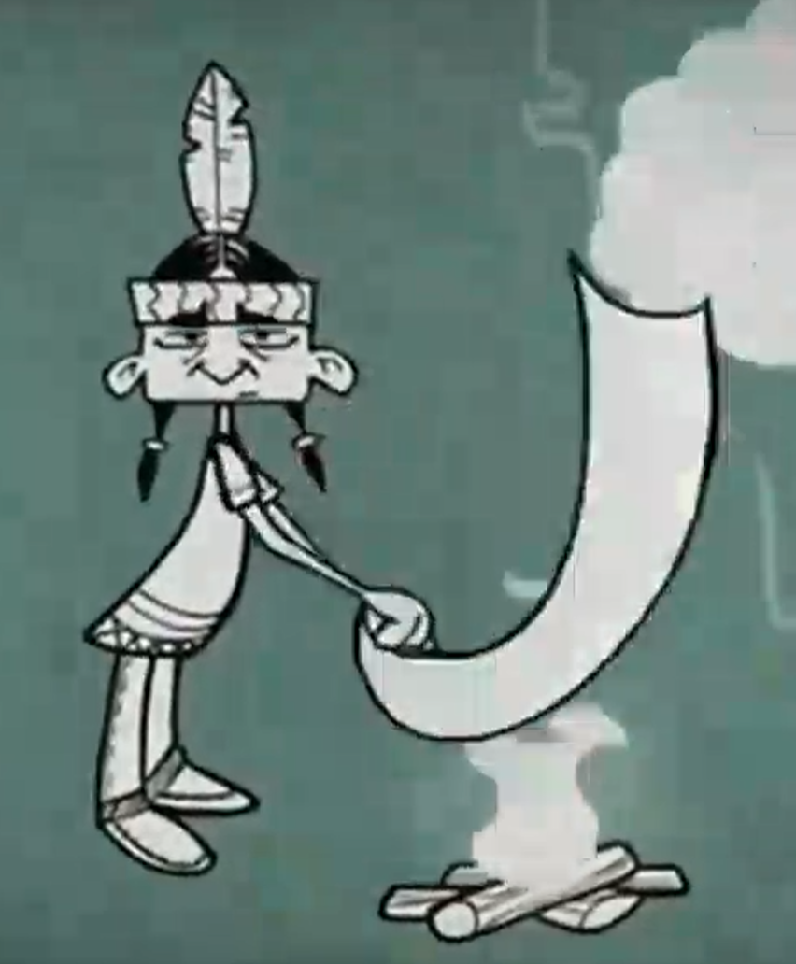
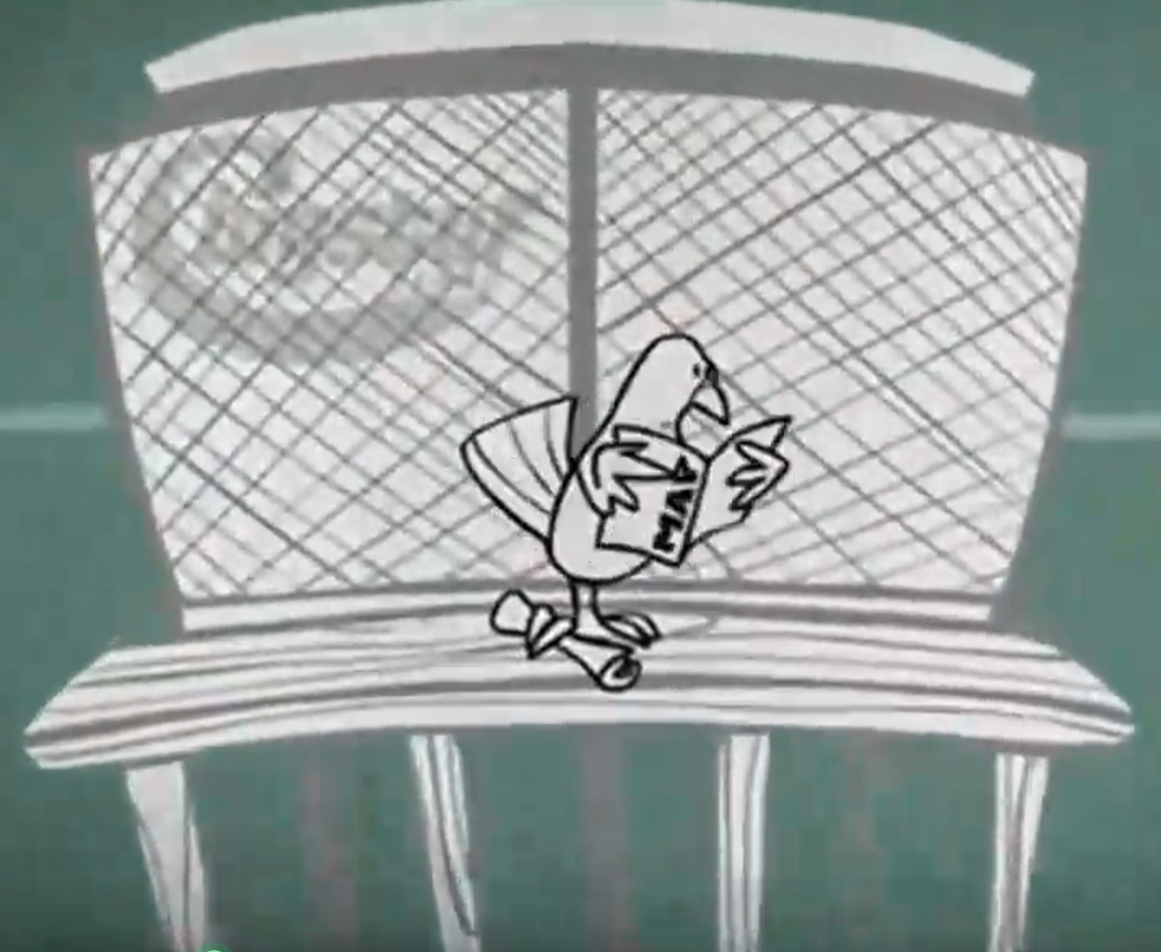
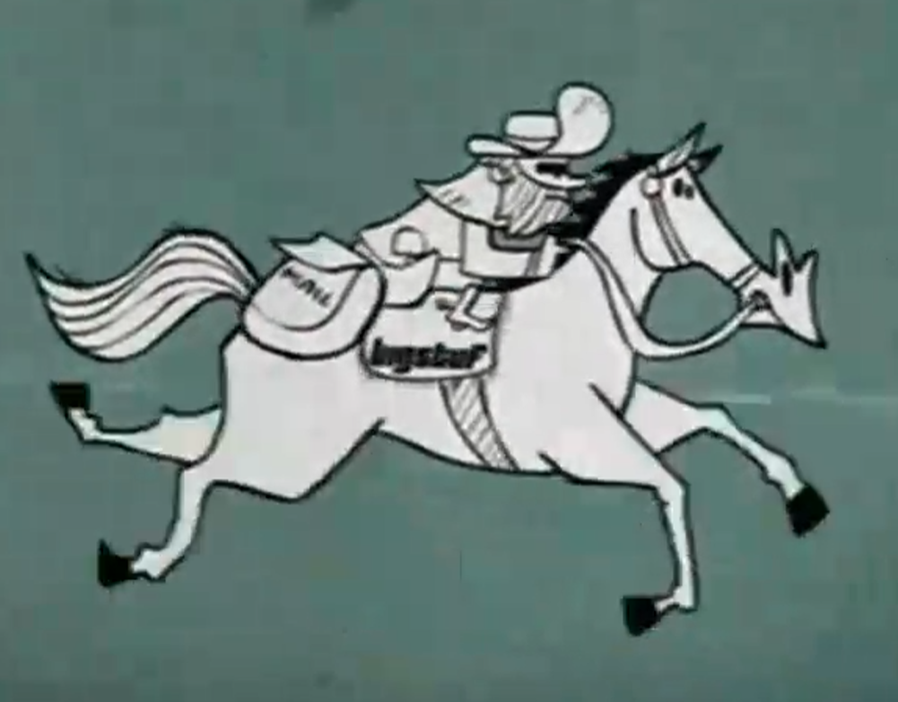
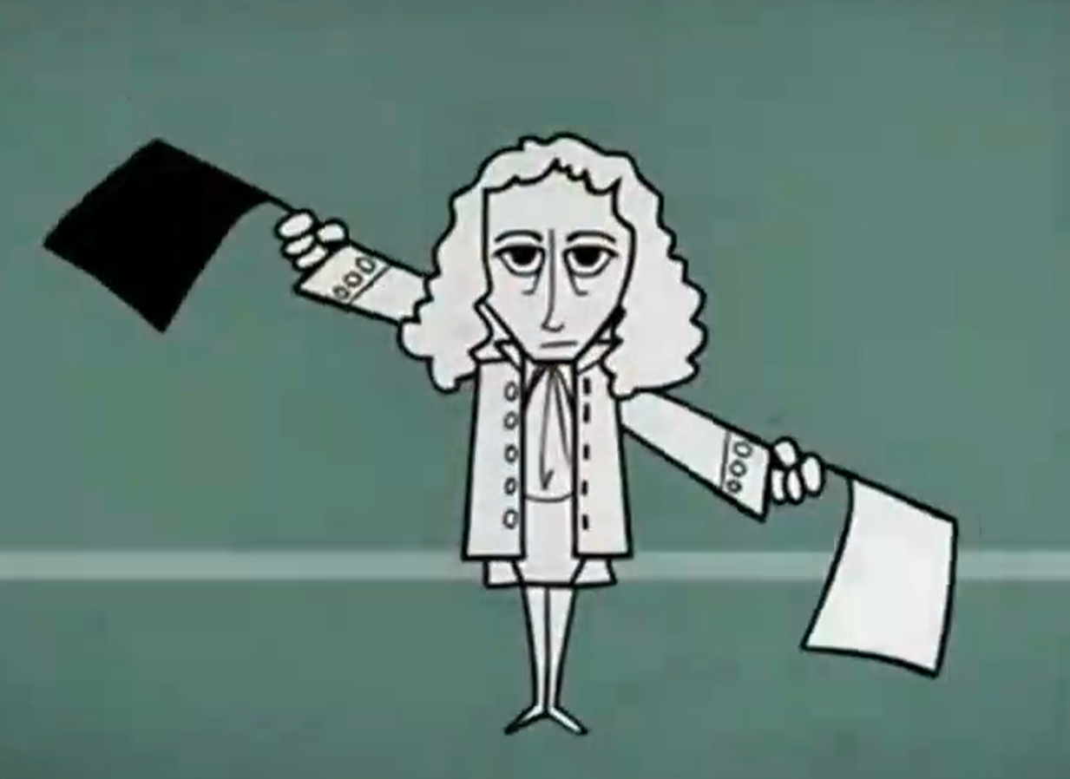
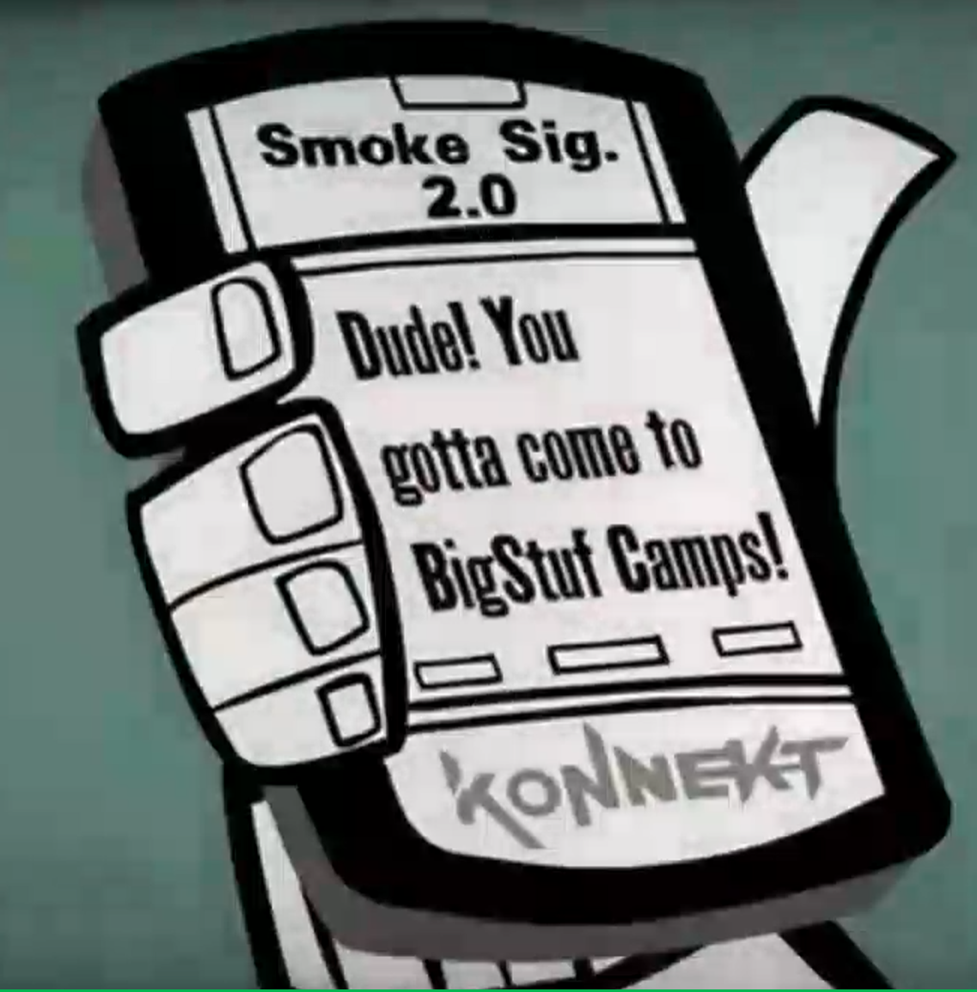
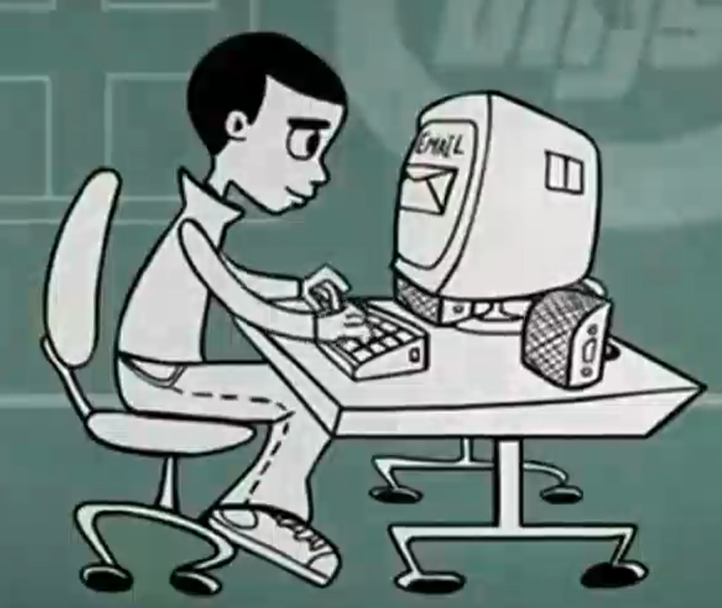
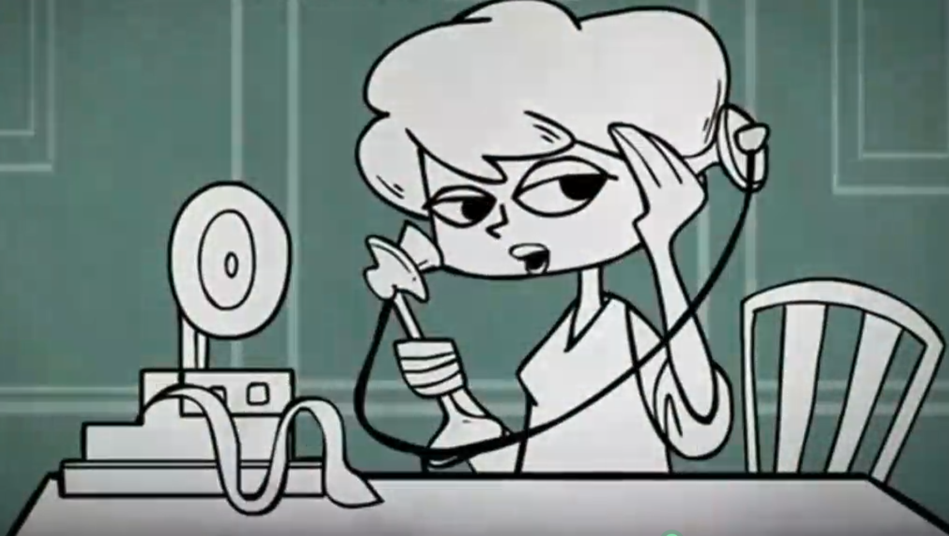
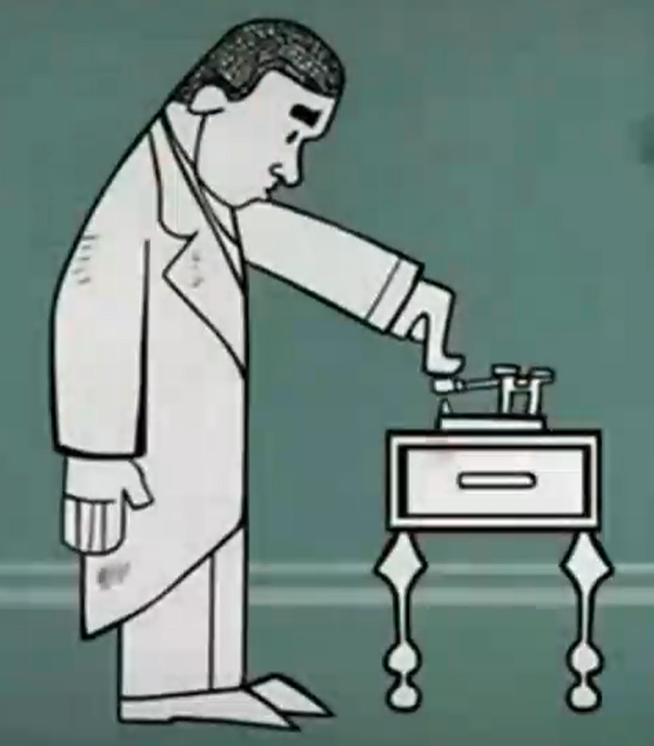
A history of communication
smoke signal
homing pigeon
pony express
semaphore
smart phone
email
telephone
telegraph

Slide 15
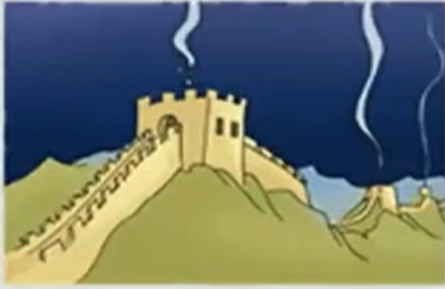
The smoke signal
（烽火传军情）
As far back as 800 BCE（公元前）, guards along the Great Wall of China sent smoke signals to warn of（警告提防） invations（入侵）. Some people use smoke to show they need help. Their friends can see the smoke, and they know there ia a problem. Then they will go to help.

Slide 16
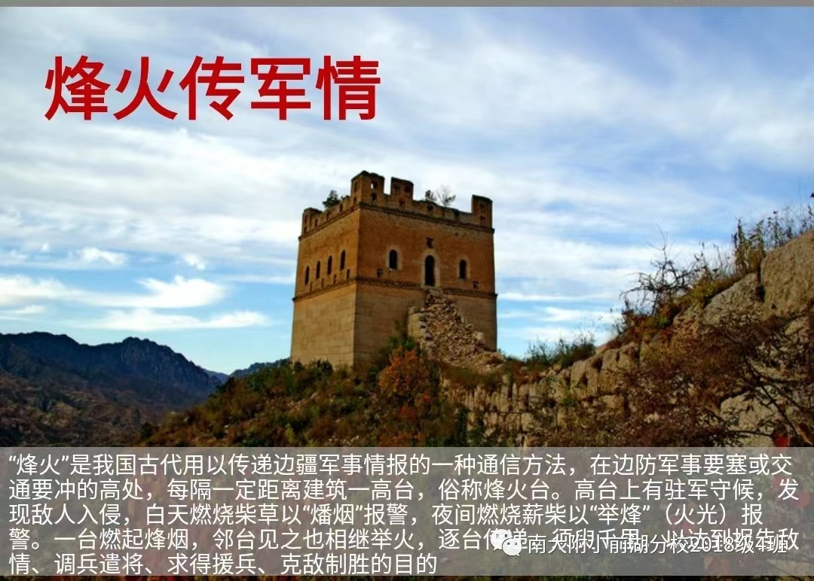
中国古代的商周时期人们就知道用烽火来远距离传递消息，在边防军事要塞或交通要冲的高处，每隔一定距离建筑一高台，俗称烽火台。高台上有驻军守候，发现敌人入侵，白天燃烧柴草以"燔烟"报警，夜间燃烧薪柴以"举烽"报警，一台燃起烽烟，临台见之也相继举火，逐台传递，须臾千里，以达到报告敌情、调兵遣将、求助援兵、克敌制胜的目的。
烽火狼烟作为我们古时重要的边防通讯手段之一，其从边疆传递消息到都城耗时为3个昼夜。虽其传递距离很可观，但其信息传递内容单一，只能传递战事开始时间，却无法知晓如战况等详细信息。
烽火狼烟传递信息速度有多快？?

Slide 17
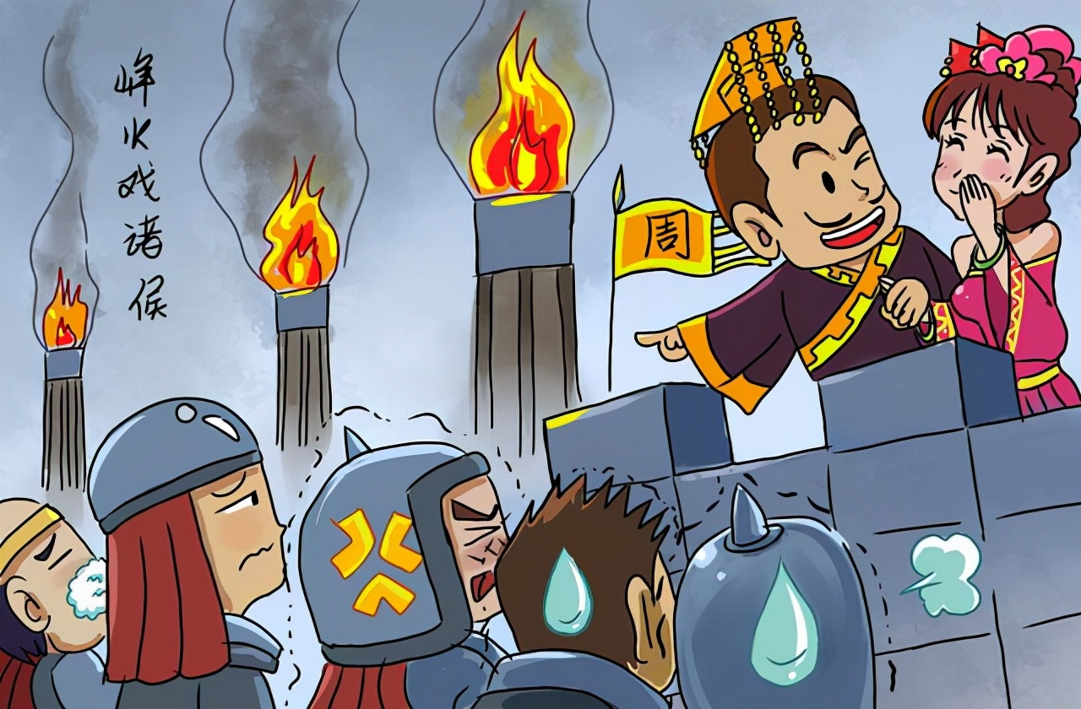
Smoke signal is an important way to send
messages in ancient
time, especially during the war.
烽火戏诸侯

Slide 18
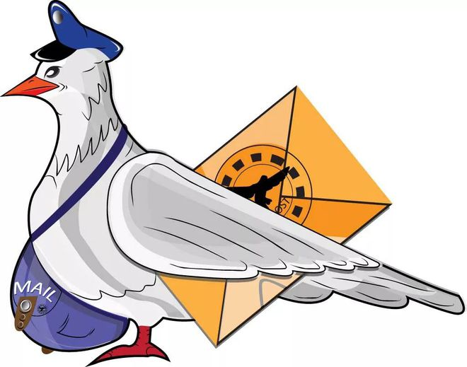
The homing pigeon （飞鸽传书）
People also use birds to send
messages. They take a bird from its home. They write a
small message on some paper and put the paper on the birds’ leg. Then the bird will fly back home with the message.
How do people send messages in this way?

Slide 19

飞鸽传书
飞鸽传书，即将信件系在信鸽的脚上传递给收件人。据说训练后的信鸽平均速度可达每小时48公里，但考虑到其一天最多只能飞行8小时，所以其日传递距离约为384公里飞鸽传书看似速度快，但其只能单向送信，而且还得专人定点接收，有着诸多不便。

Slide 20
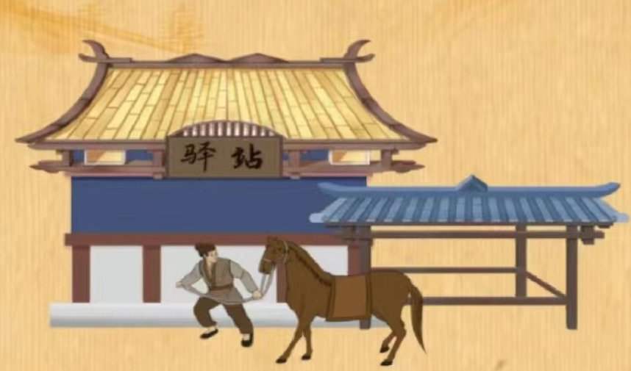
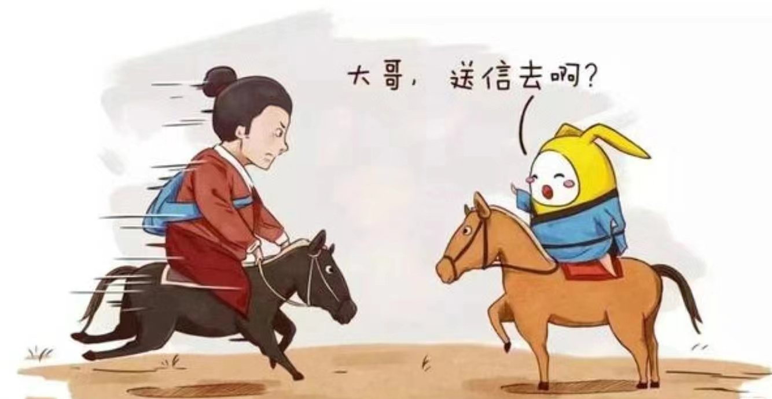
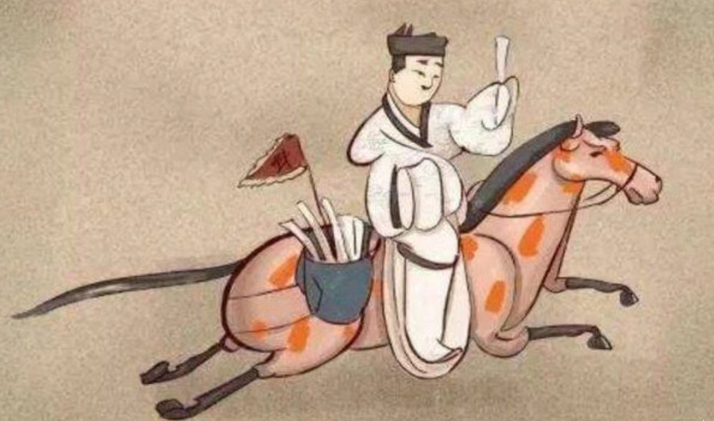
The pony express（驿马快信）
The pony express is a fast mail service in the American West and in Han Dynasty(汉朝) in China. The messengers(送信人) are usually under 18 years old and very thin. They stop at the stations for a short stay and change the horse to go on the way.

Slide 21
The pony express（驿马快信）
三号选手也是电视剧常驻"演员"，快马加鞭，骑马送信。这里就要提到汉代开始的"驿传"制度。驿站，是古代供传递军事情报的官员中途食宿、换马的场所，驿站分陆驿，水驿和水陆兼并三种方式，驿传不仅能传递书信还能传递物品，可以说是古代"快递"。它能有多快？唐朝有明文规定，陆驿快马一天走6驿即180里，再快要日行300里，最快要求日驰500里；步行人员日行50里，逆水行船时，河行40里，江行50里，其它60里；顺水时一律规定100到150里。

Slide 22
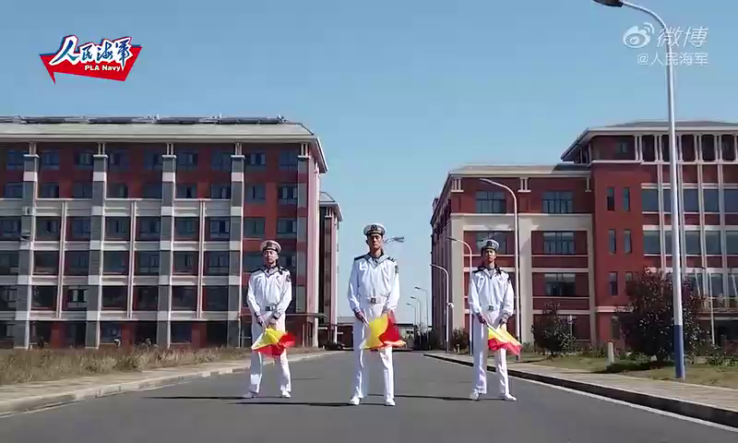
The semaphore flag（打旗语）

Slide 23
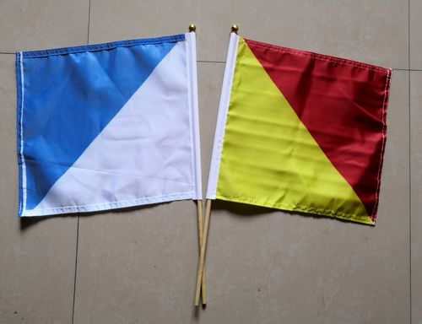
The semaphore flag（打旗语）
Semaphore---holding out your
arms in particular(特定的) positions(位置) to spell out letters is another ancient message system.
What’s the difference between the colors of the flags?

Slide 24

The telegraph（电报）

Slide 25
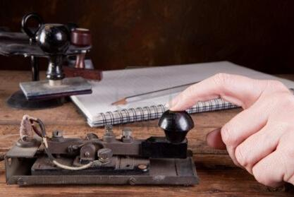
The telegraph（电报）
Electronic communication kicked off(开始) with the telegraph in 1816. Users tapped out messages(敲出信息), which were sent as electrical signals(电信号) along wires（电线）.
Morse code(莫尔斯密码) uses short and long signals(dots and dashes) to represent(代表) letters.

Slide 26
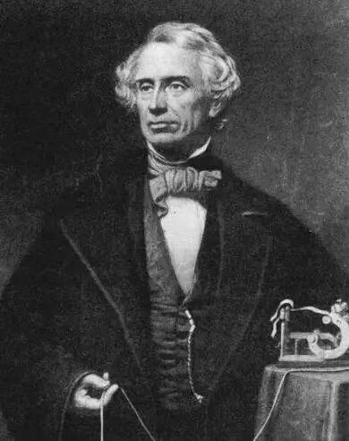
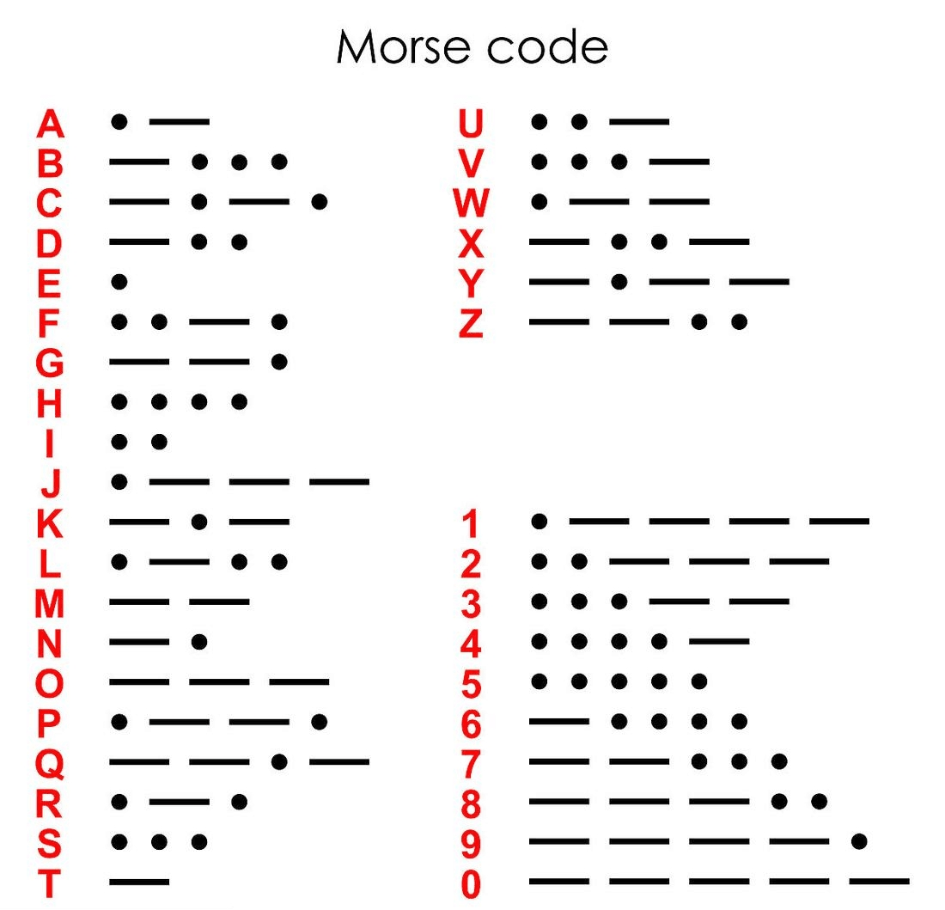
19世纪30—40年代，出现了人类历史上第一台电报机，美国人赛缪尔莫尔斯发明了电报和莫斯密码，电报的发明具有划时代的意义，它让人类获得了一种全新的信息传递方式，这种方式看不见、摸不到、听不到，完全不同于以往。
Morse
code
赛缪尔•莫尔斯

Slide 27
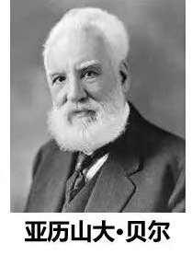
Phone

Slide 28
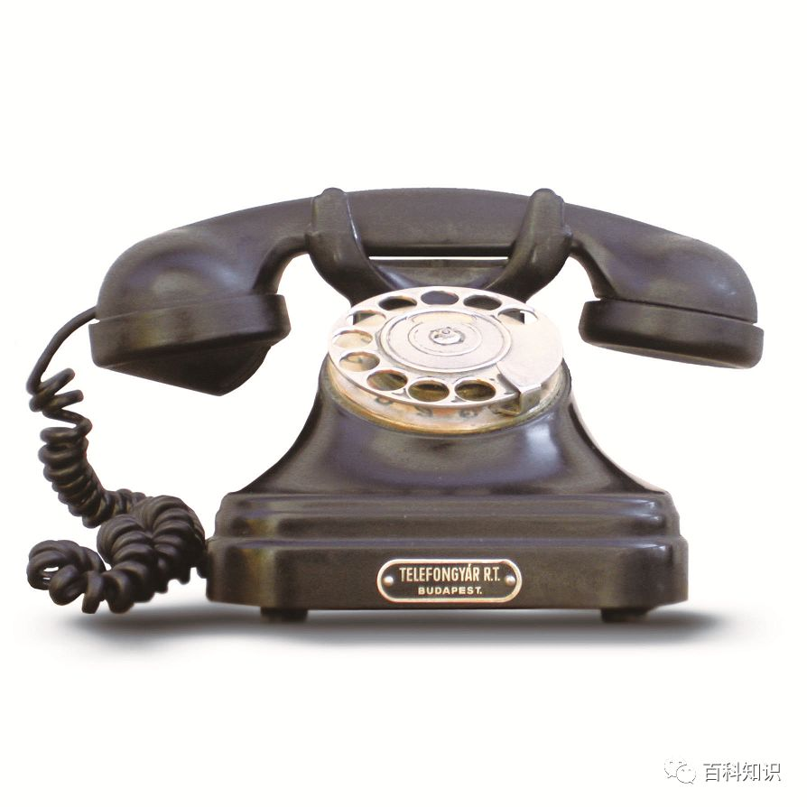
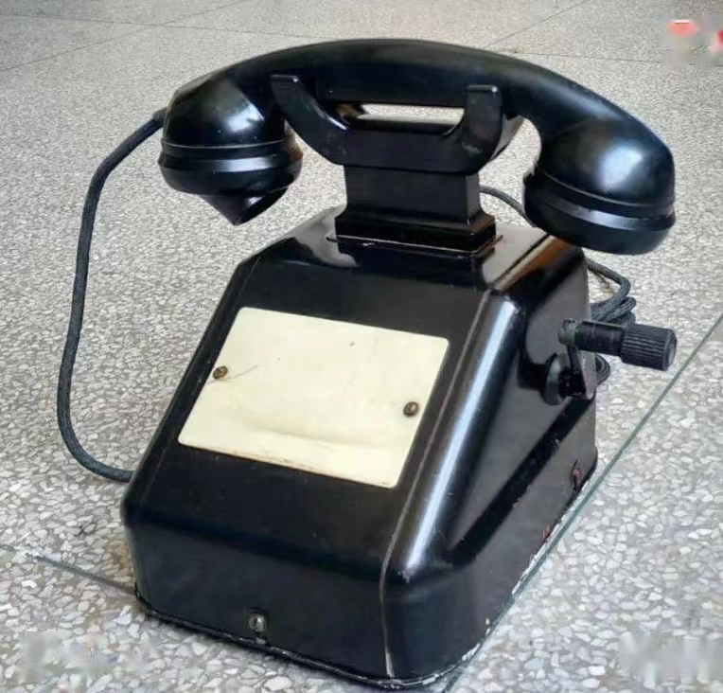
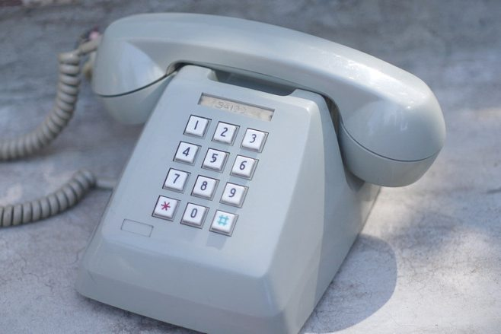
When was the first phone call made?
The first phone call was made in 1876.
Can you call the people directly(直接地) from the oldest phone directory(电话簿)?
No. You called the operator(接线员）and asked to be connected(连接).

Slide 29
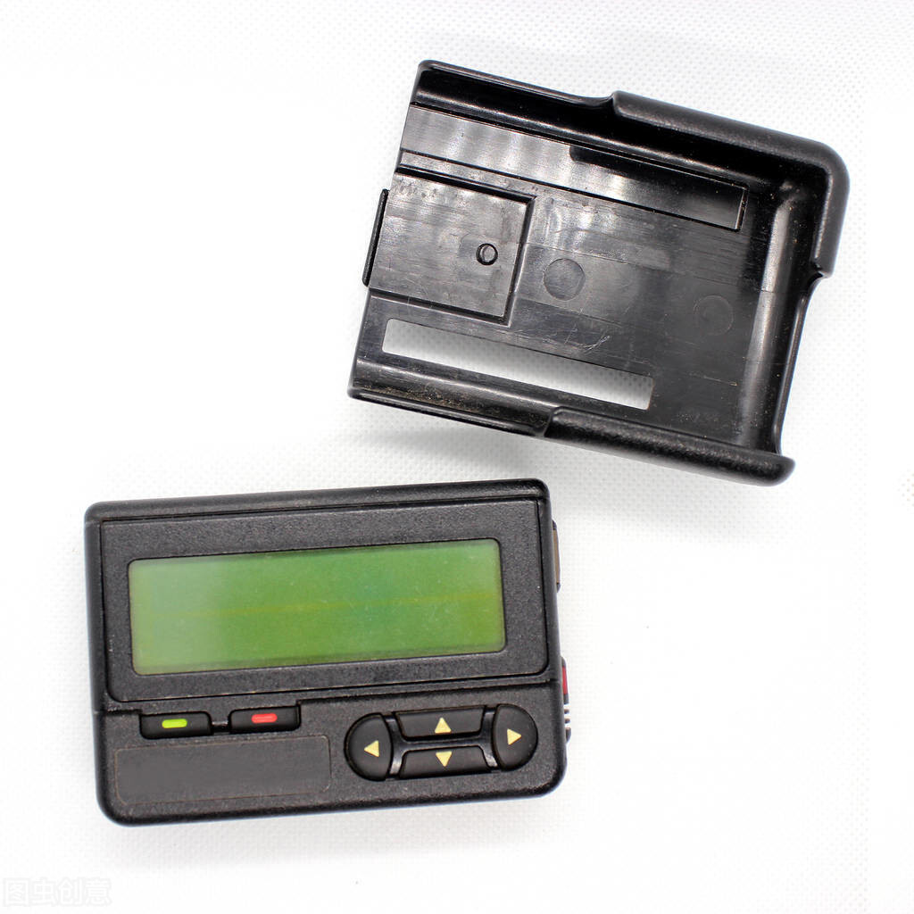
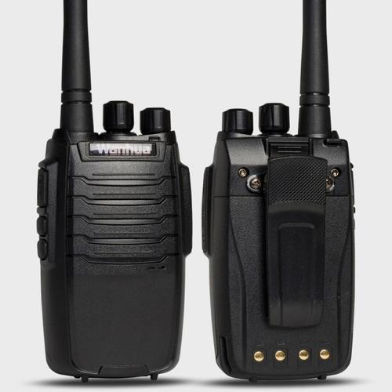
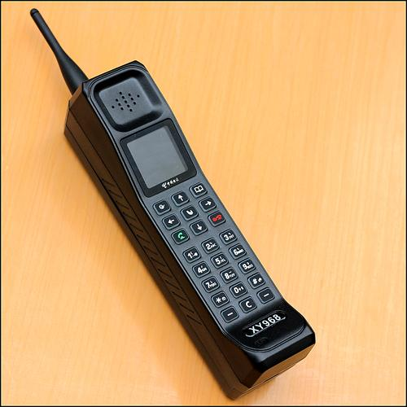
pager
(BP机/寻呼机)
hand-held
two-way radios
（无线对讲机）
DynaTAC
（大哥大）

Slide 30

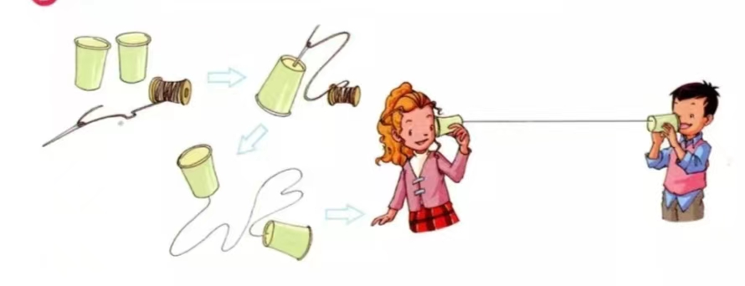
Make a toy phone
1. 在纸杯底部中间位置用笔或牙签扎好孔；
2. 让线穿过孔并在牙签上打个结，使牙签
卡在纸杯内部（线长2米）；
3. 将线拉直就可以在两端说话啦！

Slide 31
Thank you!

