Slide 1

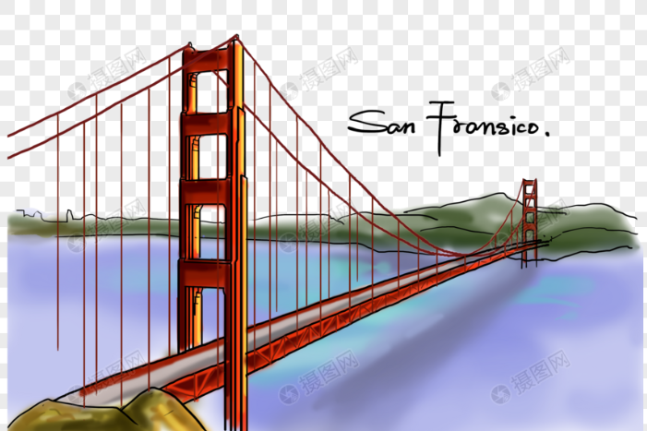
八上 Unit3 A day out
Reading I

Slide 2
Play a game
Truth or Lie

Slide 3
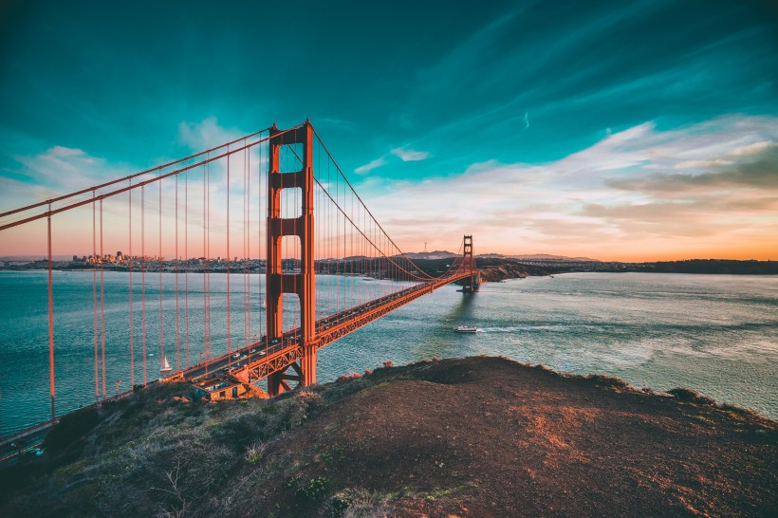
Revision
Look and say:
the Golden Gate Bridge
San Francisco

Slide 4
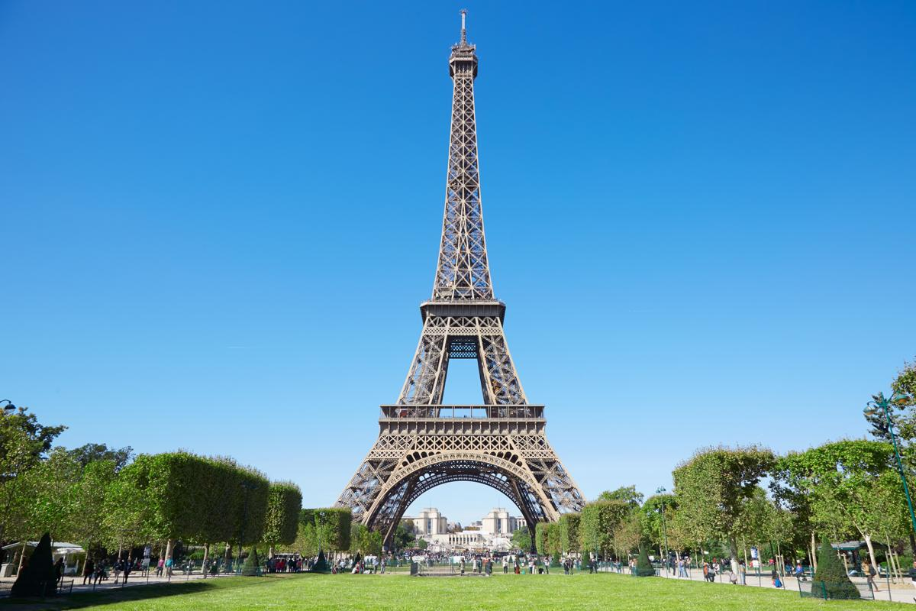
Revision
Look and say:
the Eiffel Tower
France
Do you know other places of interest in the world?

Slide 5
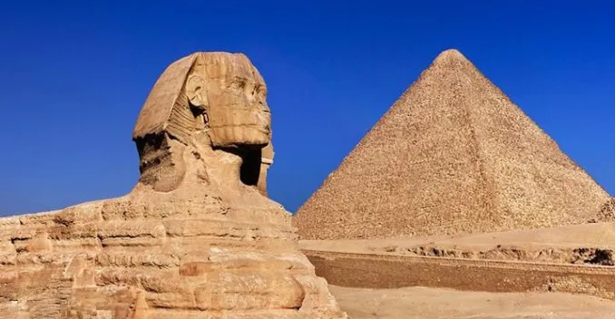
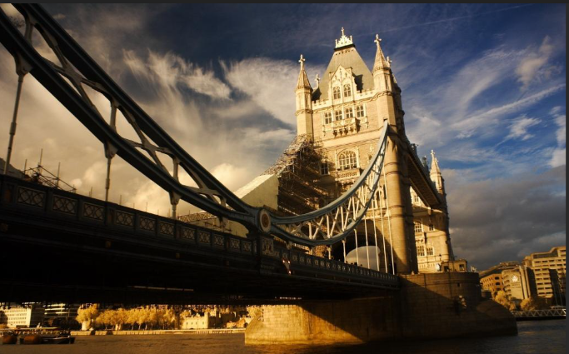
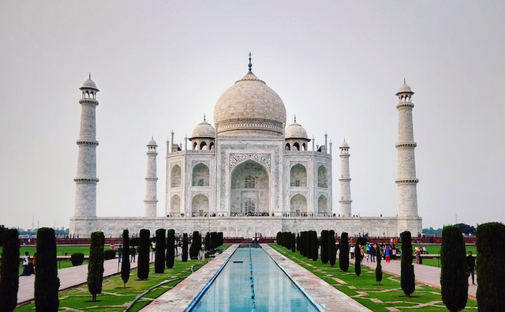
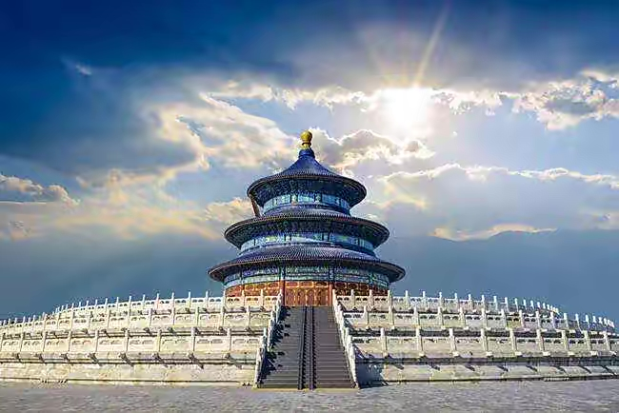
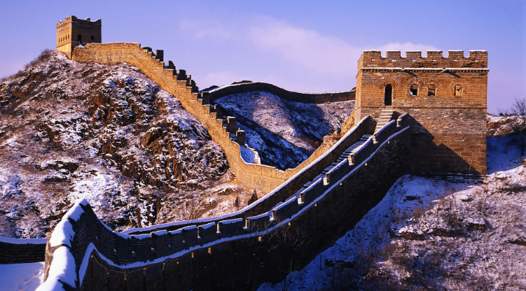
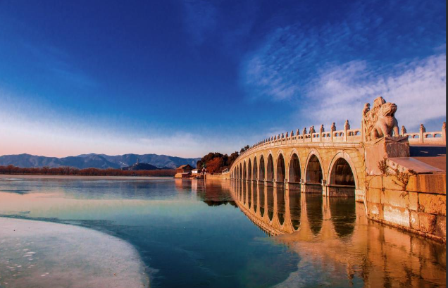
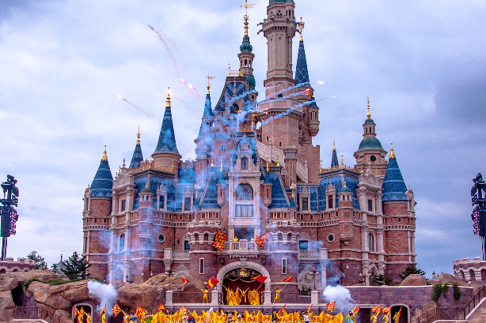
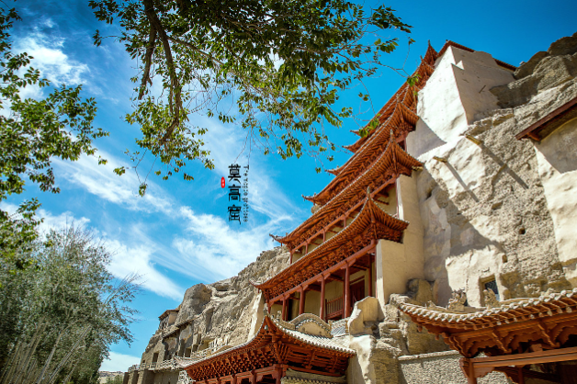
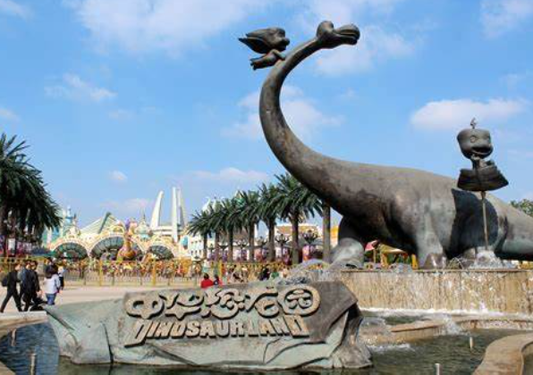
Can we travel to these places in one day?
The World Park

Slide 6
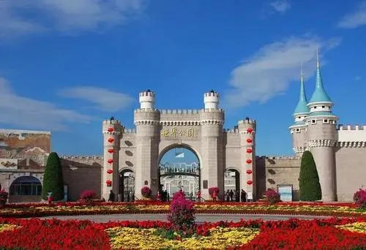
How much do you know about the World Park?
模型
In Beijing
Models of places of interest in the world
The World Park

Slide 7
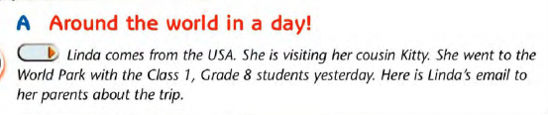
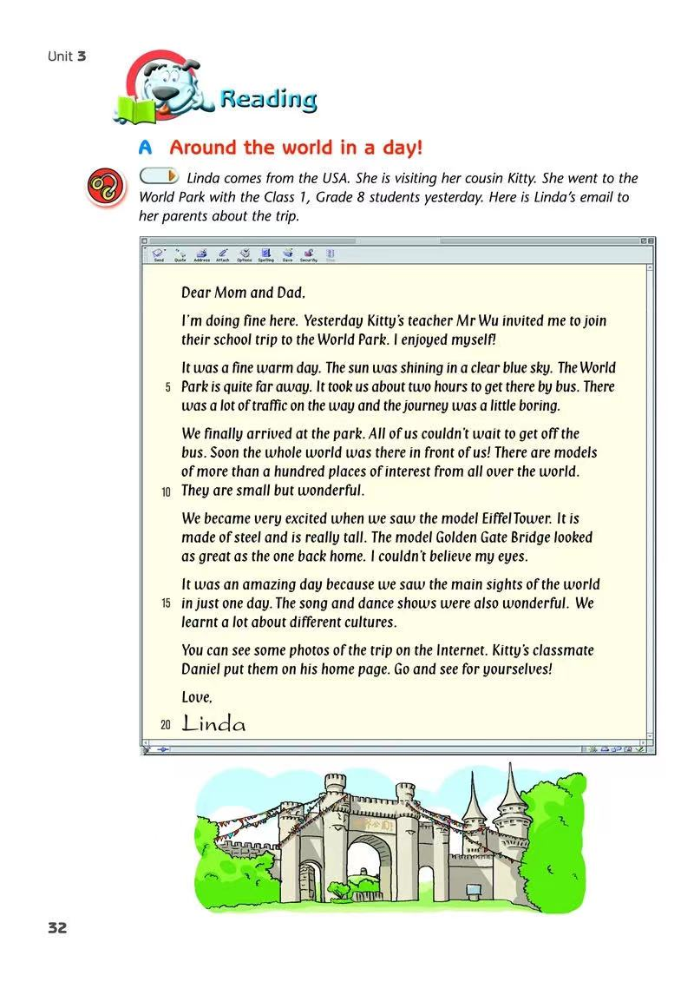

Read for topic
What is the e-mail about?
It's about the school trip to the World Park.
Tips : Pictures and headings can help you before reading.

Slide 8


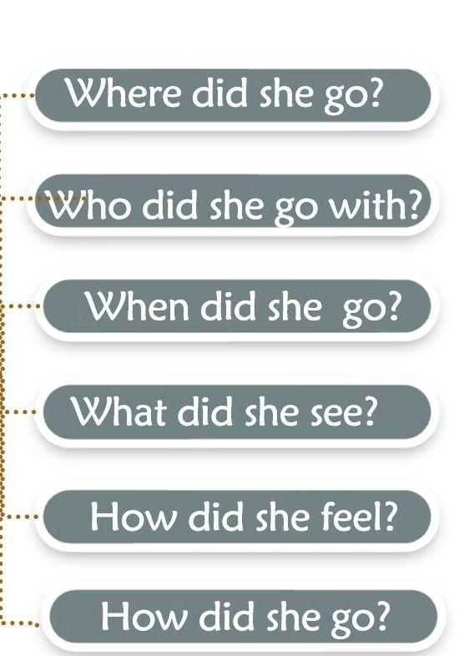
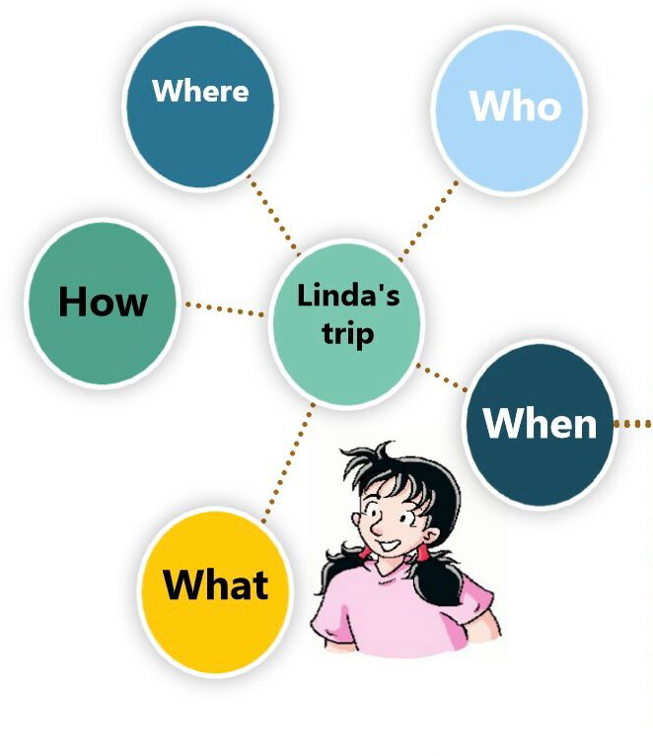
Listen and answer
The World Park
Kitty, Mr Wu ,
other students
Yesterday
Models,
song and dance shows
Enjoy herself
By bus

Slide 9

Fast reading
Do a match
(Para 6)
Before the trip
(Para 1-2)
During the trip
(Para 3-5)
After the trip

Slide 10
Read for details:Para.1~2
Did Linda enjoy the journey at first ?
/'dʒɜːni/
No.The journey was a little boring.
?
The World Park is quite far away. It took them about two hours to get there by bus.
There was a lot of traffic on the way.

Slide 11
Read for details:Para.1~2
Why did Linda write about the weather?
(Line4~5)
It was a fine warm day.
The sun was shining in a clear blue sky.
The description of weather can imply (暗示) Linda's feelings — happy and excited.

Slide 12
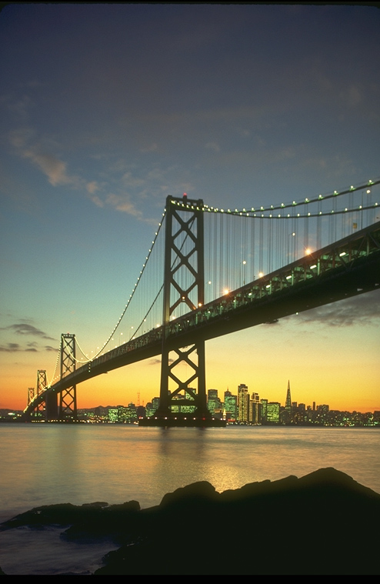
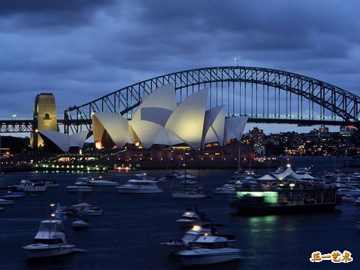
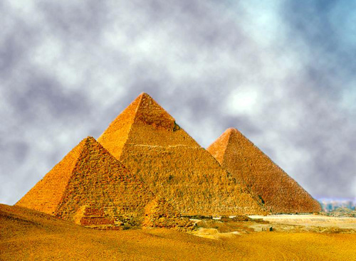
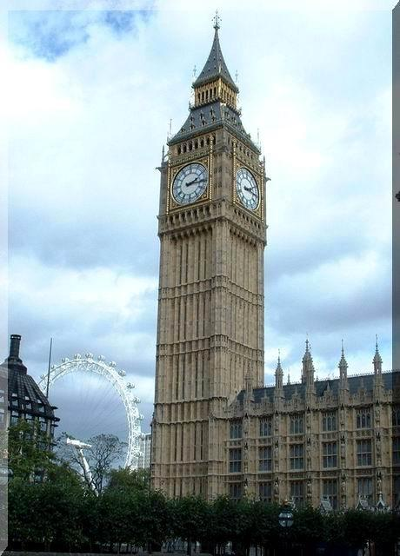

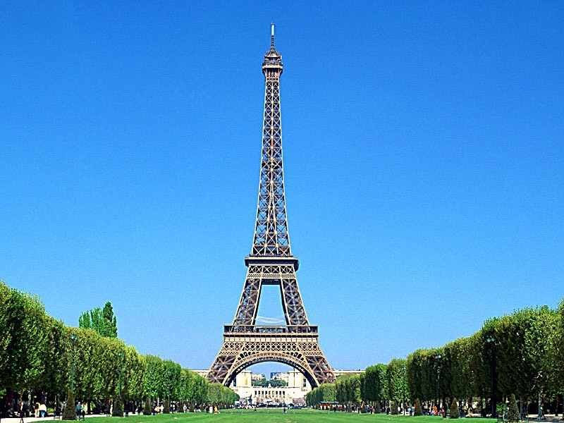
Read for details:Para.3~5
1. What is in the park?
models of
There are __________ more than a hundred ____________ from all over the world.
places of interest

Slide 13
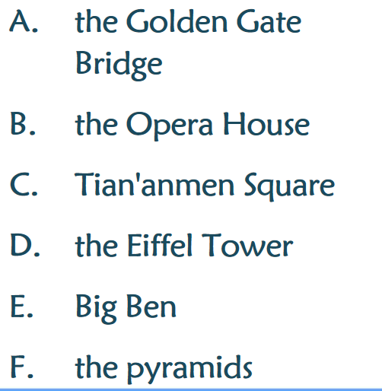

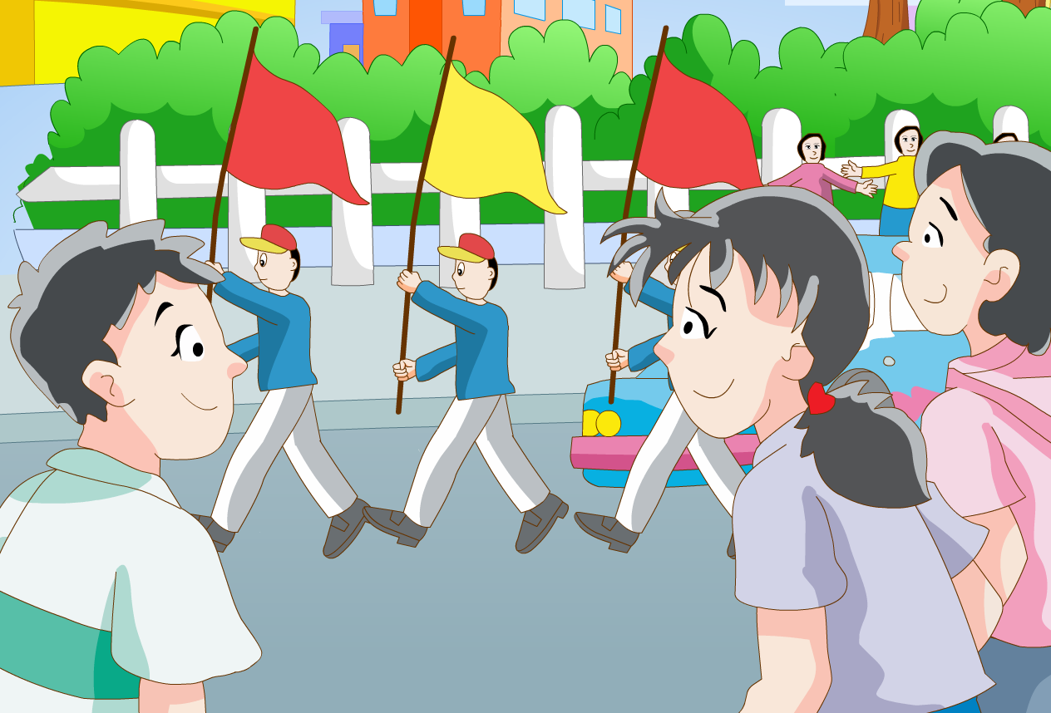
What else did they see in the World Park?
Read for details:Para.3~5
What places of interest did she see?

Slide 14
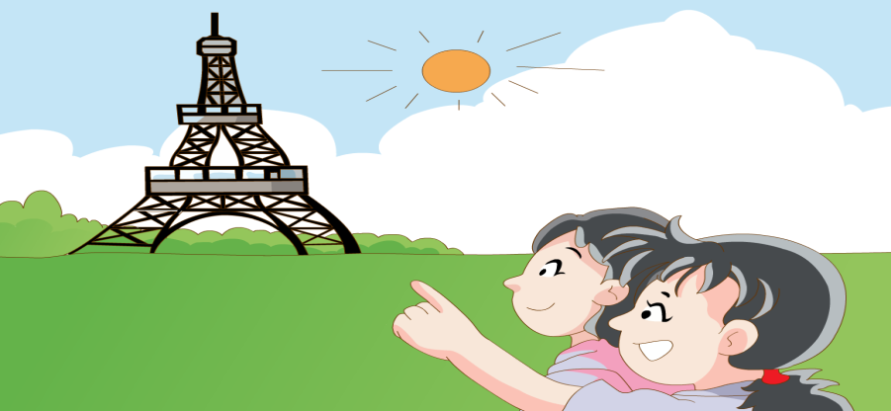
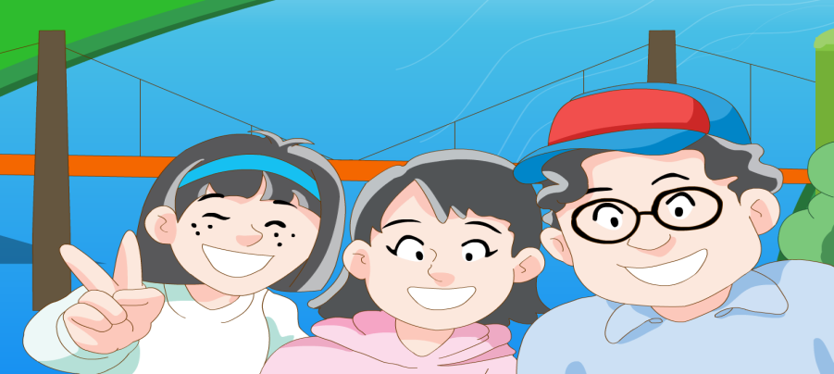
Read for details:Para.3~5
Finish Task1
the Eiffel Tower
the Golden Gate Bridge
Song and dance shows

Slide 15
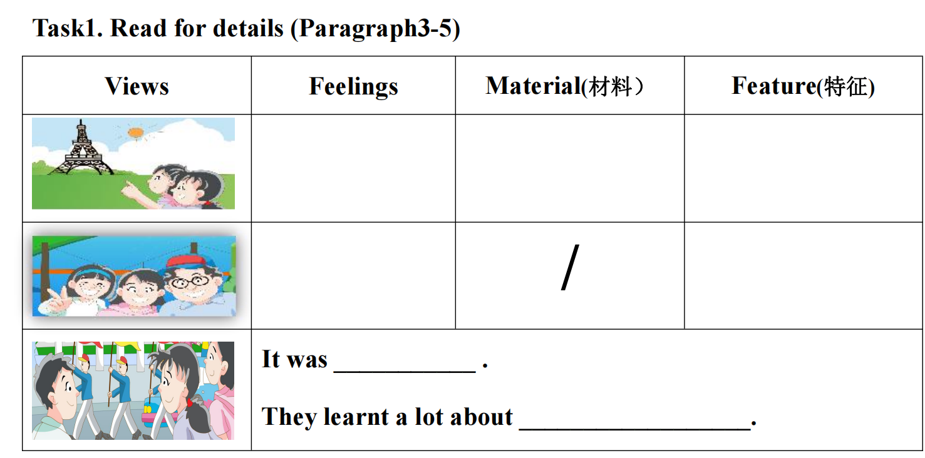
very excited
made of steel
really tall
looked as great as the one back home
couldn't believe eyes
wonderful
different cultures

Slide 16
Read for details:Para.3~5
Why did Linda think it's an amazing day ?
Because they saw the main sights of the world in just one day.

Slide 17
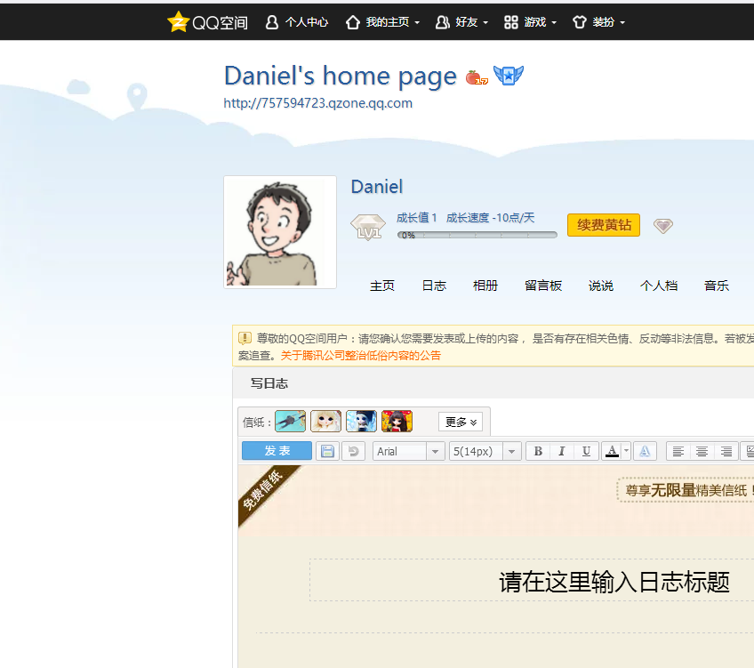



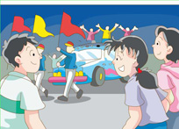
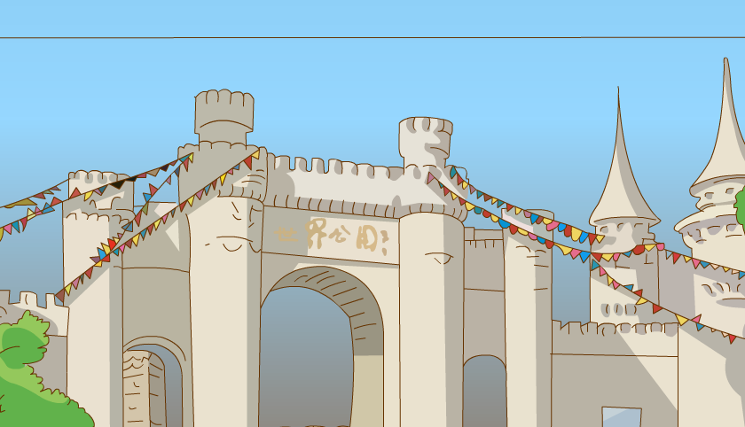
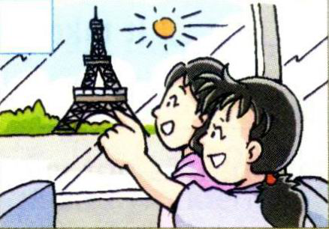
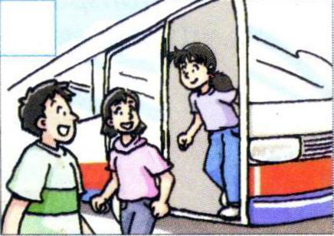
Read for details:Para.6
What did they do after the trip ?

Slide 18
Task2：Fill in the blanks
K: It was a great day yesterday. Linda really ____________.
D: But the journey was a little ______, and there was too much
_______ on the way.
K: True, but when we saw the models, we became ____________.
Linda couldn’t _____________ when she saw the model Golden
Gate Bridge. It looked ___________ the one in her country.
D: Yes. It was amazing to see the___________ of the world in a day, and it was also great to learn a lot about different __________.
K: Did you take any photos, Daniel?
D: Yes, I took some. You can see them on my ___________.
K: Great. So Linda’s parents can see them too.

Slide 19
Task2：Fill in the blanks
K: It was a great day yesterday. Linda really ____________.
D: But the journey was a little ______, and there was too much
_______ on the way.
K: True, but when we saw the models, we became ____________.
Linda couldn’t _____________ when she saw the model Golden
Gate Bridge. It looked ___________ the one in her country.
enjoyed herself
boring
traffic
very excited
believe her eyes
as great as
main sights
D: Yes. It was amazing to see the___________ of the world in a day, and it was also great to learn a lot about different __________.
K: Did you take any photos, Daniel?
D: Yes, I took some. You can see them on my ___________.
K: Great. So Linda’s parents can see them too.
cultures
home page

Slide 20
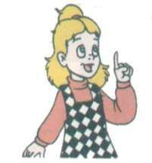
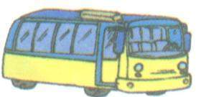
Discussion
Feelings
back home
enjoyed herself
inside the park
excited
bored
outside the World Park
on the way
.
couldn’t wait

Slide 21
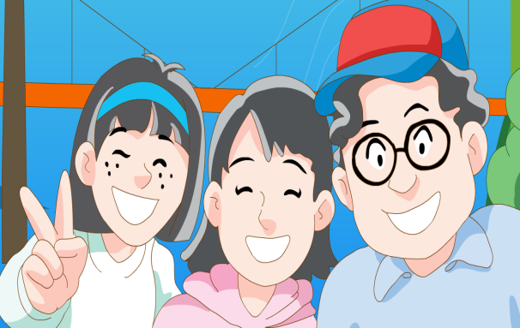
Read to think :
feelings
on the way
at the park gate
inside the park
after the trip
a little
bored
happy
very excited
amazed
anxious（渴望的）

Slide 22

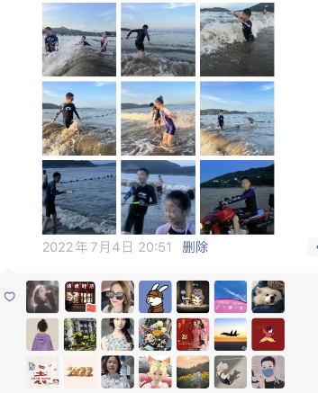
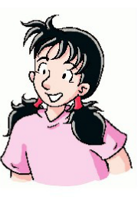
Task3: Post a friend circle
I am at the seaside with my friends. We are playing water games and swimming in the sea. We enjoy the sunset. We are having a good time.
Where
Who
Where did you go?
Who did you go with?
How
Linda's
trip
When did you go?
When
What did you see?
What
How did you feel?
How did you go?

Slide 23
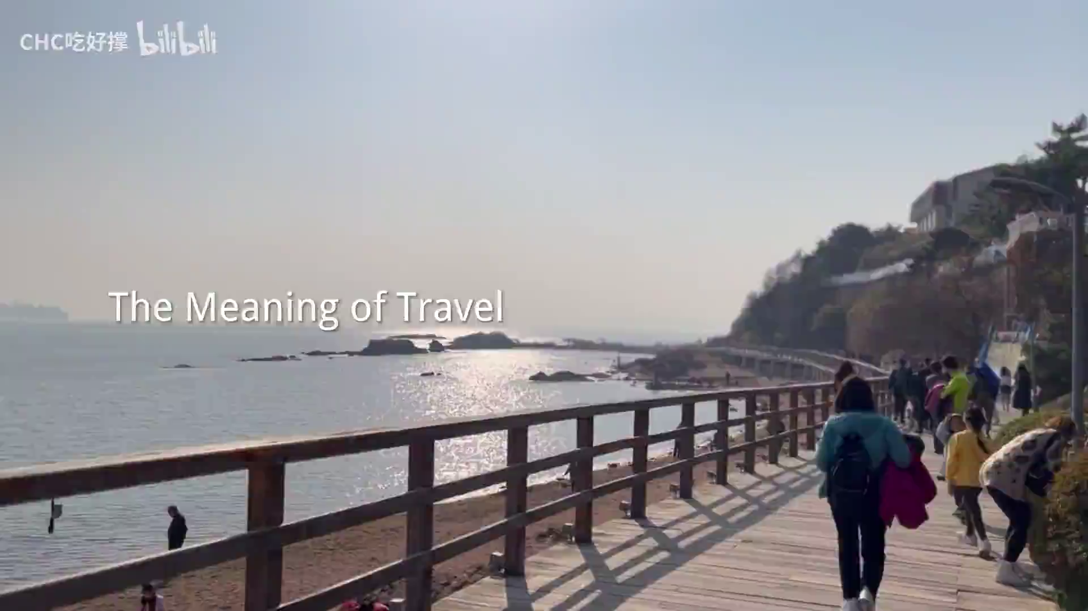
Watch and tell the meaning of travelling

Slide 24
What can we get from travelling?
make a lot of friends
enrich our knowledge of diffferent customs and cultures
help us develop a positive attitude towards life
Harvest
open our minds
widen our view
free us from stress(压力)
get us close to nature
A nice trip not only brings us joy, but also the knowledge.

Slide 25

Homework
1.Write about your trip and email me at 8346752
@qq.com
2.Search more information on the Internet about the World Park.

