Slide 1
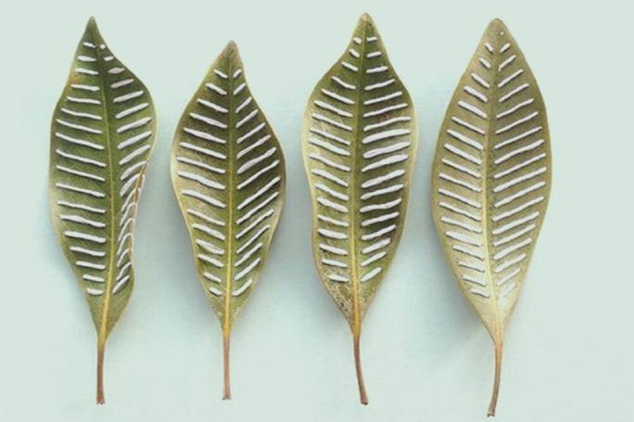
U8 Natural Disasters
Grammar
Past continuous tense & Using when, while and as
宗韩颖
2024.12.16

Slide 2
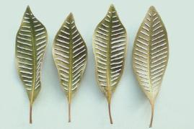
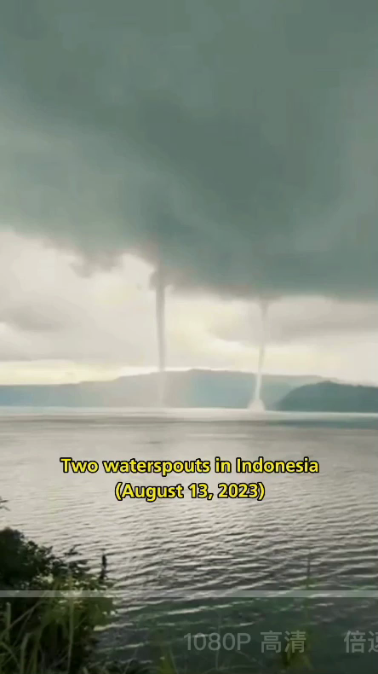
Natural disasters
flood
earthquake
typhoon
fire
...

Slide 3
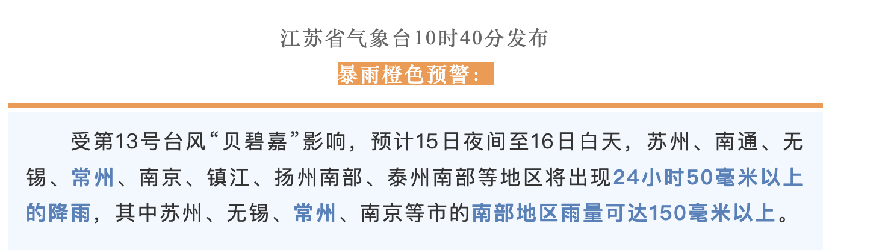
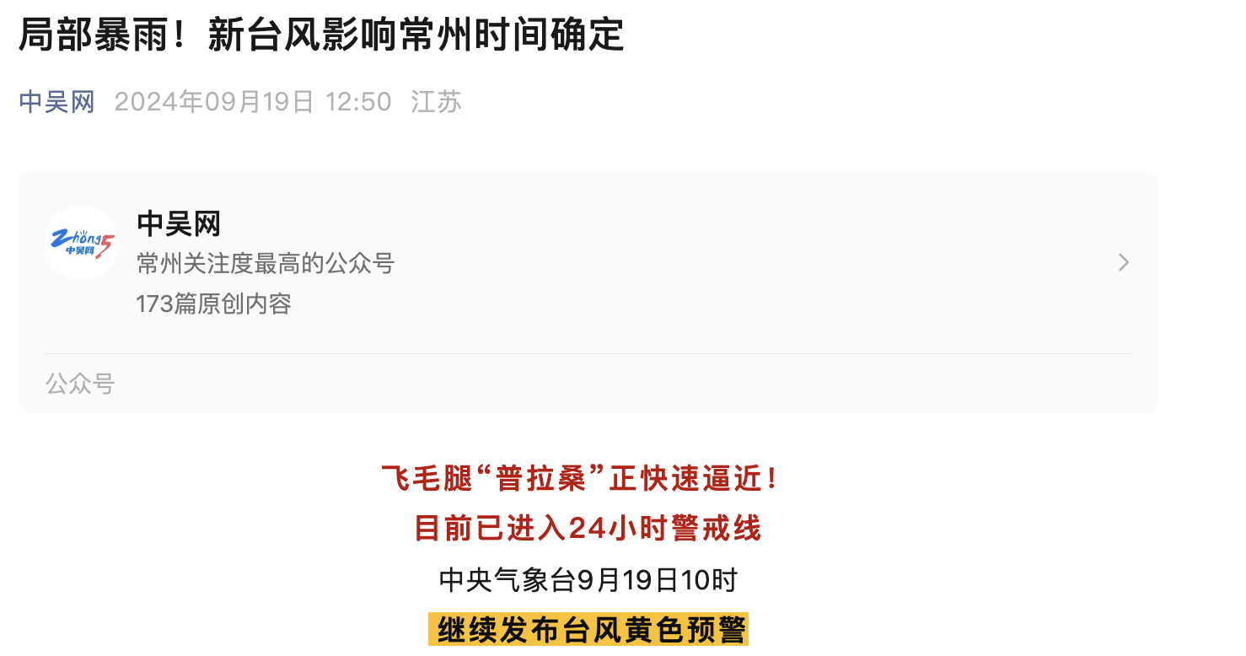
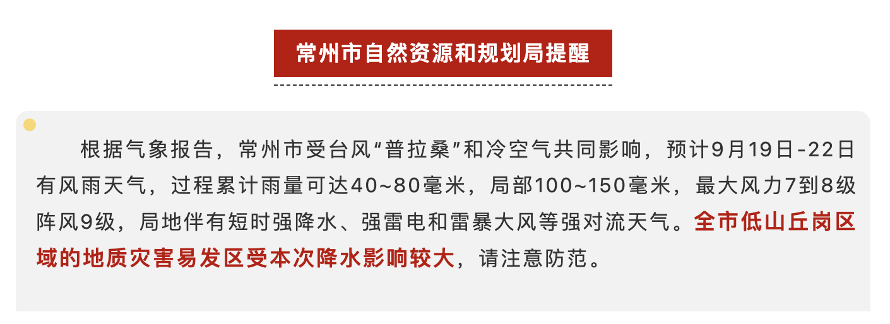
The typhoon in Changzhou
Different typhoons hit Changzhou many times this summer.

Slide 4

The typhoon in Changzhou-Sandy’s diary
It was 2 o’clock in the afternoon, strong wind were blowing outside. At that time, black clouds were making the sky very dark. It was raining heavily from morning till night yesterday.
I was at home alone and was doing my homework. My mother was shopping while my father was working in his office. I was so scared. Someone opened the door and came in as I was ringing my mother. It was mum! And soon father was back, too. We closed all the windows and stayed at home for the rest of that day. I talked with my friends about the typhoon online. Some of them were staying at home all day long, and some were waiting for the bus at the bus stop when heavy rain fell down. Luckily, everyone was fine.

Slide 5
Work out the rule 1: Definition
It was 2 o’clock in the afternoon, strong wind were blowing outside.
At that time, black clouds were making the sky very dark.
It was raining heavily from morning till night yesterday.
I was at home alone and was doing my homework.
The past continuous tense talks about things that were happening at a particular time in the past or during a certain period of time in the past.
我们用过去进行时表示过去某一时刻正在进行的动作或某一时间段内持续进行的动作。

Slide 6
Work out the rule 2: Time expressions（时间状语）
It was 2 o’clock in the afternoon, strong wind were blowing outside.
At that time, black clouds were making the sky very dark.
It was raining heavily from morning till night yesterday.
Some of them were staying at home all day long.
a particular time in the past
过去某一时刻（正在进行）
during a certain period of time in the past
过去某一段时间内（一直在进行）
at 2 o’clock in the afternoon
at that time/moment
at 7 on that day
...
the whole afternoon
from morning till night
the whole morning
all day long ...

Slide 7

Work out the rule 3: Structure（结构）
Sandy's a day at home
in the morning | 8:00 | have breakfast
 | 8:30-9:00 | do some exercise
 | 9:00-10:00 | reading books
 | 10:00-11:30 | help mum do some housework
 | 11:30 | have lunch
in the afternoon | 1:00-3:00 | do homework
肯定句：sb+was/were + doing
--What was sandy doing at 8:10?
--At 8:10 on that day, she_________________________.
was having breakfast
--What was she doing from 10:00-11:00?
--She___________________________________during that time.
was helping her mum do some housework

Slide 8
Work out the rule 3: Structure（结构）
Sandy's a day at home
in the morning | 8:00 | have breakfast
 | 8:30-9:00 | do some exercise
 | 9:00-10:00 | reading books
 | 10:00-11:30 | help mum do some housework
 | 11:30 | have lunch
in the afternoon | 1:00-3:00 | do homework
否定句：sb+was/were not doing
疑问句：Was/Were +sb+ doing？
  肯定回答：Yes, sb was/were.
  否定回答：No, sb was/were not
(wasn’t/weren’t).
as
W_____ she having breakfast at 8:10? _______,____________.
Yes she was
Was she reading books from 10:00-11:00? _______,____________.
She ______________(not read) books from 10:00-11:00.
No she wasn’t
wasn’t reading

Slide 9
Work out the rule 3: Structure（结构）
I | was (not) | doing | 时间状语
You/We/They | were (not)
He/She/It | was (not)
Was | I | doing | 时间状语
Were | you/we/they
Was | he/she/it
Yes, | I | was.
 | you/we/they | were.
 | he/she/it | was.
No, | I | wasn’t.
 | you/we/they | weren’t.
 | he/she/it | wasn’t.

Slide 10
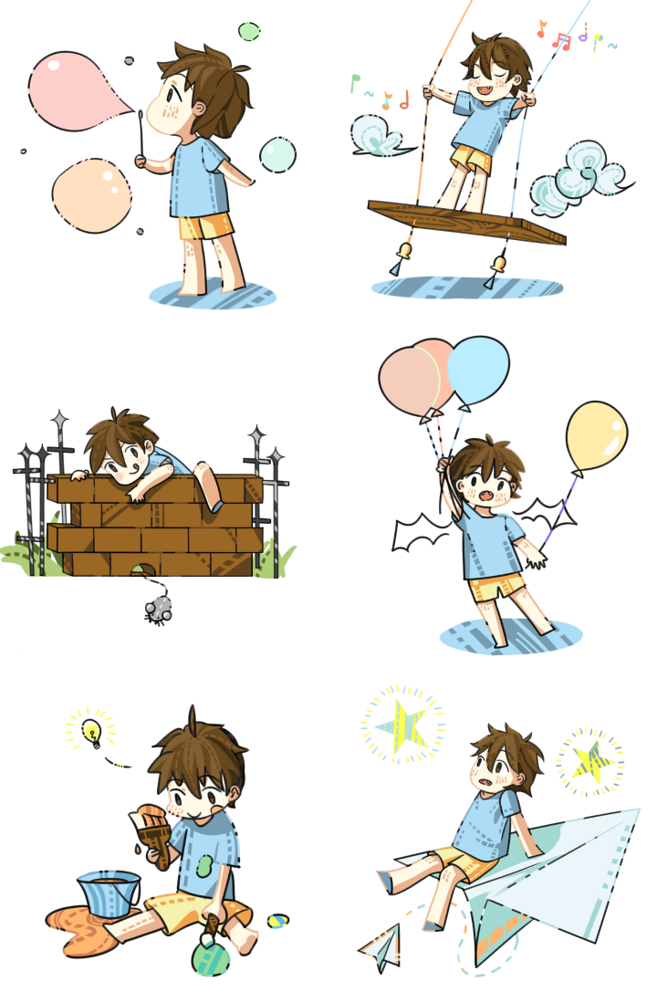
Make up a dialogue to talk about your yesterday’s timetable.
Have a talk
Your yesterday’s timetable
in the morning | 8:00
 | 8:30-9:00
 | 9:00-10:00
 | 10:00-11:30
 | 11:30
in the afternoon | 1:00-3:00
at...
from...to...
all day/night...
the whole morning/afternoon...
A: What were you doing ...yesterday?
B: ...
A: Were you...?
B: Yes/No,... I...
What about you? What were you doing...?
A: ...

Slide 11
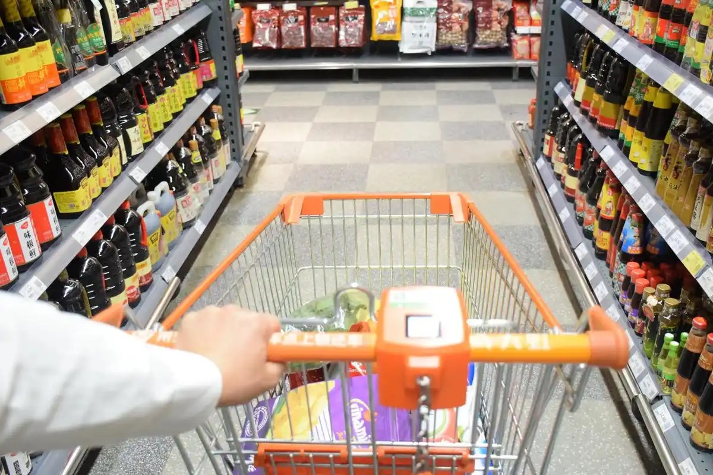
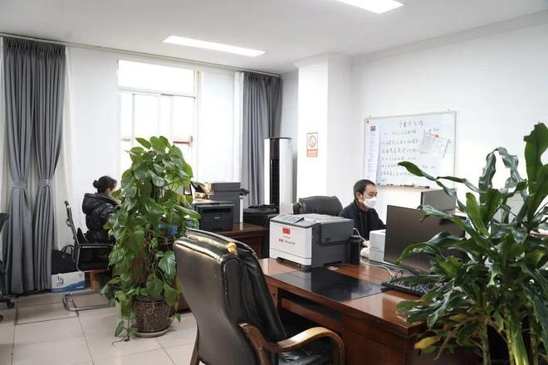
Work out the rule 4: When, while and as
What were Sandy’s mum and dad doing in the afternoon on that day?
Mum was shopping.
Dad was working in his office.
Mum was shopping while Dad was working in his office.
______ action
long
long
______ action
short?long?

Slide 12
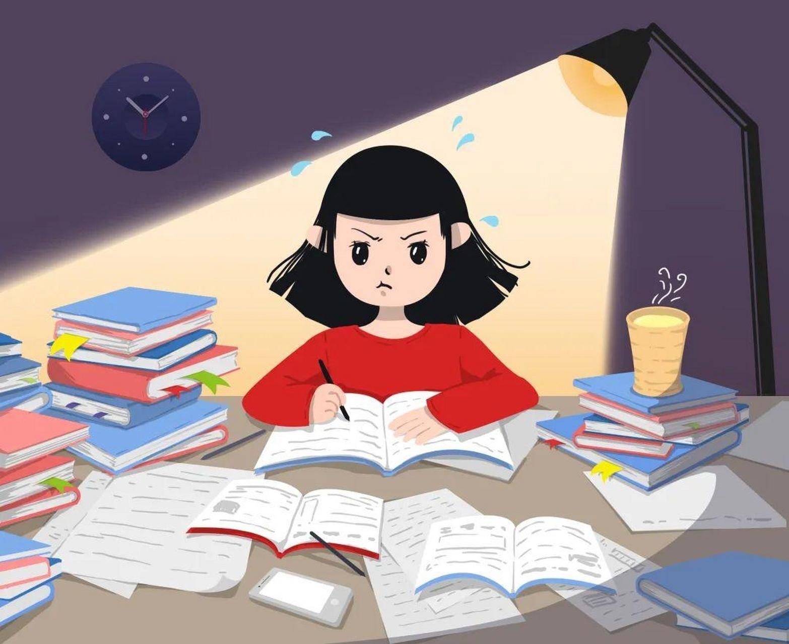
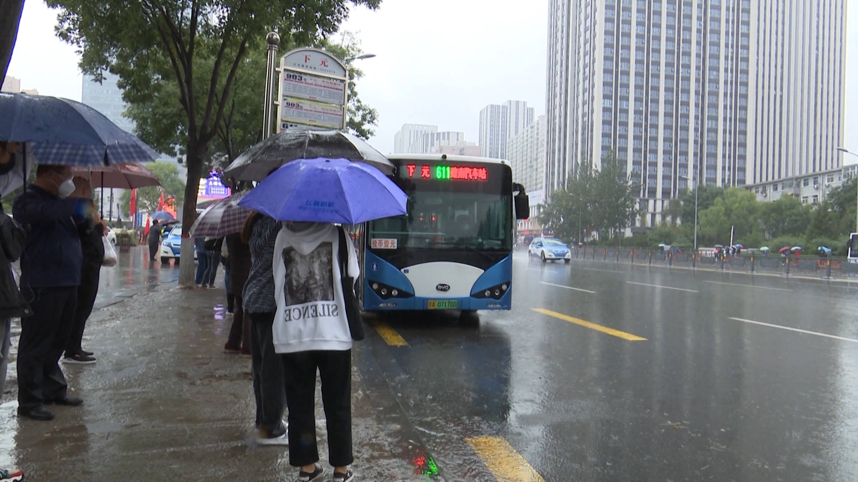
Work out the rule 4: When, while and as
What were Sandy and her classmates doing in the afternoon on that day?
Sandy was doing homework.
Her classmates were waiting for the bus.
Sandy was doing homework while her classmates were waiting for the bus.
long
______ action
long
______ action
short?long?

Slide 13
Work out the rule 4: When, while and as
Mum was shopping while Dad was working in his office.
Sandy was doing homework while her classmates were waiting for the bus.
Rule 1: If there are two long actions, we often use_________ to join them.
while
While Dad was working in his office, Mum was shopping.
While her classmates were waiting for the bus, Sandy was doing homework.
Tips: If the adverbial clause is in front of the main clause, we use a comma”,” to connect them.

Slide 14
Work out the rule 4: When, while and as
Someone opened the door and came in as I was ringing my mother.
Rule 2: When a shorter action happened at the same time as a longer action, we use ________________ tense for the longer action and the ________________ tense for the shorter tense.
short action
long action
simple past tense
一般过去时
past continuous tense
过去进行时
past continuous tense
过去进行时
Some were waiting for the bus when heavy rain fell down.
simple past tense
一般过去时
long action
short action
past continuous tense
过去进行时
simple past tense
一般过去时
Which tense时态 do we use for different actions?

Slide 15
Work out the rule 4: When, while and as
as
Someone opened the door and came in as I was ringing my mother.
short action
long action
main clause
主句
adverbial clause
状语从句
Rule 3: If the short action is in the main clause, we often use when/while/as to join them.

Slide 16
Work out the rule 4: When, while and as
when
Some were waiting for the bus when heavy rain fell down.
long action
short action
main clause
主句
adverbial clause
状语从句
Rule 4: If the long action is in the main clause, we often use when to join them.

Slide 17
Work out the rule 4: When, while and as
Think and fill in the blanks
long action +_______________+long action
long action +_______________+short action
short action +______________+long action
while
main clause
主句
when
when/while/as
Think and match
long action | simple past tense一般过去时
short action | past continuous tense 过去进行时

Slide 18
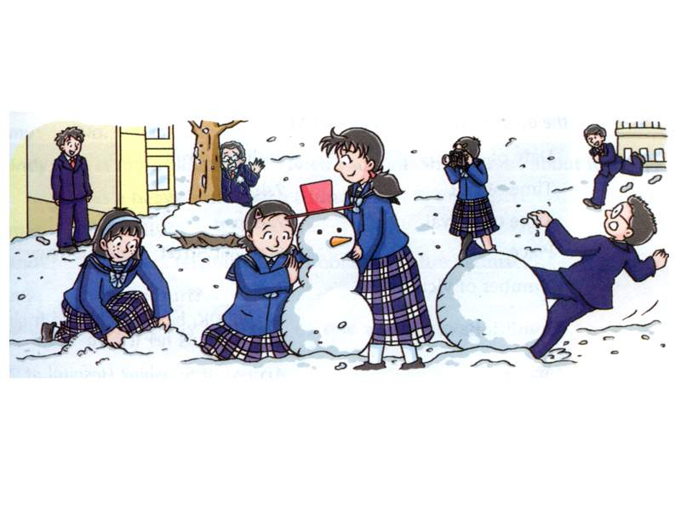
Exercises
Complete the sentences with the correct forms of the verbs in brackets. Use when, while or as to connect the sentences. (P98)
short action
1. ________ Simon ________ (arrive), Amy _______________ (get) some snow from the ground.
2. ________ Suzy and Kitty _______________ (build) a snowman, Millie _______________ (take) photos.
When
arrived
long action
was getting
long action
While
were building
was taking
long action

Slide 19
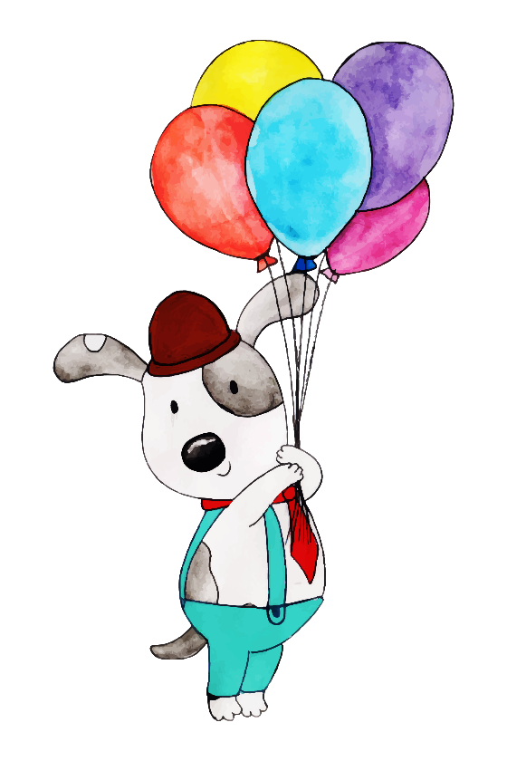
Exercises
short action
3. Daniel ________ (fall) over _______________ he _______________ (make) a big snowball.
4. Peter _______________ (hide) behind a tree ________ a snowball ________ (hit) him.
5. _______________ Millie and her classmates _______________ (play) in the snow, Andy ________ (run) towards them.
fell
when/while/as
was making
long action
long action
was hiding
short action
when
hit
When/While/As
long action
were playing
ran
short action

Slide 20
What should we do to protect ourselves from the typhoon?
Discussion
If you were at home,
If you were outside,
keep all the doors and windows closed 关闭门窗
cut the power 切断电源
save some food and water 储存食物和水
......
find a shelter 找到庇护所
Don’t hide under the trees and billboards 远离大树和广告牌
......
Calm down and never give up!

Slide 21
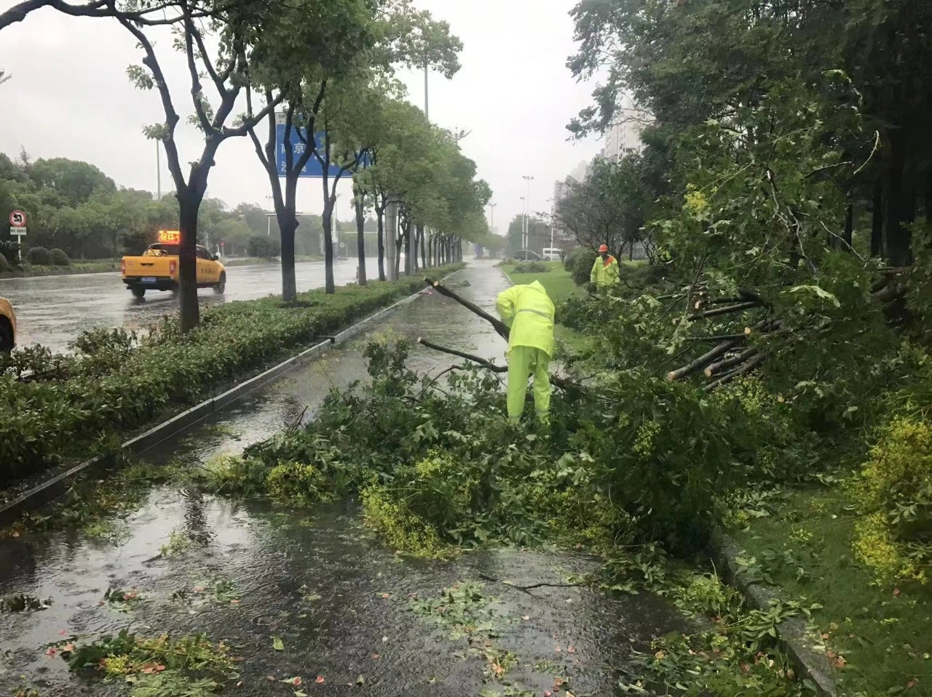
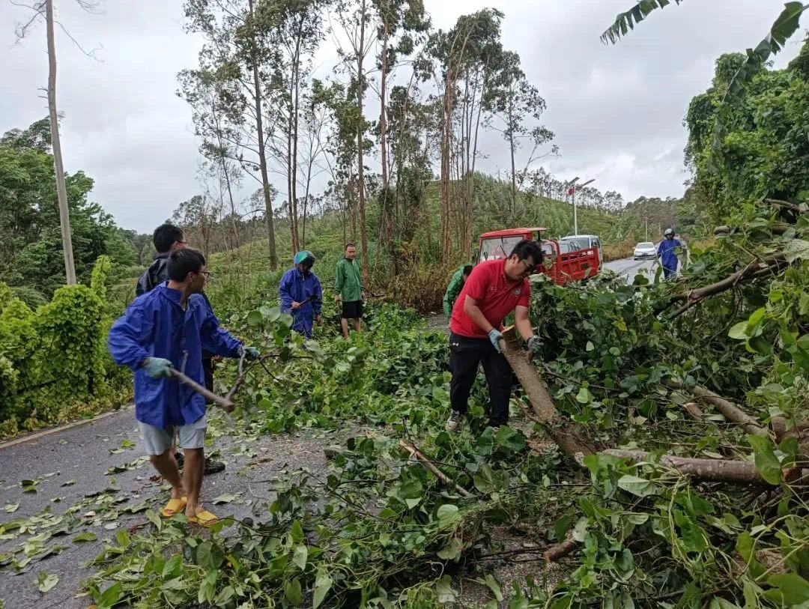
Protect our home-After the typhoon
What were they doing?
They ______________ (carry) these fallen trees away.
were carrying

Slide 22
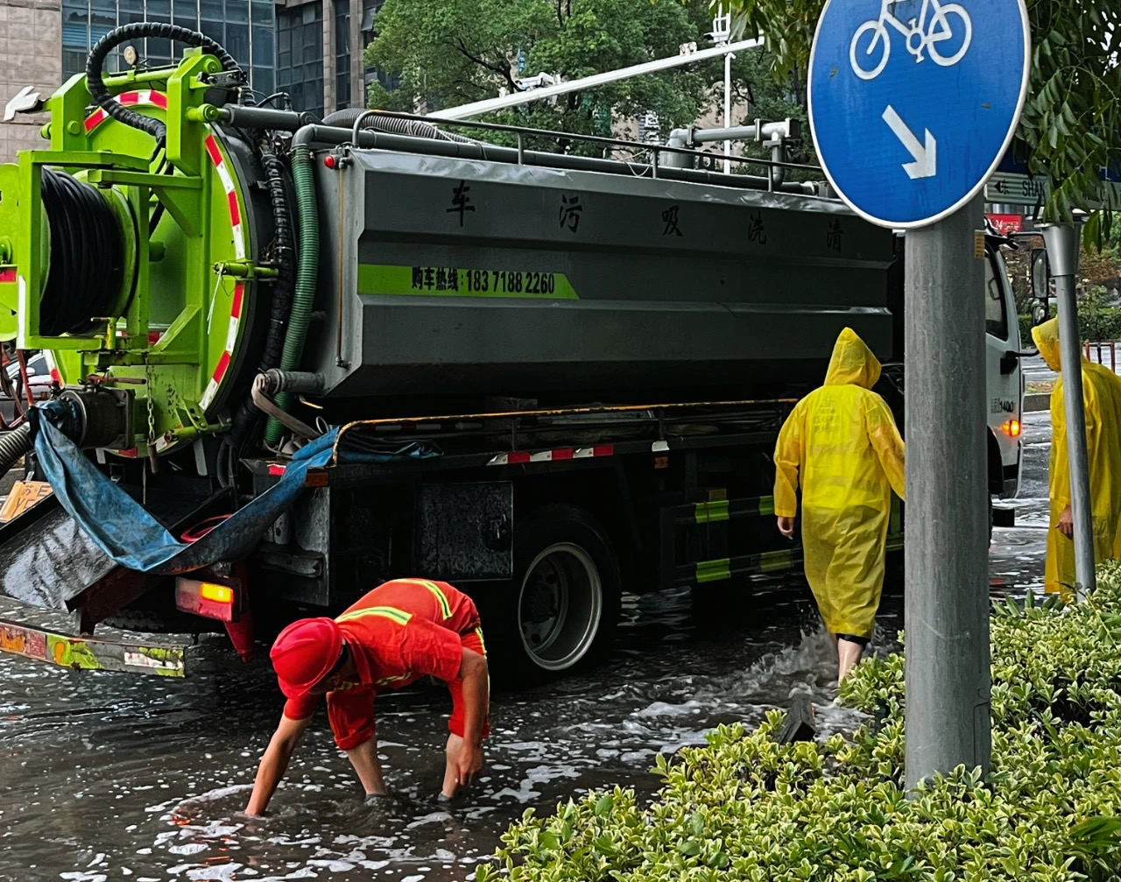
Protect our home-After the typhoon
What were they doing?
They ____________(clean) up the rubbish in the sewer下水道.
were cleaning

Slide 23
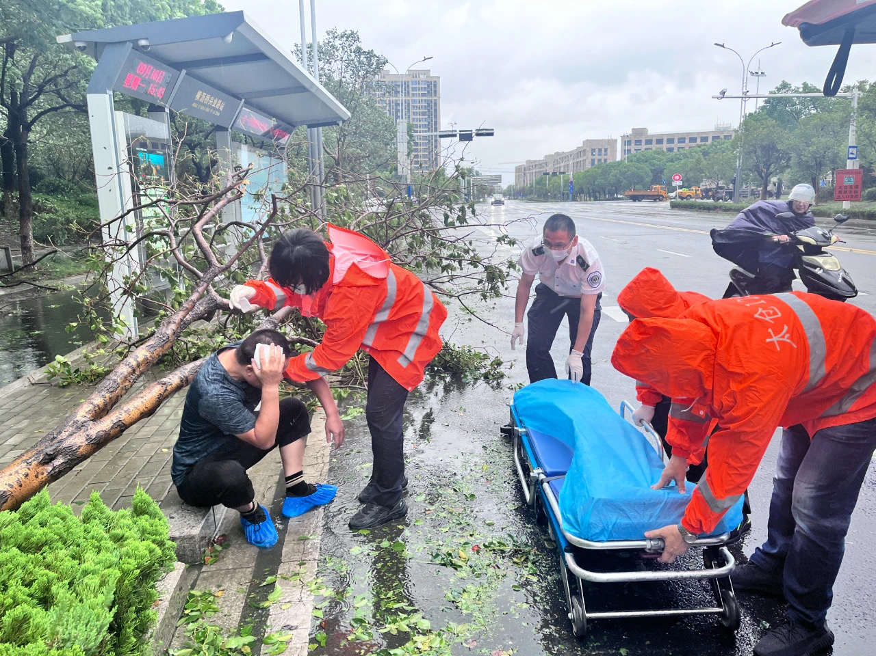
Protect our home-After the typhoon
What were they doing?
were saving
They _____________（save）injured people.

Slide 24
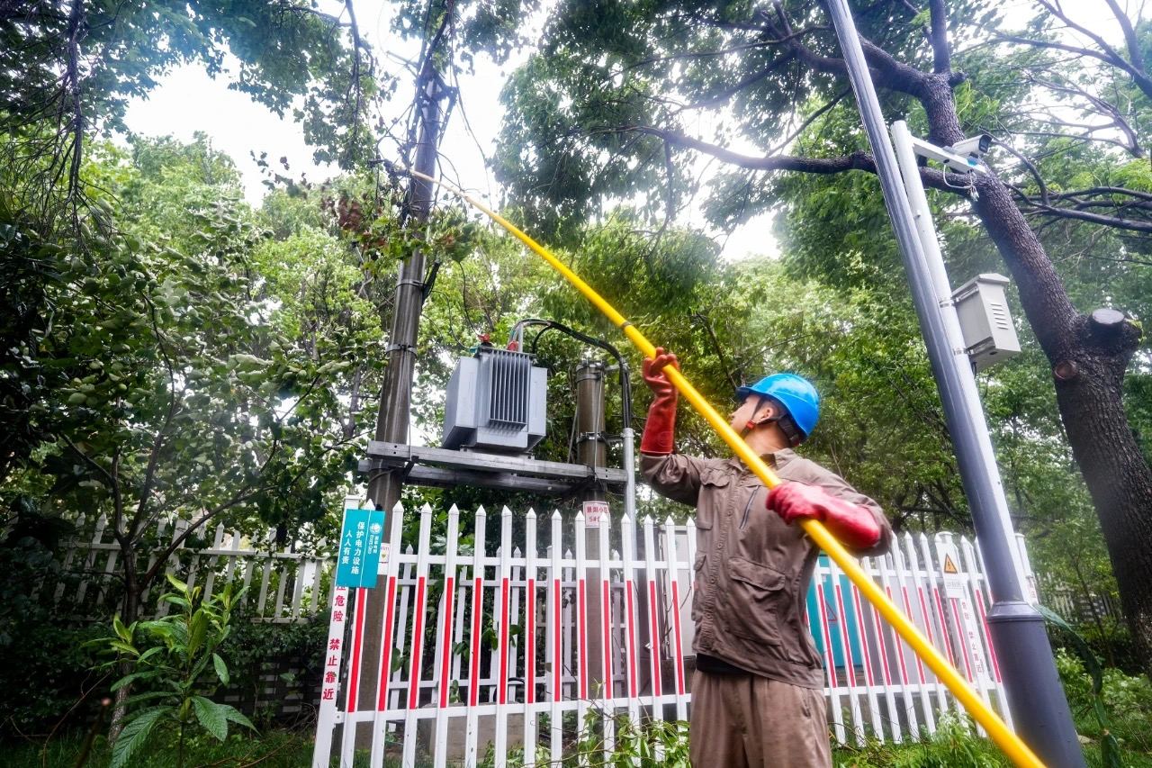
Protect our home-After the typhoon
What was he doing?
were repairing
He ____________（repair）damaged wires损坏的电线.

Slide 25
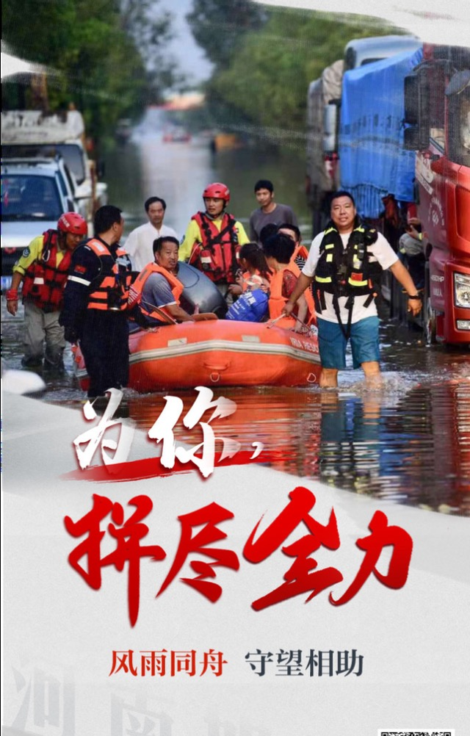
Natural disasters are merciless无情的, but we humans can protect ourselves and rebuild our home again and again.
Where we are, there is hope.

Slide 26
Homework:
1. review the usage of past continuous tense and “when, while, as”.
2. try to use past continuous tense to describe an experience of a natural disaster.

Slide 27
THANK YOU

