Slide 1
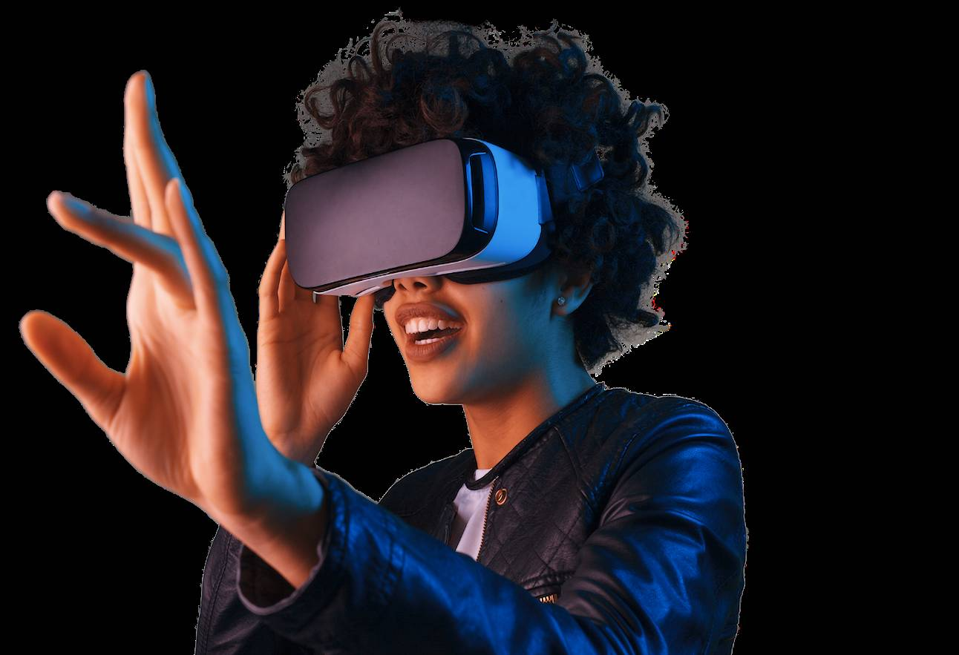

Virtual Reality
（虚拟现实）

Slide 2
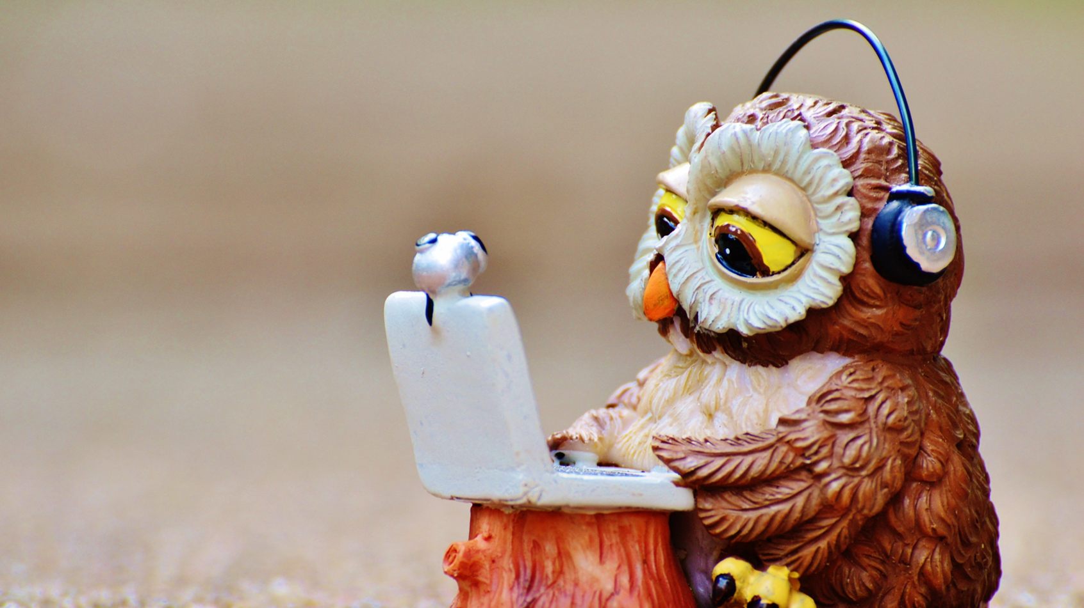
Watch the video and answer the questions.
1. Does the mother meet her daughter in the real world?
2. How can she see her dead daughter?
Notes:
good morning ,everyone, welcom to the class. in the class, you will have 2 pieces of paper, one is VR to read, the other one is VR学案1to finish the tasks, understand? ok , we will first enjoy a vidoe and answer the questions.

Slide 3
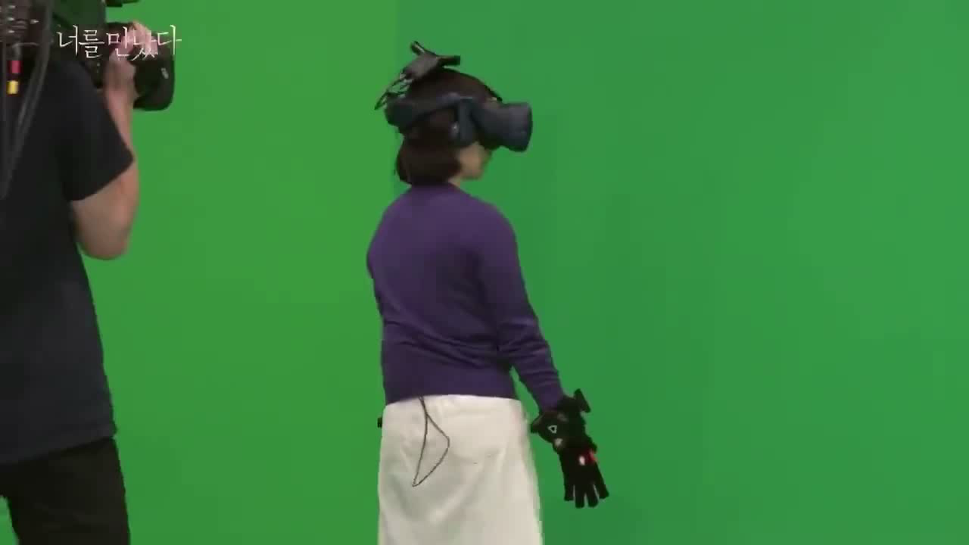
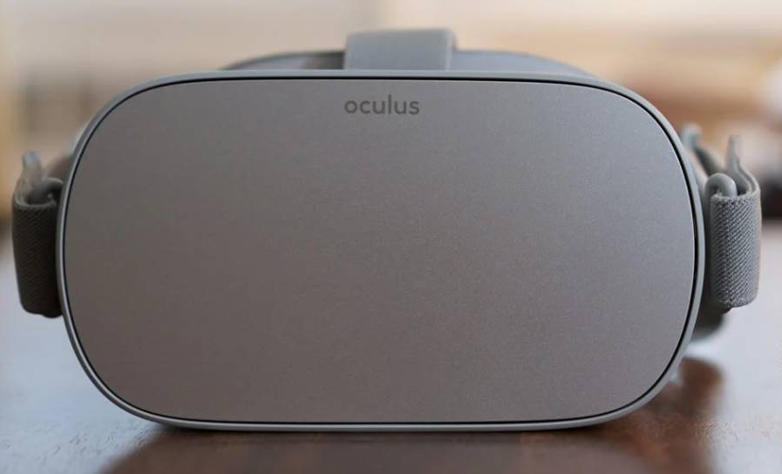

Slide 4
Watch the video and answer the questions.
1. Does the mother meet her daughter in the real world?
2. How can she see her dead daughter?
VR

Slide 5

Task1 Read and match（连线）
Tip: pay attention to the first sentence of each para.
Para. 1
a. The change of computers
Para. 2
b. VR is here to stay
Para. 3
c. VR has lots of uses
Para. 4
d. What is VR
Para. 5
e. Opinions about VR
Notes:
in the class, we will read a passage to learn about VR, this paper. pls take out your paper. read and match the main idea of each para. you can pay attention to the first sentence of each para.
let's check.... computers are important to VR. read para.1 carefully to learn how computers changed these years. read para.1 . pay attention to the times.

Slide 6
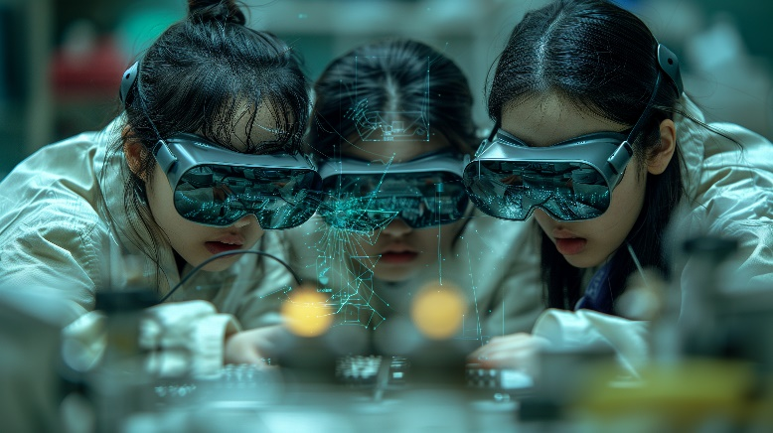
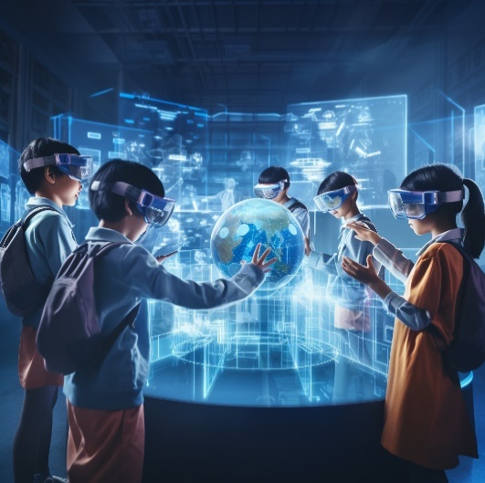
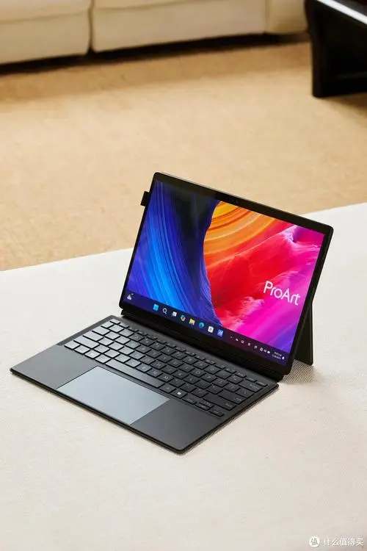
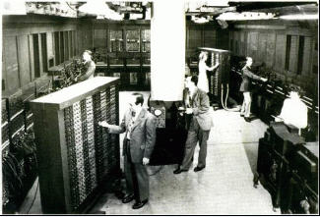
Task2 Let’s read Para1:The change of computers
Tip: pay attention to the times.（时间词）
people may see a computer-made world by using VR.
people use notebook computers
computers were big like a box
Today
Then
Long ago
Notes:
Long ago, what were computers like?...how about then. How about today? There are 2 pics of people using VR. It looks interesting. So what is VR. Do you want to know? Let’s read para.2 and finish task3.

Slide 7
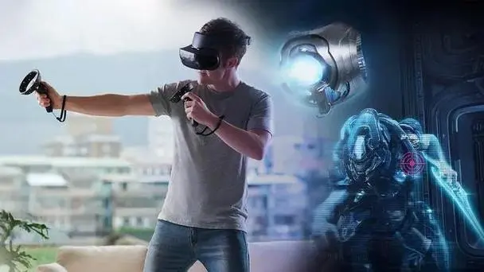
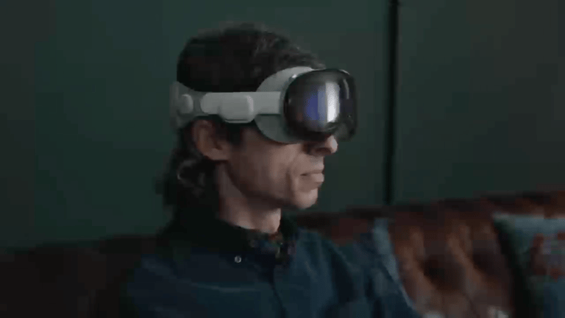
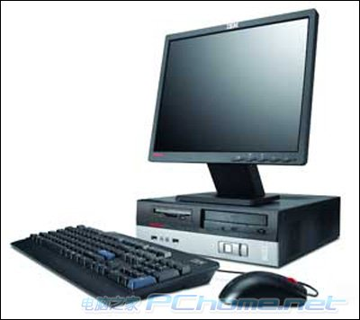
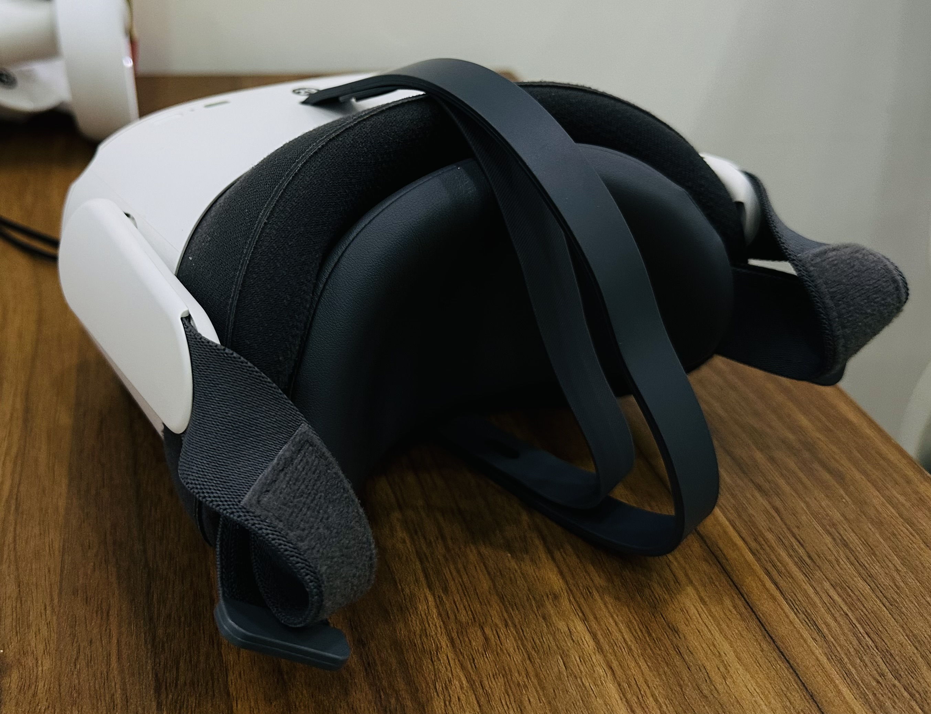
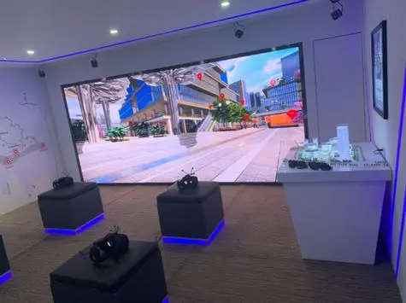
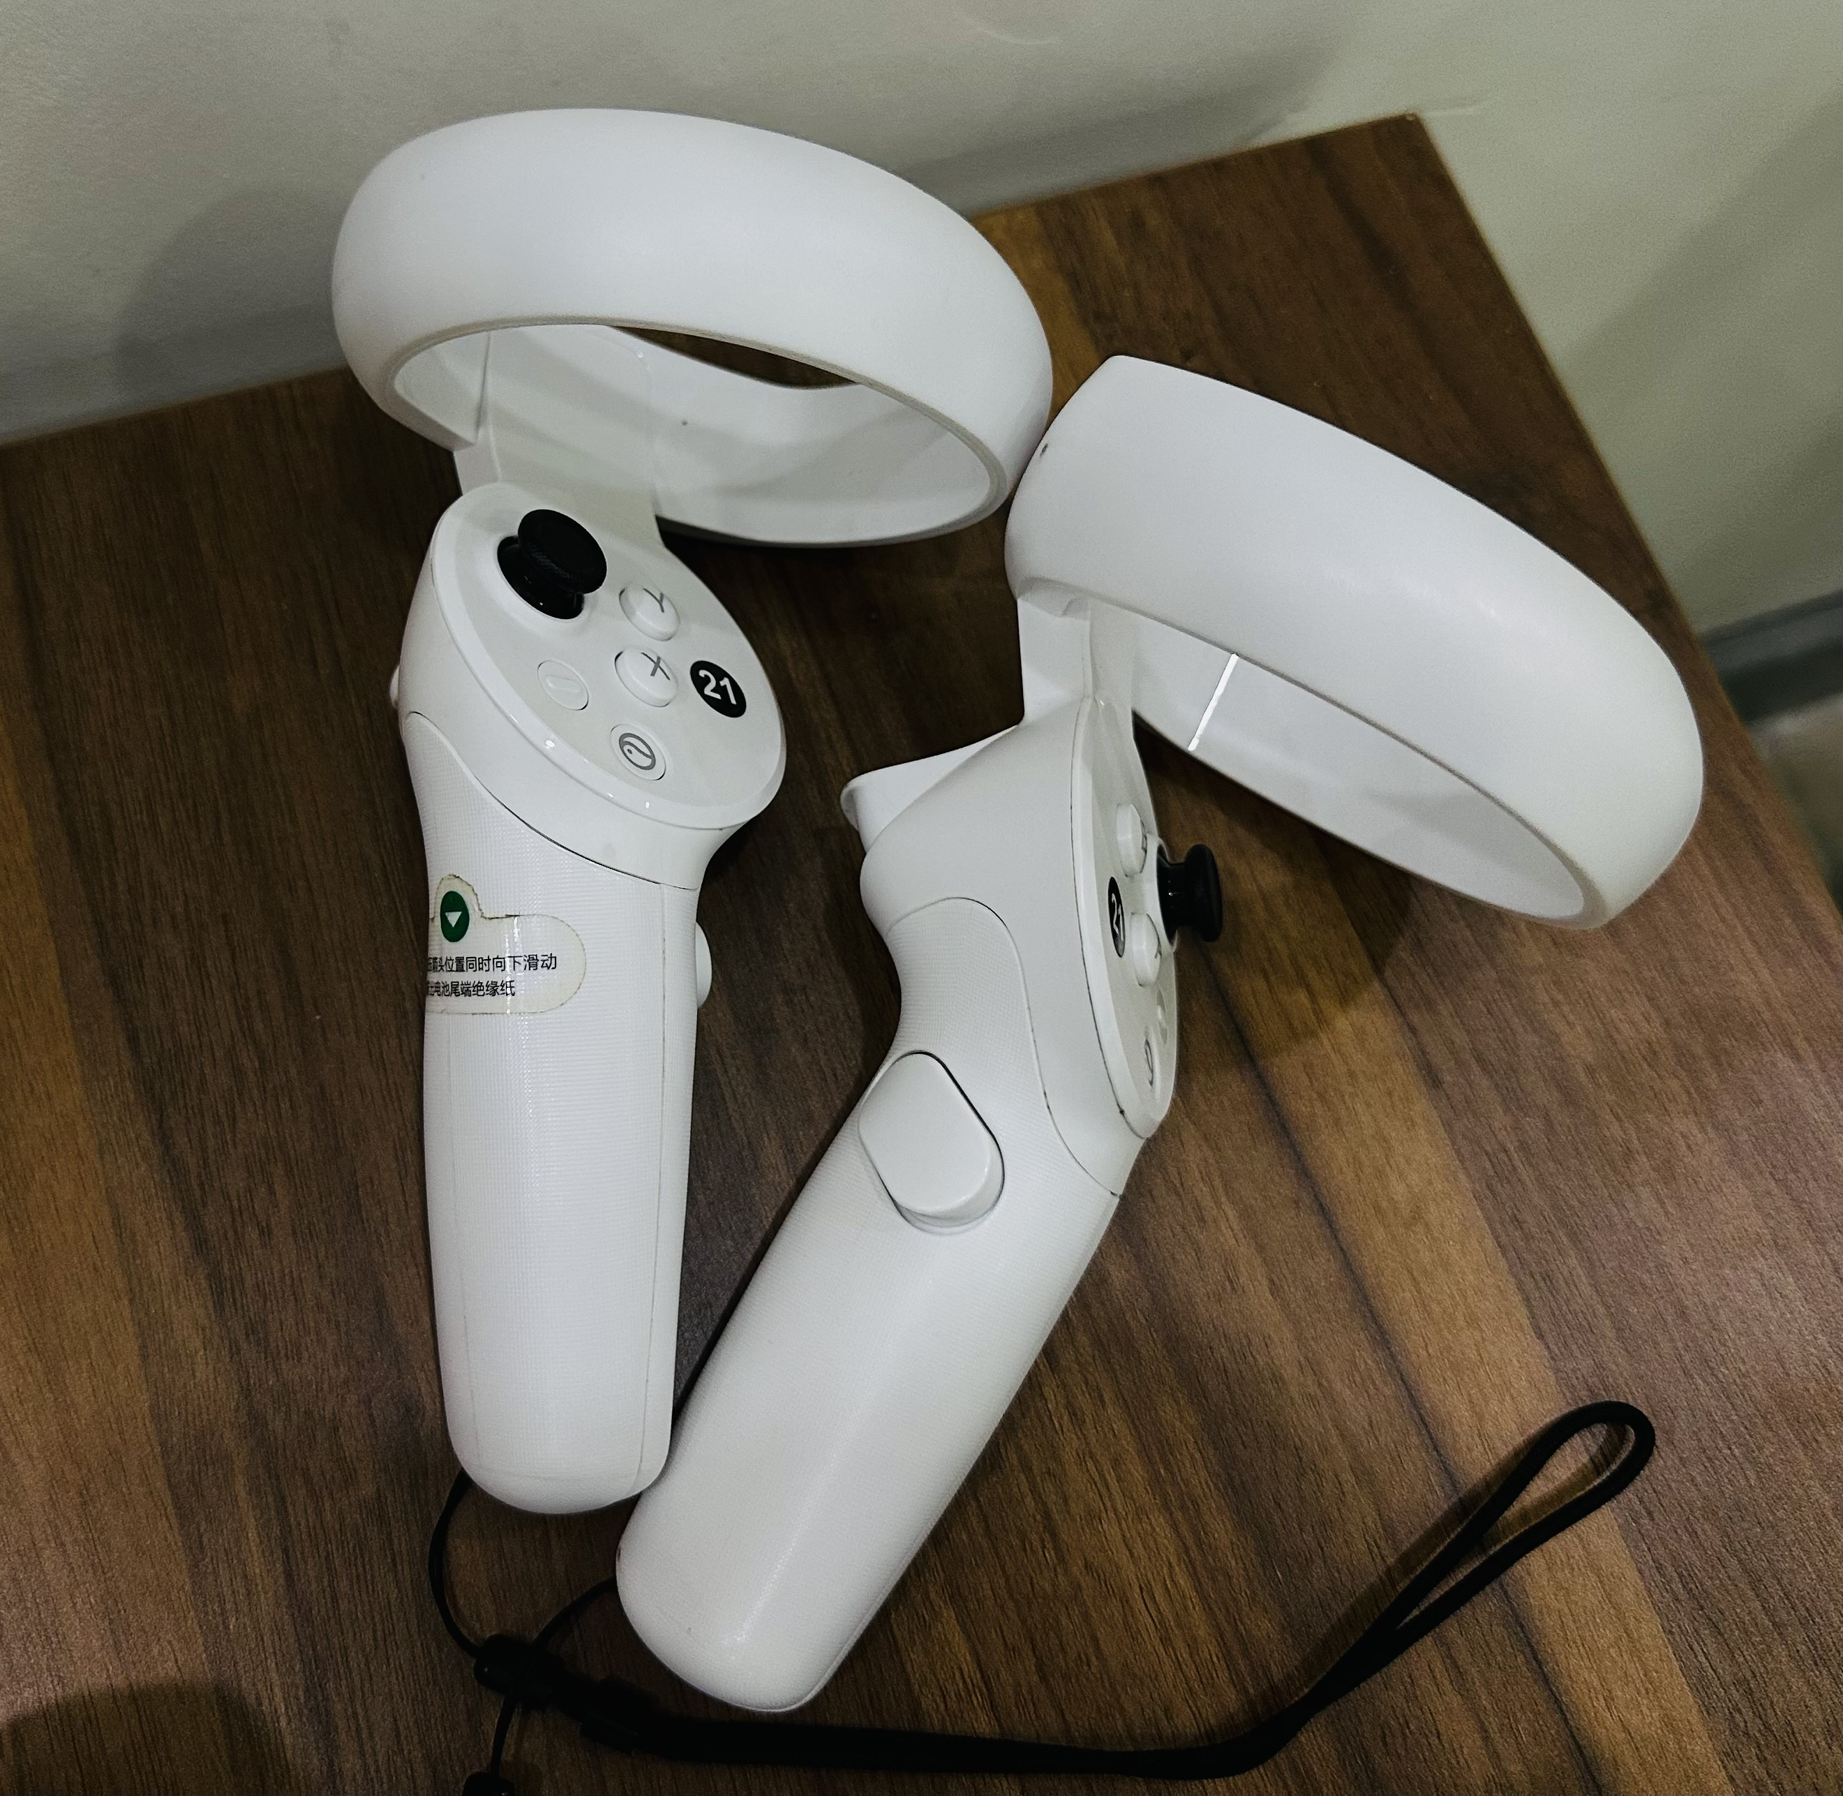
Task3 Para 2 :What is VR
virtual reality or VR
VR is a _______ world made by _____________. It’s not _______.
2. What devices（设备） do we need?
dream
computers
real
A computer
A headset
（头盔）
A screen
（屏幕）
A handle
（手柄）
Notes:
If we want to use VR., we need some devices. What devices do we need?

Slide 8
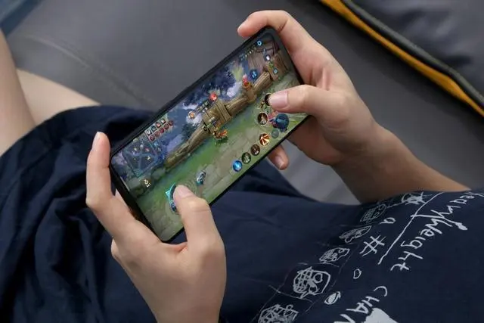
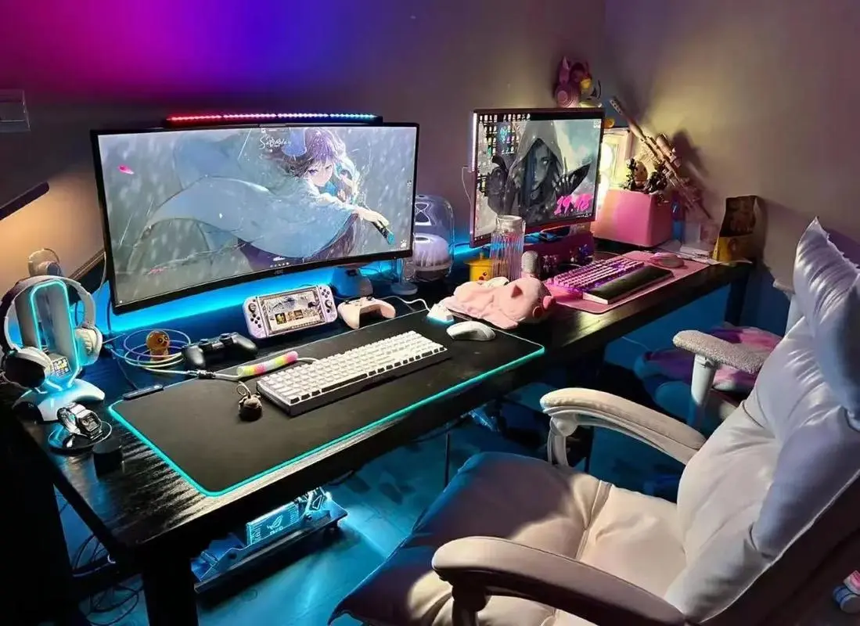
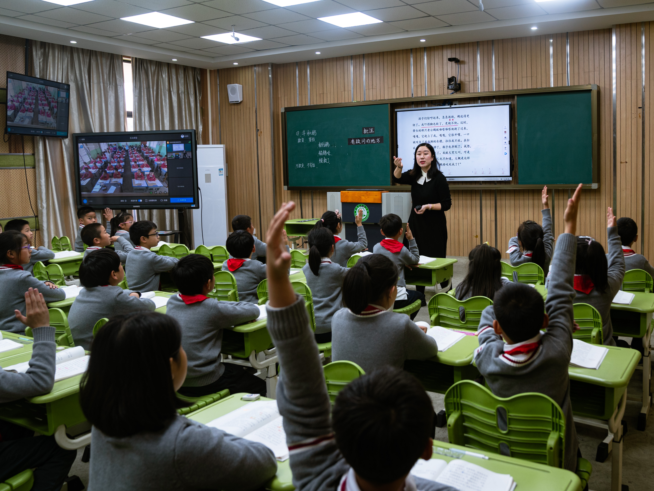

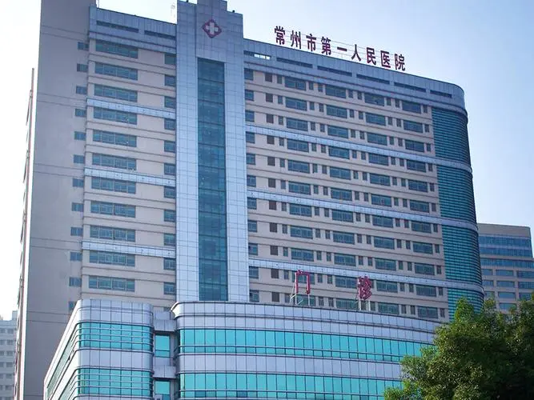
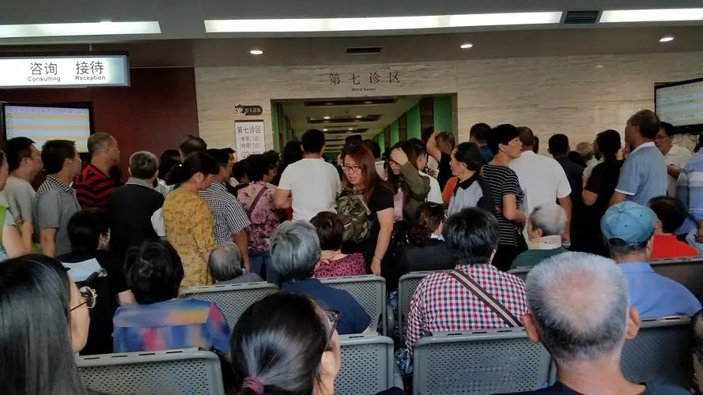
Task4 Para 3
VR has lots of uses.
Para. 3-5 (Line 15~26): Applications of VR
without（没有） VR
with VR
fly a plane
can_______________, ___________ and __________________
play these games like_______________
drive a sports car
game
fight like a hero
in a real world
learn about many countries by _____________________________
learn history by______________________
learning
see a doctor
we don’t have to __________________
we can __________________________
Notes:
It sounds like VR is amazing and can help us in many ways. For example, when we don’t have VR, we often play games with…
and we usually learn in… when we are ill, we have to go to hospital, but it is always full of people.so with VR, what will happen. Pls read para.3 and finish task4.
With VR, what games can we play?...actually, VR games have been used widely. Let’s watch and guess what they are doing?

Slide 9

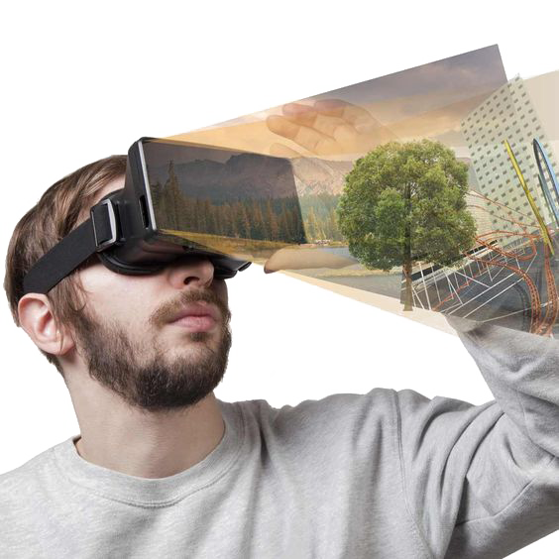
Let’s guess
What are they doing in the VR world?

Slide 10
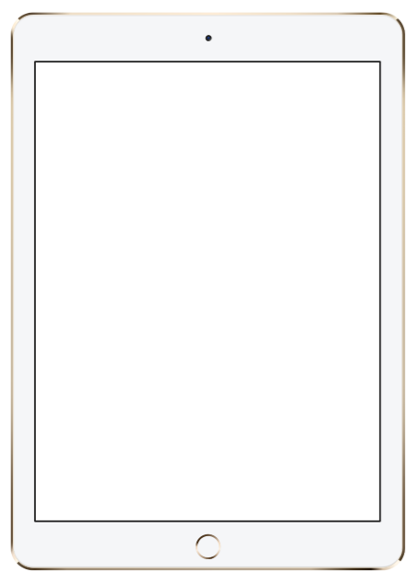
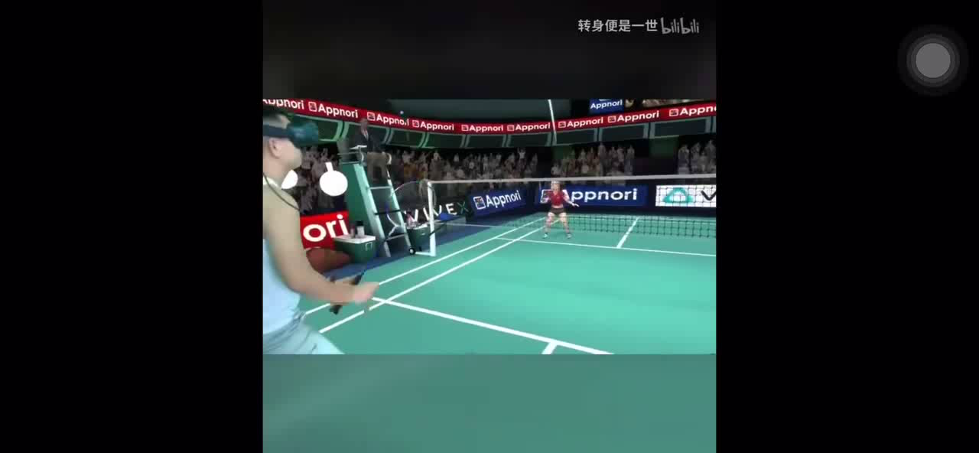

Let’s play a guessing game by watching some videos.
What is he doing in the VR world?
He is .
A .Playing badminton（羽毛球)
B .Playing tennis
C .Playing basketball
Notes:
将文章中的流泪场景通过图片和选择的模式展现，帮助同学们梳理信息

Slide 11
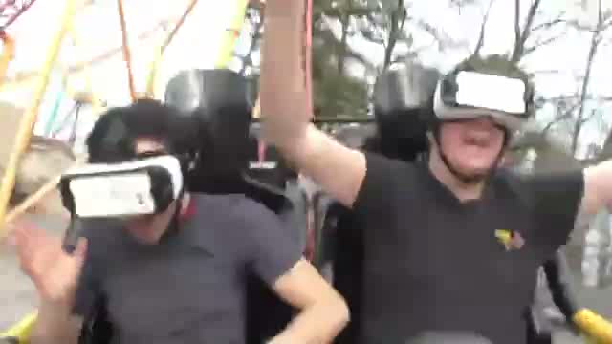
Let’s play a guessing game by watch some videos.
What are they doing in the VR world?
They are .
A . Running
B . Taking a roller coaster（过山车）
C .Jumping
Notes:
将文章中的流泪场景通过图片和选择的模式展现，帮助同学们梳理信息

Slide 12
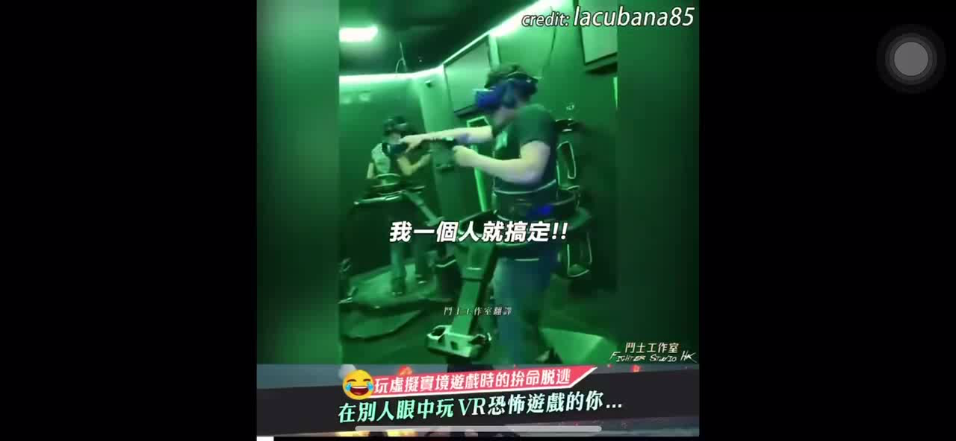
Let’s play a guessing game by watching some videos.
What are they doing in the VR world?
They are .
A .Fighting
B .Running
C .Playing a scary（令人害怕的） game
Notes:
将文章中的流泪场景通过图片和选择的模式展现，帮助同学们梳理信息

Slide 13
Task4 Para 3
VR has lots of uses.
Para. 3-5 (Line 15~26): Applications of VR
without（没有） VR
with VR
fly a plane
can_______________, ___________ and __________________
play these games like_______________
drive a sports car
game
fight like a hero
in a real world
learn about many countries by _____________________________
learn history by______________________
learning
visiting them from their classroom
talking with famous people
go to hospital
see a doctor
we don’t have to __________________
we can __________________________
see a doctor at home
convenient（方便的）
Notes:
Is it interesting? But VR isn’t just for fun. what else can it do? Let’s move on. How can we learn with vr?...how about seeing a doctor?
It’s very convenient, right? But some people don’t think so. Let’s read para.4 to learn about different opinions and finish task5.

Slide 14
Task5 Para 4
Opinions（观点） of VR
Read and finish the passage .
People have different opinions（观点）________ VR. Some people don’t think VR is good______ us. They are worried there will be games with bad ______(thing) and people may like VR ______(many) than real life. Also, people may forget how ________(talk) with real friends. _______ others don’t think so. They say VR is________(help) because it can help us _______(stop) dangers in real life by ______(test) things in VR. So the world will be _____(good) with VR.
about
for
things
more
to talk
But
helpful
stop
testing
better
Notes:
People have different opinions about vr. How about you? What do you think of vr? Talk with your partners.

Slide 15
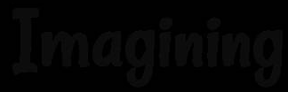
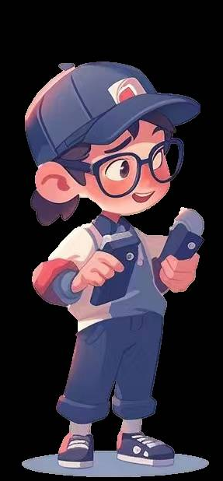
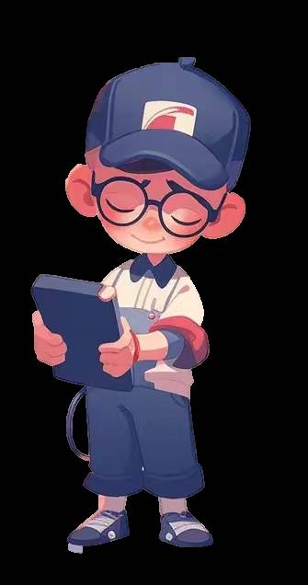
Further thinking
What do you think of VR?
I think/don’t think VR is_________,
because______________________.
VR is here to stay!
Notes:
Anyway, there may be some problems with vr. But vr is here to stay.

Slide 16

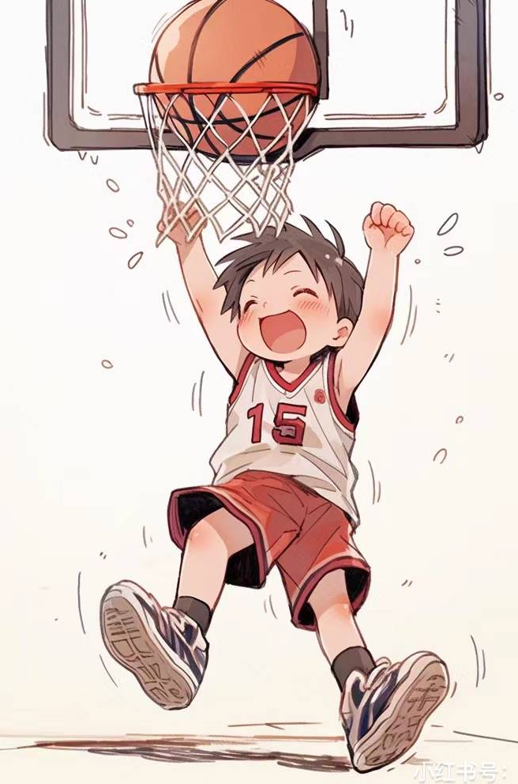

I made it!
Every coin has two sides. The key is how to use it.
凡事皆有两面性，关键是如何去使用。

Slide 17

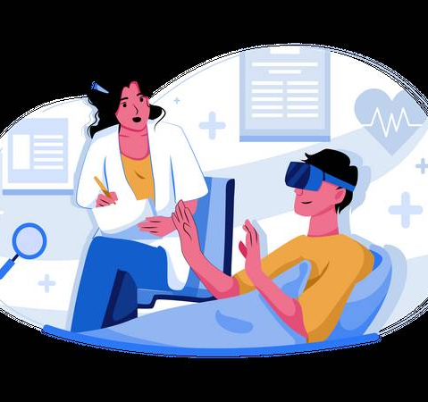
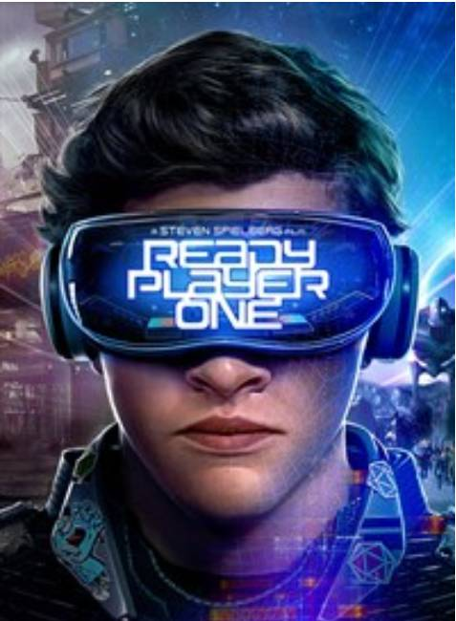

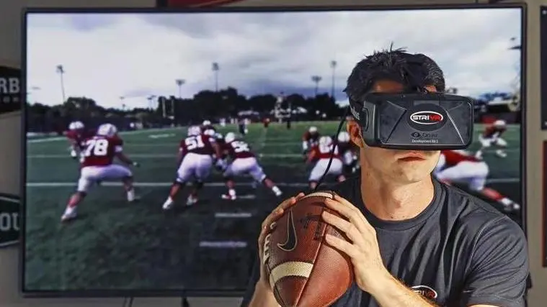
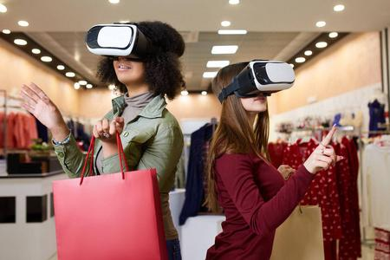

Task6: Let’s conclude（总结）
See a doctor
Learning
Game
…
What else?
What can VR do？
Travelling
Doing sports
Shopping
Notes:
From the passage, we have learned a lot about vr. Let’s conclude. What can vr do? What else?

Slide 18
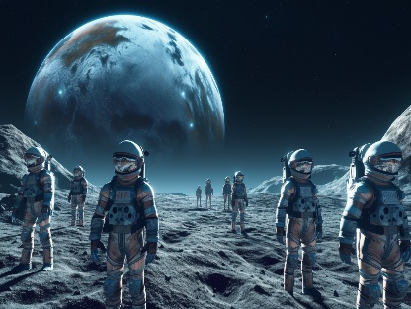
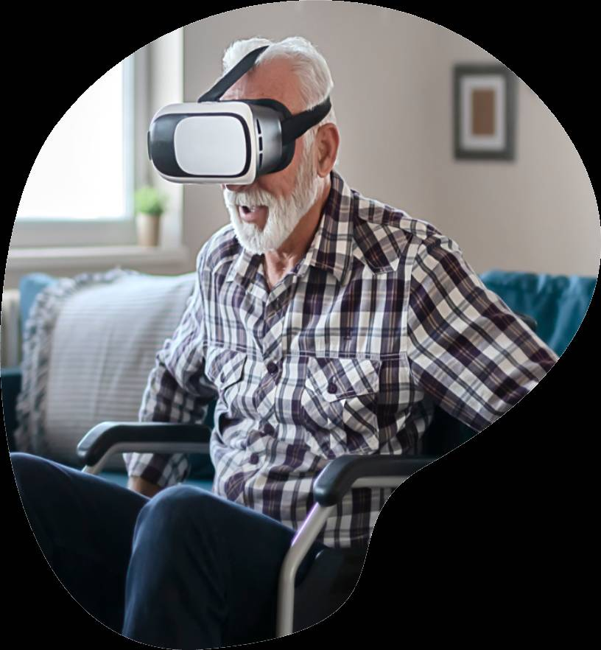
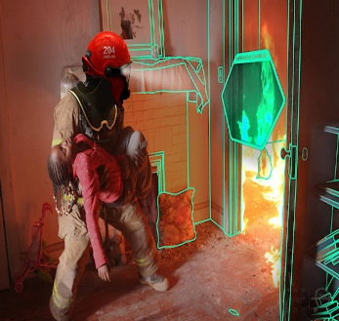

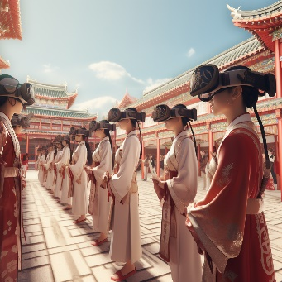
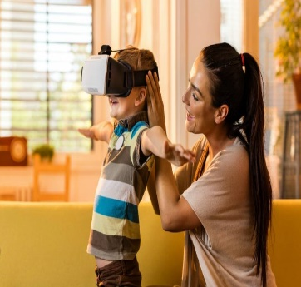
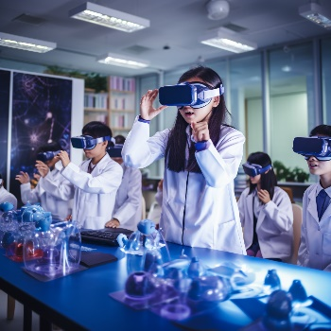

Discussion
structure
details — applications (Lines10-42 )
What do you want to use VR to do ?
I want to use VR to______________________________, because_______________________________________.
Notes:
Vr has a lot of uses> if you have a chance, what do you want to use vr to do? Talk with your partner and write your ideas on the paper. There are some examples and useful expressions on the paper.
I want to share my ideas. I want to use vr to go shopping, because it’s very convenient and I can shop around the world quickly, which can save money and time. I wonder what will happen if we apply vr into shopping. Let’s watch a video.

Slide 19
？
VR +SHOPPING

Slide 20
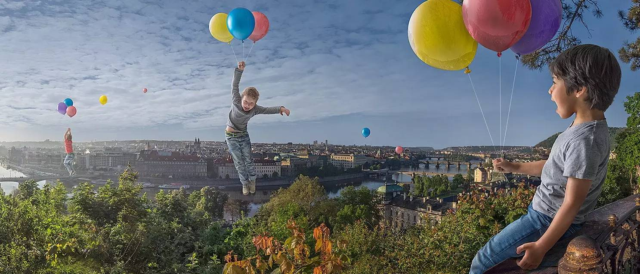
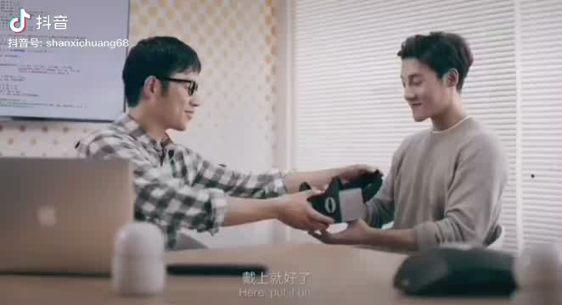

Slide 21
Group work: make a dialogue to express your opinion on VR
Carrie is a reporter from New York Times and she is asking gamers,students, businessmen whether it is all right to step into VR world. Work in groups of 4/6 to discuss it.
requirements:
1. choose a role to act.
2.state your opinion and illustrate it with ideas/example.
3. make a conclusion.
4.take notes by yourselves.
When it comes to VR, personally I think...
My view on VR is positive/negative...
That’s not entirely suitable.
As far as I’m concerned，…
Every coin has two sides.I’d like to point out that …
So many people, so many minds...
It is understandable that students/... are interested in VR...
Useful
expressions

Slide 22
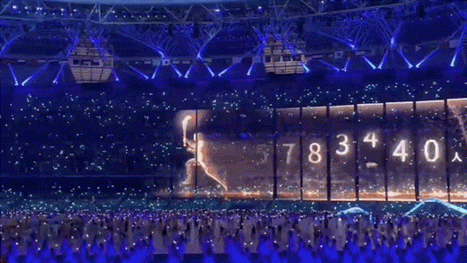
How amazing the VR is!
We should study hard and change our life with science and
technology.
VR技术是多么神奇啊，我们应该努力学习，用科学技术改变生活。
Notes:
Do you want to try go shopping with vr. Today we have a chance to shop in a real world. But before that, another friend is interested in vr too. Let’s enjoy vr with them together.

Slide 23
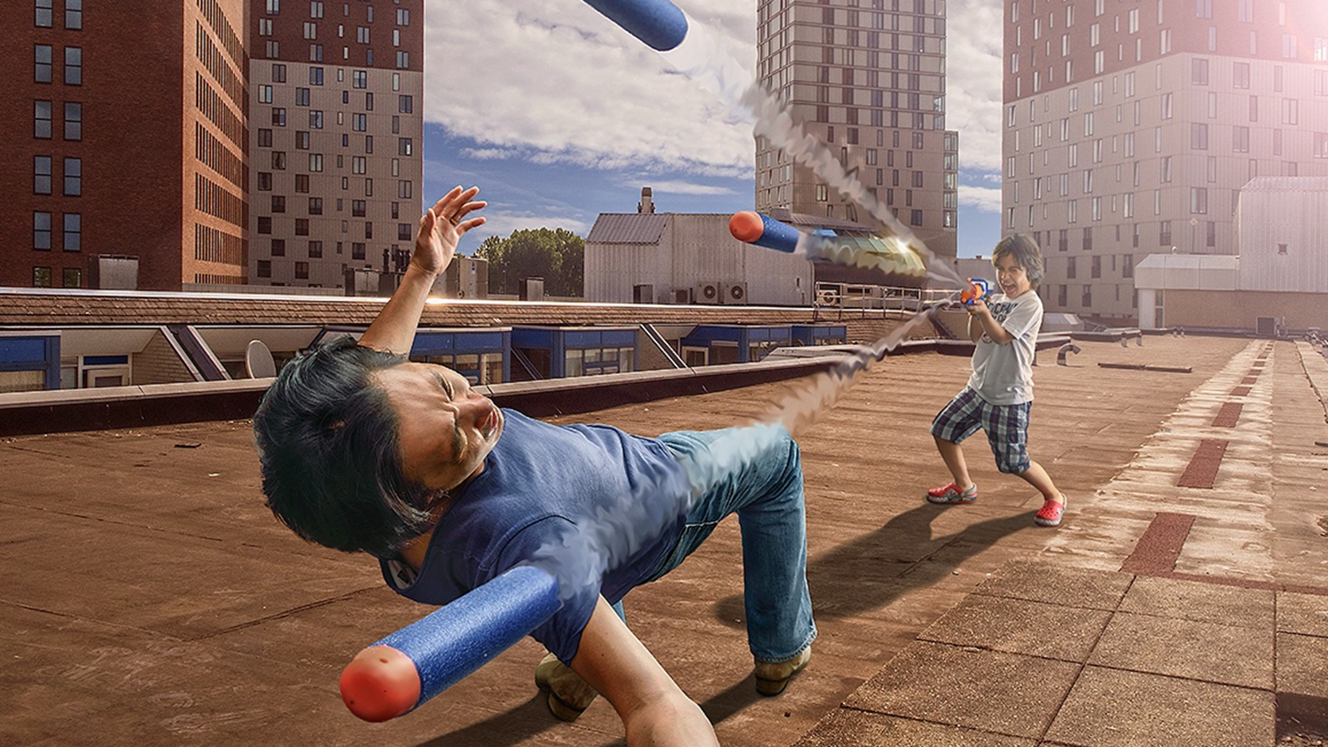
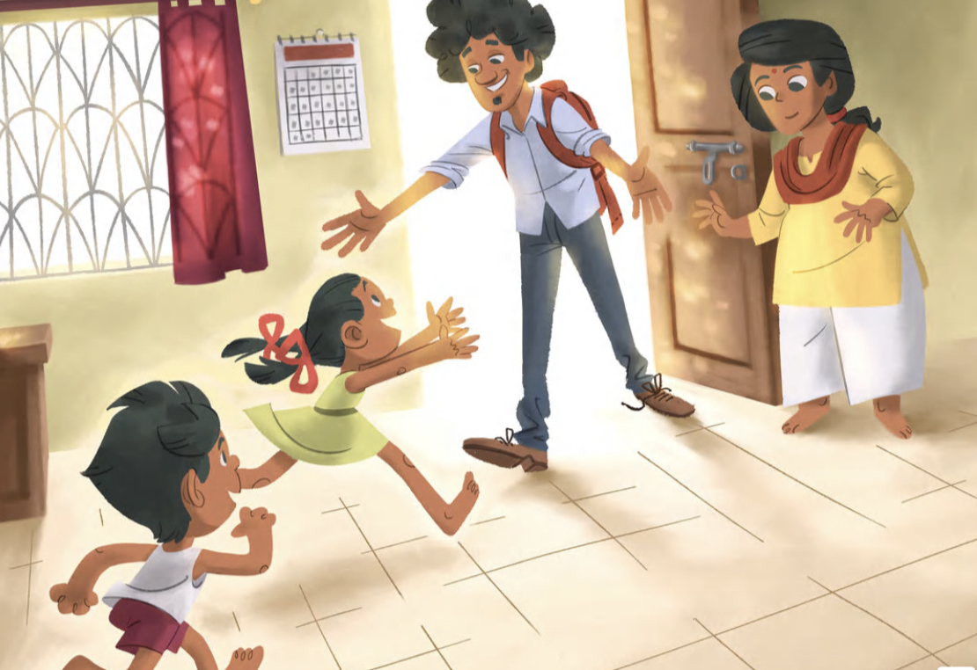

Slide 24

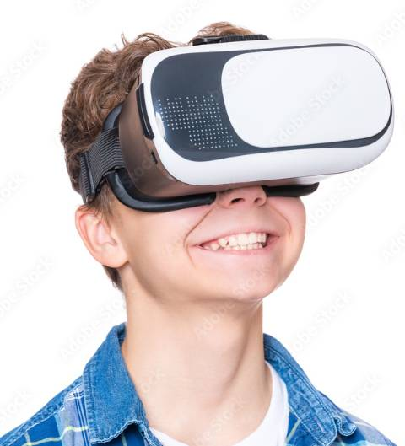
Thank you !

