Slide 1
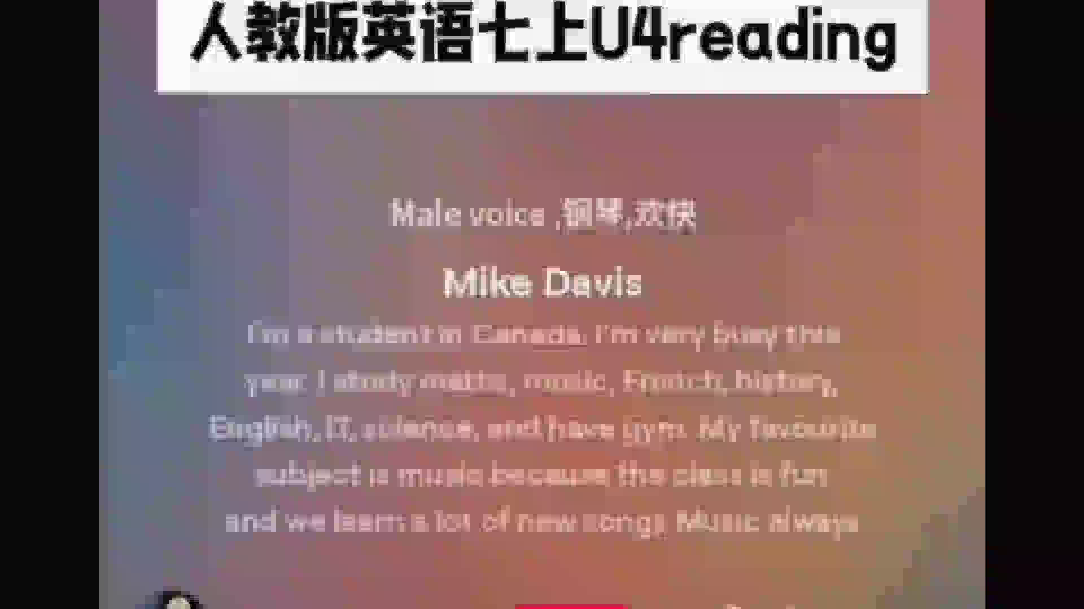

Slide 2

Unit 4 My Favourite Subject
Section B（1a-1d)
What can you learn from different subjects?
乌恰县实验中学 苏丽
Notes:
课件首页

Slide 3

Confident Users
自信的实践者
Curious Learners
好奇的学者
Careful Readers
细心的读者
Critical Thinkers
批判思考者
Learning objects
学习目标
04
03
Discuss讨论
What you can learn from different subjects
01
02
Analyze分析
the reasons
why you like
this subject
Review复习
the subjects
you learn
Talk about谈论
your favourite
subject is

Slide 4

？
Confident Users
自信的实践者
What subjects do you learn this term?
I have _________________this term.
学期
What is your favourite subject?
English
My favourite subject is________.
Why do you like it?
fun
important 重要的
Because it’s________
(因为)
useful 有用的
…
Notes:
…

Slide 5
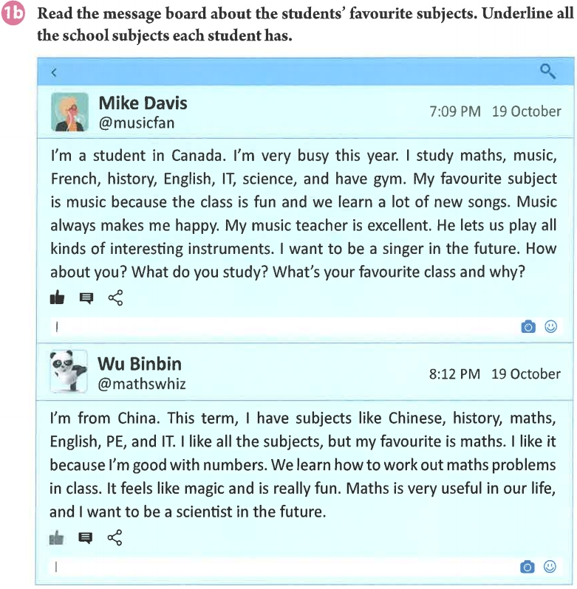


Curious Learners
好奇的学者
Predict 预测(不看文章)
Reading tip1:Pay attention to the title(关注标题) and the obvious information(明显的信息)
before reading more details.
1.Where is the text from?
A. The message board(留言板).
B. News(新闻).
C. Notice（通知）.
How much do you know
about the message board?
2.What are the texts mainly(主要) about?
A. Two students’ family.
B. Two students’ favourite subjects.
C. Two students’ interests.

Slide 6
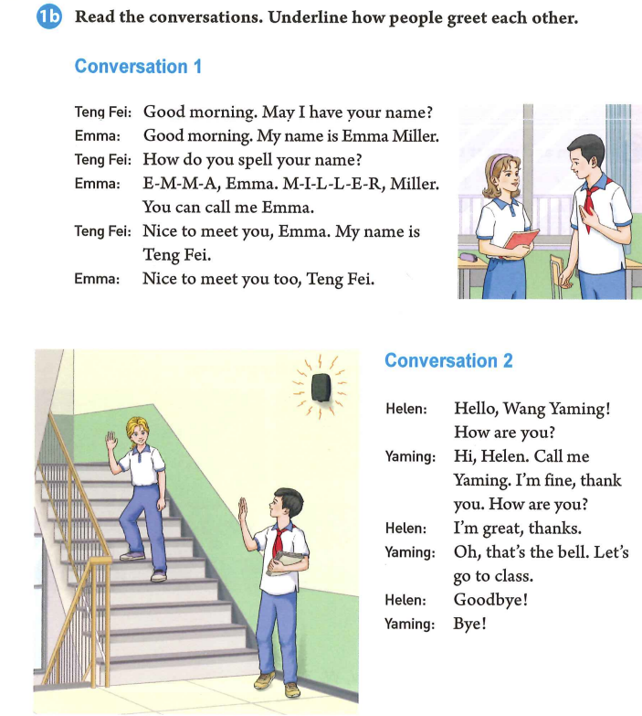
Curious Learners
好奇的学者
Task 1:Look and learn
1.Who wrote(写) it?
2.What’s his nickname(网名)?
3.What do you know from his nickname?
4.When did he post the message board?
=music+fan(迷)
Mike Davis.
Musicfan.
Maybe he is a music fan.
At 7:09 p.m..
Binbin is interested in Mike’s post.So he wants to post a comment(发表评论).
Which icon(图标) should he click(点击)?
Binbin

Slide 7
？
Curious Learners
好奇的学者
Task 1:Look and learn
1.What is Binbin’s nickname(网名)?
2.What do you know from his nickname?
3.Why does he use the panda as his avatar
4.What date(日期) did he post the message board?
=math+whiz(能手/专家)
Mathwhiz.
Maybe he loves math.
头像
Maybe he loves pandas.
The panda is the symbol(标志) of China.
The panda is a master (大师)in the film called Kung Fu Panda.
On 19 October .

Slide 8
Careful Readers
细心的读者
1b Read the message board about students' favourite subjects. Underline all the school subjects each student has on P48.
Why does Mike have to study French while(然而) Wu Binbin has to study Chinese besides
(除了) English?
Mike has
Wu Binbin has
(法语)
加拿大的双语现象源于其丰富的历史背景和多元文化政策。自16世纪末以来，‌法国和‌英国的殖民历史导致了英语和法语的共存和发展，最终在宪法中确立为官方语言。
What differnet subjects do they have?
What subjects do Mike and Binbin both(都) have?
They both have_______________________________.
maths,history,English,IT and gym(PE)

Slide 9
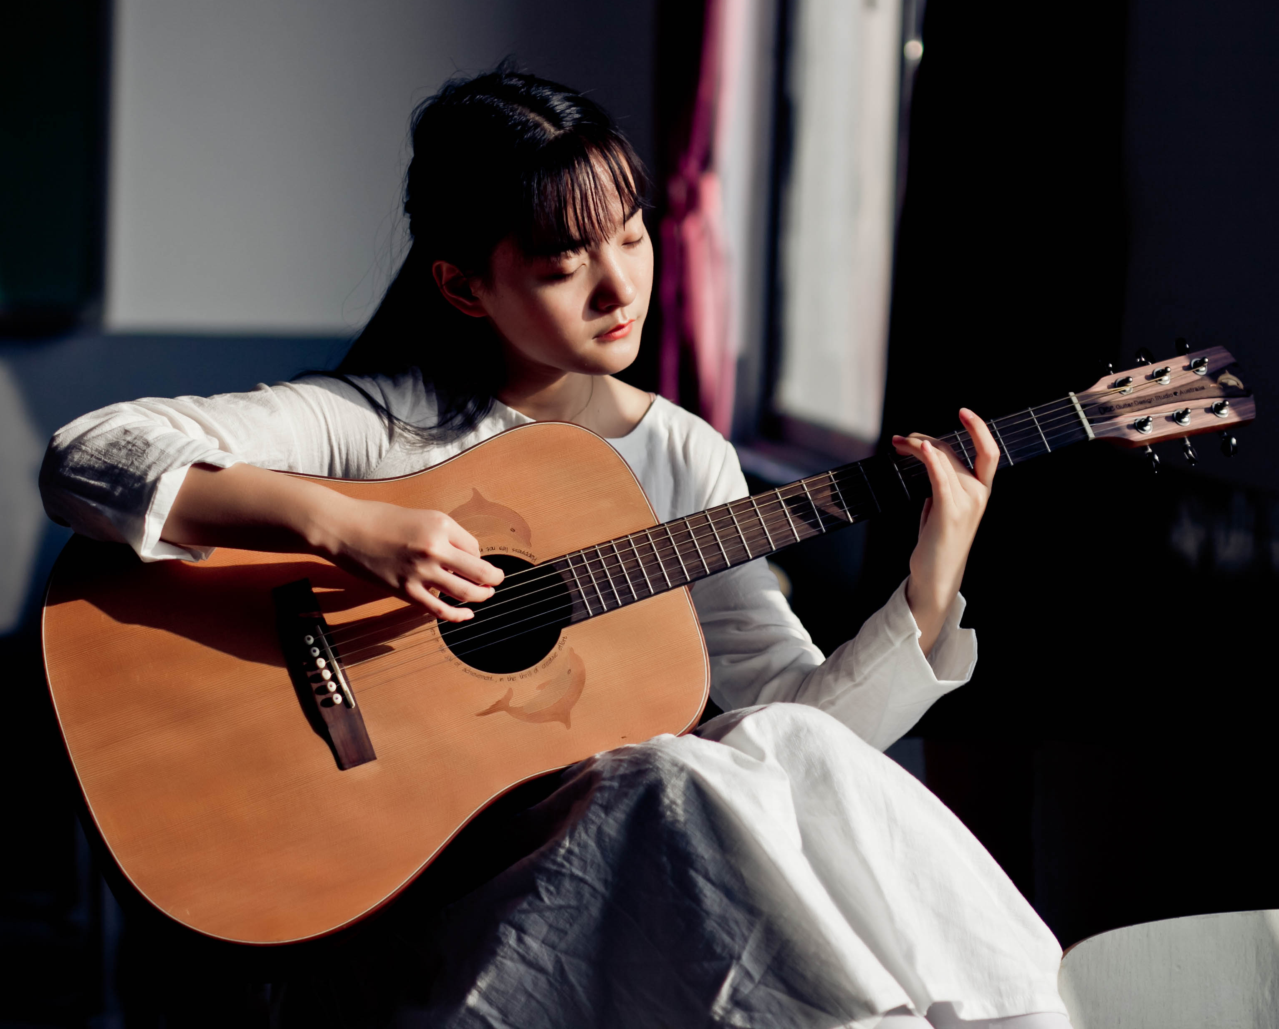
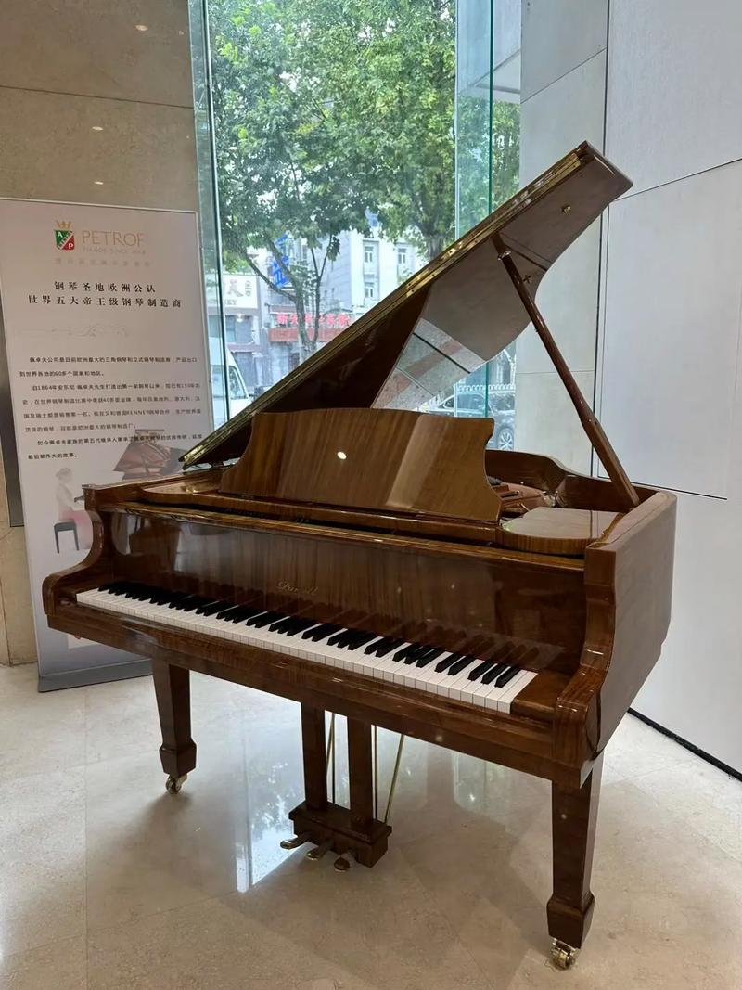
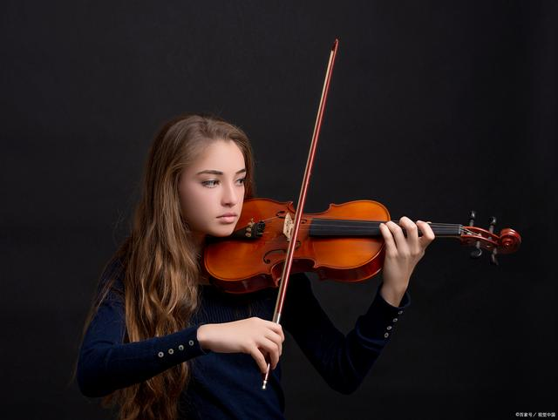
Careful Readers
细心的读者
Reason
Reading tip2:Guess the meanings of new words according to the context（根据上下文猜测词义）
very good/great
/wonderful
The class(课堂)
①the class
②the subject
③the teacher
The subject(学科)
④future job
Favorite subject:____
The teacher(老师)
1c
Future job(未来职业)
Read again and complete the table.
Name | Favorite subject | Reason(在文中标出序号)
Mike Davis
(在文中标出序号)
Because the class is fun and they learn a lot of new songs. Music always makes him happy and his music teacher is excellent....He wants to be a singer in the future.
Music

Slide 10
？
Careful Readers
细心的读者
Reasons
Your ability(能力)
The class(课堂)
①ability
Your feeling(感受)
③subject
Favorite subject:__
②feeling
The teacher(老师)
The subject(学科)
④future job
Future job(未来职业)
Discuss:How to give reasons
Name | Favorite subject | Reason (在文中标出序号)
Wu Binbin
对数字很在行
Because he is good with numbers. They learn how to work out maths problems in class....He wants to…
Maths
解决数学问题

Slide 11

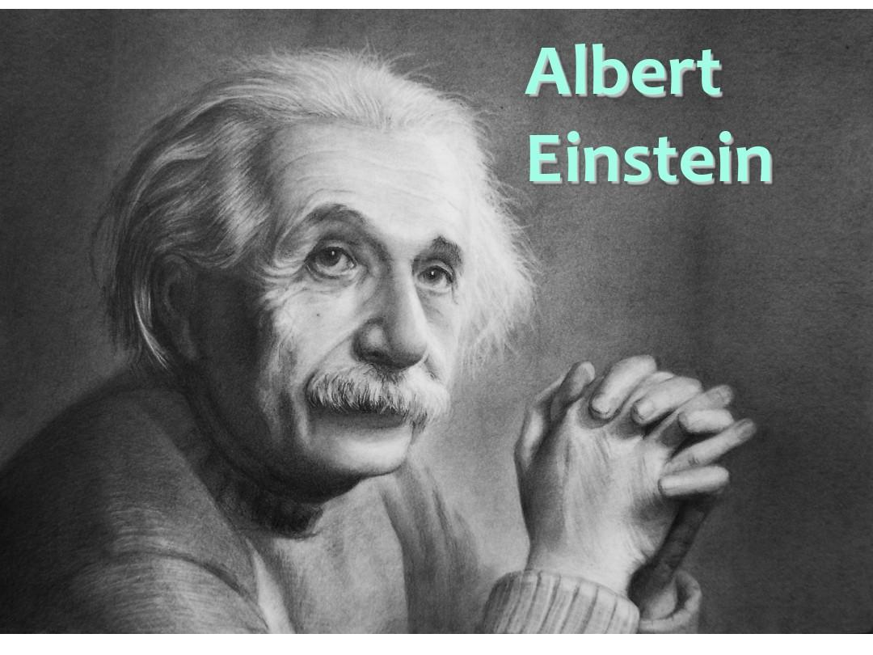
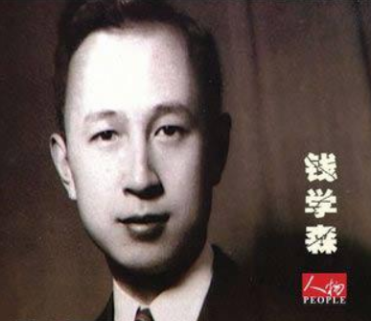
Critical Thinkers
批判思考者
Discuss and answer:
Which sentence shows his love in maths
(哪句话看出他喜欢数学)?
Where there is a will, there is a way.
Reading tip3:
人称代词it, they, she, he等可以替代上一句中提到的人，事或物。
It feels like magic and is really fun.
有志者事竟成。
What does “it” refer to(指代)?
science
A.Working out maths problems解决数学问题
B.Maths problemss数学问题
Think deeper:
Word Formation(构词法)
在文中找出依据
Reading tip 4:
Guess the meanings of new words
according to the word formation
(根据构词法猜测词义).
science--scientist 科学家
Do you think Wu Binbin can be a scientist in the future? Why or why not?
+
art--
artist 艺术家
ability 能力
He is good with numbers.
piano--
pianist钢琴家
+
It feels like magic and is really fun.
interest 兴趣
He learns how to work out maths problems.
practice 练习

Slide 12
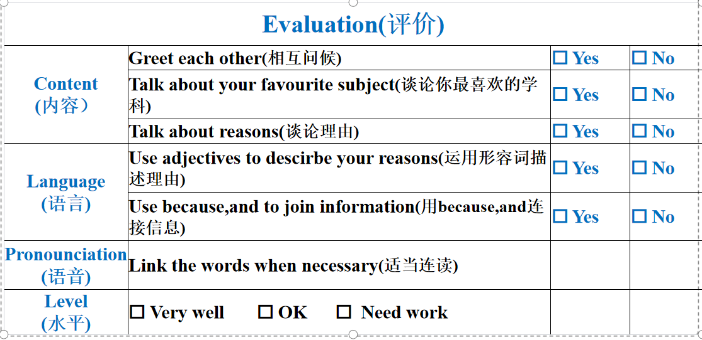
Critical Thinkers
批判思考者
Group work(小组活动)：
Show your ideas about subjects .
Reason (至少2点原因)
Name:___
be good with/at
Your ability: ______
useful/important…
The subject: ______
Subjects in this term:
___________
reallyfun/exciting/relaxing…
The class: _______
？
feel like …
Favorite subject:
_____________
Your feeling: ______
excellent/helpful/kind/patient…
Hi,Mike.I’m___.This term,I have___.
I like all the subjects,but my favourite subject is___. I like it because ___. I want to be a ___in the future. (至少2点原因)
The teacher: _____
Future job: ______
teccher/scientist…

Slide 13
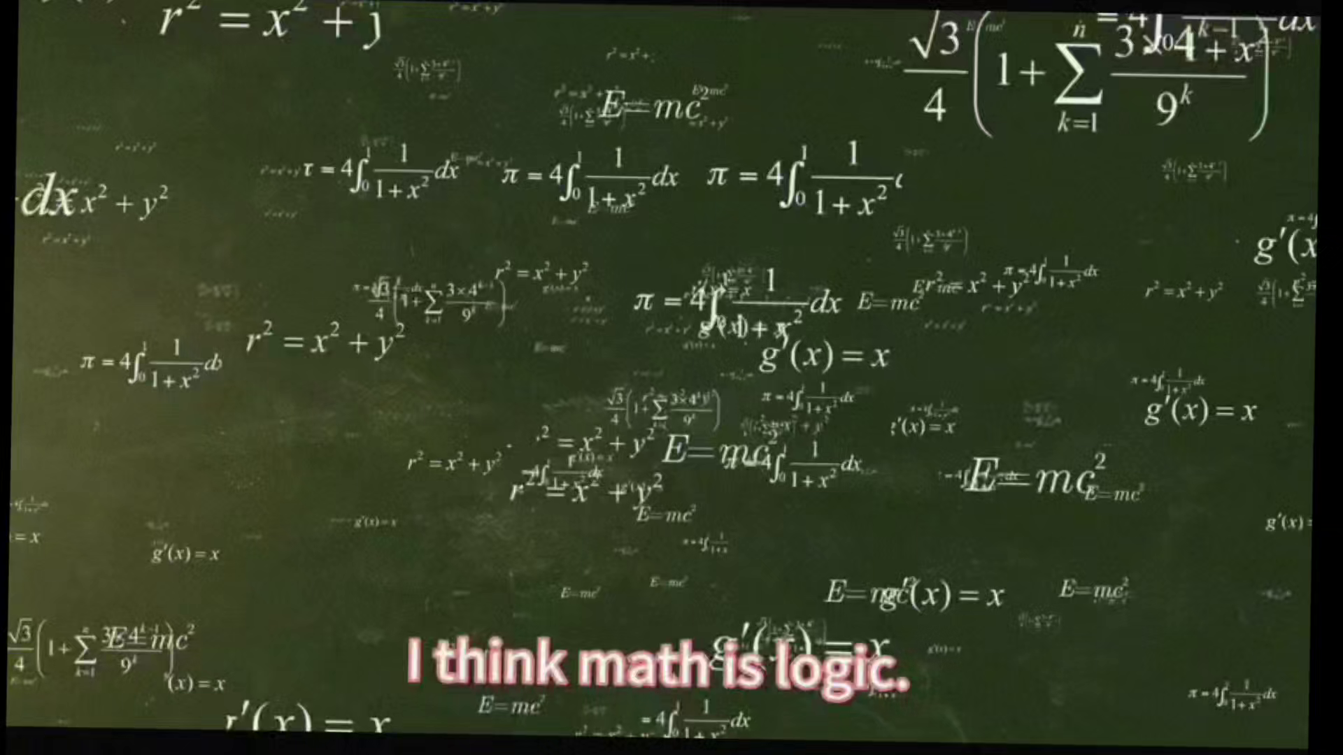
？
Confident Users
自信的实践者
Curious Learners
好奇的学者
Careful Readers
细心的读者
Critical Thinkers
批判思考者
Further thinking：
1.Do you like music or maths?Why?
2.Can we only learn subjects we like?
Every subject is important!
Big question:
What can we learn from different subjects?
Knowledge is power!
Let’s study for the future !

Slide 14
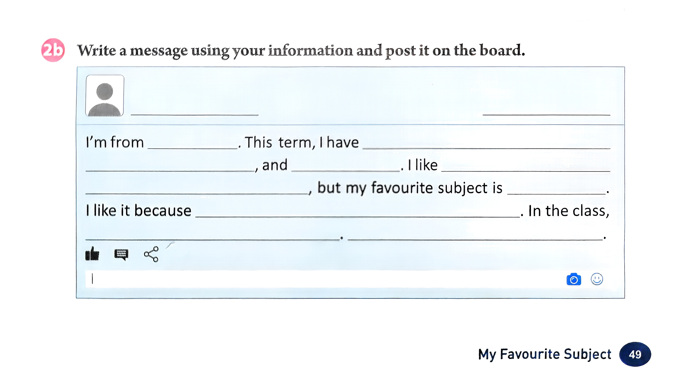
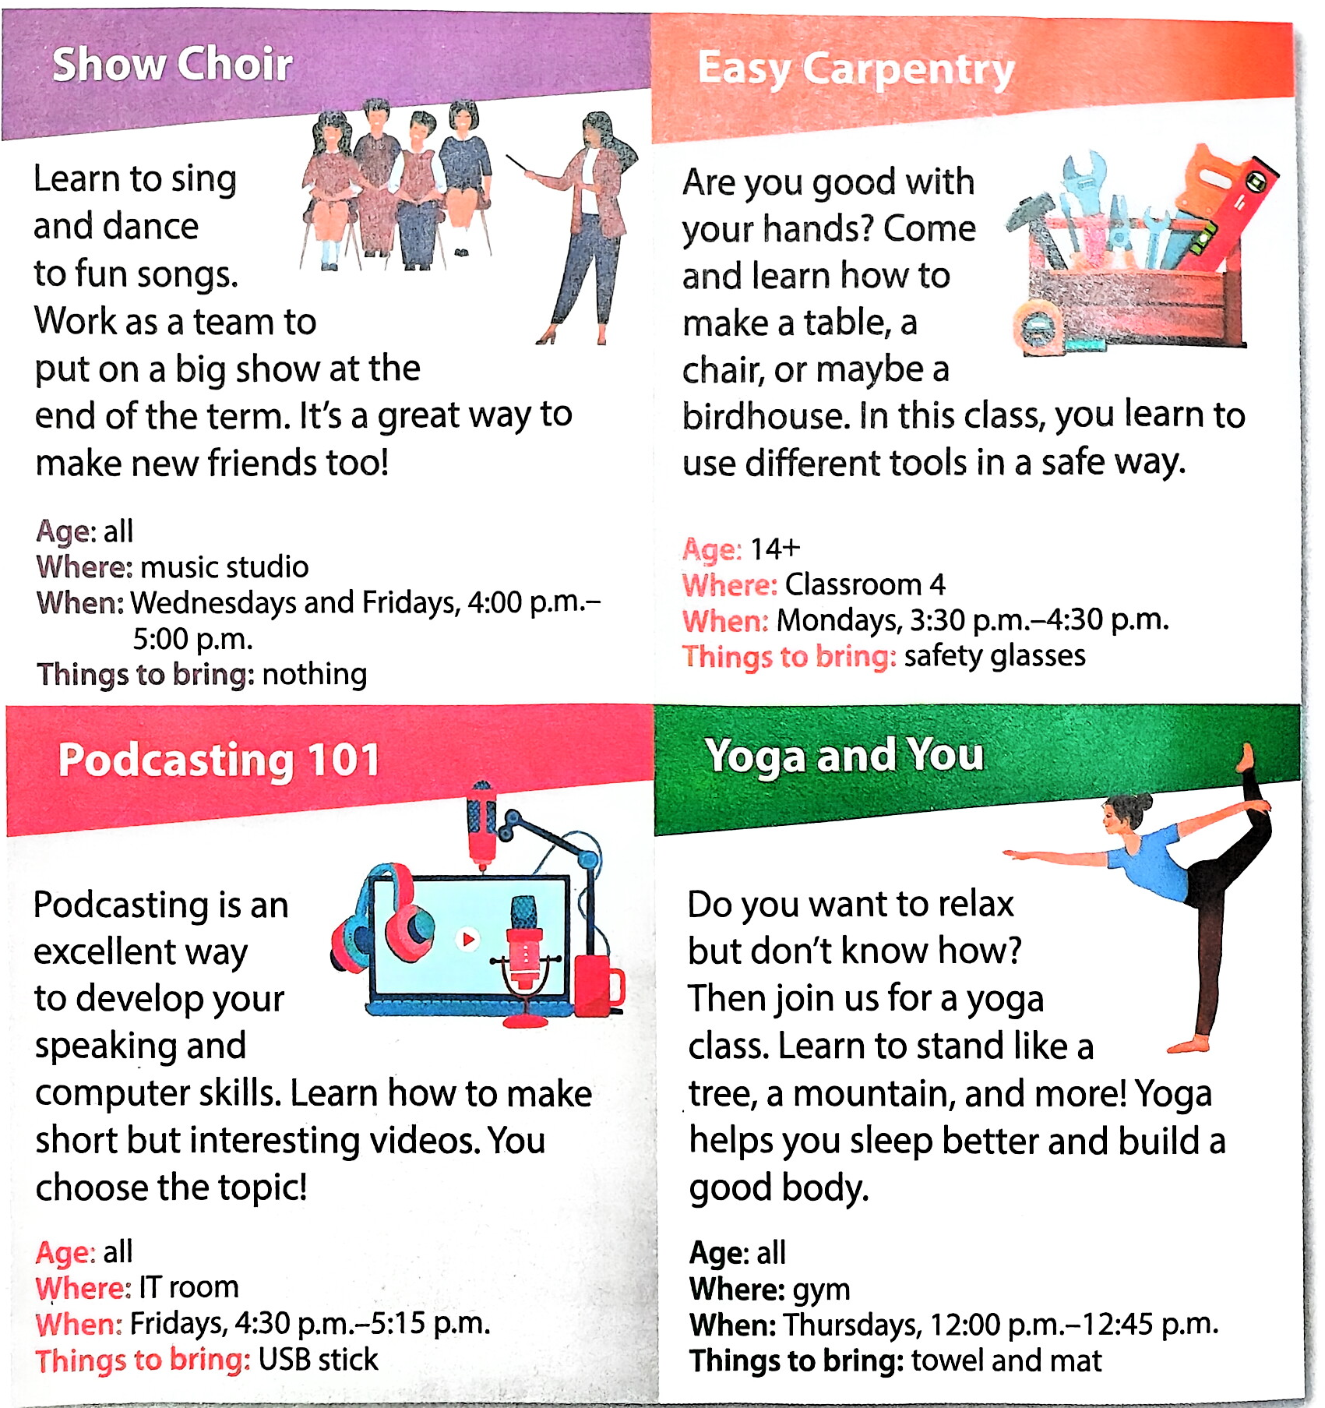

Homework
(1) Must do:
Tell your friends about your favourite subjects and reasons . .
(2)Choose to do:
Learn more about different
classes on P78.

