Slide 1
Differences of
Little / A Little
Few / A Few

Slide 2
Example Sentences
1. A few animals came to watch.
2. But few of them believed that the turtle would win.
3. so he took a little time to nap under a tree.
4.Even though there was little hope of winning.
肯定
有一些，有几个
可数名词
(a) few + [c]
否定
几乎没有
可数名词
肯定
有一些，有几个
不可数名词
(a) little + [uc]
否定
几乎没有
不可数名词

Slide 3

Understanding the Differences 1
countable（pl.） 可数名词复数 | uncountable 不可数名词
few | little
a few | a little

Slide 4

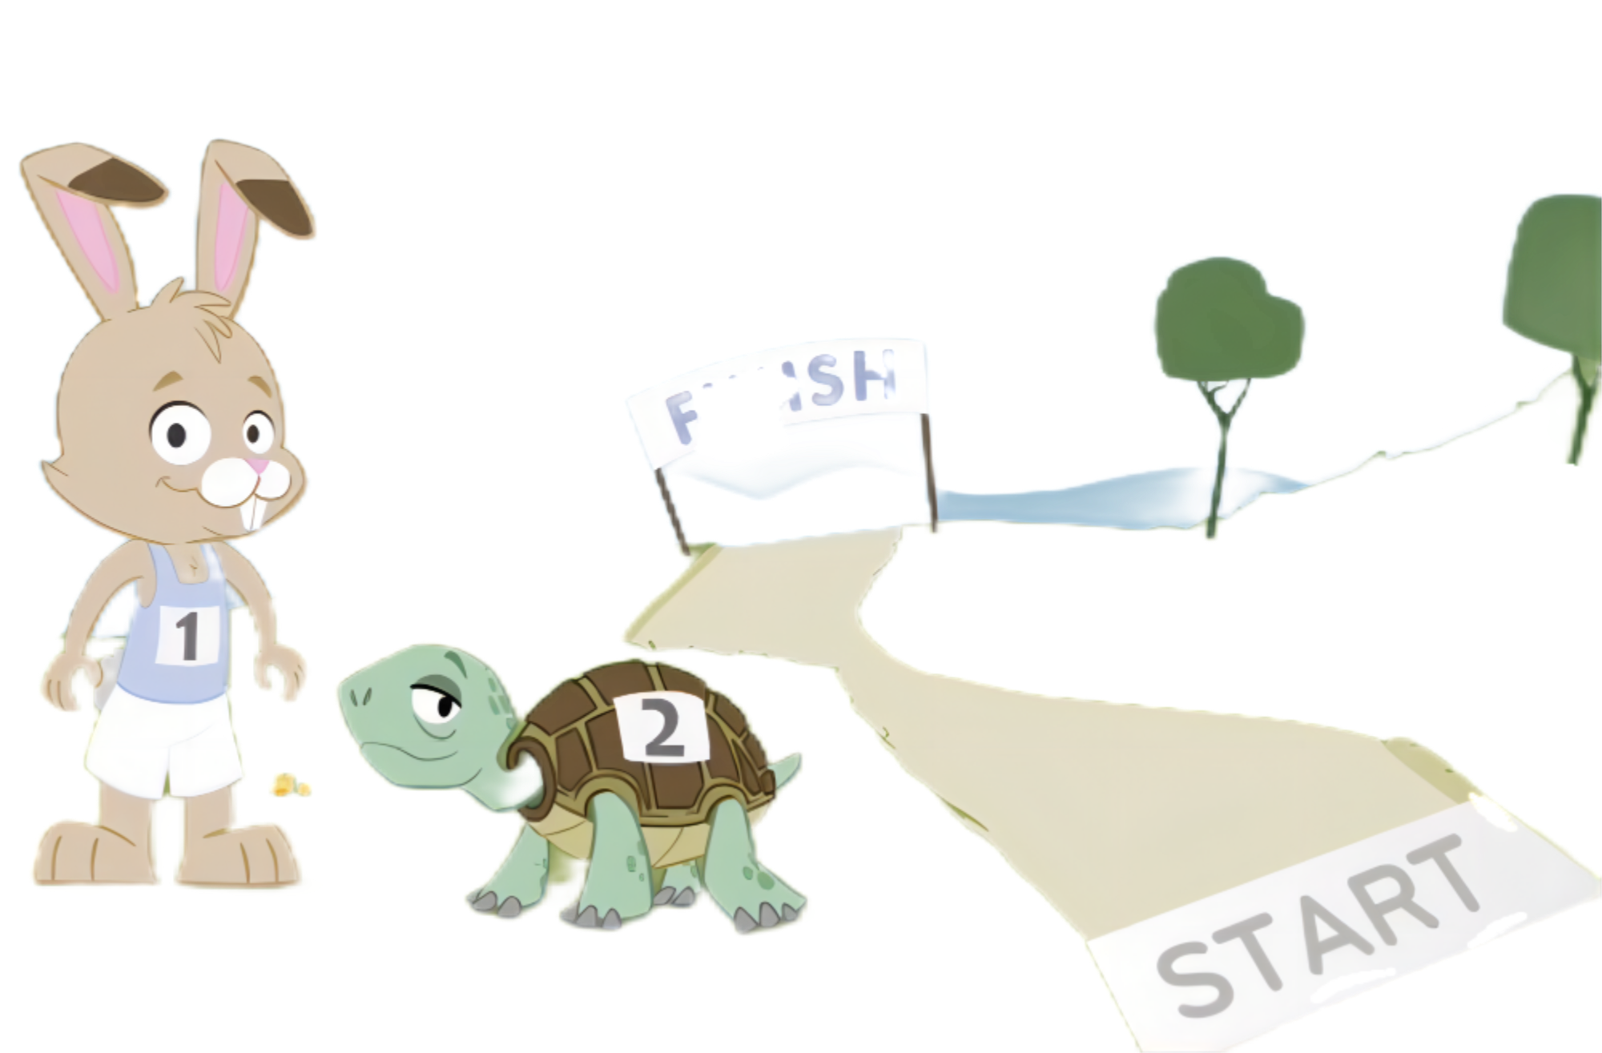

Detailed Examples--little & a little
Oh, no... I have little time left!
little = hardly any
a little = some
Come on! I still have a little time!
Notes:
1B 2C

Slide 5

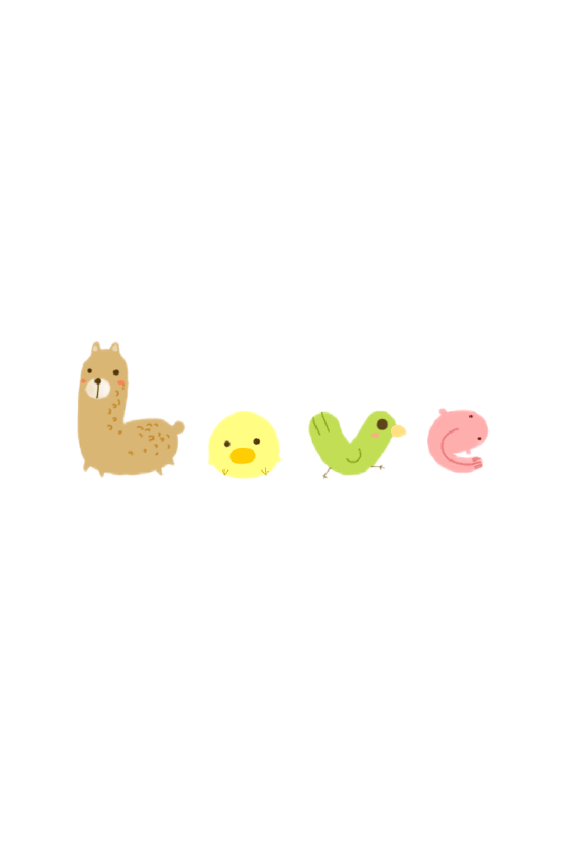
Detailed Examples--few & a few
Few animals supported Mr. Turtle.
few = hardly any
a few = some
A few animals supported Mr. Rabbit.
Notes:
1B 2C

Slide 6
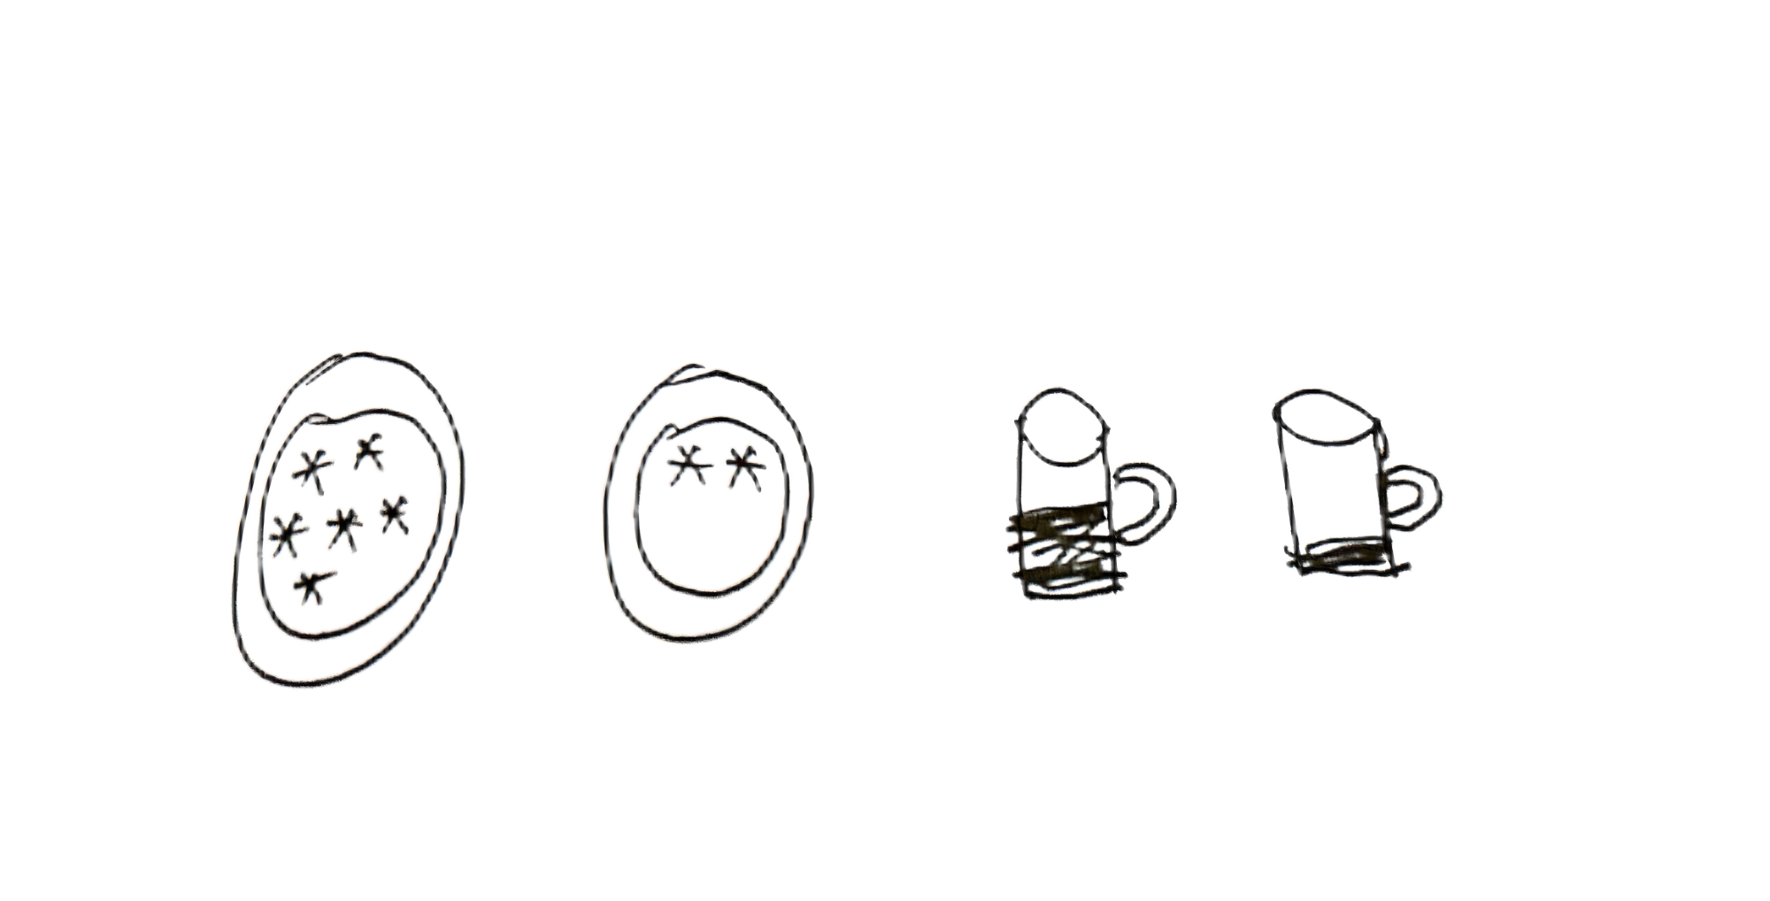
Understanding the Differences 2
 | countable（pl.） 可数名词复数 | uncountable 不可数名词
not enough = hardly no 几乎没有 | few | little | negative 否定含义
enough 有一些，有几个 | a few | a little | positive 肯定含义

Slide 7

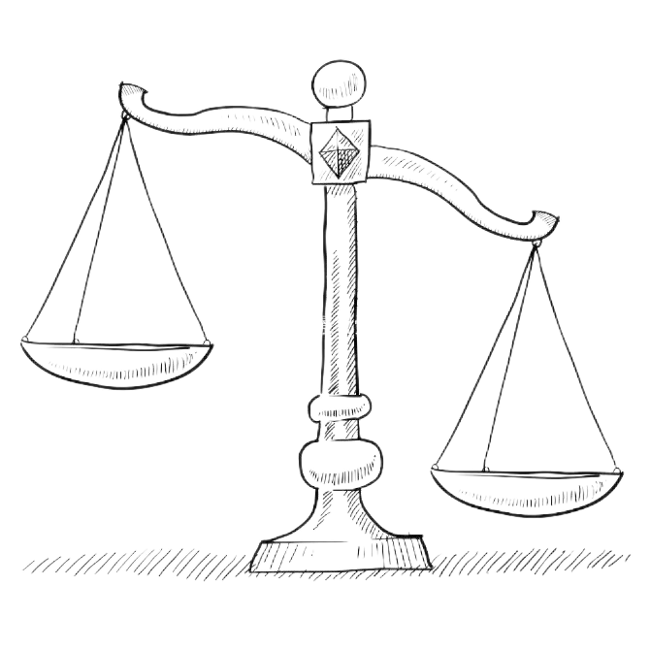
Tips for Remembering
t
t
w
i
l
e
e
f
l
数清配可数，数不清配不可数
修饰可数名词
修饰不可数名词
有 a 够无 a 不够
few
little
a few
a little

Slide 8
Practice
Fill in the blanks with (a) little / (a) few.
Because Mr. Rabbit had ______ patience, he had _______ regrets for losing the match. Mr Turtle said, "I just made _______ progress slowly but steadily. With so _____ chances left, let’s practice more for the next race."
little
a few
a little
few
Tips做题步骤
1.判断后面名词是可数名词or不可数名词
2.句意理解数量足够or不足够
 | countable（pl.） | uncountable
enough | a few | a little
not enough | few | little

Slide 9
Daily Efforts for Big Changes
A little effort each day,
Can lead to great change, they say.
But with little focus, beware,
A few good intentions may wear.
Life offers few chances, it’s true,
So make the most of what you do.

