Slide 1



Unit4 Don’t eat in class.
SectionB 2a-2c
乌恰县实验中学 苏丽

Slide 2
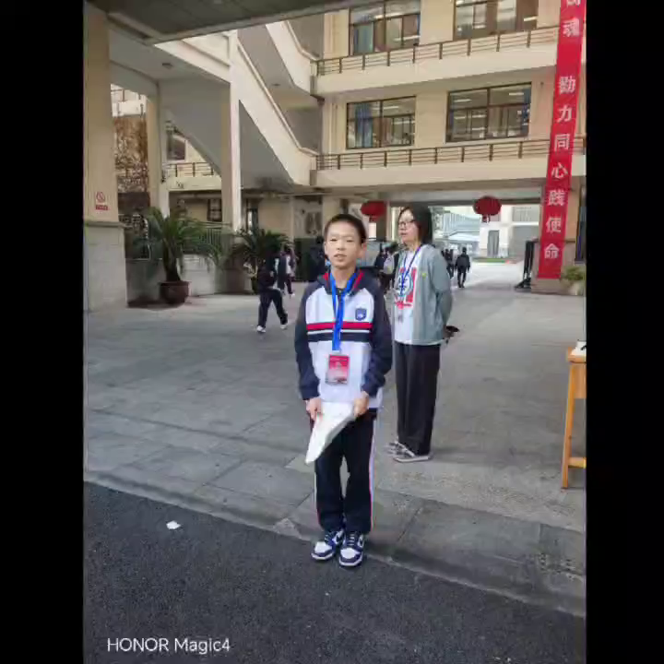

Slide 3

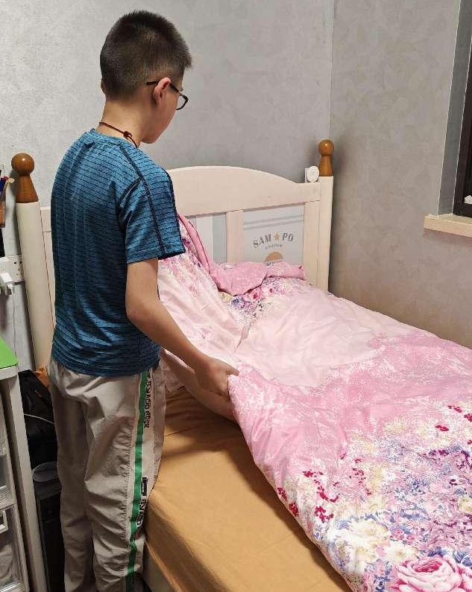
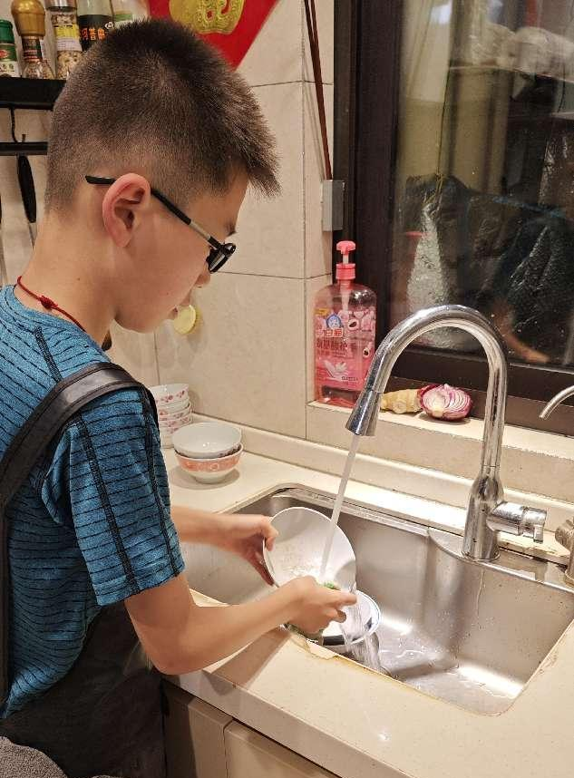
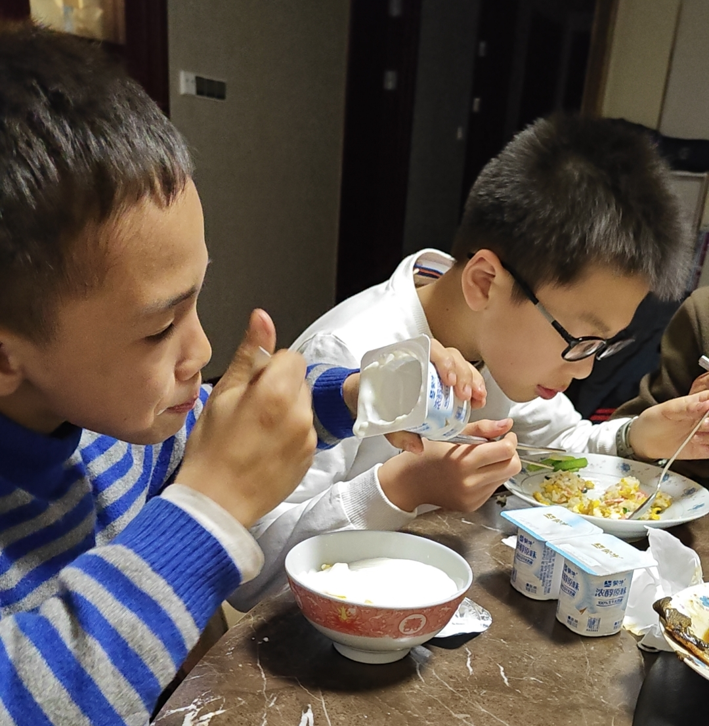
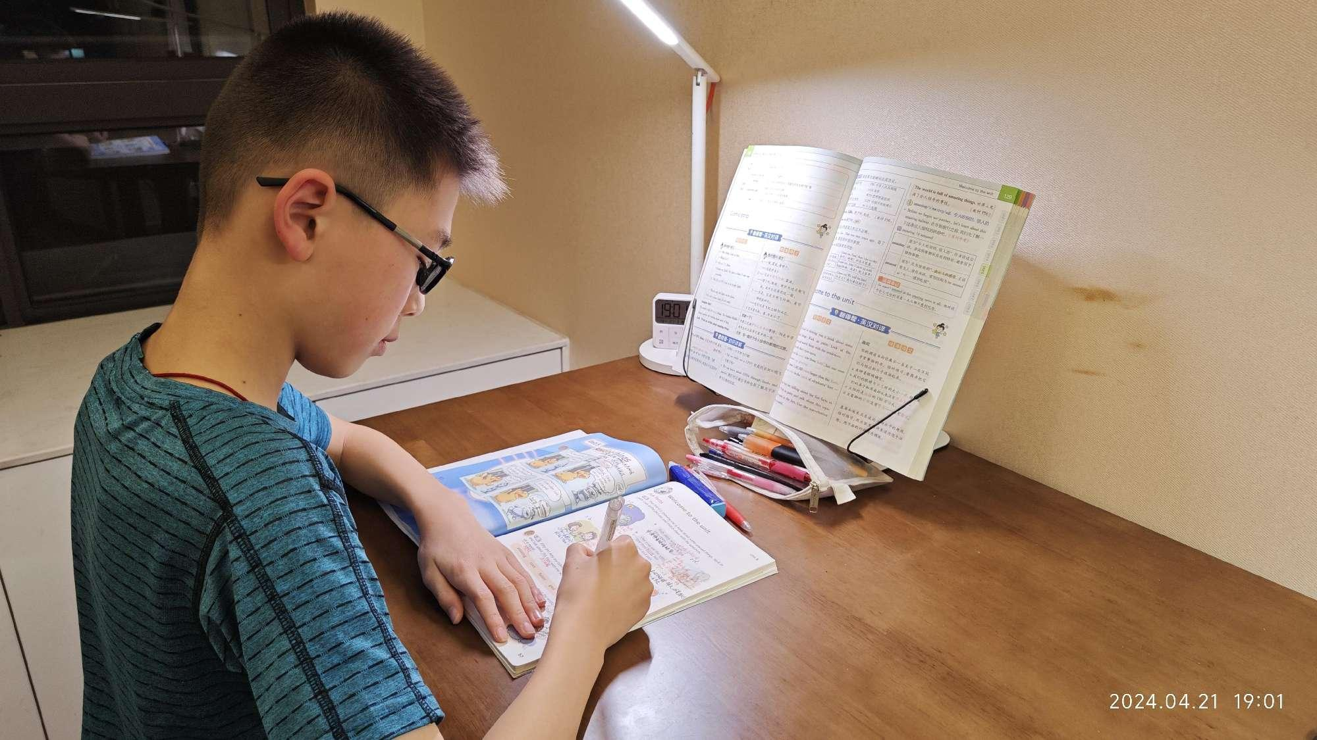
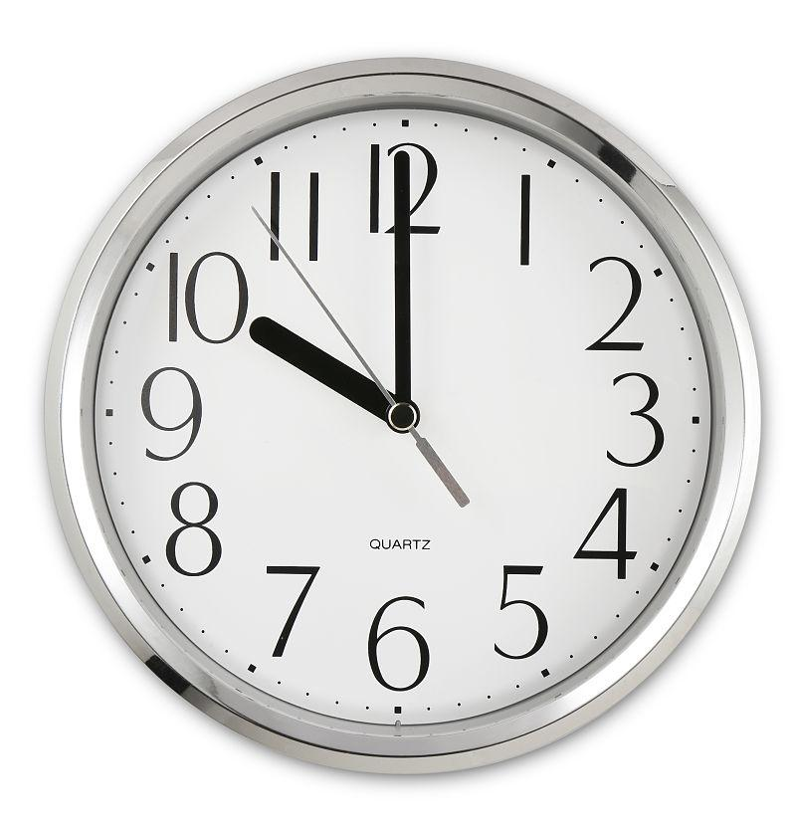
make his bed(铺床)
He can’t leave the dishes in the kitchen.
他不能把脏盘子留在厨房里。
get up at 6 a.m.
have a quick dinner
do his homework after dinner
go to bed before 10

Slide 4


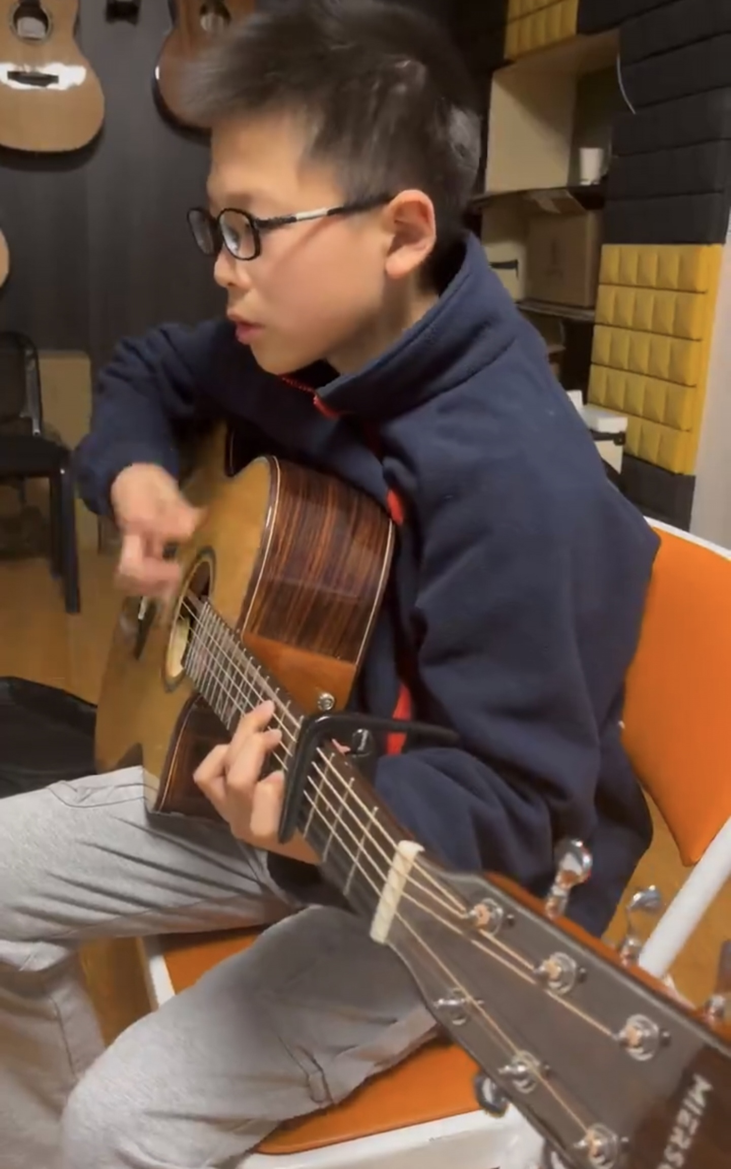
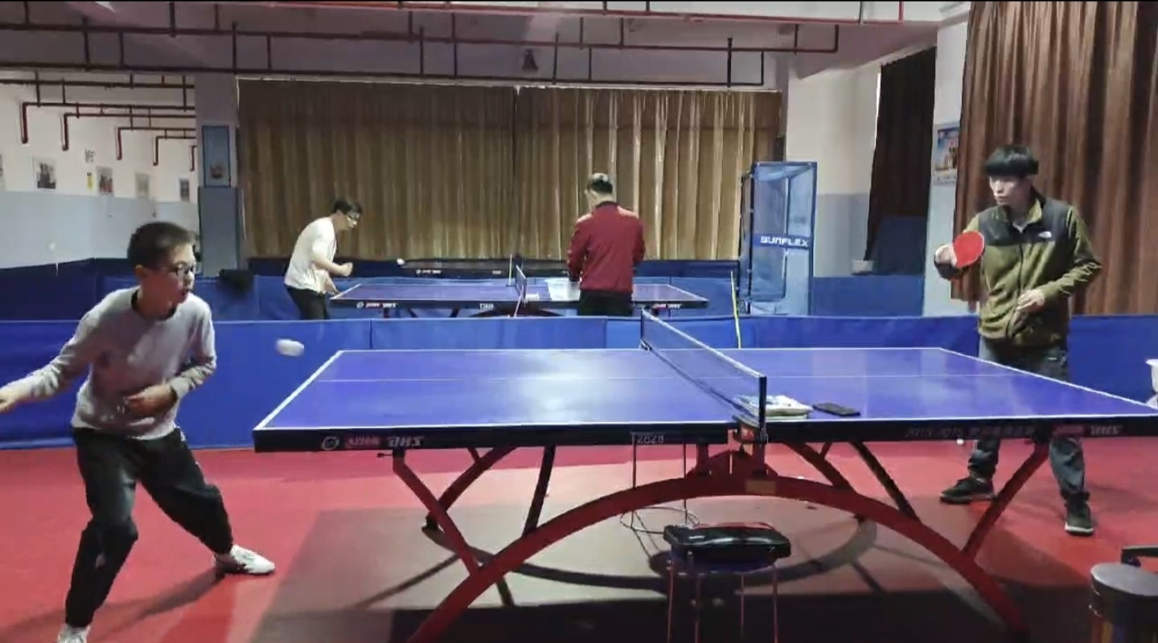

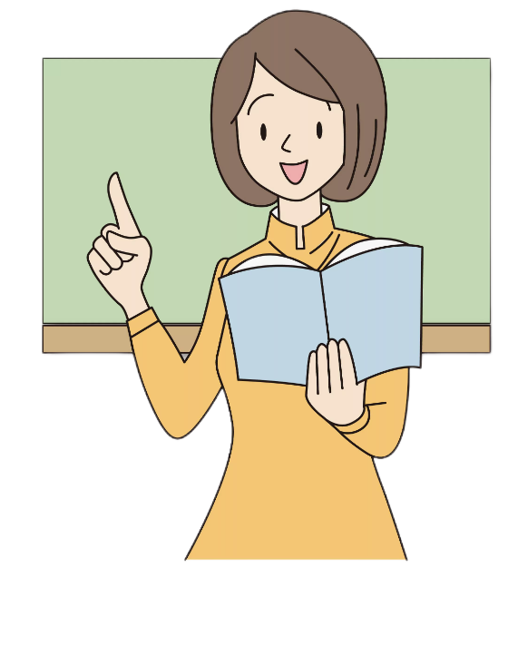


He can only play table tennis and the guitar on weekends.（他只能在周末打乒乓和吉他）
What can I do ？
If you are unhappy,who
do you like to talk to ？
如果你不开心，你喜欢找谁倾诉？
family
friend
teacher
严格的
So my son thinks his father are too strict because there are too many family rules.It’ terrible.He feels unhappy.
太多的家规
professional
专业人士
糟糕的，可怕的

Slide 5

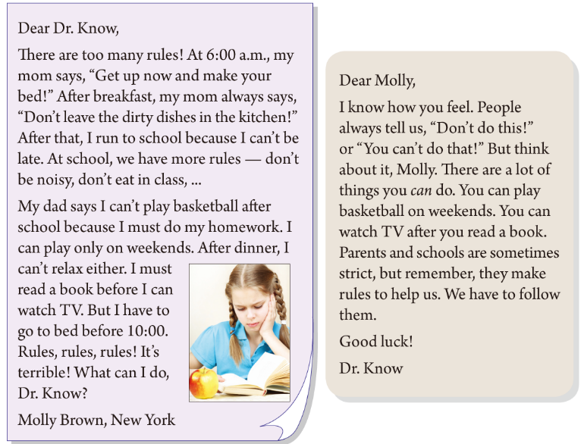



Fast reading
Skim and answer:
(快速浏览文章并回答问题)
Topic sentence
主题句
Tip1:
Topic sentence is usually at the beginning or at the end of a passage.（主题句通常在文章的开头或结尾）
Who writes the letter?
Who does she write to ?
Why is she unhappy?

Slide 6
Careful reading
Family rules
School rules
主语+can+…
Read and underline the rule(划出信提到的规则）.
1
Ways to talk about rules（谈论规则的方式）:
2
3
Do型
Don’t 型
主语+can’t…
4
①
②
④
③
⑤
5
6
主语+can+…
主语+must/have to+…
7
8
⑥
⑧
⑦
⑨
9

Slide 7
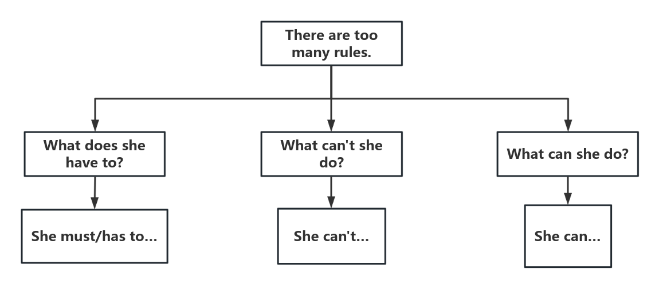

Find out the reasons and talk about them
in pairs（两人一组找全原因，一问一答）
Read again and circle the time（再读并圈出时间状语）
in the order（顺序）of_____
time
1.How does Molly feel（感觉）about the rules?How do you know that(请在文中找出相关的句子)?
Rules, rules, rules.
It’s terrible！
2.Please read the two sentences with feelings(有感情地朗读以上两句话）.
Dr. Know
(万事通博士)
knows everything!

Slide 8
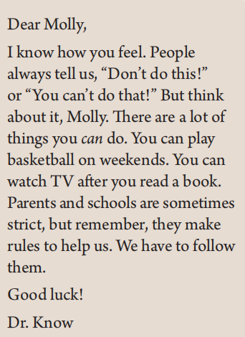
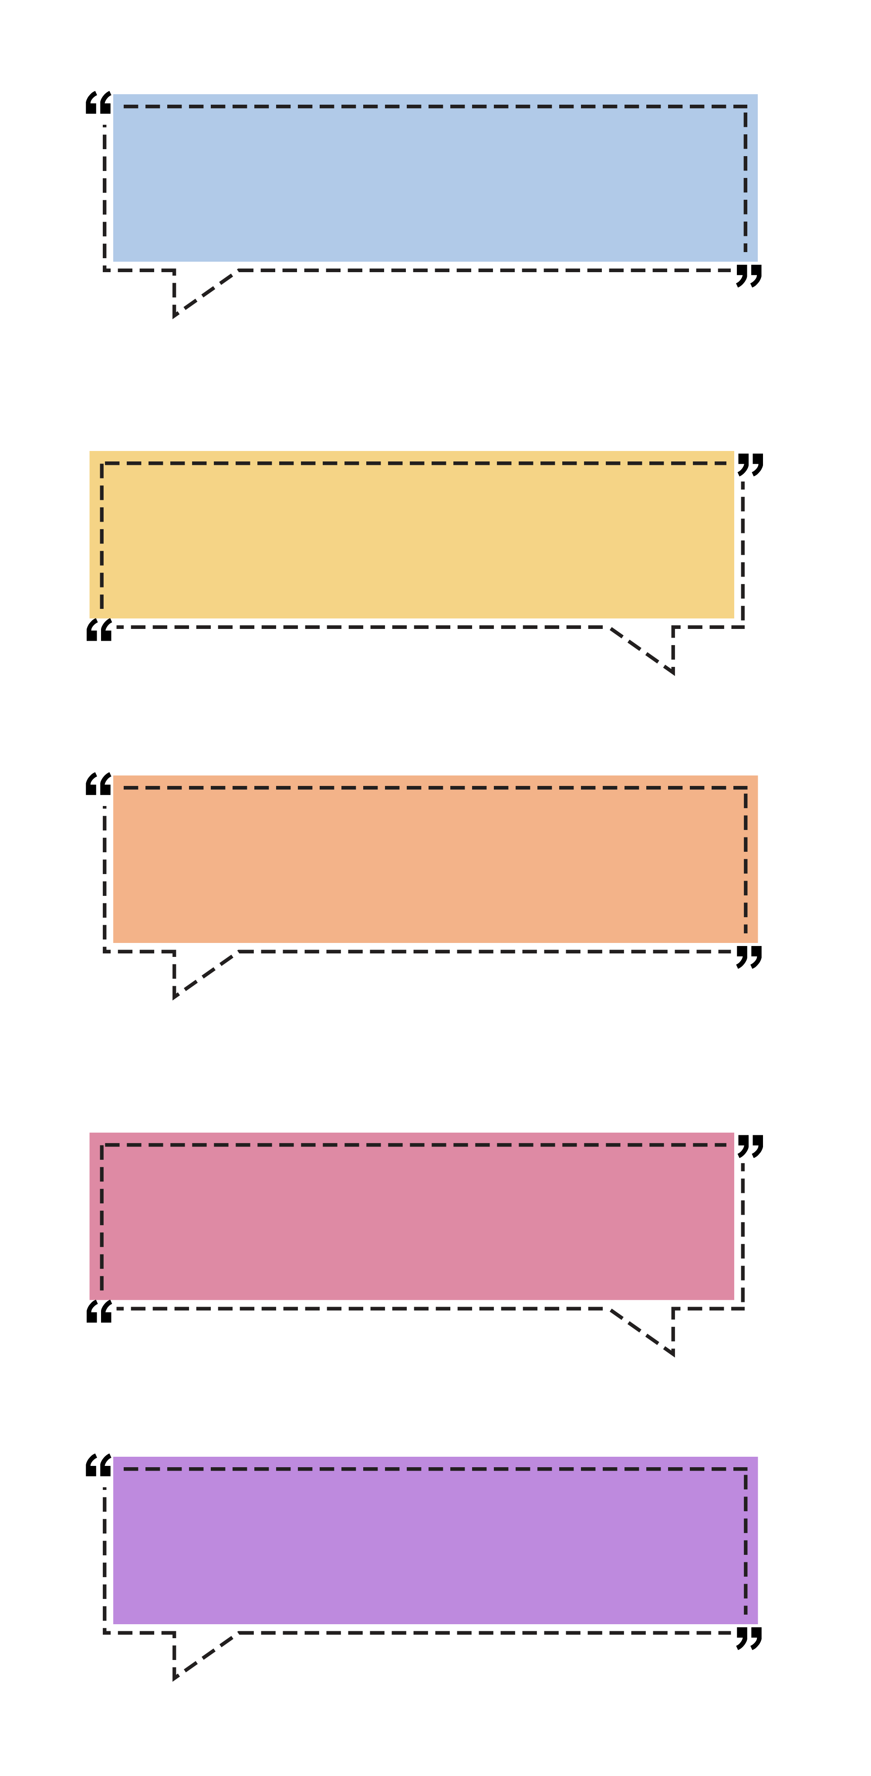
Read for advice
1.What advice(建议) does Dr. Know give?
You can play basketball.
You can watch TV after you read a book.
They make rules to helps us.
Tip2:
指示代词通常指代上一句中提到的人或物。
They make rules to help us.句中的“they”指代 _______________。
parents and schools
2.What does Dr. Know mainly(主要) tell Molly?
follow
遵守
She has to ___________ the rules.
3.What do you think of the advice?(你觉得他的建议怎样)
useful有用的
4.If you were Dr Know, what advice would you give
to Molly?(如果你是万事通博士，你会给Molly什么建议？)

Slide 9
Groupwork
Talk about some of our school rules, think about what are resonable ,what are not and give your reasons in a group of four.(四人一组讨论我们学校的校规,思考下哪些是合理的，哪些是不合理的，并给出理由，一人汇报）
Useful expressions
School rules
important 重要的
fair 公平的
unfair不公平的
terrible 糟糕的
strict 严格的
boring...
*We don’t have to waste time thinking about what to wear(
我们不必浪费时间考虑穿什么).
*We can’t focus on study with phones at school(带了手机，我们不能集中注意力来学习).
*We should bekind to others(我们对他人应该友善).
*We can learn a lot in class
(我们可以在课堂上学到很多知识)
…
*Say “hello” to the teachers
*Wear the school uniform 穿校服
*Don’t bring phones to school.
*Don’t fight.
*Listen carefully in class…
e.g. Our school has many rules.
I think Saying “hello” to the teachers is important
because it shows we are polite.

Slide 10
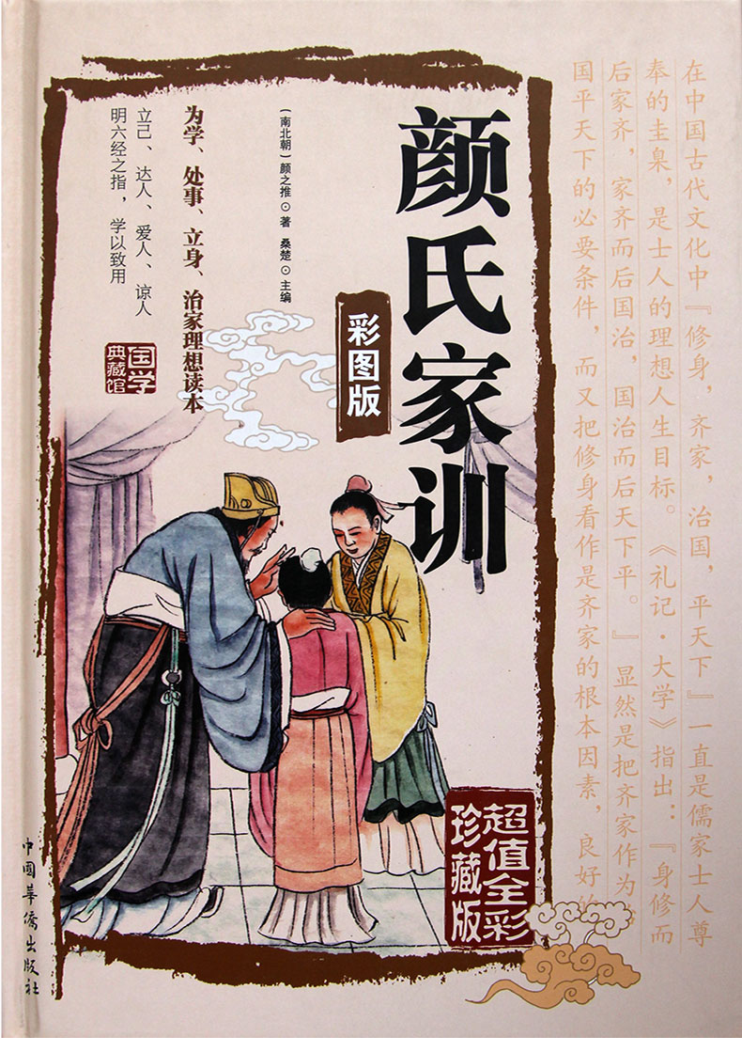
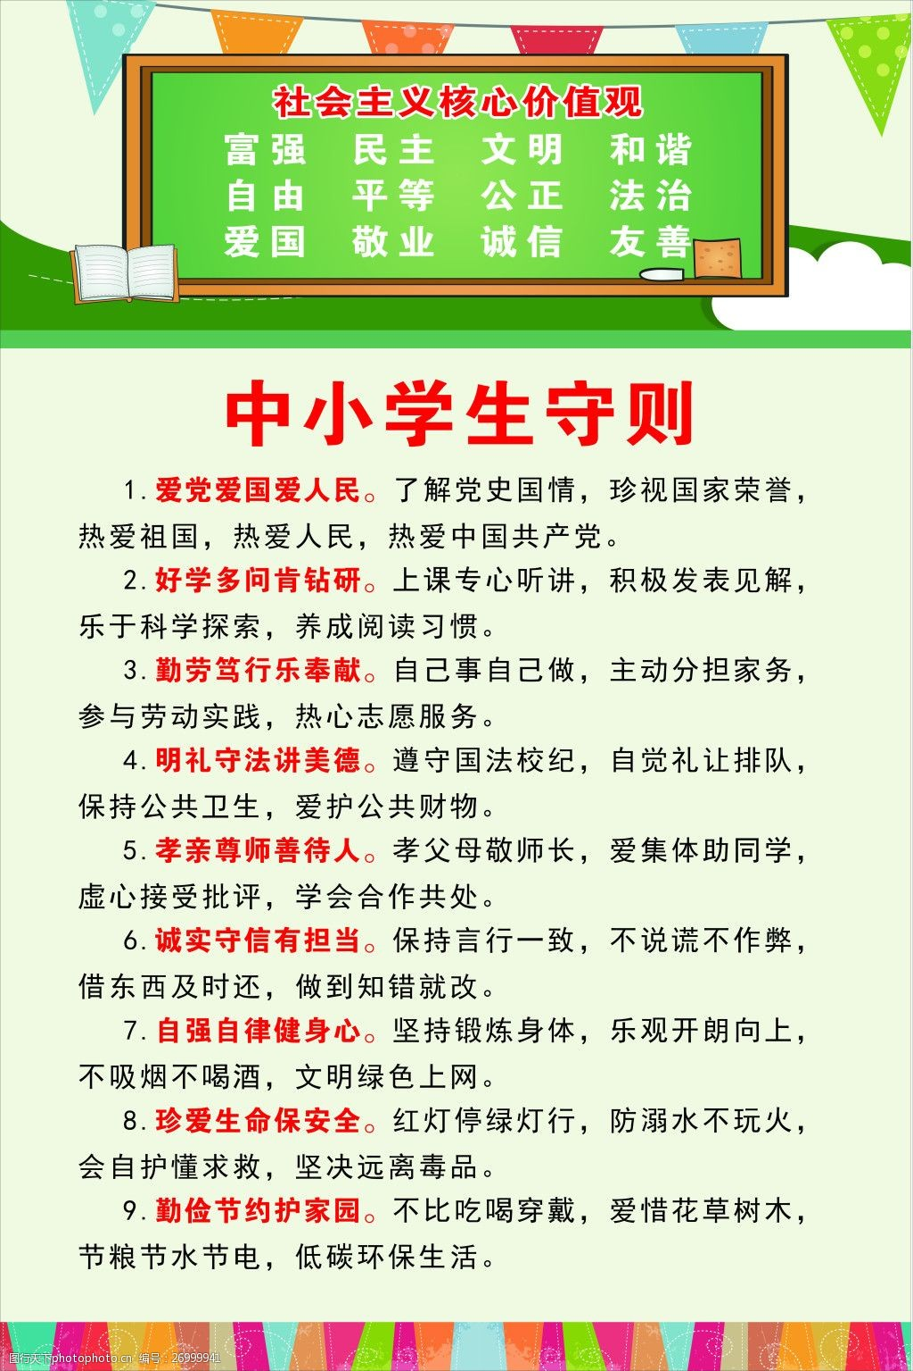
be a better person
Write your school rules down.Think about wh
r
u
l
e
remember
understand
lose 失去
enhance 提升
Dr. Know

Slide 11

Homework
Write your school rules down.Think about wh
1.Read the two letters fluently .(必做）
2.Draw a mind map and then retell the two letters .（选做）

Slide 12

Thanks

Slide 13
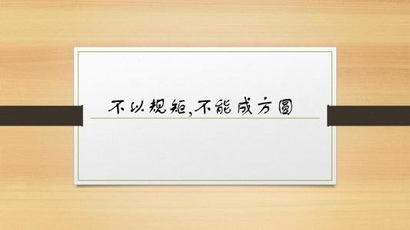
Please remember
Parents and schools make rules to help us. We have to follow them.
Try to think positively(乐观地), your life will be better.
Dr. Know
No Rules,
No Standards!

Slide 14
Careful reading
Read and underline the rules.
1
Ways to talk about rules:
2
3
1.Do型（动词原形放句首)
2.Don’t+动词原形
3.主语+can’t+动词原形
4.主语+can+动词原形
5.主语+must/have to+动词原形
①
4
5
②
④
6
③
⑤
7
⑥
8
⑦
⑧

Slide 15
time
in the order of_____
Rule
makers
Rules
1.How does Molly feel（感觉）about the rules?
Rules, rules, rules! It’s terrible!
______________she has to get up and make her bed.
______________she can’t leave dirty dishes in the kitchen.
At 6:00a.m.,
Mom
After breakfast,
2.Please read the sentence with feelings.
After that,
___________she can’t be late forschool.
___________she can’t be noisy in class.
She can’t eat in class.
Don’t worry! (不要急) Dr. Know
(万事通博士) will help you!
School
At school,
______________she has to do her homeworkfirst.
______________she can play basketball.
She has to read a book before she can watch TV.
_____________she has to go to bed .
After school,
Dad
On weekends,
Before ten,

