Slide 1
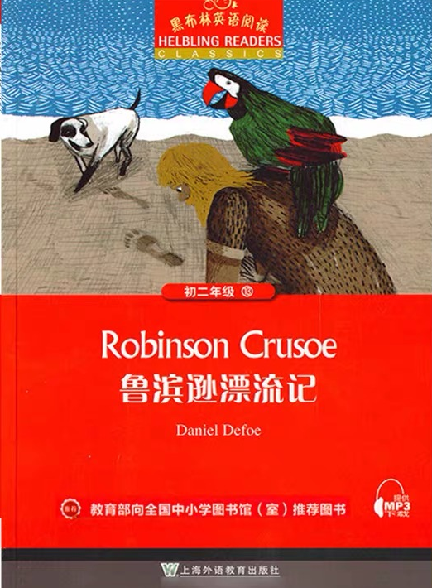

⑧
Robinson Crusoe
授课教师：季蓓莉 新桥初级中学

Slide 2
About the cover
Tip1：pay attention to the information on the cover
What can you know from the cover?
Title: Robinson Crusoe
Writer: Daniel Defoe
Picture: a man, a dog, a parrot and
footprints
＊Whose footprints ?
＊Where are they?
＊What may happen between the man and the footprints?

Slide 3
background
one of the first novels written in English
one of the earliest works of realistic novel (现实主义小说)
plots(情节):
beginning development climax ending
reflect(反映) the society

Slide 4
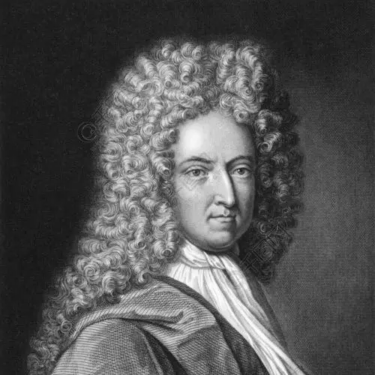
About the author
a British writer
the father of European novels 欧洲小说之父
one of the founders of modern British novels
英国现代小说奠基人之一
works: Robinson Crusoe《鲁滨逊漂流记》
The Farther Adventure of Robinson Crusoe 《鲁滨逊漂流记的回想》
Captain Jack 《杰克上校》
...
two events: Great Plague 大瘟疫1665
Great Fire 1666
have some influence on his works
Daniel Defoe

Slide 5

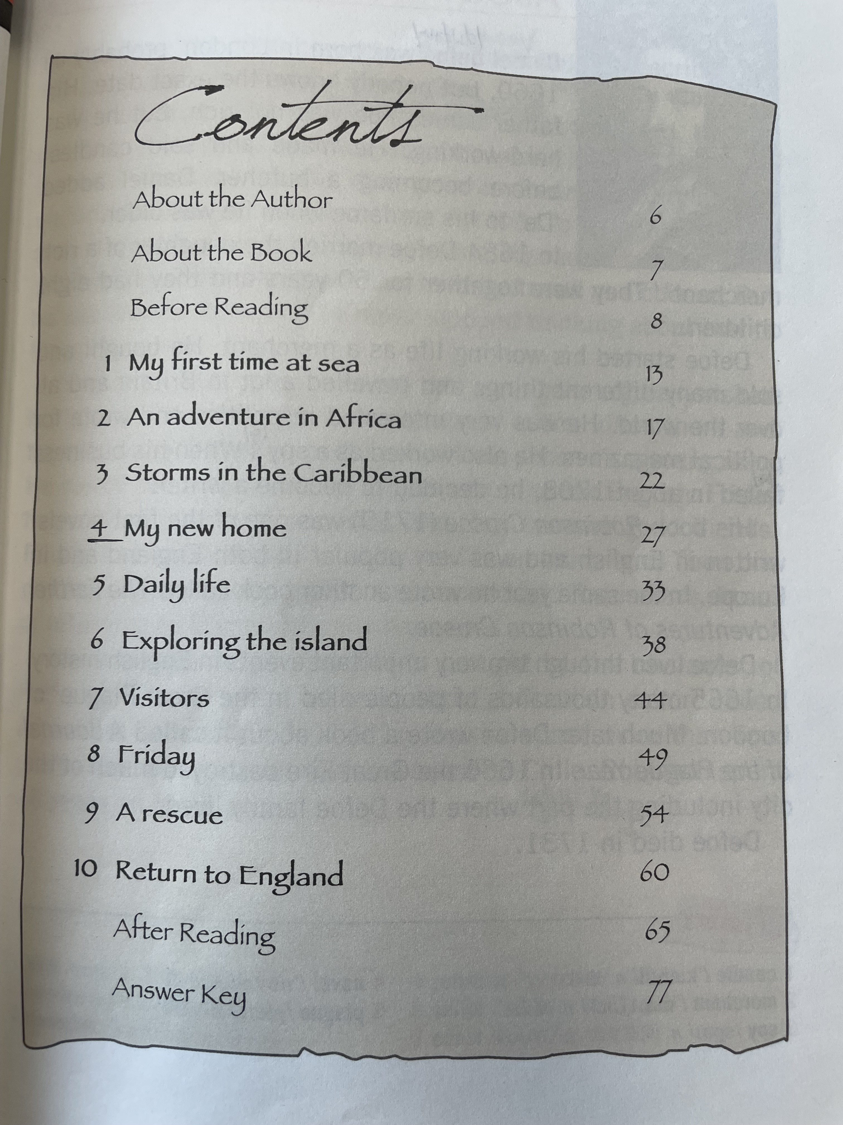
About the plot
Tip2：know the genre(体裁) of the work can help us read
Chapter 7-8
climax
Chapter 4-6
development
Chapter9-10
Chapter1-3
beginning
ending

Slide 6
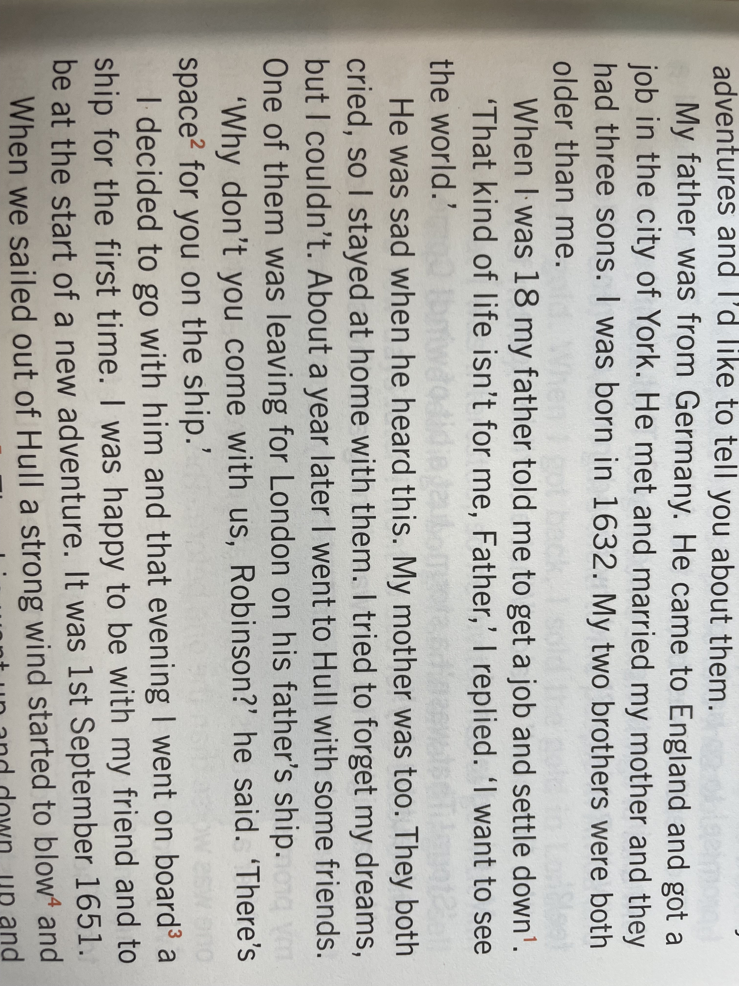
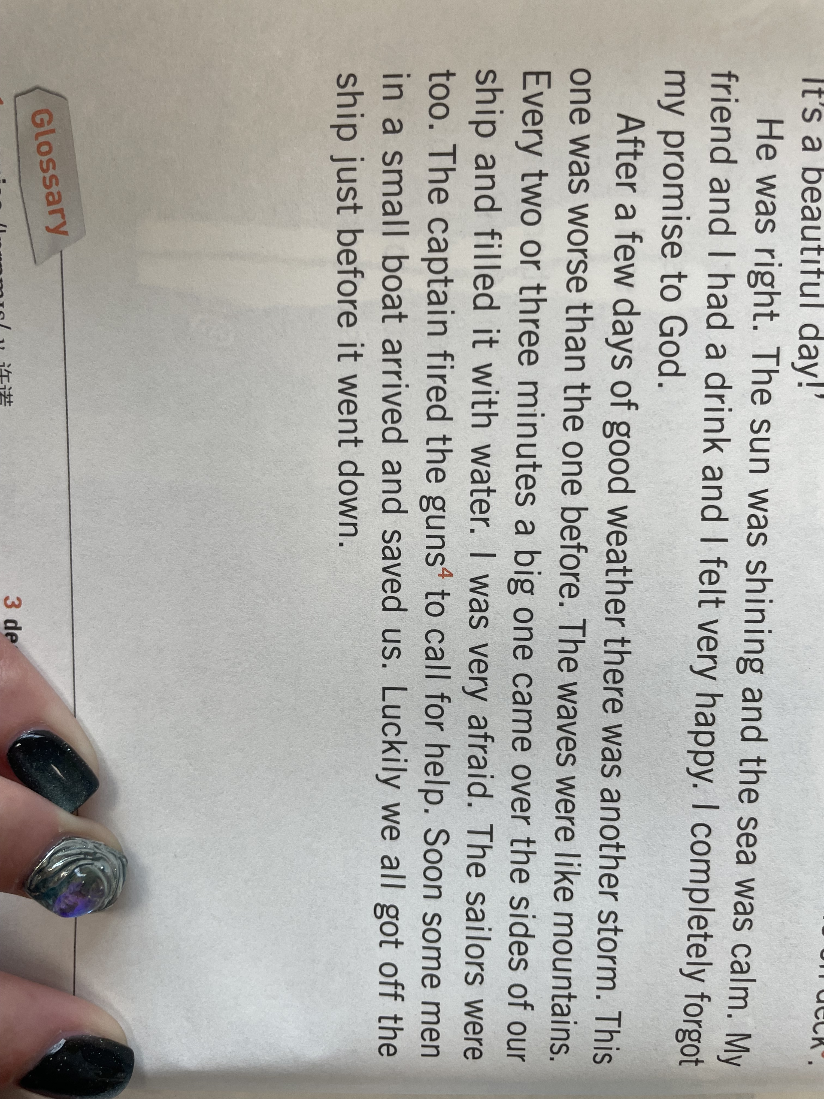
beginning(Chapter One My first time at sea)
When did Robinson sail for the first time?
1st September 1651
brave
adventurous
What do you think of Robinson ?
Was the journey easy ?

Slide 7
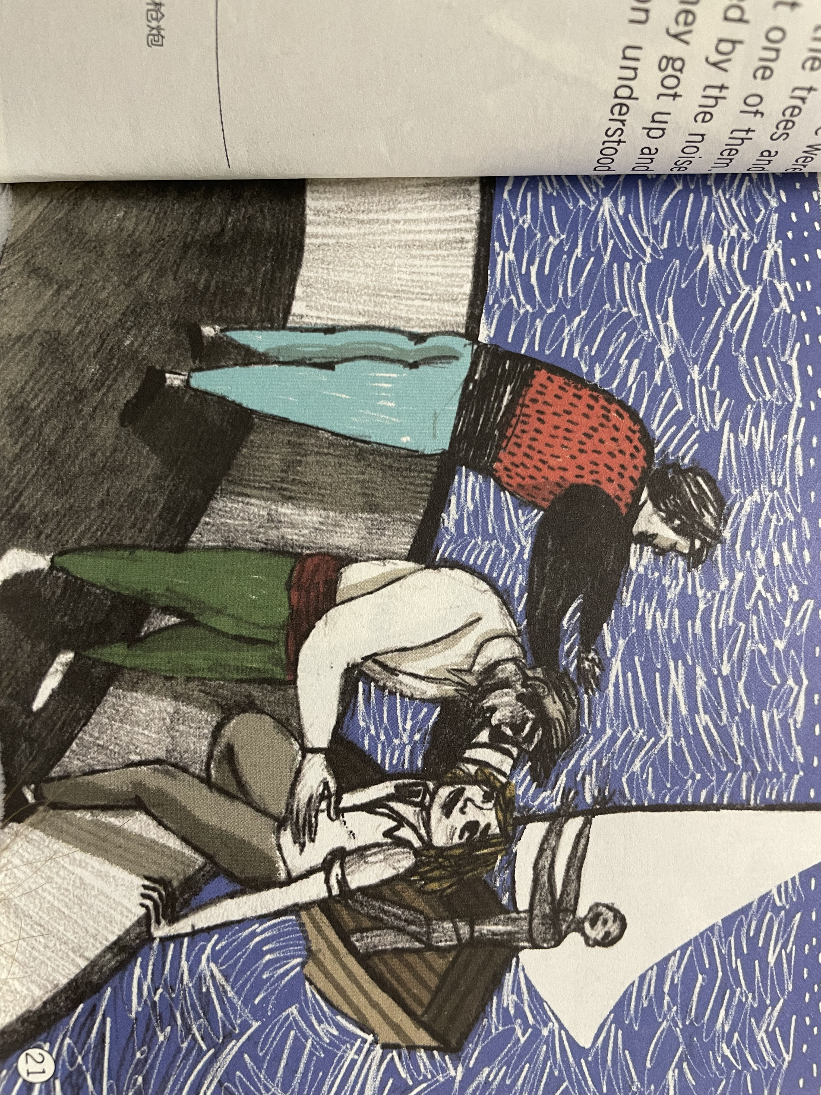
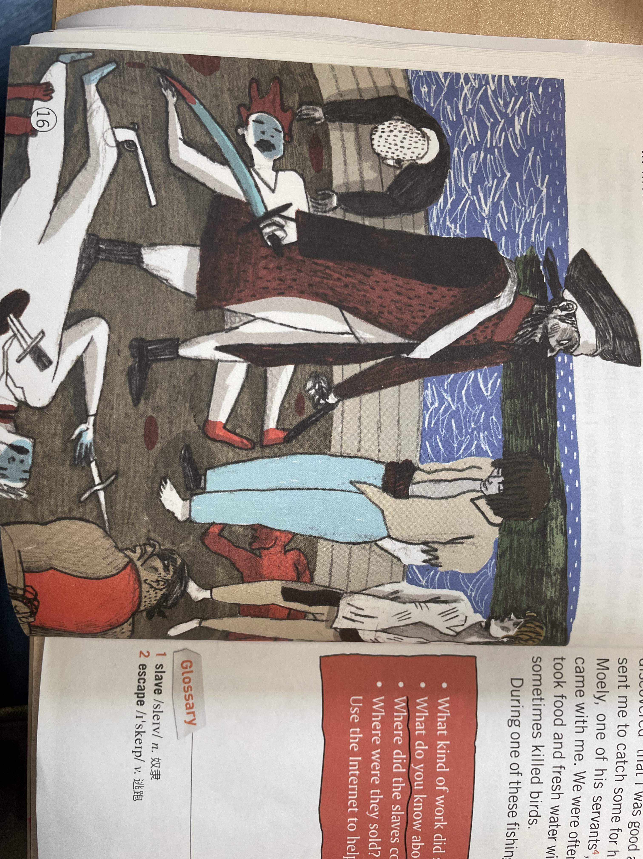
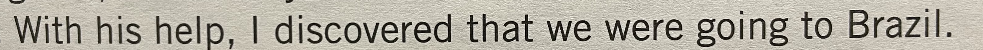
Chapter Two An adventure in Africa
Sallee
Brazil
What was the adventure in Africa?
Atlantic slave trade
大西洋奴隶贸易
It involved transportation by slave traders of enslaved African people.
在环大西洋地区将非洲大陆人民作为廉价劳动力提供给美洲大陆殖民地地区的一种贸易
Their ship was attacked by a Turkish ship.
Many people_______.
The rest became _________ and were taken to Sallee.
Most of them worked in the palace as ______.
Robinson worked in the ________garden.
died
prisoners
/ˈprɪz(ə)nə(r)/
slaves
captain’s
Did Robinson escape successfully?

Slide 8
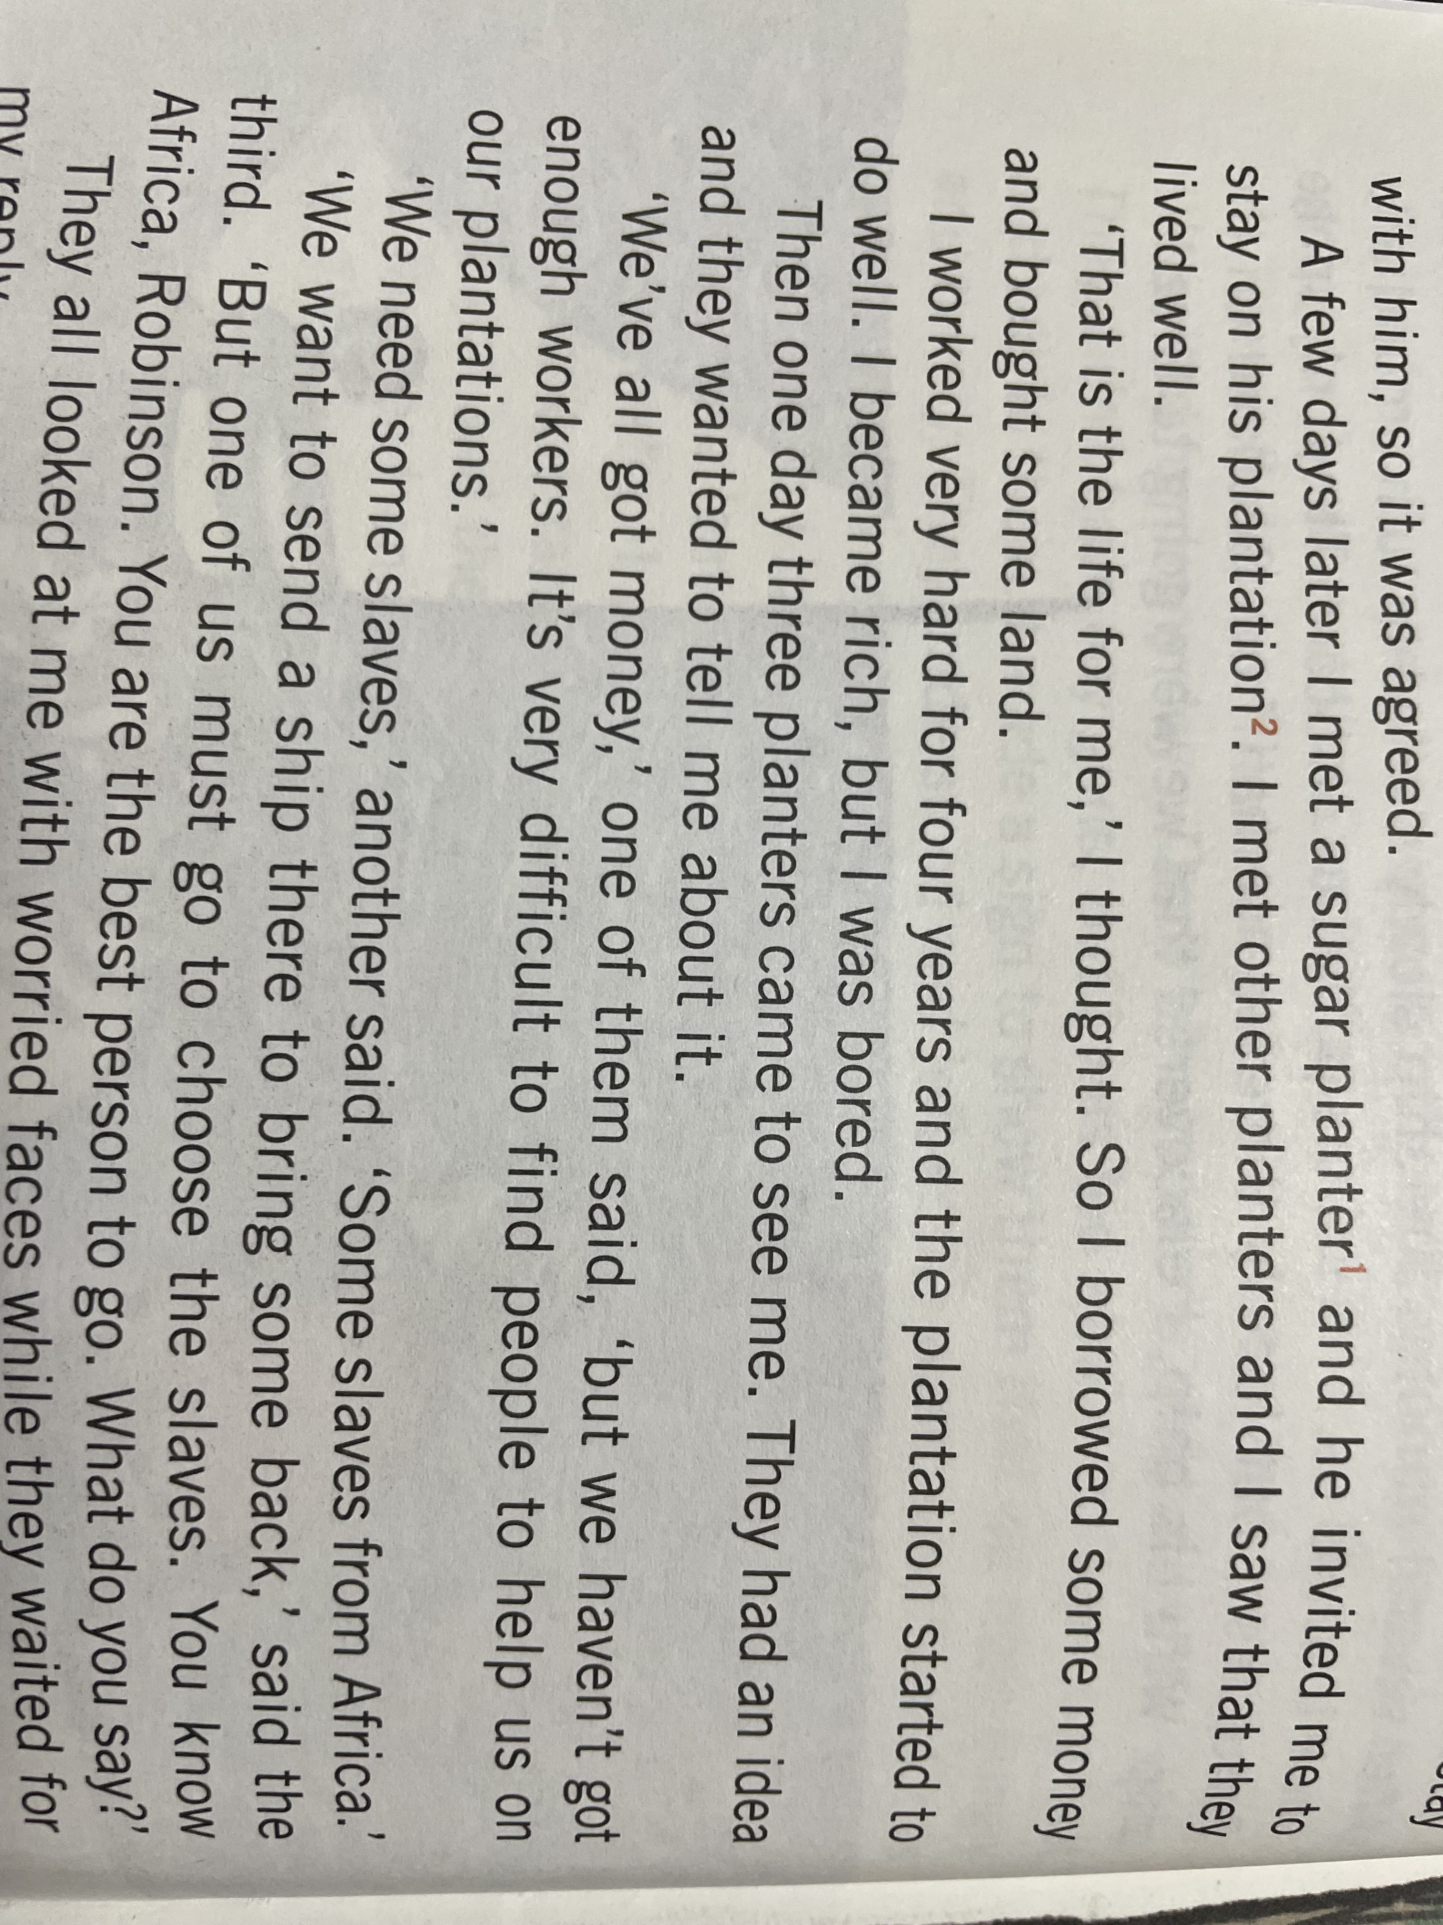
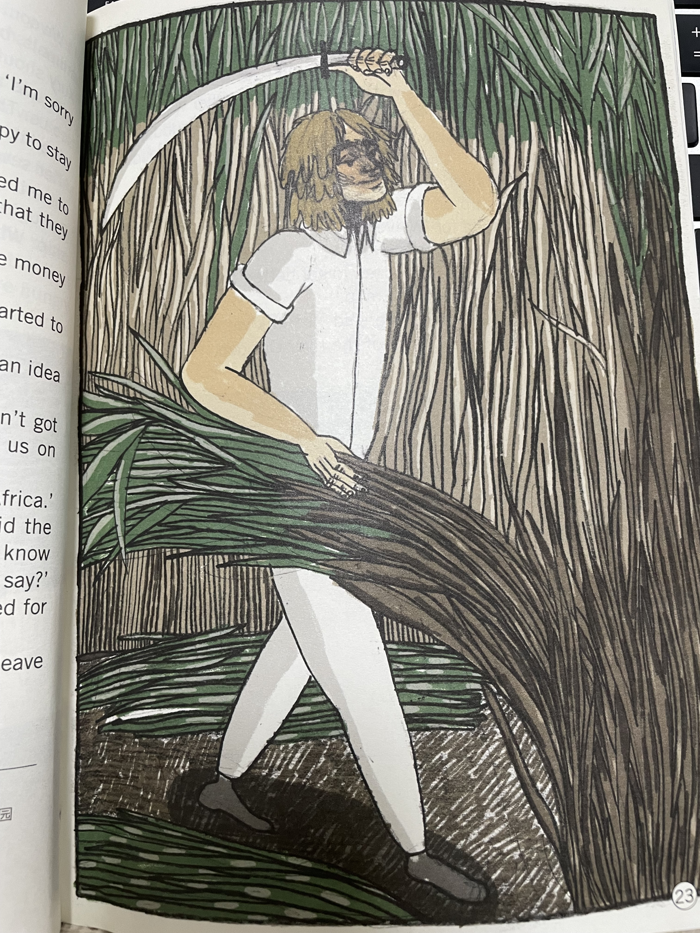
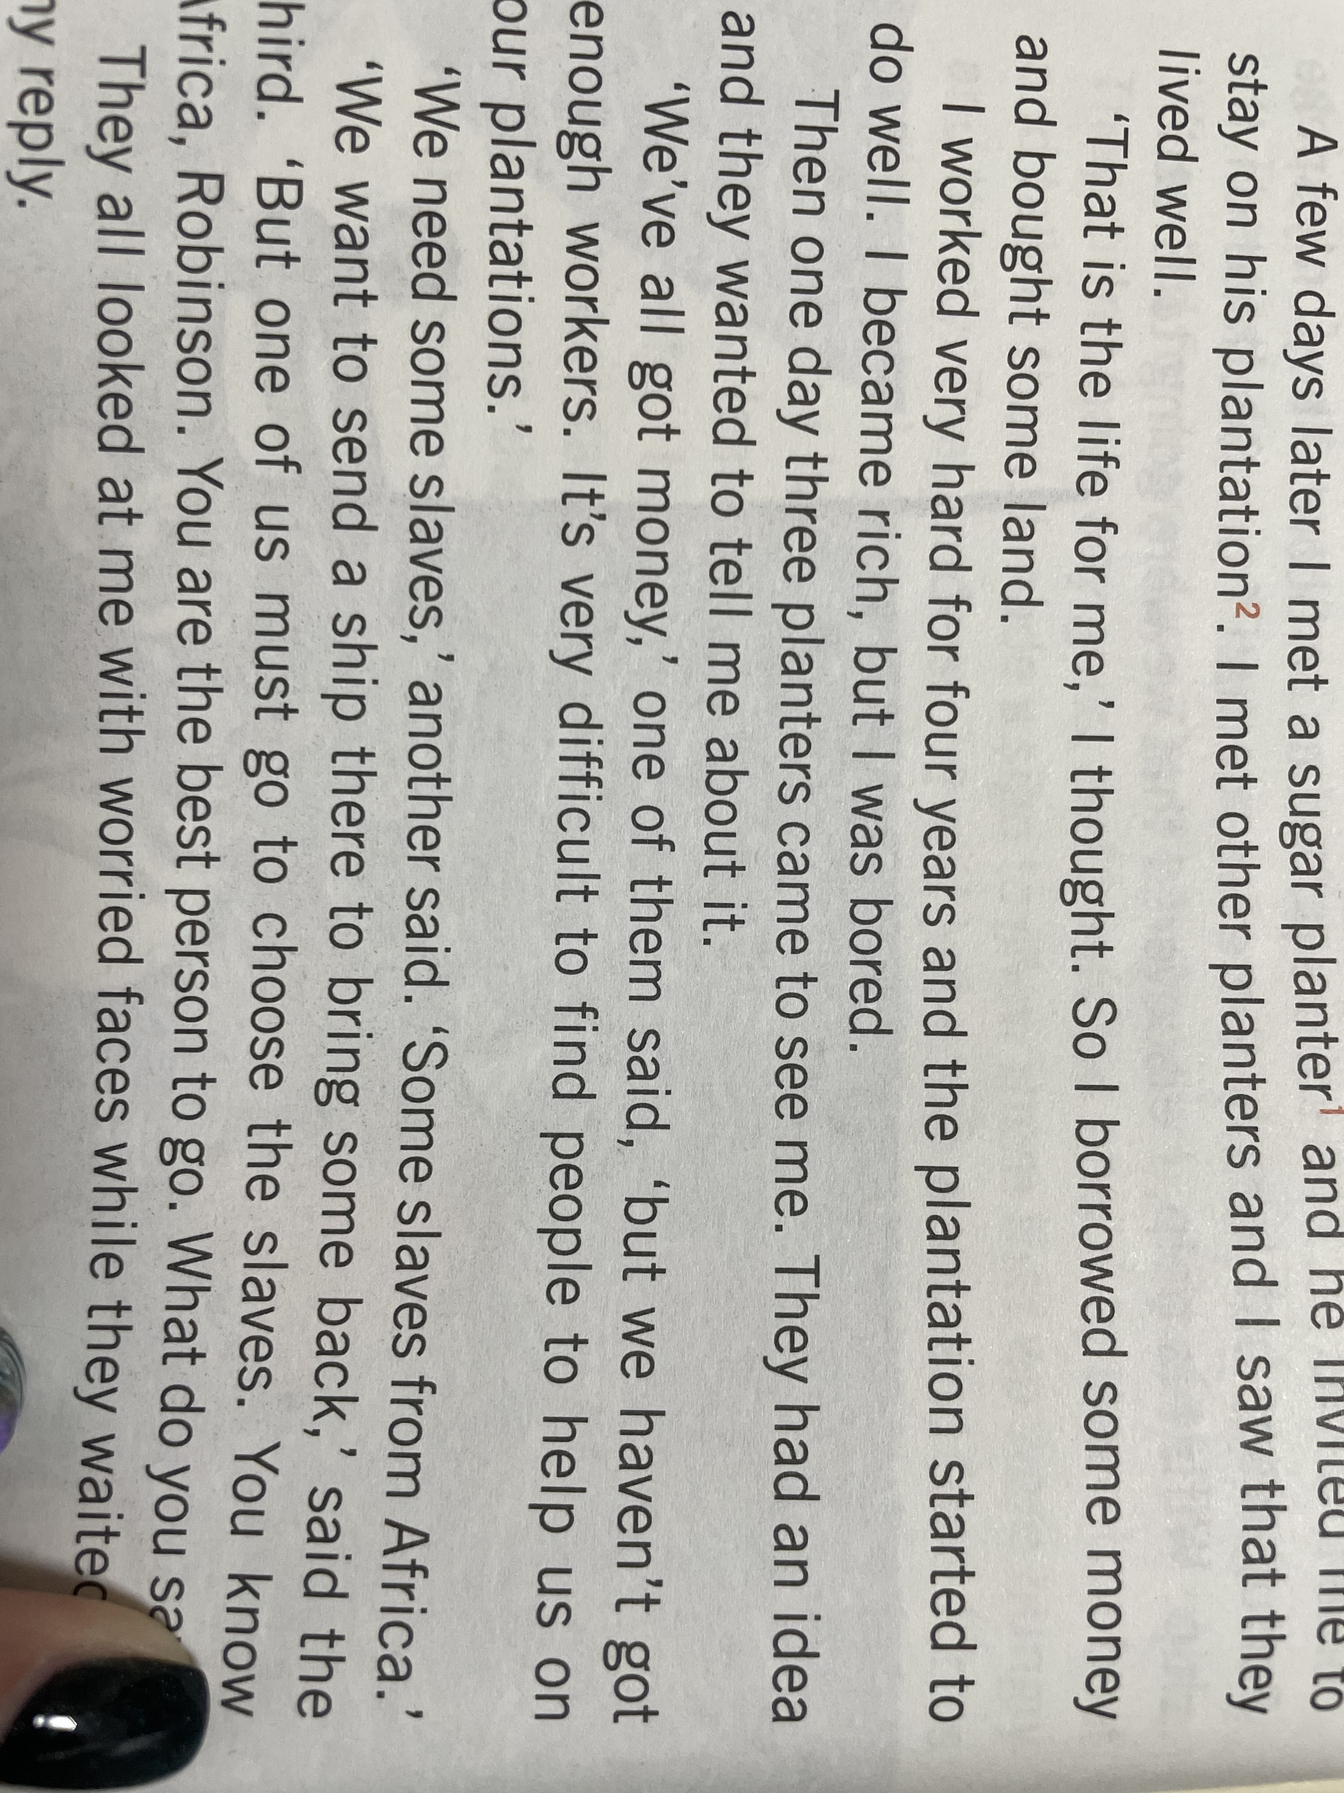
Chapter Three Storms in the Caribbean
What kind of life did Robinson have in Brazil at first?
hard-working
adventurous
They have a problem...
What do you think of Robinson ?
Atlantic slave trade

Slide 9
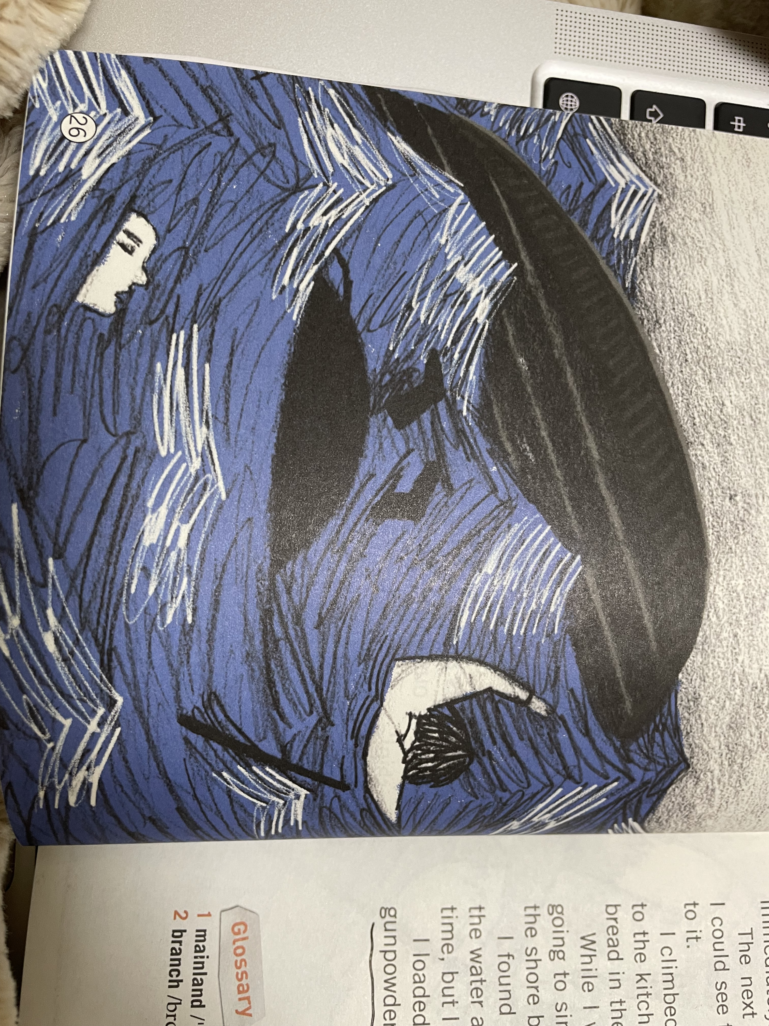
Unluckily...
the unknown land !

Slide 10
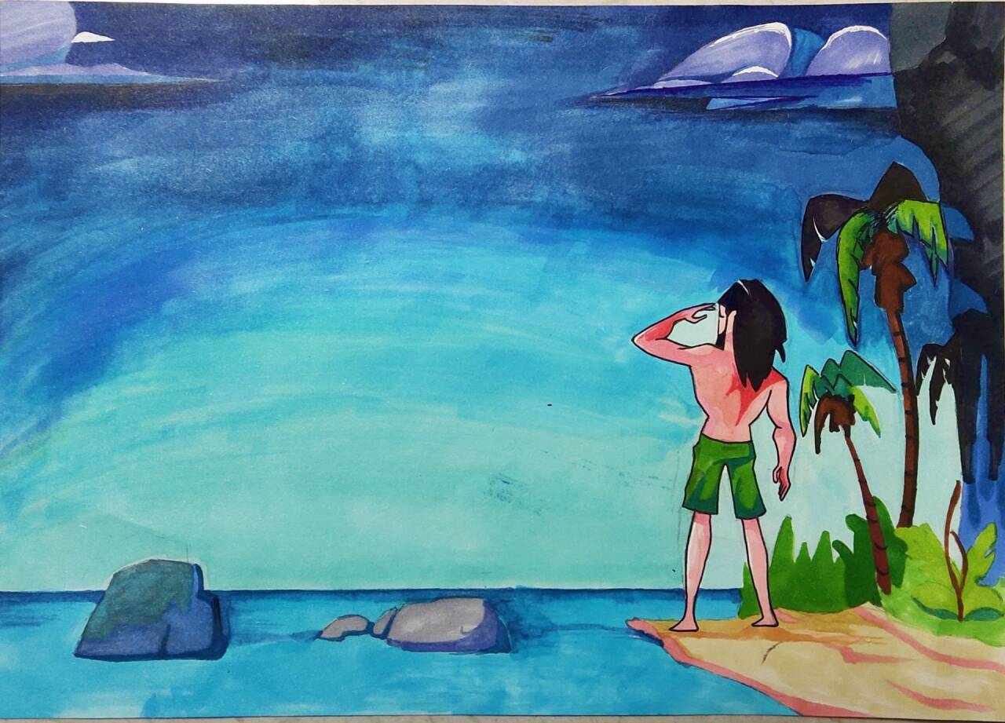
Alone on an island

Slide 11
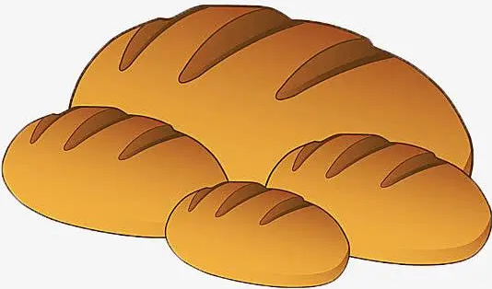
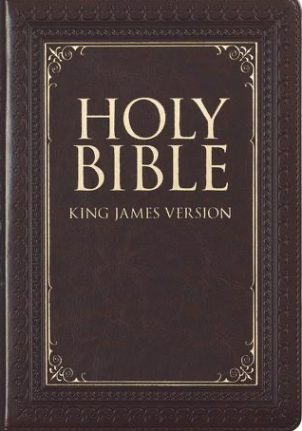

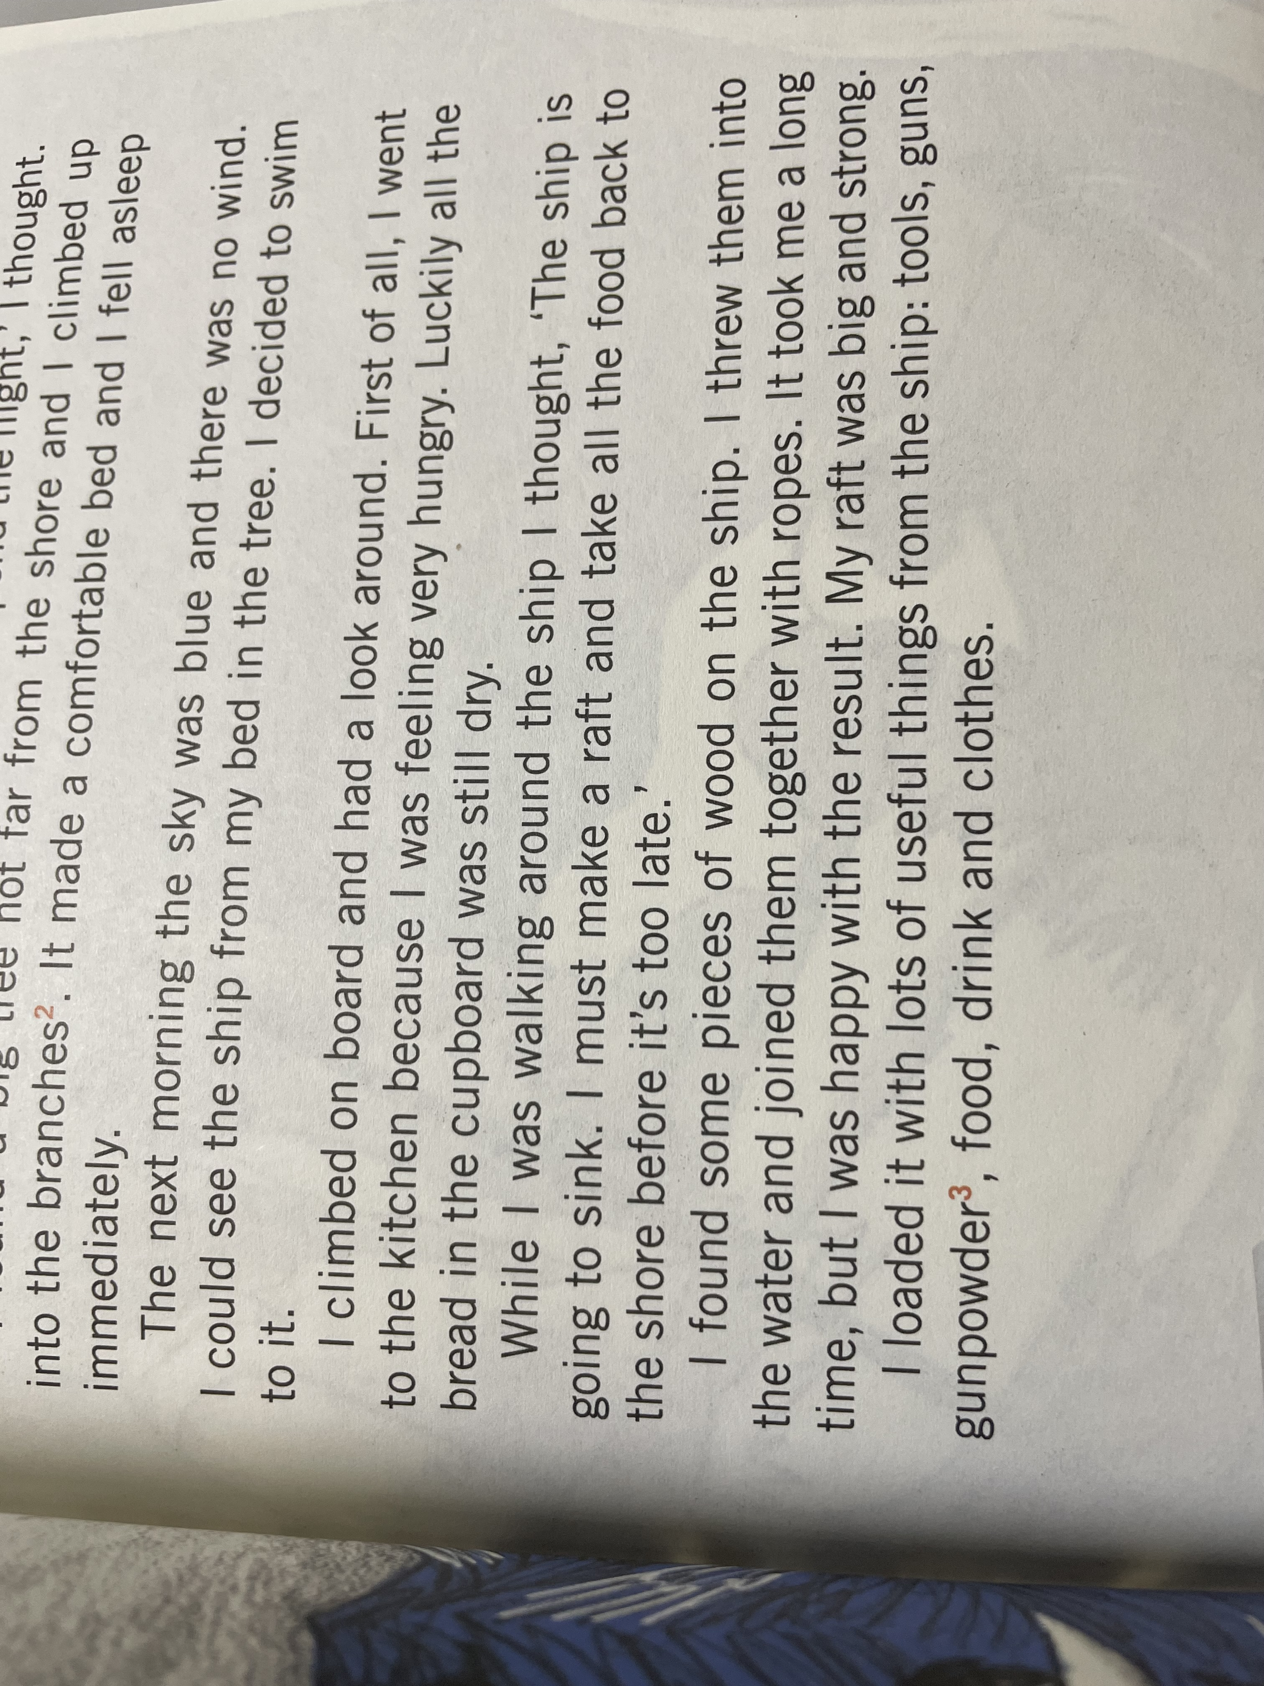
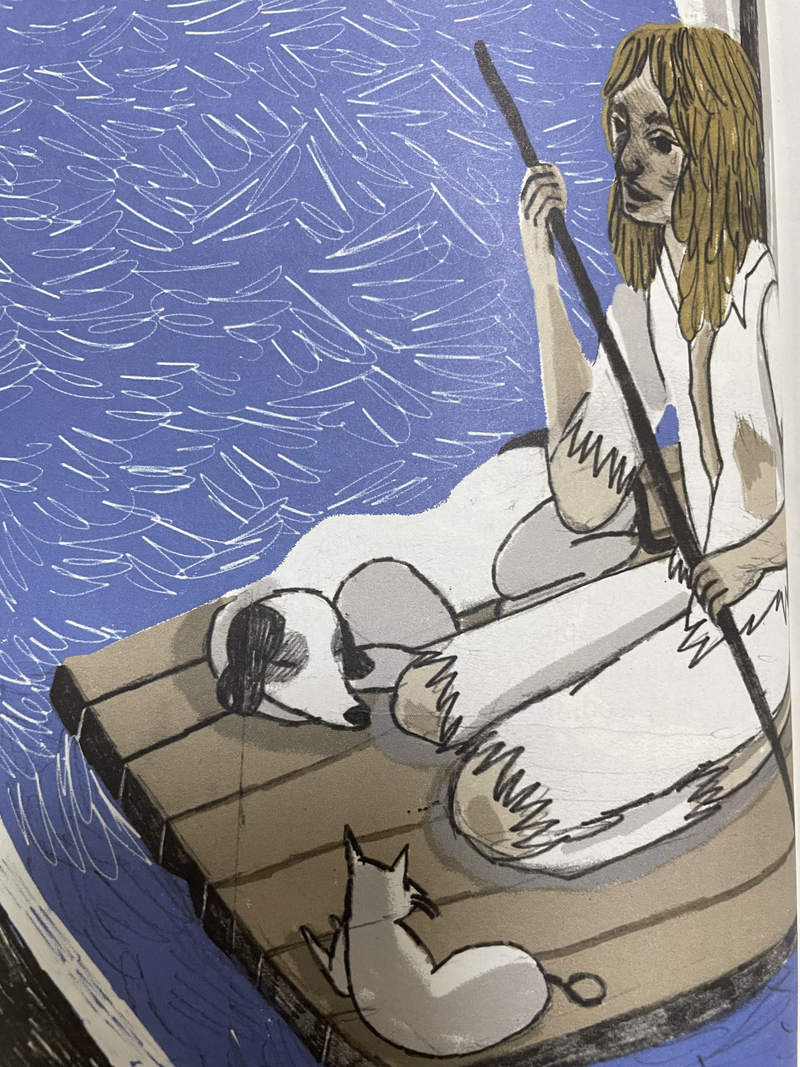
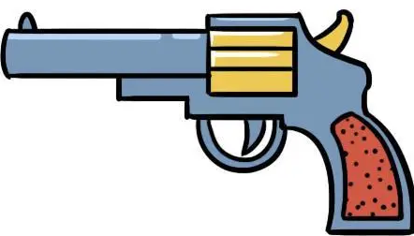
development(Chapter Four My new home)
What did Robinson have when he woke up on the island?
helpless
He had nothing!
hopeless
food
clothes
If we came to the island, what would we need?
water
fire
What did he find later?( P27)
house
...
living needs
Reading the Bible helped Robinson feel______ sorry fo himself. A. less B. more
Anything else?

Slide 12

How old was he when he first went to the sea? (P13)
19
How old was he when he arrived on the island? (P33)
27
How old was he when he finally left the island? (P64)
55
How long did he stay on the island ?
For twenty-eight years, two months and nineteen days
Why is the time so specific(具体的)?
To show it is so long!
To show Robinson was so eager(渴求的) to escape!

Slide 13
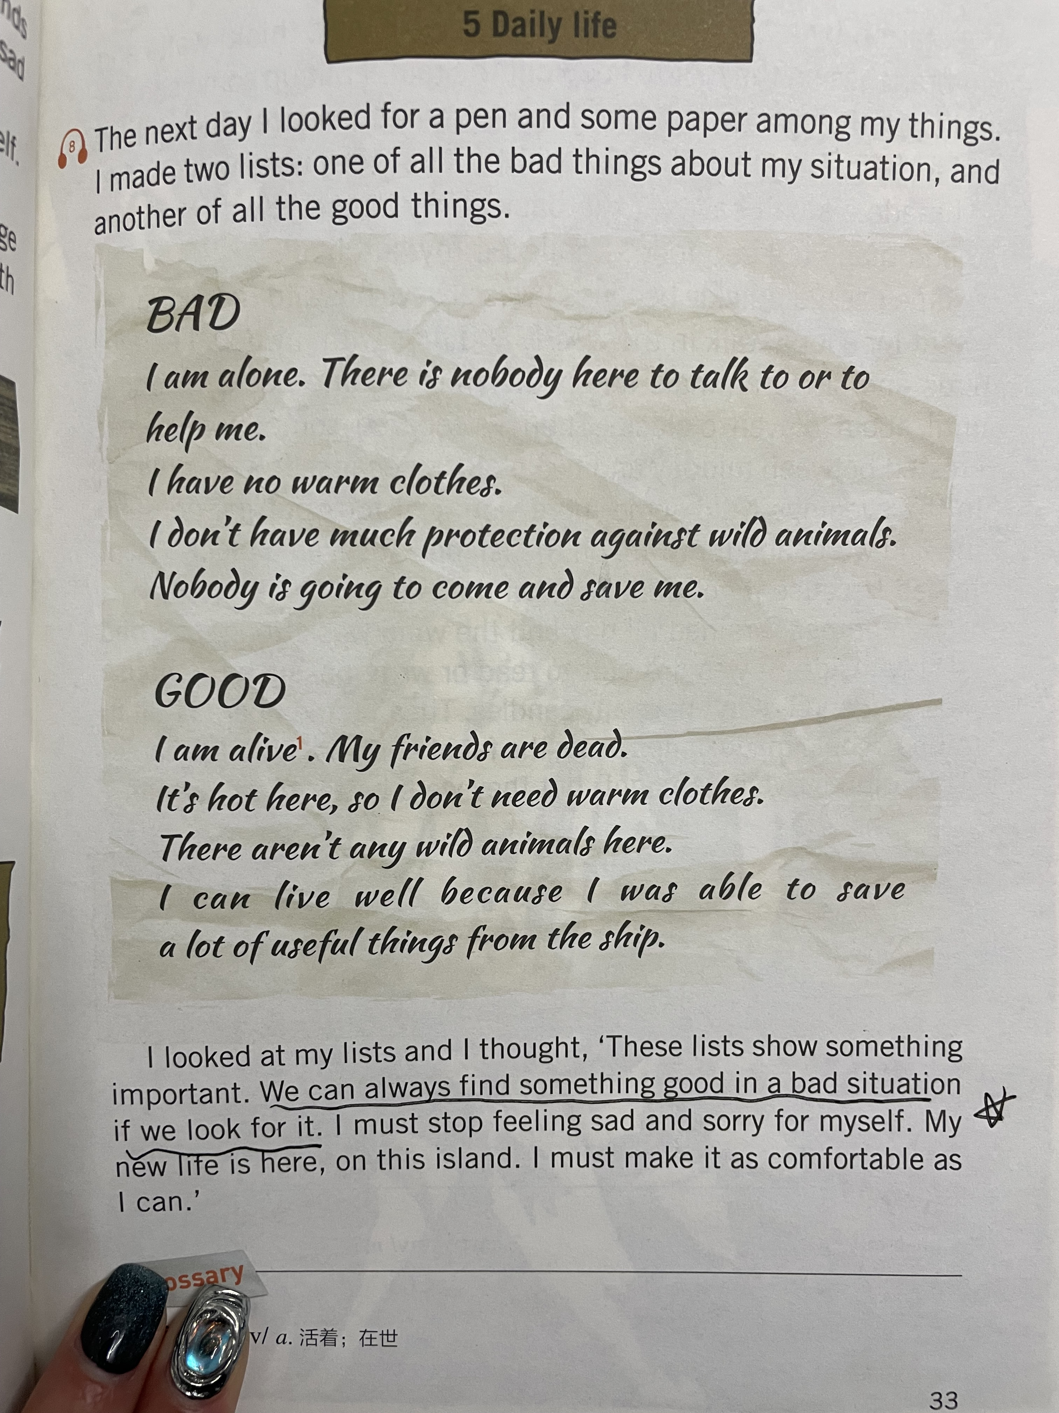
How could Robinson survive on the island for such a long time?
smart
How many new things did Robinson teach himself how to do(P34-43)?
1. make a house
2. make lamps
3. plant corn
4. make tools
5. make bowls for his food
6. make pots for cooking
7. make boats
8.make clothes
9. make butter and cheese
...
skillful
A. Where there is life, there is hope.
B. Where there is a will, there is a way.
C. Many hands make light work.
D. Rome is not built in a day.
positive 积极的
safety needs
optimistic乐观的
living needs
We can always find something good in a bad situation if we look for.

Slide 14
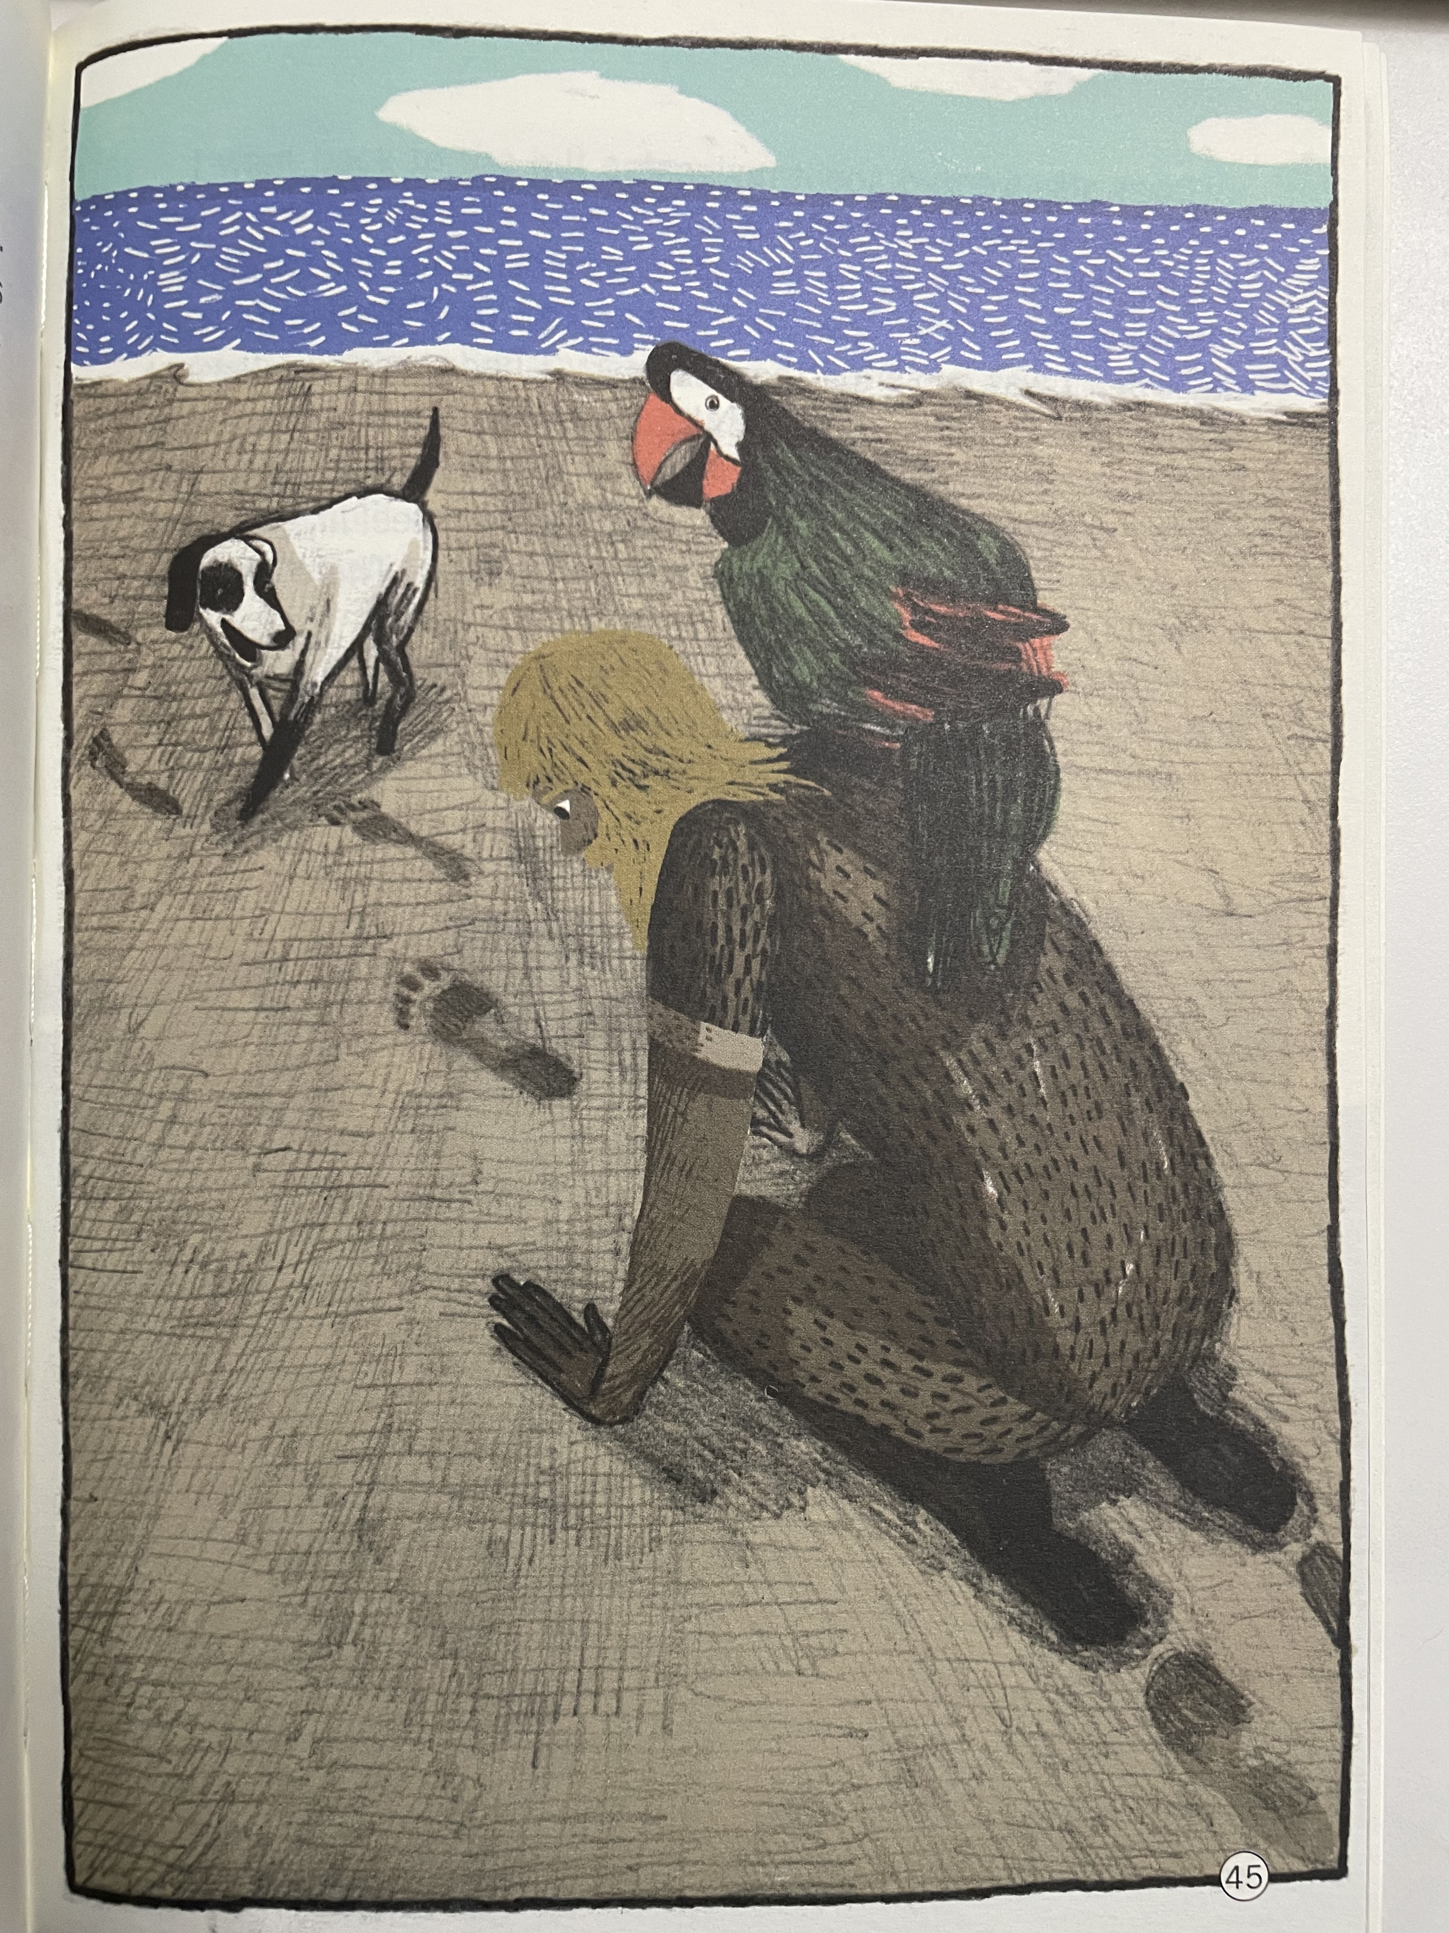
Climax(Chapter Seven Visitors)
“My life was comfortable now. I had everything I needed to live well.”
footprints!
Was there another person on my island?
Was it a cannibal/ˈkænɪbl/食人肉者?
Why do they come?
What do they want?
Are they looking for me ?
Do they want to kill me?
frightened
afraid
in Robinson’s twenty-third year on the island when he saw the savages for the first time

Slide 15
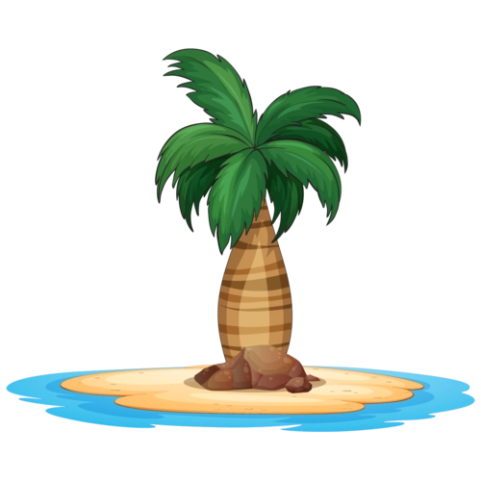
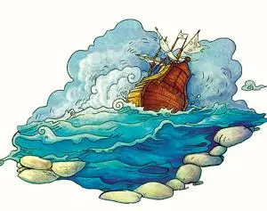

Further thinking
Why didn’t Robinson become a savage?
strong will
Struggle for survival
Survival of the fittest 适者生存

Slide 16
About the plot (Chapter7-10)
4
Friday learnt to say many words in English.
1
Robinson found a man’s footprint in the sand.
6
There was a mutiny兵变 on an English ship.
2
Robinson saw nine cannibals on a beach.
7
with Robinson’s help, the English captain got his ship back.
5
Robinson saved a Spanish.
3
Robinson saved Friday from the cannibals.

Slide 17
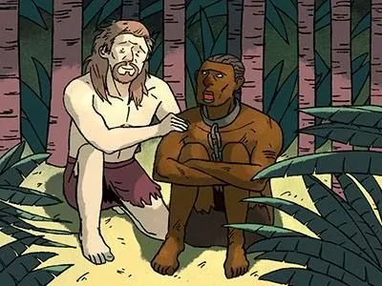
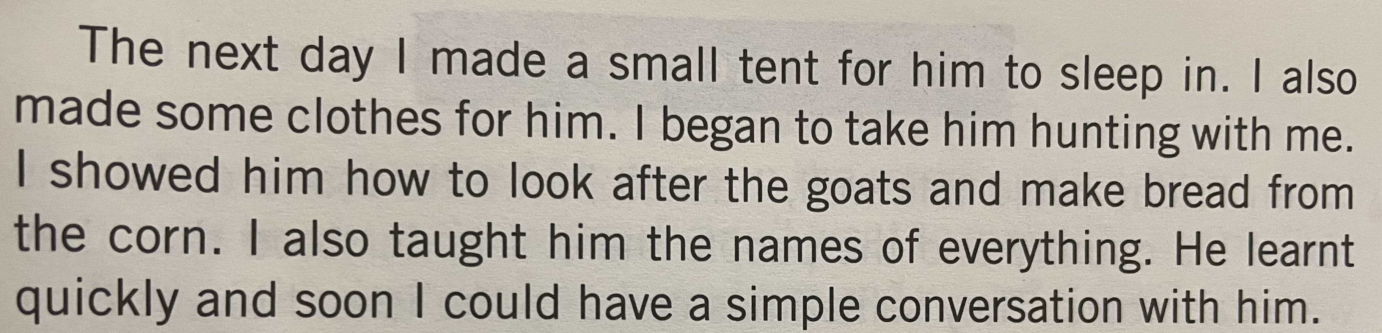
Chapter Eight Friday
Why did Robinson name him Friday?
“ I enjoyed having someone to talk to and the next three years passed very happily for me.”
Because it was the day that Robinson saved his life.
What did Robinson teach Friday? (P53)
social needs
safety needs
What was the first word Robinson taught Friday?
Why did Robinson choose to teach this word?
living needs
master

Slide 18
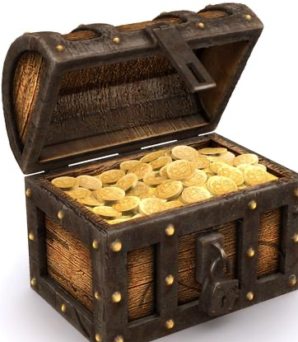
Tip3：pay attention to the social background
What was the relationship between Robinson and Friday(P53)?
Fiday was a _________ to Robinson.
servant
...
find another aspect that also shows colonialism and capitalism
friend
family
helper
social background
社会背景
Why did Robinson choose to teach this word?
esteem needs
social needs
Atlantic slave trade
colonialism
/kəˈləʊniəlɪzəm/
殖民主义
safety needs
capitalism
/ˈkæpɪtəlɪzəm/
资本主义
living needs

Slide 19
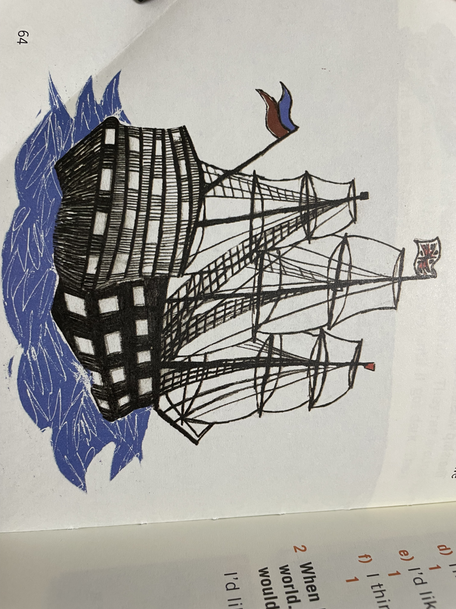
Ending
On 19th December1686, an English ship took him back to England!
Robinson returned to England just with the help of the English ship.
never give up
self-realization
F
be
saved
esteem needs
never give in
save Friday
social needs
safety needs
strong will
save himself
living needs

Slide 20
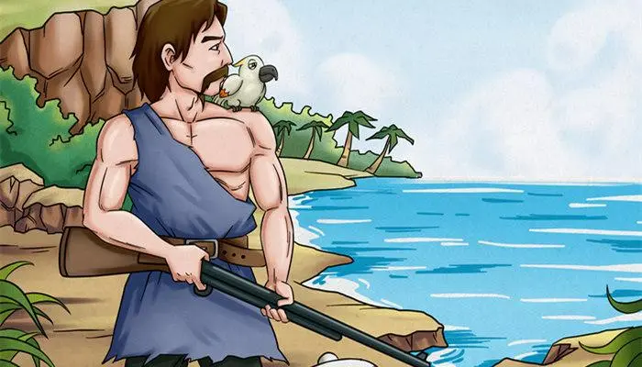
Taste personalities
What do you think of Robinson Crusoe?
Responsible
Outstanding
Brave
Independent
Never give up
Smart & skillful
Optimistic
Never give in
Robinson
That’s the true meaning of his name Robinson!
I think Robinson is__________ because____________.

Slide 21
Writing time
What will happen after they return to England?
live a happy and rich life in England?
unable to get used to(习惯) the modern life?
...
go back to the island?
go to Friday’s country?

Slide 22
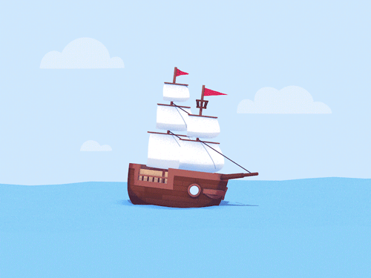
About the theme
Only if we keep on trying can we find hope in adversity !
Robinson
Struggle for survival
Struggle for self-realization
Life is like an adventure.
Life is full of ups and downs.

Slide 23
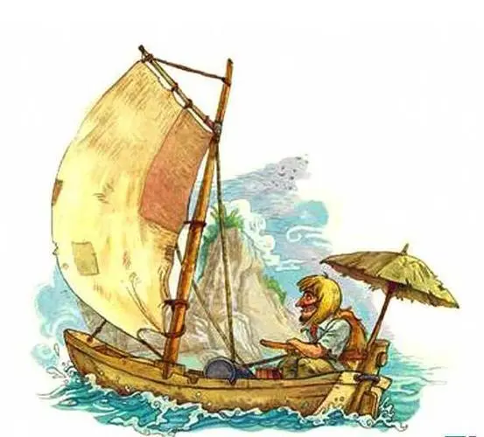
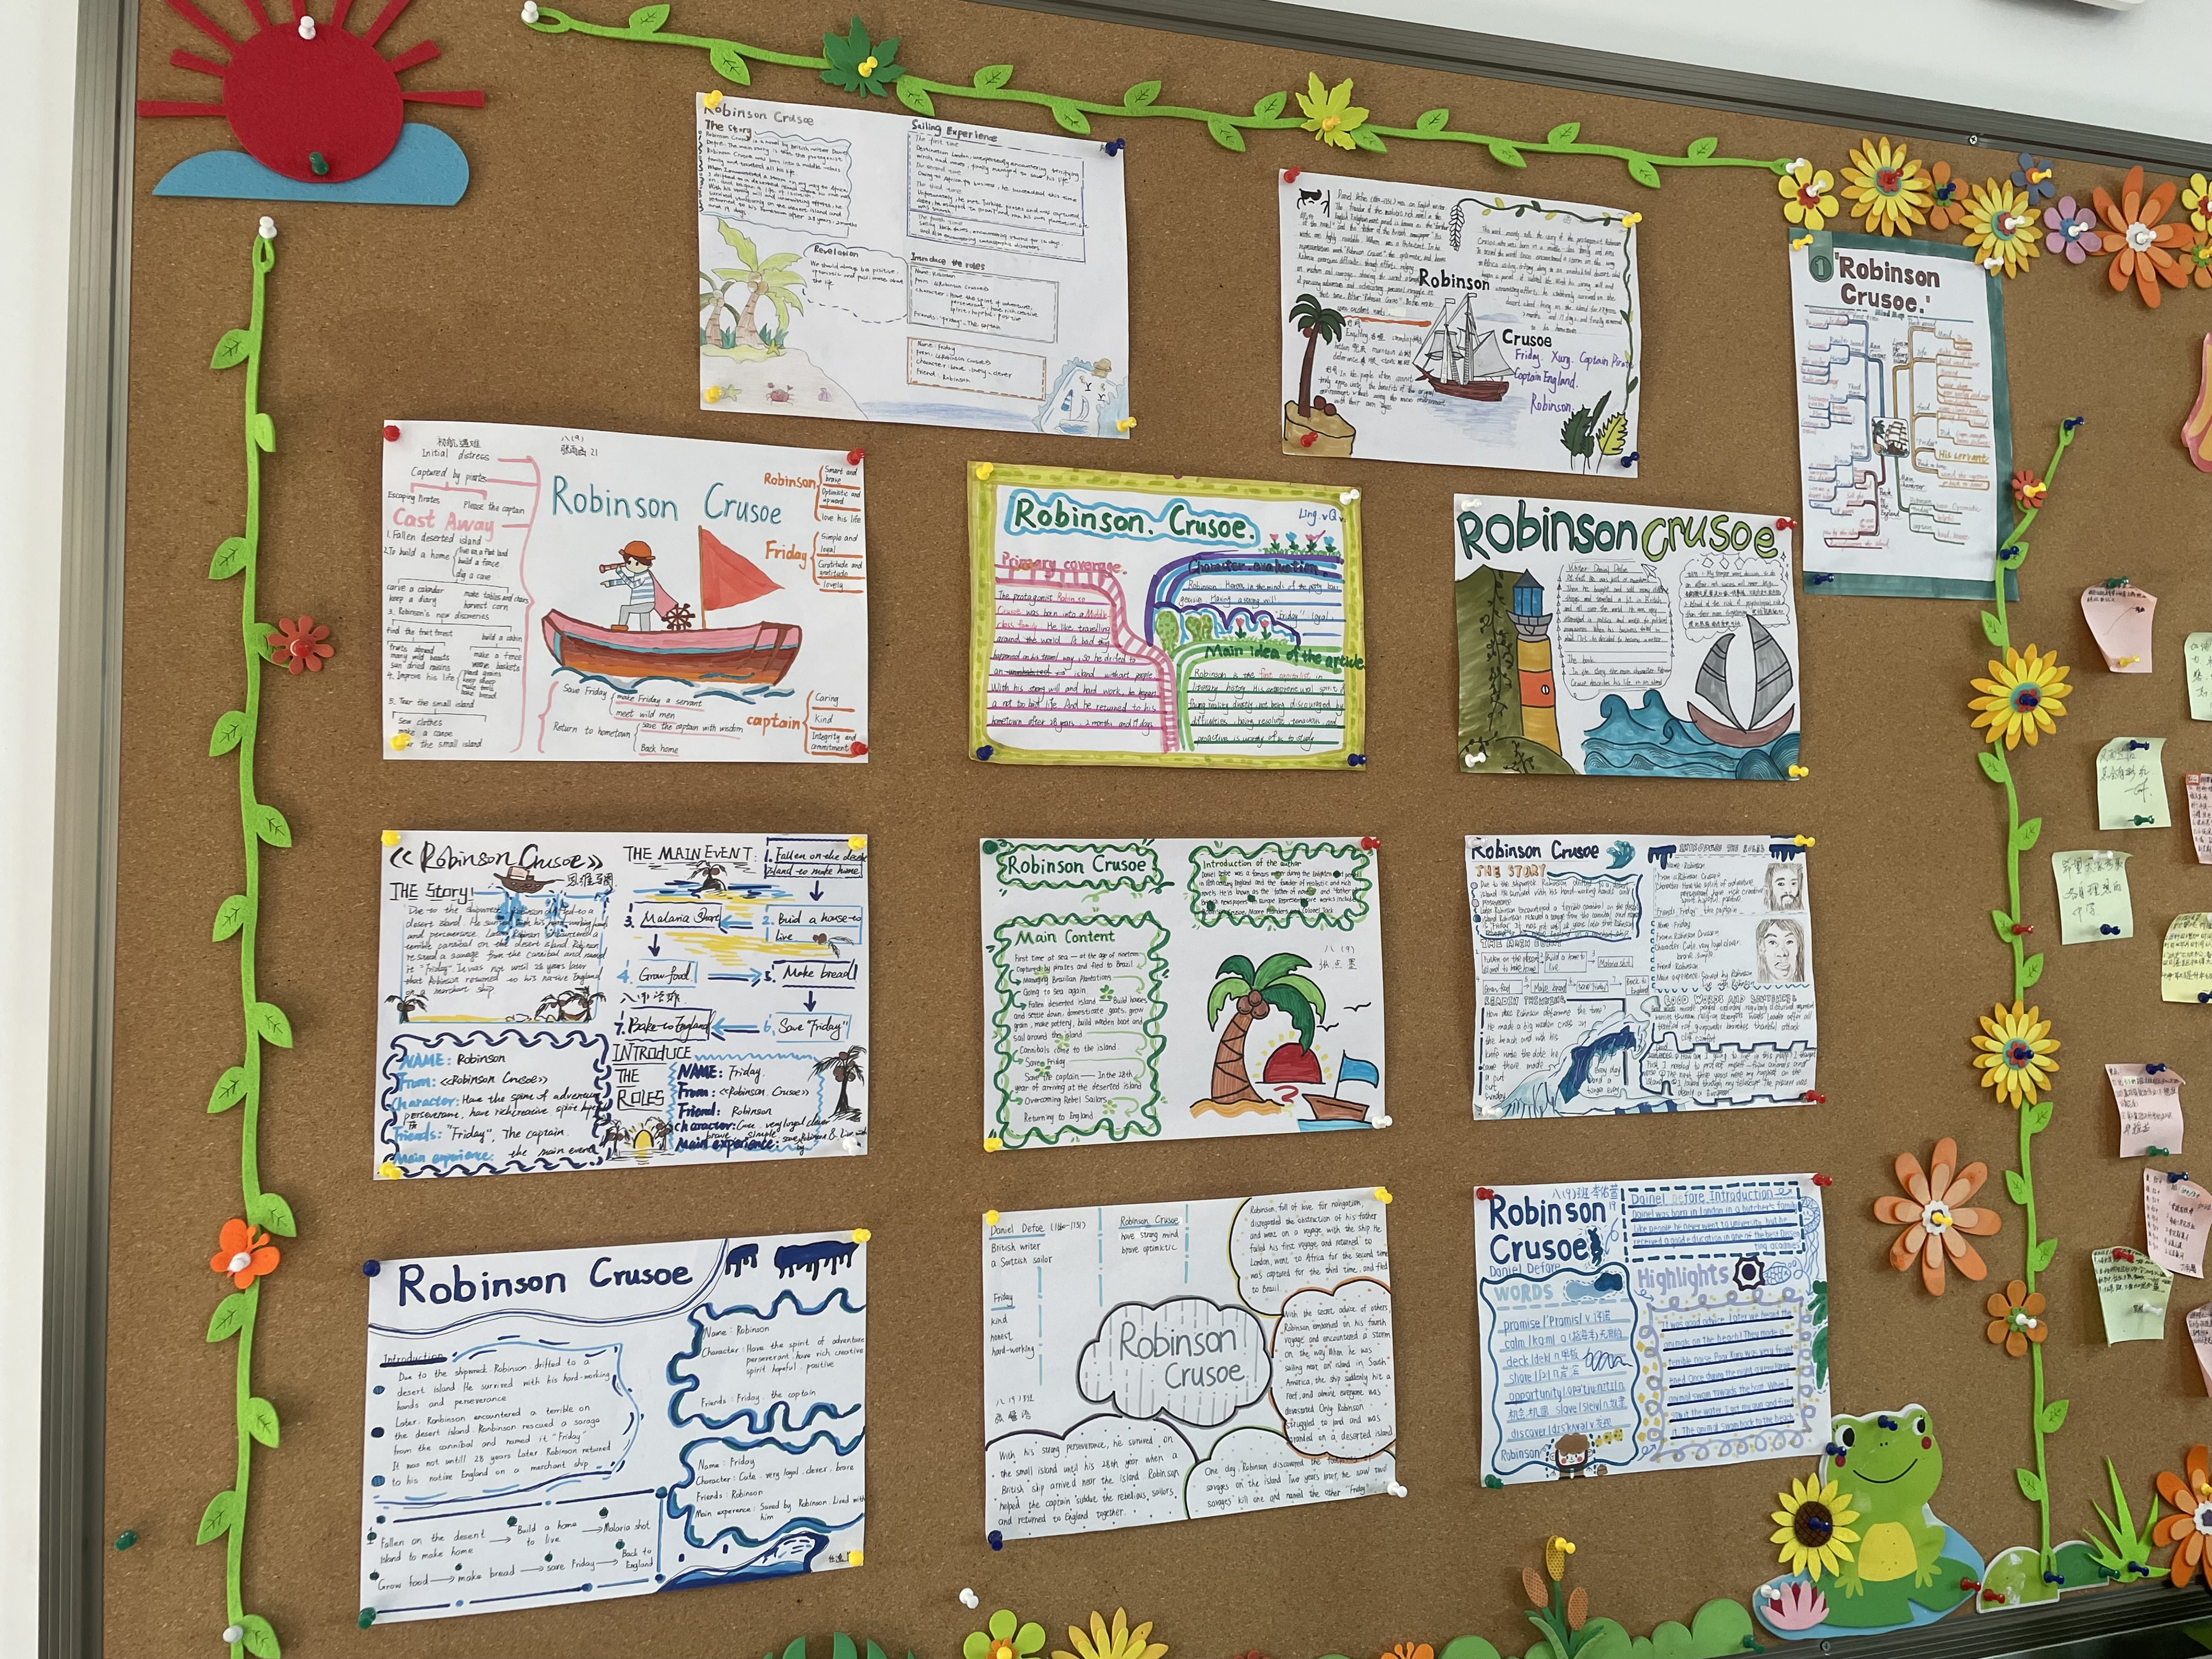
Every book opens another world to us!
Homework:
1. finish and polish your writing
2. draw a detailed picture map(P76)
3. read other works of the writer

Slide 24
Thank you !

