Slide 1
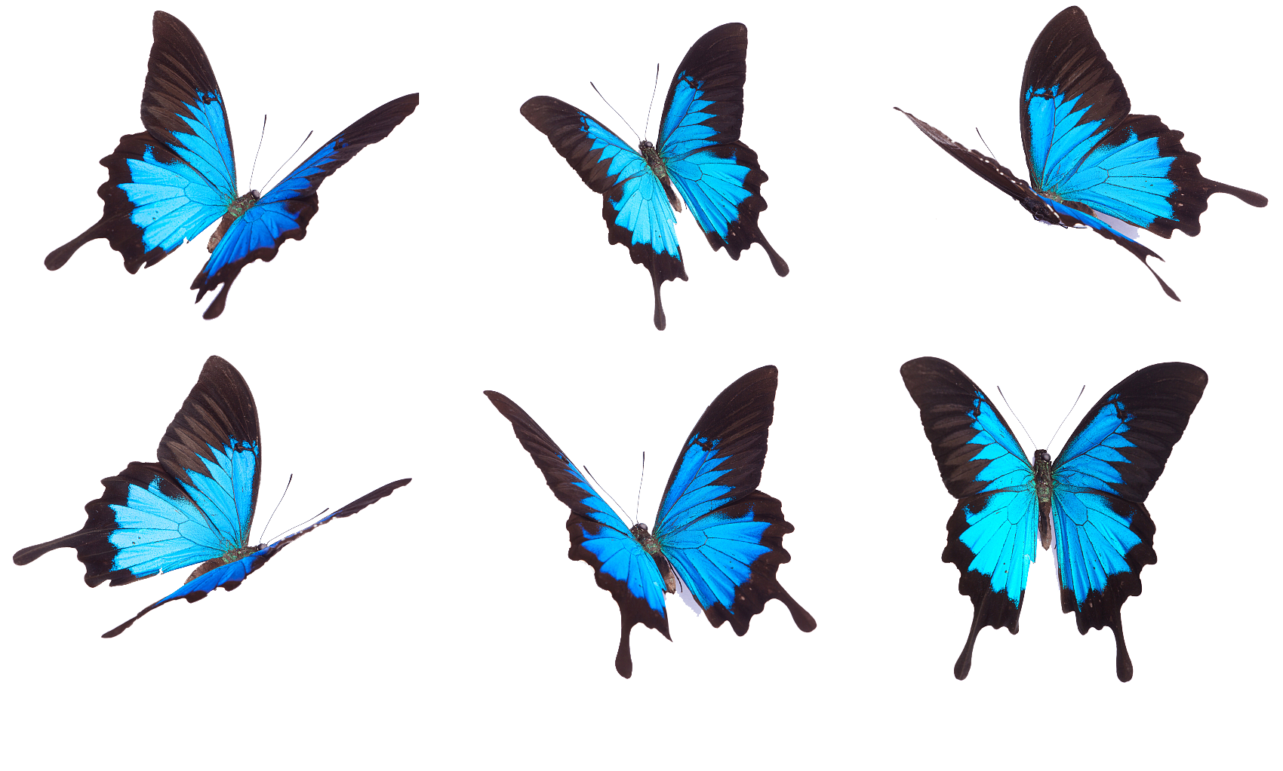
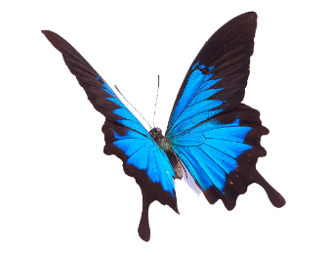

Being Like
Butterflies
常州市新北区实验中学 陈 蕾

Slide 2
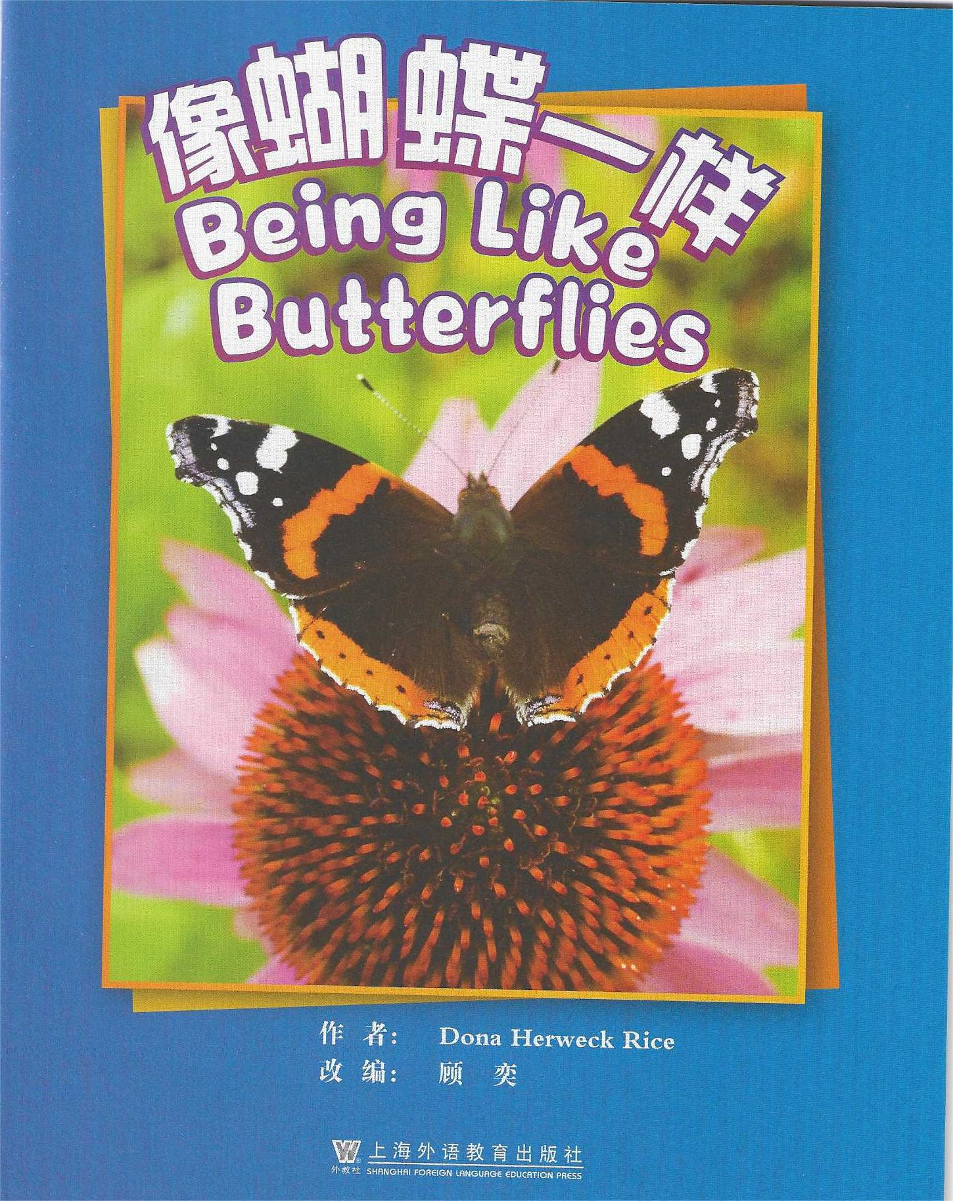
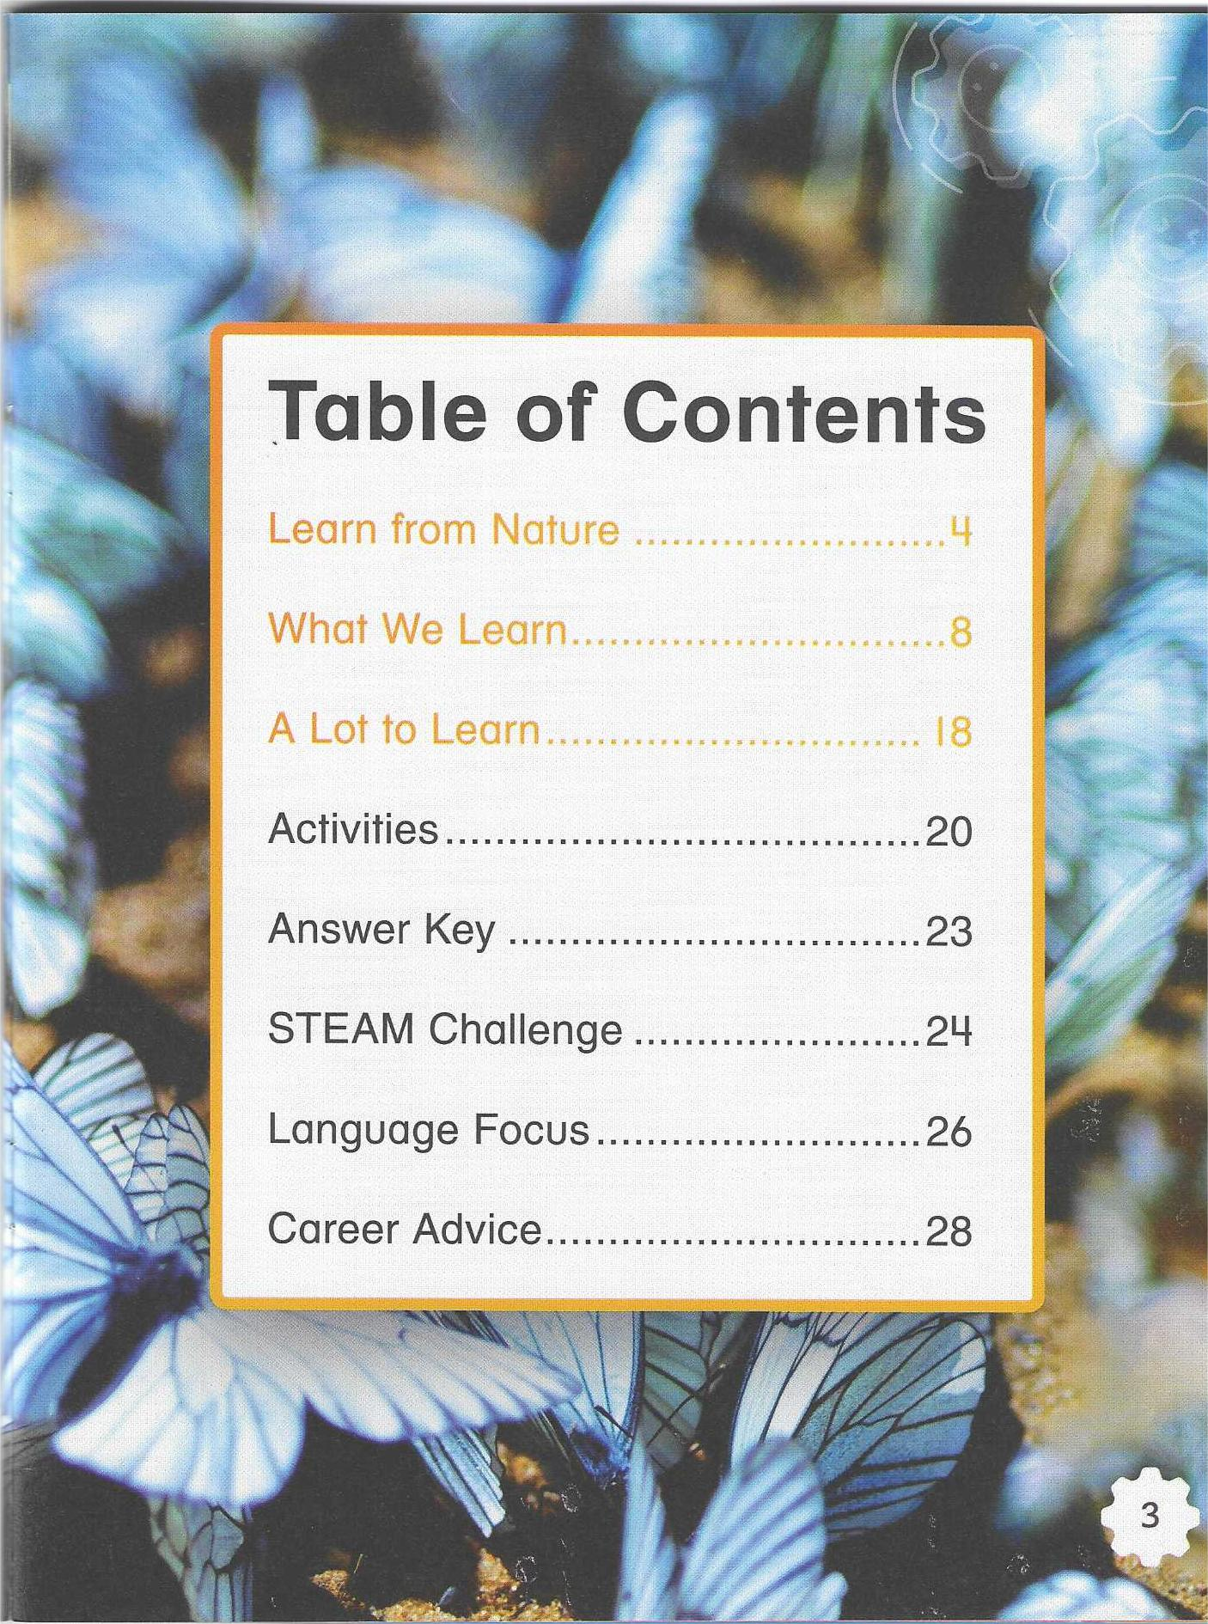
What can you see on the cover?
a butterfly
on a flower
What I KNOW | What I WANT to Learn | What I LEARNED
It has spots.
What can people learn from
...?
It has patterns of lines.
It has four wings.
butterflies?

Slide 3
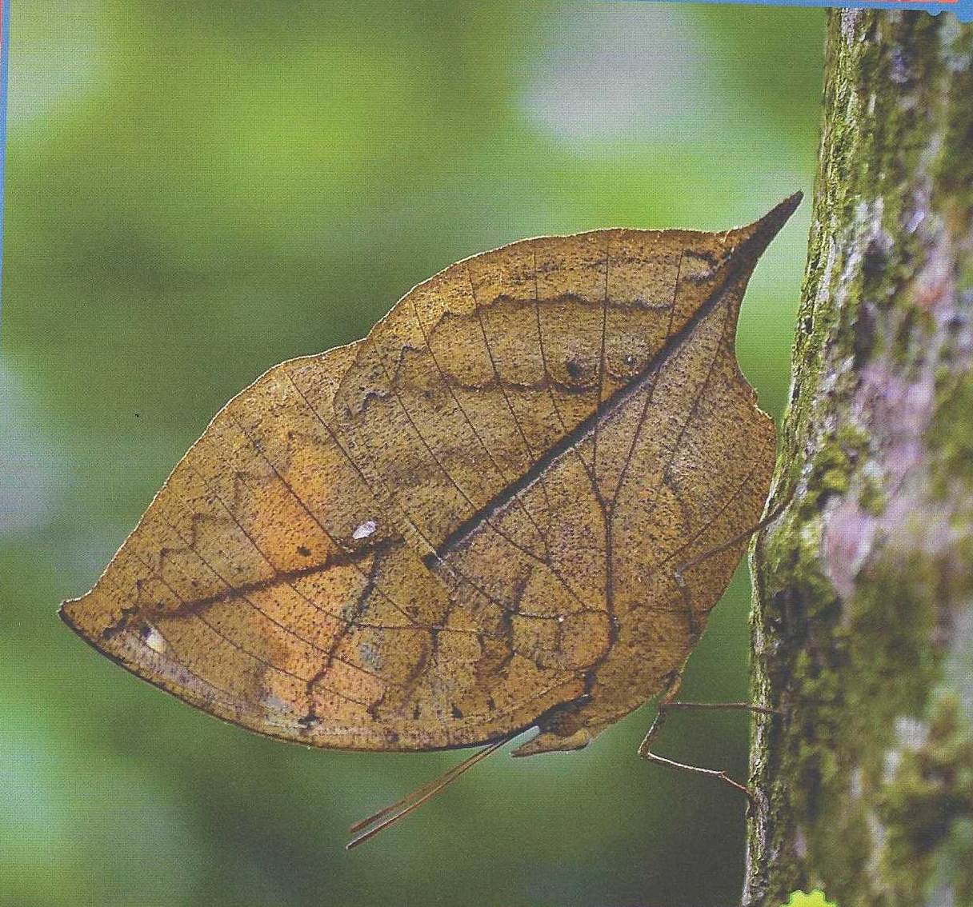
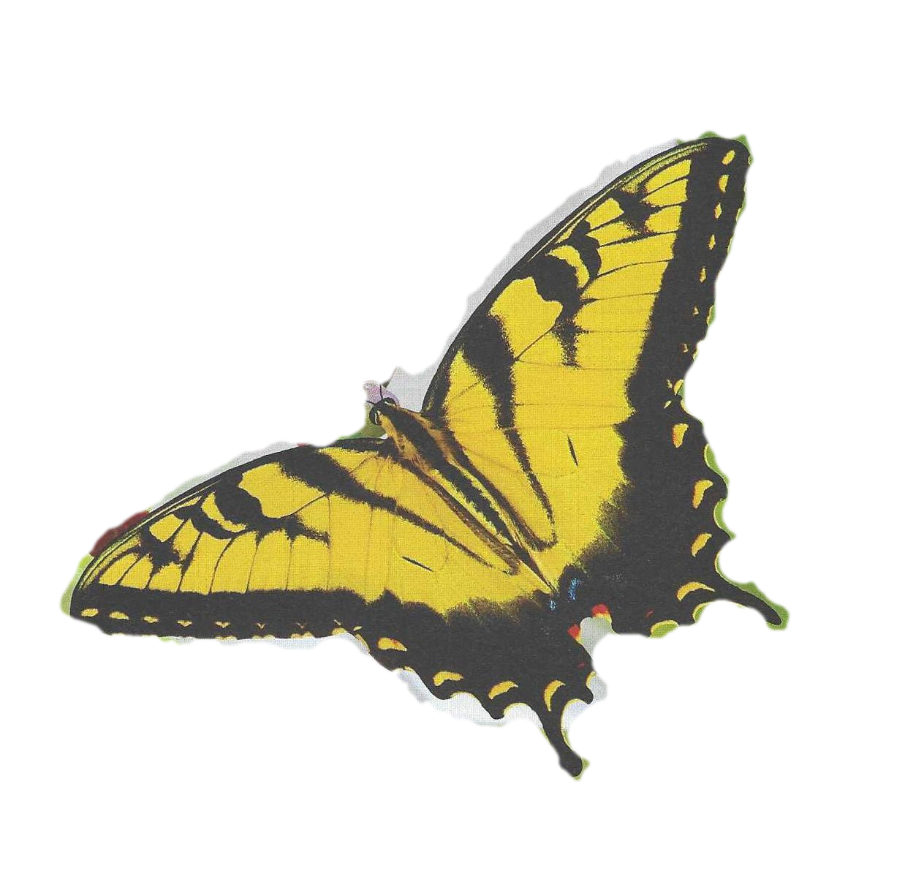
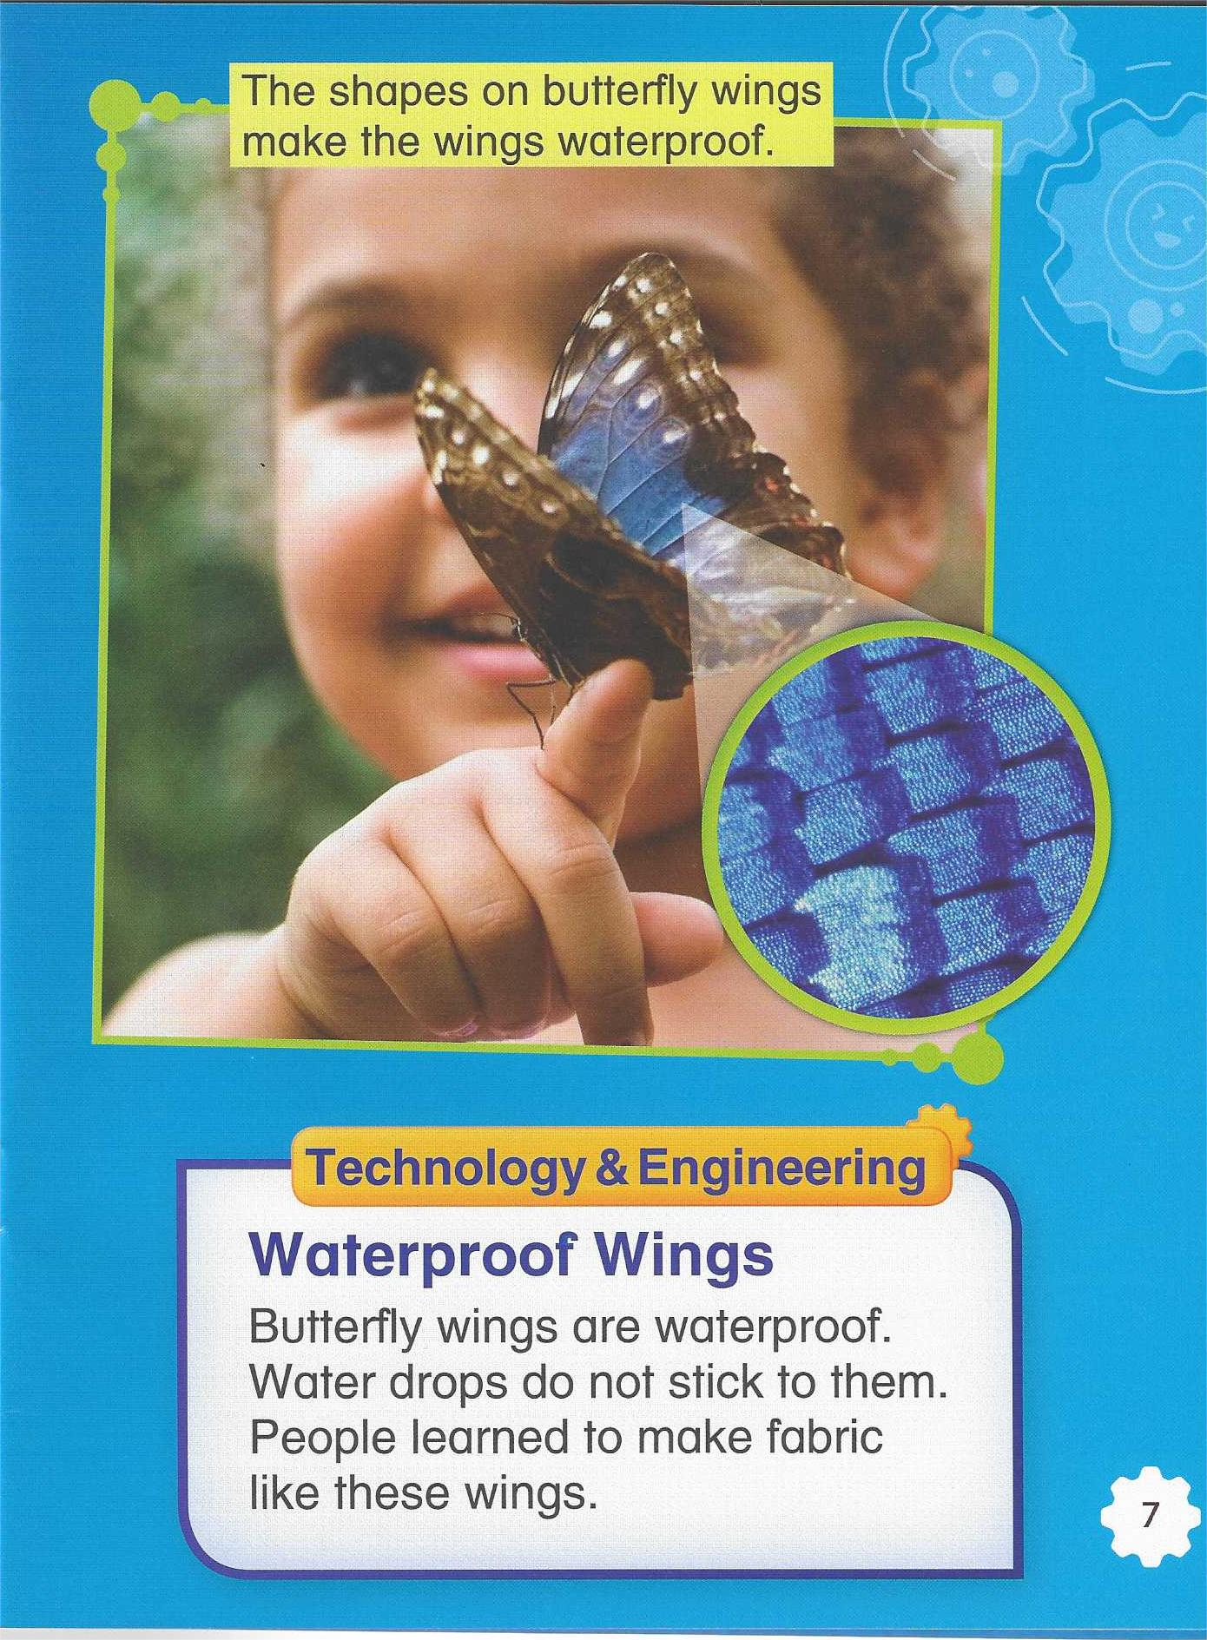
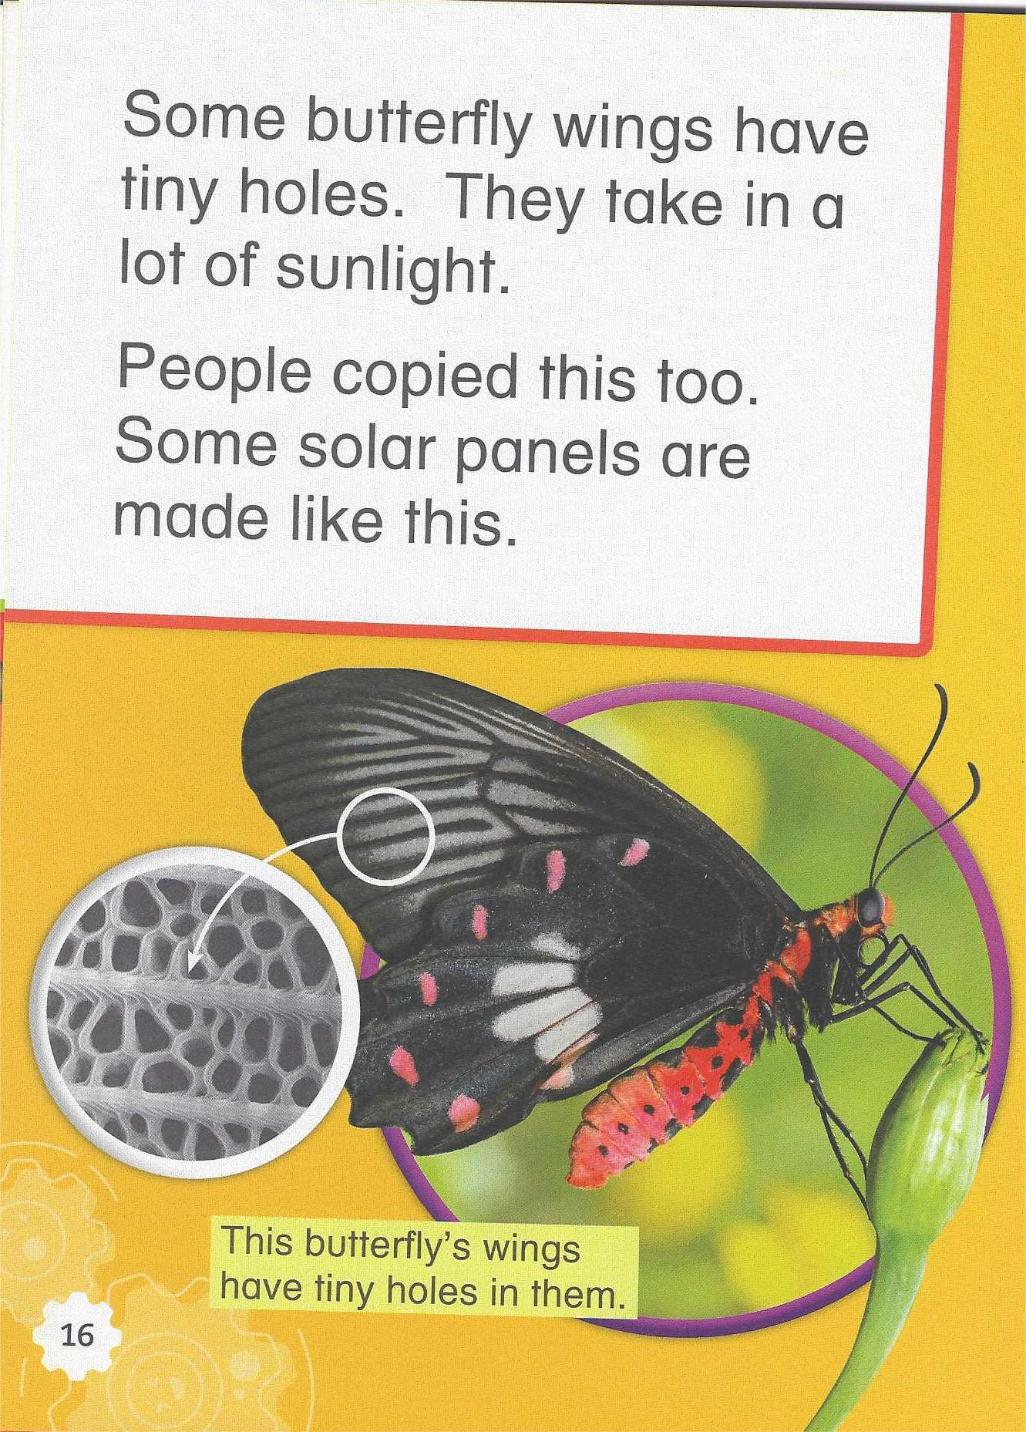
Read and match
blend in 融入
warn 警告v.
warning 警告n.
toxic 有毒的
waterproof 防水的
take in 吸收
Headings(小标题) from the book
1
2
3
4
Colors and Patterns
P10~13
Parts of Wings
P14~17
The shape on wings make them waterproof防水 and clean.
The butterfly looks like a dead leaf. It blends in with the world around it.
This butterfly’s wings have tiny holes. They take in a lot of sunlight.
The butterfly is yellow. Bright colors warn that it may be toxic有毒.
Details(细节)
Details(细节)

Slide 4
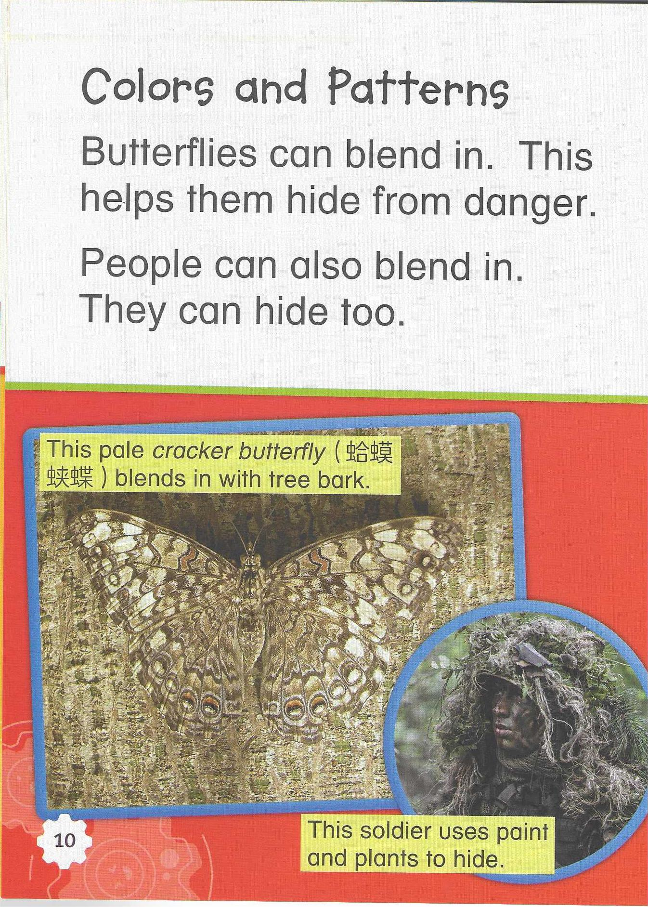
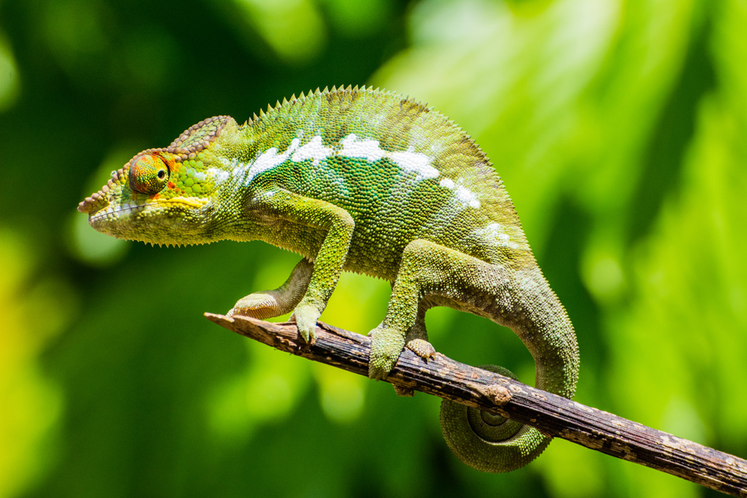
1
Colors and Patterns
(Page10~11)
Both butterflies and people can _________ in.
Butterflies use colors and patterns to help them hide from ________. One kind of butterfly looks like a dead leaf, and another one looks like tree ______.
People can blend in too. We use ________________ to ______ in the forest.
blend
danger
bark
paint and plants
chameleon变色龙
hide
Do you know other animals that can blend in?

Slide 5
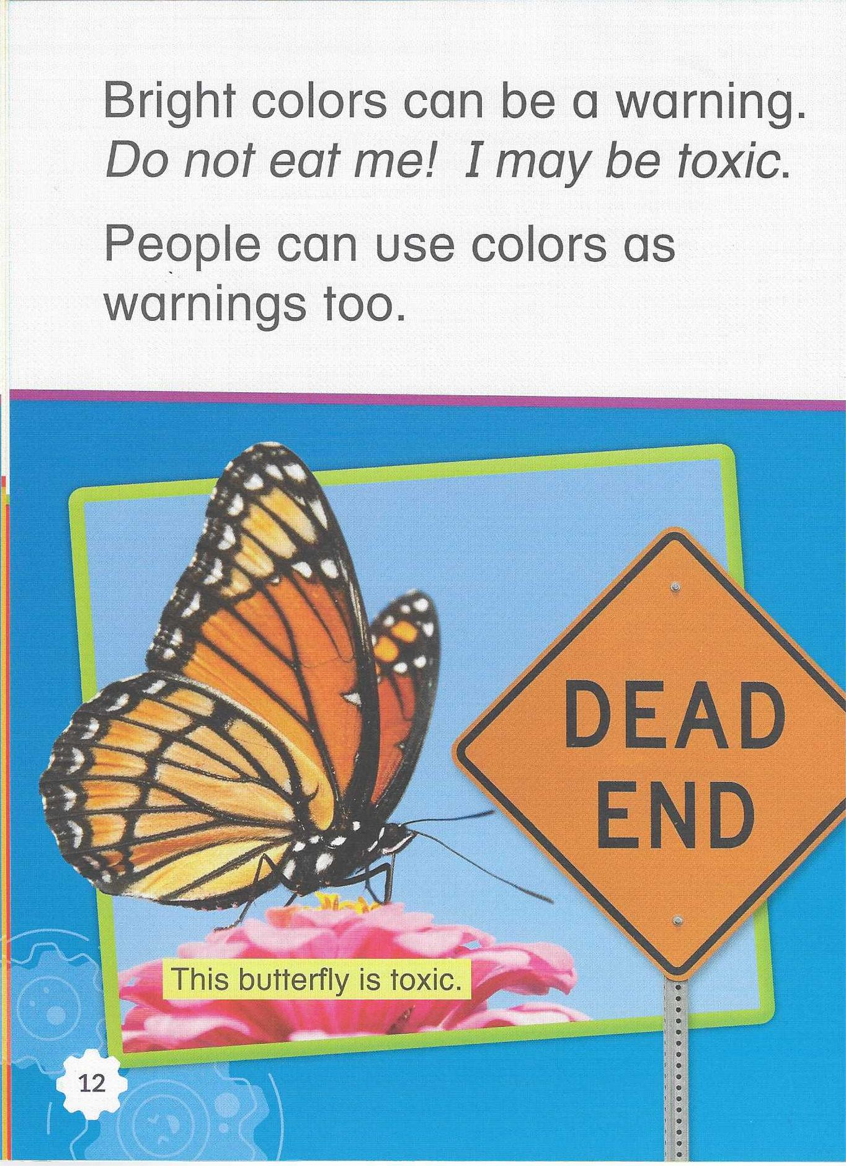
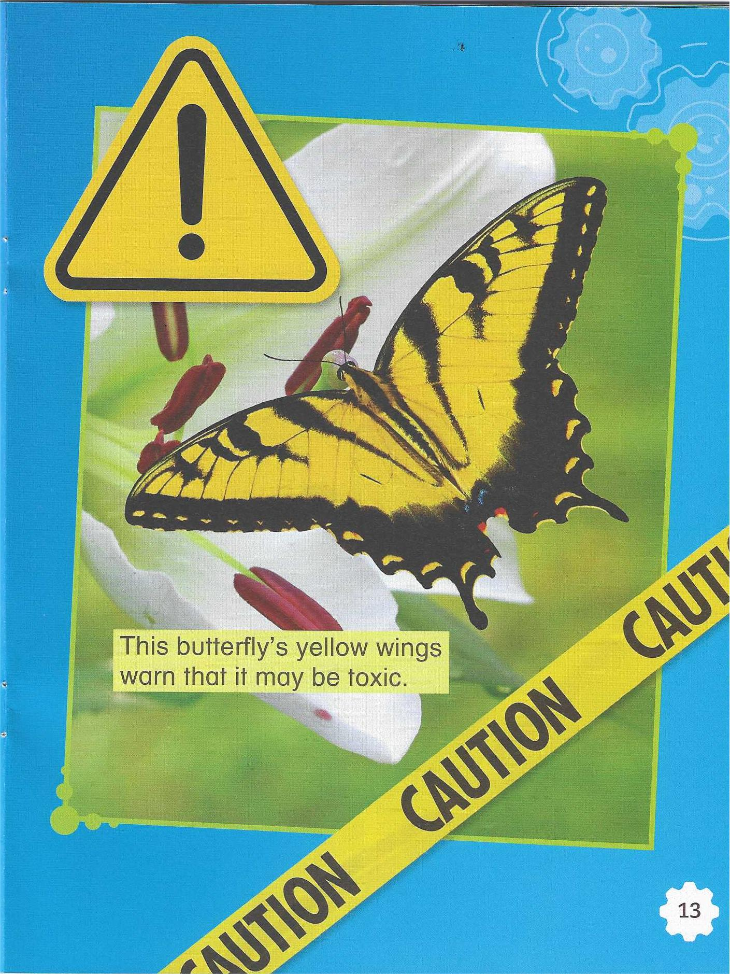
2
Colors and Patterns
(Page12~13)
How are bright colors used?
A. as a warning B. to fly C. to blend in D. to keep clean
Give advice about a new sign（指示牌）in your school. Tell what color the sign should be.

Slide 6
Fun Facts About Butterflies
The butterfly wings are covered with scales. These scales protect the wings from getting too wet or dirty, and help them take in sunlight. Butterflies cannot fly if they are too cold. They often sit in the sun to warm up before flying.
Are the scales important for butterflies?

Slide 7
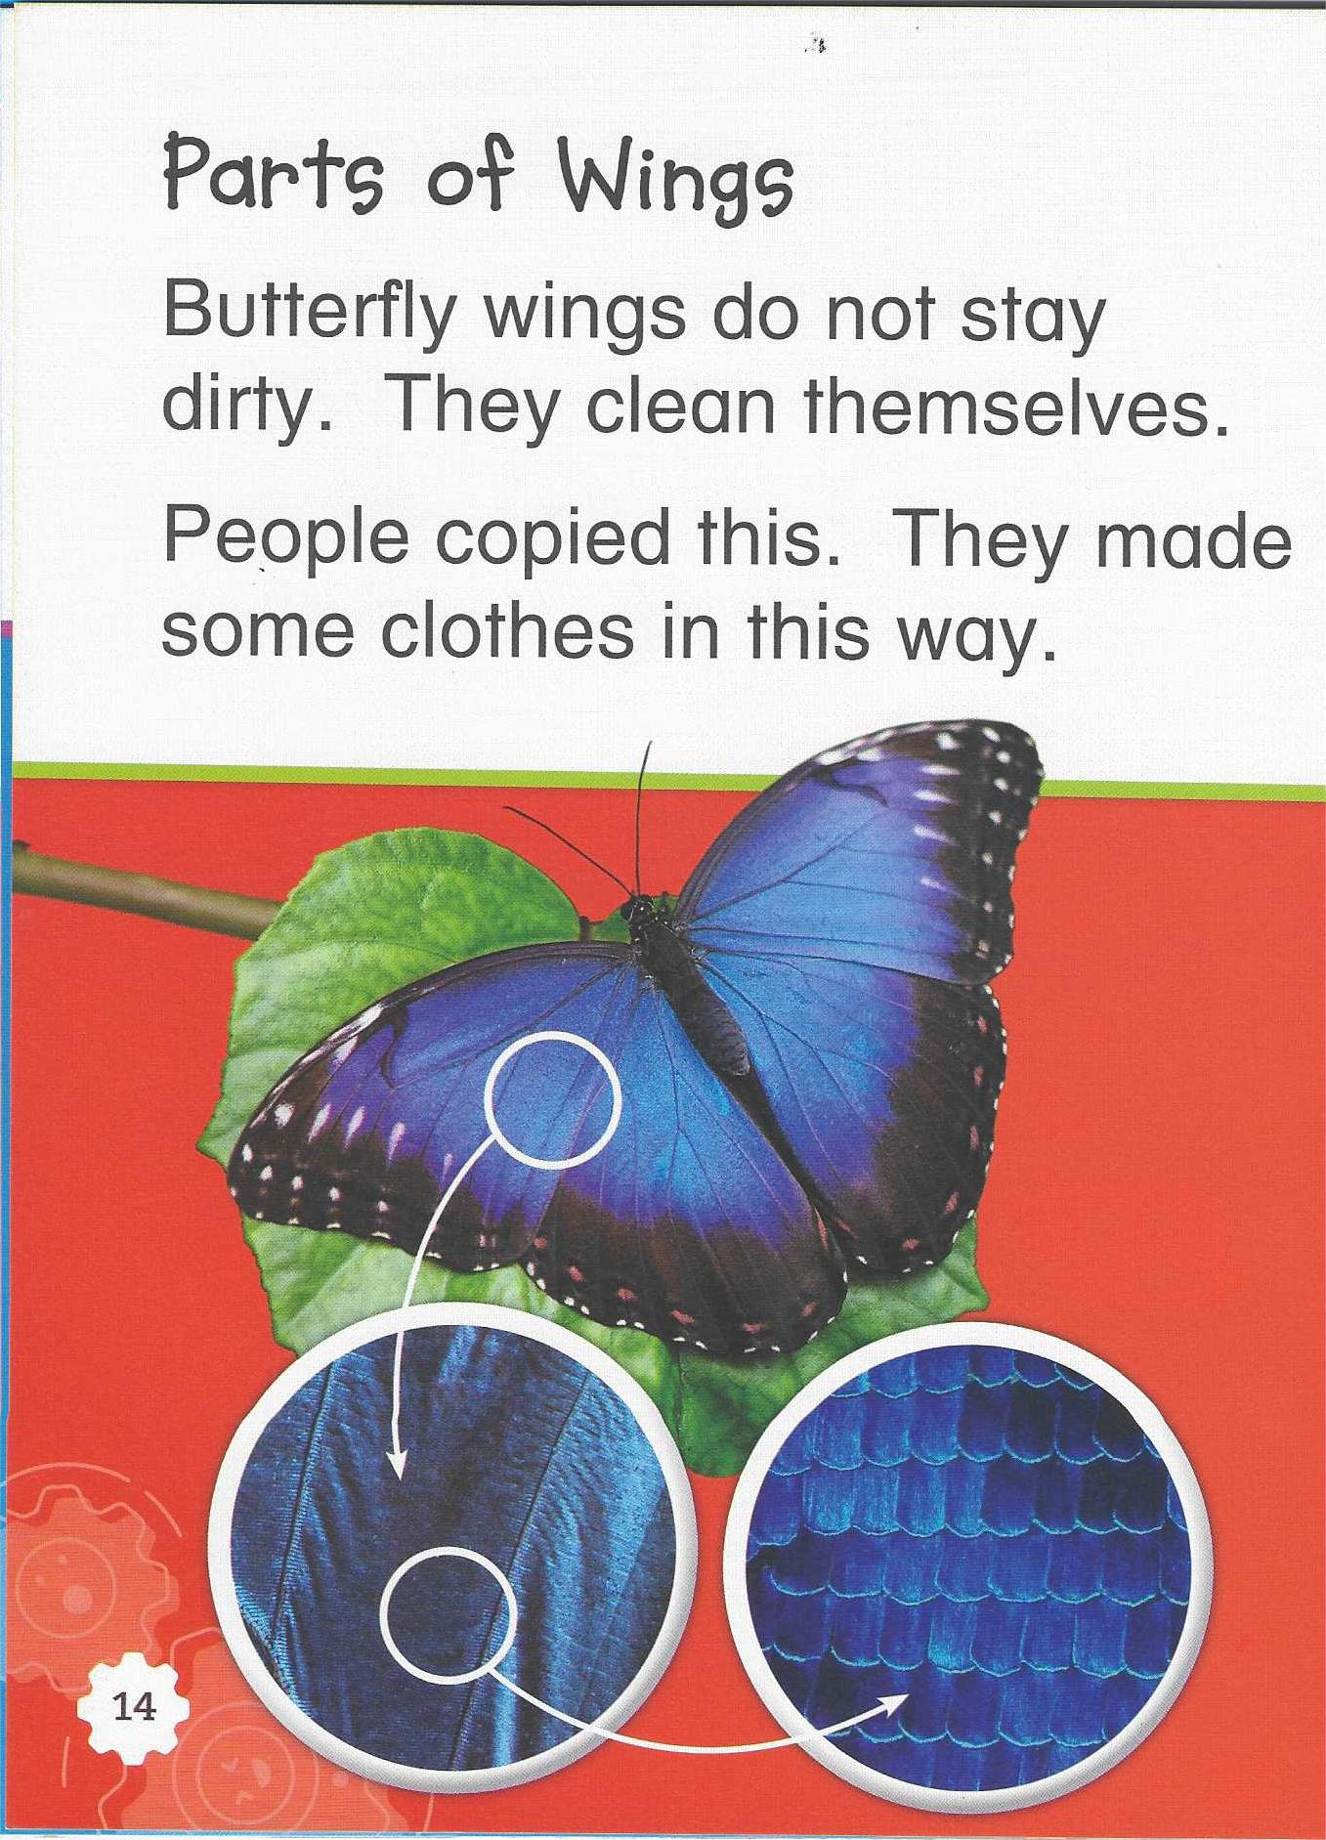
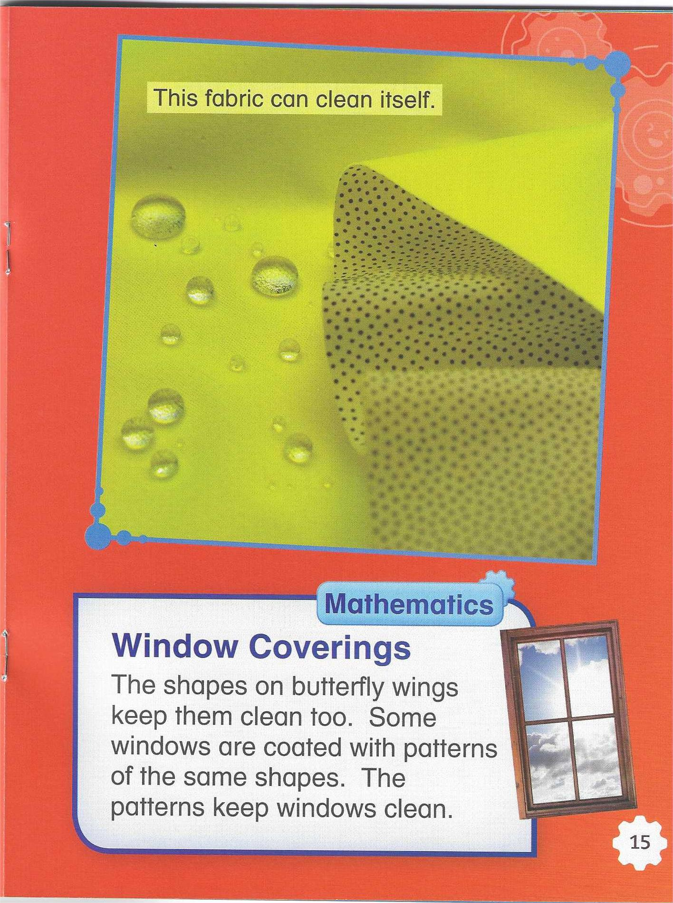
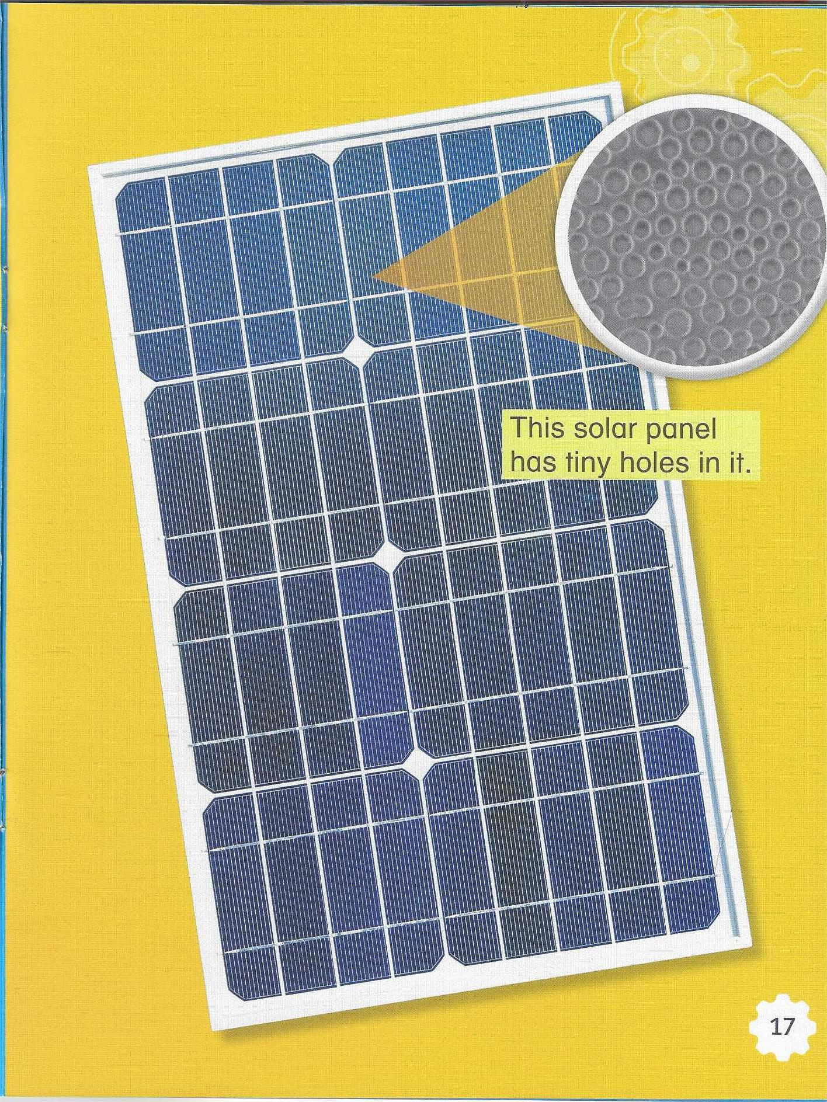
Parts of Wings
(Page7，14~16)
Which of the following is NOT an example of learning from butterflies?
A. Waterproof fabric B. Paint
C. Solar panel D. Window covering

Slide 8
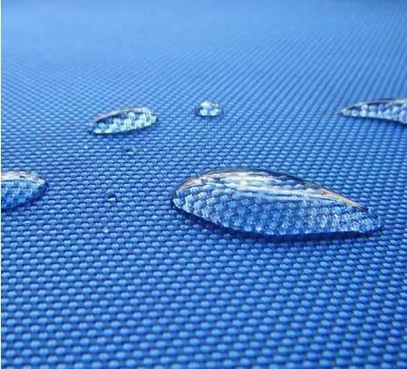
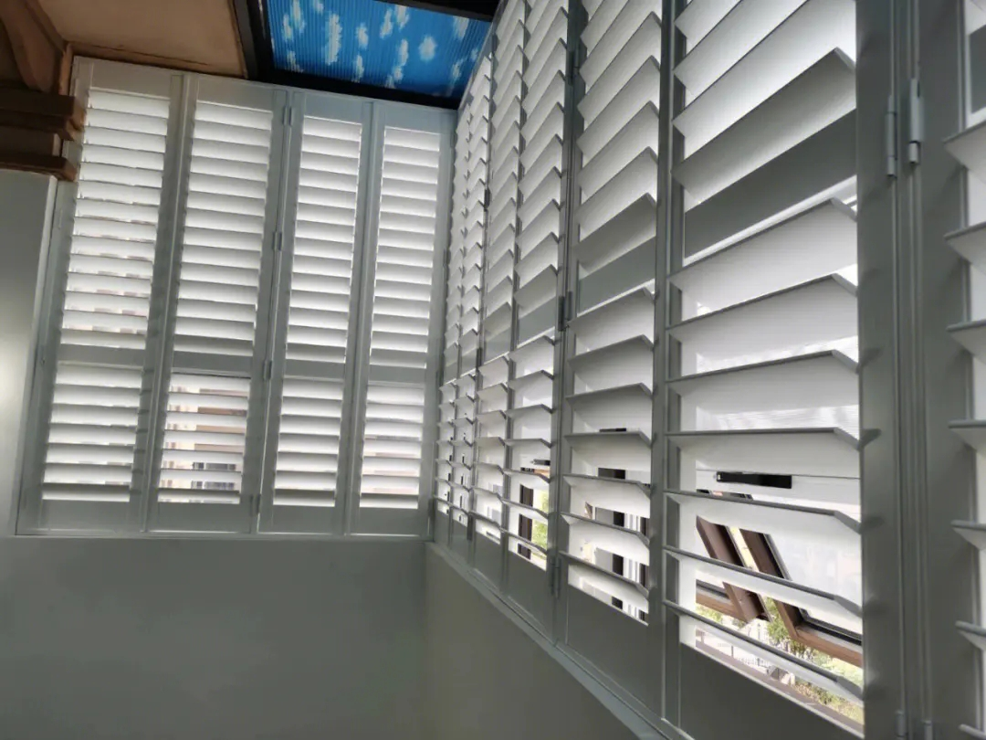
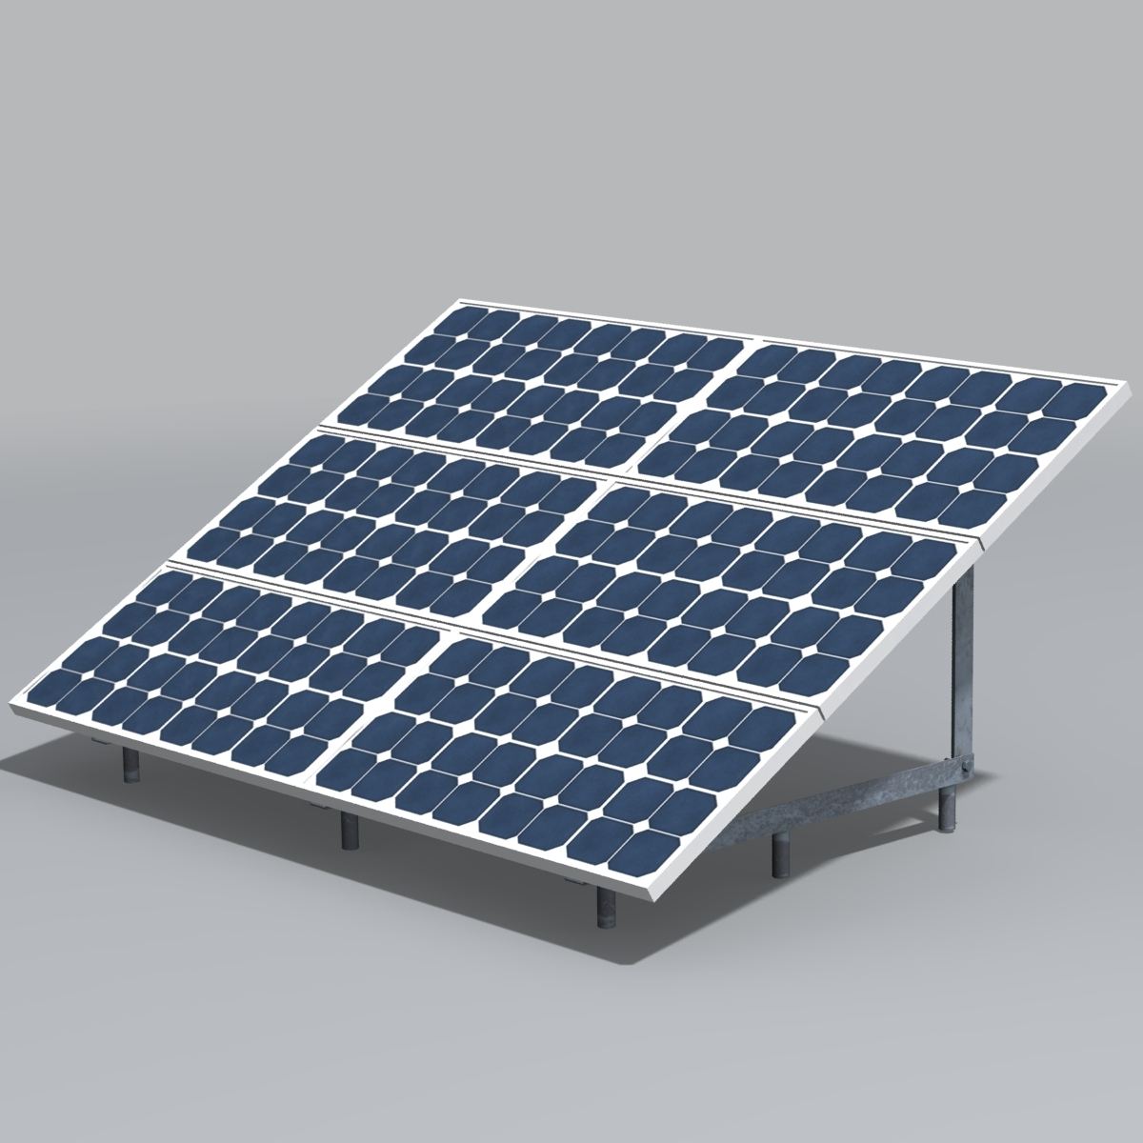
3
4
Parts of Wings
(Page7, 14~15)
the s______
tiny h_____
hapes
oles
be w________
keep c____
take in s_______
aterproof
lean
unlight
防水布料/衣服
Waterproof fabric/ clothes
百叶窗
Window coverings
太阳能电池板
solar panels

Slide 9

...of butterflies help them...
People learn from them.
We use/make...
The colors and patterns of butteflies help them blend in. People learn from them. We use paint and plants to hide.
blend in
colors
and patterns
the way to hide
blend in
be a warning
yellow or orange signs
bright colors
be waterproof
keep clean
shapes
waterproof clothes
window coverings
take in sunlight
tiny holes
solar panels

Slide 10


Information Cards
The colors and patterns of butteflies help them blend in.
People learn from them. We use paint and plants to hide.
Bright colors can be a warning...
yellow or orange signs
The shapes of butterfly wings...
waterproof clothes window coverings
...tiny holes...
take in sunlight
solar panels

Slide 11
What I KNOW | What I WANT to Learn | What I LEARNED
It has spots.
What can people learn from butterflies?
colors and patterns
parts of wings
the way to hide
a warning
waterproof fabric
window coverings
solar panels
...
It has patterns of lines.
It has four wings.
Learn from Nature.

Slide 12
Let’s visit the museum together !
Butterfly

