Slide 1
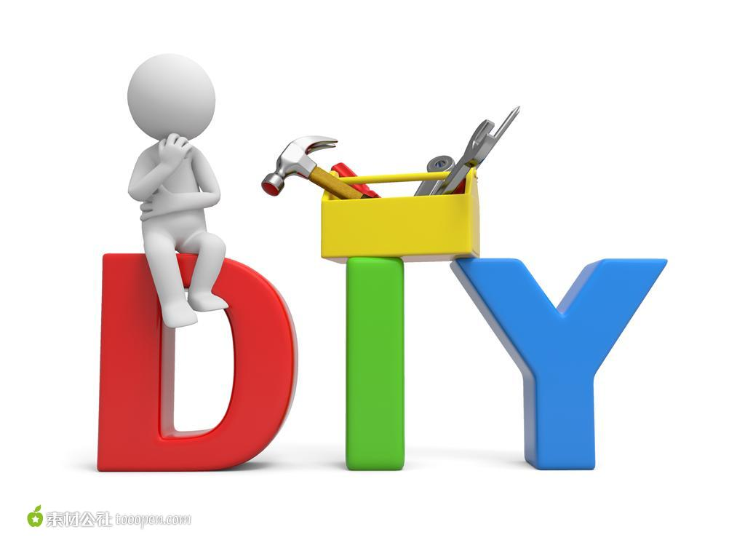
8A Unit4
Welcome to the unit
新北区实验中学 陈蕾

Slide 2
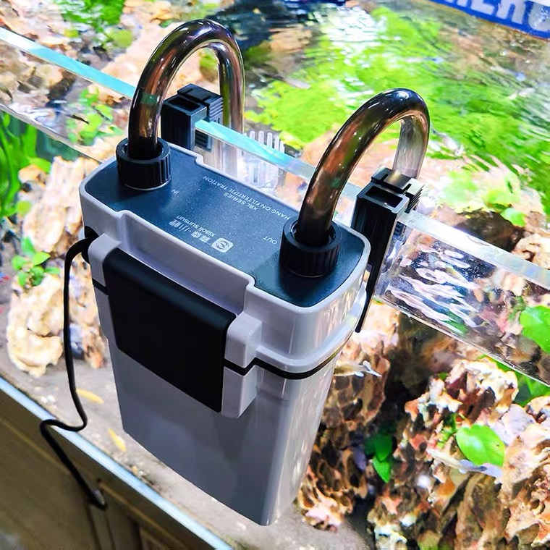
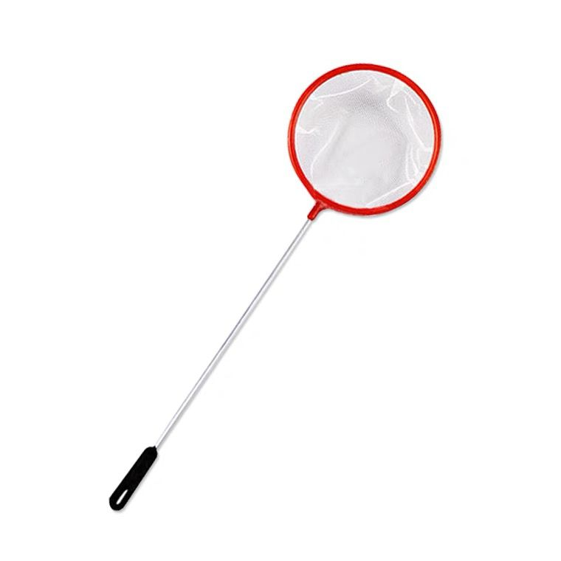
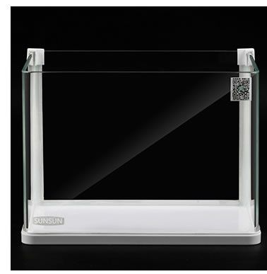
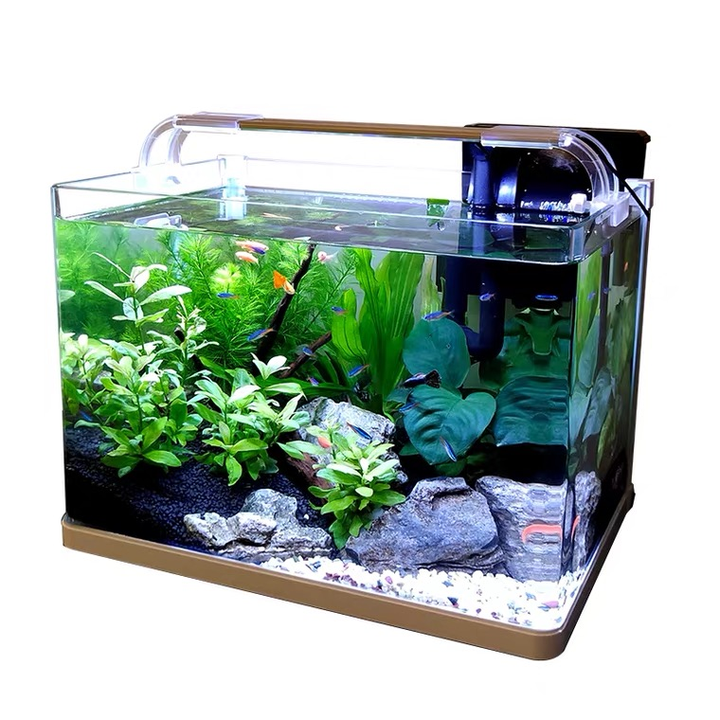
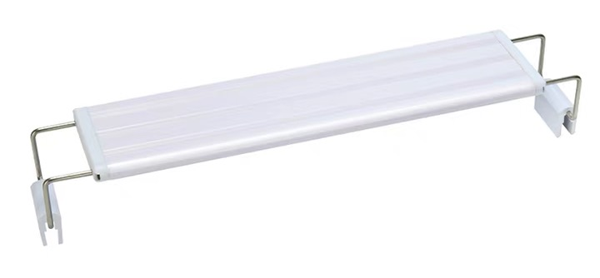
DIY a house for fish
oxygen pump
fish tank
net
ecological fish tank
light

Slide 3
net
light
oxygen pump
fish tank
Making things by hand brings me lots of fun. When I am free, I am interested in reading all kinds of books on DIY.
Today I made an ecological fish tank. First, I put sand, plants and clean water into the ________. Then I chose to put in an ______________ and a ______ because they can help make more oxygen. Finally, I used a______to move the naughty fish. Snails can also be put in the tank to eat something bad.
I am so proud that I can make a house for fish.DIY makes everything possible.
fish tank
oxygen pump
light
net

Slide 4
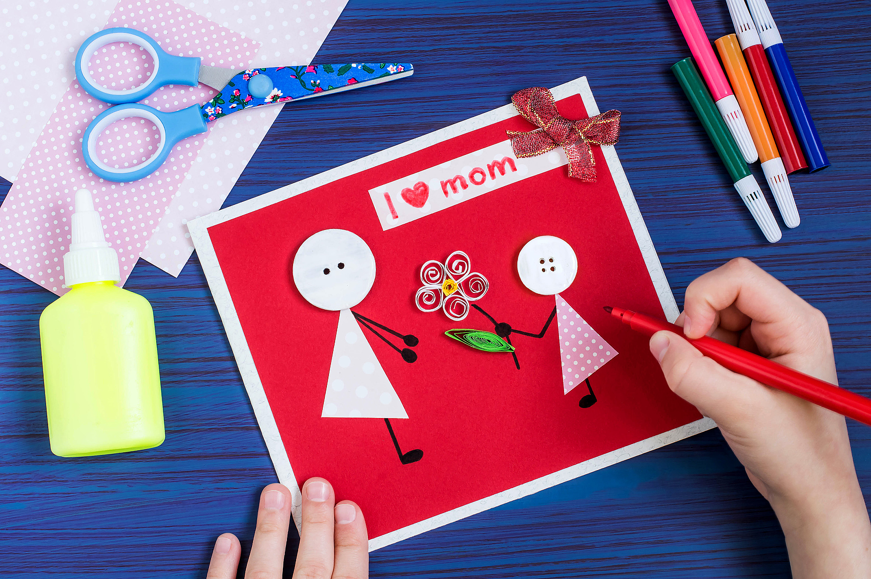
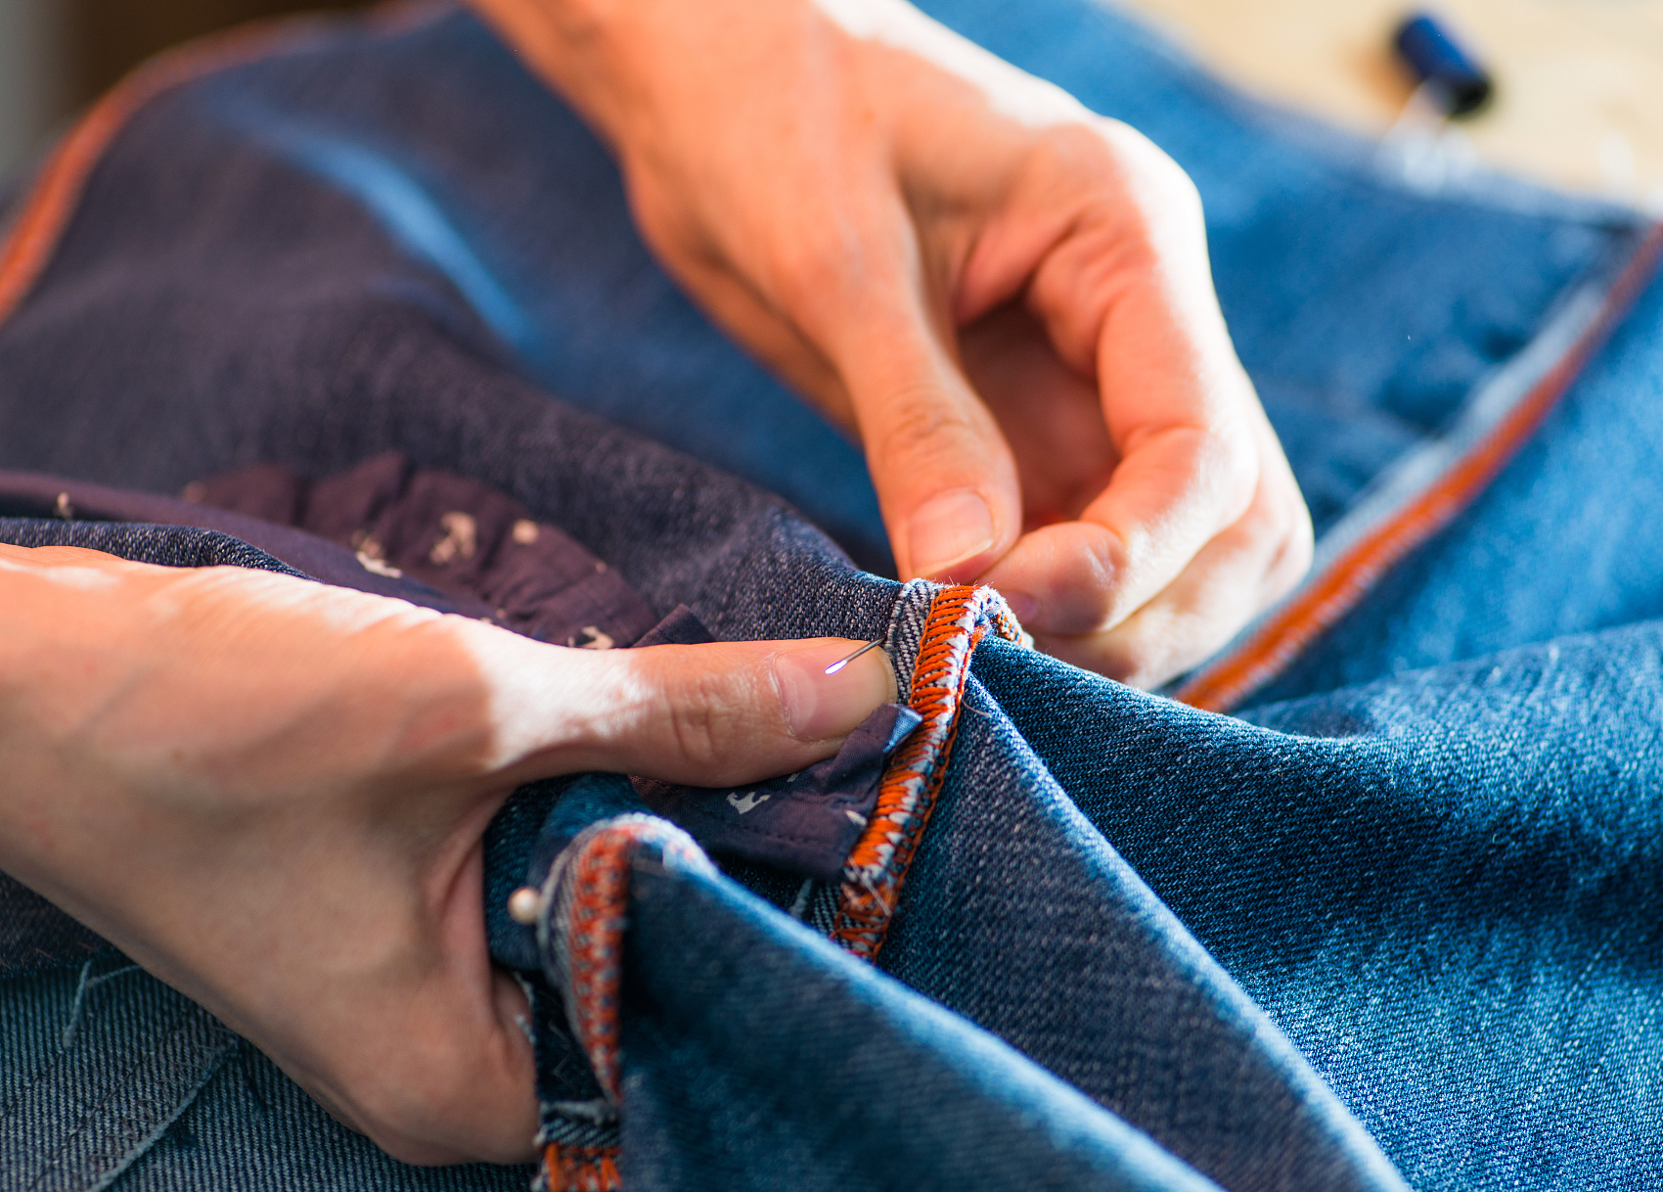
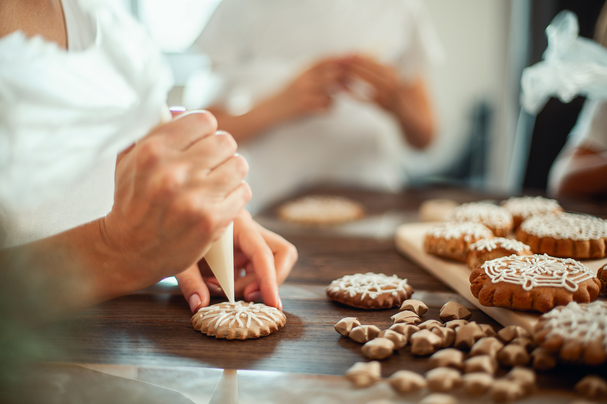

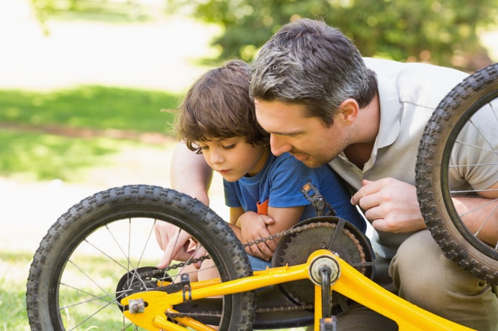

make mum a card
make things from old clothes
make biscuits
is very popular among people.
fix a bicycle
paint a room
others…

Slide 5
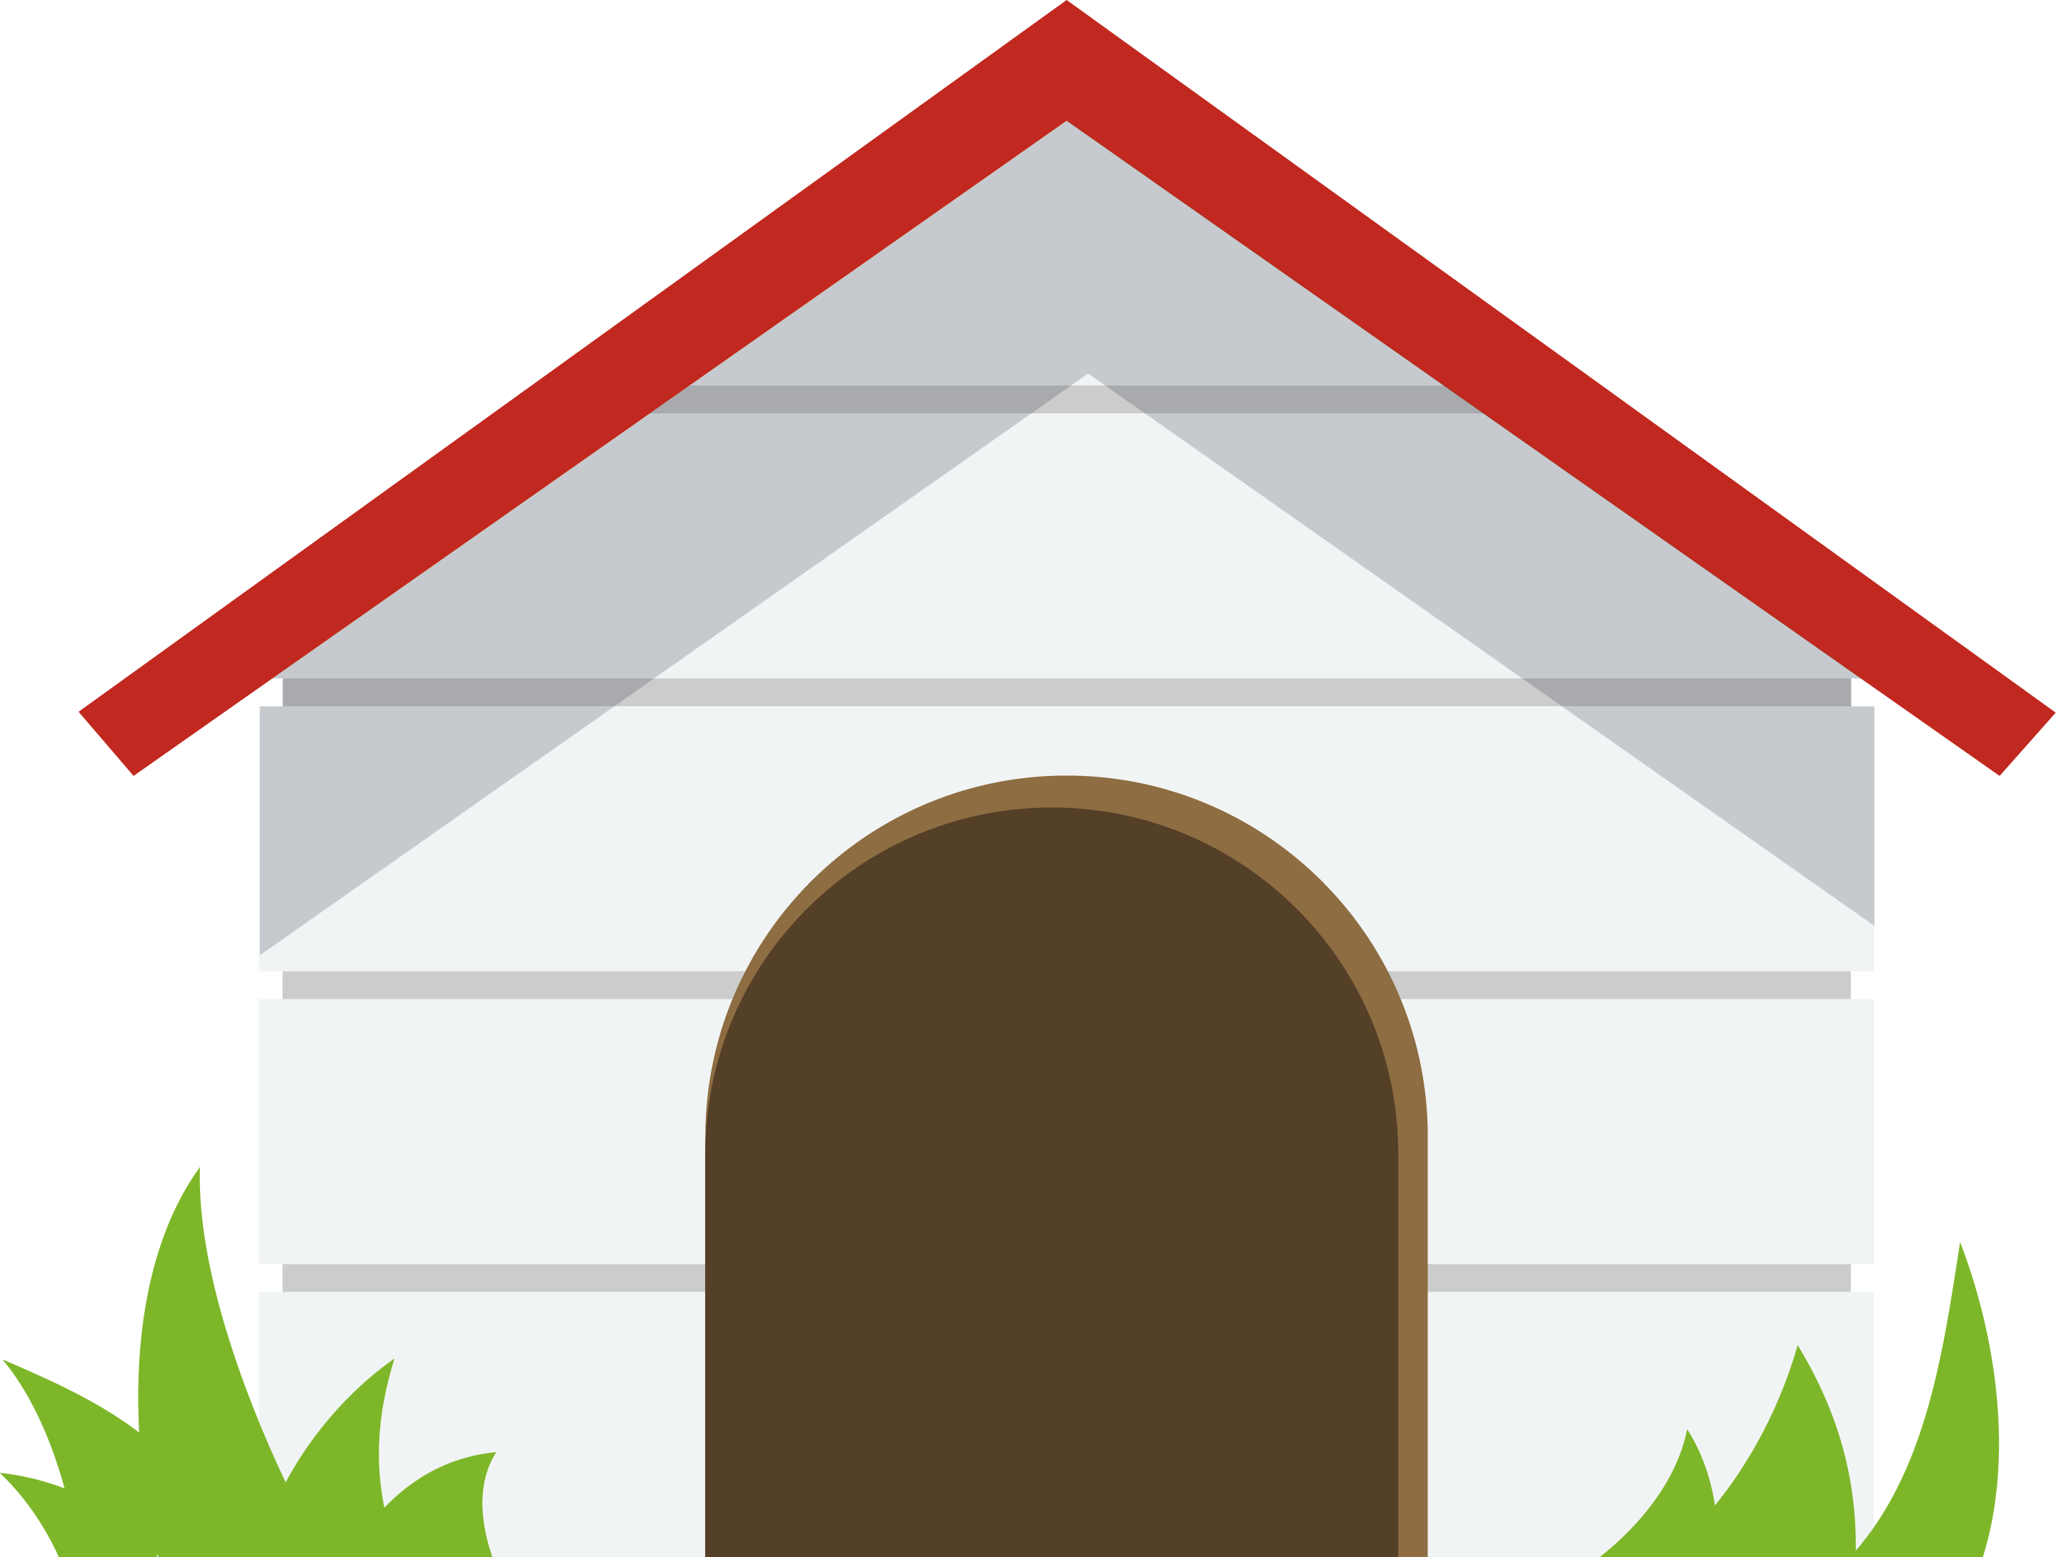
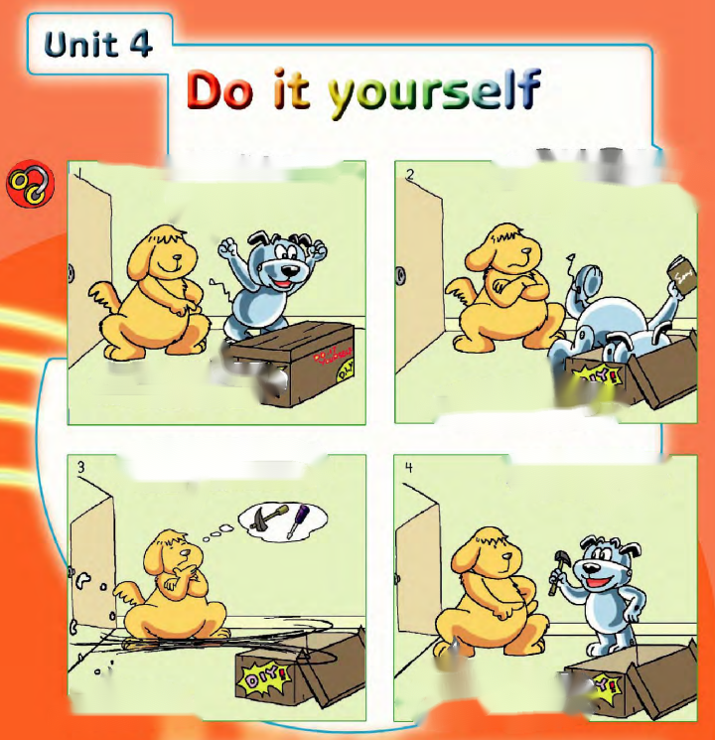

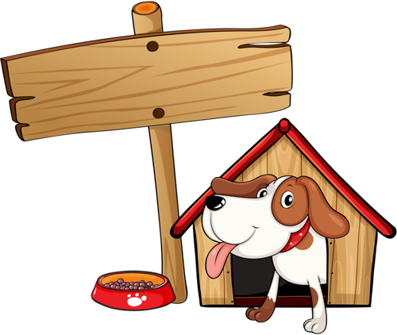
Hobo and Eddie’s DIY story
What should Hobo do first?
Will Eddie help Hobo?
[ɪnˈstrʌkʃn] 指示，说明
He should read the instructions first.
(He’d better read the instructions first.)

Slide 6


The meaning of DIY
What does DIY stand for?
what will you do before doing DIY jobs?
DIY stands for “do-it-yourself”.
read the instructions carefully.
get some tools ready.
plan everything well.
ask others for advice.
buy some DIY books.
We’ d better
Notes:
Eddie refufused to help Hobo. What do yo want to say to Eddie?语境
思维

Slide 7

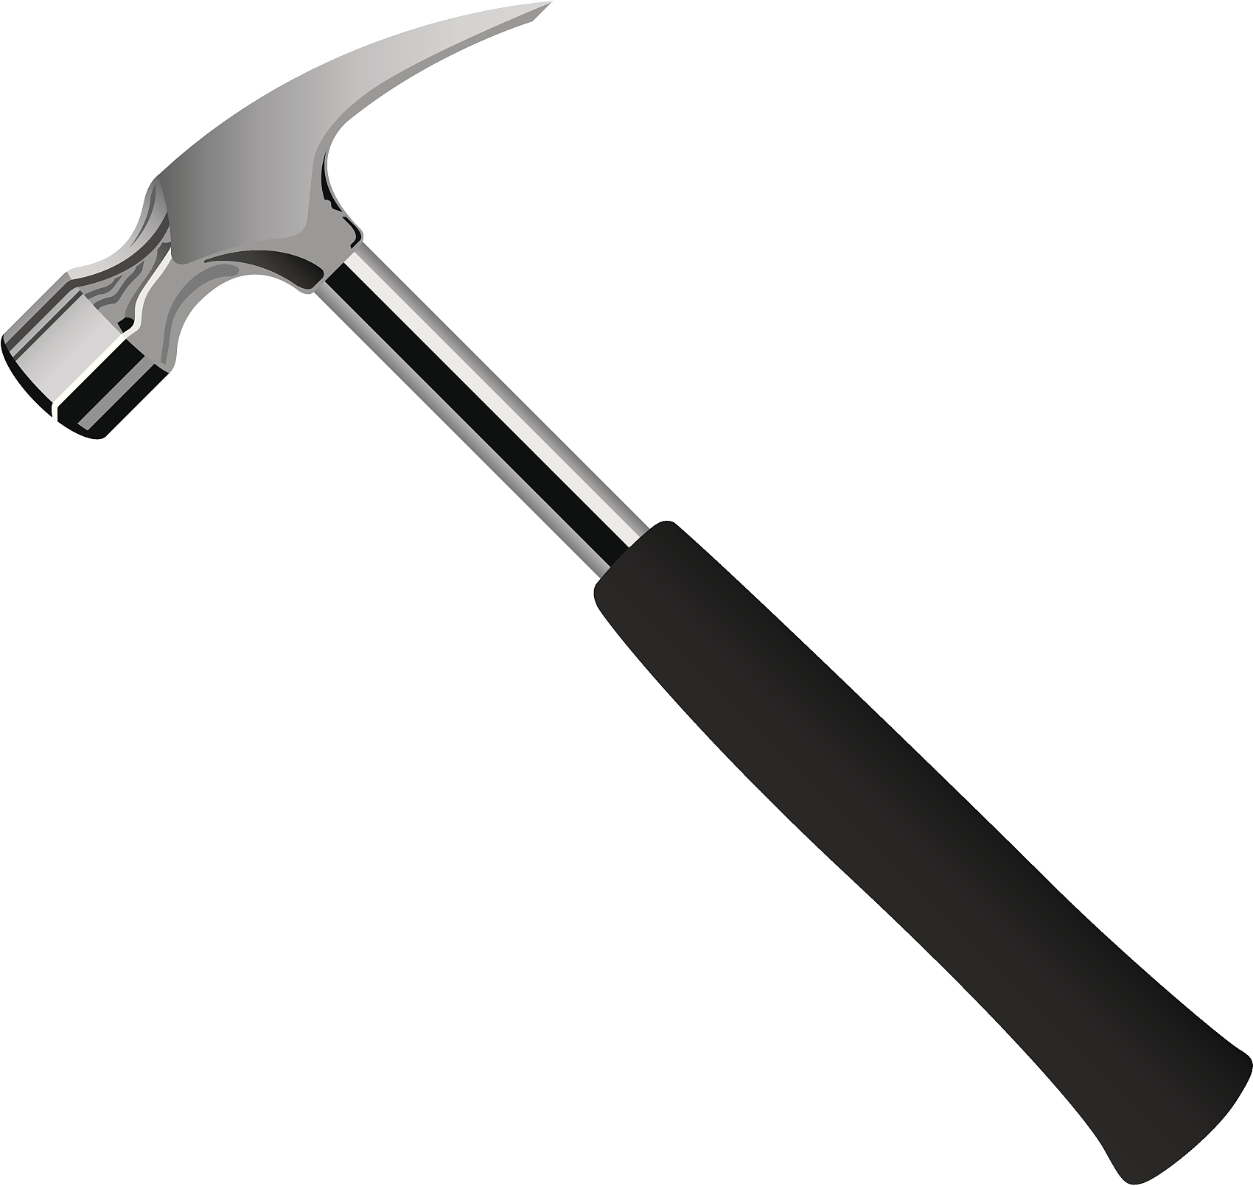
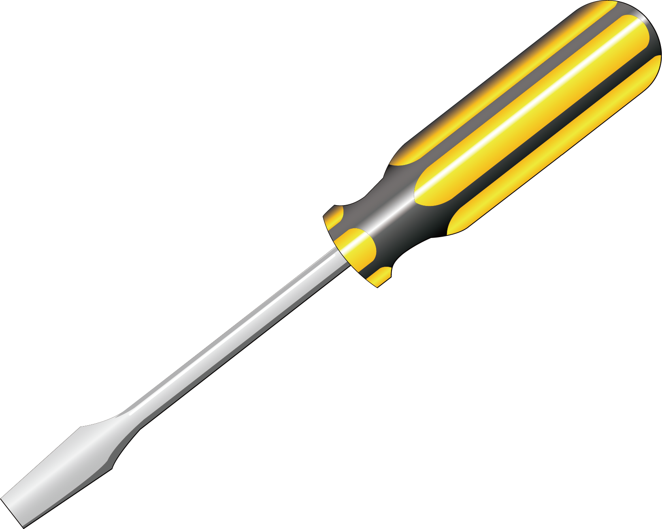
Tools
What tools does Hobo need?
hammer
[ˈhæmə]
screwdriver
[ˈskruːdraɪvə]

Slide 8
Tools
brush glue rope scissors tape
brush
glue
[brʌʃ]
[gluː]
tools
tape
rope
[teɪp]
[rəʊp]
scissors
['sɪzəz]

Slide 9
Instructions
brush glue hammer scissors tape
1. Use _________ to cut out the roofs of the house.
2. Stick the roofs with ______ and join them together with _______.
3. Hit nails(钉子) into wood with a _________ to build the wall.
4. Paint the house carefully with a _______.
scissors
glue
tape
hammer
brush

Slide 10
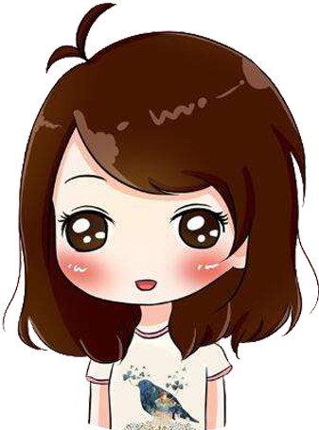
The purpose of DIY
Listen and answer
Suzy
Questions:
1.What is Suzy going to do?
2.What does she need for that?
3.Why does Suzy like DIY?
DIY is fun.
paper roses
Paper, glue and a pair of scissors.

Slide 11
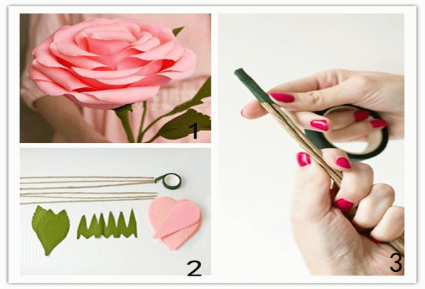

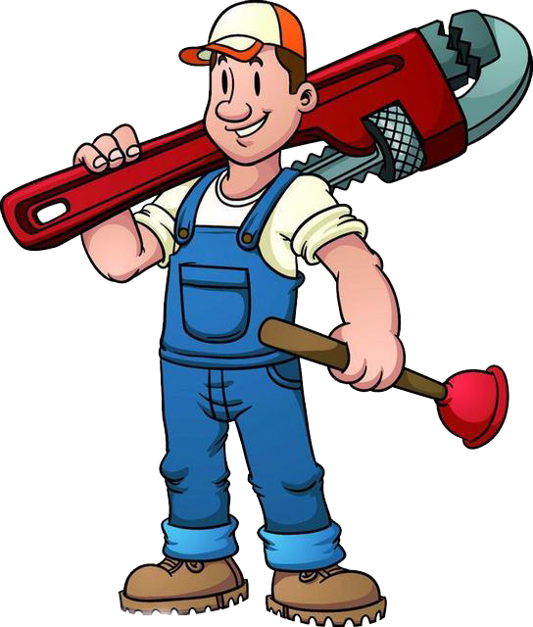

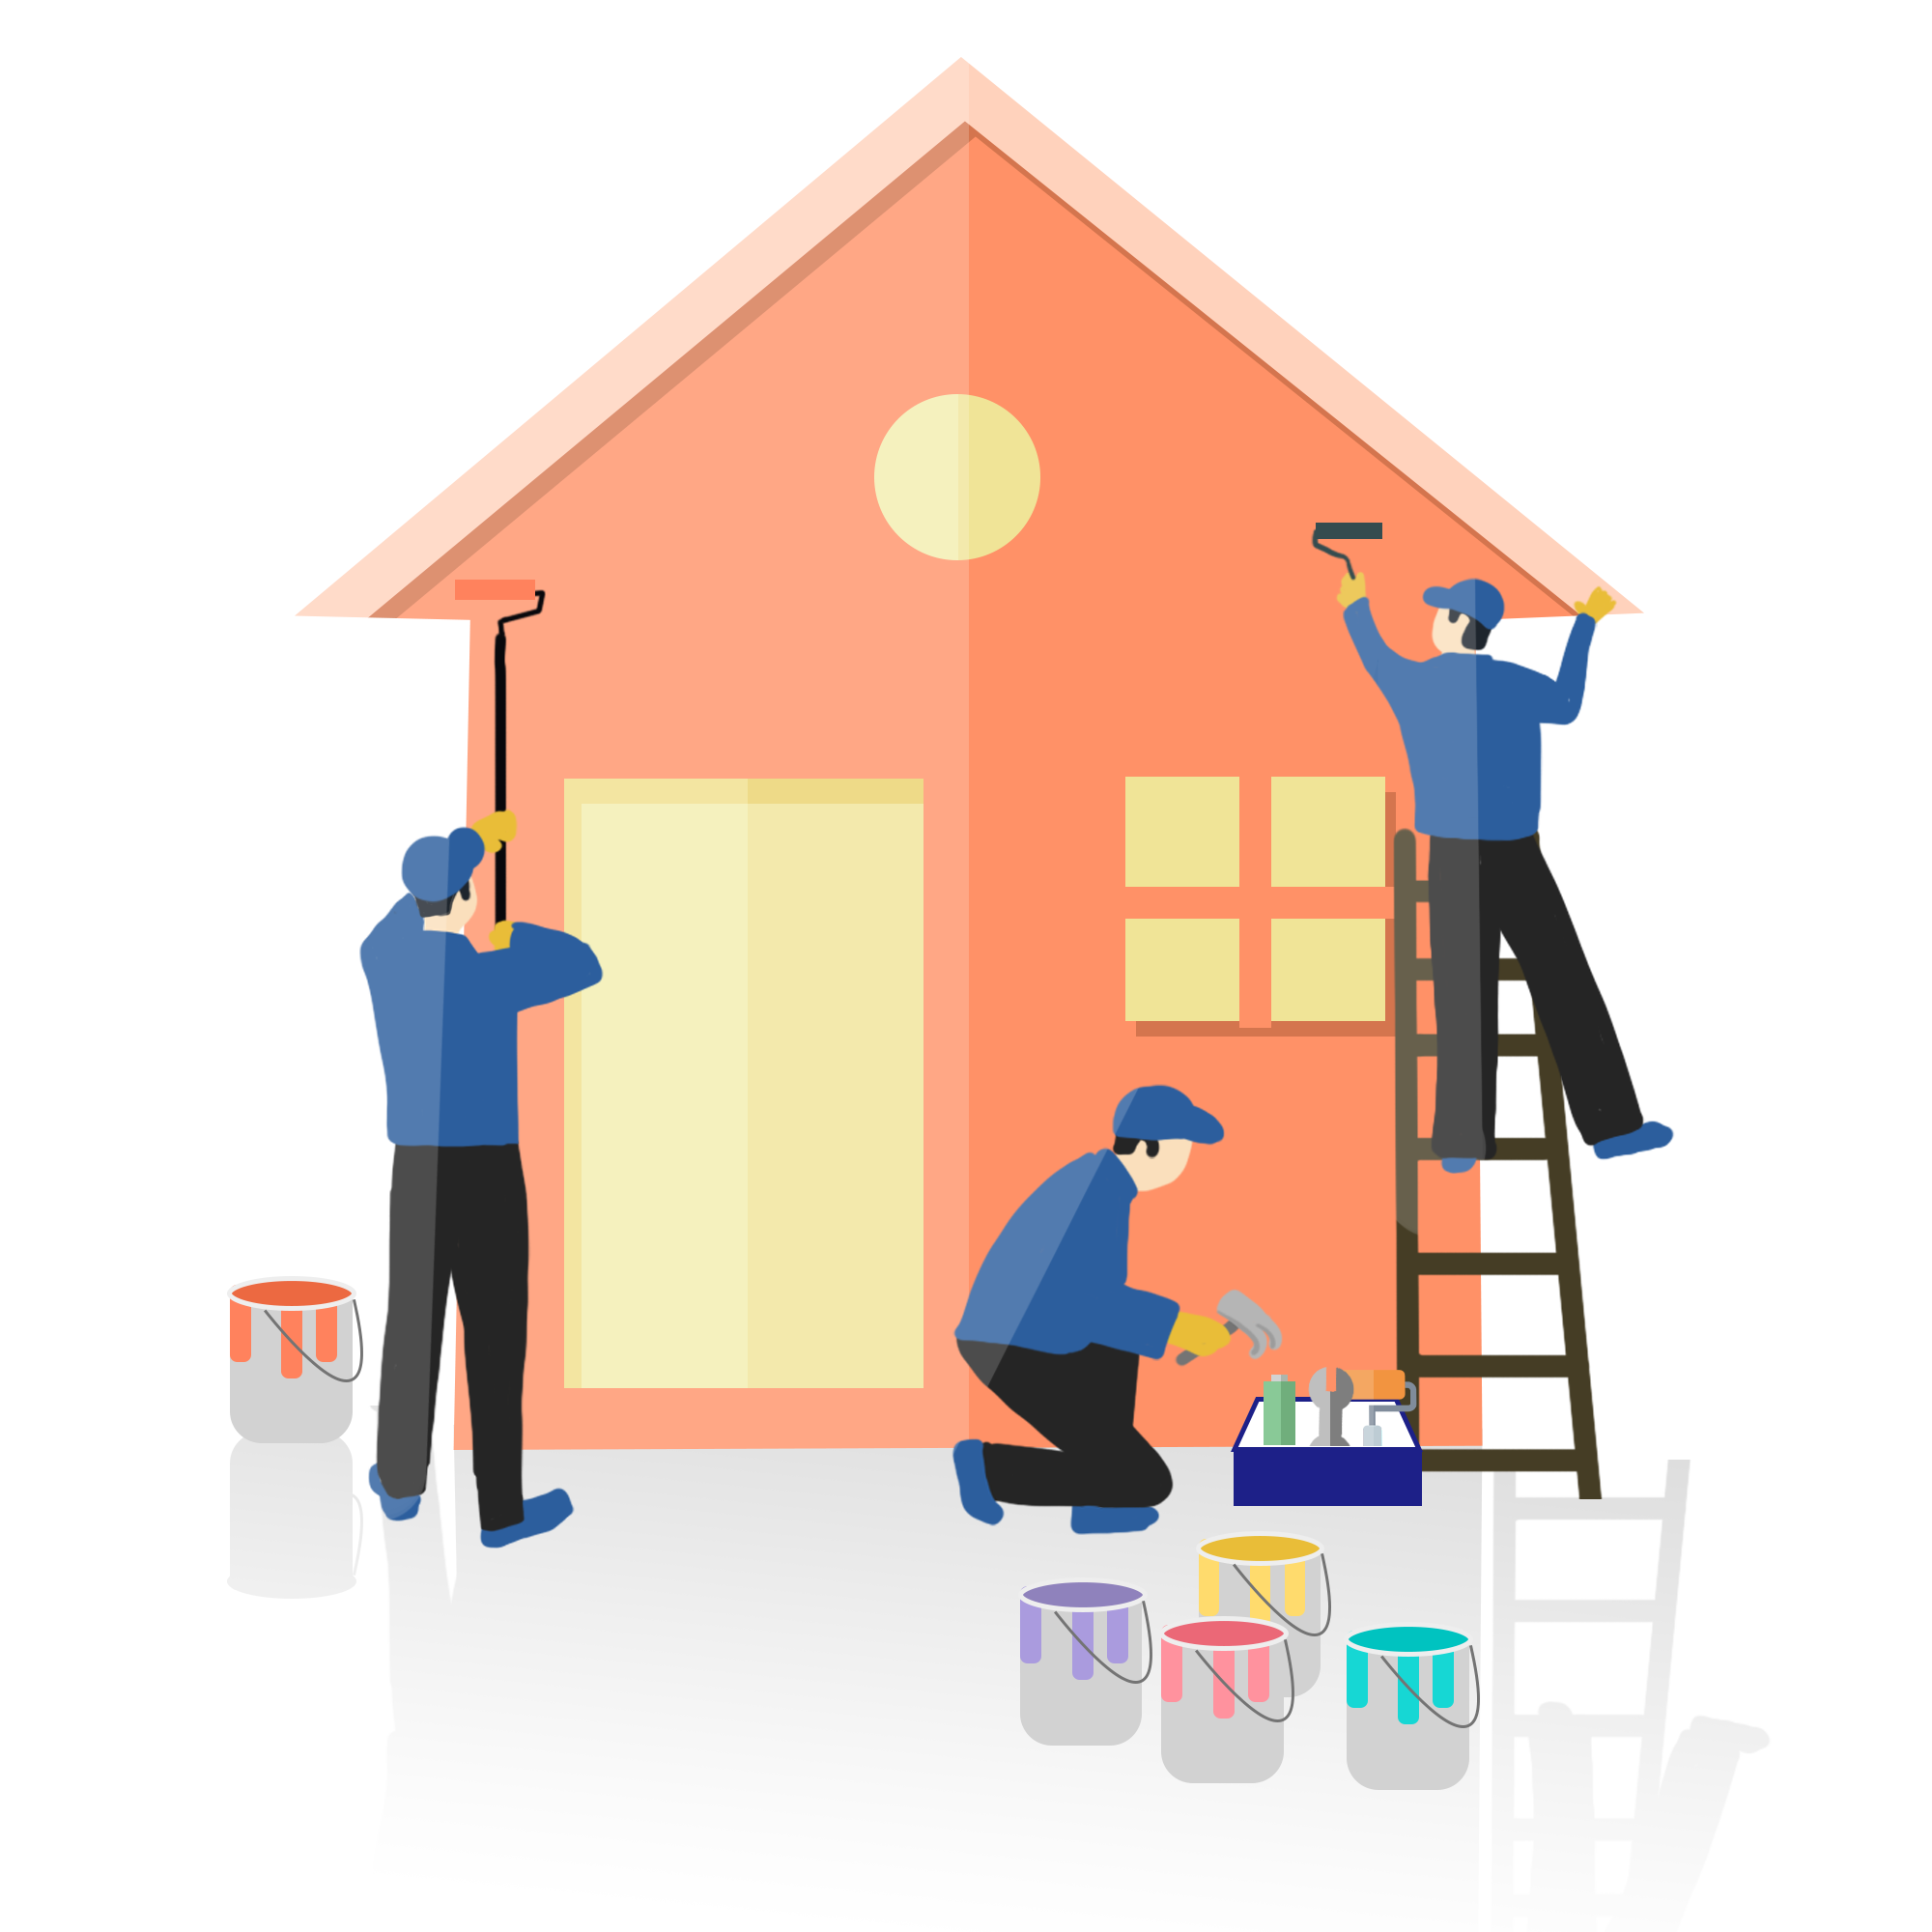

The purpose of DIY
What's DIY exactly?
make
精确地
When you do DIY,
you ______, ______
or ________ things yourself instead of ______________________.
repair
make
repair
decorate
decorate
paying someone to do it

Slide 12

make mum a card
make things from old clothes
make biscuits
A: DIY is becoming more and more popular now. Did you do any DIY works before?
B: Yes,I made/repaired/decorated _____________ before.
A: Why did you do that?
B: Because ___________________________________.
A: How did you do that?
B: I used _____________________________________.
A: Do you like DIY?
B: Yes, I do. I like/enjoy ____________. I think ___________.
No, I don’t.I think ___________________________________.
others…
fix a bicycle
paint a room

Slide 13
Origin (由来) of DIY
DIY stands for “do it yourself”.
It is not a simple sentence but a spirit(精神).
That is to do it yourself, challenge(挑战) yourself and enjoy yourself.
In the beginning, Western people decorated their houses by themselves. They found it could save a lot of money and each house was wonderful and different from others. They were very pleased.
Later, decorating houses became a hobby after work. It could make people relaxed and happy. At the same time, they could improve their abilities.
Now, DIY is becoming more and more popular in the world.

Slide 14

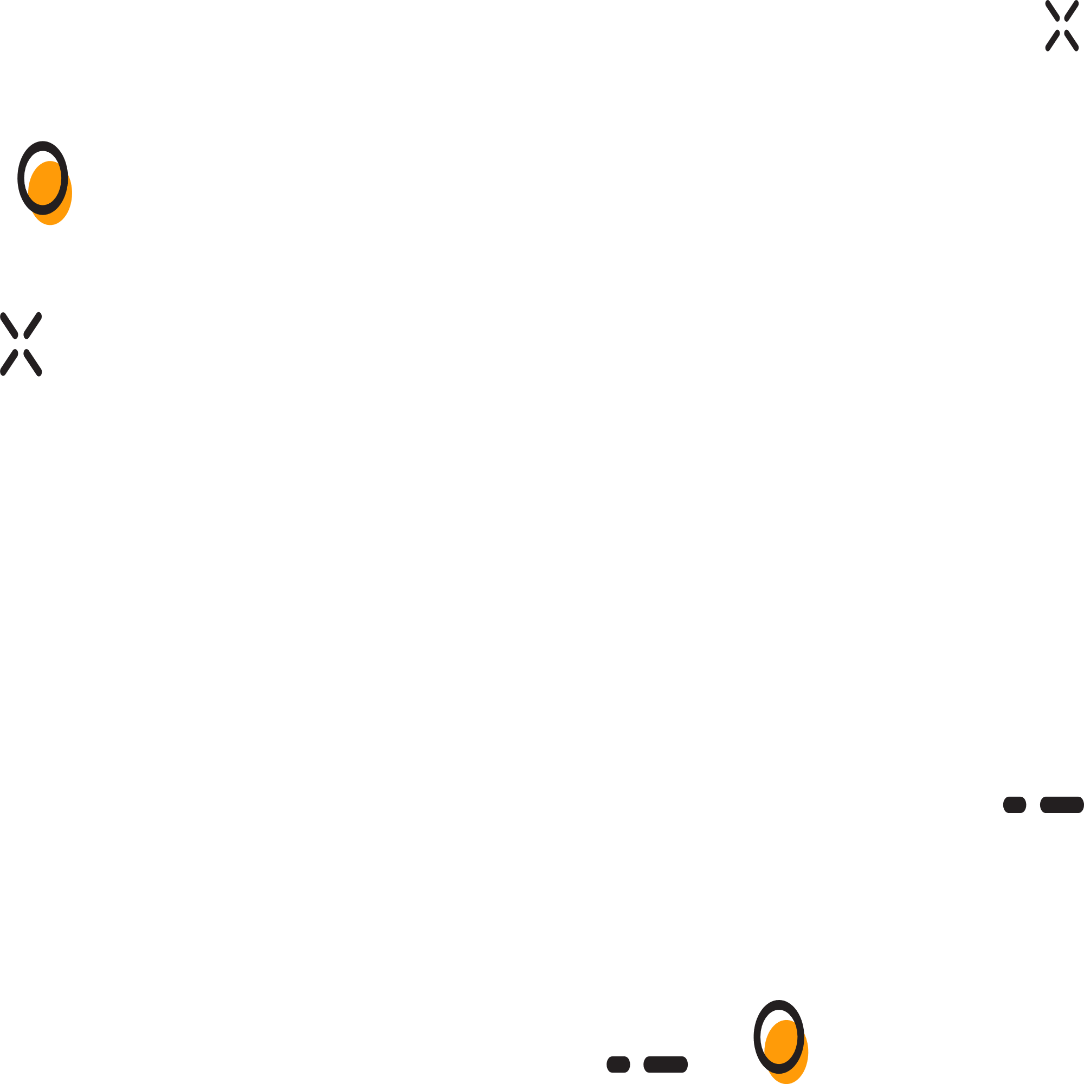
My DIY story
Tools
DIY stands for...It’s very popular...
I often (make...repair...decorate...)
DIY
Today I made...Before DIY, we had better read...and got some tools such as ....
At first I used.../ I did ...with...Then...
Finally...
Feeling
I feel... Because...
Expressiveness表达:
Cooperation合作:
Creativity创意:
A: Discussion leader
B: Timekeeper
C: Storyteller
D：Reporter

Slide 15
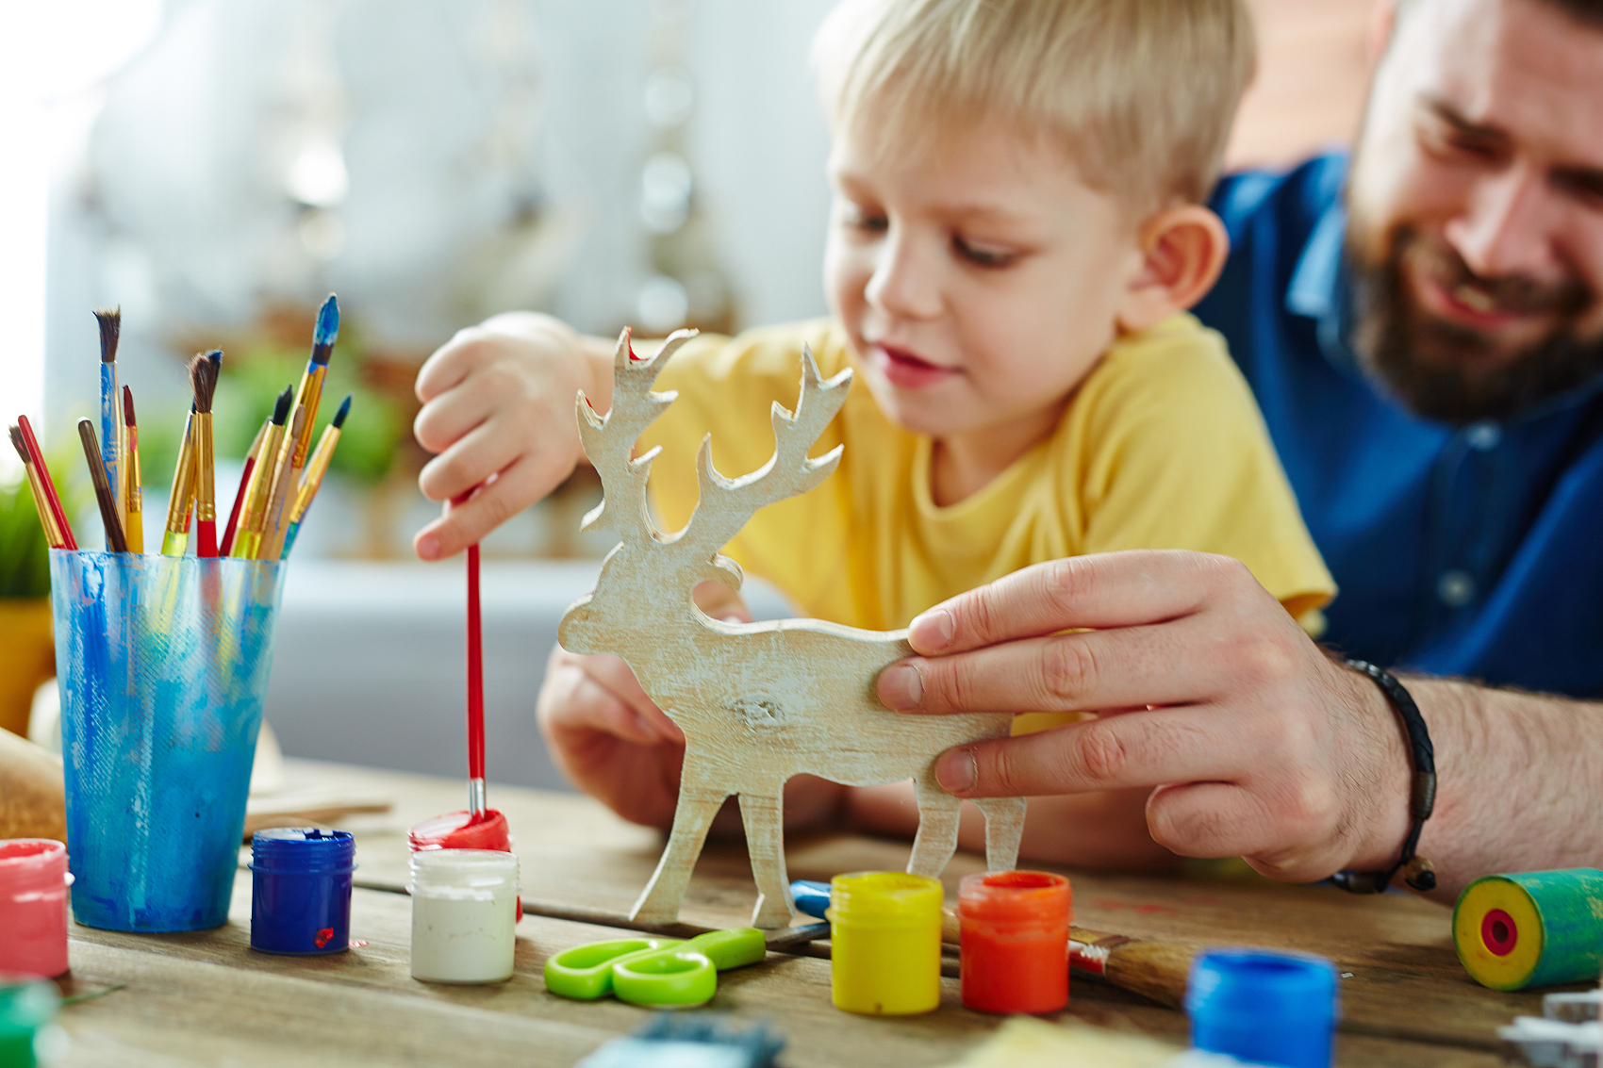
DIY can
make our life
more interesting,
more colourful!
Enjoy DIY,
enjoy your life!

Slide 16
Homework
Finish a DIY job at weekends and share your videos with us.

