Slide 1
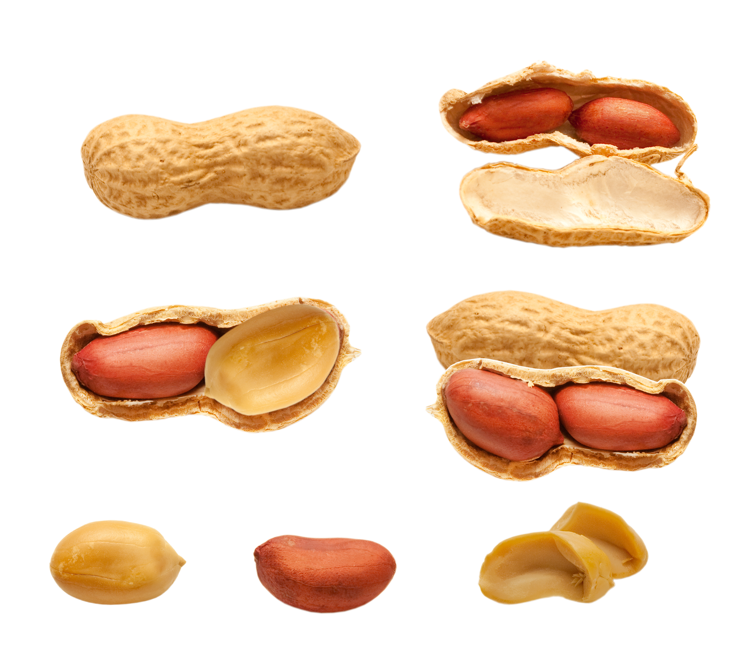
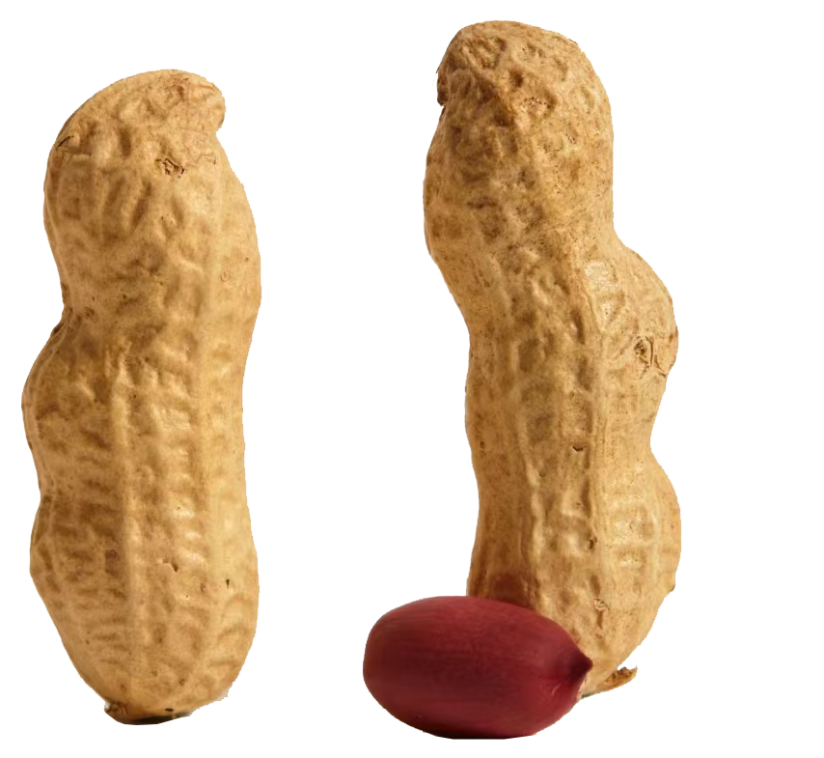


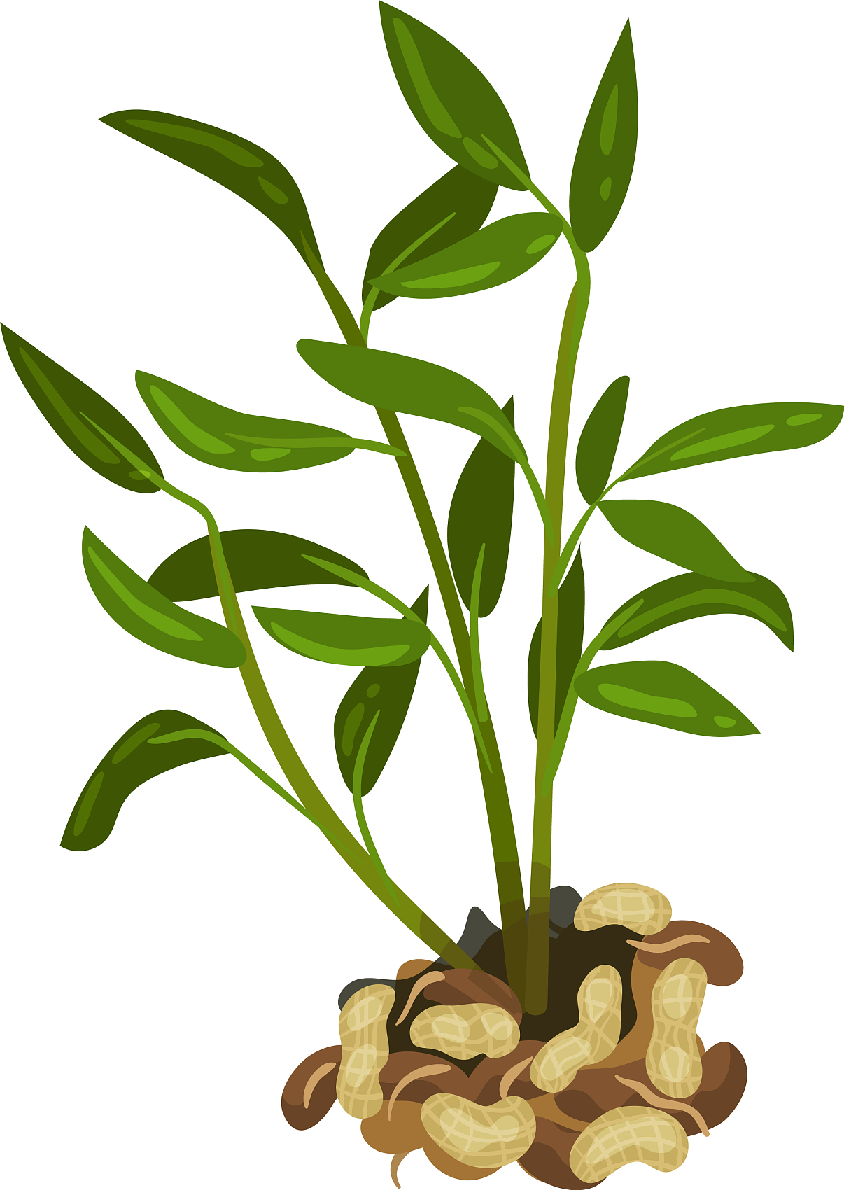
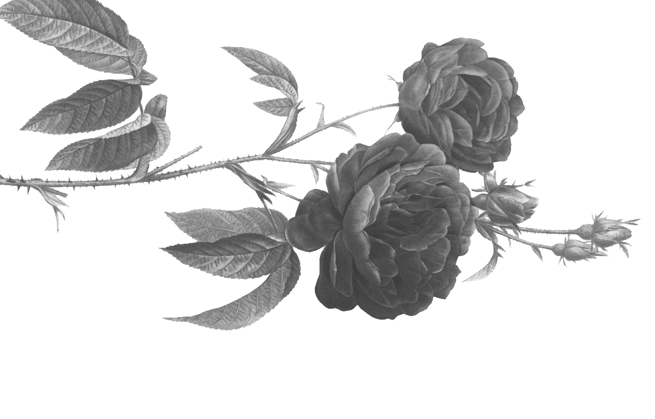

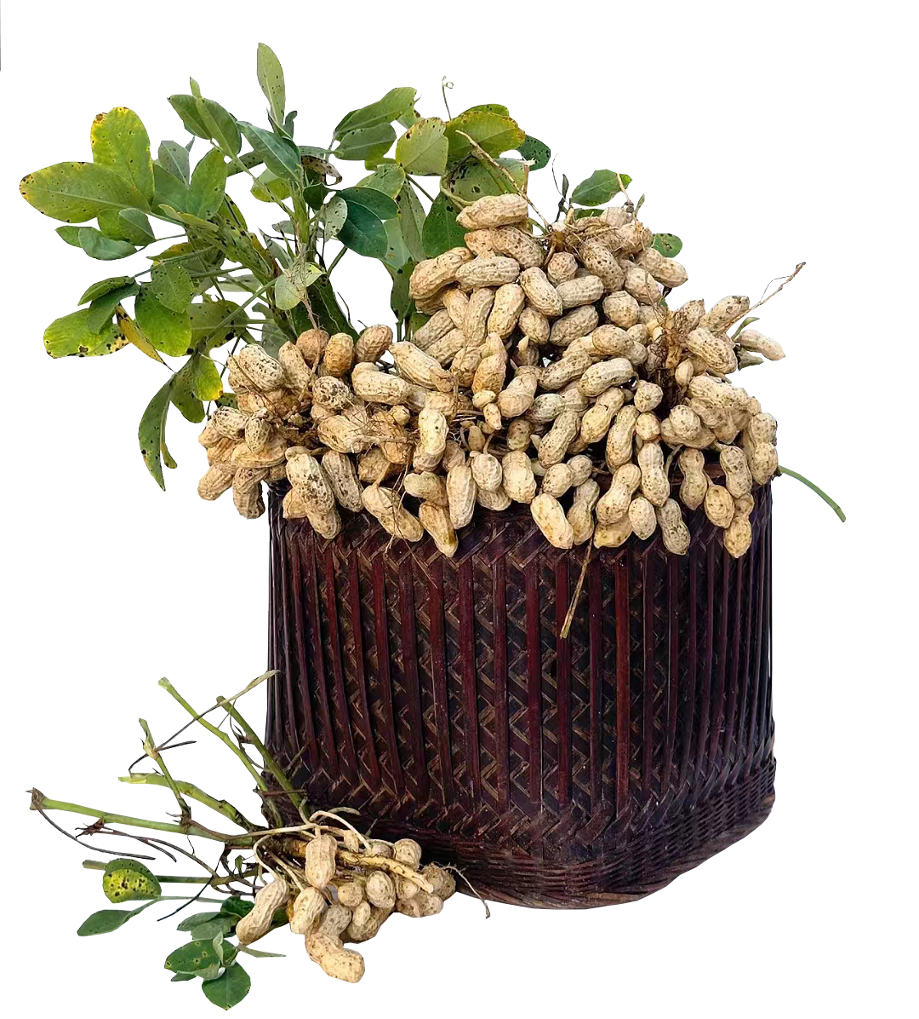
许地山
Peanuts
Changzhou Xinbei District Experimental School
Qian Fangliang

Slide 2
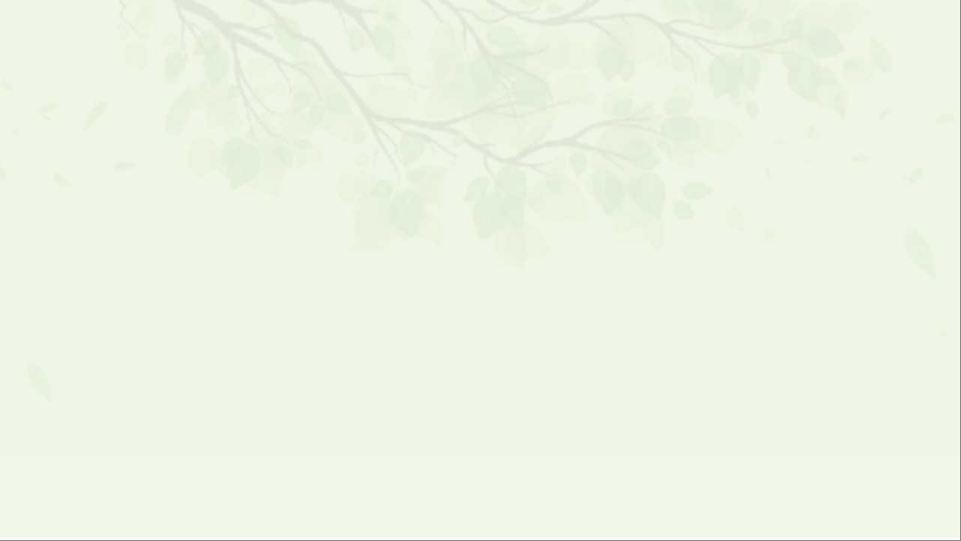

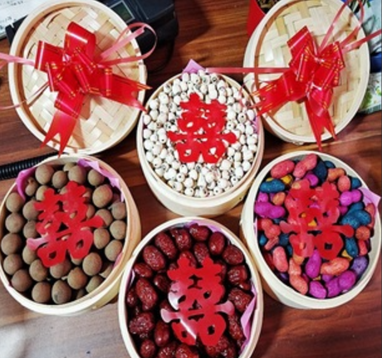
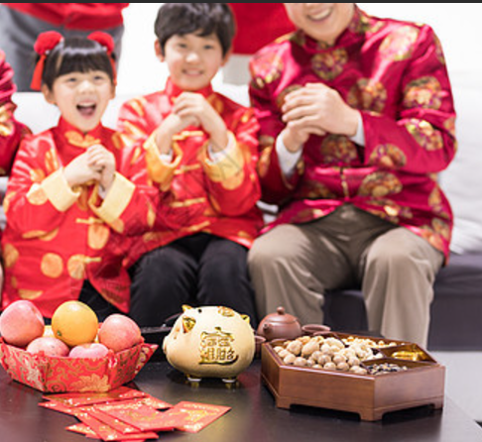
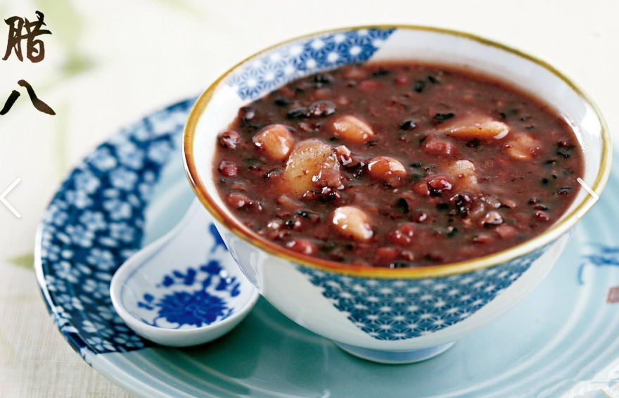
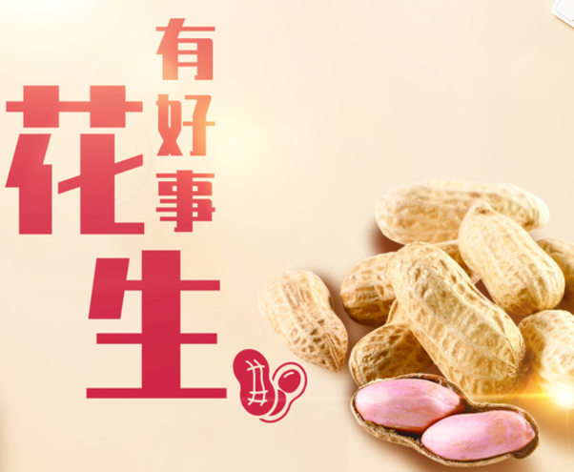
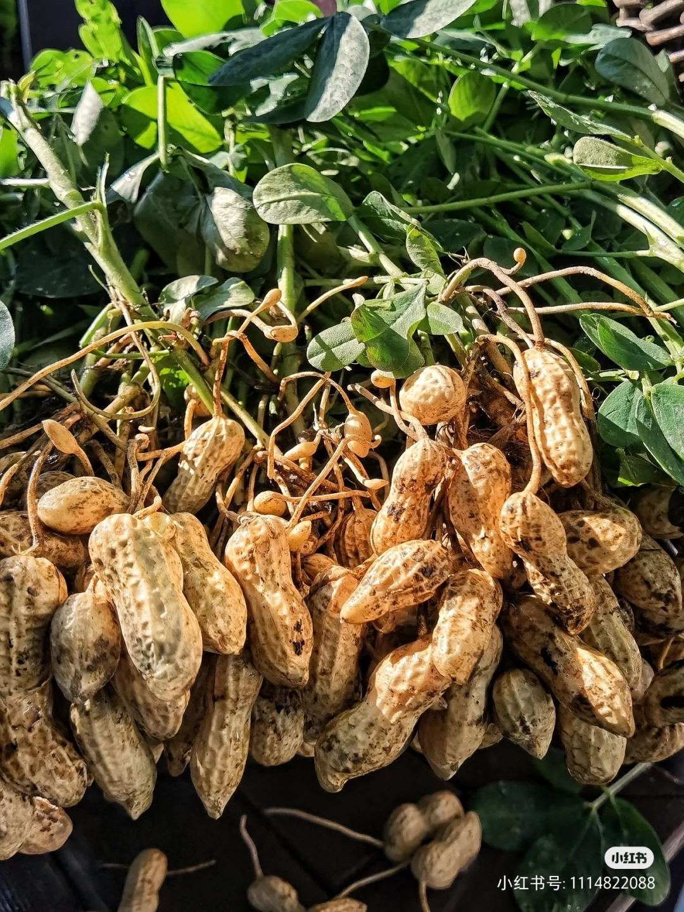
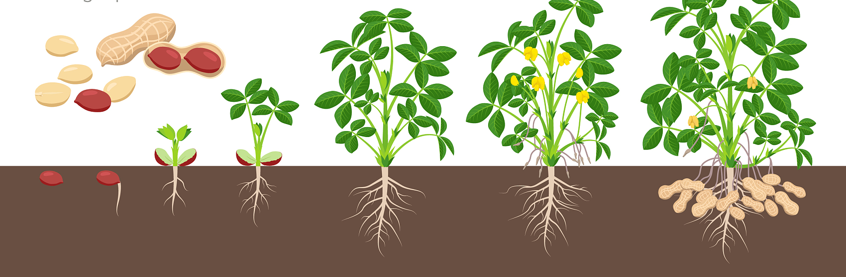
Lead-in
Read and guess
Shell like ships,
hard outside, strong and chubby,
delicious inside, red and fat,
not shown in the air,
but _______________________.
Peanuts
v. 埋藏
bury in the earth
Notes:
I have given you some peanuts.

Slide 3
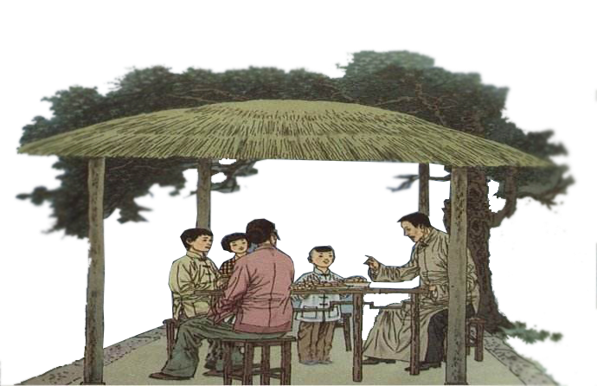
Pre-reading
Predict
What do you want to know about this picture?
Where?
Why?
What?
... ?
Who?
Notes:
For example, do you want to know who they are? What esle do you want to know?

Slide 4
While-reading
Fast-reading
Read through the passage quickly and try to answer:
1. Who are the people in the picture?
2. What did they plant? Where did they plant?
3. What type does this passage belong to?
A. exposition(说明文) B. narration（记叙文） C. news
Mother, father, brother, sister and I.
空地，荒地
Peanuts.
In a small piece of unused land at the back of the house.
Tips:
Circle the subject, time tense and questioning words.
Leave out(省略) something unimportant like subject, verb, adj, adv, etc.
Notes:
不用肥沃土地

Slide 5
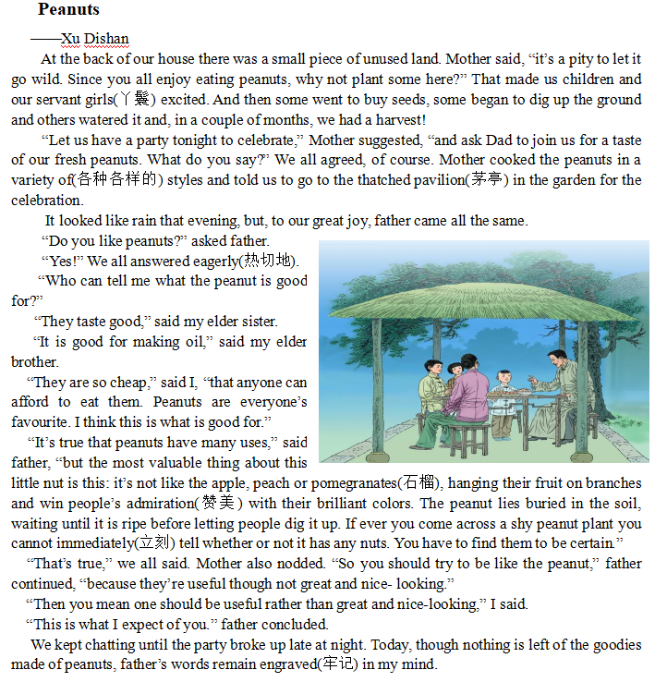
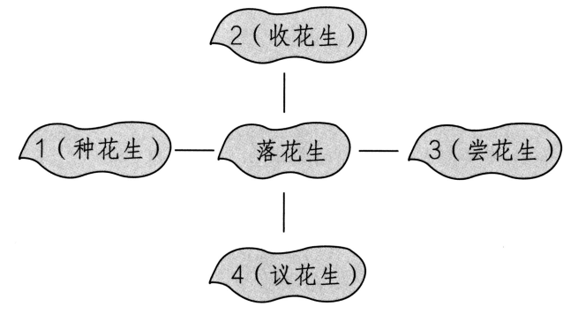
While-reading
Fast-reading
Choose four verbs to describe what the writer writes about peanuts to make a mind map(六选四).
General information:
planting,harvesting,
tasting
2.
2.Harvest
1.Plant
Peanuts
Detailed information:
discussing
1.
3.Taste
3.
4.Discuss
4.
A. Plant
B. Harvest
C. Discuss
D. Cook
E. Taste
F. Buy
Notes:
What is talked about in general/detail? We have general information about planting, harvesting and tasting.

Slide 6
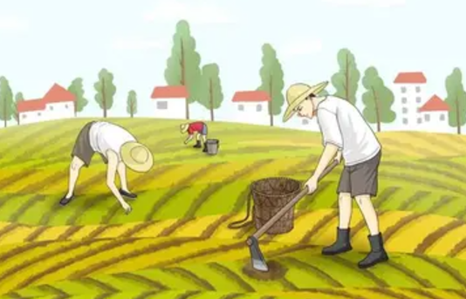
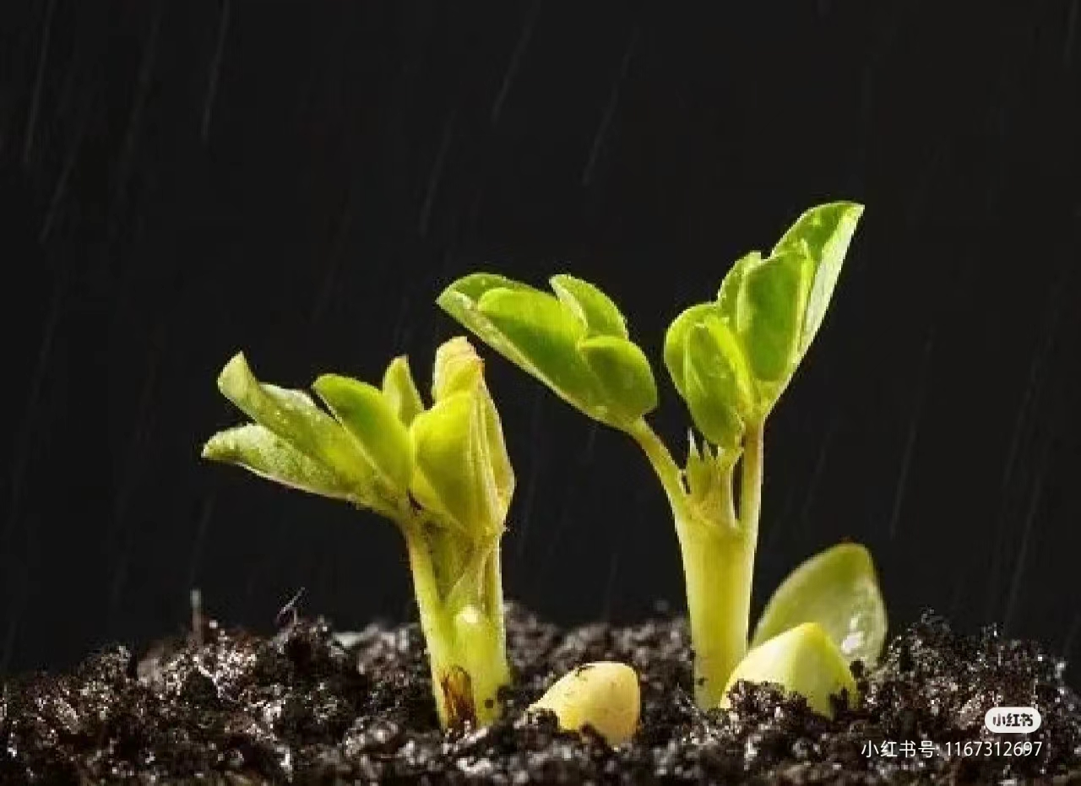
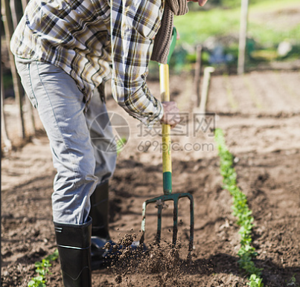
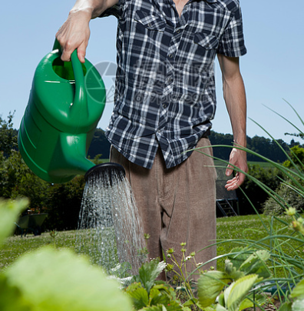
Careful reading：read Para1 and fill in the blanks.
While-reading
(用正确形式填空.)
Mother found it a waste for the small piece of 1._______ land, so we made it a 2. _______ field. Some 3. ______ seeds, some 4._____ up the ground and others 5.______it In a couple of 6._______, we 7.___ a harvest. That made us 8. ______. Through the experience of 9.___________ peanuts in the field, we are also _________ up.
unused
Labor itself is a kind of enjoyment.
unuse
plant
excite
dig
buy
peanut
water
have
grow
month
peanut
bought
Why?
What?
How?
dug
watered
months
had
excited
planting
growing
seed
dig up
water
harvest
Notes:
Read the whole sentence/passage together.

Slide 7
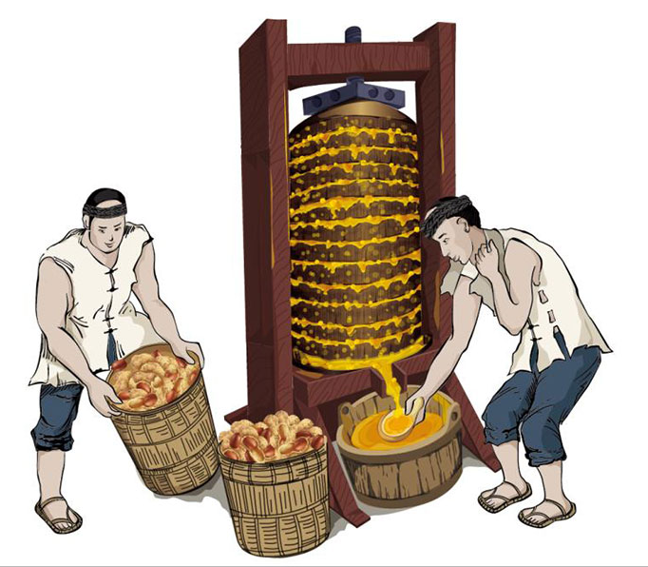
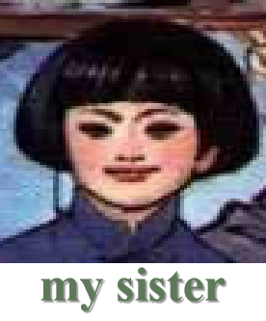
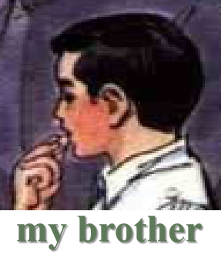
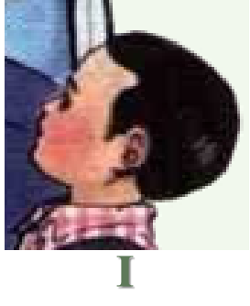
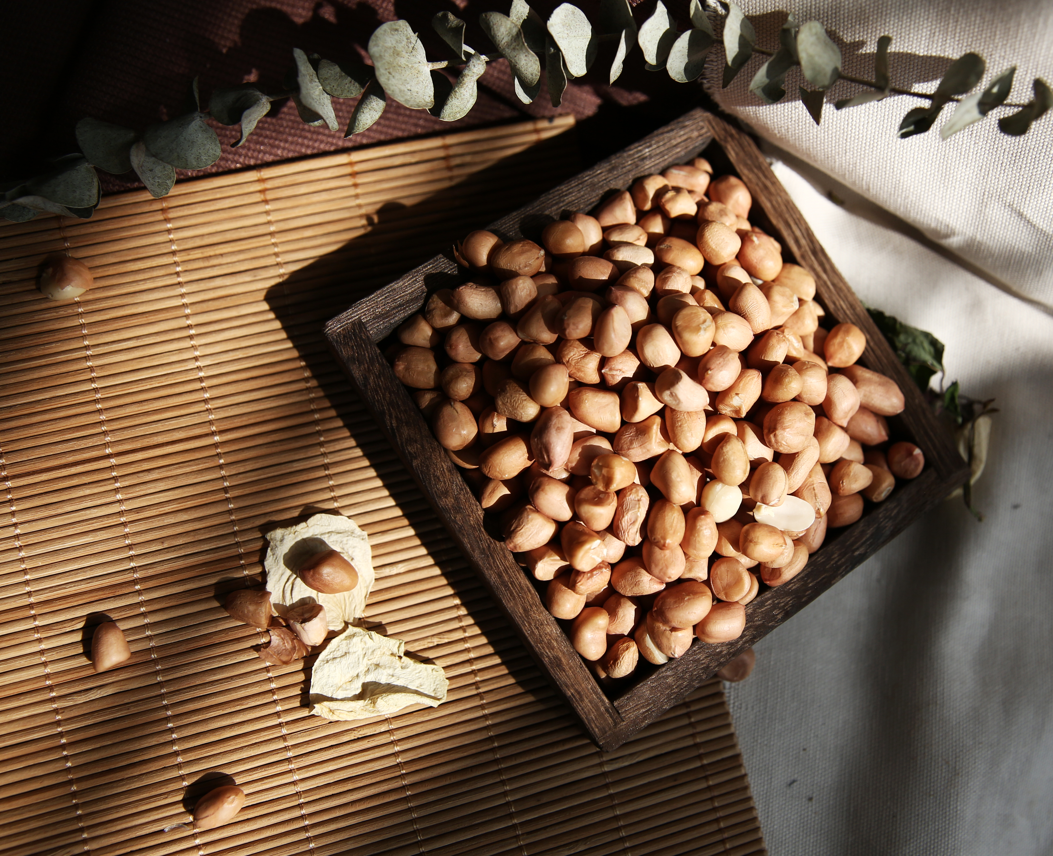
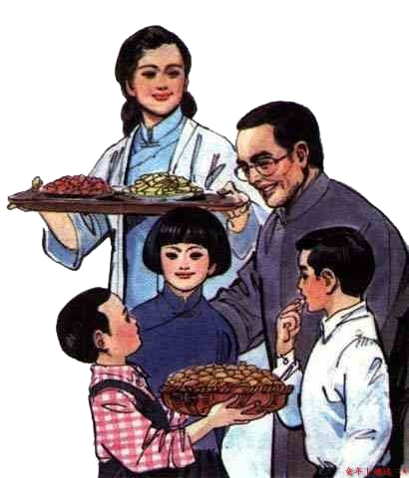
While-reading
Careful reading：Read Para4-9 and match the dialogue.
What did they say to their Father?
C
A
D
A. It is good for making oil.
B. Peanuts have many uses.
C. They are delicious to eat.
D. They are so cheap, and people like eating them.
In children’s mind, peanuts are _____________ and ____________.
delicious
useful
Notes:
做完题目，分角色朗读，感受花生的美味与好用。再引入思考，孩子们对花生的看法。再过渡到父亲的角度。

Slide 8
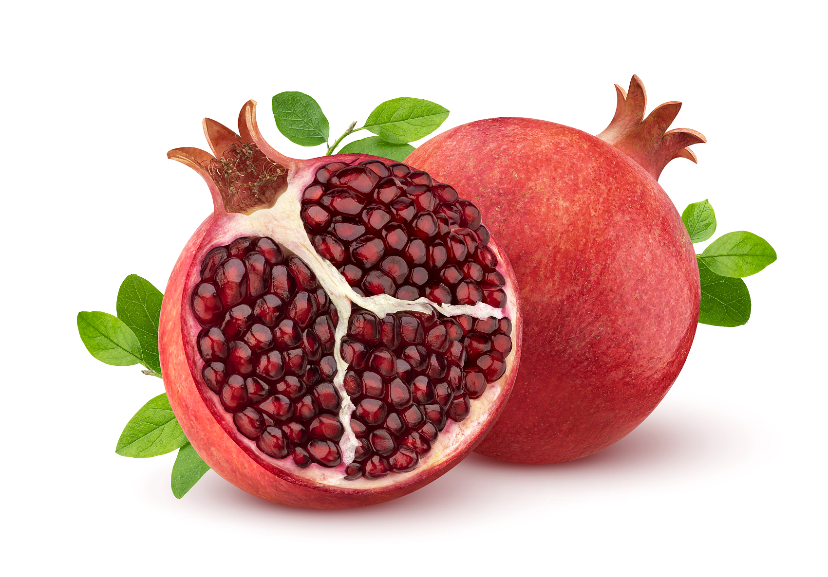
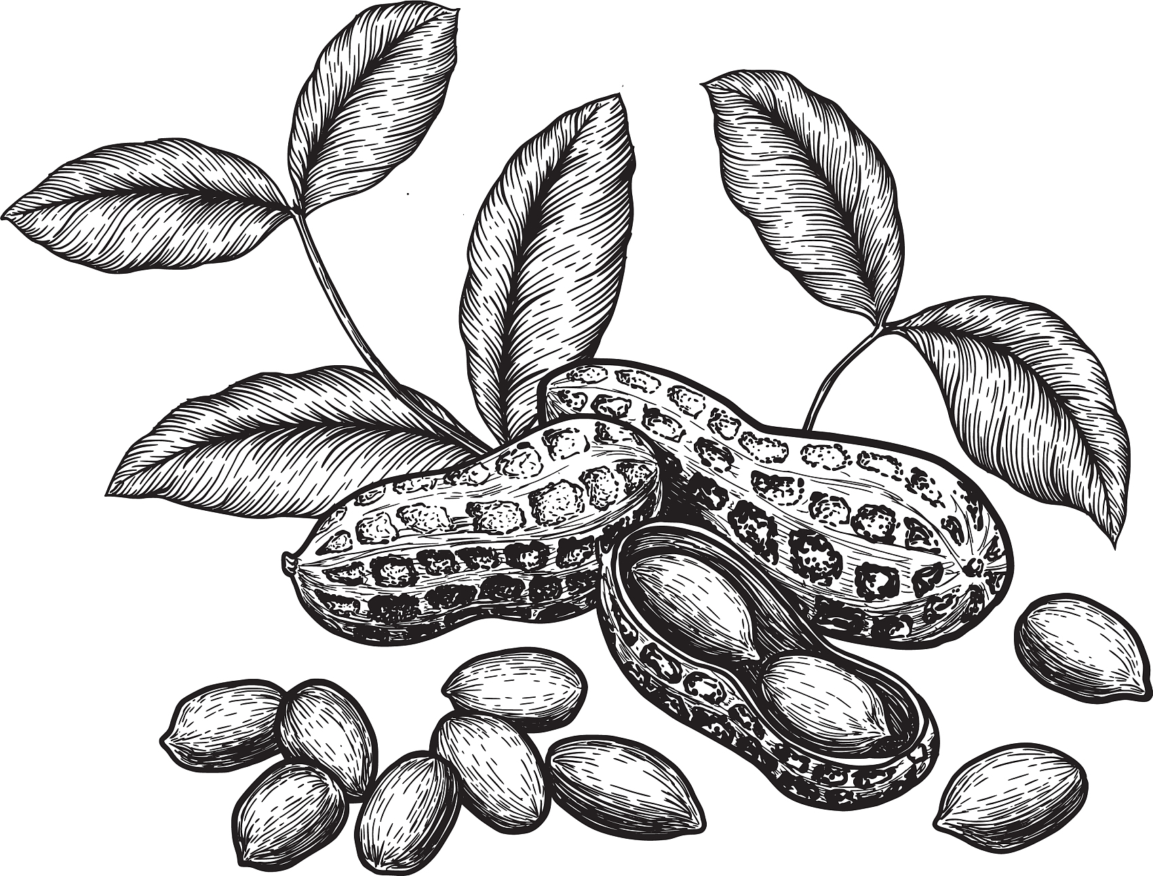
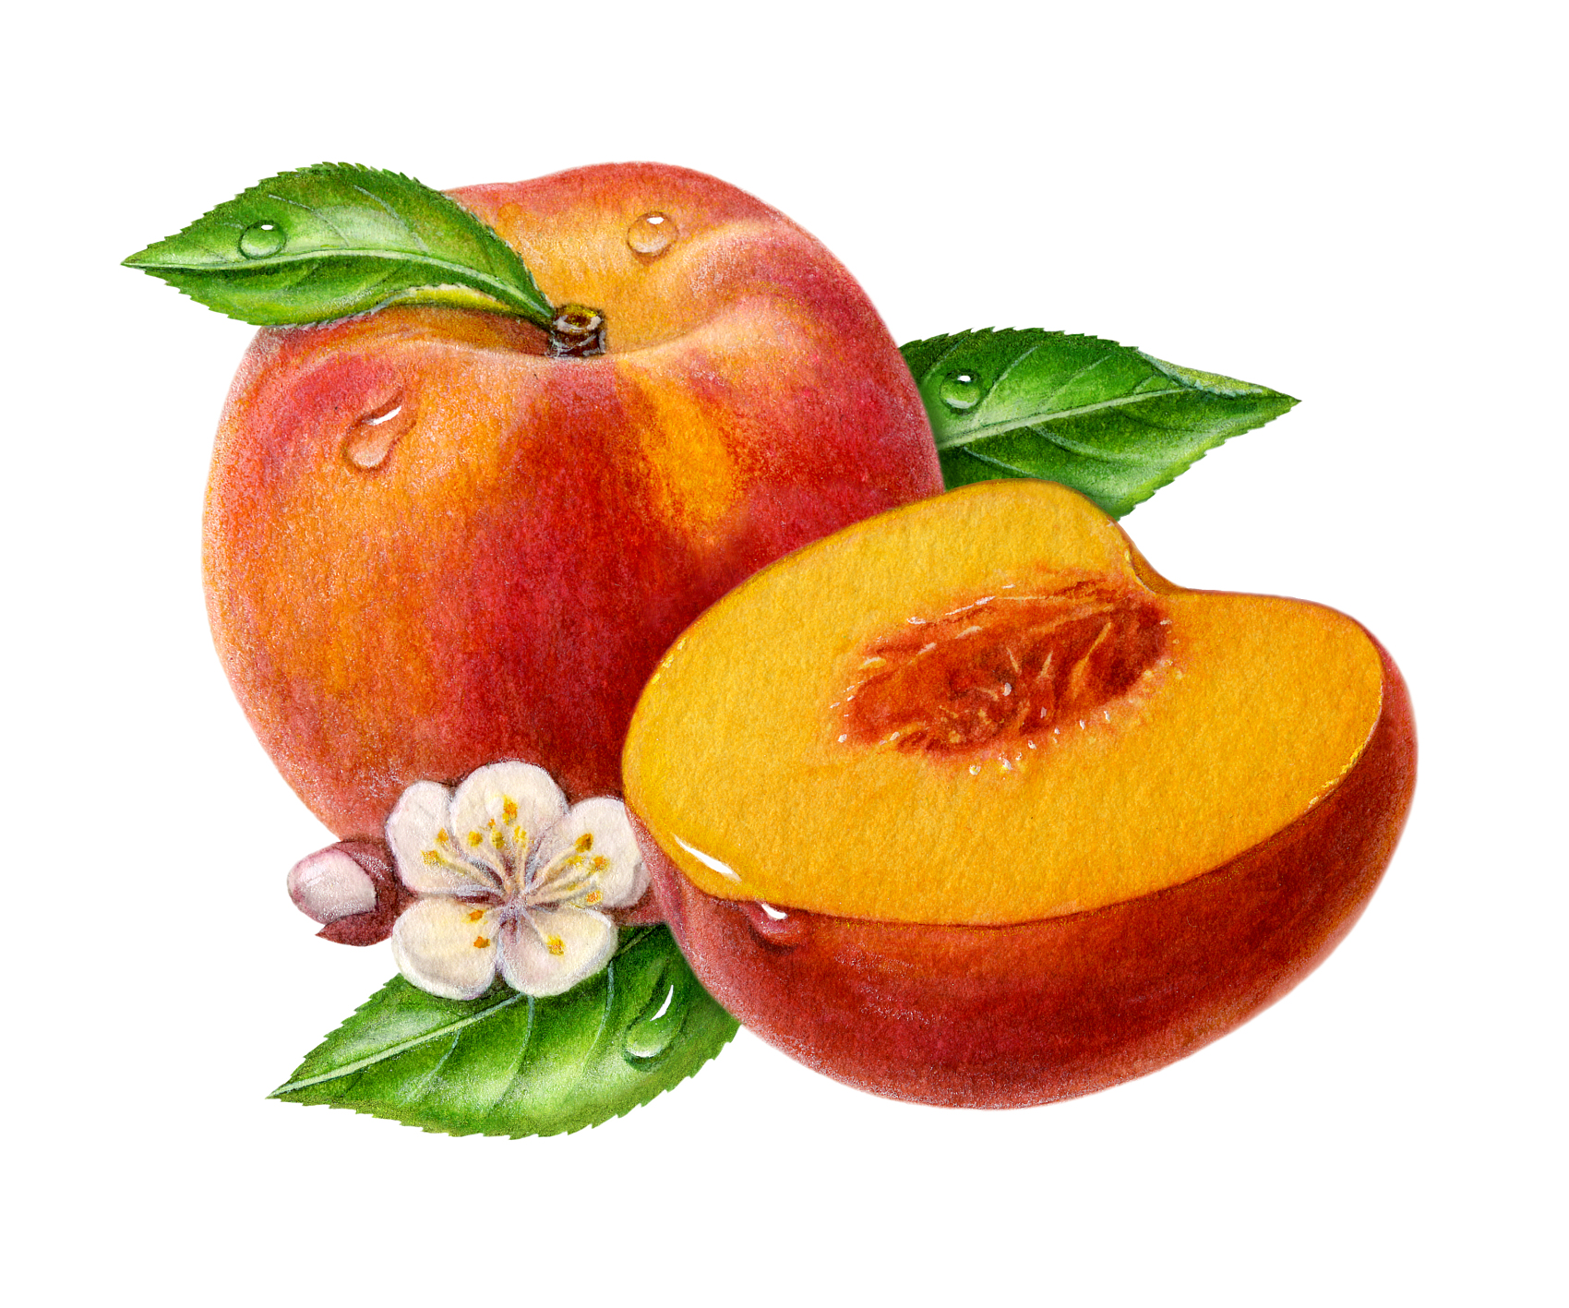
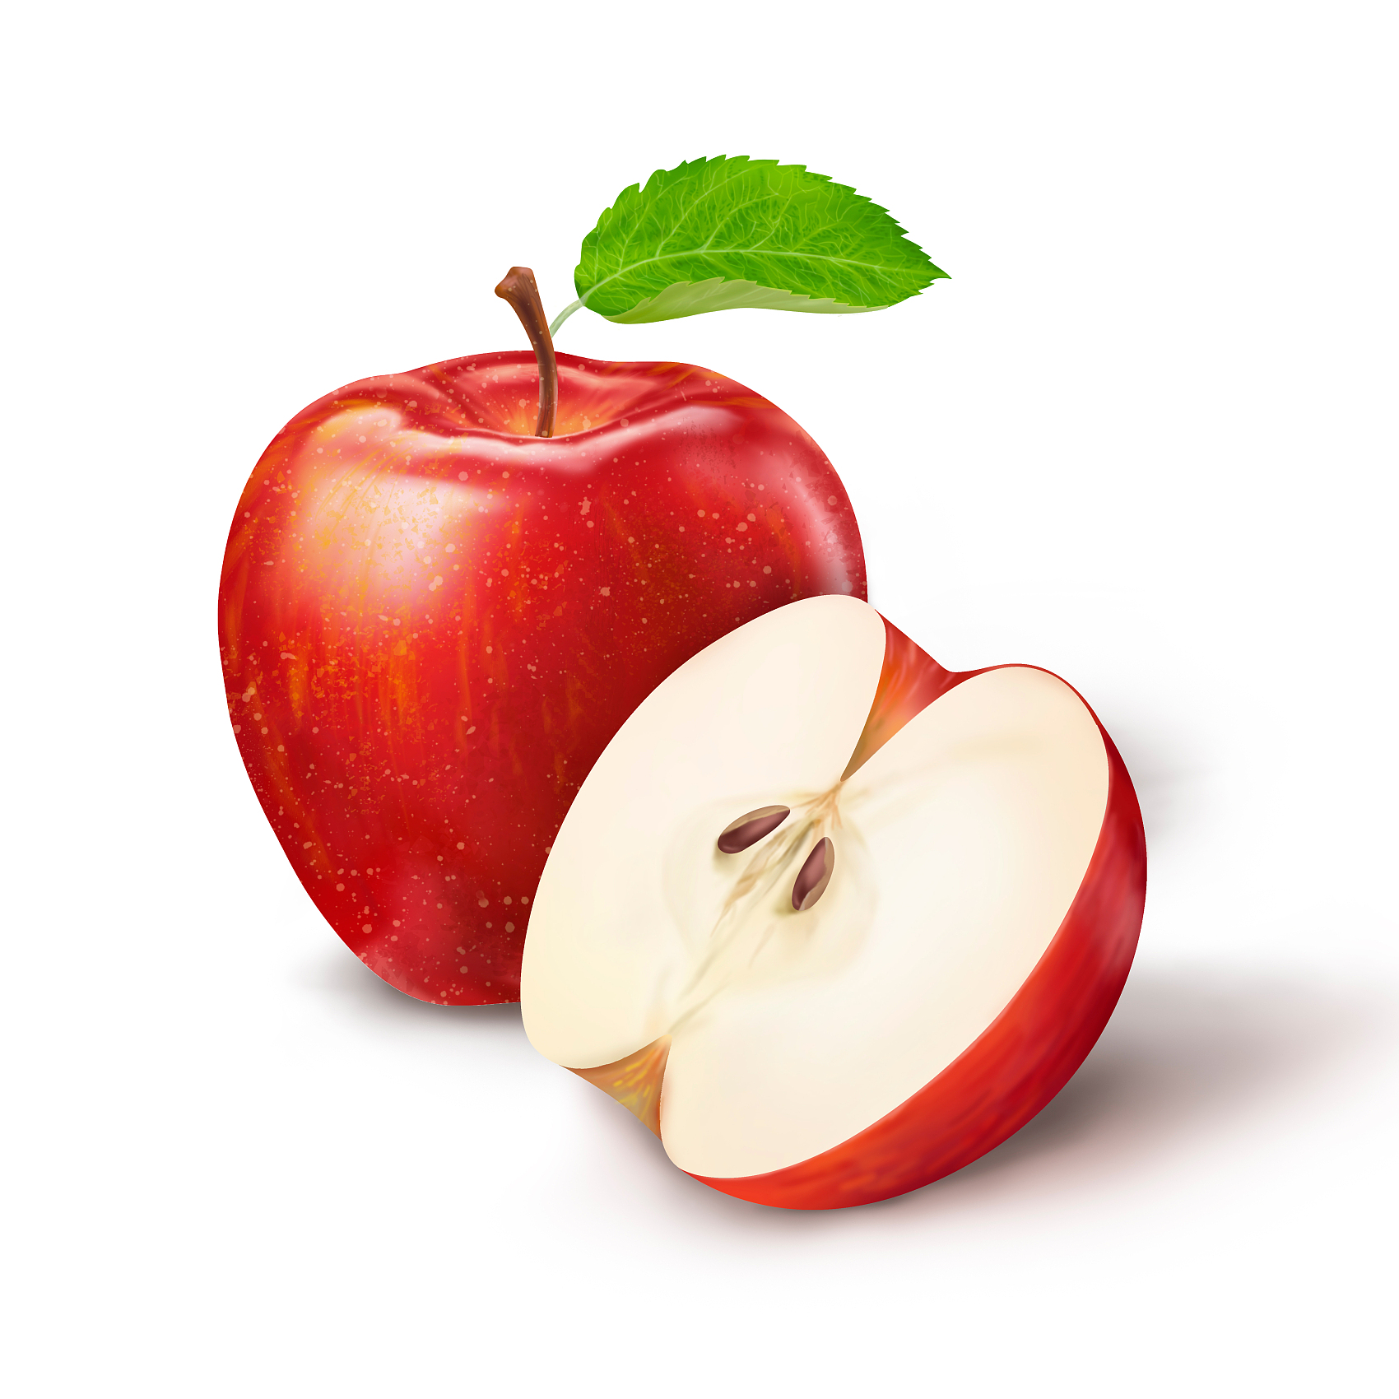

Careful reading：Read Para10-14 and answer questions.
While-reading
What's the difference between peanuts and other fruit like apples and peaches?
contrast(对比)
The peanut plant buries its fruit ______________. | They show their fruits up______________.
Until you dig it out, you can’t tell by looking at its thin stem whether _______________________. | They attract people with ____________________.
in the earth
in the air
v.吸引
v.携带
their beautiful colours
it bears fruit or not
Tips: We can guess the meaning of new words from the context.
Notes:
For peanuts, they are useful, while fruit like apples, peaches are attractive.

Slide 9
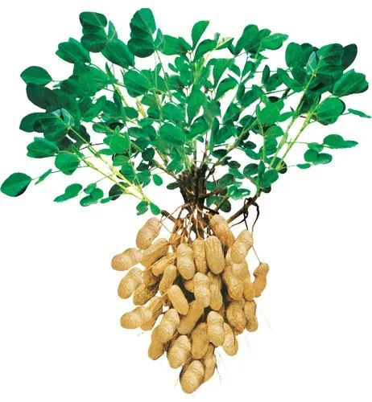
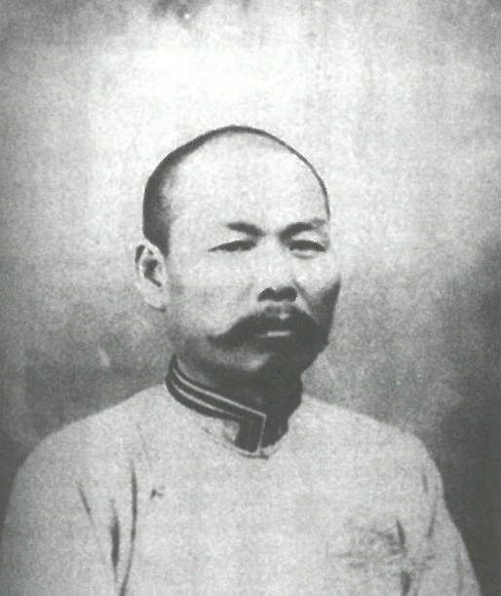
Further thinking
metaphor(隐喻)
useful but not attractive
What are the peanuts like according to Father?
What does Father expect his children to be?
They are useful, though not very attractive.
To be useful, not seeking attention and praise from others.
What’s the theme of the passage?
A. Be a person who can make money.
B. Be a person who can do things.
C. Be a person who is decent(体面的).
D. Be a person who is useful to the country, society, and others.
Xu Nanying

Slide 10
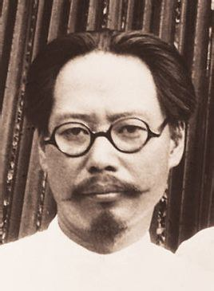
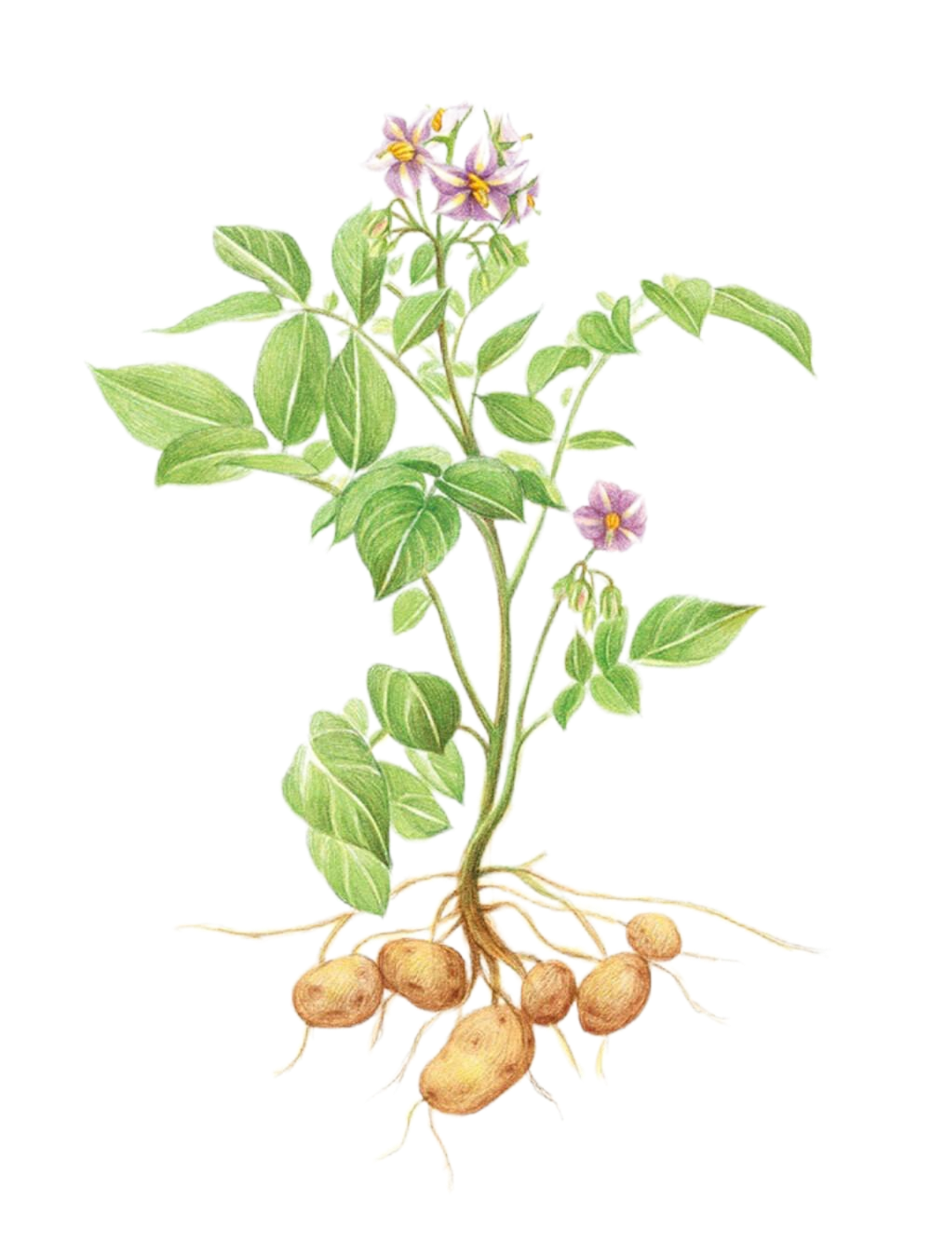
Further thinking
Title filling
Take real action to ...
What’s the best title for this passage?
落花生
议花生
尝花生
种花生
A. Planting Peanuts
B. Sharing Peanuts
C. Enjoying Peanuts
D. Be a Peanut
Xu Dishan，Luo Huasheng
Tips: The title should be tiny and crucial(关键的).
It would be better to add the original fetures of the item.
Notes:
中文标题用板书说

Slide 11
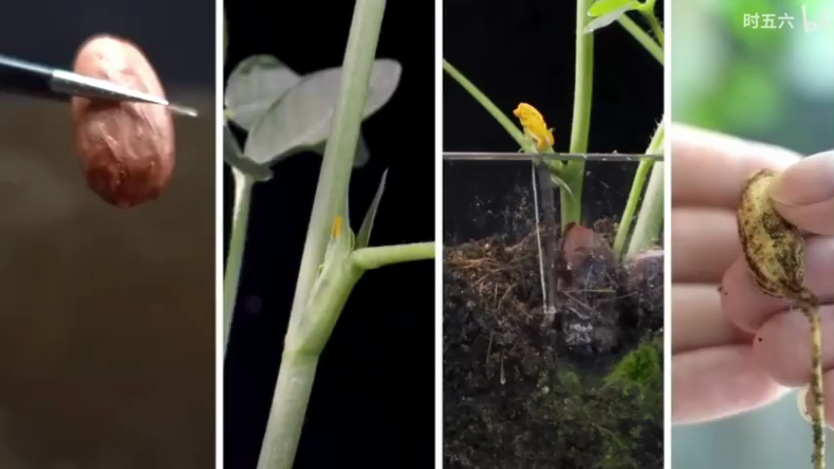

Slide 12
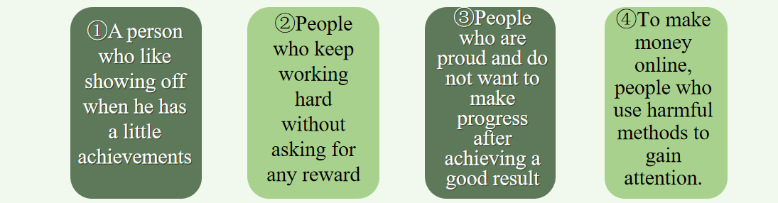




Post-reading
Discussion
Does the person behave like peanuts?
What do you think of people behaving like peanuts ?
A. simple
B. modest
C. selfish(自私)
D. selfless(无私)
E. showy
F. attractive
Notes:
学生讨论

Slide 13
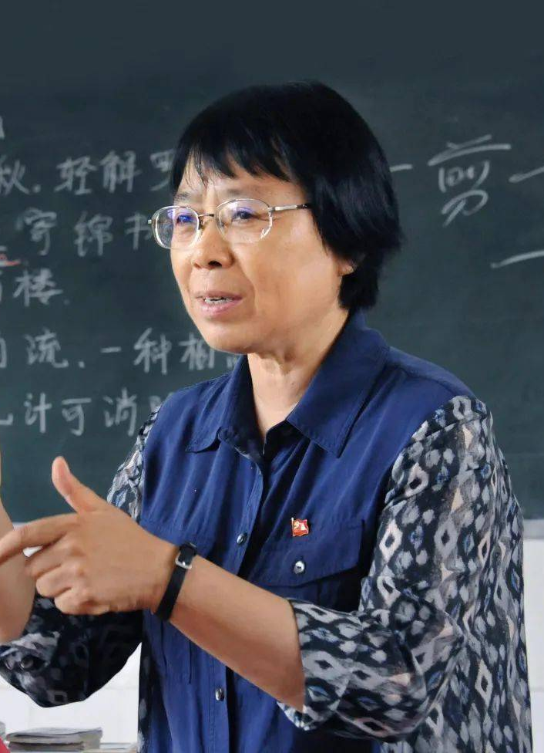
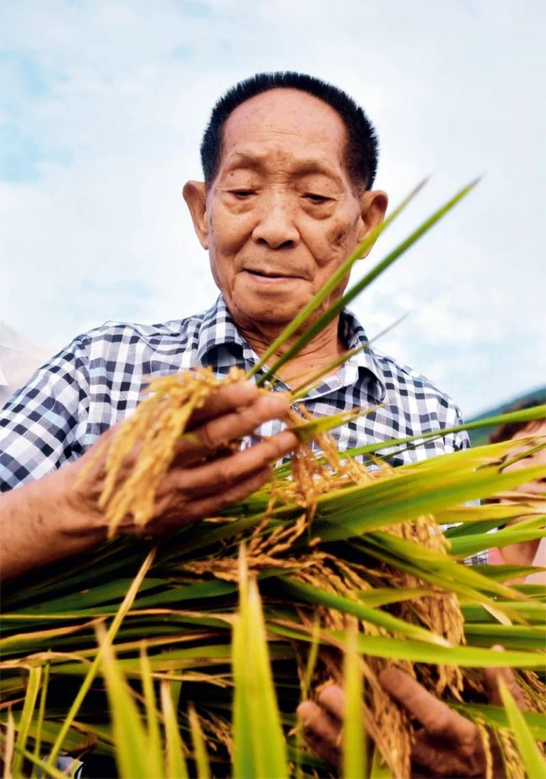
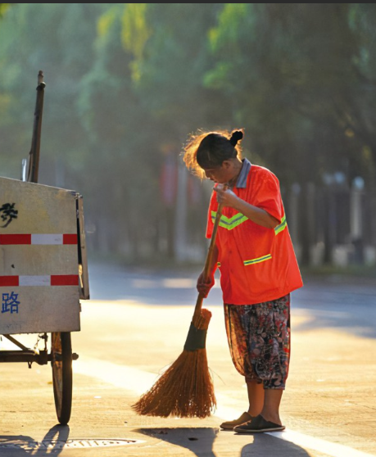
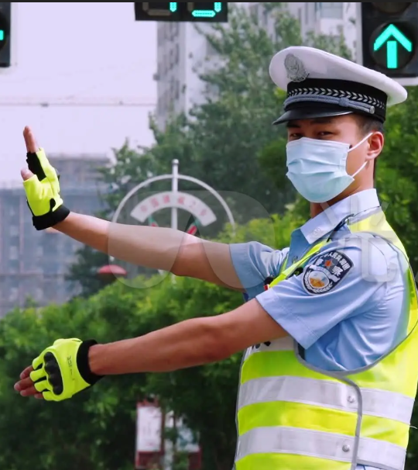
扎根于实验室潜心研究抗疟疾疫苗的屠呦呦奶奶
Discussion:
Which one do you prefer, a man like a peanut or an apple?
Do you want to be a man like them?
Yuan Longping
Stick to the rice growing field for years
Zhang Guimei
Light up the dreams of poor girls for over 40 years
Street cleaners
Bring tidiness and beauty to people by working hard
Policemen
Devote themselves to keep people safe when going out
I think ...is a man like... because...
Notes:
I think ... is a man like .../...because...

Slide 14

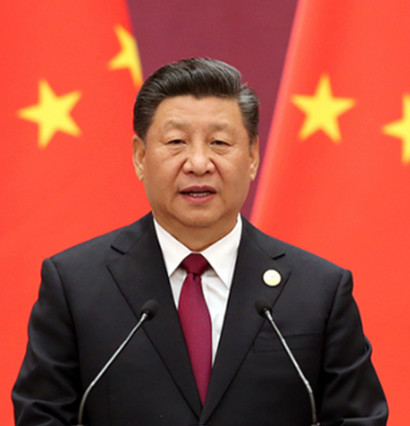
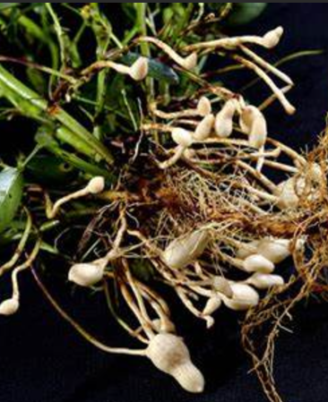
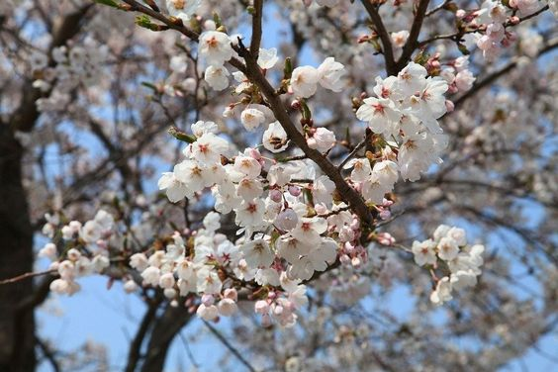
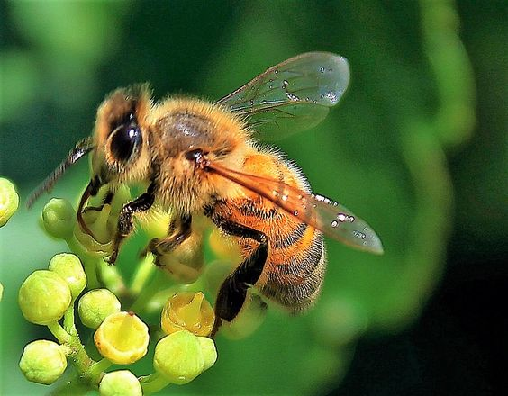
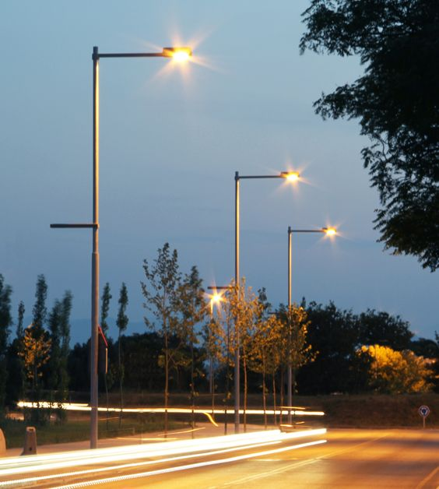
Solo work
Writing
Each student write your idea in the Peanut card.
What kind of person do you want to be?
Be a good young man in the new age who has dreams, dares to take responsibility, can endure hardships, and is willing to struggle!
做有理想、敢担当、能吃苦、肯奋斗的新时代好青年!
I want to be a man like a plum blossom because it never gives up blooming however cold the winter is. Besides, it always takes the lead to devote its beauty to people. So I want to be such a man to help people in need.
To make it come true, I will make every effort to improve myself so that I can do meaningful things to the society. No matter who I am, I will be a useful man!
peanuts plum blossoms(梅花) bees street lamps...
simple, modest, selfless never give up work hard selfless, bright

Slide 15
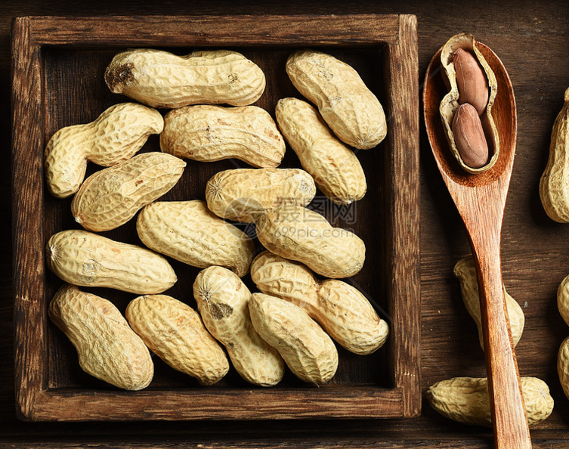

Summary
Small peanuts, big lessons!
Wisdom of peanuts
P ick up books, start each day,
E arnestly learn, don't delay.
A im up high, dream big thoughts,
N ote things well, skills be wrought.
U se mistakes, learn and grow,
T ry hard, let learning show！
Notes:
放音乐 唱诗歌

Slide 16
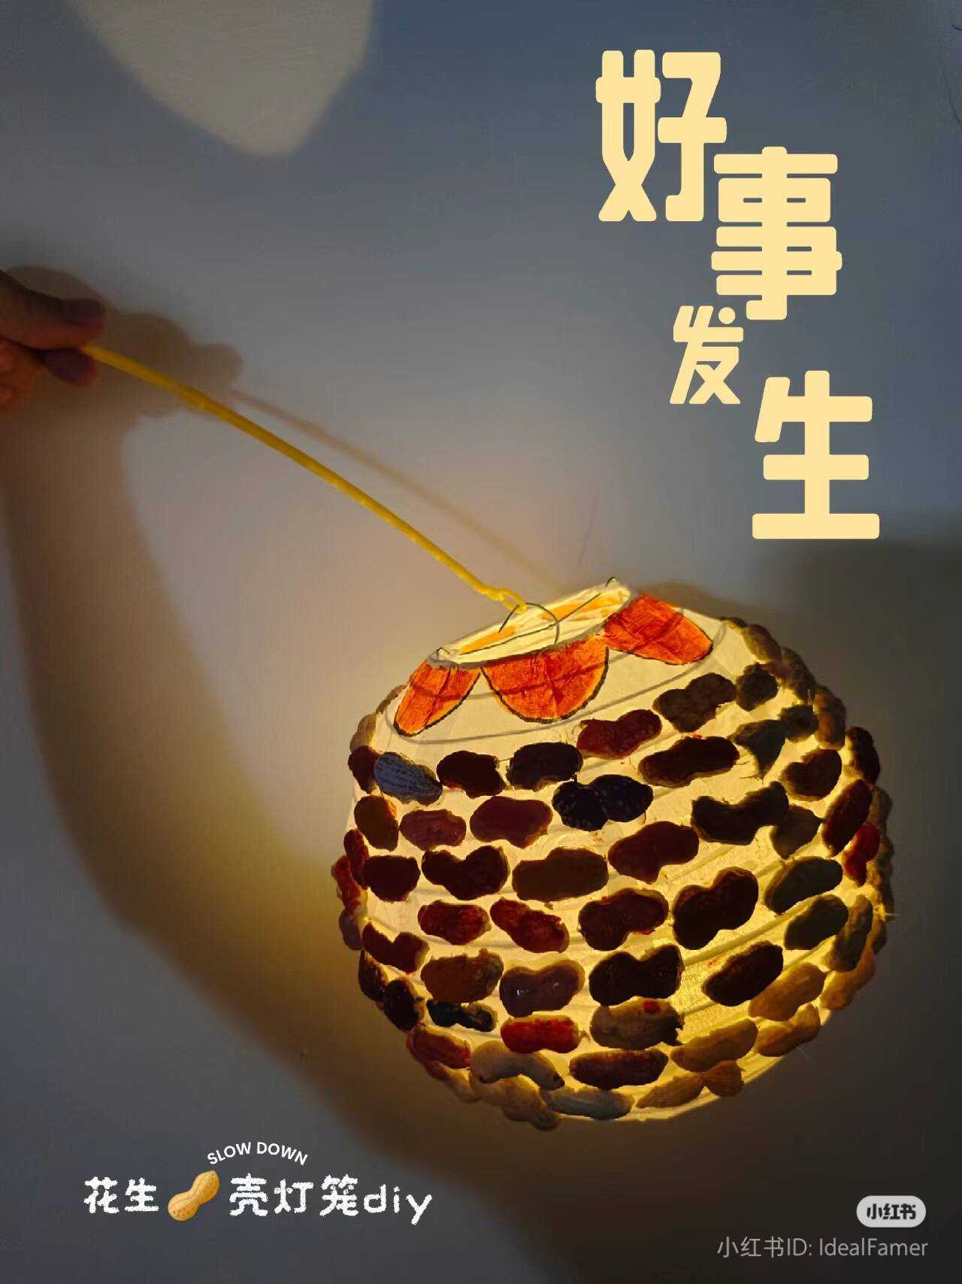
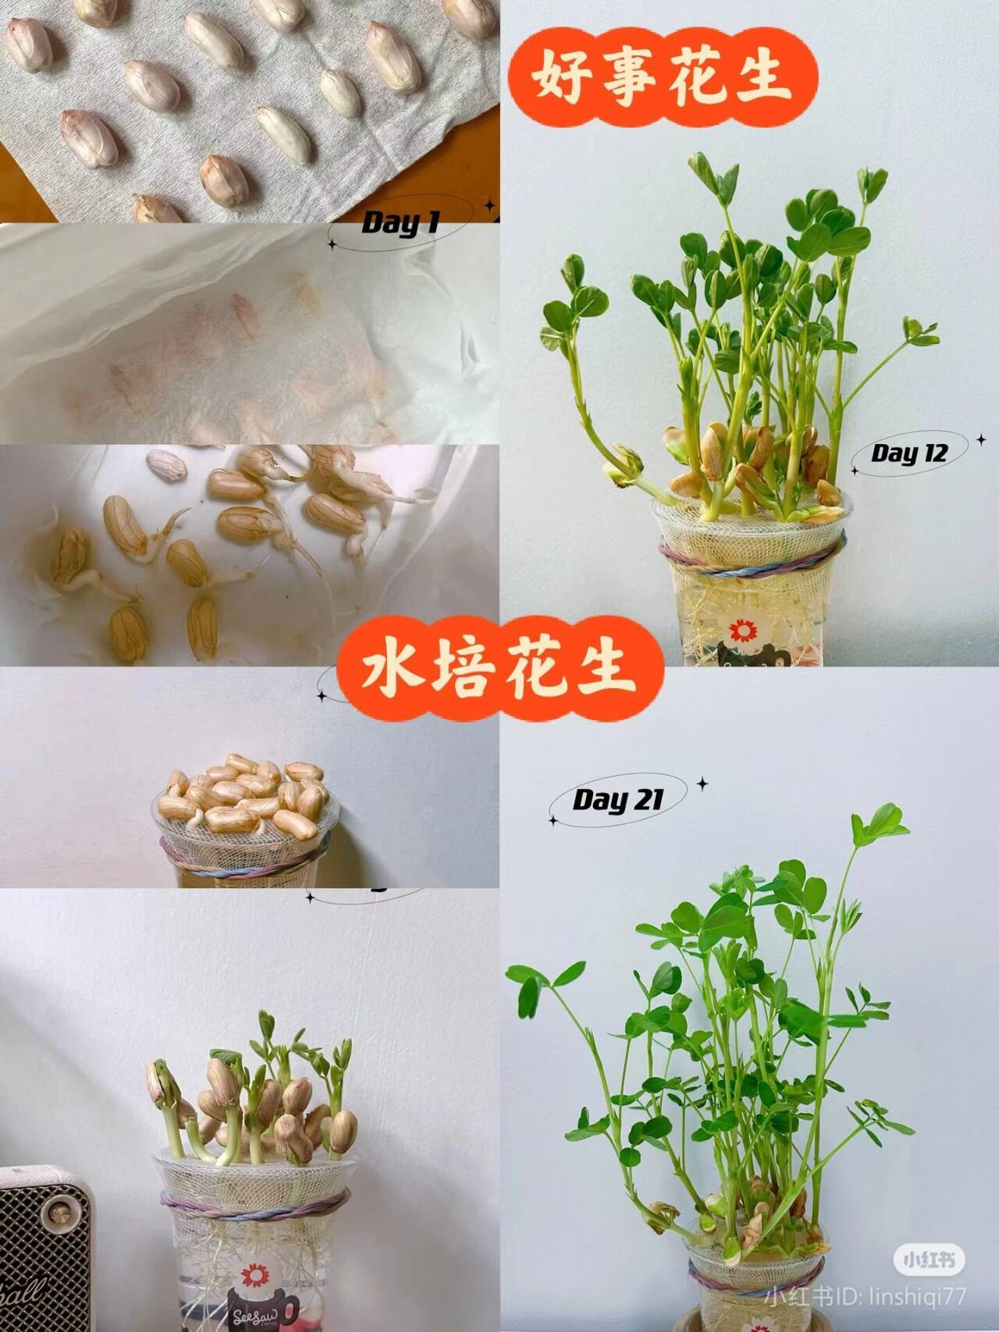
Homework
Must do
Write a review(读后感) about lessons you get from Peanuts.
Choose to do
Make a lantern out of peanut shells.
Plant a peanut with seeds and write a diary about its growth.
Recommended Books：
Tribute to the White Poplar《白杨礼赞》
The Pine style《松树的风格》
The Language of Flowers《爱莲说》

Slide 17
Thank you
Changzhou Xinbei District Experimental School
Qian Fangliang

