Slide 1
Unit4 Don't eat in class.
【Writing】
Listen carefully.
Think actively(积极思考)
Raise your hands bravely
Speak loudly
Chen Yu
Feilong Middle School

Slide 2




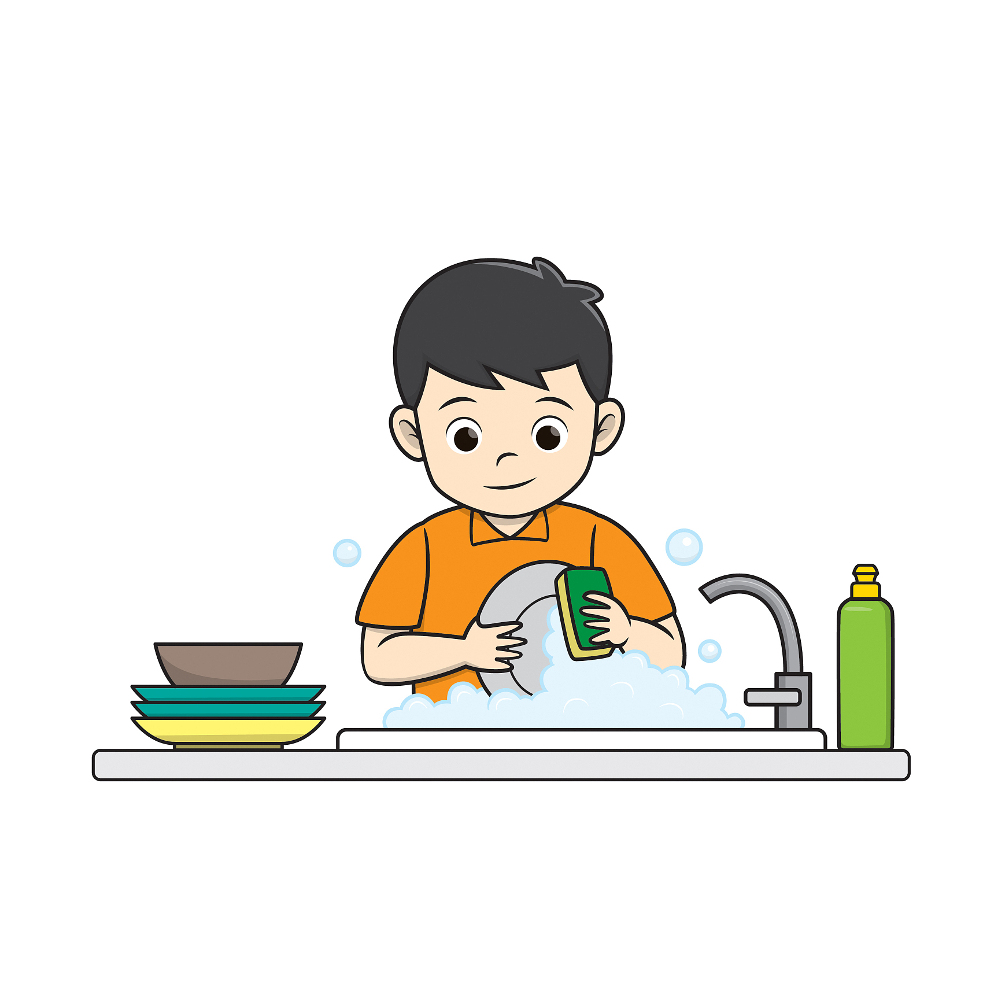






Free-talk
Pre-reading
What rules do you have
I must/have to...
I can't...

Slide 3
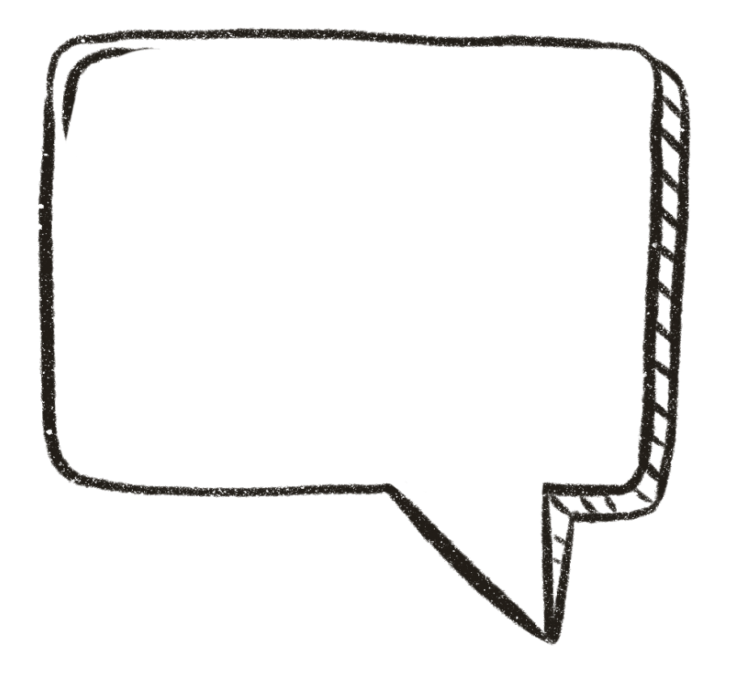
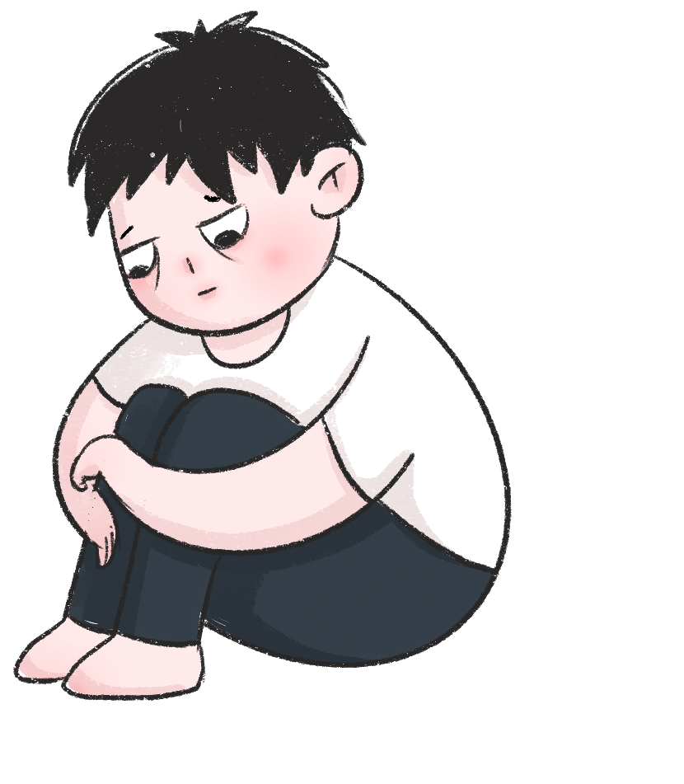
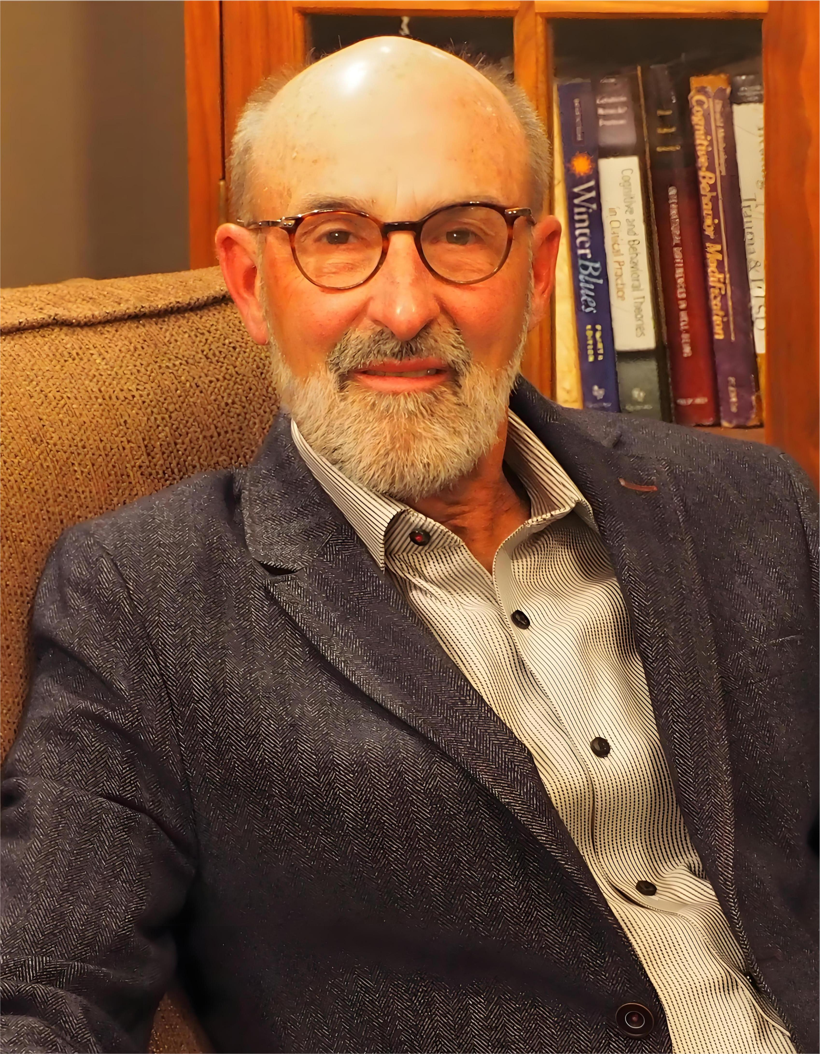

If you are not happy with these rules,
who will you talk to?
Your friends?
Your teacher?
Your parents?
Write a letter to Dr. Know to ask for help with your rules.
Dr. Know

Slide 4
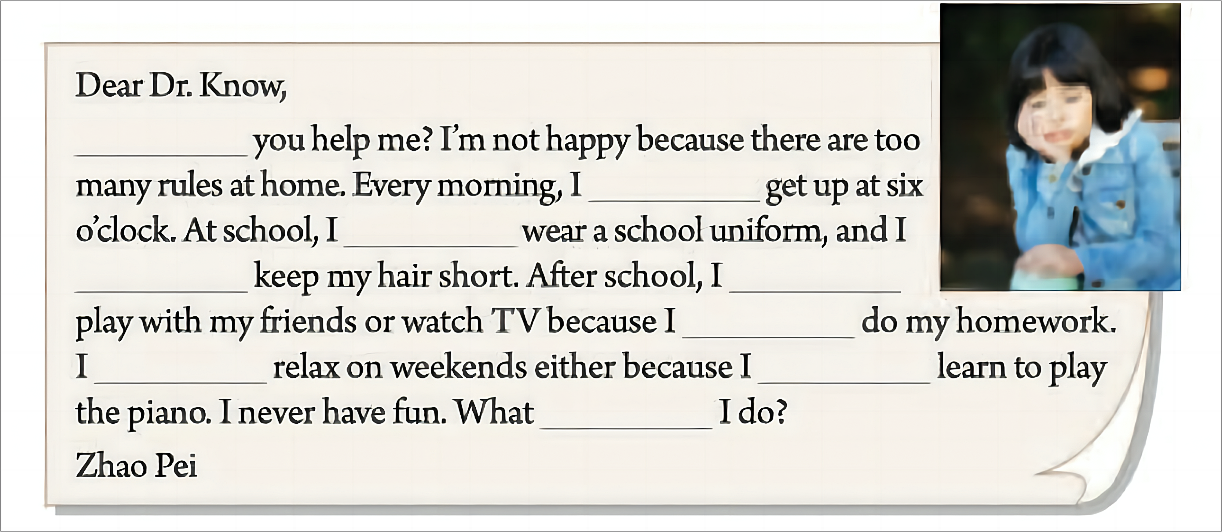
Complete Zhao Pei’s letter to Dr. Know
have to/must, can, can’t
Can
have to/must
have to/must
can’t
have to/must
have to/must
can’t
have to/must
Can

Slide 5
A clear structure
How does she feel?
What rules does Zhao Pei have?
Greeting
Dear ... ,
Introduction
Can
Purpose(目的) :
ask for help with her rules
must
Rules
must
Main body
must
can’t
have to
can’t
have to
Ending
Feelings + Hope
Can
Signature
Closing

Slide 6
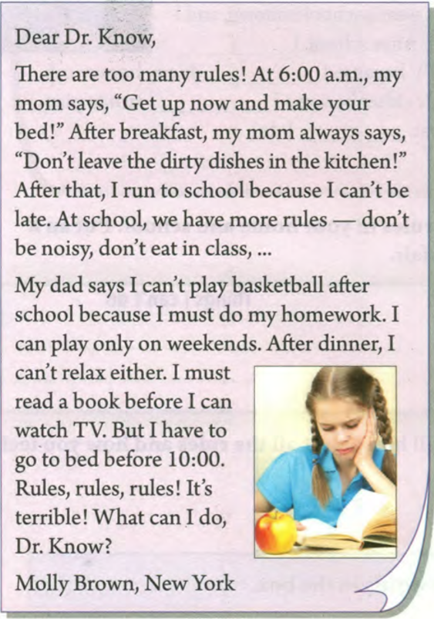
Greeting
There are many rules.
At 6:00 a.m., my
mom says, “Get up now and make your
bed!” After breakfast, my mon always says, “Don’t leave the dirty dishes in the kitchen!”
After that, I run to school because I can’t be
late. At school, we have more rules—don’t
be noisy, don’t eat in class, ...
My dad says I can’t play basketball after
school because I must do my homework. I
can play only on weekends. After dinner, I
A
clear
Structure
Introduction
Main body
can’t relax either. I must
read a book before I can
watch TV. But I have to
go to bed before 10:00.
Ending
Rules, rules, rules! It’s
terrible! What can I do,
Dr. Know?
Closing

Slide 7
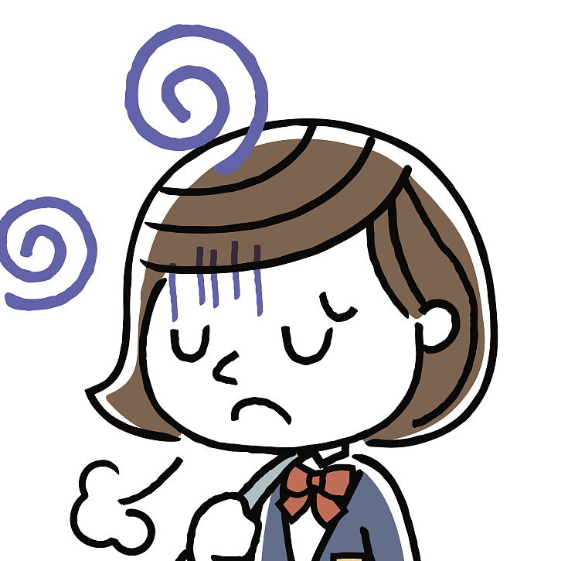
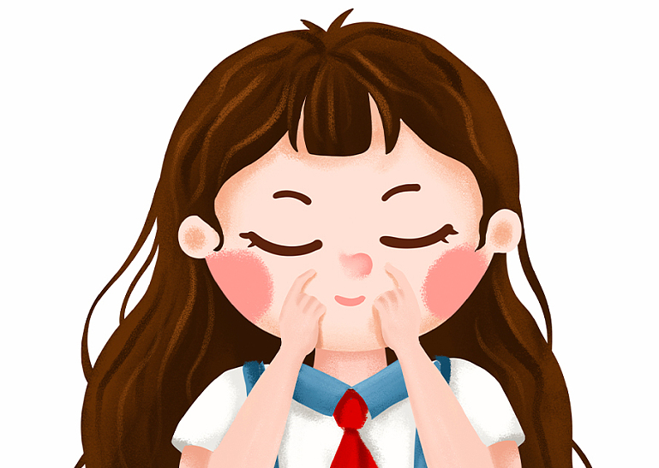

Language
Compare and think
Can you help me? I’m not happy because there are too many rules at home.
Introduction
There are too many rules!
Show our purpose
Be polite
Use adj.
repetition
重复
strong feelings
Rules, rules, rules! It’s terrible! What can I do, Dr. Know?
I never have fun.
What can I do?
Ending
_______, ______, _______!
It’s ________/ I feel _____. What can I do?

Slide 8
Language
Compare and think
Tips: Use direct speech(直接引语)
vivid(生动的).
Every morning, I must get up at six o’clock.
At 6:00 a.m, my mom says,”Get up now and make your bed!”
In class, our monitor(班长) always says,“_________________.”
In the hallways(走廊), our teacher always says,“___________.”
At home, my dad always says,“_________________________.”
imperative sentence
(祈使句)
Practice

Slide 9

Language
responsibility(责任)
At school, I have to wear a school uniform, and I must keep my hair short. After school, I can’t play with my friends or watch TV because I must do my homework. I can’t relax on weekends either because I must learn to play the piano.
study
skills
(技能)
A. too B.but
1. Why can’t she play with her friends or watch TV?
2. Why can’t she relax on weekends either?
important,helpful,
useful,necessary，...
strict, unfair(不公平)，...
3. What do you think of her family rules?
3. What do you think of her school rules?
I think it’s _________for her to ____________.

Slide 10
Language
Transitions(过渡词）
fluent(流畅的)
Opinions(观点)
persuasive(有说服力的)
Read and fill
Dear Zhang Pei,
I know how you feel. People always tell us ,“Don’t do this. You can’t do that _______!” I think you have to follow them _______ rules are strict _______important. _____________, it’s not easy to study______play the piano well, ______ you need to spend more time on it. Always remember that rules make us better.
Good luck!
Dr. Know
What does Dr. Know tell her to do?
because
or
either
because
either
but
For example
but
or
so
so
For example
Learn to think in others’ shoes
and understand rules.

Slide 11
Group-work:Talk about rules around you
social
needs
社会需求
Occasions(场合) | Rules | Opinions
At school | must have to can’t | It’s ... to .../ ...enough to.../ too...to... / ...
At home
On the road
...
personal
development
个人发展
important,helpful,
useful,necessary，...
strict, unfair(不公平)，...

Slide 12
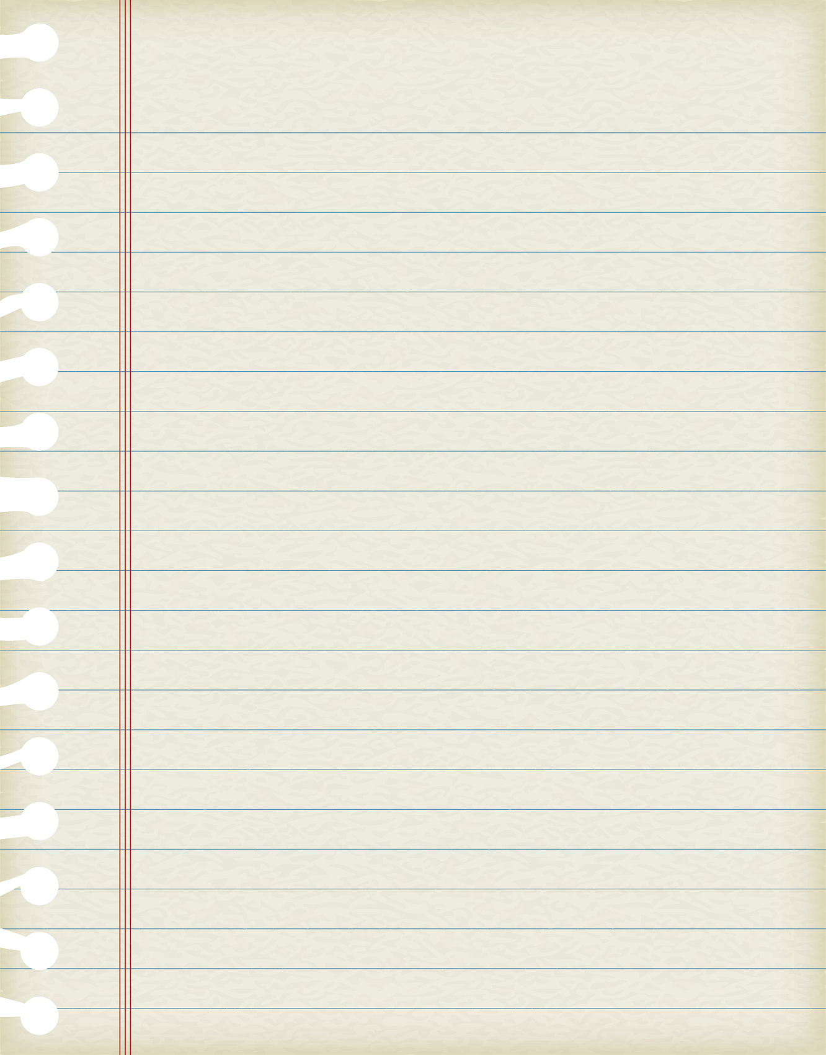
Summary
Language
Dear ...
Greeting
Introduction:
Purpose
情态动词：
must/have to/ can’t
Main body: Rules
structure
Body
direct speech
直接引语
+opinions
Transitions
过渡词
Ending:
Hope & feelings
adj. / Repetition/
It’s ... to ...
Closing
XXX
grammar
handwriting
More details

Slide 13
Writing Time
Useful expressions
Transitions
(and, too, also, or, either, but, because, so...)
Words:
important,useful,
necessary, helpful, strict(严格的),unfair(不公平的)
Sentences:
It’s ... for ... to .../
...enough to do .../
too ... to ...
Dear Dr. Know
Introduction
Purpose
Main body
Rules&opinions
Ending
Hope&feelings
XXX

Slide 14
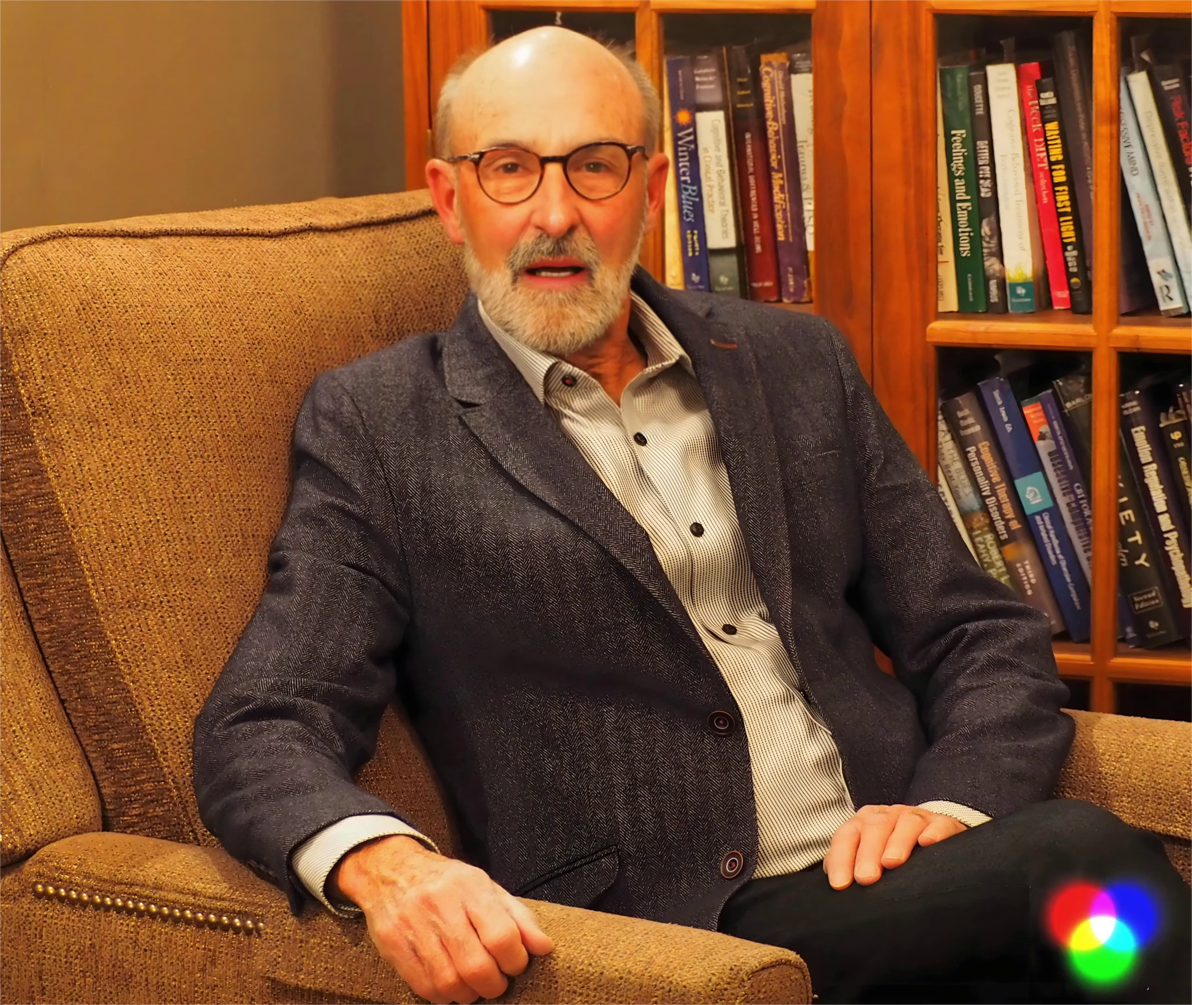

Slide 15
Rules are not roadblocks, but stepping stones.
Family
rules
School rules
Traffic rules
......

Slide 16
Homework
1. Polish your letter with the checklist.
2. Design a poster to share your rules

