Slide 1
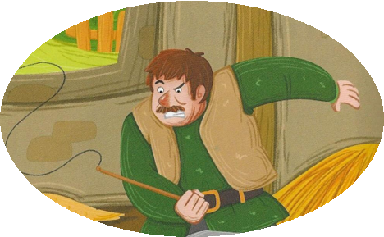
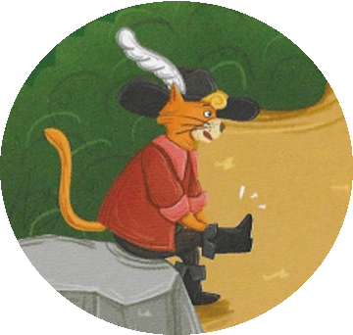
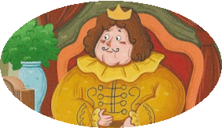
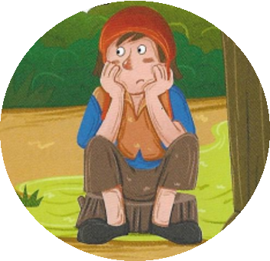
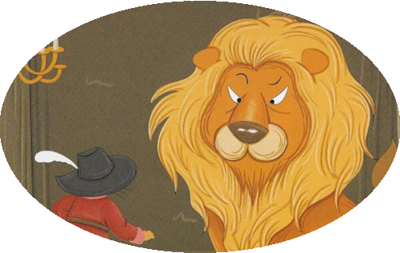
The cat in boots
------- by Chen Yu

Slide 2
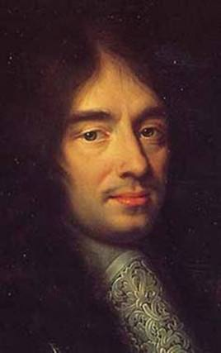


About writer
Charles Perrault
He is famous for writing
fairy story 童话
Cinderella
Sleeping Beauty

Slide 3
Main characters
· the cat in boots
---Puss
master
· the young man
---Carlyle
a farmer
?
---Marquis of Carlyle
伯爵

Slide 4
About plots
Number the following events in order 排序
4
a.Puss killed the monster
b.Carlyle was kicked out of the house by his lazy brothers
1
2
c.Puss presented preys to the king as a gift
5
d.Carlyle married the princess
3
e.Puss let Carlyle get into the water

Slide 5
About structure
Match the events with the main ideas
1.Carlyle was kicked out of the house by his lazy brothers
Introduction
Carlyle had a poor life
2.Puss presented preys to the king as a gift
Why
Main body
Puss's plans
3.Puss let Carlyle get into the water
4.Puss killed the monster
Carlyle had a happy life
Conclusion
5.Carlyle married the princess

Slide 6
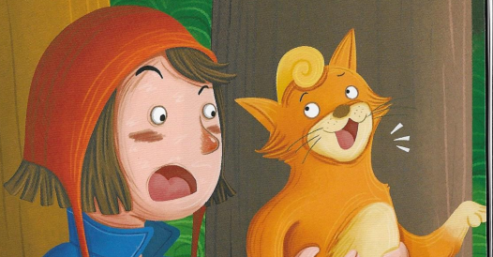
About characters
To his great surprise, the cat opened his mouth. “Don't worry, my master. You've been very nice to me,
and I’ll certainly repay you.” “I’ll bring you happiness. Just trust me."
B. 报答
A. 偿还 B. 报答 C. 付款 D. 喜欢
Q: Why did Puss help Carlyle
a nice master

Slide 7
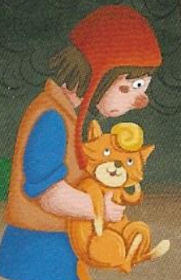
About characters
Read Page 1 and fill in the form
Carlyle | 1. He worked in the fields from ____________ till ______________. 2. He took___________of his sick father. 3. He _________ his father's funeral.
his two brothers | 1. They were_______. 2. They did _______to help. 3. They started fighting for their father's ________
early in the morning
late at night
great care
was busy
lazy
nothing
money
hard-working
caring有爱心的
not only a nice master, but also a good son

Slide 8
About intentions
Match the plans with the purpose
Puss's plans
Purpose
1.Puss presented animals to the king as a gift
To get the monster's money
2.Puss let Carlyle get into the water
To win the king's trust
3.Puss killed the monster
To change Carlyle's clothes

Slide 9
1. How did Puss catch a rabbit?
2. Did the king know Marquis of Carlyle at first?Why?
3. What did the king think of the Marquis of Carlyle later?
Plan1: Read and answer (page3)
clever!
“The Marquis of Carlyle?
Who is he?”
He set up a trap with the bag and then waited patiently behind a tree
patient!
“The Marquis of Carlyle is
surely a generous man.”
No, he didn't.
He thought Carlyle was a generous Marquis.
Group-work: Finish the table and talk about plan1
What | Why
First, Puss set up _________ Then, he waited ______________ | To catch _________
Next, Puss presented ____________ as _________ | To win _________
After that, the king believed Carlyle was _________
a trap with a bag
preys
patiently behind a tree
preys to the king
the king's trust
a gift from Marquis of Carlyle
a generous Marquis

Slide 10
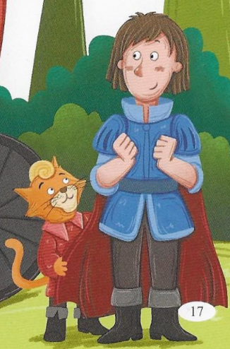
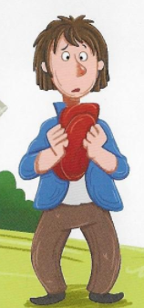
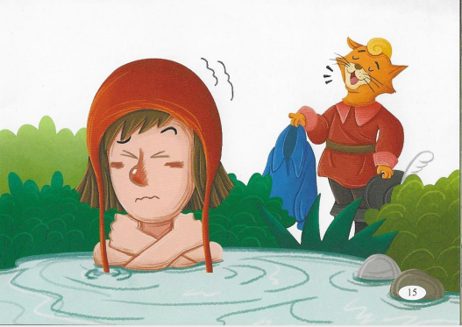
Plan2: Make up a dialogue
a farmer
old and dirty
a Marquis
different, handsome
A: Why did Puss ask his master to get
into the cold water?
B: Because at first Carlyle was a ...
His clothes were ...
A: I know, and now his clothes are ...
He looks so ...

Slide 11
About intentions&characters
look like, help, sent,
trusted, change
clever!
In order to _________ Carlyle's clothes and make him _______ a real Marquis.
First, Puss let Carlyle get into the water.
Then, he asked the king for ______.
The king ______ the cat and ______ Carlyle clothes.
change
look like
careful!
help
trusted
sent

Slide 12
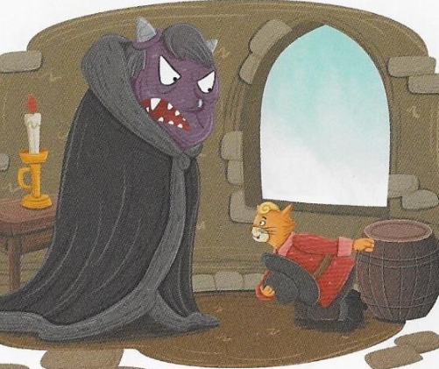
Plan3
VS
the little cat
the man-eating monster
Act it out!
Watch and answer
1. What did the monster change into first?
2. What did the monster change into then?
a huge lion
a tiny mouse
Further thinking:
If Puss said a mouse first, what may happen?
to eat the monster
to win the monster's trust
Carlyle became a rich Marquis

Slide 13
About intentions&characters
VS
the little cat
the man-eating monster
little
but
cleverer
Pair-work: make up a dialogue
stronger
but
overproud
A: Why did Puss eat the monster?
B: Because ...
A: How did he win the monster?
B: First, he asked ... to change into a ... to ...
Then, he asked ... to change into a ... to ...
A: How ... he is !
brave

Slide 14
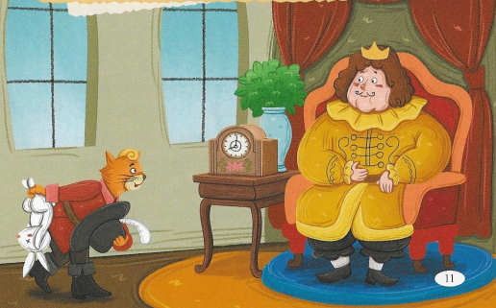
Plans
Plots
Purpose
Qualities
1. set up... waited
2. presented ...
catch ...
win ...
clever
patient
1. ...get into ...
2. ...ask ... for help
3. ...sent clothes...
his clothes were...
change ...
his clothes are...
clever
careful
Group-work: Talk about Puss
1. change into ...
2. change into ...
win ...
eat ...
clever
brave
A: I think Puss is ...
First, he...to... Then, he...to...
B: I think he is a ... cat
First, he...to... Then, he ...to...
C: I agree. He is also ...
First, he...to... Then. he ... to ...
D: What' more, all he did is for ...
What a ... pet he is !
helpful
loyal

Slide 15
Writing Time
clever
brave
Write about Puss
patient
These days, we are reading
a book 'The Cat in Boots'. I like
this _____,_____ and _____ cat.
careful
Puss is ...
At first, he ... to ...
Then, he ... to ...
After that, ...
helpful
loyal
1. set up... waited
2. presented ...
catch ...
win ...
Puss is also ...
First, he ...
Then, he ...
...
1. ...get into ...
2. ...ask ... for help
3. ...sent clothes...
his clothes were...
change ...
his clothes are...
What's more, Puss is a ... pet.
He did ... for ... How ... he is!
1. change into ...
2. change into ...
win ...
eat ...

Slide 16
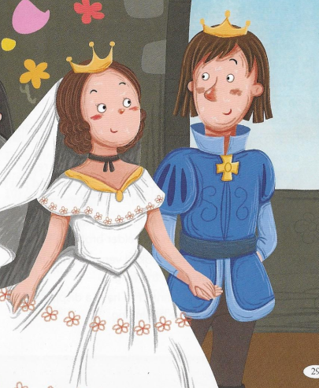
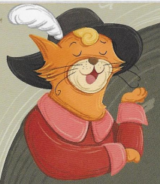
Conclusion
Be kind to others
Believe in others
a big surprise is waiting for you!

