Slide 1





Tai Hu Bay Music Festival

Slide 2
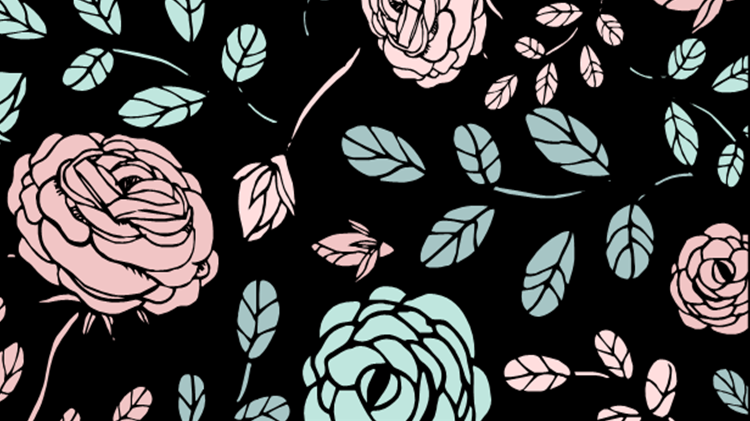
What I love most
Reading & Writing Revision
Feilong Middle School
Lv Hong

Slide 3
Many people love music so much that hundreds of thousands of people went to Tai Hu Bay Music Festival.
Why do people love music so much?
Music is one of the most important art forms.
It can make people feel relaxed after a busy day.
It can make people feel less stressed.
It can cheer people up when they feel blue.
There’s another reason why people love music so much.

Slide 4
Reading
Cloze
完形填空

Slide 5
Tips for Cloze
In all the world's cultures, people sing, play instruments, and celebrate with music. It plays such an important role in our lives that people 1 much time to its study. Experts(专家) are finding that 2 the way our brains deal with music, learning to play an instrument or just listening to music can have a large number of benefits (益处).
Music education has received a lot of 3 . Learning to play an instrument can help children improve Maths, science, and language 4 . One study in Canada followed children's IQ scores for nine months, 5 that children who studied music had the biggest test score improvements. The secret may lie in the way reading music and playing notes (音符) use several parts of the brain, raising our 6 to learn school subjects.
Music is also used for 7 purposes, such as the treatment of diseases which influence memory. The secret lies in the way the brain deals with music. That's 8 an old song can remind you of something that happened years ago. For patients suffering from diseases like Alzheimer's, listening to music can help 9 hidden memories by building up musical pathways to memories.
Studies of the music and brain connection often centre on classical music, 10 it activates(激活) both the left and right sides of our brains. One study observed (观察) people's brain activity as they listened to music by composer William Boyce. It found that the brain activity was the highest during the short breaks(中断) between the movements of a piece. During each break, the person's brain expected what would come next, while organizing what he or she had just 11 . This process (进程) is 12 to the way our brain organizes information. It may explain why classical music can help improve memory.
General (总)
Para1: Music has many benefits.
Tip1:topic
Tip2:main idea
What are the benefits?
Specific (分)
Para2-4: 3 benefits.

Slide 6

In all the world's cultures, people sing, play instruments, and celebrate with music. It plays such an important role in our lives that people 1 much time to its study. Experts(专家) are finding that 2 the way our brains deal with music, learning to play an instrument or just listening to music can have a large number of benefits (益处).
Music education has received a lot of 3 . Learning to play an instrument can help children improve Maths, science, and language 4 . One study in Canada followed children's IQ scores for nine months, 5 that children who studied music had the biggest test score improvements. The secret may lie in the way reading music and playing notes (音符) use several parts of the brain, raising our 6 to learn school subjects.
Music is also used for 7 purposes, such as the treatment of diseases which influence memory. The secret lies in the way the brain deals with music. That's 8 an old song can remind you of something that happened years ago. For patients suffering from diseases like Alzheimer's, listening to music can help 9 hidden memories by building up musical pathways to memories.
Studies of the music and brain connection often centre on classical music, 10 it activates(激活) both the left and right sides of our brains. One study observed (观察) people's brain activity as they listened to music by composer William Boyce. It found that the brain activity was the highest during the short breaks(中断) between the movements of a piece. During each break, the person's brain expected what would come next, while organizing what he or she had just 11 . This process (进程) is 12 to the way our brain organizes information. It may explain why classical music can help improve memory.
3 benefits
分数 技能
分数 天赋
4. A. marks B. skills
C. points D.talents
7. A. medical
B. musical
C. personal
D.practical
医学的
音乐的
个人的
实际的
因果关系
effect(果)
cause(因)
如果 由于
虽然 除非
10. A. if B. since
C. though D.unless

Slide 7
Tips for Cloze
In all the world's cultures, people sing, play instruments, and celebrate with music. It plays such an important role in our lives that people 1 much time to its study. Experts(专家) are finding that 2 the way our brains deal with music, learning to play an instrument or just listening to music can have a large number of benefits (益处).
Music education has received a lot of 3 . Learning to play an instrument can help children improve Maths, science, and language 4 . One study in Canada followed children's IQ scores for nine months, 5 that children who studied music had the biggest test score improvements. The secret may lie in the way reading music and playing notes (音符) use several parts of the brain, raising our 6 to learn school subjects.
Music is also used for 7 purposes, such as the treatment of diseases which influence memory. The secret lies in the way the brain deals with music. That's 8 an old song can remind you of something that happened years ago. For patients suffering from diseases like Alzheimer's, listening to music can help 9 hidden memories by building up musical pathways to memories.
Studies of the music and brain connection often centre on classical music, 10 it activates(激活) both the left and right sides of our brains. One study observed (观察) people's brain activity as they listened to music by composer William Boyce. It found that the brain activity was the highest during the short breaks(中断) between the movements of a piece. During each break, the person's brain expected what would come next, while organizing what he or she had just 11 . This process (进程) is 12 to the way our brain organizes information. It may explain why classical music can help improve memory.
Tip1:topic
Tip2:main idea
Tip3:context
(上下文)
Context refers to the preceding utterances and/or the following ones.
上下文是指前面的话语和/或下面的话语

Slide 8
More practice for context
In all the world's cultures, people sing, play instruments, and celebrate with music. It plays such an important role in our lives that people 1 much time to its study. Experts(专家) are finding that 2 the way our brains deal with music, learning to play an instrument or just listening to music can have a large number of benefits (益处).
Music education has received a lot of 3 . Learning to play an instrument can help children improve Maths, science, and language 4 . One study in Canada followed children's IQ scores for nine months, 5 that children who studied music had the biggest test score improvements. The secret may lie in the way reading music and playing notes (音符) use several parts of the brain, raising our 6 to learn school subjects.
Music is also used for 7 purposes, such as the treatment of diseases which influence memory. The secret lies in the way the brain deals with music. That's 8 an old song can remind you of something that happened years ago. For patients suffering from diseases like Alzheimer's, listening to music can help 9 hidden memories by building up musical pathways to memories.
Studies of the music and brain connection often centre on classical music, 10 it activates(激活) both the left and right sides of our brains. One study observed (观察) people's brain activity as they listened to music by composer William Boyce. It found that the brain activity was the highest during the short breaks(中断) between the movements of a piece. During each break, the person's brain expected what would come next, while organizing what he or she had just 11 . This process (进程) is 12 to the way our brain organizes information. It may explain why classical music can help improve memory.
2. A. instead of
B. because of
C. thanks to
D.according to
代替
因为
幸亏
根据
cause(因)
因果关系
effect(果)
effect(果)
cause(因)
3. A. help B. gifts
C. attention D.work
因果关系
cause(因)
effect(果)
8. A. how B. when
C. why D.what
因果关系

Slide 9
More practice for context
In all the world's cultures, people sing, play instruments, and celebrate with music. It plays such an important role in our lives that people 1 much time to its study. Experts(专家) are finding that 2 the way our brains deal with music, learning to play an instrument or just listening to music can have a large number of benefits (益处).
Music education has received a lot of 3 . Learning to play an instrument can help children improve Maths, science, and language 4 . One study in Canada followed children's IQ scores for nine months, 5 that children who studied music had the biggest test score improvements. The secret may lie in the way reading music and playing notes (音符) use several parts of the brain, raising our 6 to learn school subjects.
Music is also used for 7 purposes, such as the treatment of diseases which influence memory. The secret lies in the way the brain deals with music. That's 8 an old song can remind you of something that happened years ago. For patients suffering from diseases like Alzheimer's, listening to music can help 9 hidden memories by building up musical pathways to memories.
Studies of the music and brain connection often centre on classical music, 10 it activates(激活) both the left and right sides of our brains. One study observed (观察) people's brain activity as they listened to music by composer William Boyce. It found that the brain activity was the highest during the short breaks(中断) between the movements of a piece. During each break, the person's brain expected what would come next, while organizing what he or she had just 11 . This process (进程) is 12 to the way our brain organizes information. It may explain why classical music can help improve memory.
9. A. put up
B. wake up
C. turn up
D.take up
张贴
唤醒
调高(音量)
占据
11. A. heard B. sung
C. said D.done

Slide 10
1. 动名词作主语
1. 动名词作主语
1. 动名词作主语
In all the world's cultures, people sing, play instruments, and celebrate with music. It plays such an important role in our lives that people 1 much time to its study. Experts(专家) are finding that 2 the way our brains deal with music, learning to play an instrument or just listening to music can have a large number of benefits (益处).
Music education has received a lot of 3 . Learning to play an instrument can help children improve Maths, science, and language 4 . One study in Canada followed children's IQ scores for nine months, 5 that children who studied music had the biggest test score improvements. The secret may lie in the way reading music and playing notes (音符) use several parts of the brain, raising our 6 to learn school subjects.
Music is also used for 7 purposes, such as the treatment of diseases which influence memory. The secret lies in the way the brain deals with music. That's 8 an old song can remind you of something that happened years ago. For patients suffering from diseases like Alzheimer's, listening to music can help 9 hidden memories by building up musical pathways to memories.
Studies of the music and brain connection often centre on classical music, 10 it activates(激活) both the left and right sides of our brains. One study observed (观察) people's brain activity as they listened to music by composer William Boyce. It found that the brain activity was the highest during the short breaks(中断) between the movements of a piece. During each break, the person's brain expected what would come next, while organizing what he or she had just 11 . This process (进程) is 12 to the way our brain organizes information. It may explain why classical music can help improve memory.
Learning to play an instrument can help children improve Maths,science, and language skills.
Learning to play an instrument can help children improve Maths,science, and language skills.
Learning to play an instrument can help children improve Maths,science, and language skills.
helpful/of great help for children to
helpful/of great help for children to
To improve Maths, science,and language skills, it is _______________________________ _______________________ .
To improve Maths, science,and language skills, it is _______________________________ _______________________ .
helpful/of great help for children to
To improve Maths, science,and language skills, it is _______________________________ _______________________ .
learn to play an instrument
learn to play an instrument
learn to play an instrument
定语从句
定语从句
2. ...such as the treatment of diseases which influence memory.
2. ...such as the treatment of diseases which influence memory.
Simon更喜欢对我们有积极影响的音乐。
Simon更喜欢对我们有积极影响的音乐。
prefers music that/which has a positive influence on us
Simon ______________________________________________ .
prefers music that/which has a positive influence on us
Simon ______________________________________________ .
3. both ... and ... “(两者) 都”
not only ... but (also)... “不仅……而且……”
either ... or... “要么……要么……”
neither ... nor... “(两者) 都不”
(1)树木不仅能减少噪声污染，而且能够挡风停沙。
not only reduce noise pollution, but also prevent the wind and sand
Trees can ___________________________________________________ .
(2)要么是Jack要么是Mike经常为他们的老师分发作业本。
Either Jack or Mike often hands out exercise books
____________________________________________ for their teachers.
(3)Lily和她妈妈都对这个沙发不满意，因为它占据了太多空间。
Neither Lily nor her mother is satisfied with the sofa because it takes up
________________________________________________________ too much space .

Slide 11
In all the world's cultures, people sing, play instruments, and celebrate with music. It plays such an important role in our lives that people 1 much time to its study. Experts(专家) are finding that 2 the way our brains deal with music, learning to play an instrument or just listening to music can have a large number of benefits (益处).
Music education has received a lot of 3 . Learning to play an instrument can help children improve Maths, science, and language 4 . One study in Canada followed children's IQ scores for nine months, 5 that children who studied music had the biggest test score improvements. The secret may lie in the way reading music and playing notes (音符) use several parts of the brain, raising our 6 to learn school subjects.
Music is also used for 7 purposes, such as the treatment of diseases which influence memory. The secret lies in the way the brain deals with music. That's 8 an old song can remind you of something that happened years ago. For patients suffering from diseases like Alzheimer's, listening to music can help 9 hidden memories by building up musical pathways to memories.
Studies of the music and brain connection often centre on classical music, 10 it activates(激活) both the left and right sides of our brains. One study observed (观察) people's brain activity as they listened to music by composer William Boyce. It found that the brain activity was the highest during the short breaks(中断) between the movements of a piece. During each break, the person's brain expected what would come next, while organizing what he or she had just 11 . This process (进程) is 12 to the way our brain organizes information. It may explain why classical music can help improve memory.
4. benefit n. “益处”／v. “使受益”
(1) benefit from “从......中受益”
(2) beneficial adj. “有益的”
5. suffer v. “遭受”
(1) suffer from “患(病)；遭受(折磨)”
Learning to play an instrument or just listening to music can have a large number of benefits.
benefit from
We can ___________ learning to play an instrument or just listening to music.
is beneficial for
Learning to play an instrument or just listening to music __________________ us.
很多青少年正遭受着焦虑和抑郁的折磨。
are suffering from
Many teenagers ________________________ anxiety and depression.
(2) For patients suffering from diseases like...
后置定语 (表示主动)
很多难以处理压力的青少年正遭受着焦虑和抑郁的折磨。
having difficulty dealing with stress are suffering from
Many teenagers ___________________________________________ anxiety and depression.
很多难以处理压力的青少年正遭受着焦虑和抑郁的折磨。

Slide 12
Tips for Cloze
In all the world's cultures, people sing, play instruments, and celebrate with music. It plays such an important role in our lives that people 1 much time to its study. Experts(专家) are finding that 2 the way our brains deal with music, learning to play an instrument or just listening to music can have a large number of benefits (益处).
Music education has received a lot of 3 . Learning to play an instrument can help children improve Maths, science, and language 4 . One study in Canada followed children's IQ scores for nine months, 5 that children who studied music had the biggest test score improvements. The secret may lie in the way reading music and playing notes (音符) use several parts of the brain, raising our 6 to learn school subjects.
Music is also used for 7 purposes, such as the treatment of diseases which influence memory. The secret lies in the way the brain deals with music. That's 8 an old song can remind you of something that happened years ago. For patients suffering from diseases like Alzheimer's, listening to music can help 9 hidden memories by building up musical pathways to memories.
Studies of the music and brain connection often centre on classical music, 10 it activates(激活) both the left and right sides of our brains. One study observed (观察) people's brain activity as they listened to music by composer William Boyce. It found that the brain activity was the highest during the short breaks(中断) between the movements of a piece. During each break, the person's brain expected what would come next, while organizing what he or she had just 11 . This process (进程) is 12 to the way our brain organizes information. It may explain why classical music can help improve memory.
Tip1:topic
Tip2:main idea
Tip3:context
(上下文)
5. A. believing
B. considering
C. explaining
D.discovering
相信
考虑
解释
发现

Slide 13
Tips for Cloze
In all the world's cultures, people sing, play instruments, and celebrate with music. It plays such an important role in our lives that people 1 much time to its study. Experts(专家) are finding that 2 the way our brains deal with music, learning to play an instrument or just listening to music can have a large number of benefits (益处).
Music education has received a lot of 3 . Learning to play an instrument can help children improve Maths, science, and language 4 . One study in Canada followed children's IQ scores for nine months, 5 that children who studied music had the biggest test score improvements. The secret may lie in the way reading music and playing notes (音符) use several parts of the brain, raising our 6 to learn school subjects.
Music is also used for 7 purposes, such as the treatment of diseases which influence memory. The secret lies in the way the brain deals with music. That's 8 an old song can remind you of something that happened years ago. For patients suffering from diseases like Alzheimer's, listening to music can help 9 hidden memories by building up musical pathways to memories.
Studies of the music and brain connection often centre on classical music, 10 it activates(激活) both the left and right sides of our brains. One study observed (观察) people's brain activity as they listened to music by composer William Boyce. It found that the brain activity was the highest during the short breaks(中断) between the movements of a piece. During each break, the person's brain expected what would come next, while organizing what he or she had just 11 . This process (进程) is 12 to the way our brain organizes information. It may explain why classical music can help improve memory.
Tip1:topic
Tip2:main idea
Tip3:context
(上下文)
to on
1. A. devote B. spend
C. control D.organize
6. A. habit
B. knowledge
C. interest
D. ability
of
of
in
to do
to do
to do
to sth 相似
to sth 相近
12. A.used
B. able
C. similar
D. close

Slide 14
Tips for Cloze
In all the world's cultures, people sing, play instruments, and celebrate with music. It plays such an important role in our lives that people 1 much time to its study. Experts(专家) are finding that 2 the way our brains deal with music, learning to play an instrument or just listening to music can have a large number of benefits (益处).
Music education has received a lot of 3 . Learning to play an instrument can help children improve Maths, science, and language 4 . One study in Canada followed children's IQ scores for nine months, 5 that children who studied music had the biggest test score improvements. The secret may lie in the way reading music and playing notes (音符) use several parts of the brain, raising our 6 to learn school subjects.
Music is also used for 7 purposes, such as the treatment of diseases which influence memory. The secret lies in the way the brain deals with music. That's 8 an old song can remind you of something that happened years ago. For patients suffering from diseases like Alzheimer's, listening to music can help 9 hidden memories by building up musical pathways to memories.
Studies of the music and brain connection often centre on classical music, 10 it activates(激活) both the left and right sides of our brains. One study observed (观察) people's brain activity as they listened to music by composer William Boyce. It found that the brain activity was the highest during the short breaks(中断) between the movements of a piece. During each break, the person's brain expected what would come next, while organizing what he or she had just 11 . This process (进程) is 12 to the way our brain organizes information. It may explain why classical music can help improve memory.
Tip1:topic
Tip2:main idea
Tip3:context
(上下文)
Tip4: words
&
phrases

Slide 15
主主 从主
In all the world's cultures, people sing, play instruments, and celebrate with music. It plays such an important role in our lives that people 1 much time to its study. Experts(专家) are finding that 2 the way our brains deal with music, learning to play an instrument or just listening to music can have a large number of benefits (益处).
Music education has received a lot of 3 . Learning to play an instrument can help children improve Maths, science, and language 4 . One study in Canada followed children's IQ scores for nine months, 5 that children who studied music had the biggest test score improvements. The secret may lie in the way reading music and playing notes (音符) use several parts of the brain, raising our 6 to learn school subjects.
Music is also used for 7 purposes, such as the treatment of diseases which influence memory. The secret lies in the way the brain deals with music. That's 8 an old song can remind you of something that happened years ago. For patients suffering from diseases like Alzheimer's, listening to music can help 9 hidden memories by building up musical pathways to memories.
Studies of the music and brain connection often centre on classical music, 10 it activates(激活) both the left and right sides of our brains. One study observed (观察) people's brain activity as they listened to music by composer William Boyce. It found that the brain activity was the highest during the short breaks(中断) between the movements of a piece. During each break, the person's brain expected what would come next, while organizing what he or she had just 11 . This process (进程) is 12 to the way our brain organizes information. It may explain why classical music can help improve memory.
One study it
6. One study in Canada followed children’s IQ scores for nine months, so it discovered that...
discovering that...
discovered 主谓关系
他刻苦训练，终于成功地实现了成为音乐家地梦想。
One study
practised hard
succeeded in achieving his dream to be a musician
He ____________, so he finally ______________________________________.
Practising hard
succeeded in achieving his dream to be a musician
______________, he finally ______________________________________.

Slide 16
7. play an important role/part in... “在......中起重要作用”
8. such/so...that... “如此......以至于......”
In all the world's cultures, people sing, play instruments, and celebrate with music. It plays such an important role in our lives that people 1 much time to its study. Experts(专家) are finding that 2 the way our brains deal with music, learning to play an instrument or just listening to music can have a large number of benefits (益处).
Music education has received a lot of 3 . Learning to play an instrument can help children improve Maths, science, and language 4 . One study in Canada followed children's IQ scores for nine months, 5 that children who studied music had the biggest test score improvements. The secret may lie in the way reading music and playing notes (音符) use several parts of the brain, raising our 6 to learn school subjects.
Music is also used for 7 purposes, such as the treatment of diseases which influence memory. The secret lies in the way the brain deals with music. That's 8 an old song can remind you of something that happened years ago. For patients suffering from diseases like Alzheimer's, listening to music can help 9 hidden memories by building up musical pathways to memories.
Studies of the music and brain connection often centre on classical music, 10 it activates(激活) both the left and right sides of our brains. One study observed (观察) people's brain activity as they listened to music by composer William Boyce. It found that the brain activity was the highest during the short breaks(中断) between the movements of a piece. During each break, the person's brain expected what would come next, while organizing what he or she had just 11 . This process (进程) is 12 to the way our brain organizes information. It may explain why classical music can help improve memory.
体育运动在孩子的成长中起重要作用。
Sports __________________________________ children.
She __________________________________ play the lead role.
Her performance _____________________________ all the judges at the last Olympic Games.
play an important role in the growth of
她是如此有表演天赋，以至于经常被选来当主演。
has such a gift for acting that she is often chosen to
她在上届奥运会上的表现如此完美，以至赢得了所有评委的高度赞扬。
was so perfect that she won high praise from

Slide 17
Reading
Reading Comprehension
阅读理解

Slide 18
When I was 10, I was always joked by my buddy Co-Curricular Activities (CCA) mates, including John. Words were like,“Dick is the best player in the CCA! He only knows how to play 'Mary had a Little Lamb' on the trumpet(小号)!”
Once the moment I left thе school, I took out my earpiece, listening to recordings like a broken recorder. I got so concentrated (专注的) that I didn't see the wall in front and fell on the ground. Luckily for me, a passer-by saw what had happened and immediately called the 120. When I woke up in the hospital, however, the nurse told me that l suffered serious leg injuries. I could have stopped practicing but that was not what I wanted. I wanted to practice even in the hospital.“One leg injury would not stop me; it would only make me feel more motivated, ” I replied to the nurse.
That was a hard period of my life. If I had not been careless, I would not have this problem. Yet if I haven't gotten myself into this problem, I would not be as motivated and would not have that experience teaching me a life lesson. My parents and my best friend had come to give me emotional support, telling me what had happened during CCA today and advising me on how to become a better player. After day-and-night hard practice, I finally perfected and went back to my CCA.
On the selection day, the conductor (指挥) praised me and asked how I had improved so much. I explained that it was because of my determination, my family and my friends. The conductor then said that I was a role model and that the whole band should follow my motivation and practice instead of being like John.
This experience made me what I am today. Recently, I am the best player and the head of the secondary school military band.
Tips for Reading Comprehension
Tip1: Questions first.
1. What did the writer want to do after hearing the nurse's words?
A. Leave his team. B. Meet his family and friends.
C. Stop practicing and get some rest. D. Continue his practice in the hospital.
2. Why was the writer praised by the conductor?
A. He performed better than John. B. He didn't give up even with leg injuries.
C He was chosen to be the role model. D. He got the first prize on the selection day.
3. What does the underlined word in Paragraph 2 probably mean?
A. organized. B. relaxed. C. regretted. D. encouraged.
4. Which can be the best title for the text?
A. A Possible Chance B. An Unexpected Result C. An Experience to Shape Myself D. A Wish to Be Better

Slide 19
When I was 10, I was always joked by my buddy Co-Curricular Activities (CCA) mates, including John. Words were like,“Dick is the best player in the CCA! He only knows how to play 'Mary had a Little Lamb' on the trumpet(小号)!”
Once the moment I left thе school, I took out my earpiece, listening to recordings like a broken recorder. I got so concentrated (专注的) that I didn't see the wall in front and fell on the ground. Luckily for me, a passer-by saw what had happened and immediately called the 120. When I woke up in the hospital, however, the nurse told me that l suffered serious leg injuries. I could have stopped practicing but that was not what I wanted. I wanted to practice even in the hospital.“One leg injury would not stop me; it would only make me feel more motivated, ” I replied to the nurse.
Tips for Reading Comprehension
Tip1: Questions first.
Tip2: Key words.
1. What did the writer want to do after hearing the nurse's words?
A. Leave his team. B. Meet his family and friends.
C. Stop practicing and get some rest. D. Continue his practice in the hospital.

Slide 20
When I was 10, I was always joked by my buddy Co-Curricular Activities (CCA) mates, including John. Words were like,“Dick is the best player in the CCA! He only knows how to play 'Mary had a Little Lamb' on the trumpet(小号)!”
Once the moment I left thе school, I took out my earpiece, listening to recordings like a broken recorder. I got so concentrated (专注的) that I didn't see the wall in front and fell on the ground. Luckily for me, a passer-by saw what had happened and immediately called the 120. When I woke up in the hospital, however, the nurse told me that l suffered serious leg injuries. I could have stopped practicing but that was not what I wanted. I wanted to practice even in the hospital.“One leg injury would not stop me; it would only make me feel more motivated, ” I replied to the nurse.
Why was Dick in hospital?
9. concentrated adj.专注的
concentrate on ... 专心于
作为初三学生，我们应该专心于学业。
supposed to concentrate on our studies
As Grade 9 students, we are _________________________________________.

Slide 21
Tips for Reading Comprehension
On the selection day, the conductor (指挥) praised me and asked how I had improved so much. I explained that it was because of my determination, my family and my friends. The conductor then said that I was a role model and that the whole band should follow my motivation and practice instead of being like John.
This experience made me what I am today. Recently, I am the best player and the head of the secondary school military band.
Tip1: Questions first.
Tip2: Key words.
Tip3: Infer(推断).
2. Why was the writer praised by the conductor?
A. He performed better than John B. He didn't give up even with leg injuries.
C He was chosen to be the role model. D. He got the first prize on the selection day.

Slide 22
On the selection day, the conductor (指挥) praised me and asked how I had improved so much. I explained that it was because of my determination, my family and my friends. The conductor then said that I was a role model and that the whole band should follow my motivation and practice instead of being like John.
This experience made me what I am today. Recently, I am the best player and the head of the secondary school military band.
How did Dick deal with the difficulty and improve so much?
10. determination n.决心
be determined to do ... 决心做……
为了取得更大的进步，我决心更刻苦的练习。
am determined to practise harder to make greater progress
I ________________________________________________ .

Slide 23
Tips for Reading Comprehension
Once the moment I left thе school, I took out my earpiece, listening to recordings like a broken recorder. I got so concentrated (专注的) that I didn't see the wall in front and fell on the ground. Luckily for me, a passer-by saw what had happened and immediately called the 120. When I woke up in the hospital, however, the nurse told me that l suffered serious leg injuries. I could have stopped practicing but that was not what I wanted. I wanted to practice even in the hospital.“One leg injury would not stop me; it would only make me feel more motivated, ” I replied to the nurse.
Tip1: Questions first.
Tip2: Key words.
Tip3: Infer(推断).
Tip4: Context.
3. What does the underlined word in Paragraph 2 probably mean?
A. organized. B. relaxed. C. regretted. D. encouraged.

Slide 24
context
Word formation(构词法)
With their unconditional help, dogs provide the blind with confidence.
Guess the meaning of the words
un + condition + al
无条件的 adj.
definition(定义)
A plumber is someone who knows how to fix broken pipes.
管道工 n.
synonyms/antonyms(近／反义词)
12-year-old Sally is an active girl, but her sister is quite sedate.
冷静的，不苟言笑的 adj.

Slide 25
When I was 10, I was always joked by my buddy Co-Curricular Activities (CCA) mates, including John. Words were like,“Dick is the best player in the CCA! He only knows how to play 'Mary had a Little Lamb' on the trumpet(小号)!”
Once the moment I left thе school, I took out my earpiece, listening to recordings like a broken recorder. I got so concentrated (专注的) that I didn't see the wall in front and fell on the ground. Luckily for me, a passer-by saw what had happened and immediately called the 120. When I woke up in the hospital, however, the nurse told me that l suffered serious leg injuries. I could have stopped practicing but that was not what I wanted. I wanted to practice even in the hospital.“One leg injury would not stop me; it would only make me feel more motivated, ” I replied to the nurse.
That was a hard period of my life. If I had not been careless, I would not have this problem. Yet if I haven't gotten myself into this problem, I would not be as motivated and would not have that experience teaching me a life lesson. My parents and my best friend had come to give me emotional support, telling me what had happened during CCA today and advising me on how to become a better player. After day-and-night hard practice, I finally perfected and went back to my CCA.
On the selection day, the conductor (指挥) praised me and asked how I had improved so much. I explained that it was because of my determination, my family and my friends. The conductor then said that I was a role model and that the whole band should follow my motivation and practice instead of being like John.
This experience made me what I am today. Recently, I am the best player and the head of the secondary school military band.
4. Which can be the best title for the text?
A. A Possible Chance B. An Unexpected Result
C. An Experience to Shape Myself D. A Wish to Be Better

Slide 26
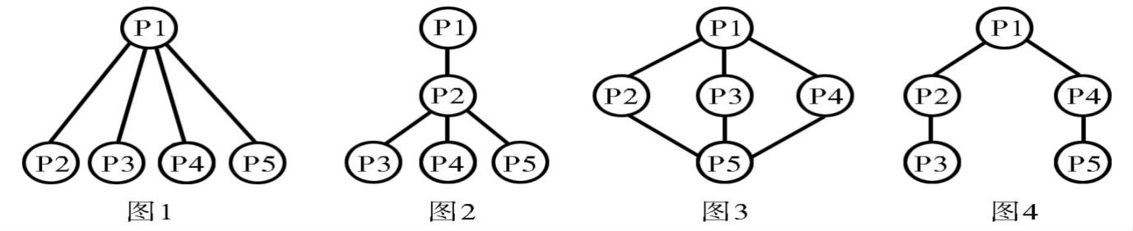
Structure
（结构）
A
B
C
D

Slide 27

What genre(体裁) is this passage?
A. Narrative(记叙文)
B. Exposition(说明文)
C. Argumentative writing(议论文)
Structure
Main idea
What genre(体裁) is this passage?
A. Narrative(记叙文)
B. Exposition(说明文)
C. Argumentative writing(议论文)
Main body
an experience
in the beginning
Conclusion
the opinion
in the middle
Introduction
background information
in the end
conclude
（总结）

Slide 28
When I was 10, I was always joked by my buddy Co-Curricular Activities (CCA) mates, including John. Words were like,“Dick is the best player in the CCA! He only knows how to play 'Mary had a Little Lamb' on the trumpet(小号)!”
Once the moment I left thе school, I took out my earpiece, listening to recordings like a broken recorder. I got so concentrated (专注的) that I didn't see the wall in front and fell on the ground. Luckily for me, a passer-by saw what had happened and immediately called the 120. When I woke up in the hospital, however, the nurse told me that l suffered serious leg injuries. I could have stopped practicing but that was not what I wanted. I wanted to practice even in the hospital.“One leg injury would not stop me; it would only make me feel more motivated, ” I replied to the nurse.
That was a hard period of my life. If I had not been careless, I would not have this problem. Yet if I haven't gotten myself into this problem, I would not be as motivated and would not have that experience teaching me a life lesson. My parents and my best friend had come to give me emotional support, telling me what had happened during CCA today and advising me on how to become a better player. After day-and-night hard practice, I finally perfected and went back to my CCA.
On the selection day, the conductor (指挥) praised me and asked how I had improved so much. I explained that it was because of my determination, my family and my friends. The conductor then said that I was a role model and that the whole band should follow my motivation and practice instead of being like John.
This experience made me what I am today. Recently, I am the best player and the head of the secondary school military band.
Tips for Reading Comprehension
Tip1: Questions first.
Tip2: Key words.
Tip3: Infer(推断).
Tip4: Context.
Tip5: Main idea.
What do you think of Dick?
He is hard-working, determined......
He never gives up...
4. Which can be the best title for the text?
A. A Possible Chance B. An Unexpected Result
C. An Experience to Shape Myself D. A Wish to Be Better

Slide 29
Writing
Write about things you love most

Slide 30
写作评价参考标准
项 目 items | 标准 standards | 细则 examples | 总分 (15分） | 自查得分 | 同伴互评得分
内 容content | 要点齐全；逻辑性强(complete and logical) | 1. love and reasons 2. difficulty and solutions 3. qualities | 3
结 构structure | 结构完整，段落分明(integral and clear) | at least 3 paragraphs | 1
语 言language | 语法正确；语意清楚；语句流畅；表达丰富(accurate,fluent &beautiful ) | 1. No mistakes 2. Upper-class expressions (高级词汇和句式） 3. different sentence structures (一语多表，无重复句式） 4. transtions | 8
细 节details | 字数 (the number) | About100 words | 1
 | 字迹(handwriting) | Clear&clean | 1
 | 标点(punctuation) | “.”“,” | 1
Ways to mark(标记）: ～～ beautiful phrases and sentences transitions（过渡词） mistakes

Slide 31
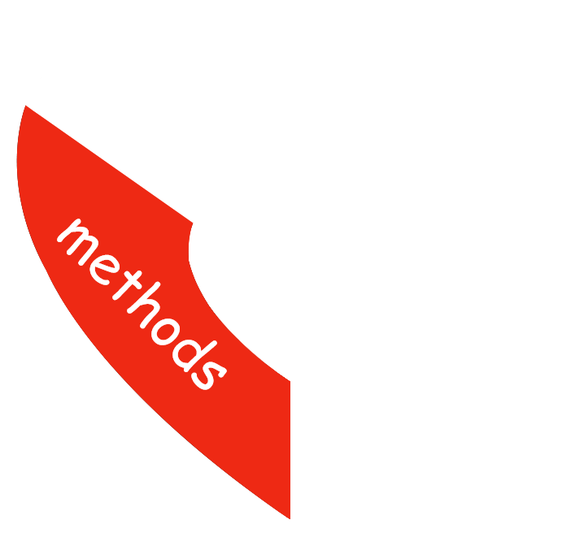



so/such...that..., both...and...
concentrated，suffer from
play an important role in,
determination, beneficial
Reading
Cloze:
Tip1: topic
Tip2: main idea
Tip3: context
Tip4: words & phrases
Reading Comprehension
Tip1: questions first
Tip2: key words
Tip3: infer
Tip4: context
Tip5: main idea
Writing
Love: music
Reasons: benefits
Difficulty:
& an experience
Solutions:
Qualities:
determination
persistence
strong will
diligence

Slide 32
Homework
1. Required: Polish your writing and share it with others;
2. Encouraged: Memorize the words and phrases you learned.

