Slide 1

Unit 3 Online tours
Integrated skills & Study skills

Slide 2
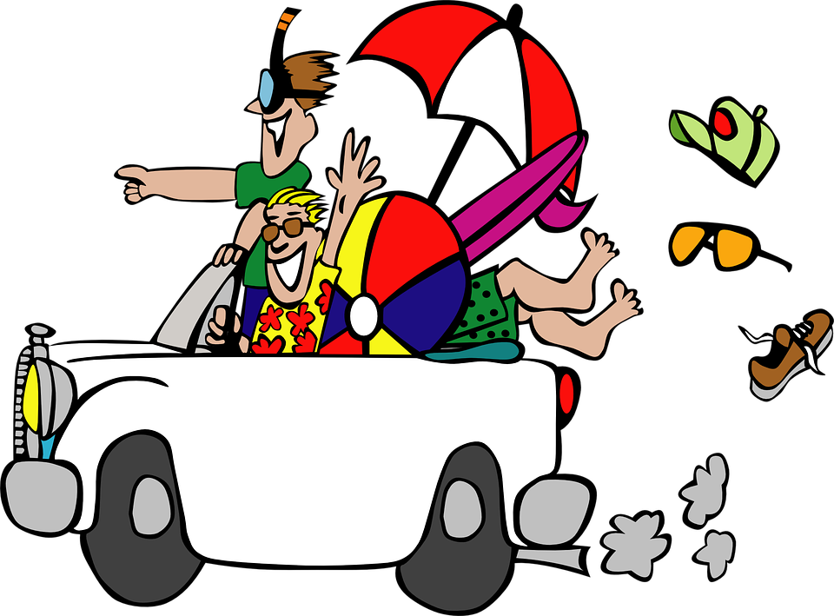
Integrated skills

Slide 3
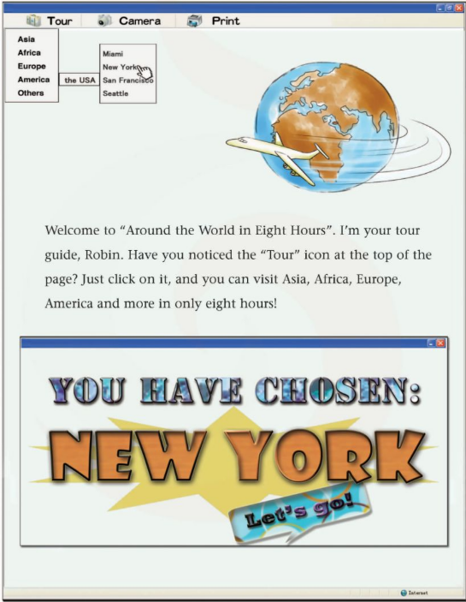
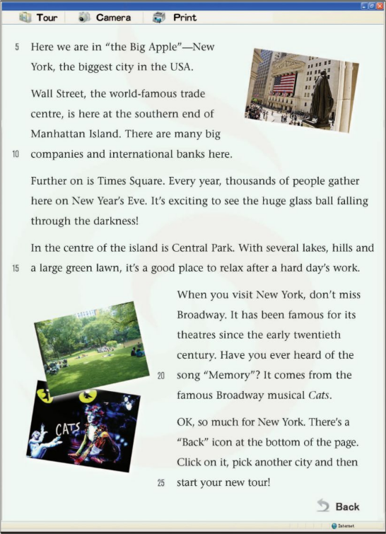
Review
1.How can we visit New York on the website?
2.What places of interest can we visit in New York?
Click on the “Tour” icon at the top of the page,pick a city and then you can visit it.
Wall Street,Times Square,Central Park and Broadway.

Slide 4

Free Talk
What other country do you want to visit?
What places of interest do you want to visit in the country?

Slide 5


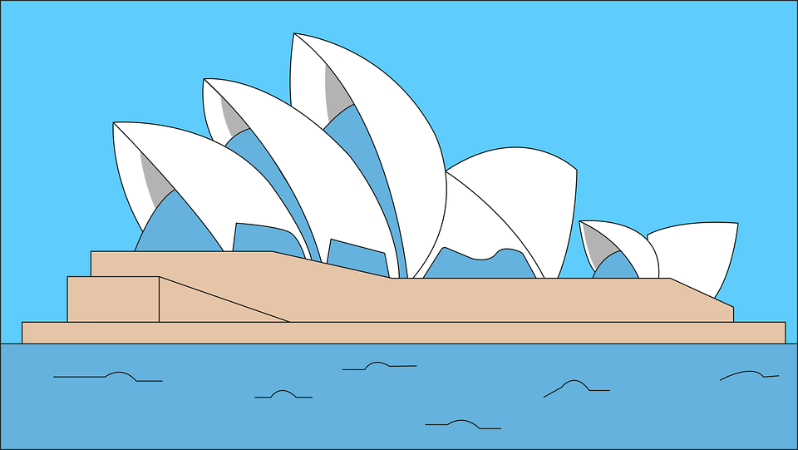
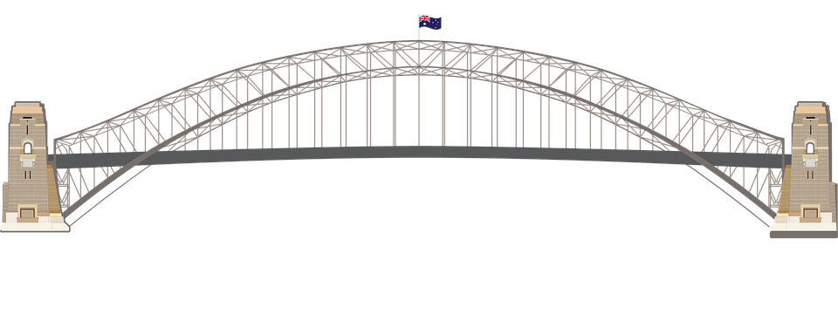
Guess: which city does Mrs.Li want to visit?

Slide 6
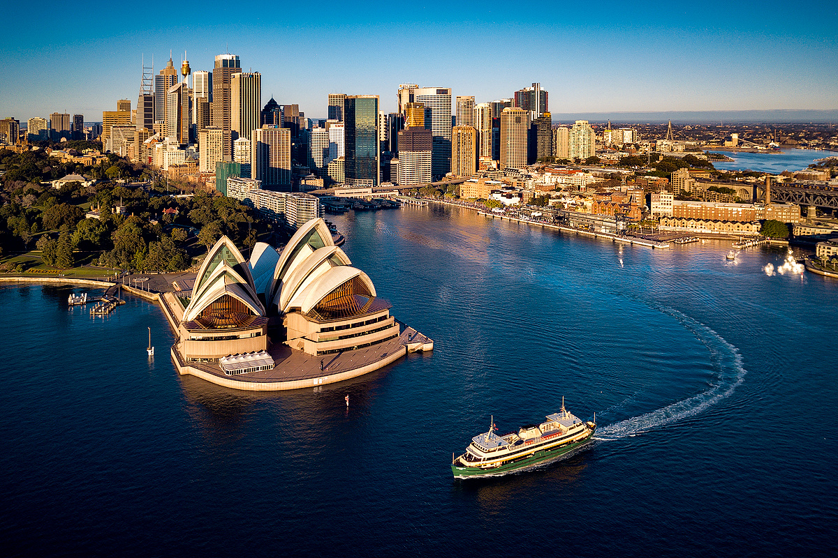
Sydney is on the south-east coast of Australia.
It is the largest city in Australia.
/kəʊst/ n.海岸

Slide 7
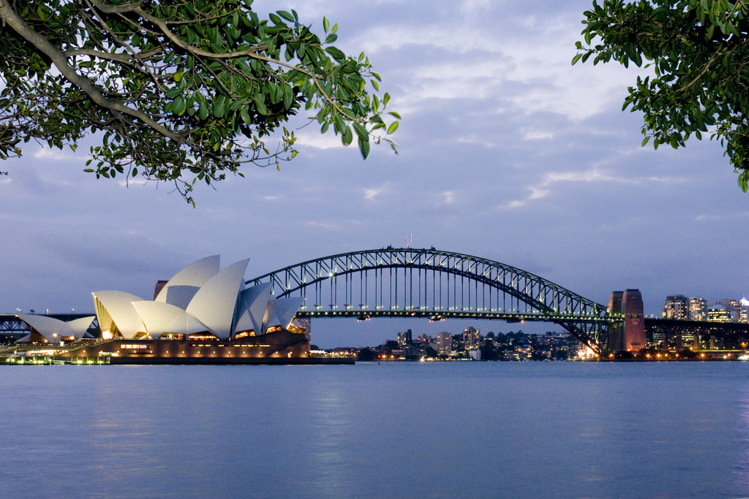
The Harbour Bridge is near the Sydney Opera House.
the Harbour Bridge
sails
/seɪlz/ n.帆
the Sydney Opera House
The Sydney Opera House looks like a ship with many sails.

Slide 8
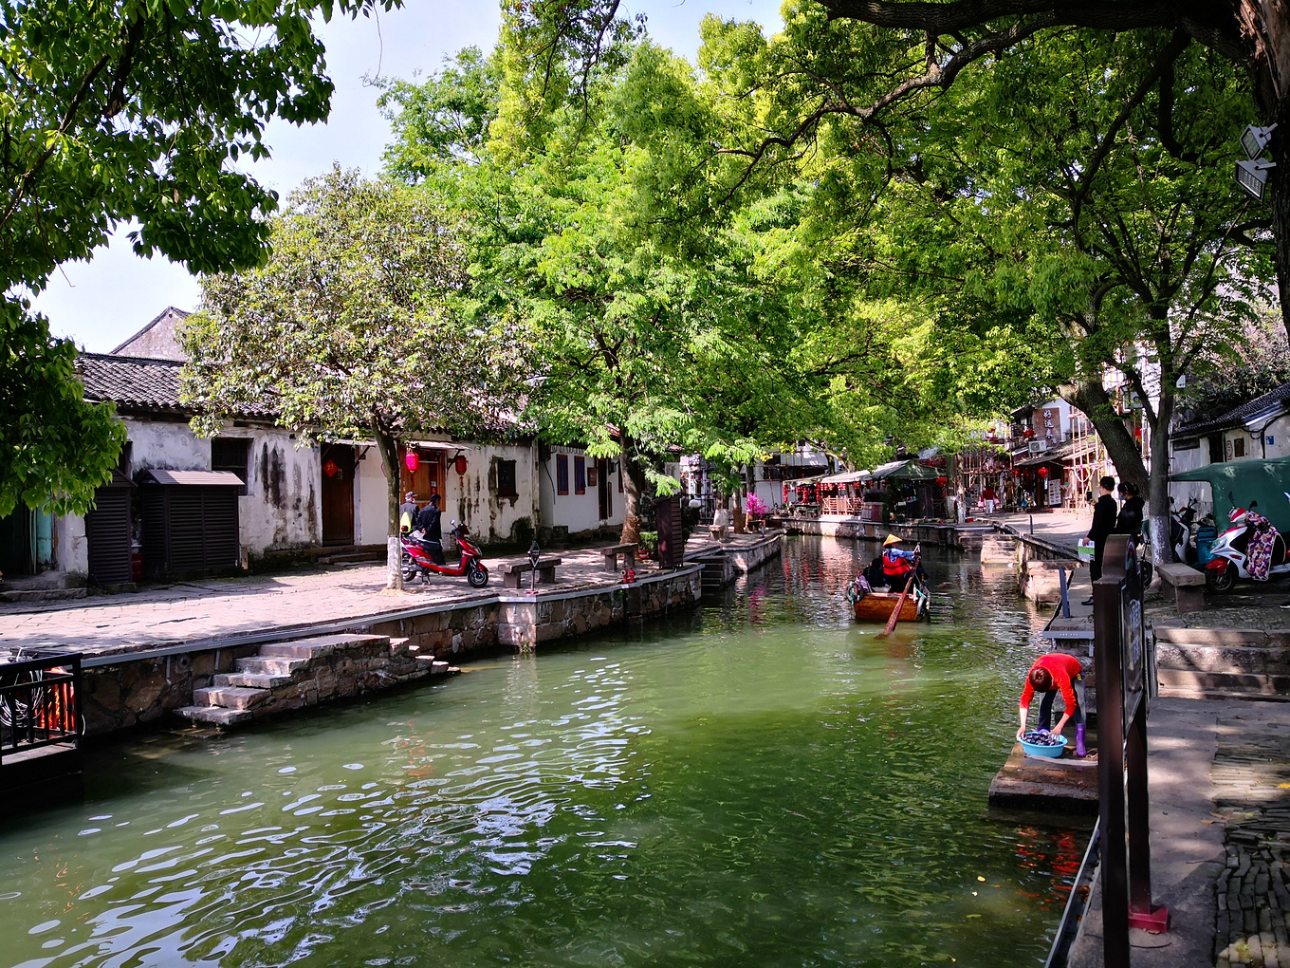
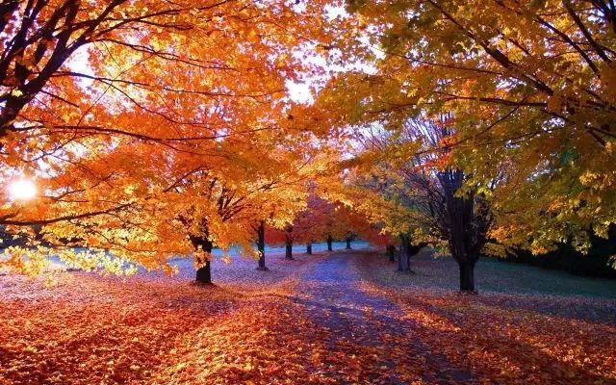
Two pictures taken in March
Which season is it？
Spring
China
Australian seasons are the ______________ of ours.
opposite
adj. 对立的
Autumn
Australia

Slide 9
How can we travel around Australia in a few minutes?
China
in the northern part of the Earth
opposite position,
long distance
Australia
in the southern part of the Earth

Slide 10
The website called “Around the world in Eight Hours”
more

Slide 11
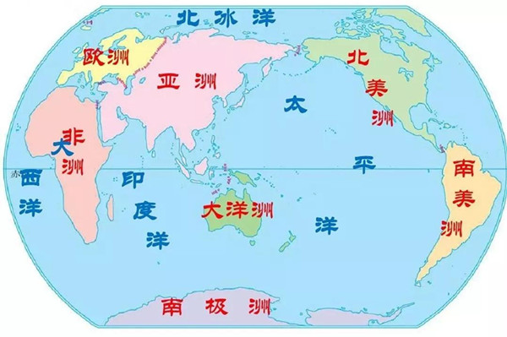
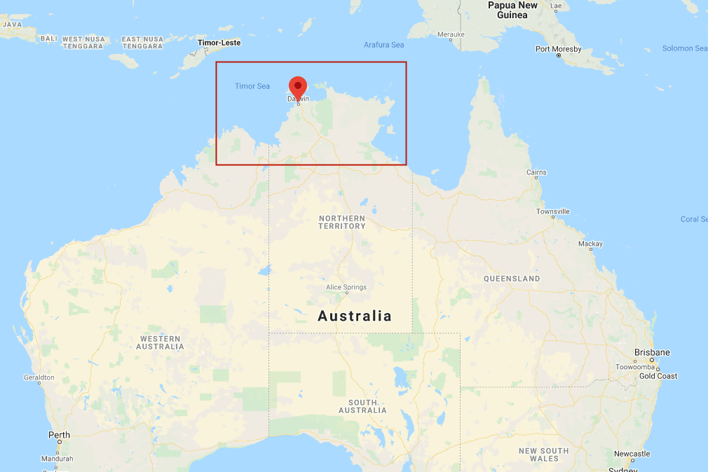
Daniel and Peter are also planning an online tour of Sydney,Australia.
Which continent（洲） should they pick?
[ˈkɒntɪnənt]
Europe
North America
Asia
Africa
Oceania
[ˌoʊʃiˈɑːniə]
South America

Slide 12

Pre-listening
If we click on the “Camera” icon,we may __________________________ . If we click on the “Printer” icon,maybe we can ______________________
All the icons are in the ___________ at the top of the page.
see some pictures of Sydney,Australia
print the pictures we want
menu
Sydney

Slide 13


A1
How to use the website
The website takes you to different places around the world. To learn about a city, just find it in the menu ____________ of the page and click on it. If you click on the “________” icon, you will see some ________ of the city first. Further down at the ________ of the page, you can also find other information about the city.
at the top
Camera
pictures
bottom
1.Predicting before listening
2.Write down the first letter of the key words.

Slide 14

Speak up: My pleasure
How to start an online tour
Listen to a conversation and find out how to start an online tour.

Slide 15
How do we start an online tour of a city?
2. What should we do if we want to look at
the pictures of the city?
3. How do we print the pictures?
B
Just click on the “Tour” icon and it will start.
Sandy is asking for Millie’s help with the online tour. Listen to their conversation and then answer the questions. (P 44)
Click on the “Camera” icon, and you can see many pictures of the city.
Click on the “Print” icon.

Slide 16
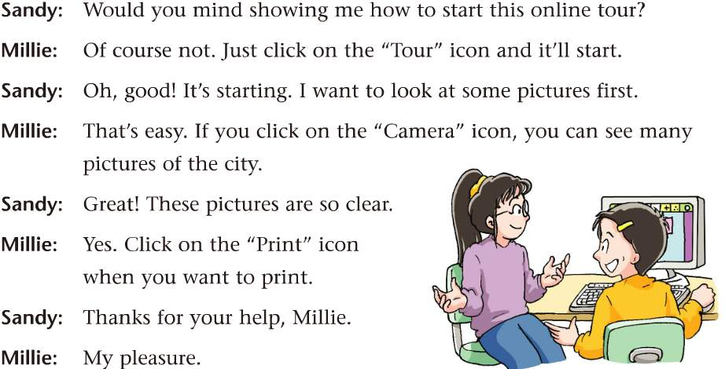
（你介意做……）ask for help
（不介意）respond to request
1. How to ask for help?
2. How to respond（回应） to others’ requests（要求）?
3. How to respond（回应） to others’ thanks?
（我的荣幸）respond to thanks

Slide 17
1. Let’s read together
2. Talk to your partner about the problems you may have when having an online tour. Use the conversation as a model.

Slide 18




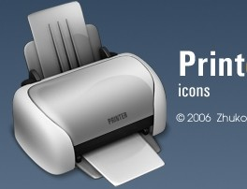
Create new conversations
A: Would you mind showing me how to start this online tour of ...?
B: Of course not. Just click on … and it’ll start.
A: Oh, good. I want to know about the ... first.
B: If you click on the “...” icon, you can
see ... there.
A: Fantastic. How can we get to the most famous ... in ...?
B: Click on the “Transport” icon and you will see/find how to get there easily.
A: Thanks for your help.
B: My pleasure.

Slide 19
Peter took some notes of Sydney.Try to help him decide whether they are true or not.

Slide 20
A2
T or F ?
Try to guess some of the answers according to what you already know.
1. Sydney is on the north-east coast of Australia.
2. Sydney is the largest city in Australia.
3. Sydney is near a lake .
4. The Sydney Opera House looks like a ship with many sails.
5. It takes about 30 minutes to climb the Harbour Bridge.
6. In April, it is spring in Australia.
F
south-east
T
1sea1
F
T
F
three hours
F
autumn

Slide 21
A3
Today Daniel and I took an online tour on the website “Around the World in Eight Hours”.
Sydney is on the __________ coast of Australia. It is the __________ city in Australia.
On the website, we saw lots of pictures of Sydney. Sydney is near the ____. There are many beautiful ________ there. We also saw a wonderful building called the______________________. It is a _______ and looks like a ______ with many sails.
Near the Sydney Opera House is the famous ________________ . People can climb it. It takes about ___________ . It is really cool!
Australian seasons are the opposite of ours. For example, in April, it is ________ in Australia.
south-east
largest
sea
beaches
Sydney Opera House
theatre
ship
Harbour Bridge
three hours
autumn

Slide 22
Futher Thinking
What kind of trip do you like better, travelling online or going out for a trip? And why?
◆ It doesn’t take a long time or cost much.
◆ We can have fun and learn more about the world
at the same time in a short time.
◆ We don’t feel so tired during the trip.
◆ We can talk to the local people and enjoy the local food.
◆ We can be close to nature and enjoy the beauty
of nature.

Slide 23
A New Robot may Change the Future
Developed by US company OpenAI, ChatGPT has taken the internet by storm, winning 100 million users since it came out in November 2022. People can ask the robot to write stories and emails, create recipes(食谱), translate languages, and answer all kinds of questions.
Compared with other chatbots (聊天机器人),ChatGPT uses a much bigger database (数据库)for training, It also uses stronger software(软件)and hardware(硬件)to learn things by itself. For example, if it provides a wrong answer to your question, you can tell it the right one and it will make corrections(改正).
what
why

Slide 24
“But one big problem with ChatGPT is that it makes mistakes or even gives false information. When Lisa, a 28-year-old from the USA, used the robot to write an essay (论文), it “gave out nonexist academic citations(不存在的学术引用)”，she told The Guardian. Since the robot is trained using words from the internet, it can also pick up on the internet's biases (偏见) about certain groups, These are all things that need to be dealt with.
What’s the problem with ChatGPT?

Slide 25
Embrace(拥抱) the new technology
Use it properly!

Slide 26
Thank you!

