Slide 1
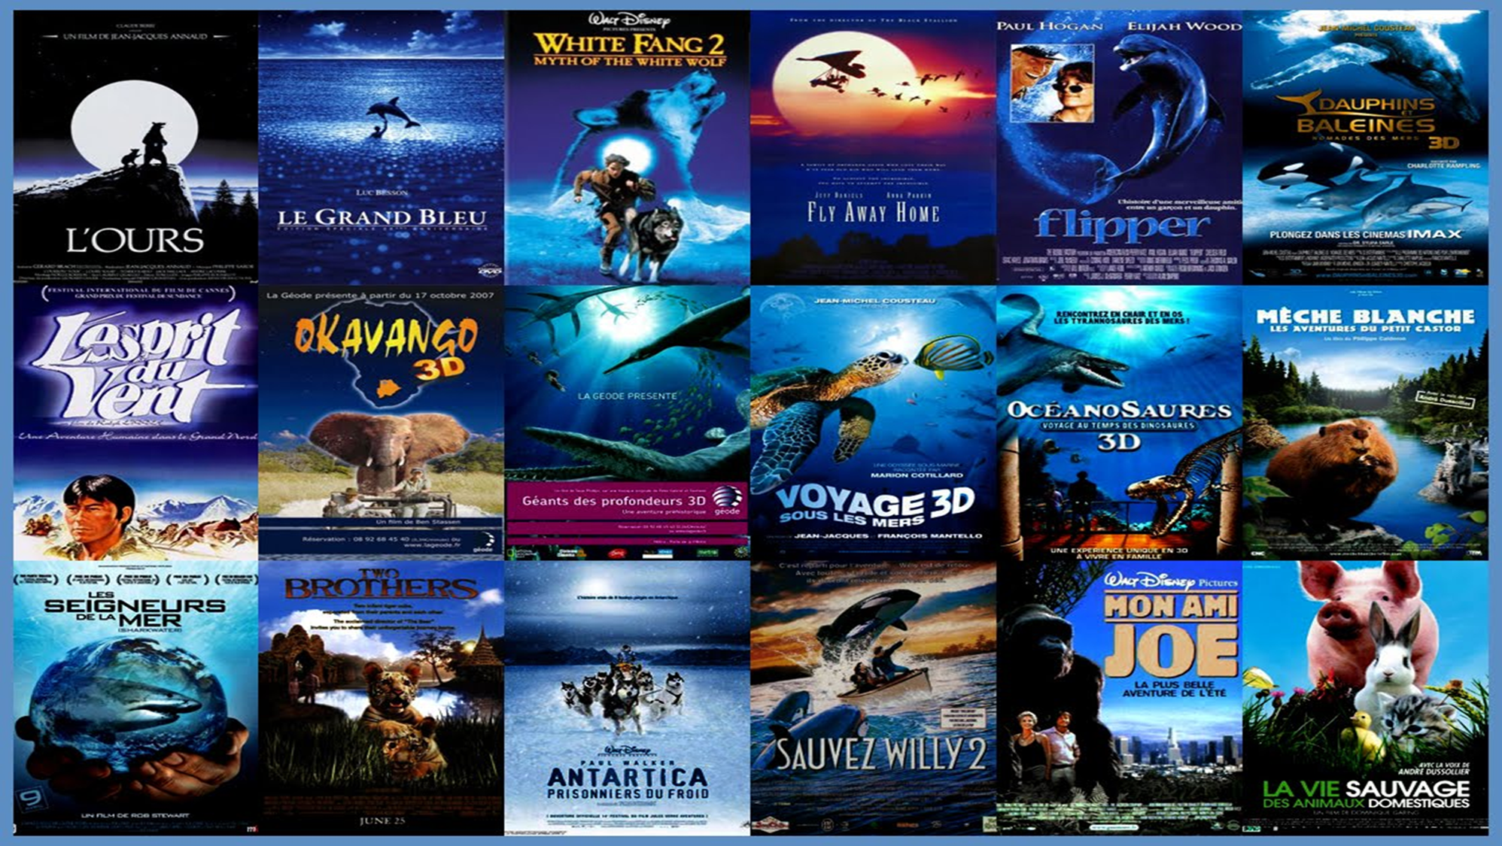
Where is the the home to film industry?
Hollywood

Slide 2

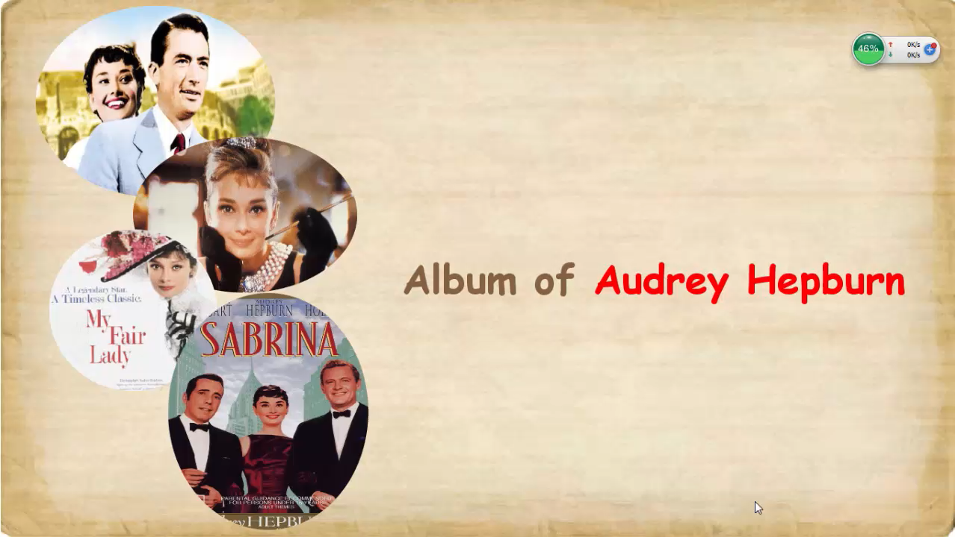
A great actress

Slide 3
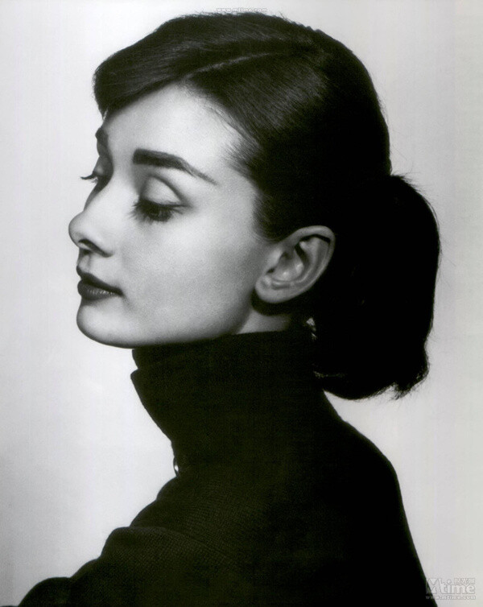
吸引你的注意力
What catches your attention when you see her photo?
/'ɔ:dri 'hepbə:n/
Audrey Hepburn
奥黛丽-赫本
Her beauty and charm.
/tʃɑːm/ 魅力

Slide 4
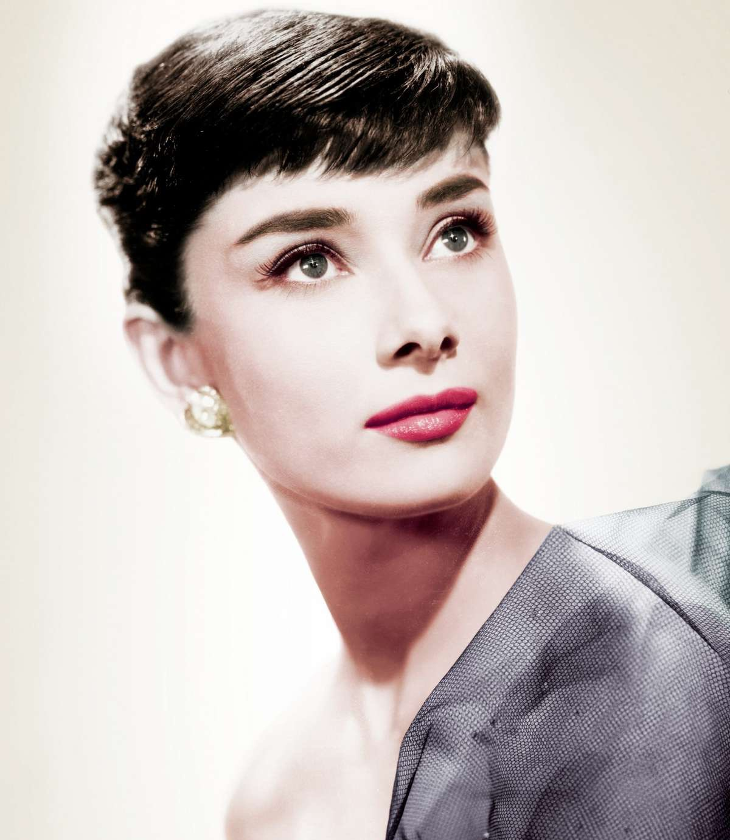
Hollywood’s all-time best
—Audrey Hepburn
一向的；空前的
9A Unit 7 Reading 1
Only because of her beauty?

Slide 5
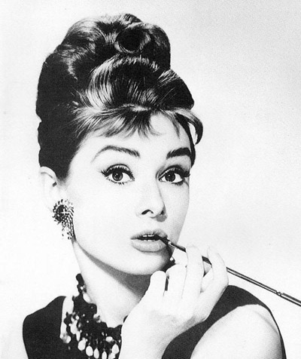

Read for main idea
The article mainly tells us about _____________.
A. Audrey Hepburn’s films
B. Audrey Hepburn’s kindness
C. Audrey Hepburn’s acting skills
D. Audrey Hepburn’s lifetime(一生)
biography （人物传记）

Slide 6
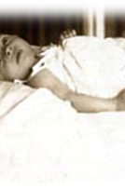
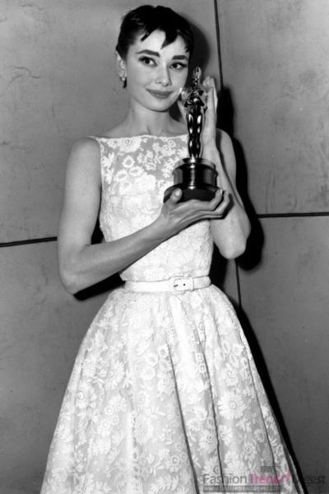
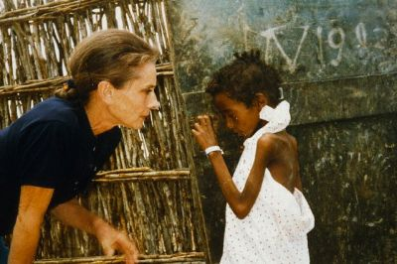
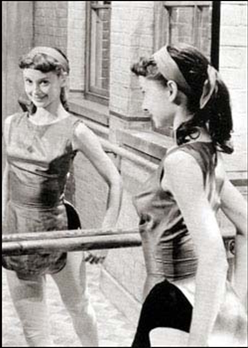
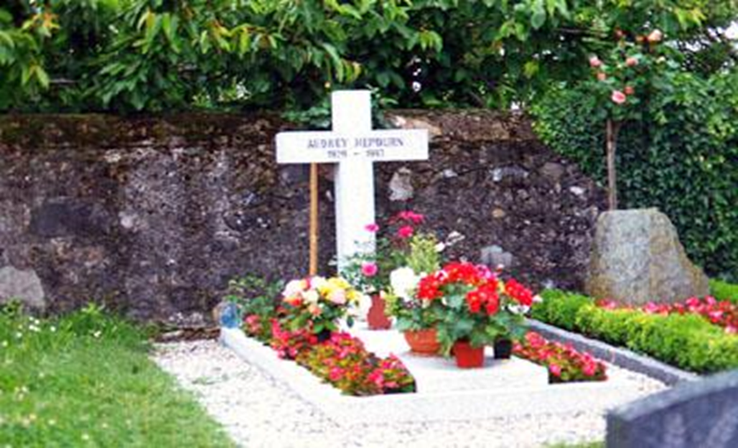
Hepburn’s lifetime
Para 2
Para 3,4,5
Para 6
Para 7
Her early life
Her acting career
Her work for UNICEF
She ___________ in 1993.
passed away
Dancer
Actress
Humanitarian
1929
1953
1993

Slide 7
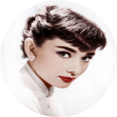
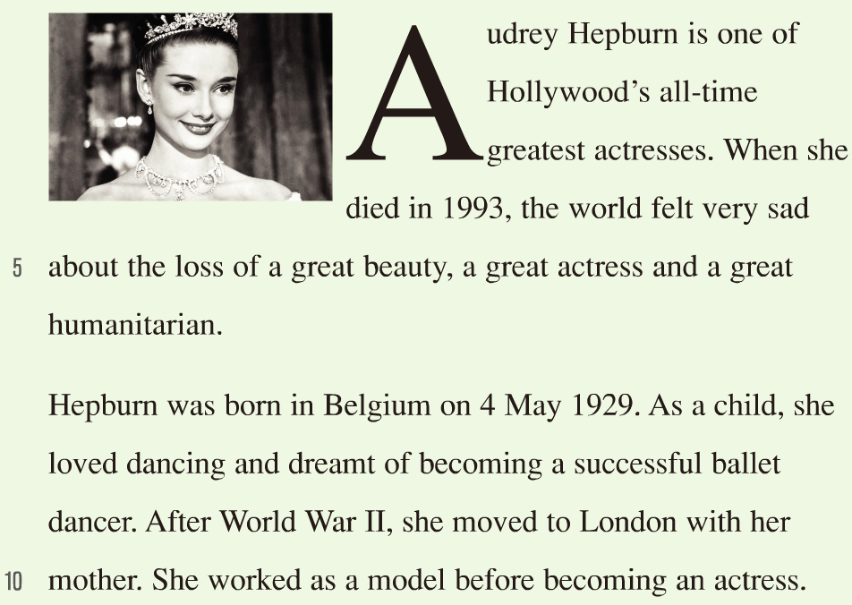
Introduction (Para 1 )
Why is she Hollywood’s all-time best ?
Why did the world feel very sad in 1993?
If someone is a humanitarian, he or she ________.
a. loves animals
b. protecs the environment
c. cares a lot about people
[hjuːˌmænɪˈteəriən]

Slide 8
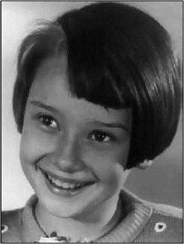

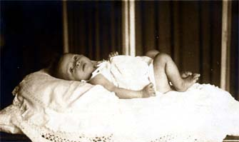
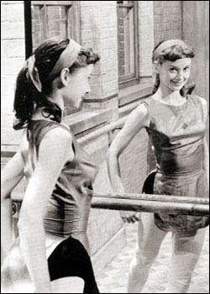
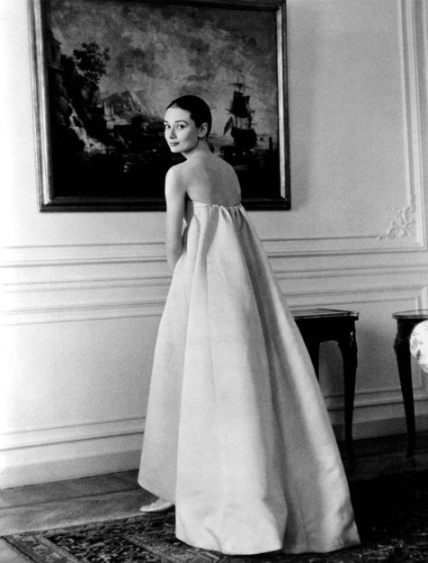
Hepburn’s early life (Para 2 )
A great beauty
1. Where was Hepburn born?
In Belgium.
2. What was her dream when she was a child?
She dreamt of becoming a successful ballet dancer.
3. What did she work as before becoming an actress?
She worked as a model.
What experiences help Hepburn (a born beauty) to be a lady full of charm?
love dancing ballet
a lady full of charm
work as a model

Slide 9
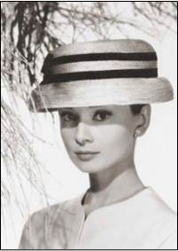
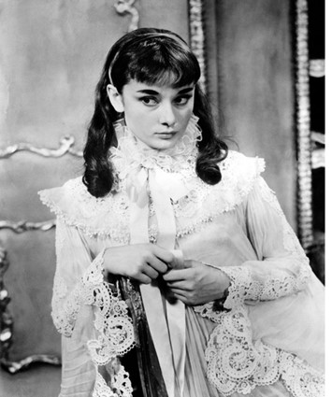
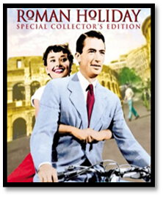
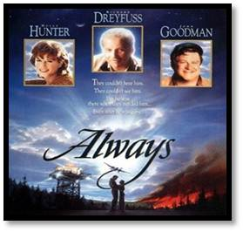
Hepburn's acting career (Para 3~5)
3 works
Para 3
Para 4
Para 5
marked the beginning of her successful career
won the Oscar for the Best Actress
made her final appearance
n. 出现；露面；外貌

Slide 10
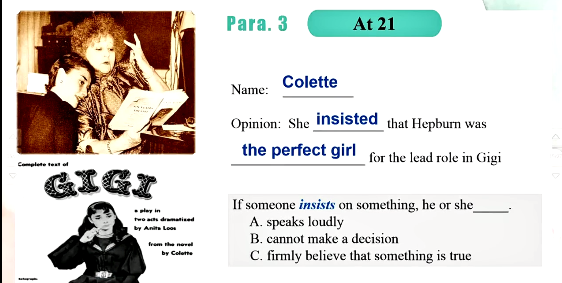
Para3
Collette
Writer：_______________
Opinion: She ___________ that Hepburn was ________________ for the lead role in Gigi.
insisted
the perfect girl
main character 主角
1951
If someone insists on something, he or she _______
a.speaks loudly
b.cannot make a decision
c.is sure to say that something is true

Slide 11

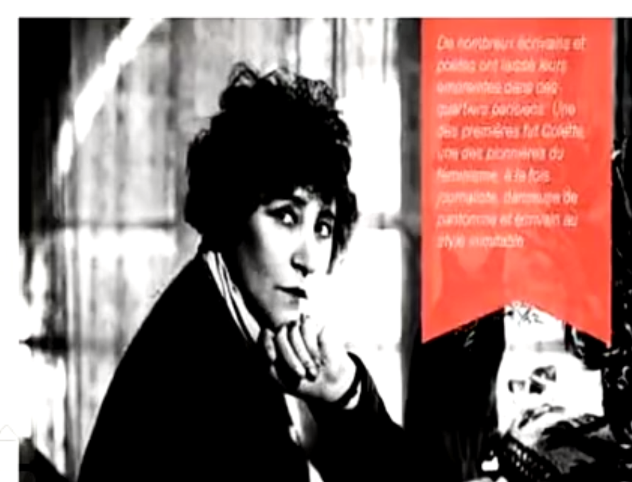
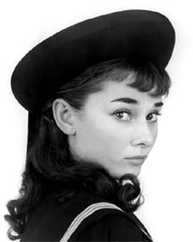
Pair work :Role play
Student A: Hepburn Student B:colette
Para 3
A: Hi,Ms Colette, it is my great honor to meet you .
B: Thank you, my dear. I have been watching your performances, and I believe you ……in Gigi.
A:“Oh, really? But I never （原因）….. before. Are you sure I am the right choice?”
B:“Of course. You are/have (品质） ……. These are exactly what the character needs. Trust me, you will shine.”
Notes:
Okay, do you think this is a good dialogue? Very good. Some. Okay, let's give them a big hand. Anther pair, the grils. Please gives us your show. You are so good actress. Thank you.

Slide 12
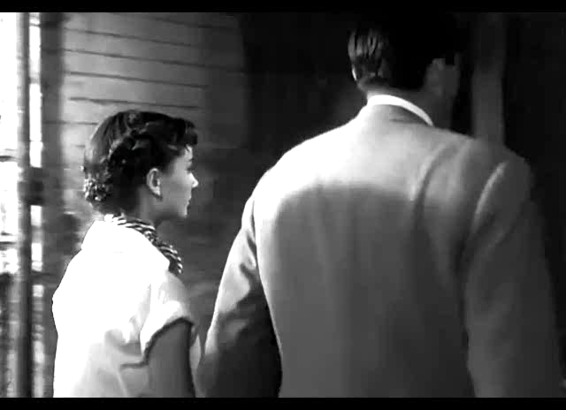
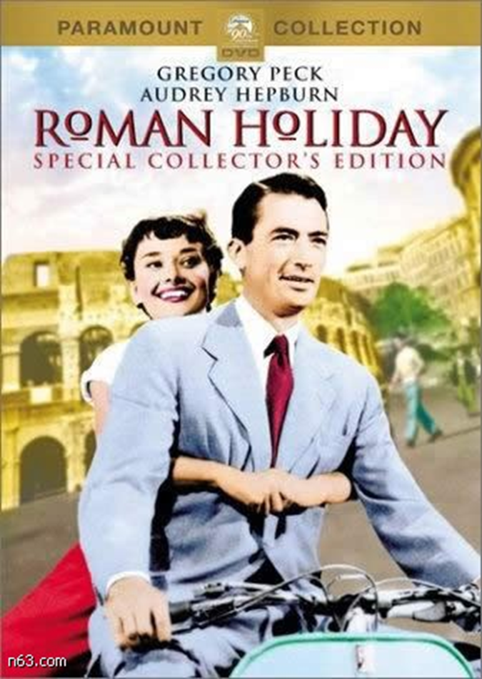
Para 4
1953
Notes:
Okay, and after that, only two years later, another important thing happened, She played in her best film. That is the Roman Holiday. so let's enjoy a small part of this film and try to know more about it. Do you like it? Very much so. In this film, we can see a beautiful young woman and a handsome gentlemen, can you guess what kind of film it is? A horror film, a cartoon, a romantic film? Yes it is a romantic film.

Slide 13
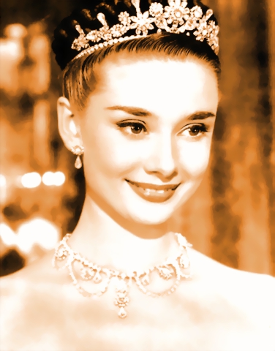
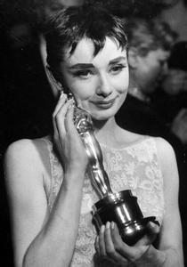
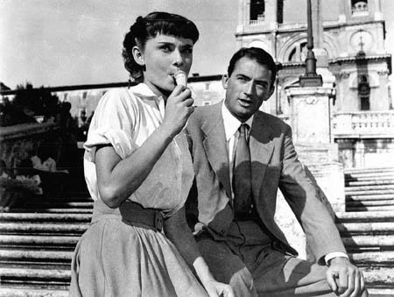
During her lifetime,she had four more Oscar nominations（提名）.
Hepburn won an Oscar for Best Actress.
1.What role did she play of?
2.What happened to her
after the film?
She played the lead role of a young princess.
She became world-famous .
Notes:
What role did she play of? What happened to her after the film? How do you think of her acting skills? Are you willing to introduce or recommend this film to your friends so that more people know about this wonderful film. Okay, so I will give you two minutes to prepare your little speech, your little introduction.

Slide 14
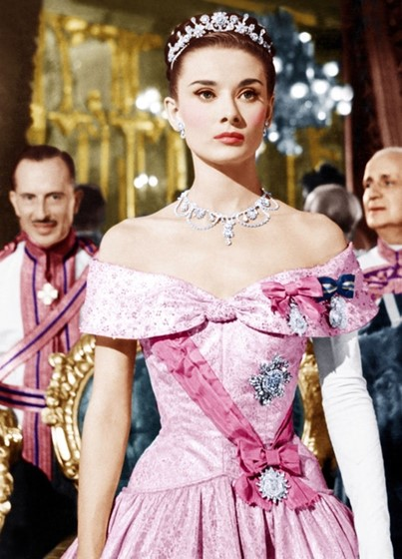
Make a speech
Hello, everyone!
Please allow me to recommend an old but wonderful film to you. That’ s Roman holiday.
Hepburn plays the role of_________.I think she looks________and __________in the film. As a result, the film was a big _________.What’s more, she won an Oscar for Best________.
This film is well worth watching .
Notes:
Ask two students to show it .

Slide 15
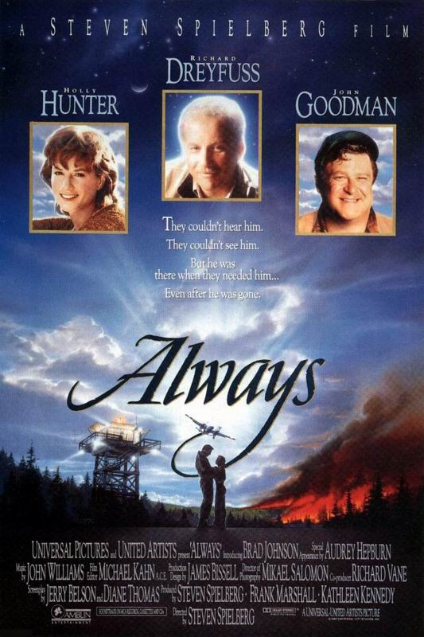
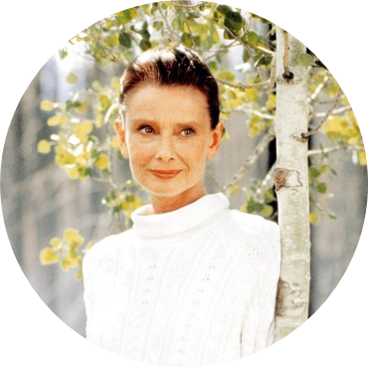
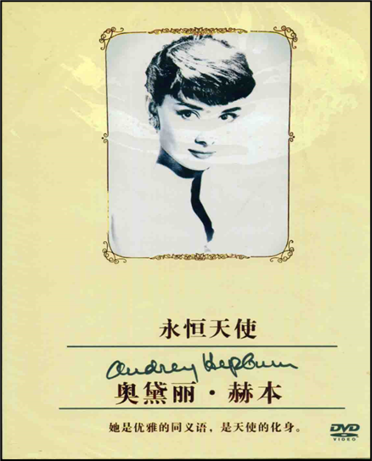
Para 5
In the film Always, she played the role of a ____________.
A.princess B. angel C.writer
Further thinking :
What makes her ?
a great actress
Hard work
Personality
Talent
Beauty
Notes:
what about her last film? That is always. Alright, so what was the role she played in this film? She played the role of a angel. This is her final appearance in the film. She wasn’t young any more, but she was still like an angel. She was so elgant. She has the personality of an angel. Though her works, let's think about this question. Do you agree that Audrey Herpburn is a great actress? And what makes a great actress? Is this only because of her beauty? What else did she need? This girl. Do you wanna to try? Yes, I think you're looking at me. Okay. She is not only good at acting,but also works very hard. She played many films , So she, her personality, her hard work, and don't forget that she won an Oscar when she was only 23. So she also, she must also be very talented. This all makes a great actress, right. Was her achievement just in film? NO, herbpburn’s achievement beyond the film industry.

Slide 16
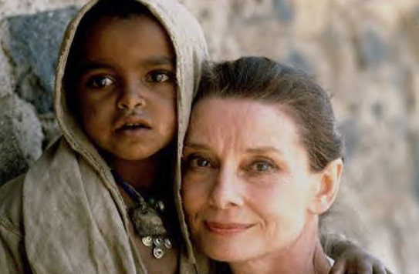
Her later life
A great humanitarian (Para 6)
1.What did she start to do in 1950s?
She began to work for UNICEF
（联合国儿童基金会）.
2.Why did she do so ?
She spent her last few years working closely with UNICEF to help poor children in different parts of the world

Slide 17
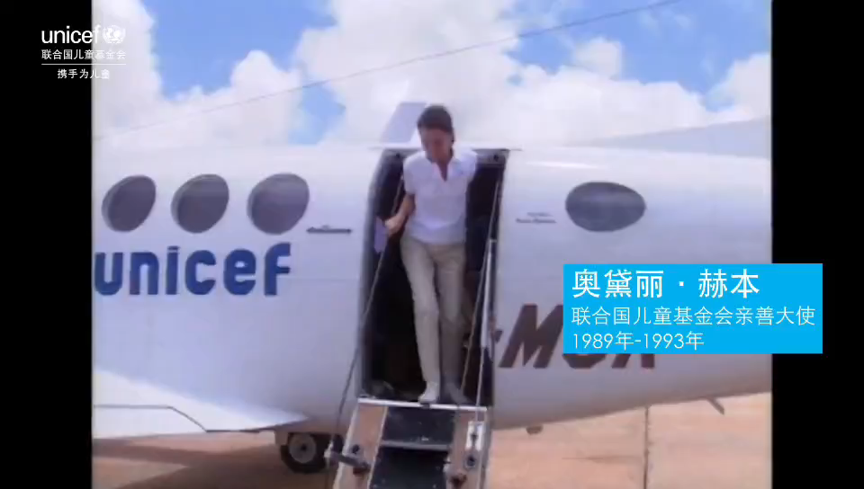
What do you think of her ?
A great humanitarian
Notes:
From this video ,what do you think of herpburn? Yes she is a great humanitarian。she is not only beauty outside but also has a beautiful inner. So what does beauty to you ?

Slide 18
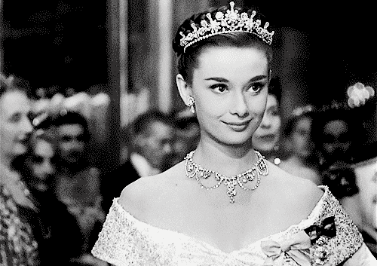
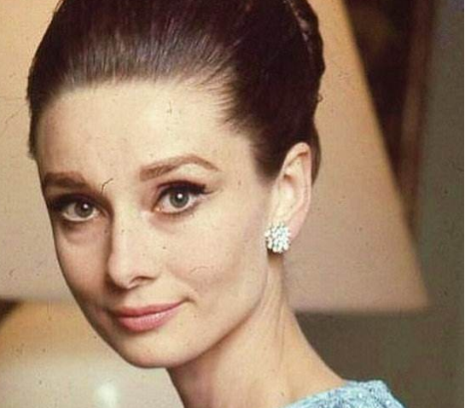
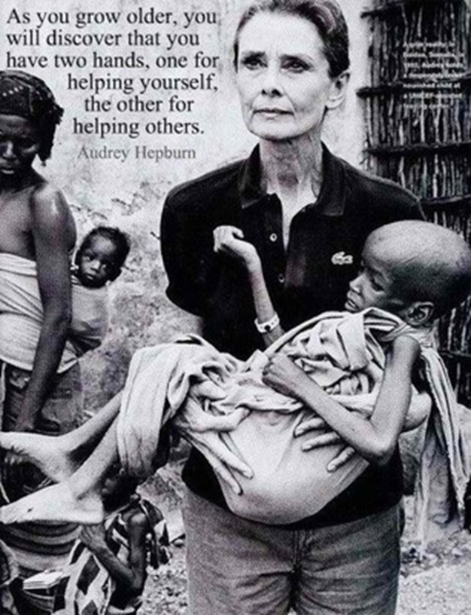
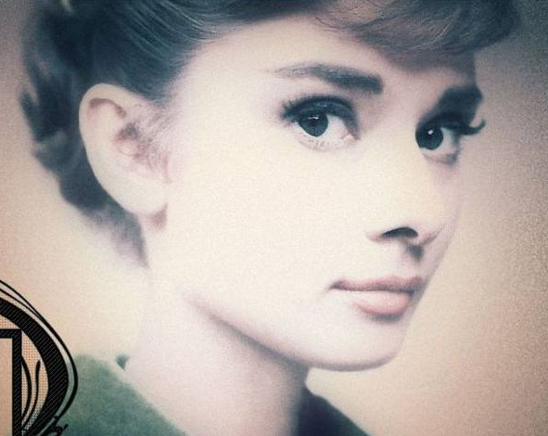
Thinking :What does beauty mean to you?
“Beauty is being the best possible version of yourself, inside and out.”
—Audrey Hepburn
“As you grow older, you will discover that you have two hands, one for helping yourself, the other for helping others.”
—Audrey Hepburn

Slide 19

Read Para 7 and fill in the blanks.
In 1991, Audrey discovered that ___________________.
At the age of 63, Audrey ____________ peacefully in her sleep.
she had cancer
passed away

Slide 20
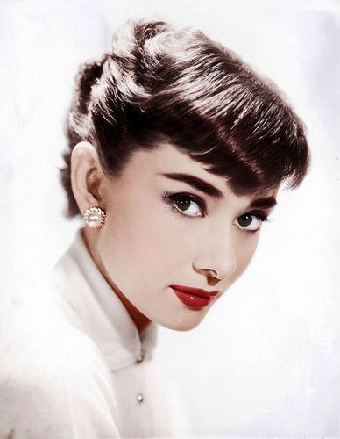
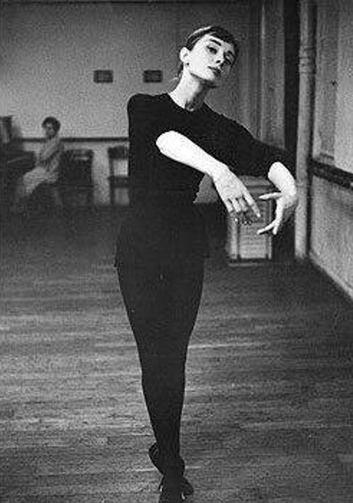
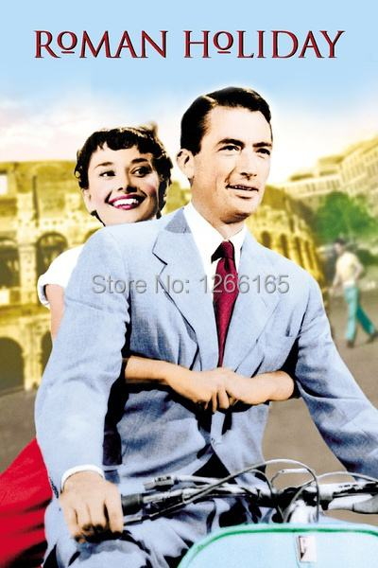
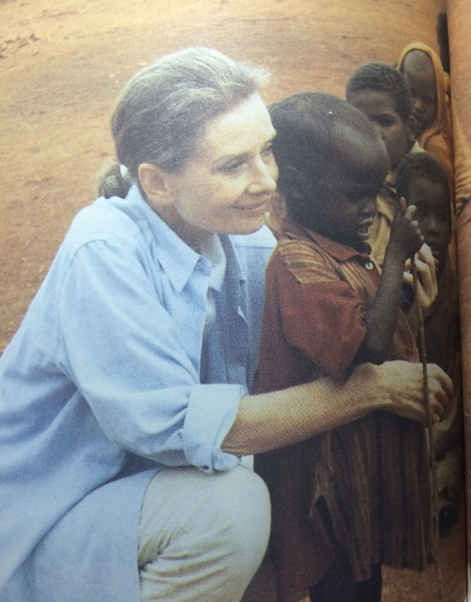
Group work
Hepburn in our eyes
In our eyes, Audrey Hepburn is a great __________.
Thanks to her, we understand
that ____________________.
We should______________.

Slide 21
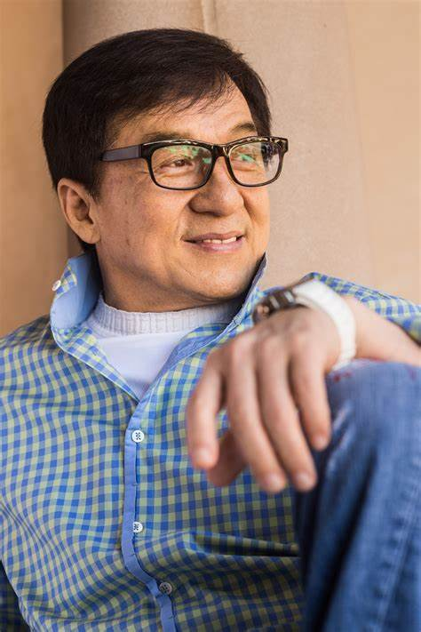
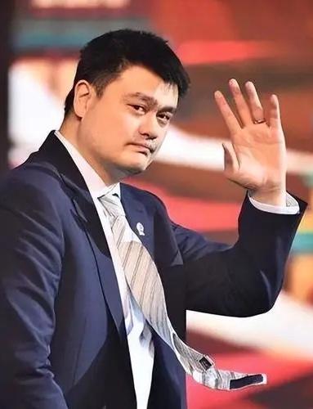
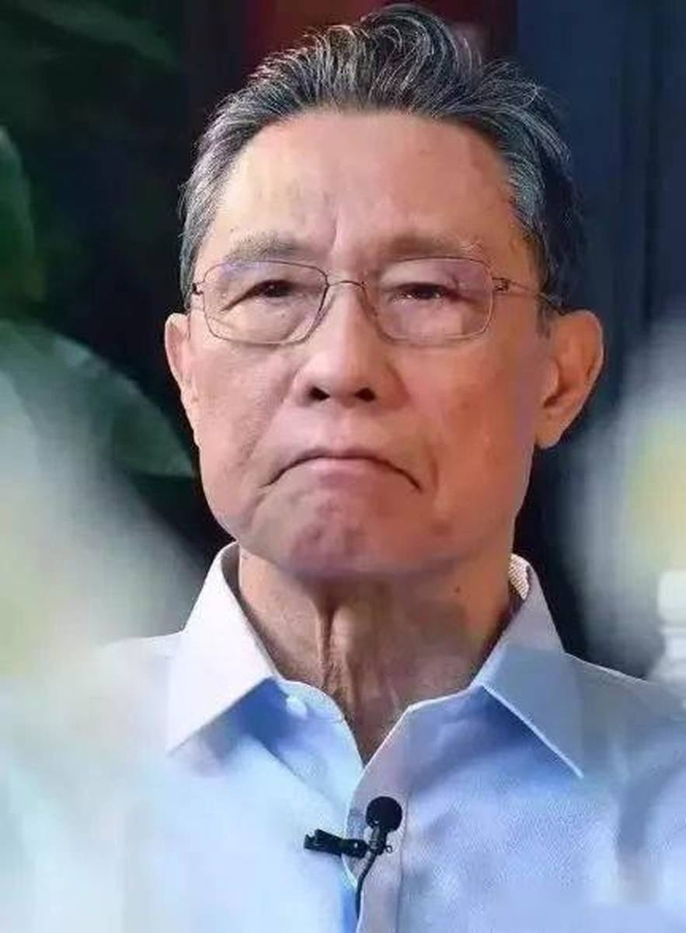
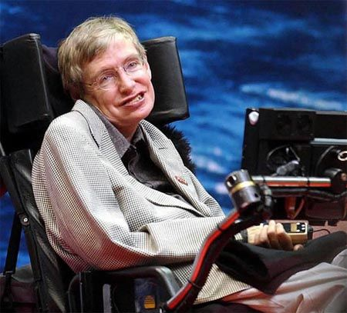
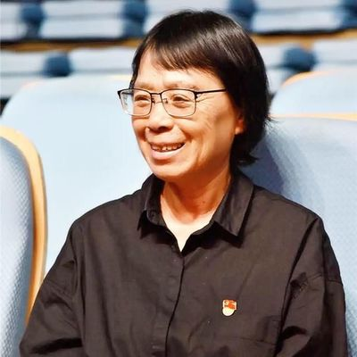
Show my superstar
Group activity:
What is he or she ？
What has he or she done?
What can you learn from him or her ?

Slide 22
Beauty is being the best
possible version of yourself, inside and out.
-Audrey Hepburn

Slide 23

Homework
Homework for everyone (必做)
Retell Audrey Hepburn’s story with the help of the mind map.
Finish your writing my superstar and share it with others.
Homework for someone (选做)
Watch one of Audrey Hepburn’s films.

Slide 24
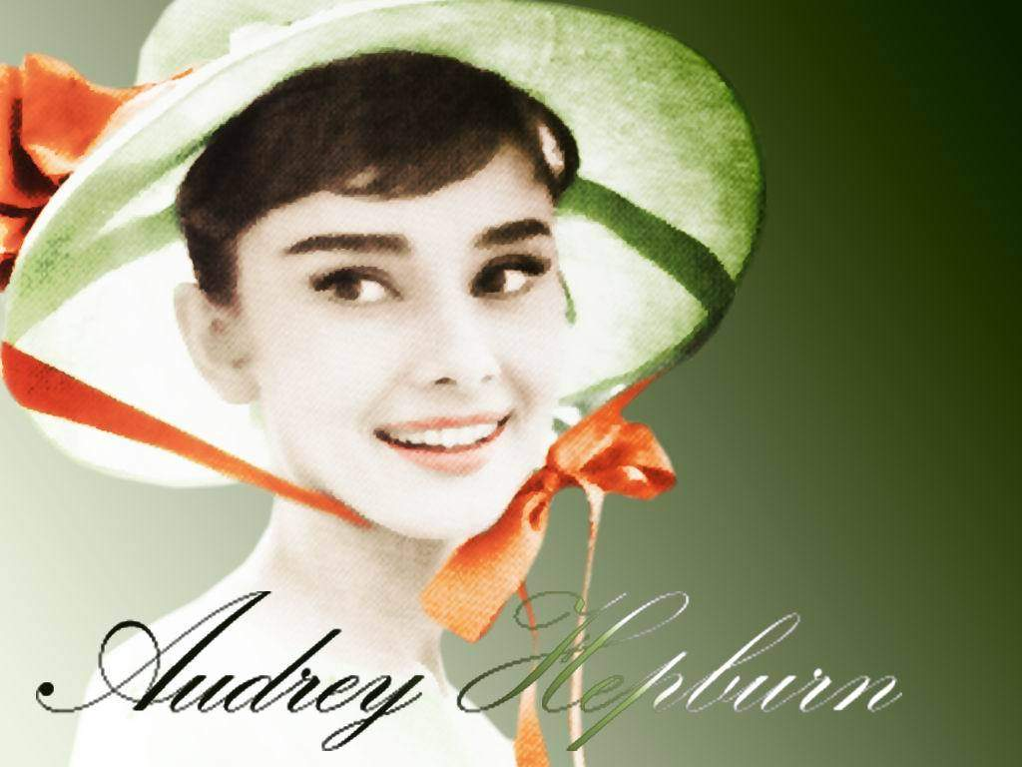
Thanks
a lot!

