Slide 1
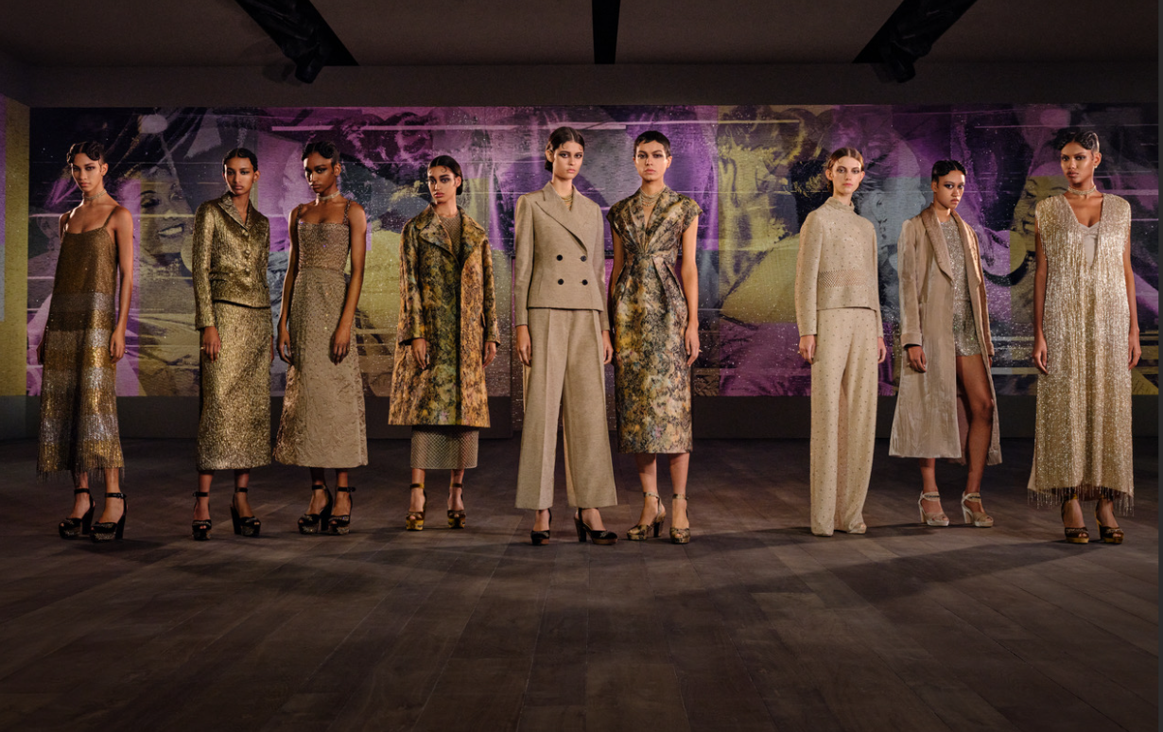
U6 My clothes, my style

Slide 2
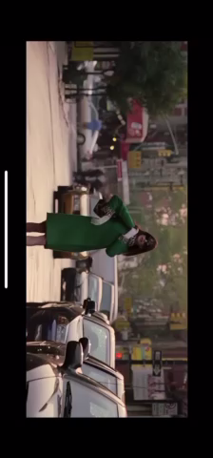
Guess: What is she? (What is her job?)

Slide 3
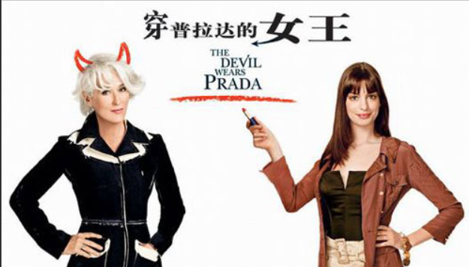
Let’s help her!
Her boss
Andy
gives hard work

Slide 4
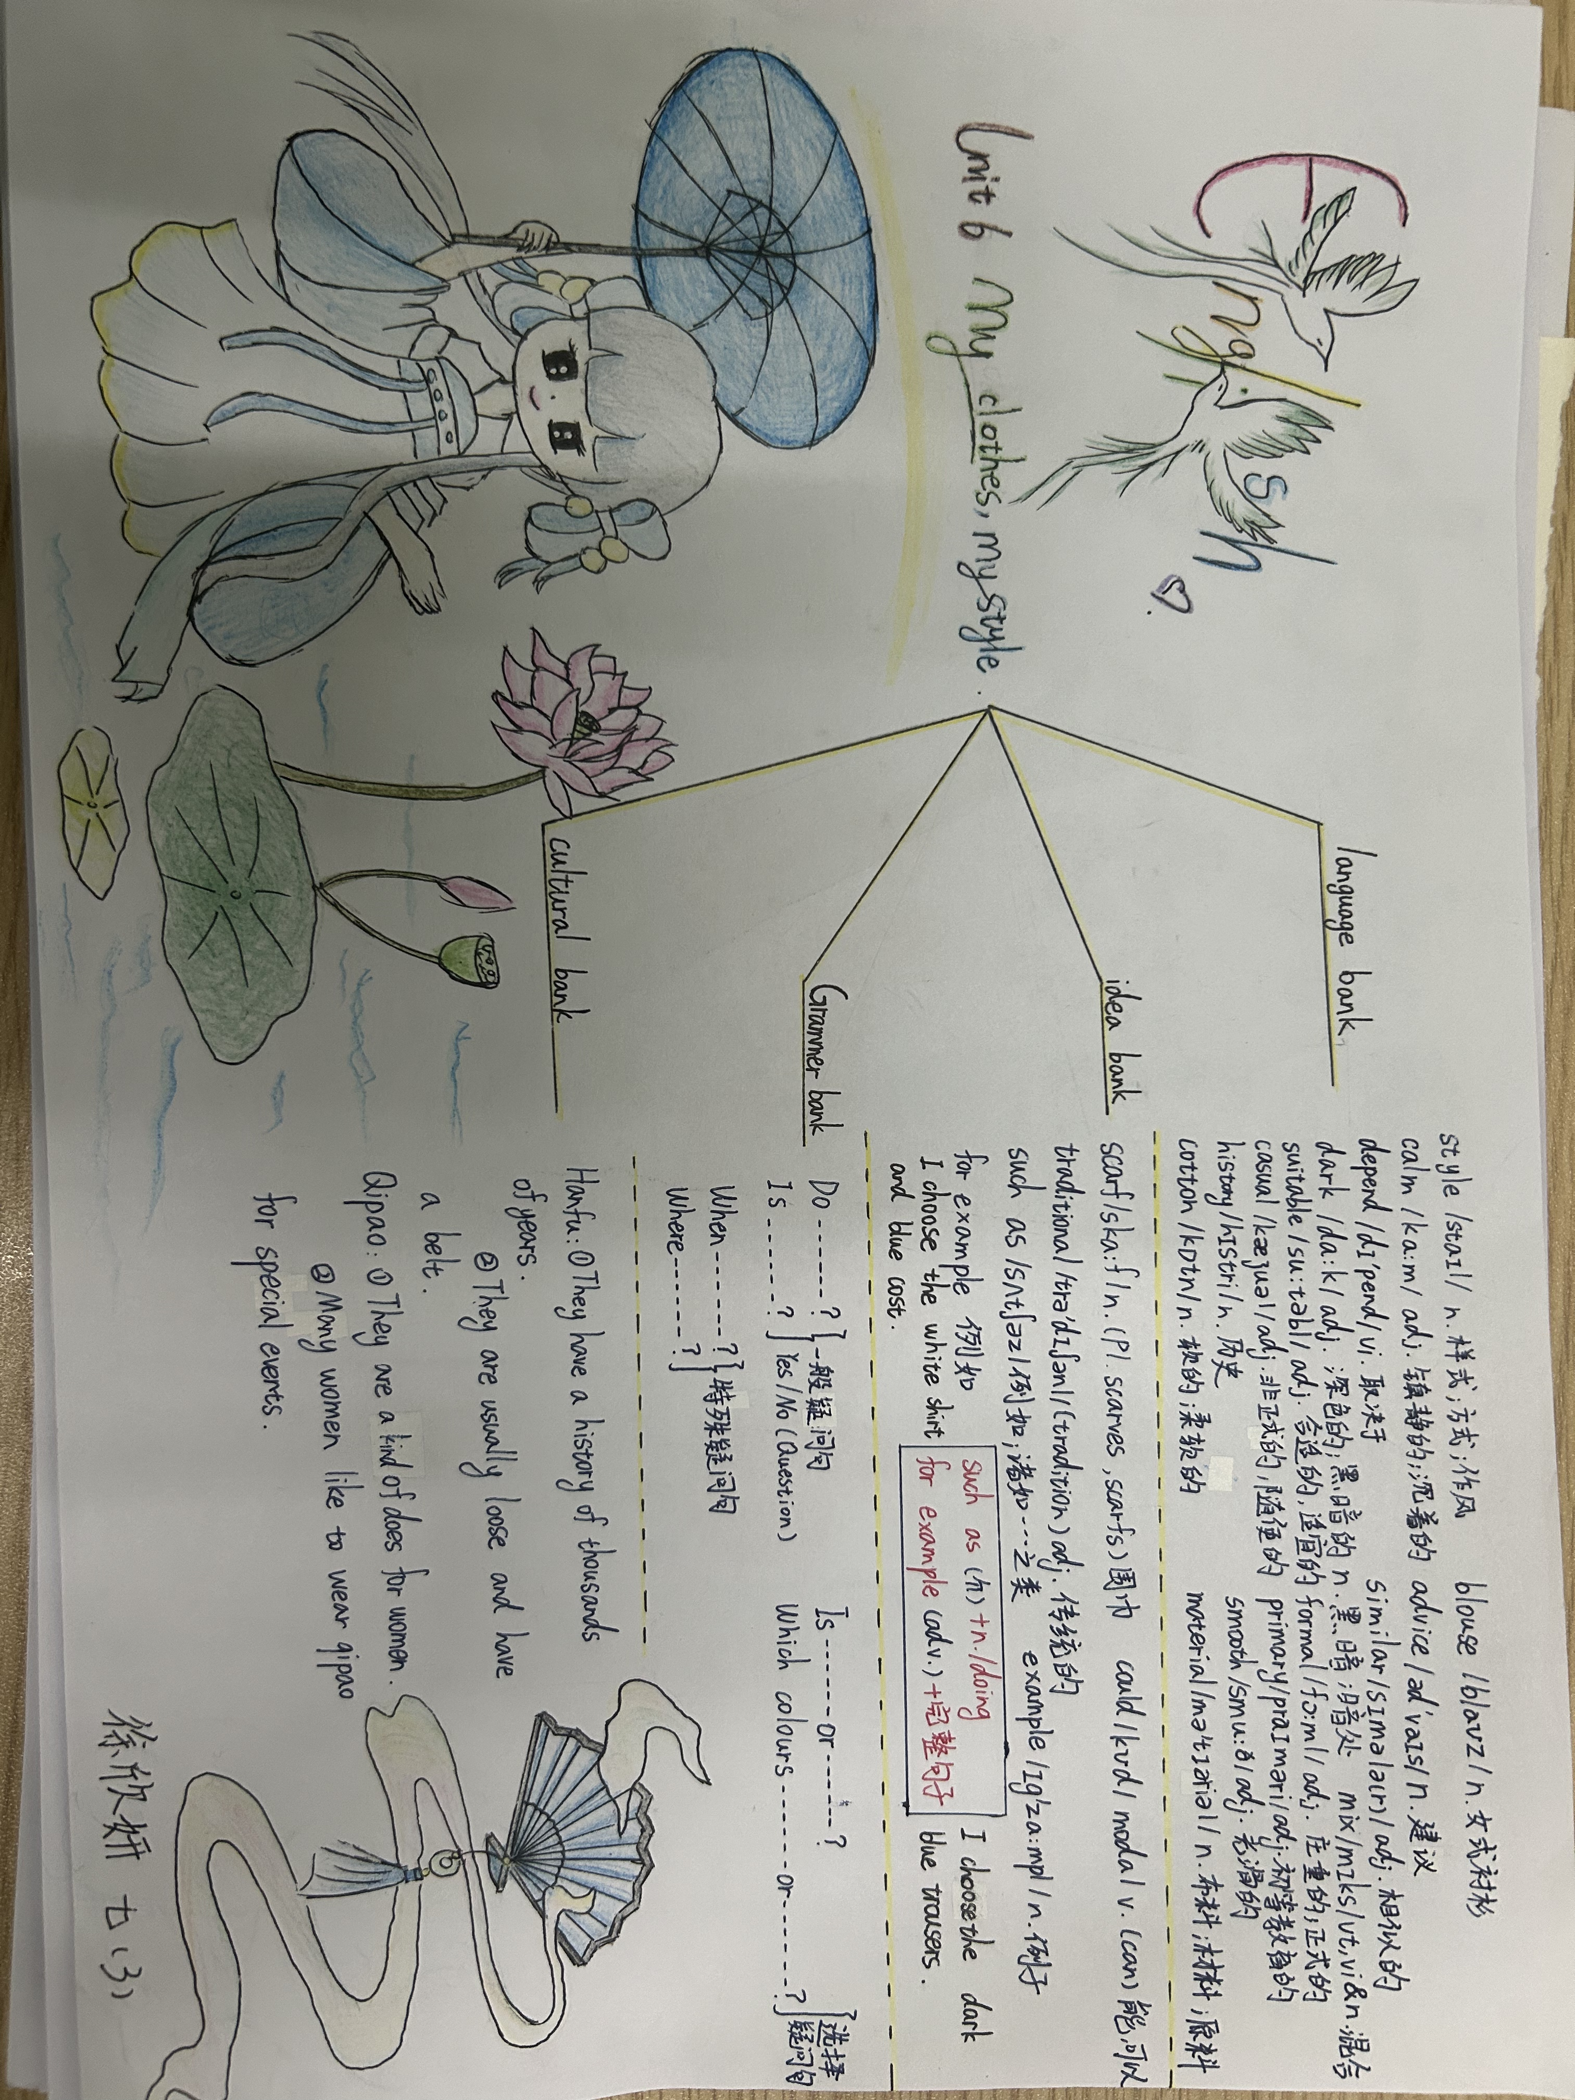
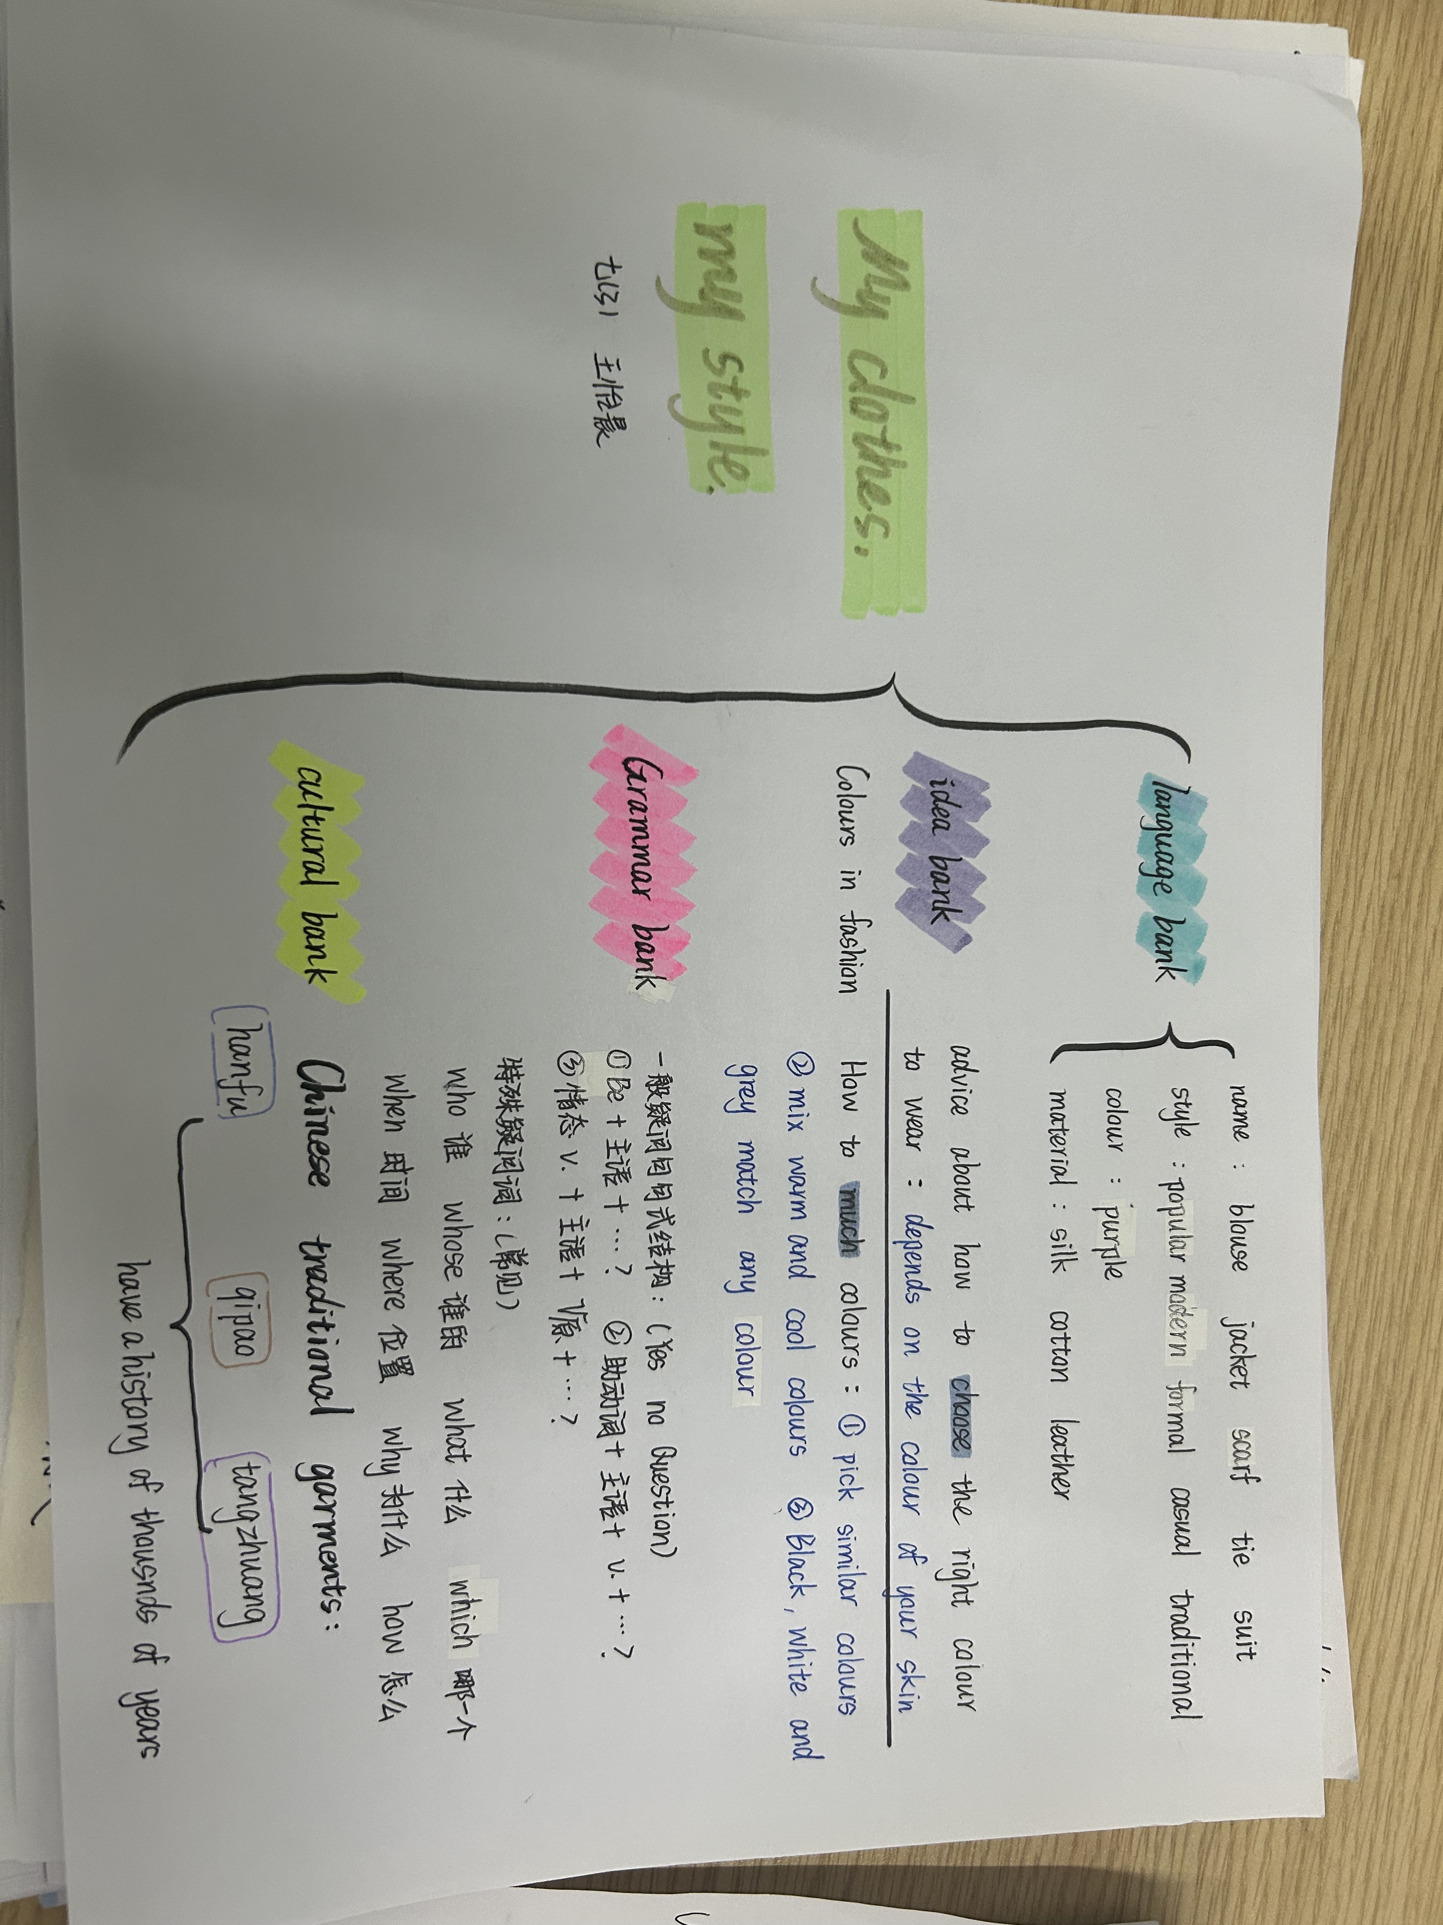
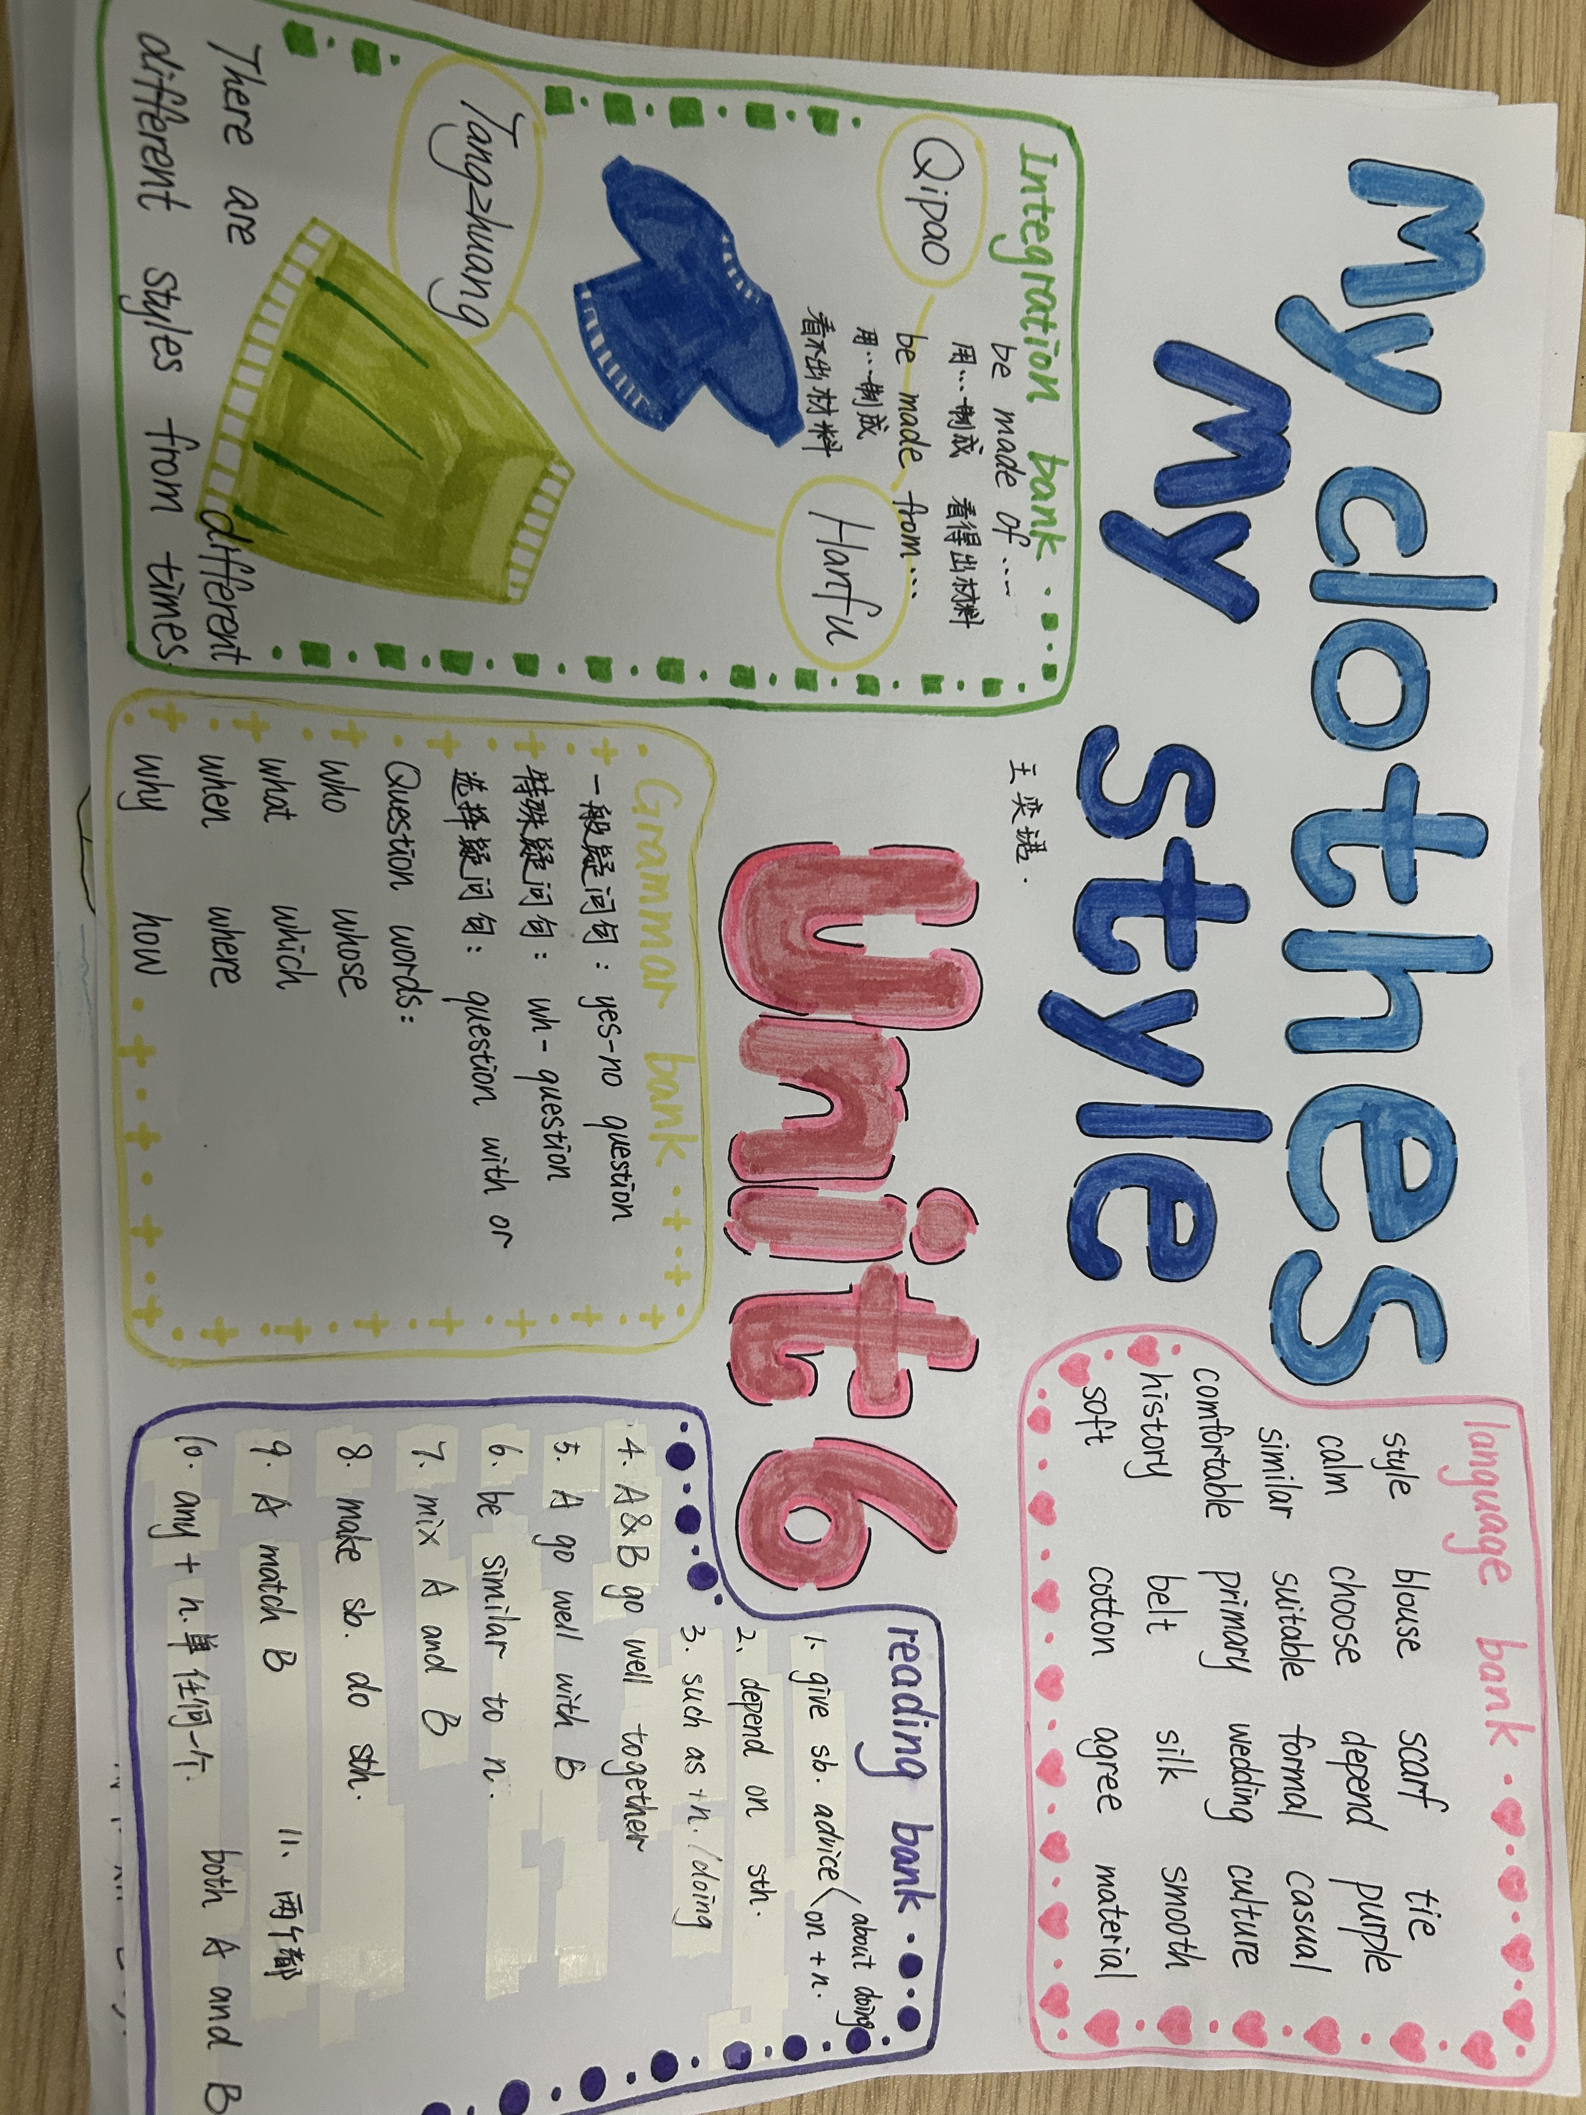
Work 1: To know about clothes

Slide 5
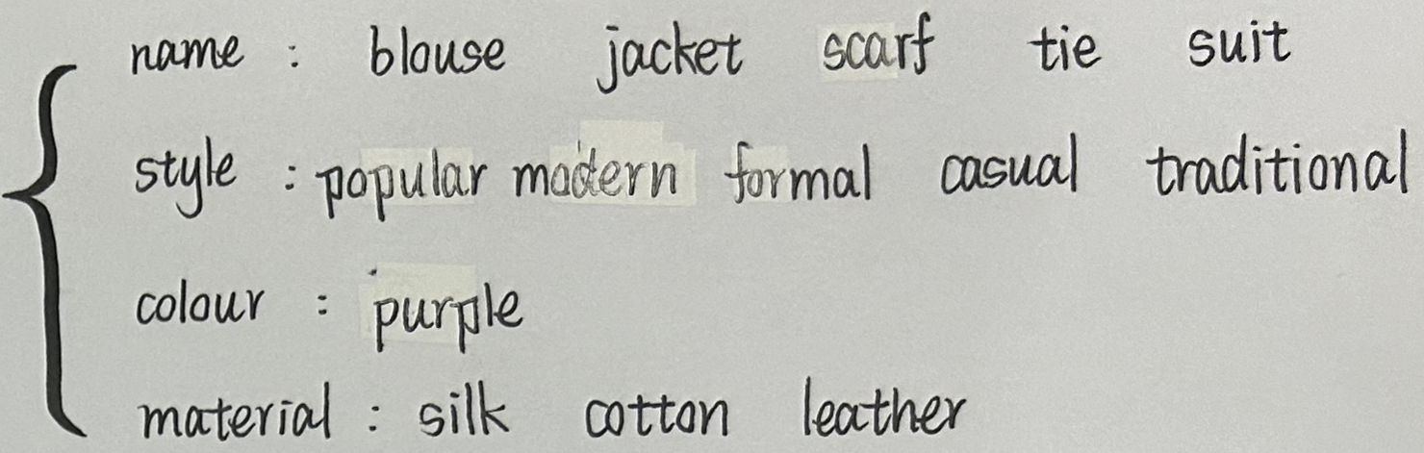
Work 1: To know about clothes
Features!!!

Slide 6
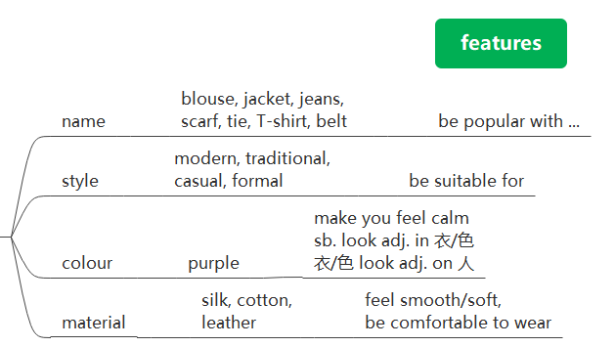
Work 1: To know about clothes

Slide 7
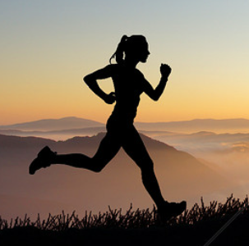

Work 1: To know about clothes
Talk about what to wear in each occasion(场合) with you classmates

Slide 8

Work 2: To match colours
Review your Idea Bank to give √ or × for the following colour tips:
1: Try to pick similar colours.
2: Mix warm and cool clolours.
3: Warm colours and cool colours make each other stand out.
4: Don’t wear more than three colours at one time.
5: Black, white and grey go well with/match any colour.
6: Grey is suitable for both formal suits and casual clothes.

Slide 9
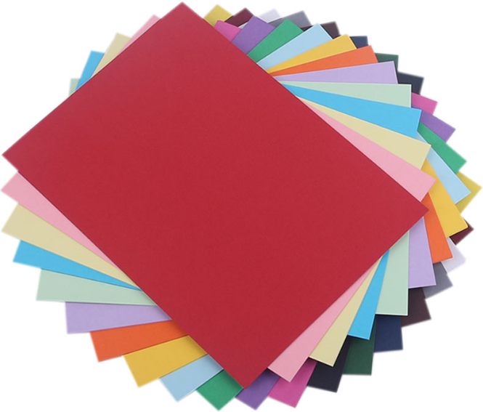
Work 2: To match colours
Groupwork: pick colours and say the colour tip

Slide 10
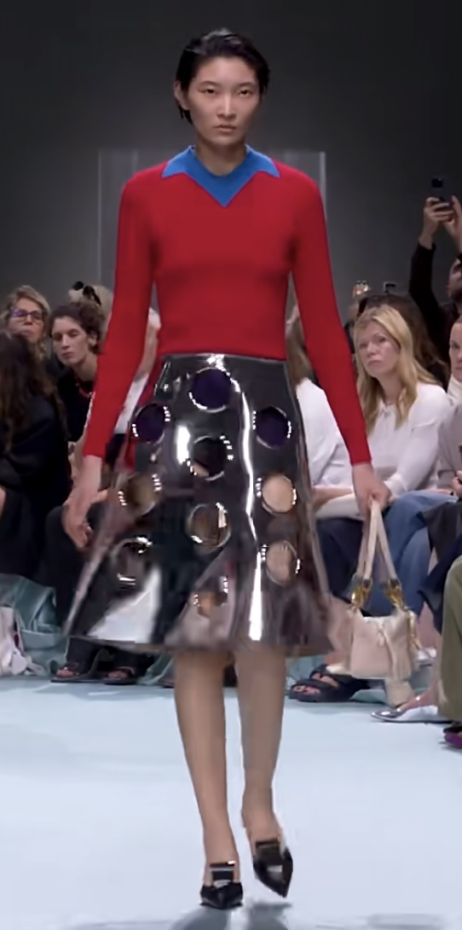
Work 2: To match colours
Write about the Parada clothes
· 女士衬衫：红蓝（使人感到快乐），混合了冷暖色，因为冷暖色互相衬托，由棉制成（穿起来舒服）
· 短裙：由皮革制成，黑色与任何颜色都可搭配。风格适合派对，并在年轻人中流行，人穿短裙显得精干

Slide 11
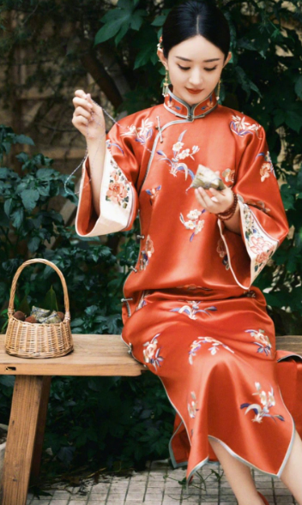
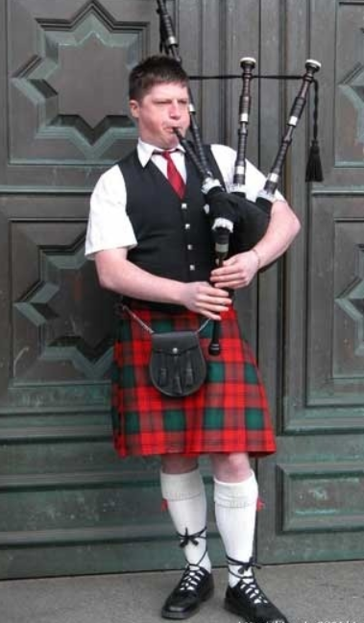
Work 3: To get foreign markets (海外市场)
请根据画线部分，编写合适的问句，并对话展示 (Review your Grammar Bank)
People in different countries have their own different traditional clothes.
More and more Chinese people choose to wear hanfu and qipao on special days. Qipao are usually made of (1) silk. They feel (2) smooth and soft. The girl (3) in Qipao looks elegant(高雅的).
In Scotland, (4) men may wear a skirt with a shirt in the street. The skirts are (5) Scottish men’s traditional clothes. Scottish men celebrate festivals (6) by wearing this type of clothes.
What are Qipao usually made of
(1) ___________________________________________________?
(2) ___________________________________________________?
(3) ___________________________________________________?
(4) ___________________________________________________?
(5) ___________________________________________________?
(6) ___________________________________________________?
How do they feel
Which girl looks elegant
Who may wear a skirt with a shirt in the street in Scotland
Whose traditional clothes are the skirts
How do Scottish men celebrate festivals

Slide 12

Work 3: To get foreign markets (海外市场)
易错疑问词 | 用法
Whose
How long/How often
How far
How soon
谁的
多长时间/频率
距离
多久之后（将来）
1. — How long do you read fashion magazines every day? — ___________
A. Three to six times B. In the morning
C. Once a month D. More than two hours.
2. — __________ is it from here to the fashion show?
— About twenty minutes’ walk.
A. How far B. How long C. How soon D. How often
3. — ______________ will you get foreign markets? — In two years.
How soon

Slide 13
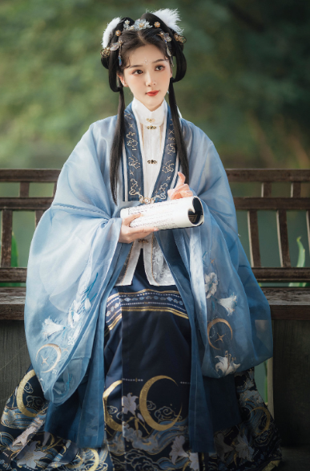
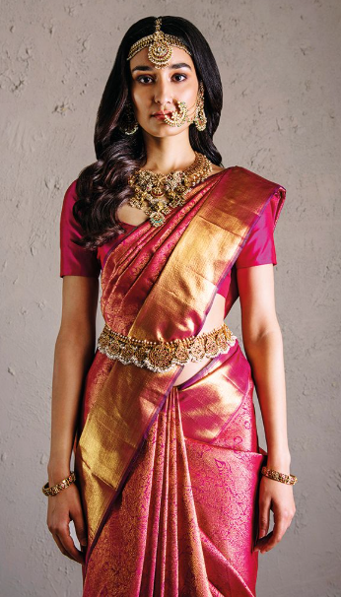
Work 3: To get foreign markets (海外市场)
To get foreign markets, you must learn about the culture behind clothes.

Slide 14
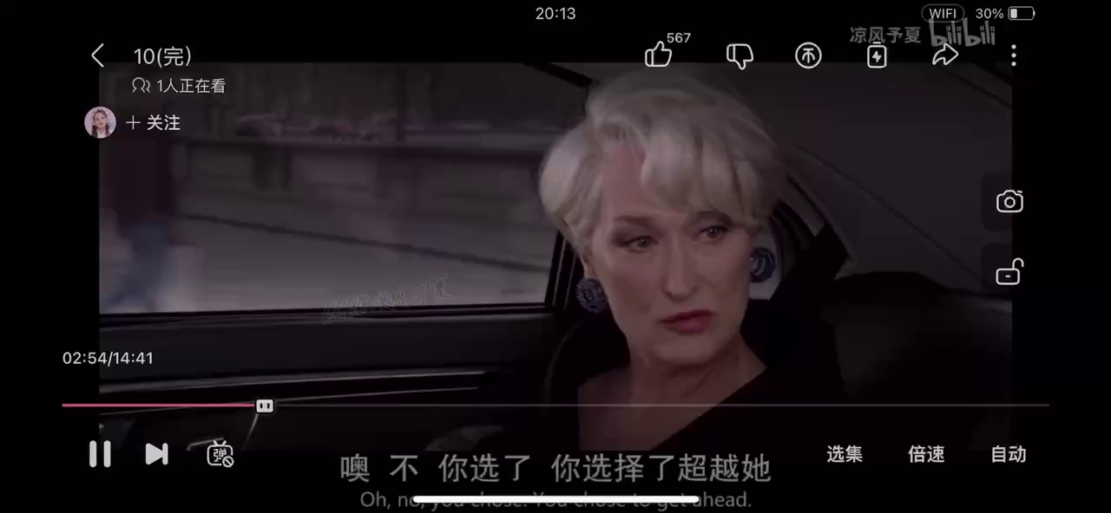
Does Andy want the job at last?

Slide 15
Discussion: What do clothes mean to you?
1. Cultural confidence (文化自信)
As a Chinese, we are proud of(自豪) our traditional clothes and the culture!
2. Dress properly(恰当的)！
3. Dressing is a way of life.
To live a life that you want!

