Slide 1
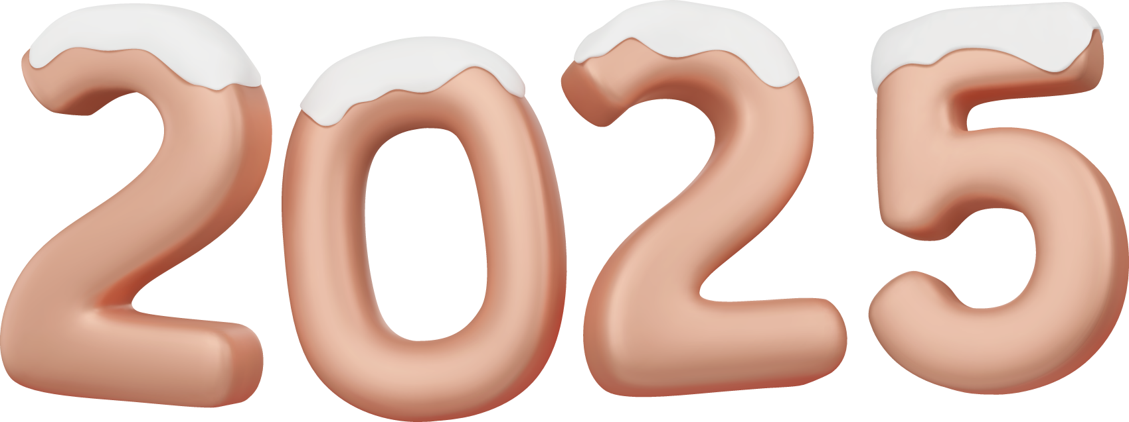
Unit 8 Let’s celebrate!
Revision

Slide 2
Enjoy a poem
It’s a day for family.
Everyone is happy on that day.
It’s sweet and special.
We will get together.
I am so happy today.
We visit family for that day.
All of us can enjoy it.
Love, a lot of love.

Slide 3

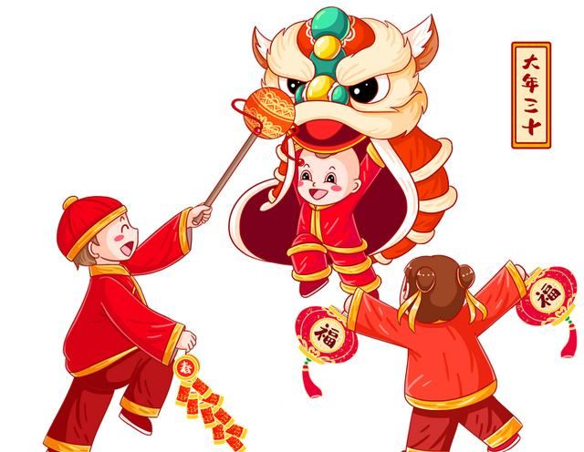
Activity 1: Brainstorming
who
what
why
festivials
when
how

Slide 4
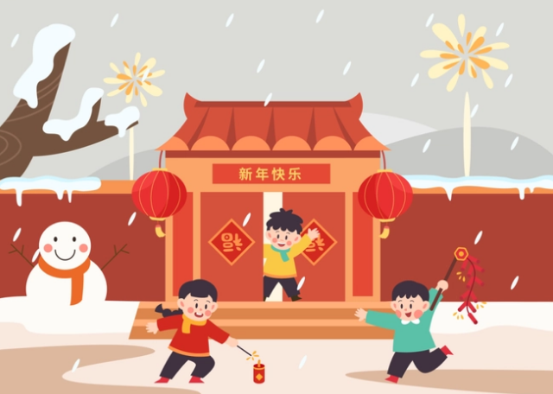
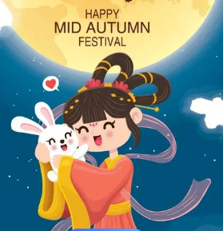
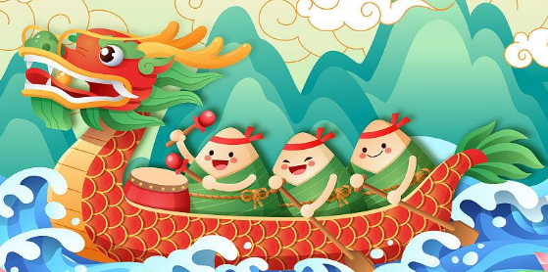
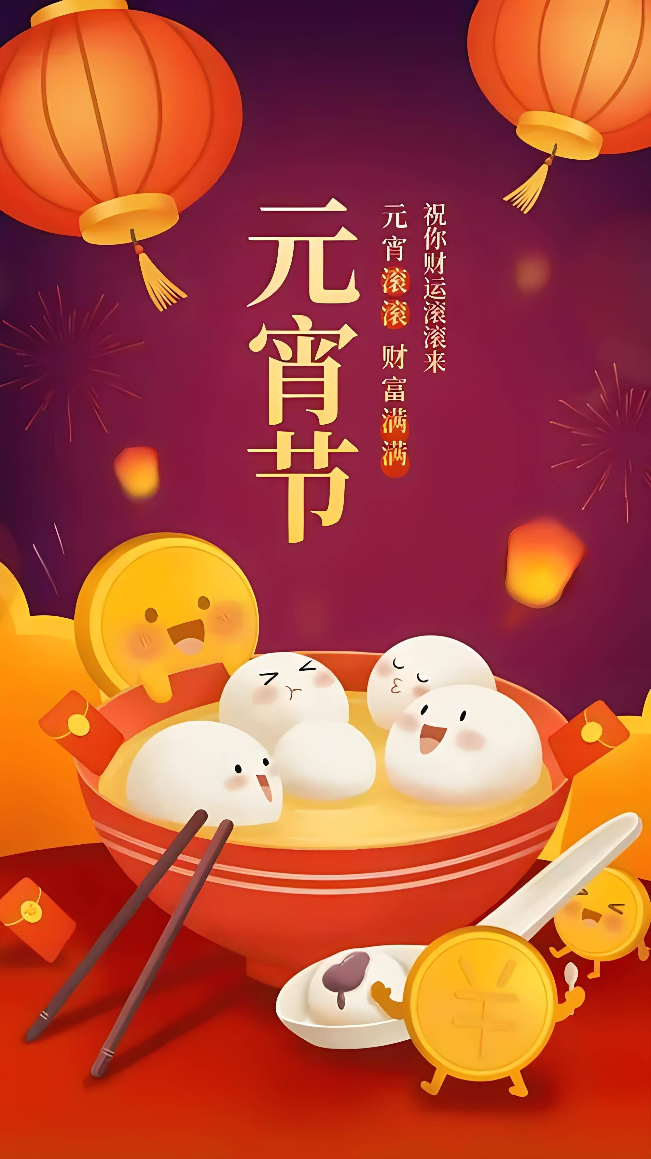
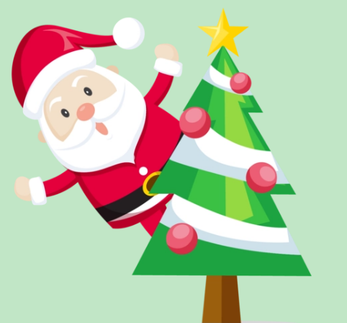
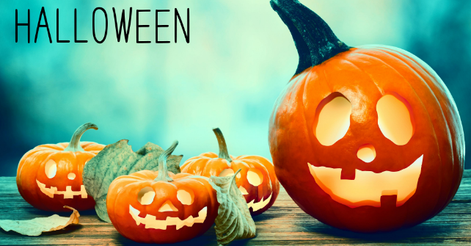
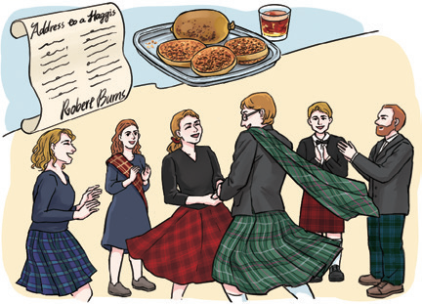
Activity 2: Talk about Chinese festivals and western festivals

Slide 5


who
most Chinese people celebrate it
why
what
an important holiday in China
show the best wishes for the coming year
clean/ put up/ get together / have/ watch / visit...
in Janunary or February
When
How

Slide 6

who
most Chinese people celebrate it
what
why
The Mid-Autumn Festival
a traditonal holiday in China
celebrate the harvest
enjoy/ eat/ get together
in August
How
When

Slide 7
who
most Chinese people celebrate it
what
why
The Dragon Boat Festival
an important holiday in China
remember the great poet Qu Yuan
race/ eat
in May
When
How

Slide 8
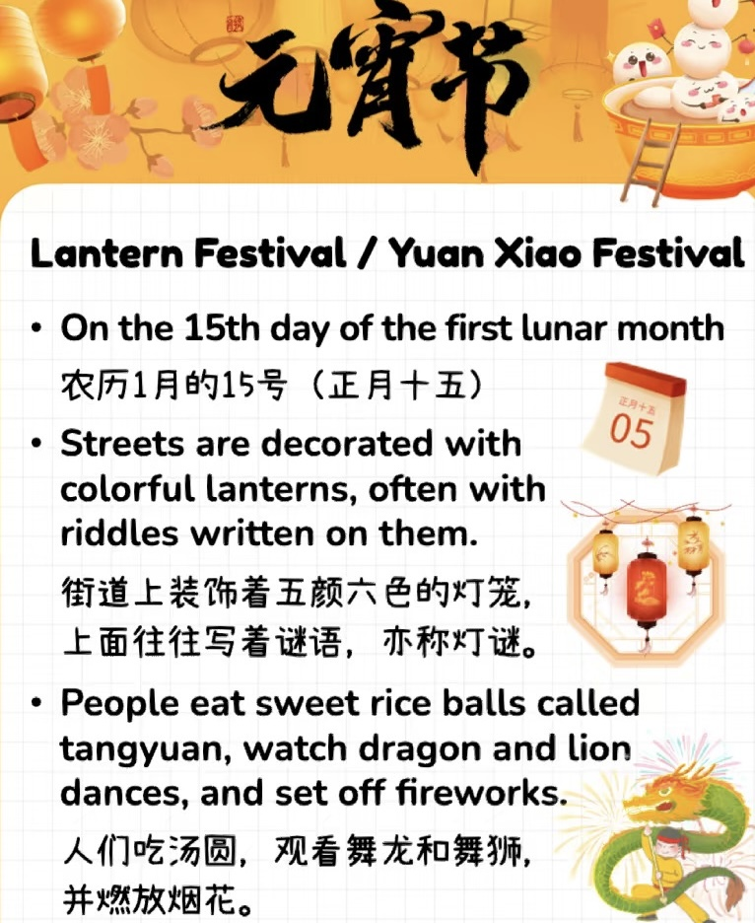
what
a meaningful holiday in China
in February
When
who
most Chinese people
The Lantern Festival
enjoy/ guess /
eat/watch
How
hope for the health and happiness for the whole year
why

Slide 9
who
most western people celebrate it
what
why
an important holiday in western countries
Christmas
spread the love and hope to the world
get together /give/ sing
in December
When
How

Slide 10
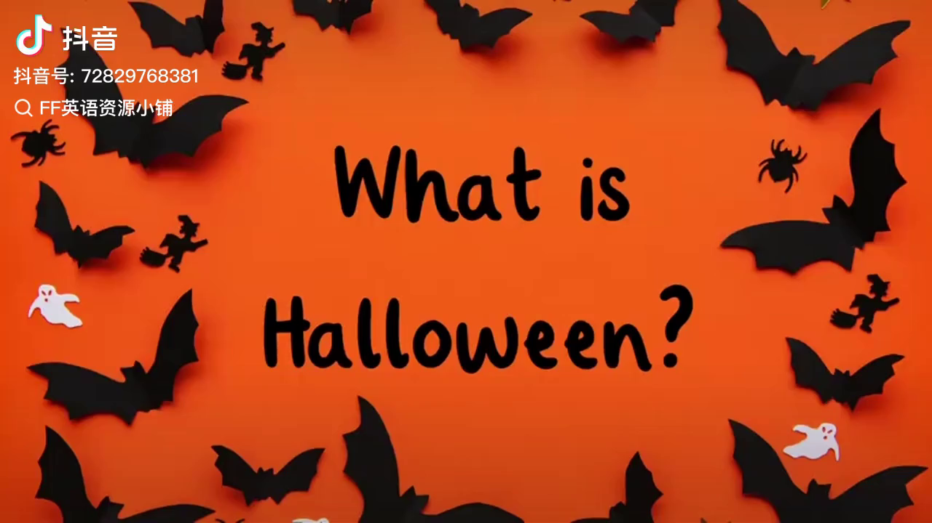
who
most western people celebrate it
what
why
a popular holiday in western countries
Halloween
mark the end of the harvest season
dressing up/ trick-or-treating/ carve
in October
When
How
Notes:
dressing up custumes/ carve the pumpkin

Slide 11
who
Scottish celebrate it
what
why
an important holiday in western countries
Burns Night
celebrate the life and work of the great poet, Robert Burns
in January
get together /eat/ read
When
How

Slide 12

Activity 3: Compare
What attidude (态度) should we have toward different festivals around the world?
Chinese
Western
Respect
bridge

Slide 13

The Spring Festival
The Dragon Boat Festival
hopeful
p
s
safe
a
e
h
The Lantern Festival
The Mid-Autumn Festival
united
r
e d
bright
it
r
n
i
spread (传播)
inherit (传承)

Slide 14
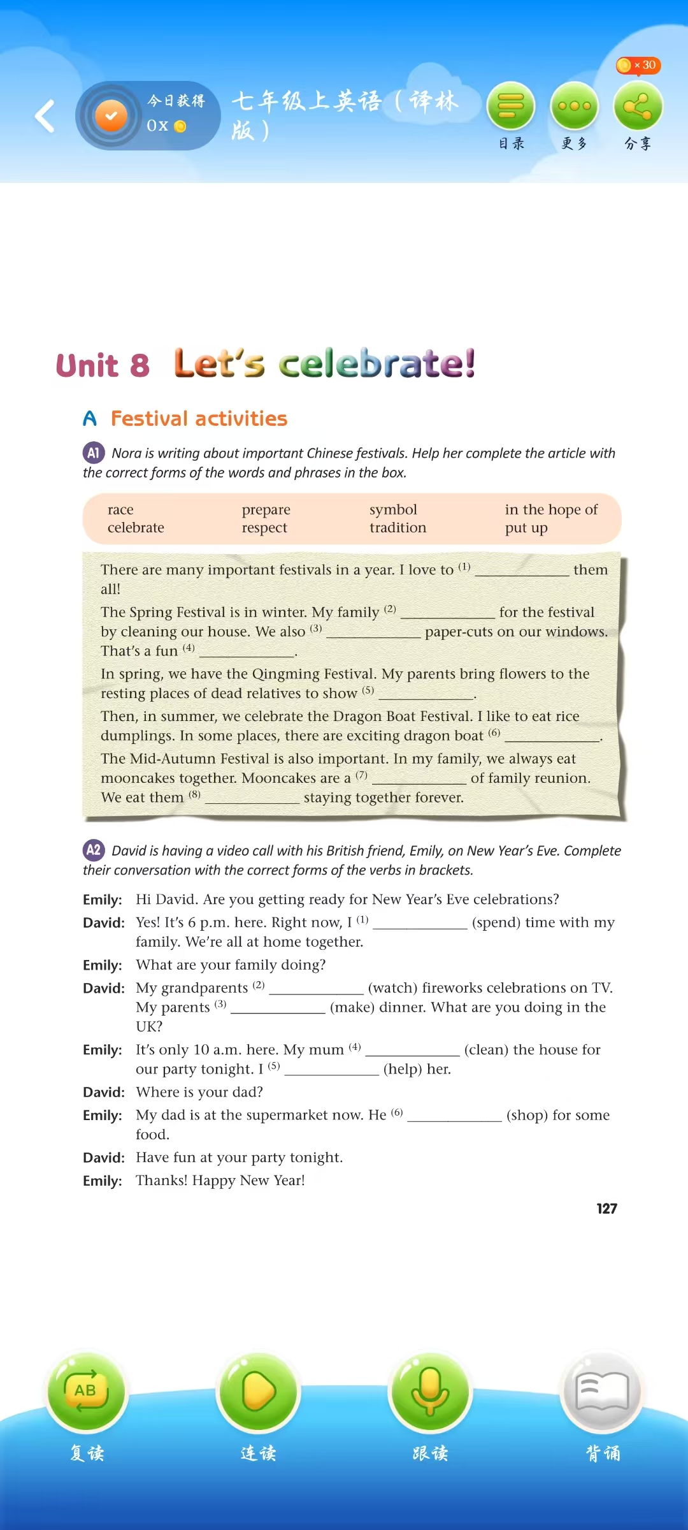








Activity 4: Practice P127

Slide 15






Activity 4: Practice & Role play

Slide 16
Activity 5: Finish your mind-map
who
what
your
favourite
festival
why
when
how

Slide 17
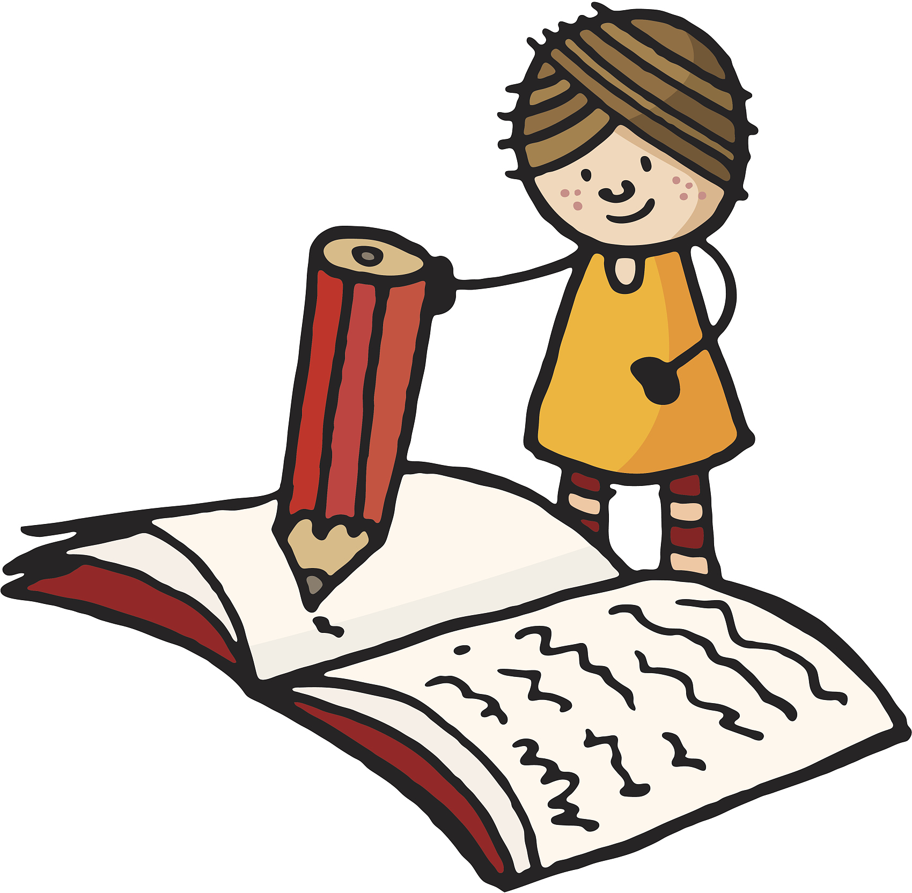
Activity 6: Write about your favourite festival
Writing
My favourite festival

Slide 18


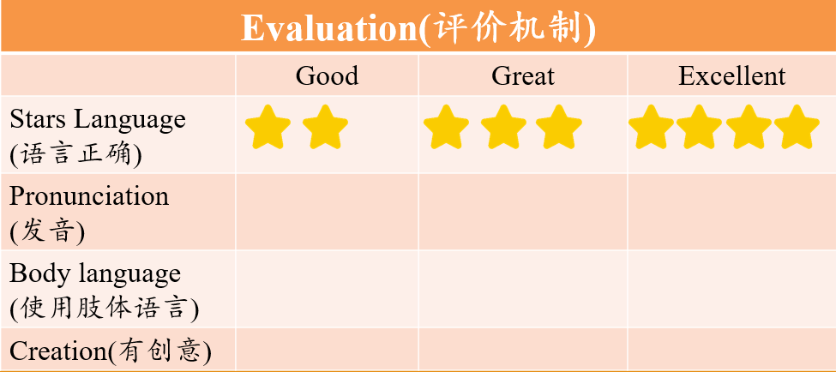
5
Production
5
Report

Slide 19
















The Spring Festival
The Dragon Boat Festival
The Lantern Festival
The Mid-Autumn Festival

Slide 20
Homework
Must do
Finish your writing and polish it in pairs.
Choose to do
Make a poster for your favourite festival.

Slide 21
Thank you!

