Slide 1
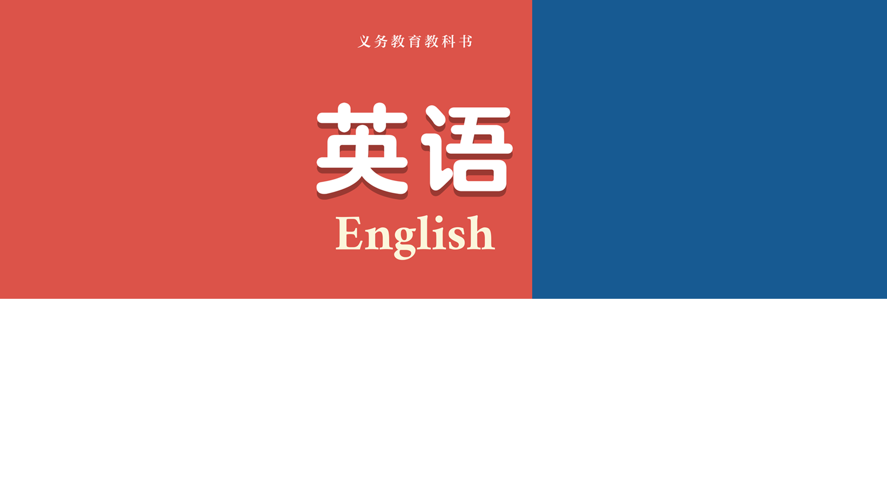
七年级上册
Unit 5-8
Grammar Review

Slide 2

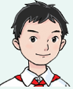
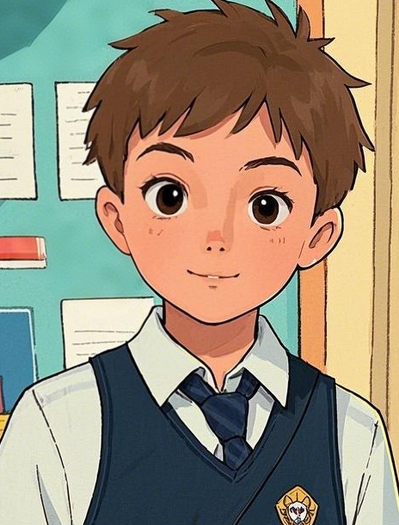
What do you usually do for the Spring Festival?
We...
Simon
a Chinese student
Will
an exchange student from England

Slide 3
Sounds great! I’d love to spend the Spring Festival in China one day.
Why not? Come and join us!
Simon
Will

Slide 4
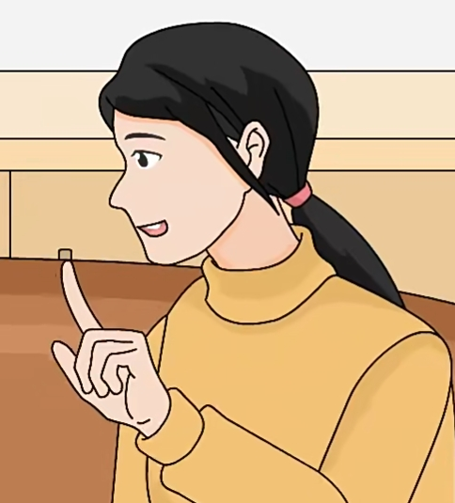
Simon, here is a shopping list. Open the fridge and check what we have first.
Okay!
Simon

Slide 5
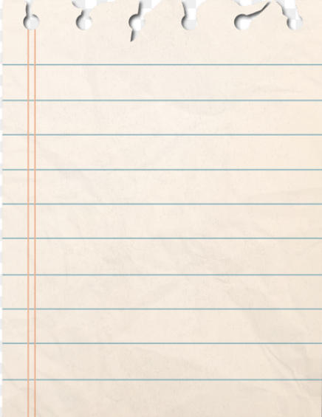
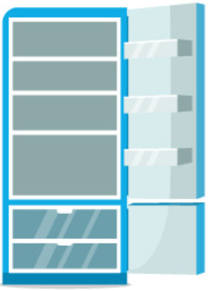
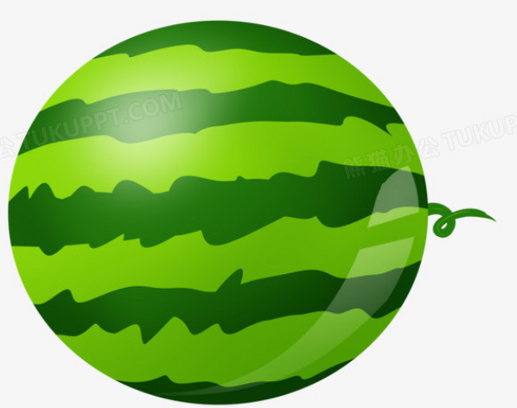
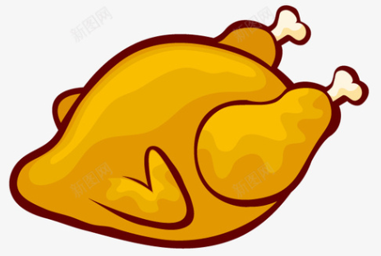
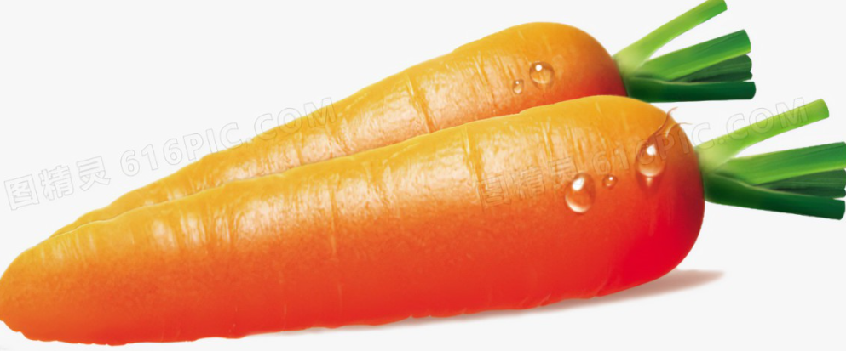
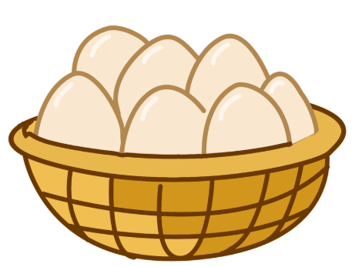
Shopping List
Find mistakes and correct
carrots
eggs
chicken
cucumbers
tomatoes
strawberries
Simon: I remember there are a watermelon. Are there some carrots in the fridge?
Will: Yes, there are. There are some chicken and eggs as well. But we don’t have some cucumbers. We need to buy any.
Simon: OK. We don’t have any drinks. Would you like any orange juice?
Will: Of course!
any
is
is
any
some
some

Slide 6
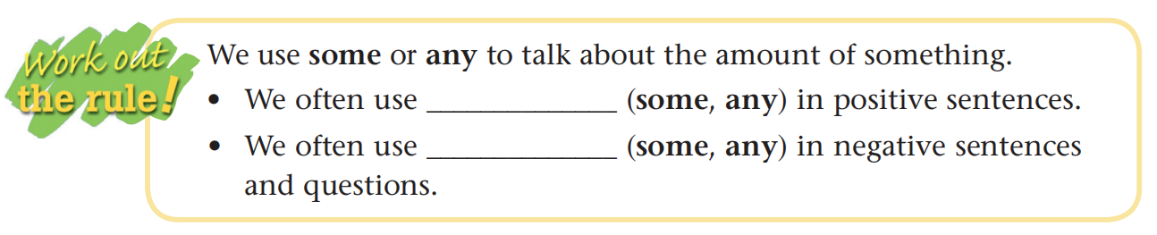
Using some/any
Are there any carrots in the fridge?
But we don’t have any cucumbers.
We need to buy some.
Would you like some orange juice?
Would you like...?
Can/Could I/you...?
Why not/don’t you...?
What/ How about...?
May I...?
We can use some in questions when we are making offers or requests. We use it when we expect the answer to be “yes”.
some
any

Slide 7
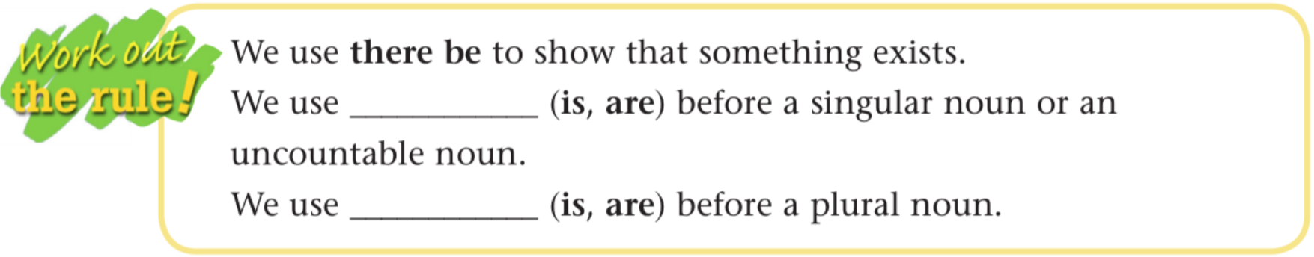
Using there be
I remember there is a watermelon.
Are there any carrots in the fridge?
Yes, there are.
There is some chicken and eggs as well.
就近原则
is
are

Slide 8
There is a new mall across the street. Let’s go shopping!
OK!
Simon
Will

Slide 9
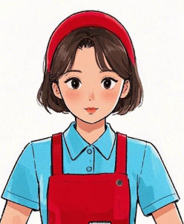
Hello, I want to buy...
Wait a minute! I am making labels (标签).
Salesperson
Simon
She is very busy! Let’s help her.
Will

Slide 10
Countable nouns
potato _________
box _________
pepper _________
match _________
tomato _________
mango _________
sweet _________
strawberry _________
peach _________
cherry _________
knife _________
cucumber _________
potatoes
sweets
boxes
strawberries
peppers
peaches
matches
cherries
Salesperson
tomatoes
knives
We need to form the plural of countable nouns.
mangoes
cucumbers

Slide 11
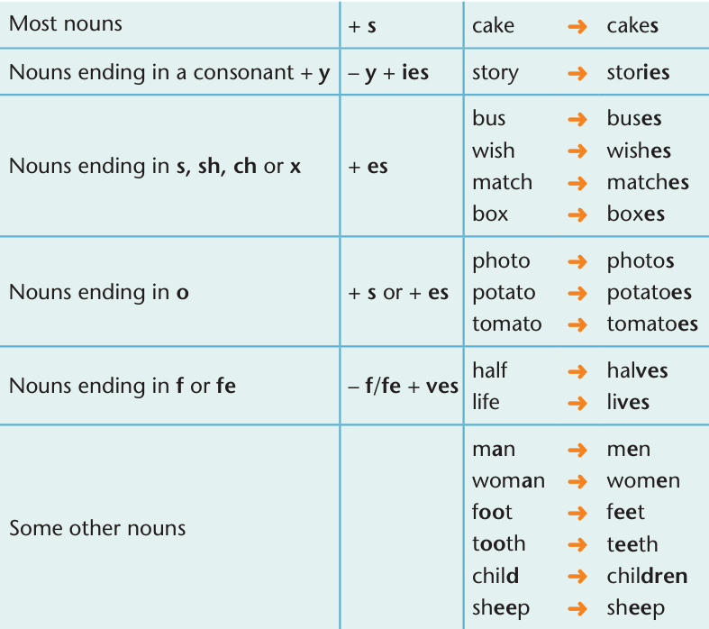
You do it so fast! How?
Salesperson
By using the rules!
Simon

Slide 12

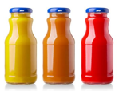
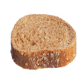
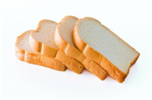
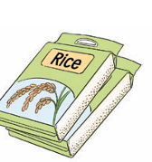

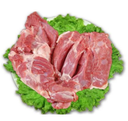
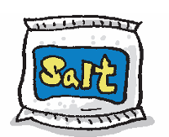
Uncountable nouns
A + 量词 + of + U.n.;
基数词+量词复数+of +U.n.
Great! What about the uncountable nouns?
piece
four pieces of bread
bottle
a ______of bread
a ______ of juice
three bottles of juice
Salesperson
Simon
4 公斤
Just like this...
two bags of rice
two cartons of milk
two packets of salt
four kilos of meat

Slide 13
That’s very useful! By the way, would you like some sweets?
We...
Salesperson
Simon

Slide 14
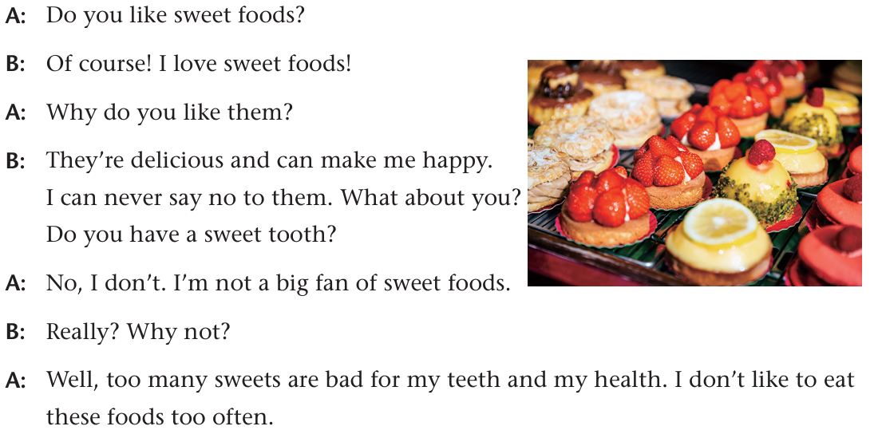
A life without health is like a river without water!
Q2 : Does Simon like sweet foods? Why?
Q1 : Does Will like sweet foods? Why?
Simon:
Will:
Simon:
Will:
Simon:
Will:
Simon:

Slide 15
Finished! Then we can buy some new clothes.
Wonderful!
Simon
Will

Slide 16

Asking questions
Will: _______ do you want to buy for the new year?
Simon: A coat made of cotton.
Will: _______ coat do you like best?
Simon: I like the red one best.
Will: _______do you like it?
Simon: Because red is my favourite colour.
Will: ___________ does this coat cost?
Simon: It costs me 300 yuan.
What
Which
Why
How much

Slide 17
Asking questions
Will: _______ do you often go shopping with?
Simon: I usually go shopping with my mother.
Will: _______ she good at choosing clothes?
Simon: Yes, she is.
Will: _______ do you go shopping?
Simon: I go shopping at the new mall near my school.
Will: __________ do you buy new clothes?
Simon: Once a month.
Will: _______you like buying new clothes?
Simon: Of course!
Who
Is
Where
How often
Do

Slide 18
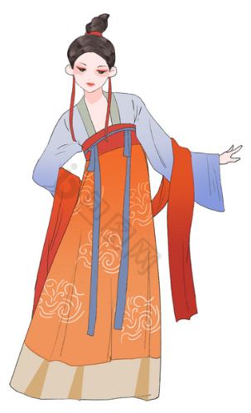
What are people over there wearing?
Will
Hanfu, one type of traditional clothes in China.
Simon

Slide 19
Why do people choose to wear Hanfu during the Spring Festival?
Will
Because...
Simon

Slide 20
Mum, Dad, we are back!
They are so busy!
Simon
Will

Slide 21
Present continuous tense
get ready for clean put up cook learn
What are they doing? They__________________the Spring Festival. Simon’s mum____________the room and his father____________the Spring Festival couplets. What about his grandma? Oh, she__________the meal. His cousins____________the dragon dance from his grandpa.
are getting ready for
is cleaning
is putting up
is cooking
are learning

Slide 22
Present continuous tense
 | Present continuous tense (现在进行时)
用法
构成
提示
表示现在或现阶段正在进行或发生的动作。
be + doing(动词-ing形式)
1. 鲜明时间状语：now, right now, at the moment, these days, It’s...o’clock...
2. 明确提示词：Look!/Listen!...
3. 上下文语境：
—Where is your father?
—Oh, he is cleaning his car.

Slide 23
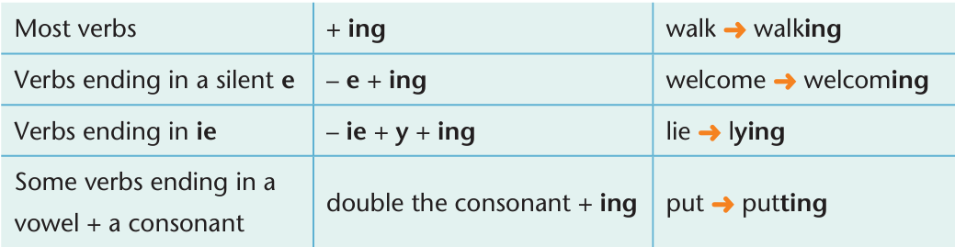
Present continuous tense

Slide 24
Tense
 | Simple present tense (一般现在时) | Present continuous tense (现在进行时)
用法 |  | 现在进行时表示现在或现阶段正在进行或发生的动作。
构成 |  | be + doing(动词-ing形式)
一般现在时表示现在的状态，经常的或习惯性的动作。
do/does

Slide 25
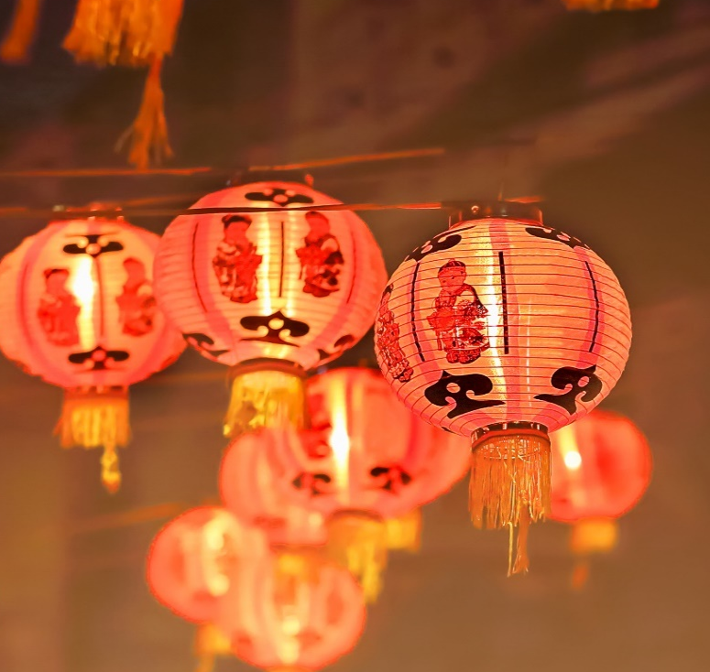
Finish the following sentences with proper tenses.
(1) Listen! Somebody __________(sing).
(2) —Lucy seldom____________(watch)TV in the evening, right?
— Yes. But she ____________(watch) TV with kids now.
(3) It’s 12 o’clock. We_______________(celebrate) the new year.
(4) Look, we each _______(have) a nice present for New Year.
(5) —Where’s your brother?
— He ____________(have) a shower.
(6) —Excuse me, but you ____________(sit) in my seat.
—Oh, I’m sorry.
is singing
watches
is watching
are celebrating
have
表示喜好、状态的动词不用进行时：know, understand, love, like, want, hope, hear, see, find, have(拥有)。
is having
are sitting

Slide 26

Using some/any
Would you like...?
Can/Could I/you...?
Why not/don’t you...?
What/ How about...?
May I...?
some
any
Using there be
is
就近原则
are
Countable &Uncountable nouns
A + 量词 + of + U.n.;
基数词+量词复数+of +U.n.

Slide 27
Asking questions
wh-words: what, which, who, why, how, when, where, how often, how much...
Tense
 | Simple present tense (一般现在时) | Present continuous tense (现在进行时)
用法 | 一般现在时表示现在的状态，经常的或习惯性的动作。 | 现在进行时表示现在或现阶段正在进行或发生的动作。
构成 | do/does | be + doing(动词-ing形式)

Slide 28
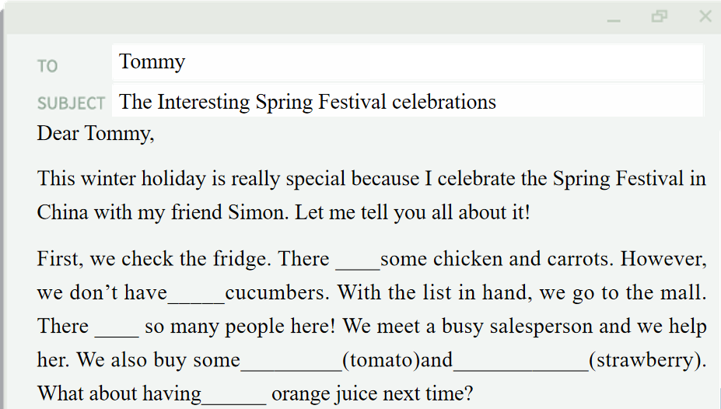
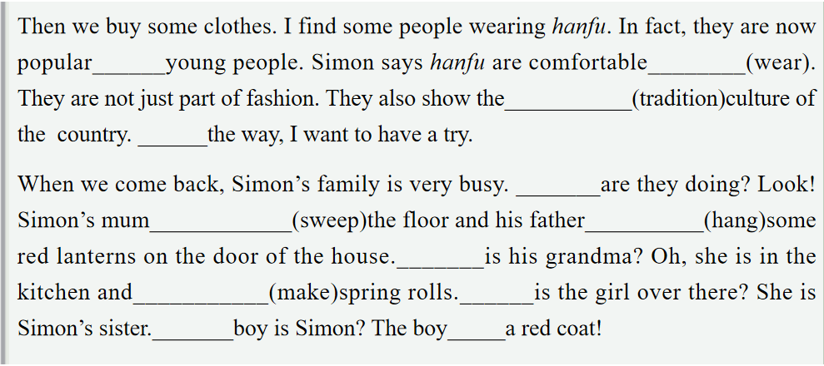
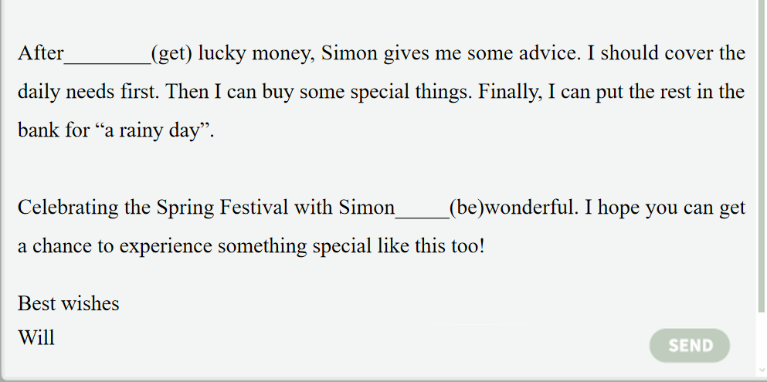
Write an email
I can’t wait to share it with my friends!
Will
Then you can write an email.
Simon

Slide 29
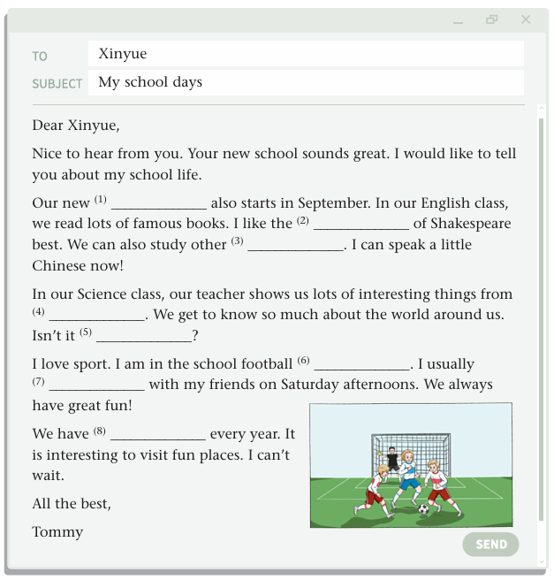
Write an email
Tommy
The Interesting Spring Festival celebrations
Dear Tommy,
This winter holiday is really special because I celebrate the Spring Festival in China with my friend Simon. Let me tell you all about it!
First, we check the fridge. There ____some chicken and carrots. However, we don’t have_____cucumbers. With the list in hand, we go to the mall. There ____ so many people here! We meet a busy salesperson and we help her. We also buy some_________(tomato)and____________(strawberry). What about having______ orange juice next time?
is
any
are
tomatoes
strawberries
some

Slide 30
Write an email
Then we buy some clothes. I find some people wearing hanfu. In fact, they are now popular______young people. Simon says hanfu are comfortable________(wear). They are not just part of fashion. They also show the___________(tradition)culture of the country. ______the way, I want to have a try.
When we come back, Simon’s family is very busy. _______are they doing? Look! Simon’s mum____________(sweep)the floor and his father__________(hang)some red lanterns on the door of the house._______is his grandma? Oh, she is in the kitchen and___________(make)spring rolls.______is the girl over there? She is Simon’s sister._______boy is Simon? The boy_____a red coat!
with
to wear
traditional
By
What
is sweeping
is hanging
Where
is making
Who
Which
in

Slide 31
Write an email
After________(get) lucky money, Simon gives me some advice. I should cover the daily needs first. Then I can buy some special things. Finally, I can put the rest in the bank for “a rainy day”.
Celebrating the Spring Festival with Simon_____(be)wonderful. I hope you can get a chance to experience something special like this too!
getting
is
Best wishes
Will

Slide 32
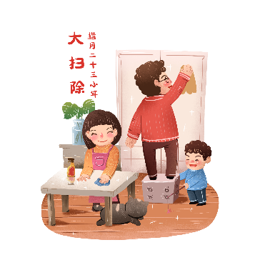
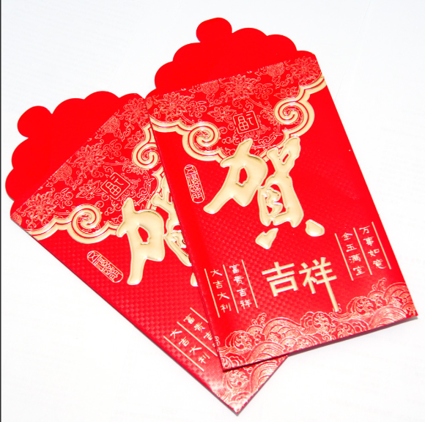
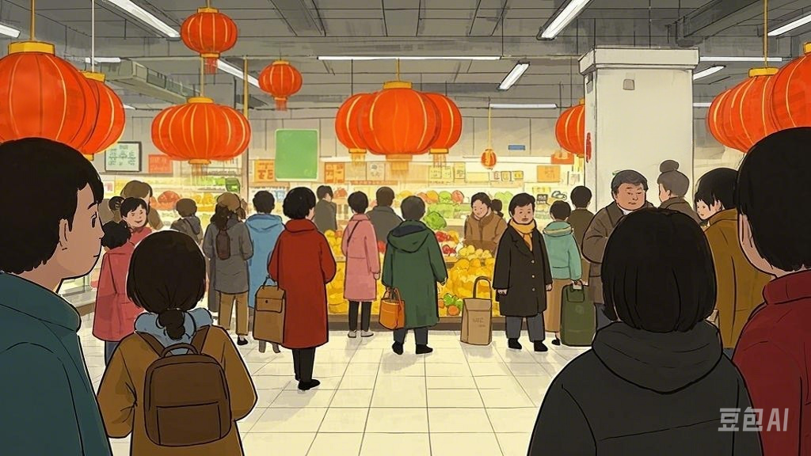
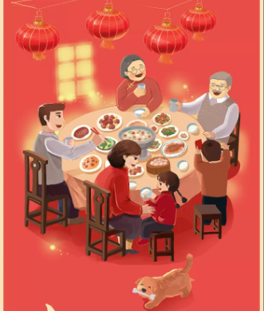
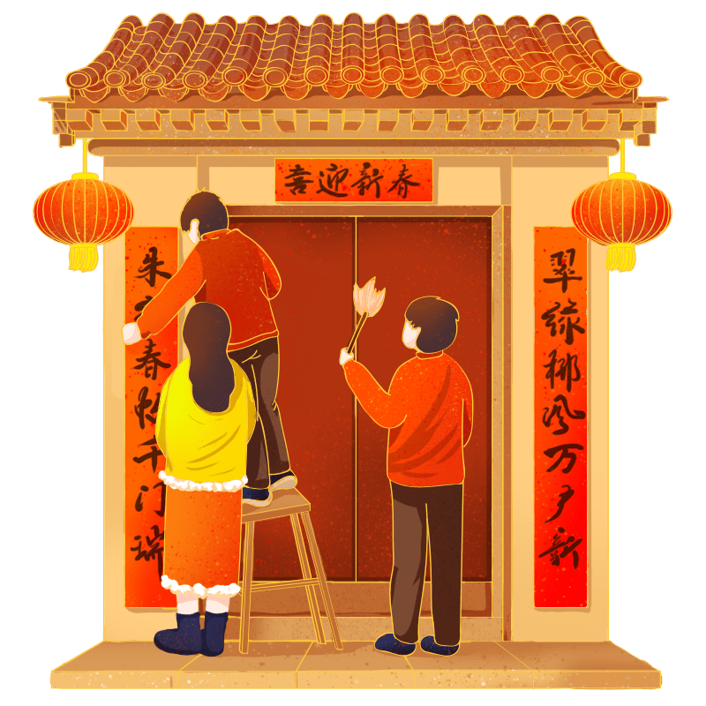
Further thinking
Q: Which part of the celebrations do you like best? Why?

Slide 33
Homework
Compulsory homework:
(1) Write an article about your favourite part and the reason.
(2) Review four units’ grammar rules.
Optional homework:
Search more about some interesting New Year celebrations and share them with your classmates.

Slide 34
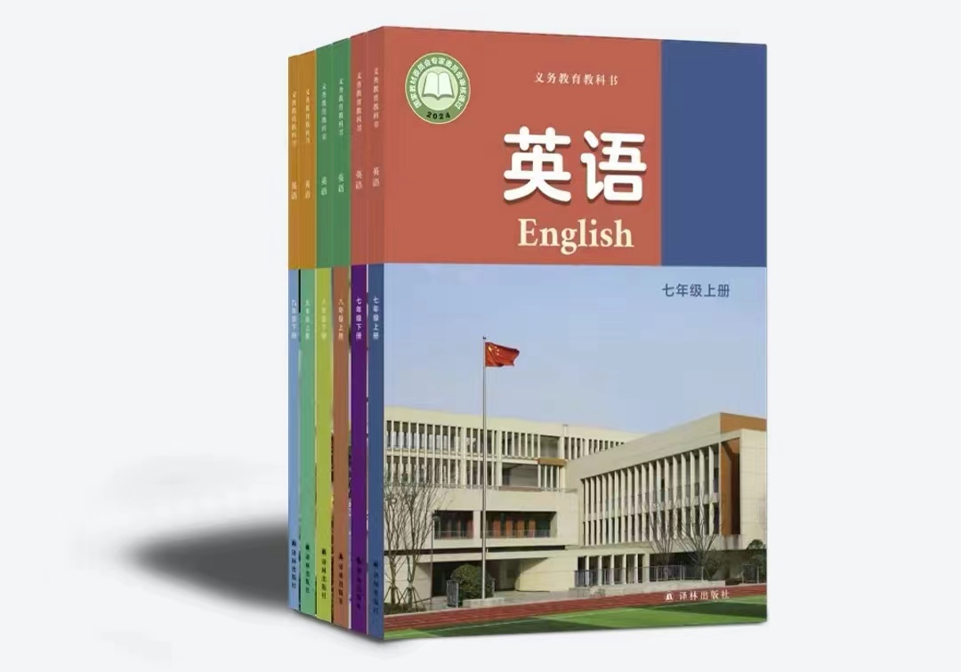
Thanks for your listening!

