Slide 1

Unit 8
Let’s celebrate !
Reading 1

Slide 2

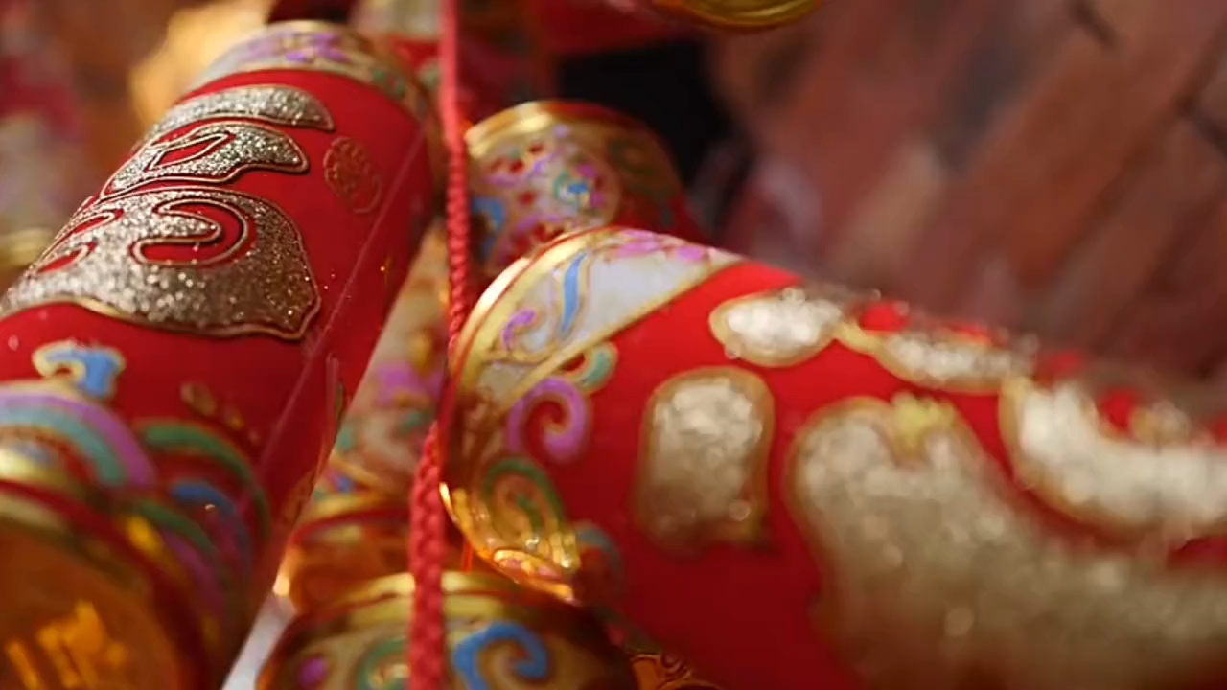
Watch and answer
1
Warm up
Q：What’s the video about?
The Spring Festival.

Slide 3
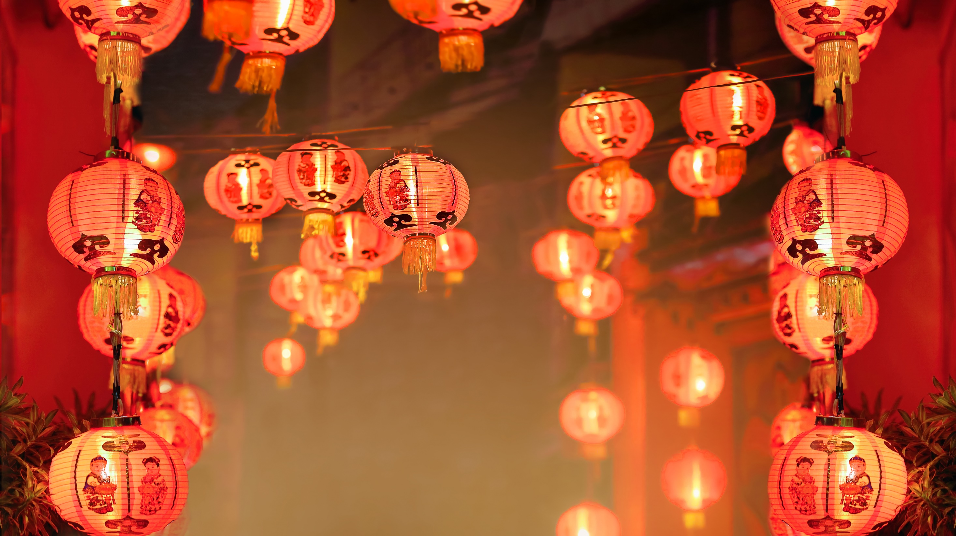
2
Warm up

Slide 4

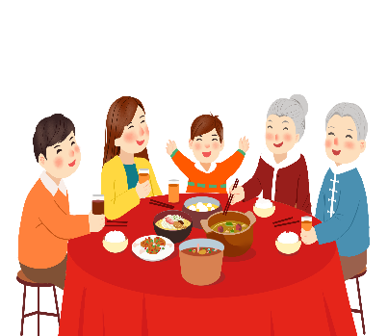

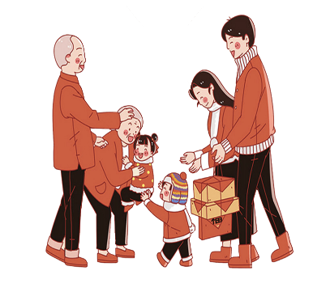
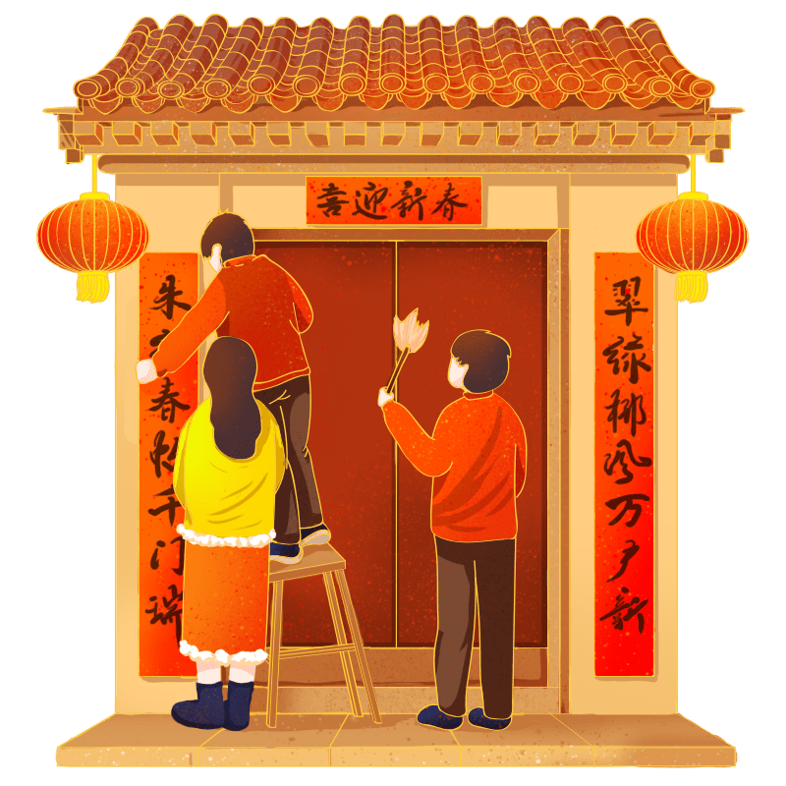
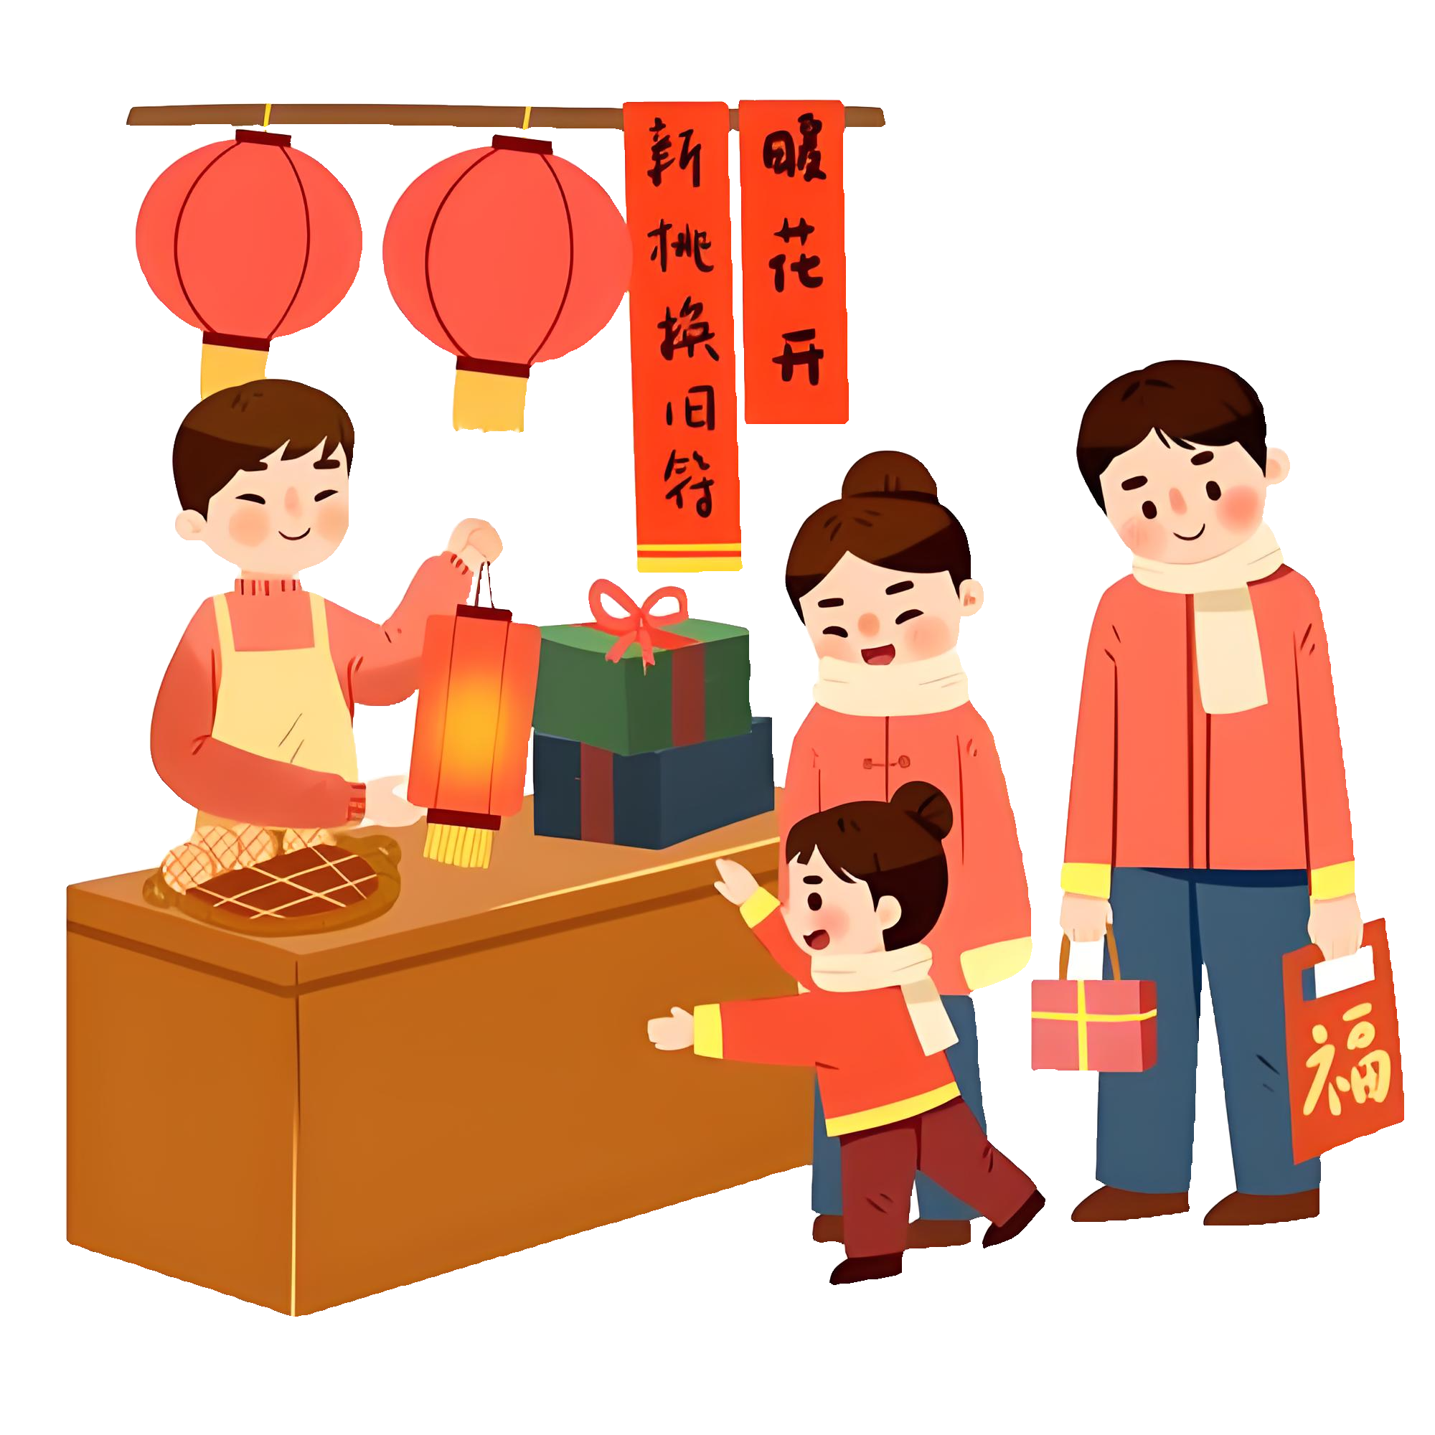
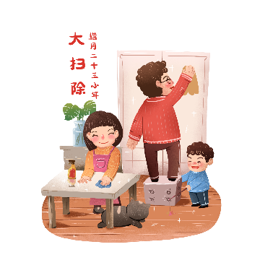
Q：How do people celebrate them?
2
Warm up
Spring Festival
have a big dinner
visit relatives
clean house
New Year shopping
put up couplets

Slide 5

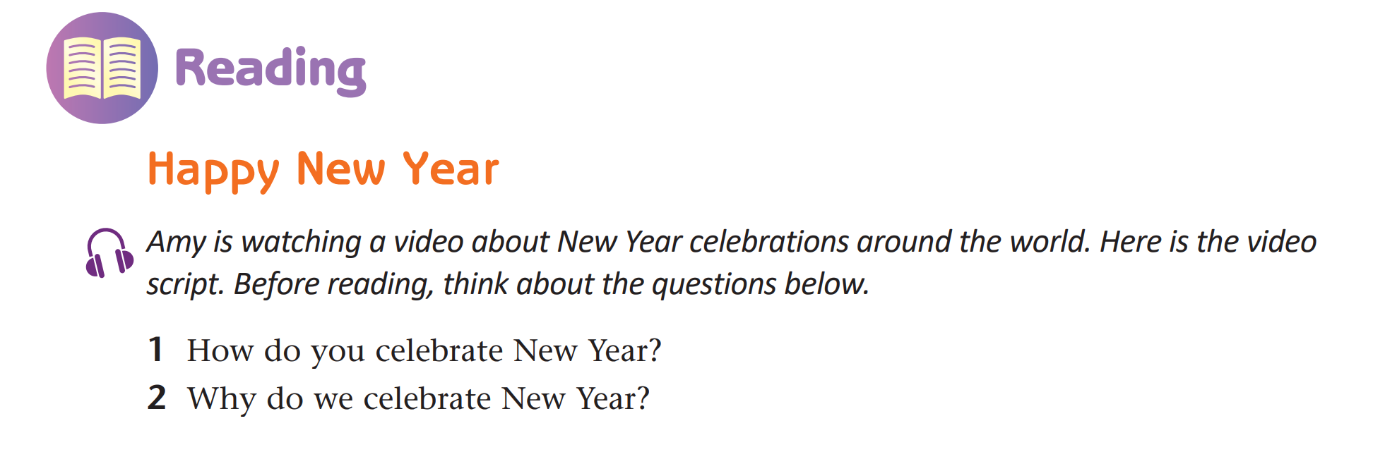
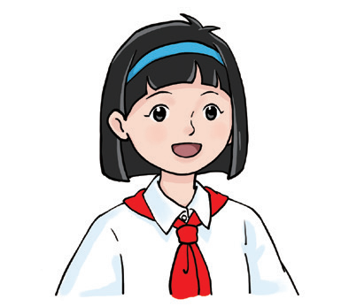
3
Pre-reading
What is the text type of the passage?
the video script
It is _____________________.
script /skrɪpt/视频脚本

Slide 6
3
Pre-reading
Amy is watching a video. Here is the video script.
What is the passage about?
New Year
It is about ___________
___________ around the world.
celebrations
Reading Skill 1:
标题和图片
可以帮助我们了解文章大意。

Slide 7
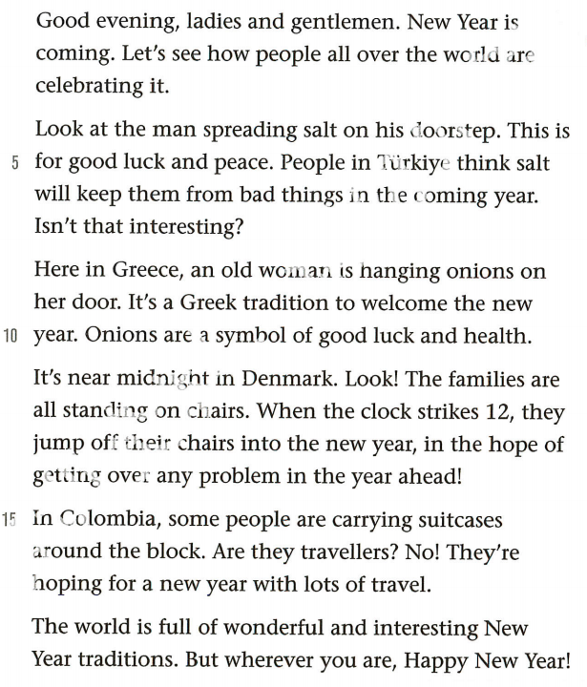
Read for structure
1
Match the main idea with each paragraph.
2
Para.1
Para.2
Para.3
Para.4
Para.5
Para.6
introduction to the topic
of the video
New Year celebrations
around the world
conclusion and best wishes
3
4
5
6

Slide 8
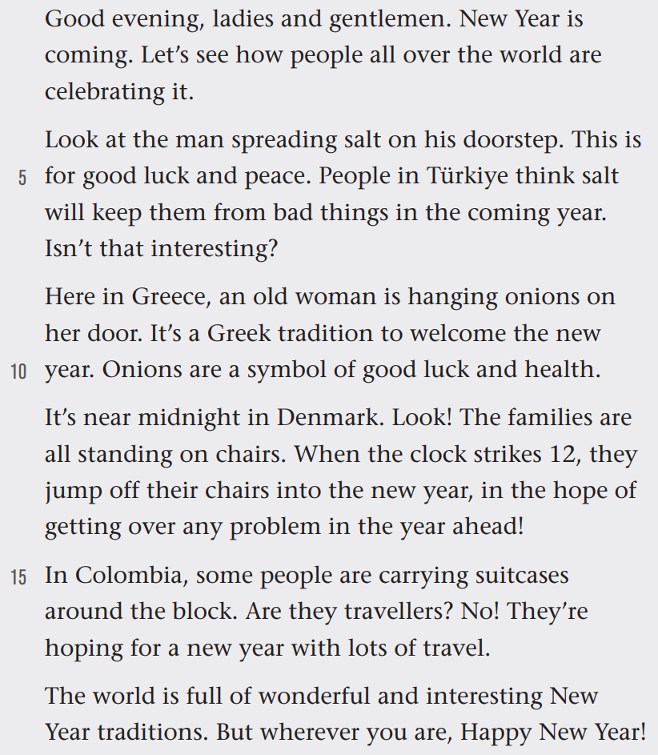
Match the main idea with each paragraph.
4
While-reading
Introduction
Para.1
introduction to the topic of the video
Para.2
New Year celebrations around the world
Para.3
Main body
Para.4
Para.5
conclusion and best wishes
Para.6
conclusion

Slide 9
Read and answer
Para 1
Good evening, ladies and gentlemen. New Year is coming. Let's see how people all over the world are celebrating it.
As a video script, what are the differences of the passage from others?
Tip
Greetings at the beginning
Conversational intonation
“Ladies and gentlemen” is a common way to address a group of people, especially in a formal, public setting.

Slide 10
While-reading
Read and answer
4
How many countries are there?
What countries are mentioned ?
Four.
Türkiye Greece
Denmark Colombia

Slide 11
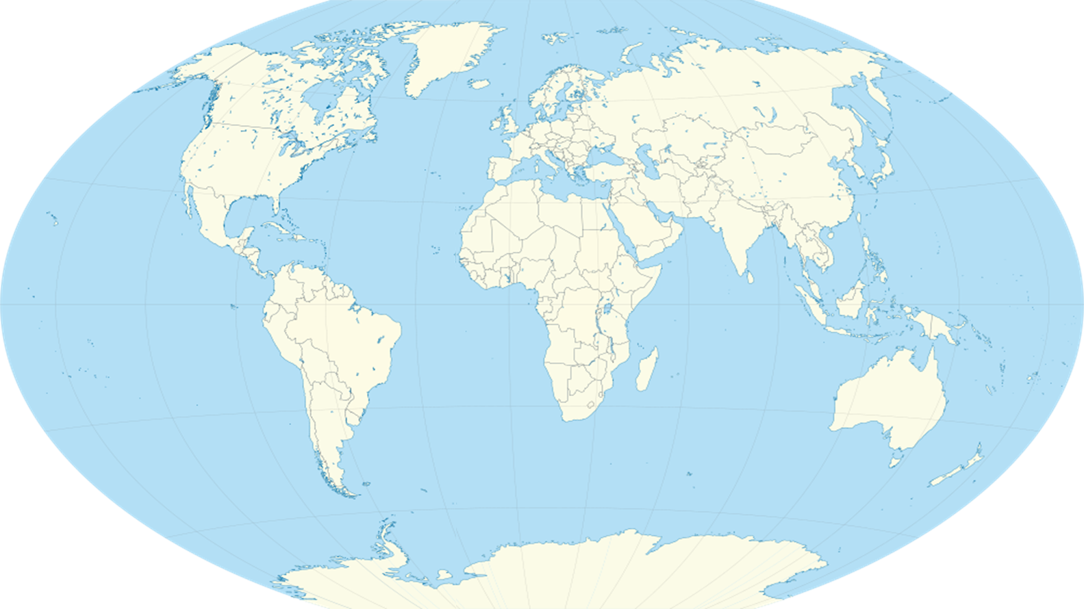
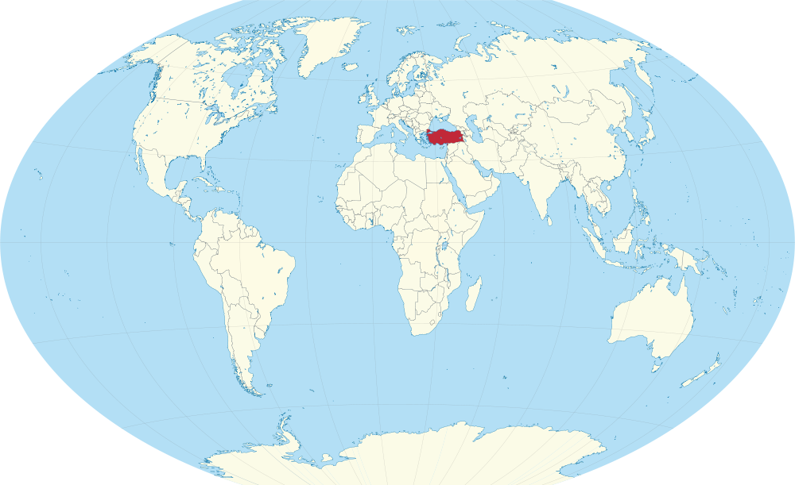
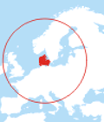
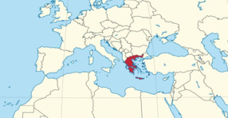
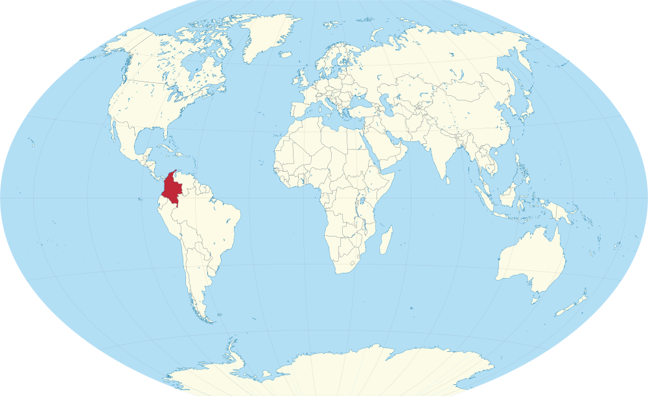
4
While-reading
Denmark /ˈdenmɑːk/
丹麦
Greece/griːs/
希腊
Türkiye/'tə:ki/
土耳其
Colombia
/kəˈlʌmbɪə/
哥伦比亚

Slide 12
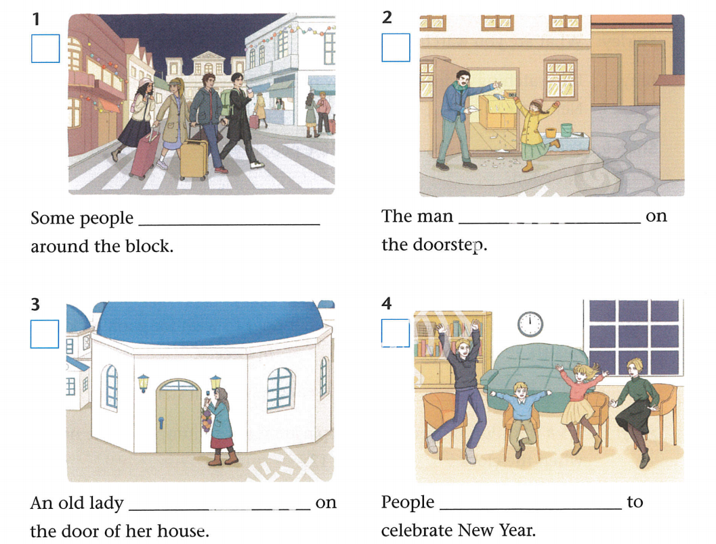




Read for details
1
2
3
are carrying suitcases
is spreading salt
4
5
are jumping
off their chairs
6
is hanging onions
P95A

Slide 13
While-reading
Read and fill in the blanks.
4
Country | Celebration | Reason
Türkiye
Greece
Denmark
Colombia

Slide 14
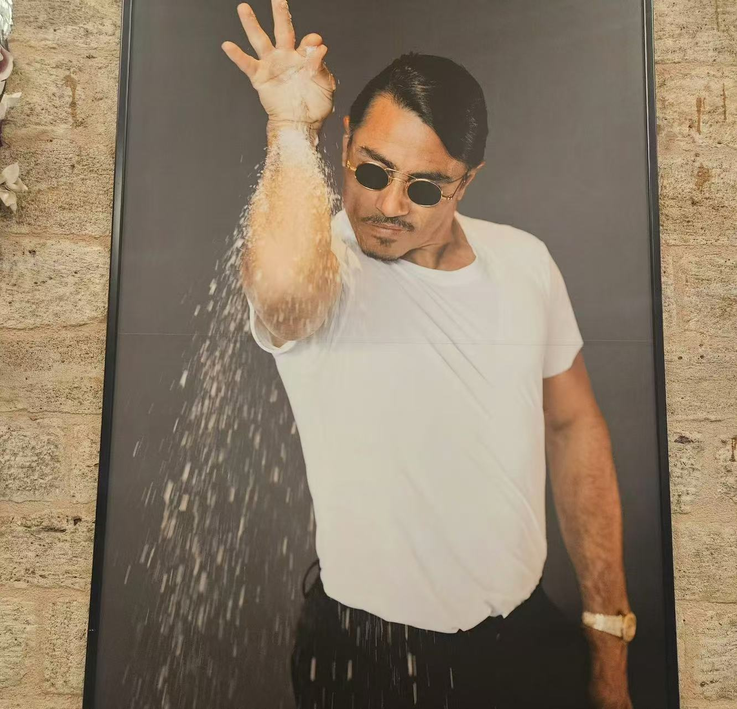
While-reading
Read and fill in the blanks.
4
Country | Celebration | Reason
Türkiye
spread salt on the doorstep
Salt will keep them from bad things.

Slide 15

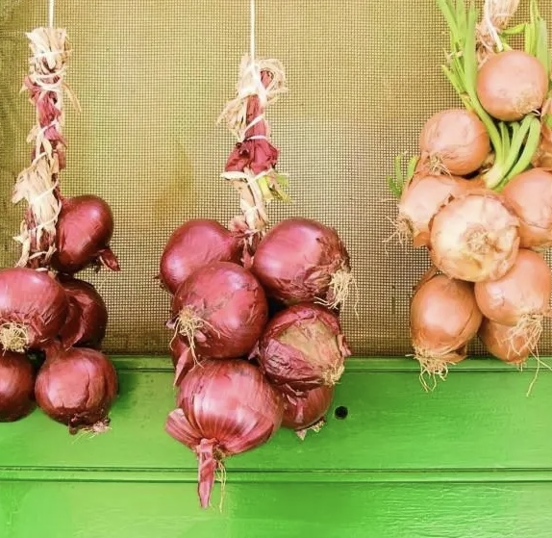
While-reading
Read and fill in the blanks.
4
Country | Celebration | Reason
Greece
hang onions on the door
Onions are a symbol of good luck and health.

Slide 16

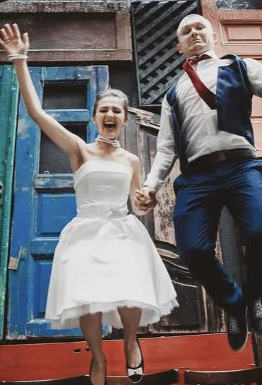
While-reading
Read and fill in the blanks.
4
Country | Celebration | Reason
Denmark
jump off their chairs
Get over any problems in the year ahead.

Slide 17
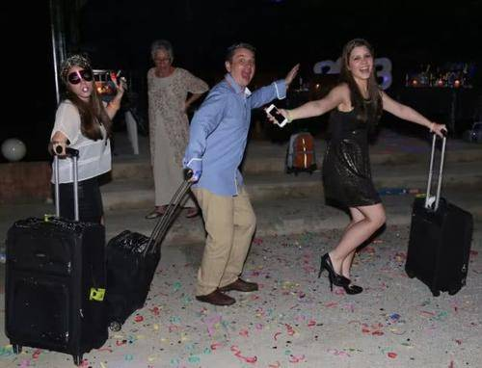
While-reading
Read and fill in the blanks.
4
Country | Celebration | Reason
Colombia
carry suitcases around the block
Hope for a new year with lots of travel.

Slide 18
Read for thinking
Is there anything in common about New Year traditions?
Country | Celebration | Reason
Türkiye
Greece
Denmark
Colombia
spread salt
on the doorstep
Salt will keep them from
bad things.
New Year is a new beginning.
They express good
expectations for the future.
对未来美好的期望
Onions are a symbol of
good luck and health.
hang onions on the door
Get over any problems
in the year ahead.
jump off their chairs
Hope for a new year with
lots of travel.
carry suitcases
around the block
Notes:
They express good expectations for the future and send best wishes to family and friends.

Slide 19
Post-reading
Write a T if a sentence is true or an F if it is false.
5
F
salt
_______1.People in Türkiye like to spread sugar on the ground to welcome the new year.
_______ 2.Greek people think onions can bring them good luck and health.
_______ 3.People in Denmark sit on chairs quietly to welcome the new
year.
_______ 4.In Colombia, people carry suitcases around the block to catch the train home.
_______ 5.The video is about some interesting New Year celebrations in different countries.
T
F
jump off their chairs
F
hope for a new
year with lots of travel
T

Slide 20
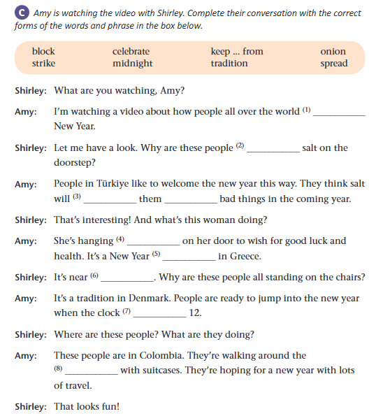
Post-reading
celebrate
spreading
keep from
onions
tradition
midnight
strikes
block

Slide 21
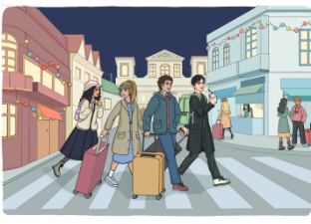
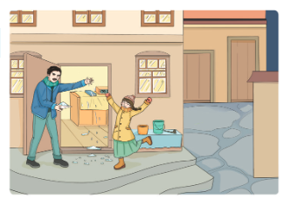
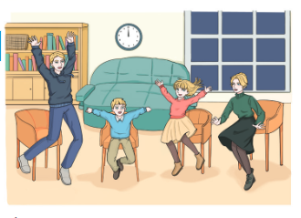
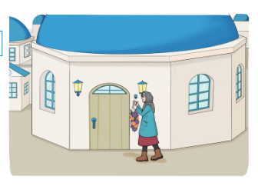
1
Post-reading
Read and talk
Pair work: Pick one picture and talk about it
A: Look at picture 1/2/3/4. What is/are... doing?
B: He/She is.... /They are...
A: Why does he/she do this? /Why do they do this?
B: ...
A: How interesting!
2
4
3

Slide 22
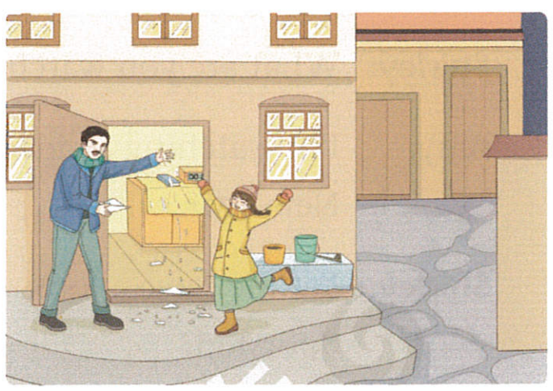
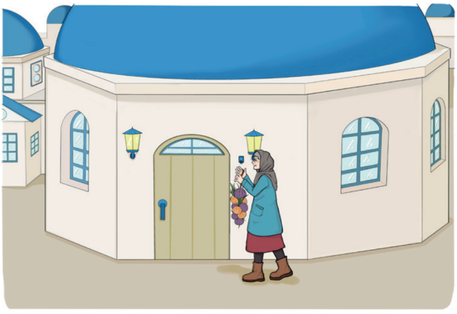
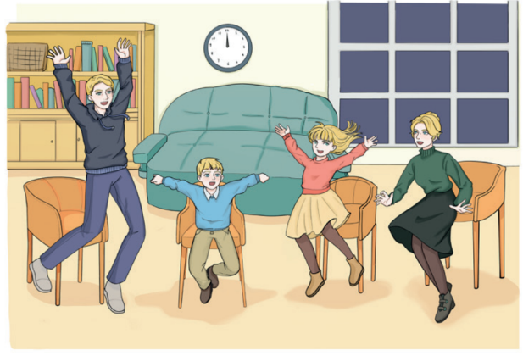
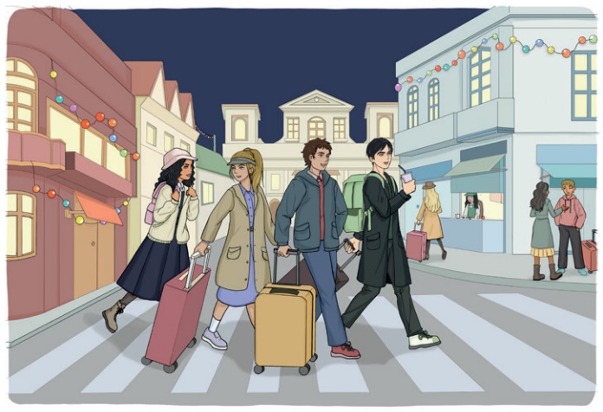
5
Post-reading
Think about the question below. Share your answers .
Which of the celebrations in the four countries interests you most? Why?
Türkiye
Greece
Denmark
Colombia

Slide 23
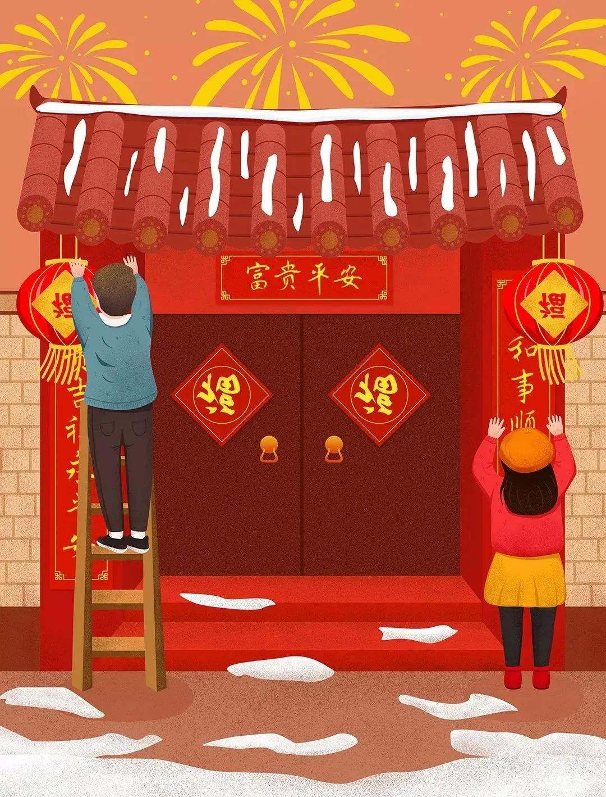
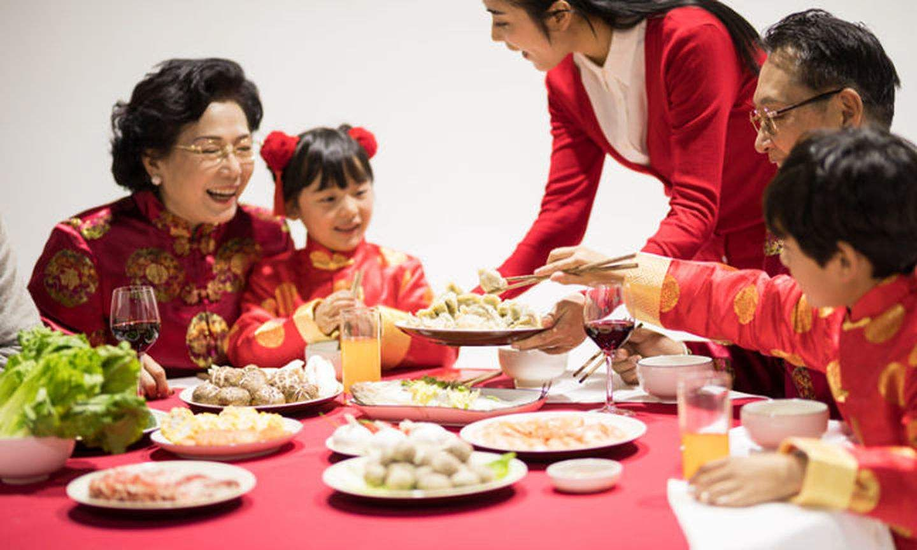

Post-reading
Do you know any Chinese ways to celebrate New year? Share one with your classmates.

Slide 24
What attitude should we hold to different cultures and traditions?
By learning about New year’s celebrations around the world, we can appreciate culture diversity.
Each traditions reflects unique culture values and customs.
Keep peace throughout the world
Respect culture diversity

Slide 25
Good evening, ladies and gentlemen. New Year is coming. Let's see how people all over the world are celebrating it.
Look at the man spreading salt on his doorstep. This is for good luck and peace. People in Türkiye think salt will keep them from bad things in the coming year. Isn't that interesting?
Here in Greece, an old woman is hanging onions on her door. It's a Greek tradition to welcome the new year. Onions are a symbol of good luck and health.
It's near midnight in Denmark. Look! The families are all standing on chairs. When the clock strikes 12, they jump off their chairs into the new year, in the hope of getting over any problem in the year ahead!
In Colombia, some people are carrying suitcases around the block. Are they travellers? No! They' re hoping for a new year with lots of travel.
The world is full of wonderful and interesting New Year traditions. But wherever you are, Happy New Year!
Post-reading
Let’s appreciate
Tips of being a good presenter
How does the video script attract viewers?
1. Be polite.
2. Use imperative sentences to catch the attention of viewers.
3. Use rhetorical questions to emphasize your opinion or attract interest.
4. Use the present continuous tense to make you feel real and vivid.

Slide 26
Homework
Must do
Introduce some interesting New Year celebrations to your family.
Choose to do
Look for more New Year celebrations on the internet.

Slide 27

Thank you

