Slide 1

七年级上册
Unit 7 Be wise with money
Reading

Slide 2



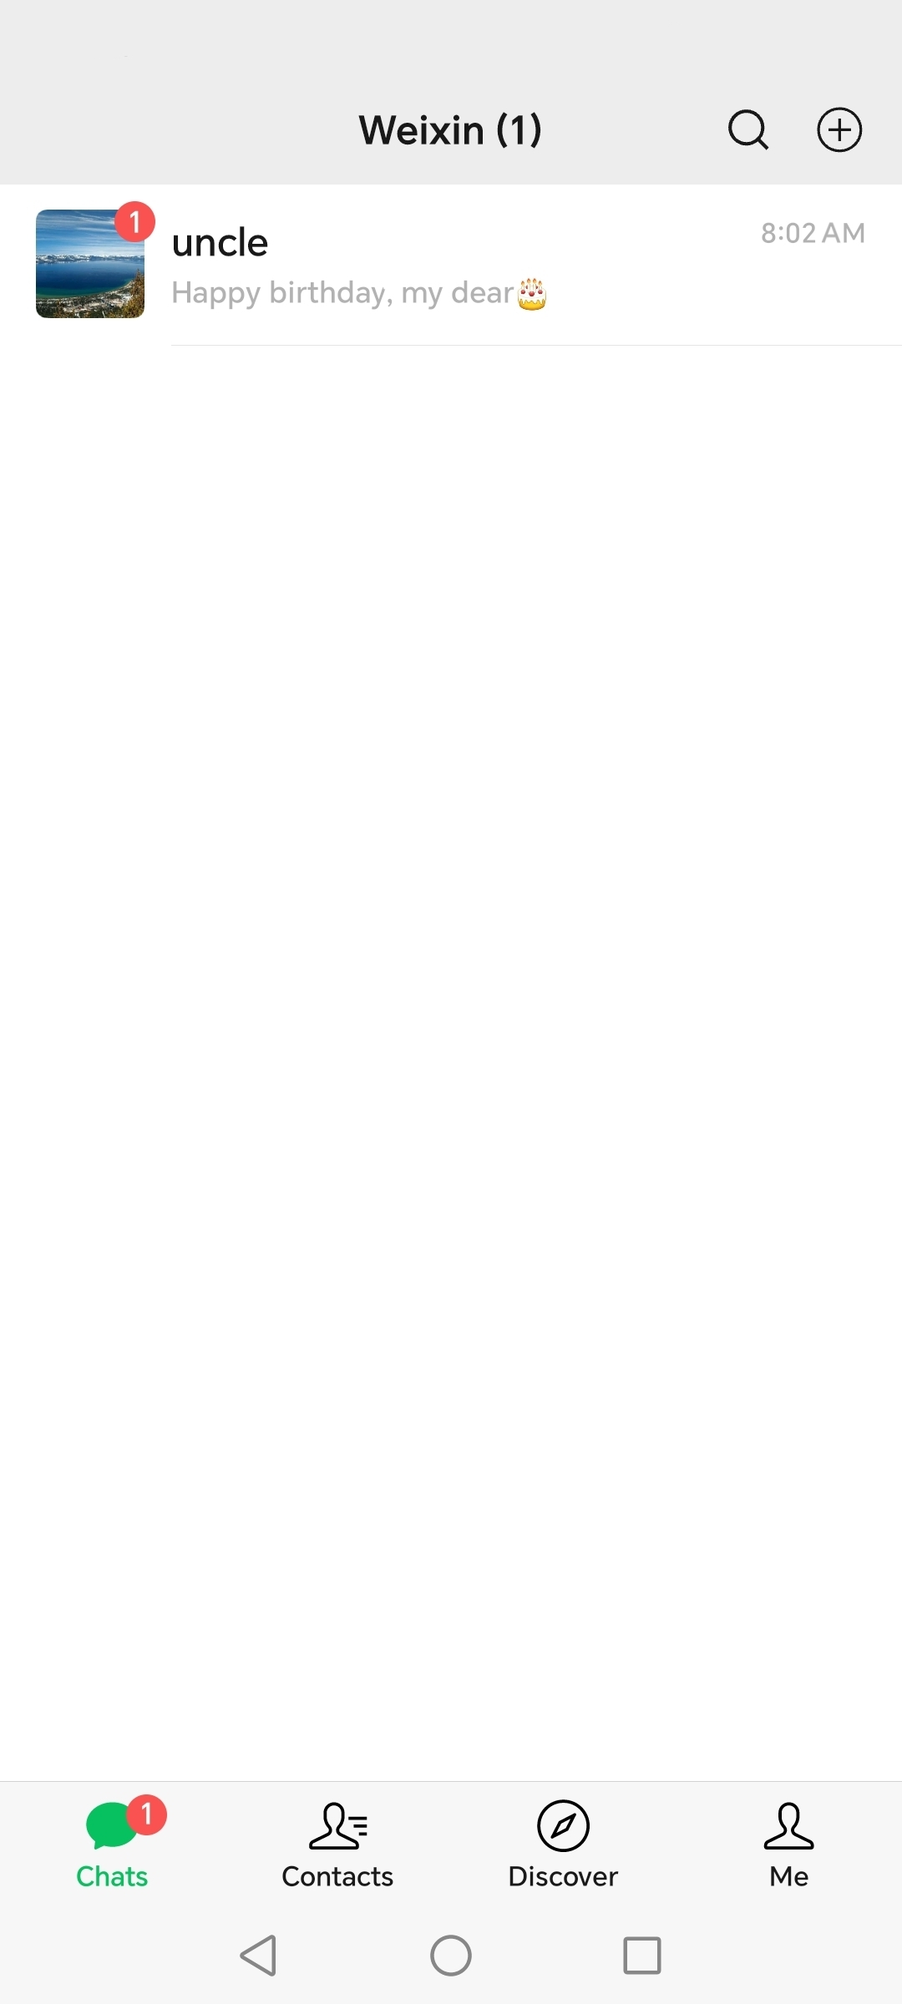
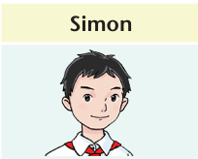
Lead-in

Slide 3
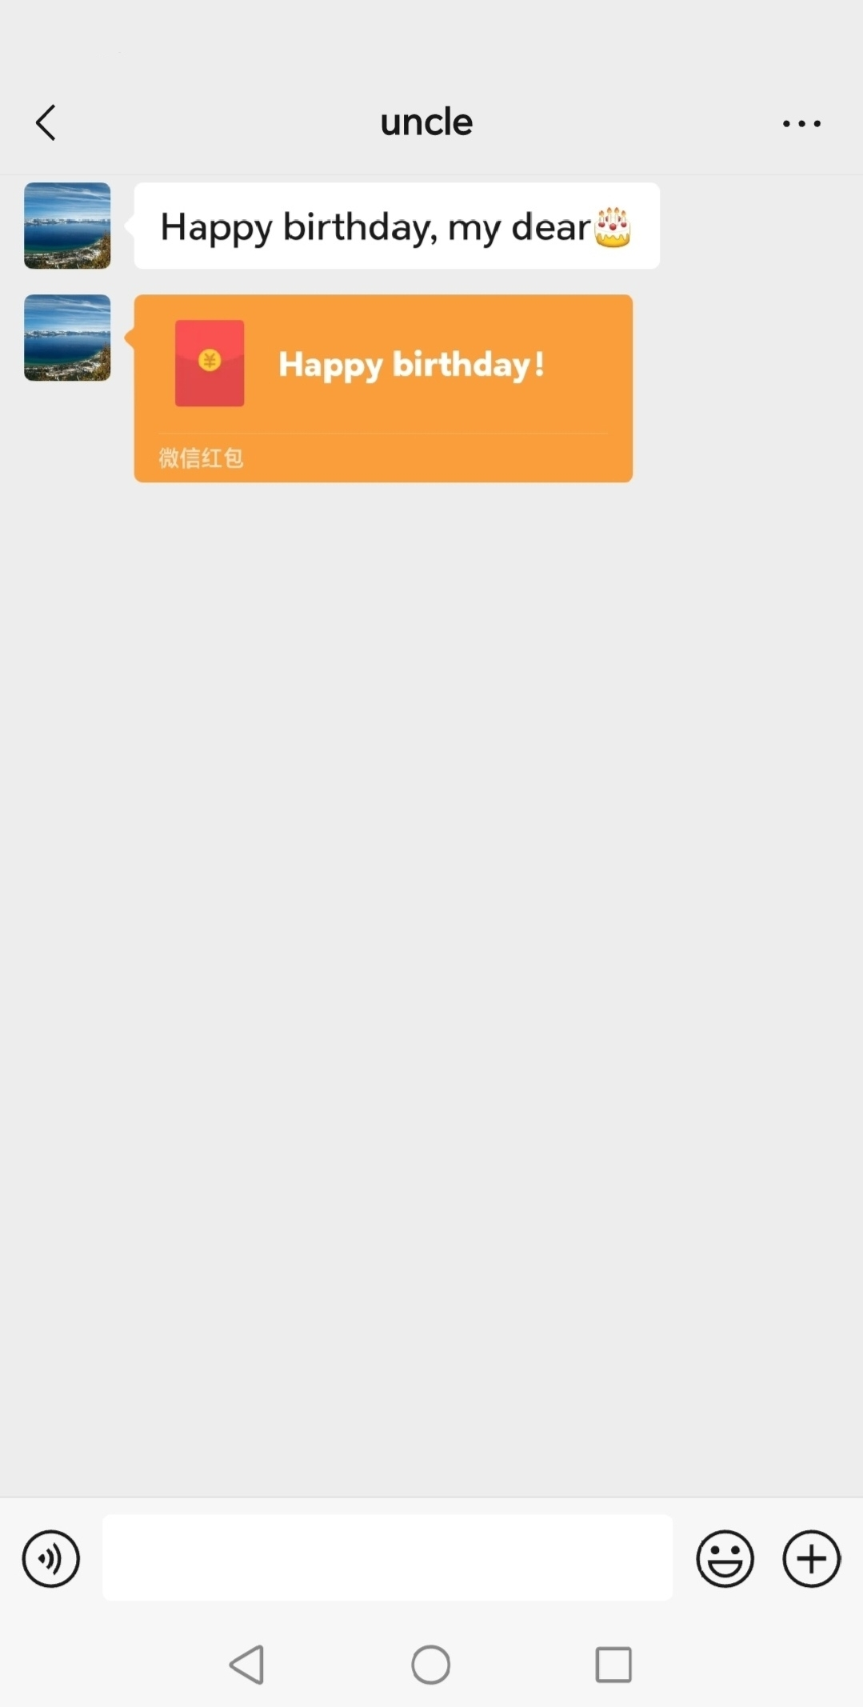
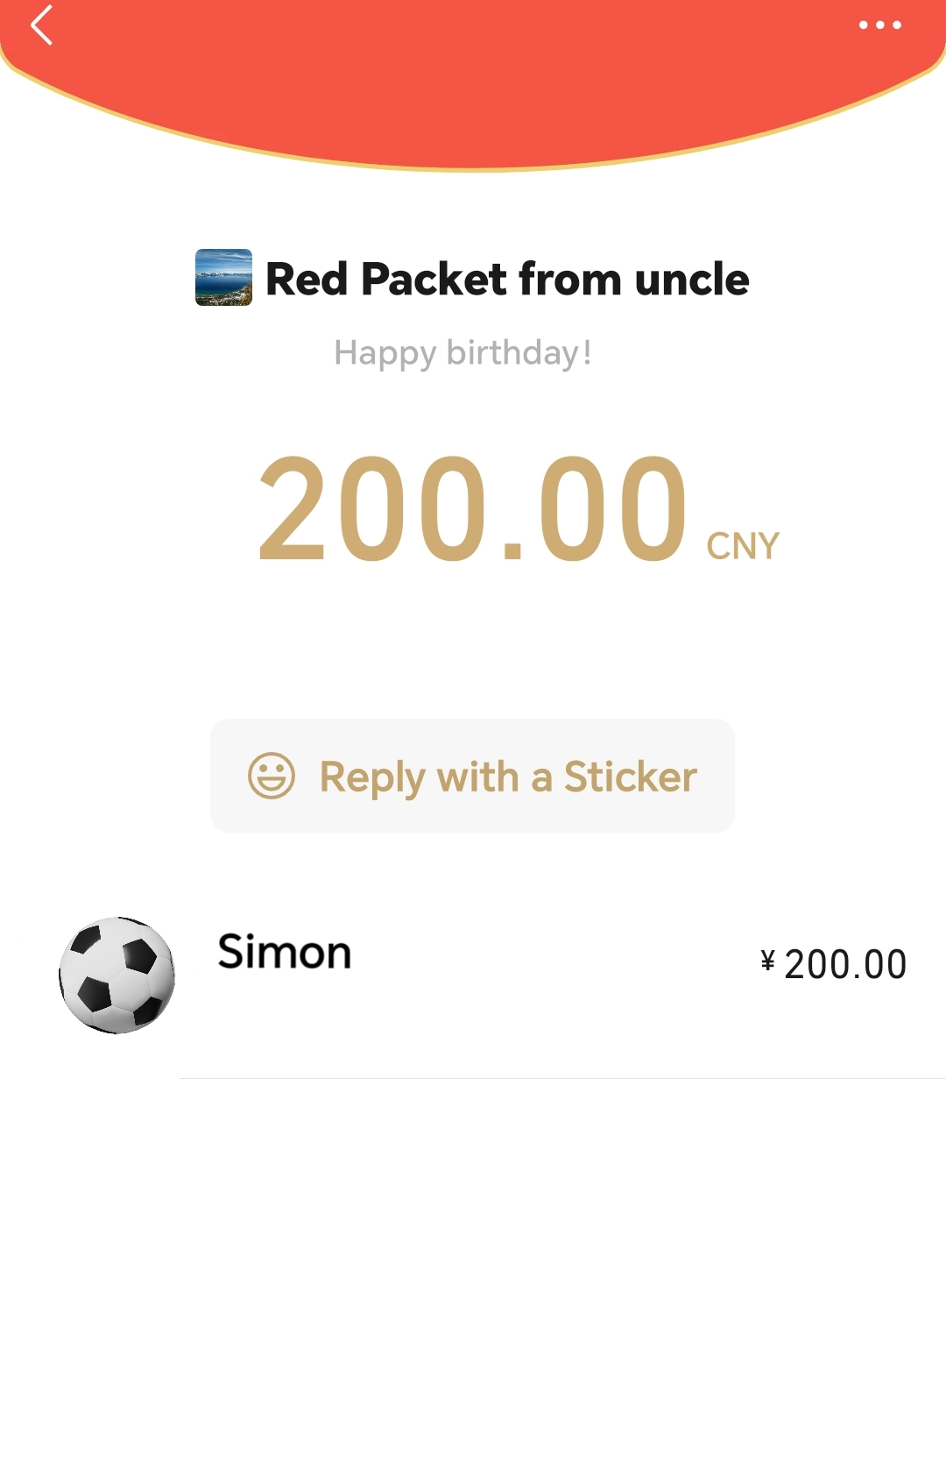
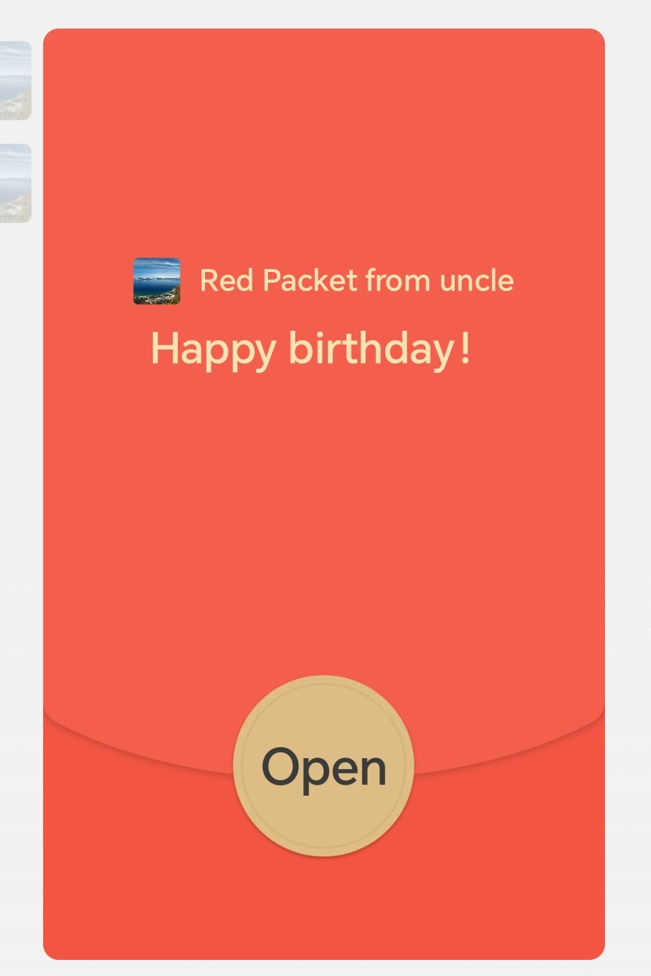
Lead-in

Slide 4
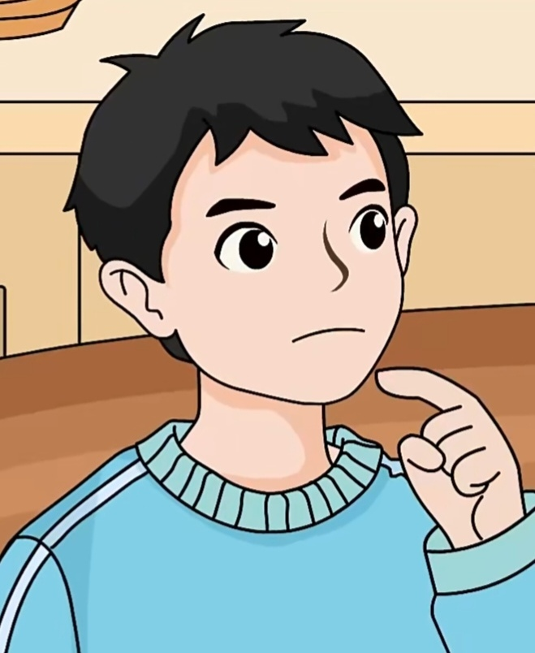
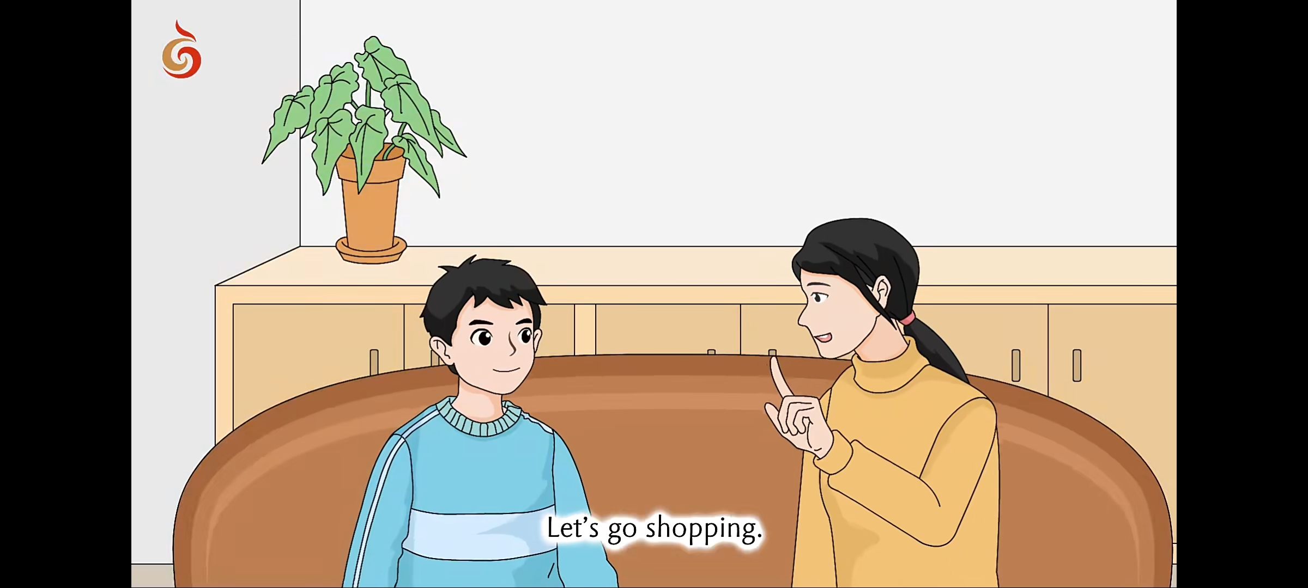
Lead-in
That’s a lot of money!
What should I do?

Slide 5
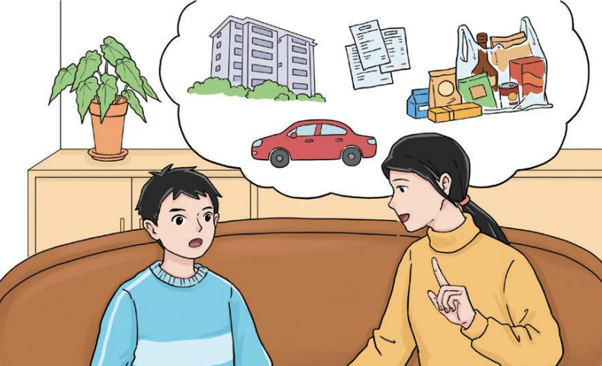
Pre-reading
bill
(账单)
house
food
What can you see in this picture?
car
What are they talking about?
How his family manages their money；
How to manage Simon’s pocket money；
...

Slide 6
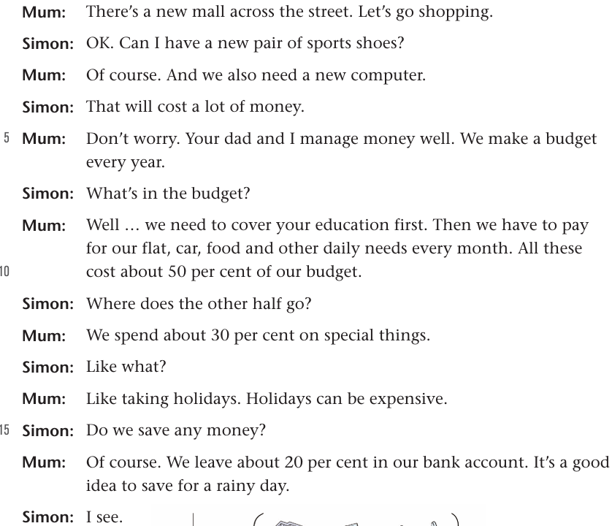
1
Pre-reading
2
3
4
Q: What are they talking about at the beginning?
5
6
7
8
They are talking about shopping.
9
10
11
12
Line_____~_____.
1
6
13
14
15
16
17
18

Slide 7
While reading
Q1: What do they plan to buy?
They plan to buy a new pair of sports shoes and a new computer.
Q2: Are they expensive?
Yes.

Slide 8
While reading
Q3:Do they have enough money? Why or why not?
Yes. Because they manage money well.
Q4:How does Simon’s family manage their money?
By making a budget every year.
Q5:What will they talk about next?
The family budget.

Slide 9
1
While reading
2
3
Line_____~_____.
4
1
6
5
Shopping plan
6
7
8
9
10
11
Line_____~_____.
7
18
12
13
Family budget
14
15
16
17
18

Slide 10
While reading
Q：How does his mum answer these questions?
Q：How many questions are there?

Slide 11
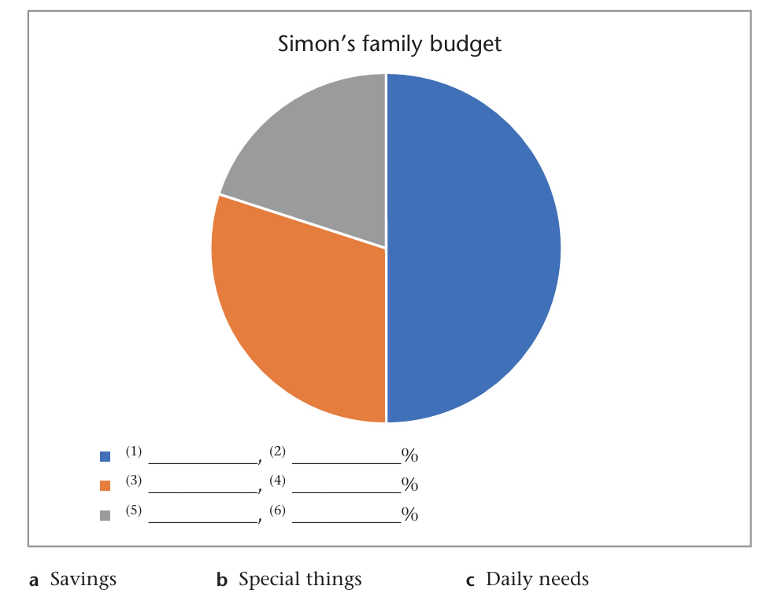
While reading
20
50
___%
30
___%
___%

Slide 12
While reading
___%
Simon’s education
C. Daily needs
flat
___%
50
car
food

Slide 13
While reading
20
___%
Simon’s education
flat
C. Daily needs
50
___%
Taking holidays
B. Special things
30
car
___%
food

Slide 14
While reading
Can we live without food?
But can we live without expensive holidays?
Simon’s education
20
___%
flat
C. Daily needs
50
___%
Taking holidays
B. Special things
30
car
___%
food
wants
needs

Slide 15
While reading
Cover the needs first!
Check your understanding of the difference between “wants” and “needs”!
wants
needs
Clothes
New toys
Health care
A film ticket

Slide 16
While reading
20
___%
50
Simon’s education
___%
30
A. Savings
___%
20
___%
flat
50
C. Daily needs
___%
B. Special things
30
car
Taking holidays
___%
food

Slide 17

While reading
未雨绸缪
What does Simon’s mum mean by saying “to save for a rainy day”?
20
___%
___%
accidents, troubles, bad things, hard days...
She means they should save money for a time when they will need it.

Slide 18
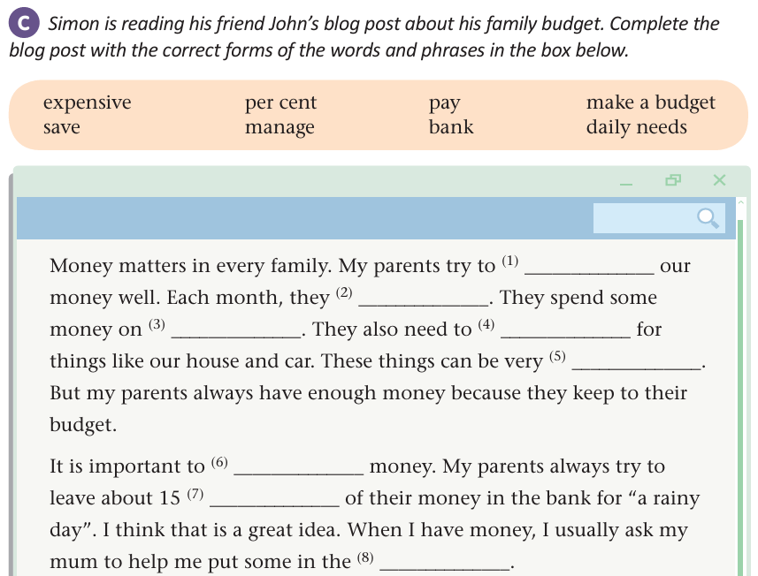
While reading
manage
make a budget
daily needs
pay
expensive
save
per cent
bank

Slide 19
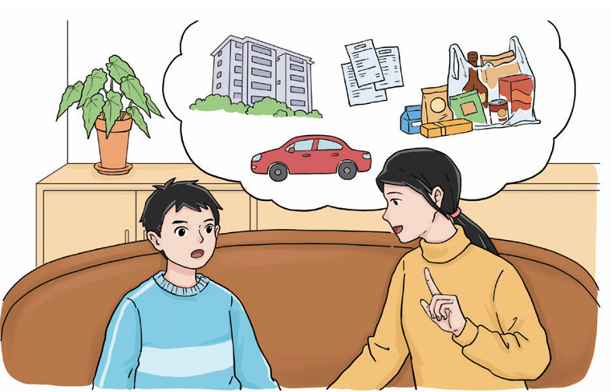

Post-reading
Q: Do you think it is important to make a budget? Why or why not?

Slide 20
Post-reading
You can make a budget!
I need some advice...

Slide 21
Post-reading
Savings
__%
Daily needs
50
___%
Special things
___%
First, Simon can spend 50 per cent of his money on daily needs. He can buy school things like .
Second, he can spend per cent on special things. Simon is interested in sports and he often plays football after school, so he .
Finally, he can leave about per cent in his bank account for “a rainy day”.

Slide 22
Post-reading
Make a budget for Simon!
A: Hi Simon, happy birthday!
Simon: Thank you!
A: What do you get for your birthday?
Simon: My uncle sends me an online red packet. But I don’t know how to make a budget.
A: Don’t worry, I can give you some advice. First, you can spend____ per cent on daily needs. You can ____________________________________________________________.
Simon: You are right. We need to cover the needs first.
A: Second, you can spend____ per cent on special things. You can_____________________.
Simon: I can’t agree more. Finally, I can ____________________________. Thanks for your advice! You are so helpful and kind.

Slide 23
Post-reading
Being wise with money is an important lesson in your life.
Hope you will become wiser with money!

Slide 24
Homework
Compulsory homework:
(1) Read the conversation about Simon’s family management loudly and correctly.
(2) Go on to finish your family budget and share it with your friends or parents.
Optional homework:
Read some other classmates’ family budgets and get more information about the formation of the budget.

Slide 25
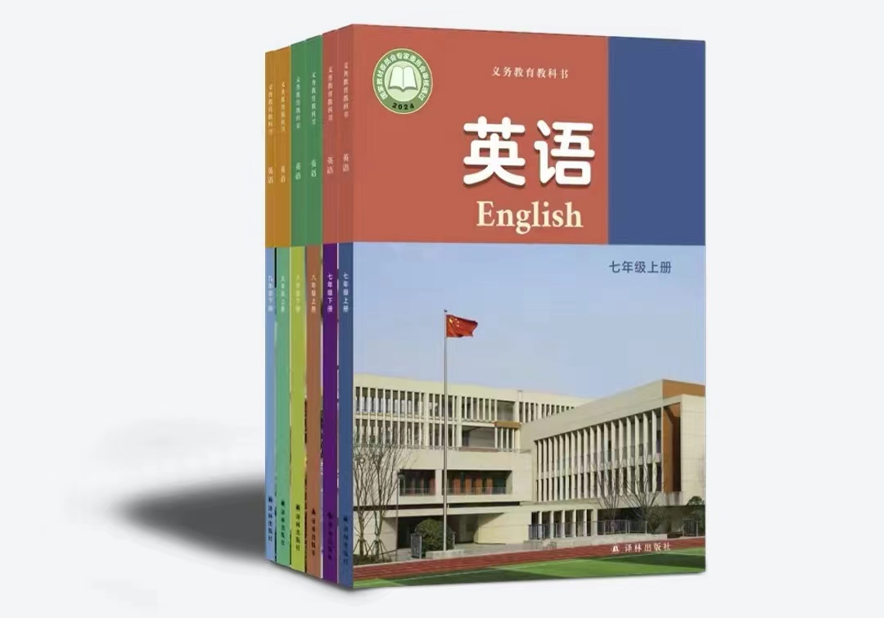
Thanks for your listening!

