Slide 1
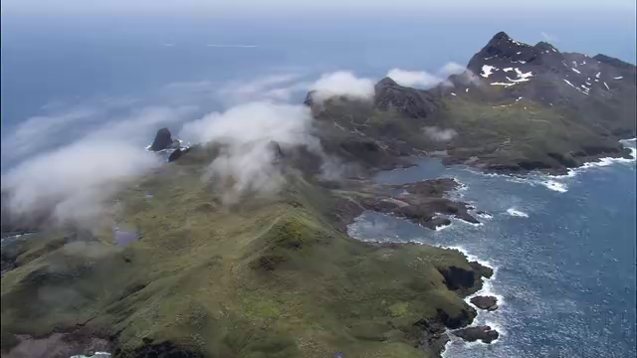
The first flight

Slide 2

8A U6 Birdwatching
Integrated Skills
彭 雨
龙城初级中学

Slide 3
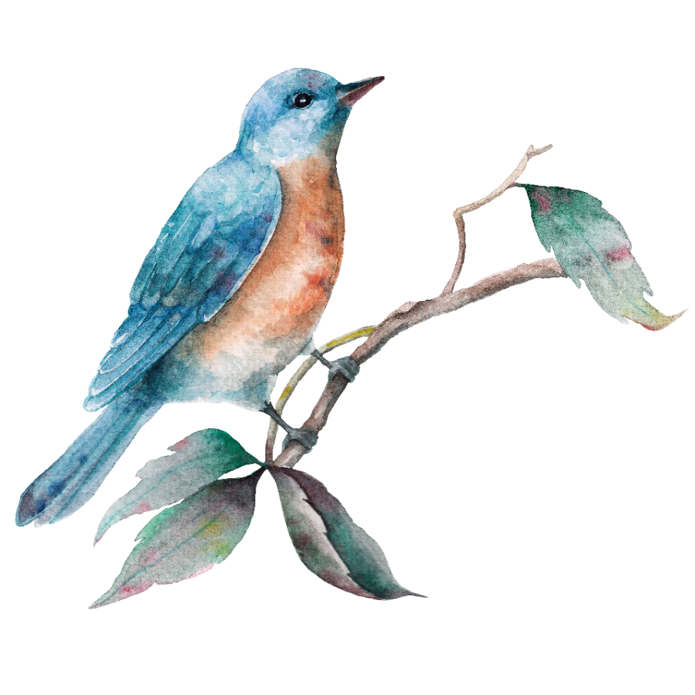
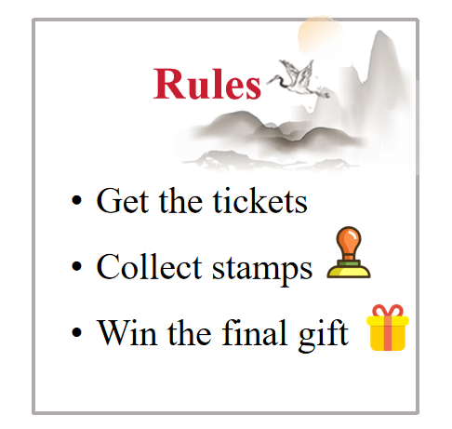

Lead-in
The Royal Society for the
Protection of Birds (RSPB)
皇家鸟类保护协会
ticket

Slide 4
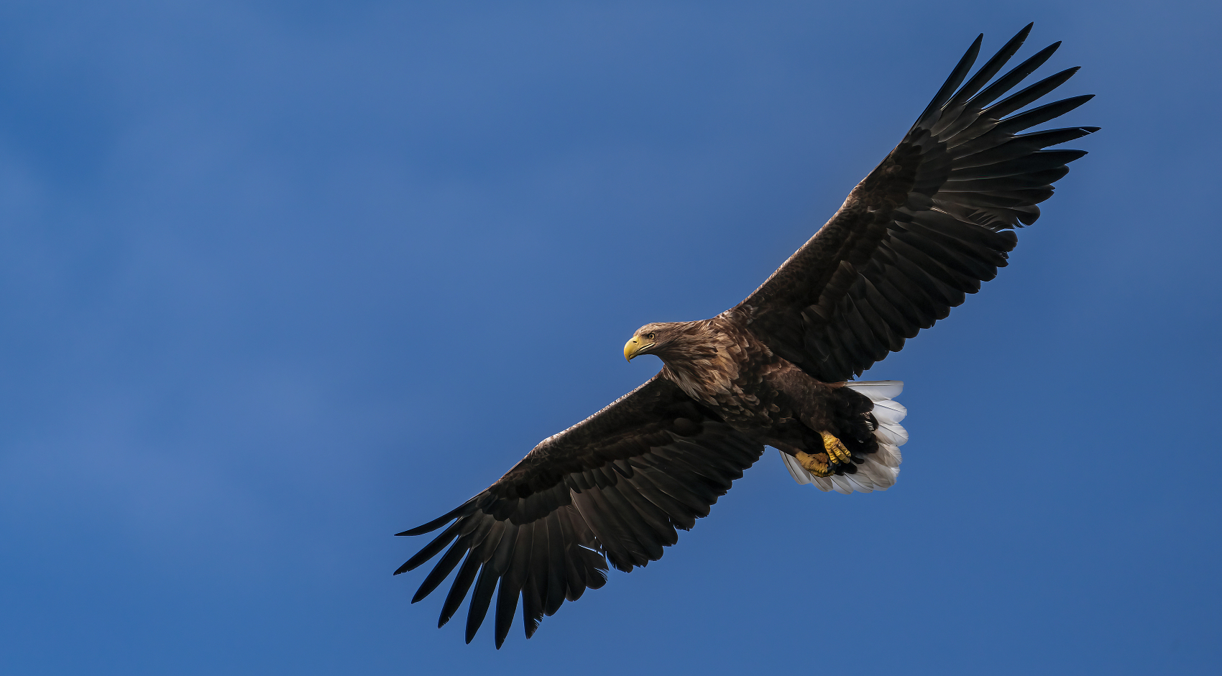
Warm-up: A Bird Test
Eagle
brown
broad
have _______feathers and _______ wings

Slide 5
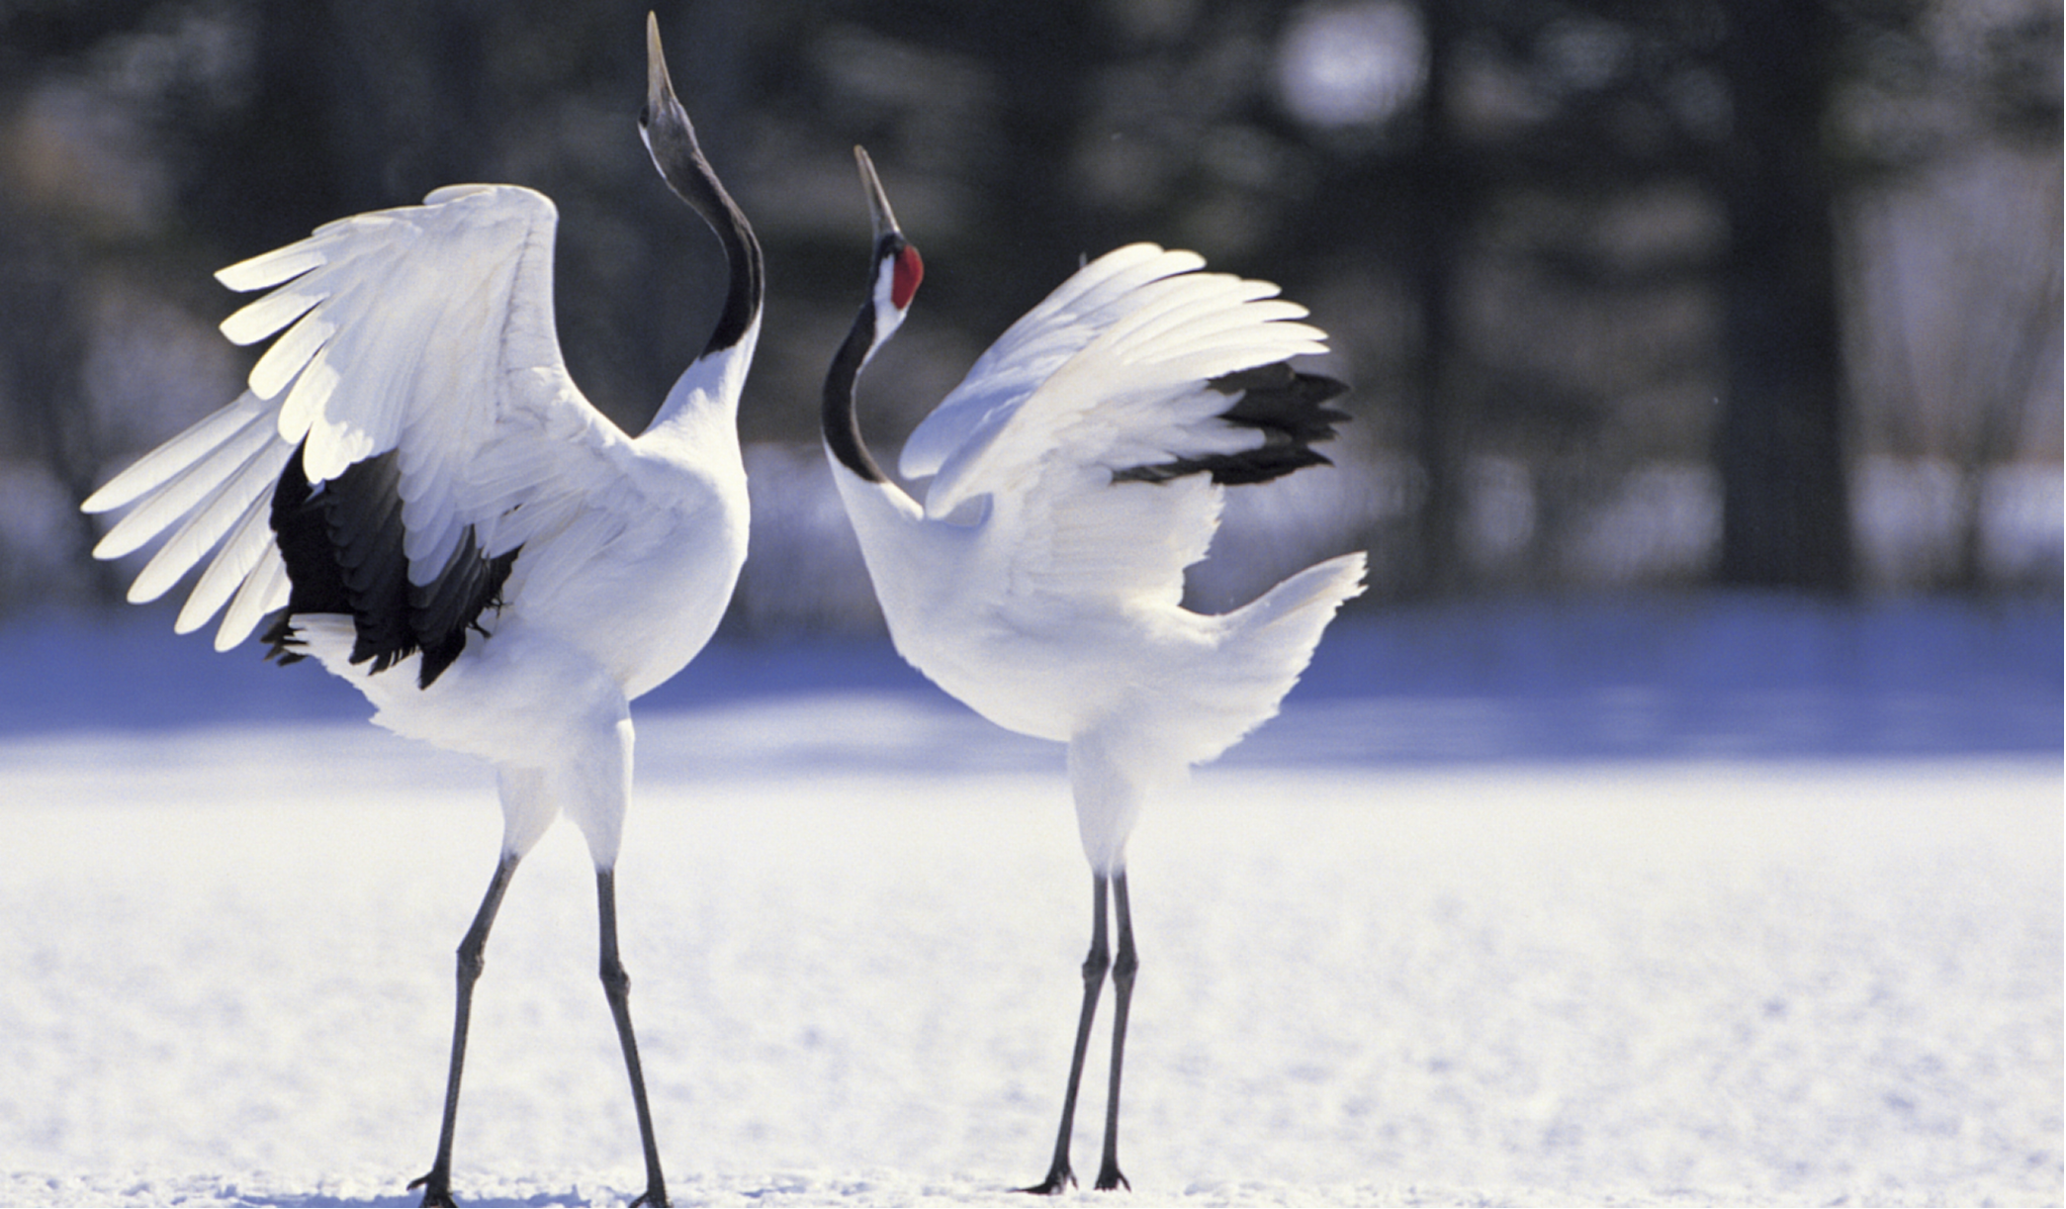
Crane
long ____and a ____ ___ ____
tall
legs
long
thin
neck

Slide 6
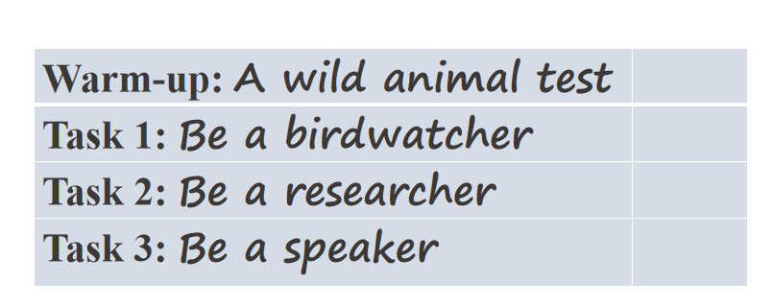

Tips for joining RSPB
Task lists
ticket

Slide 7
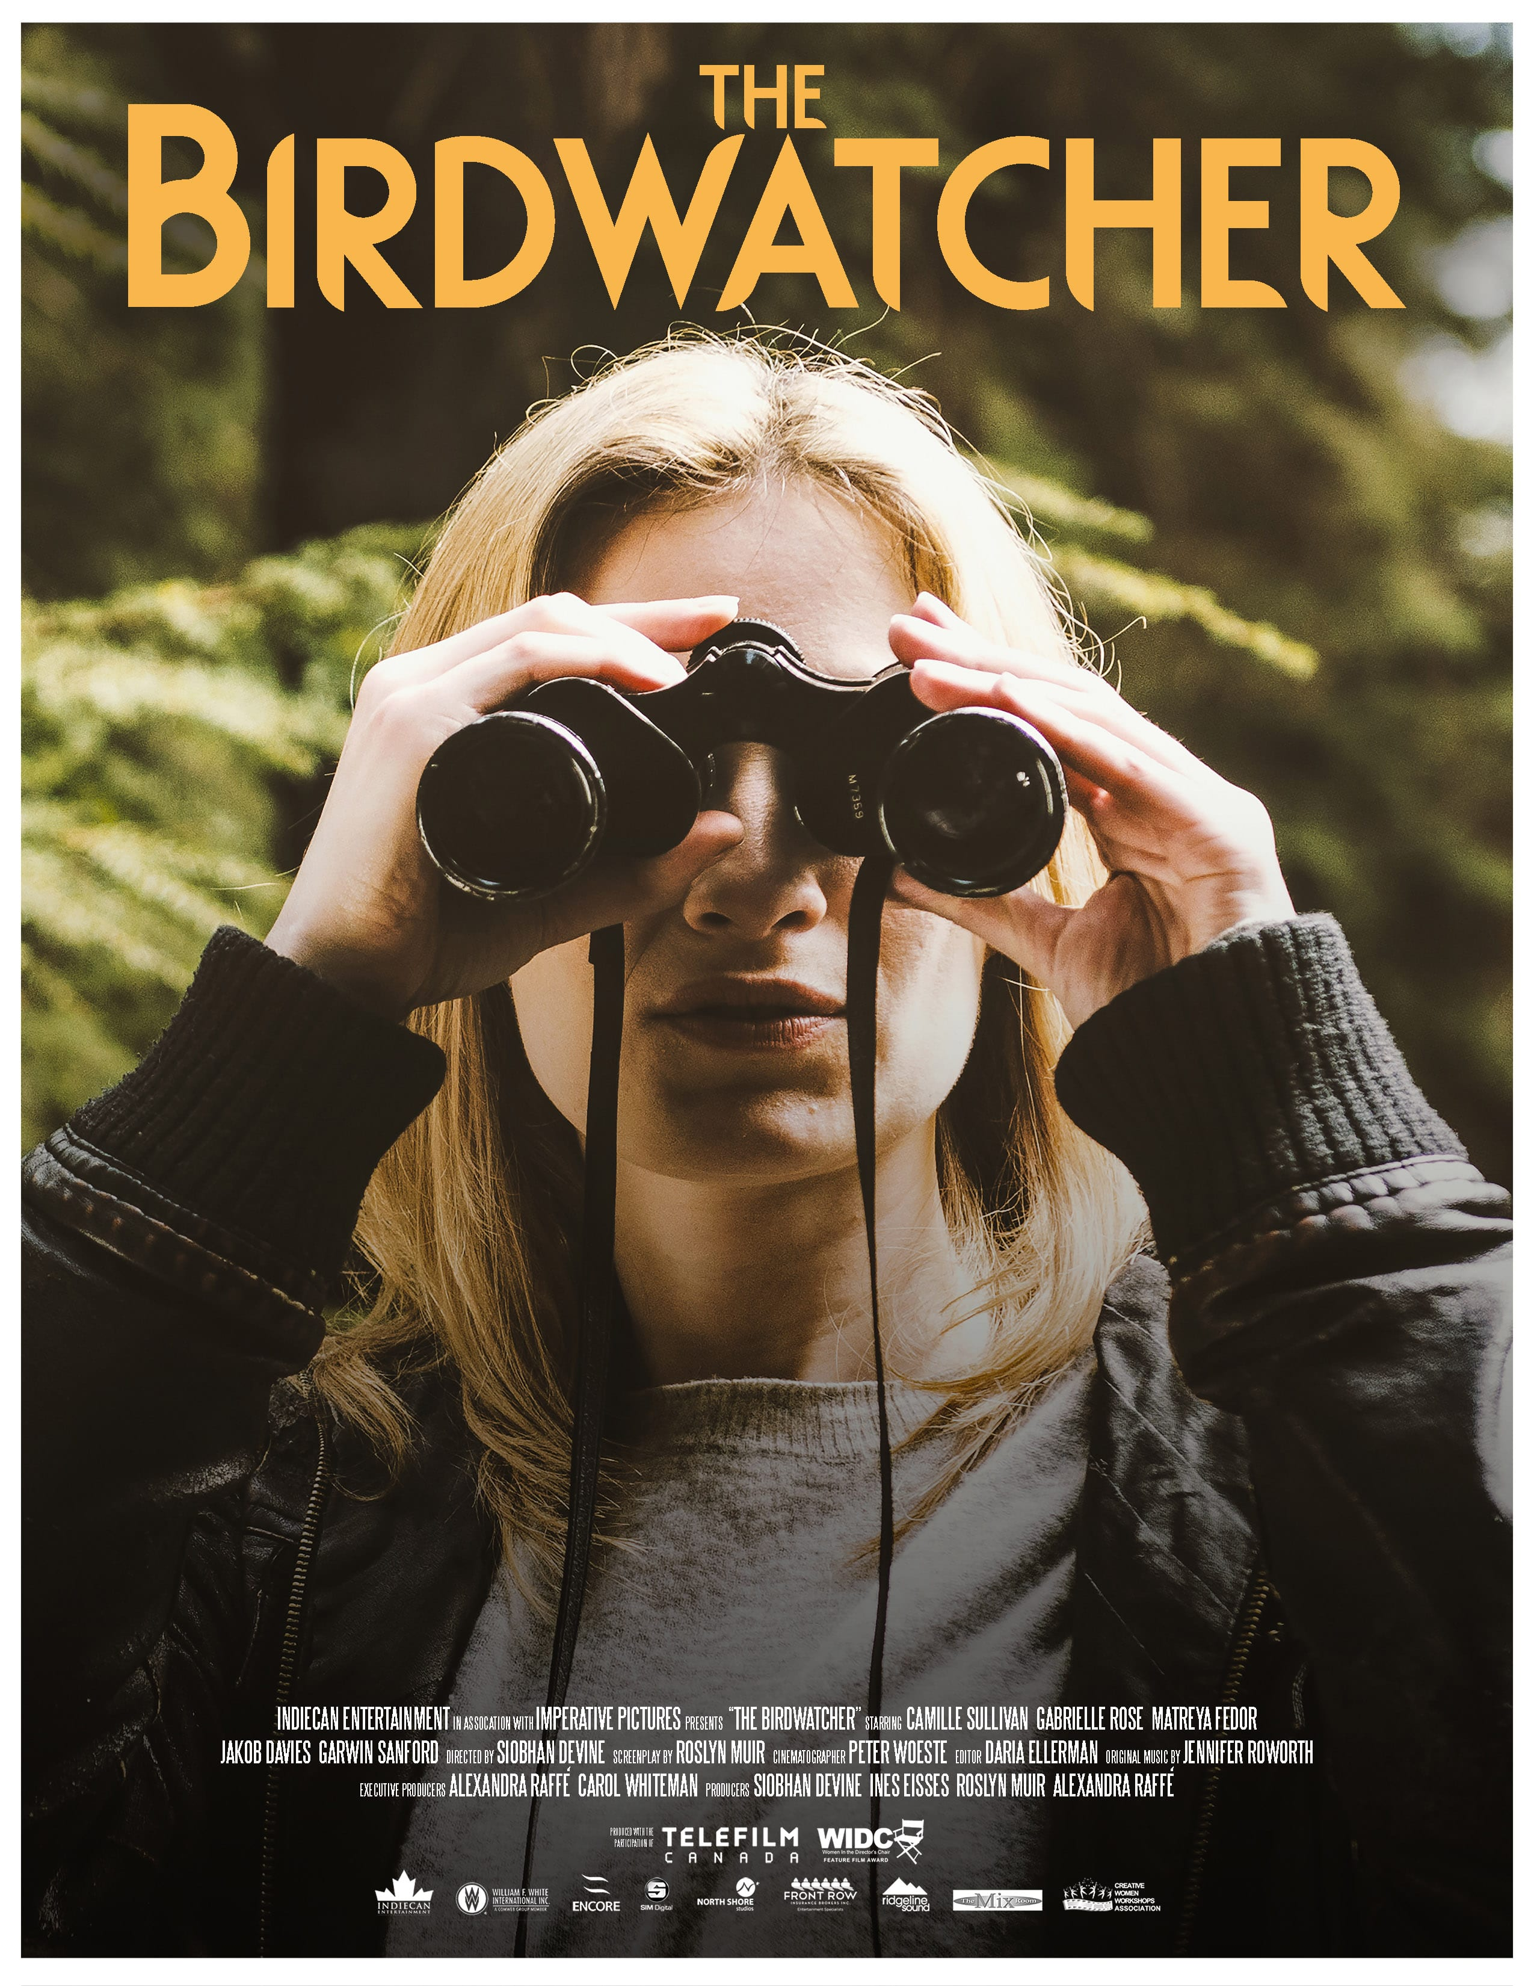
Be a birdwatcher

Slide 8
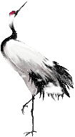








Task 1: Be a birdwatcher——Listening & Ticking
Daniel wants to go birdwatching.
Find out what Sandy advises him to take.
a notebook
a pair of binoculars
some water

Slide 9
Task 1: Be a birdwatcher——Listening & Answering
Why does Sandy advise Daniel to take these thing?
Listening Tip1:
Write down some key words while listening.
Because it will help him see the birds more clearly.
Because it takes hours to watch birds and he may get thirsty.
Because it can help him to write down what he sees.

Slide 10
Task 1: Be a birdwatcher——Reading & Thinking
Asking for advice
Giving advice
Daniel: What should we take with us when we go birdwatching, Sandy?
Sandy: You’d better take a pair of binoculars. They’ll help you see
the birds more clearly.
Daniel: OK. What else should we take?
Sandy: You should take some water. Usually it takes hours to
watch the birds. You may get thirsty.
Daniel: All right. Anything else?
Sandy: Take a notebook with you to write down what you see.
Daniel: OK. Thanks, Sandy.

Slide 11
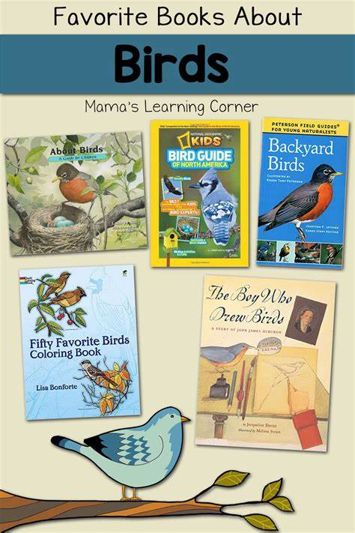
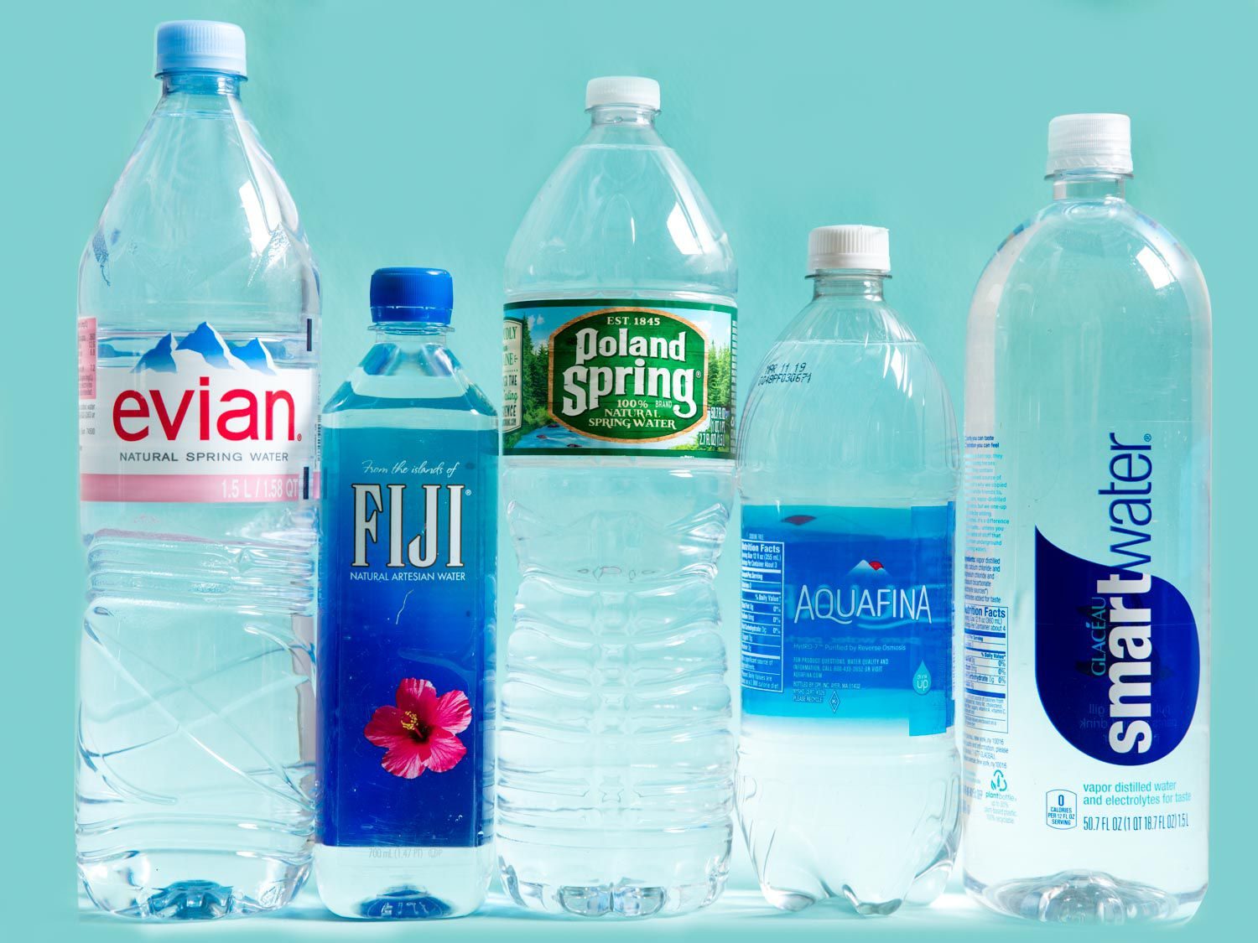
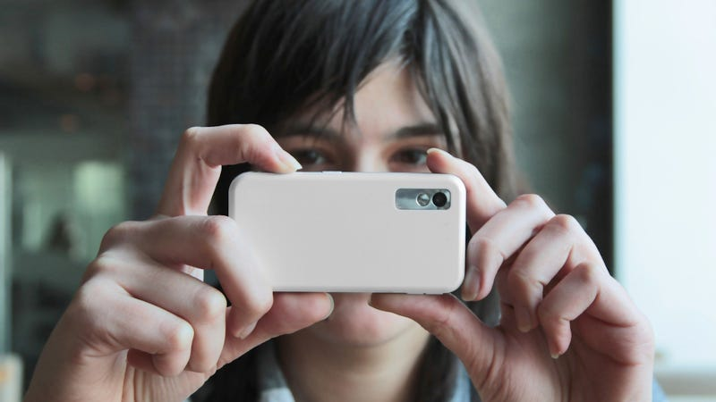

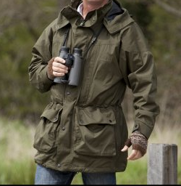
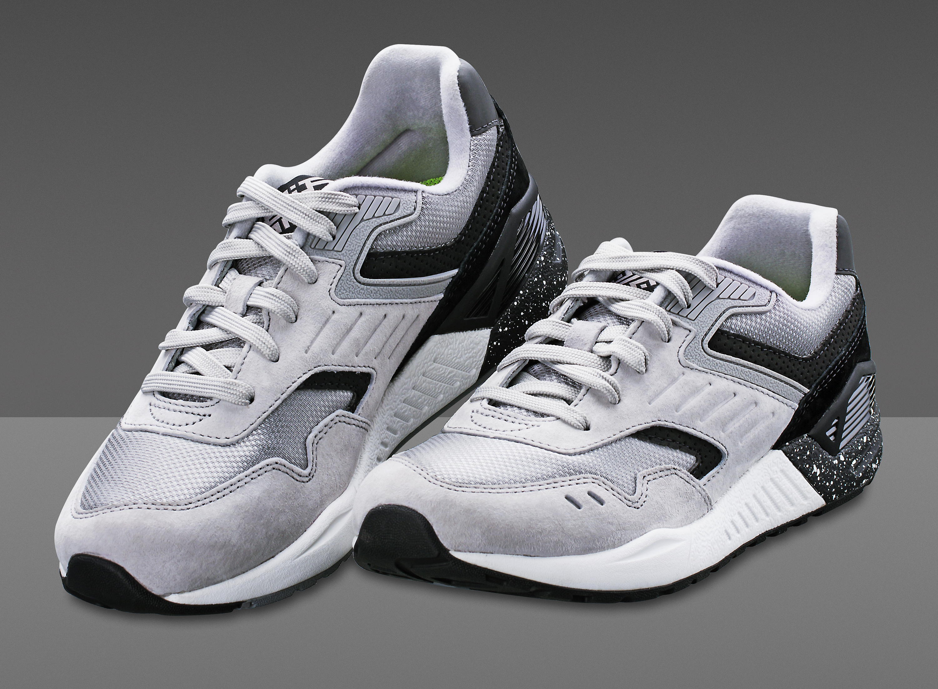
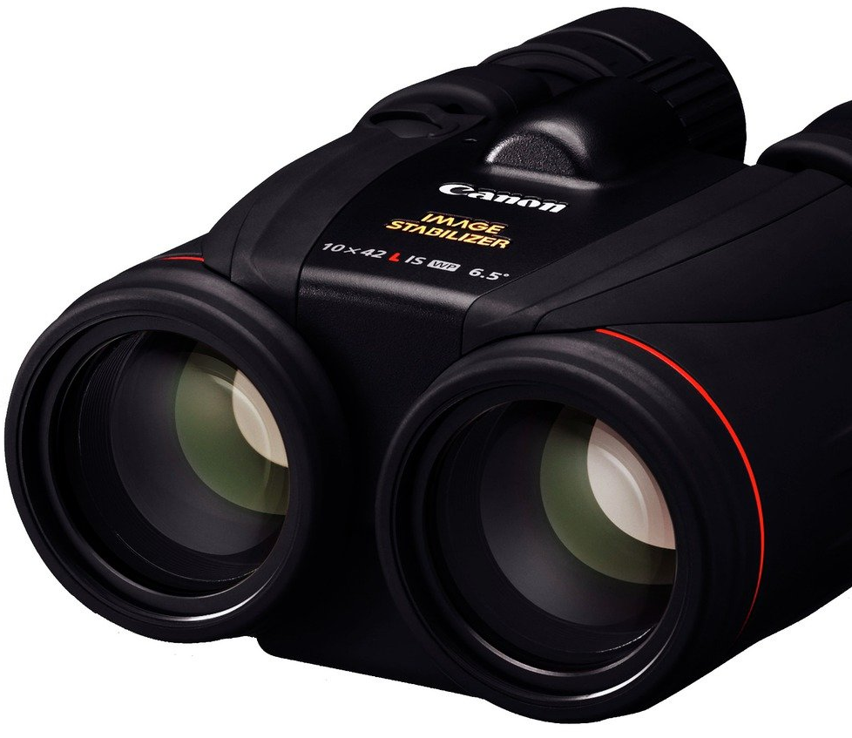
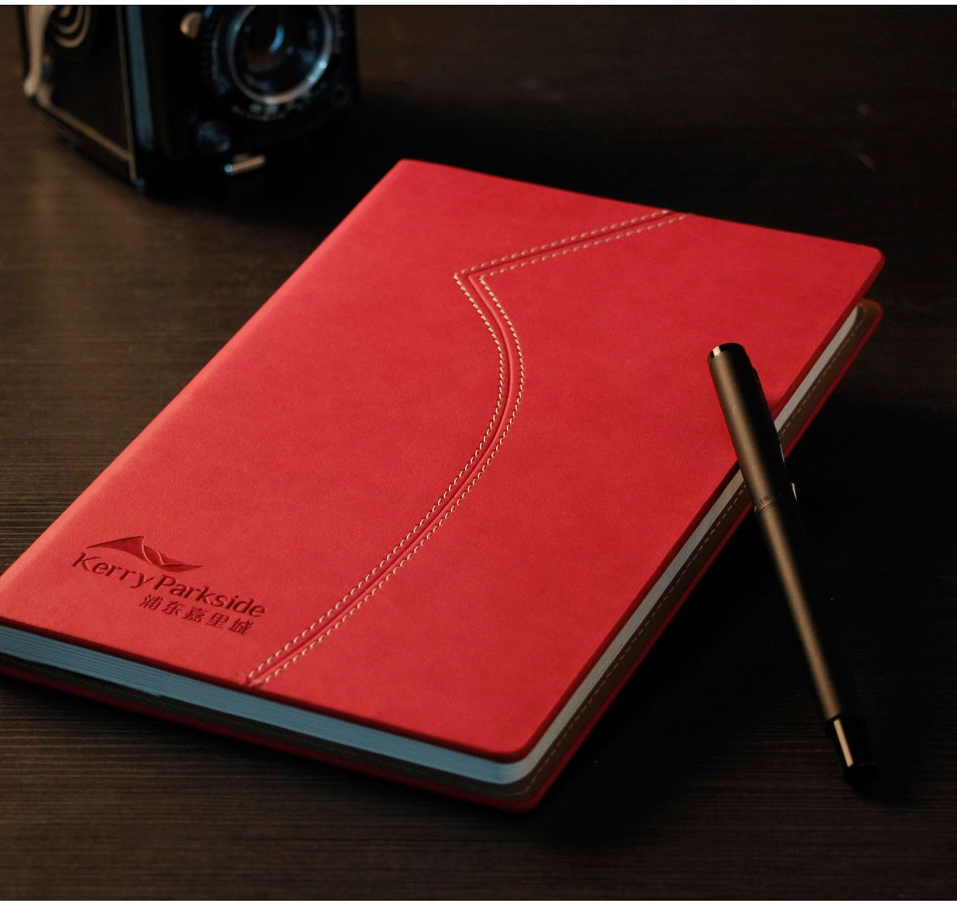
Pair work:
Talk with your partners to talk about other things we can bring.
A: What should we take with us when we go on a trip to Hongmei Park?
B: You’d better take...
A: Ok. What else should we take?
B: You should take ...
A: All right! Anything else?
B: Take ...
A: That’s a good idea. Thanks.
表示建议的句型：
Let’s do...
Why not do...
I think you can...
How about...
Remember to...
It’s important/necessary to...

Slide 12
Be a birdwatcher
Be a researcher
Be a speaker

Slide 13

Be a birdwatcher
Be a researcher
/rɪˈsɜːtʃə(r)/ 研究者
Be a speaker

Slide 14
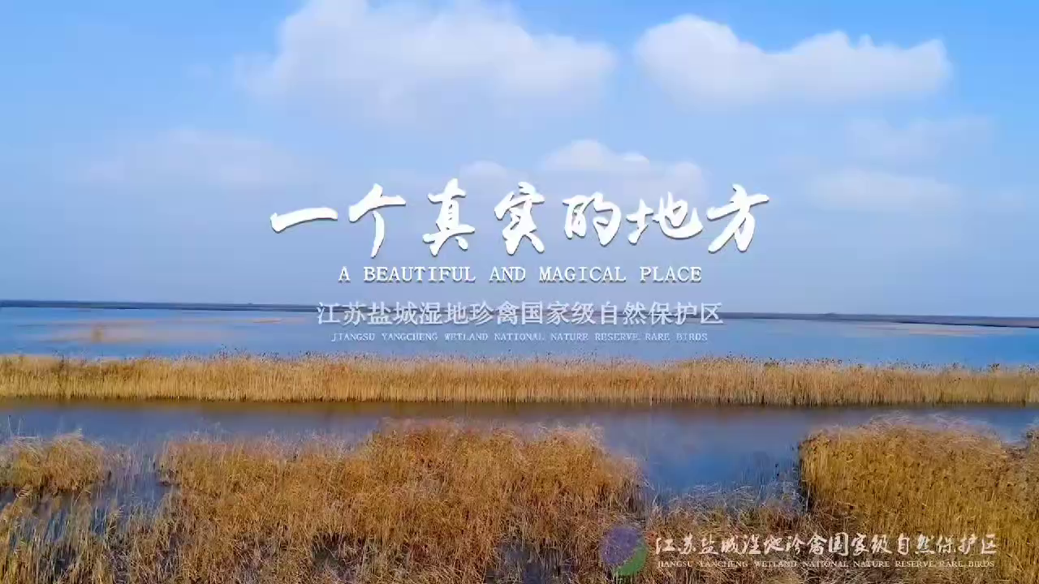
Enjoy a video!
Yancheng Nature Reserve

Slide 15
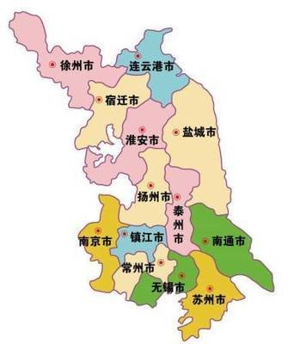
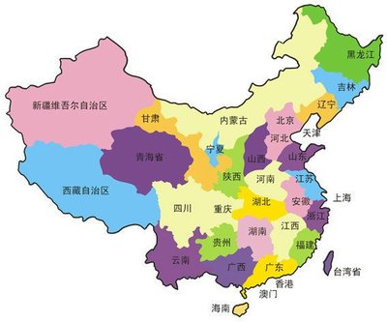
Task 2: Be a researcher——Predicting
Where is Yancheng Nature Reserve?
It’s in Jiangsu Province in East China.
N
W
E
S

Slide 16
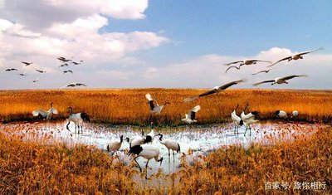
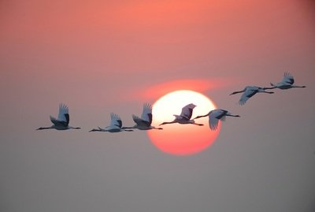
Task 2: Be a researcher——Predicting
What can we do at Yancheng Nature Reserve?
Is it a place to buy/hunt/watch birds?

Slide 17
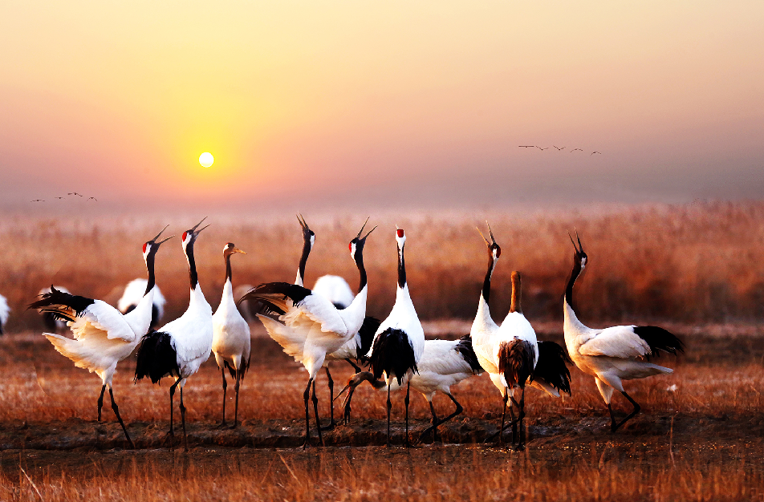
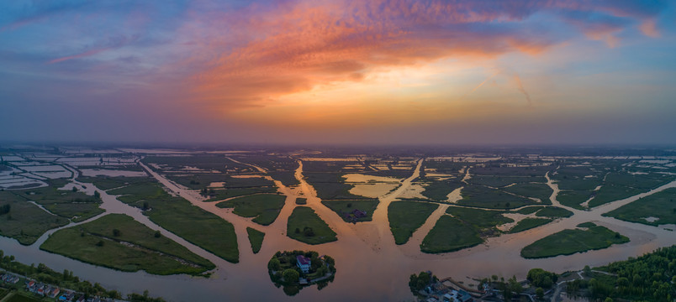
Task 2: Be a researcher——Predicting
How big is Yancheng Nature Reserve?
453/4,530/45,300 square kilometers
Listening Tip2:
Pay more attention(注意) to numbers.

Slide 18
Task 2: Be a researcher——Predicting
1. Yancheng Nature Reserve is in ____ Province in ____ China.
A. Heilongjiang, North-east B. Hainan, South C. Jiangsu, East
2. Yancheng Nature Reserve is a perfect place to ____.
A. buy the birds B. hunt the birds C. watch the birds
3. The reserve covers an area of over ____ square kilometres.
A. 453 B. 4,530 C. 45,300
4. Yancheng is the ____ home to the red-crowned cranes in China.
A. largest B. second largest C. third largest
5. About ____ red-crowned cranes fly to Yancheng Nature Reserve every year to spend the winter.
A. 100 to 300 B. 300 to 1,000 C. 1,000 to 3,000
6. In ____, Yancheng Nature Reserve became one of the world’s most important wetlands.
A. 1997 B. 2002 C. 1992
where
Listening Tip3:
Read to get key words.
what to do
how big
how important
how many
when

Slide 19
Task 2: Be a researcher——While-listening
1. Yancheng Nature Reserve is in ____ Province in ____ China.
A. Heilongjiang, North-east B. Hainan, South C. Jiangsu, East
2. Yancheng Nature Reserve is a perfect place to ____.
A. buy the birds B. hunt the birds C. watch the birds
3. The reserve covers an area of over ____ square kilometres.
A. 453 B. 4,530 C. 45,300
4. Yancheng is the ____ home to the red-crowned cranes in China.
A. largest B. second largest C. third largest
5. About ____ red-crowned cranes fly to Yancheng Nature Reserve every year to spend the winter.
A. 100 to 300 B. 300 to 1,000 C. 1,000 to 3,000
6. In ____, Yancheng Nature Reserve became one of the world’s most important wetlands.
A. 1997 B. 2002 C. 1992

Slide 20
Task 2: Be a researcher——Post-listening
1. Where is Yancheng Nature Reserve?
It is in ... Province in ... China.
2. What can we do at Yancheng Nature Reserve?
It is a perfect place to ...
3. How big is the reserve?
It covers an area of over ... square kilometres.
4. How important is Yancheng?
It is the ... home to the red-crowned cranes in China.
5. How many red-crowned cranes fly to it every year ?
It’s about ...
6. When did it become one of the world’s most important wetlands?
In ...
Pair work:
Check your answer with your partner first.

Slide 21
Task 2: Be a researcher——Post-listening
1. Yancheng Nature Reserve is in ____ Province in ____ China.
A. Heilongjiang, North-east B. Hainan, South C. Jiangsu, East
2. Yancheng Nature Reserve is a perfect place to ____.
A. buy the birds B. hunt the birds C. watch the birds
3. The reserve covers an area of over ____ square kilometres.
A. 453 B. 4,530 C. 45,300
4. Yancheng is the ____ home to the red-crowned cranes in China.
A. largest B. second largest C. third largest
5. About ____ red-crowned cranes fly to Yancheng Nature Reserve every year to spend the winter.
A. 100 to 300 B. 300 to 1,000 C. 1,000 to 3,000
6. In ____, Yancheng Nature Reserve became one of the world’s most important wetlands.
A. 1997 B. 2002 C. 1992
√
√
√
√
√
√

Slide 22
Task 2: Be a researcher——Listening
Fill in the blanks according to A1(根据A1填空第一二段)
Yancheng Nature Reserve is in Jiangsu Province in _____China. It covers an area of over _______ square kilometres. It became one of the world’s most important wetlands in ______.
Yancheng Nature Reserve is home to different kinds of plants and rare birds. There are not many ___________________ in the world, but there are some in Yancheng Nature Reserve. It is a perfect place to go _____________.
(Listen and fill in the blanks)听第三段并填空。
People celebrate the World Wetlands Day on __________ each year. We should protect the wetlands not only because they are home to many plants, birds and _______, but also because they are important to the _______ of people all over the world.
East
4,530
2002
red-crowned cranes
birdwatching
2 February
animals
health

Slide 23
Task 2: Be a researcher——Post-listening
Let’s find out key phrases(词组) together!
East
Yancheng Nature Reserve is in Jiangsu Province in _____China. It covers an area of over _______ square kilometres. It became one of the world’s most important wetlands in ______.
Yancheng Nature Reserve is home to different kinds of plants and rare birds. There are not many ___________________ in the world, but there are some in Yancheng Nature Reserve. It is a perfect place to go _____________.
People celebrate the World Wetlands Day on __________ each year. We should protect the wetlands not only because they are home to many plants, birds and _______, but also because they are important to the _______ of people all over the world.
4,530
2002
red-crowned cranes
birdwatching
2 February
animals
health

Slide 24

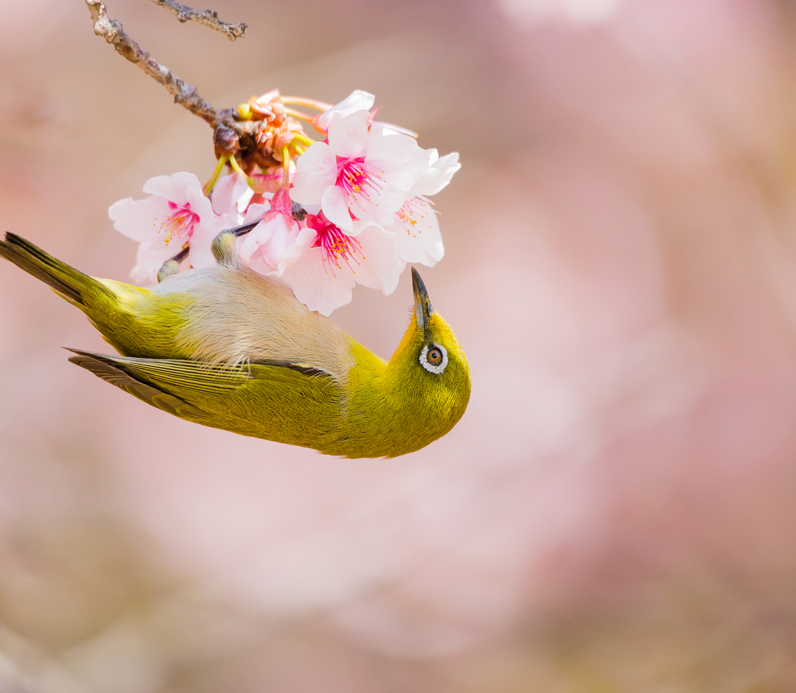
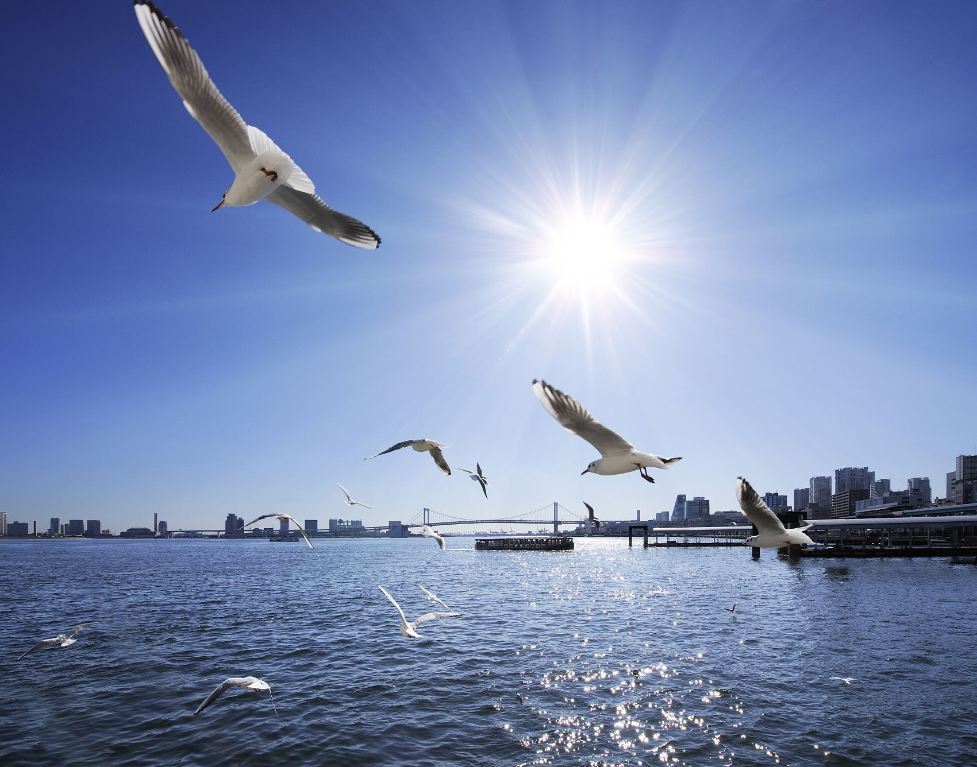
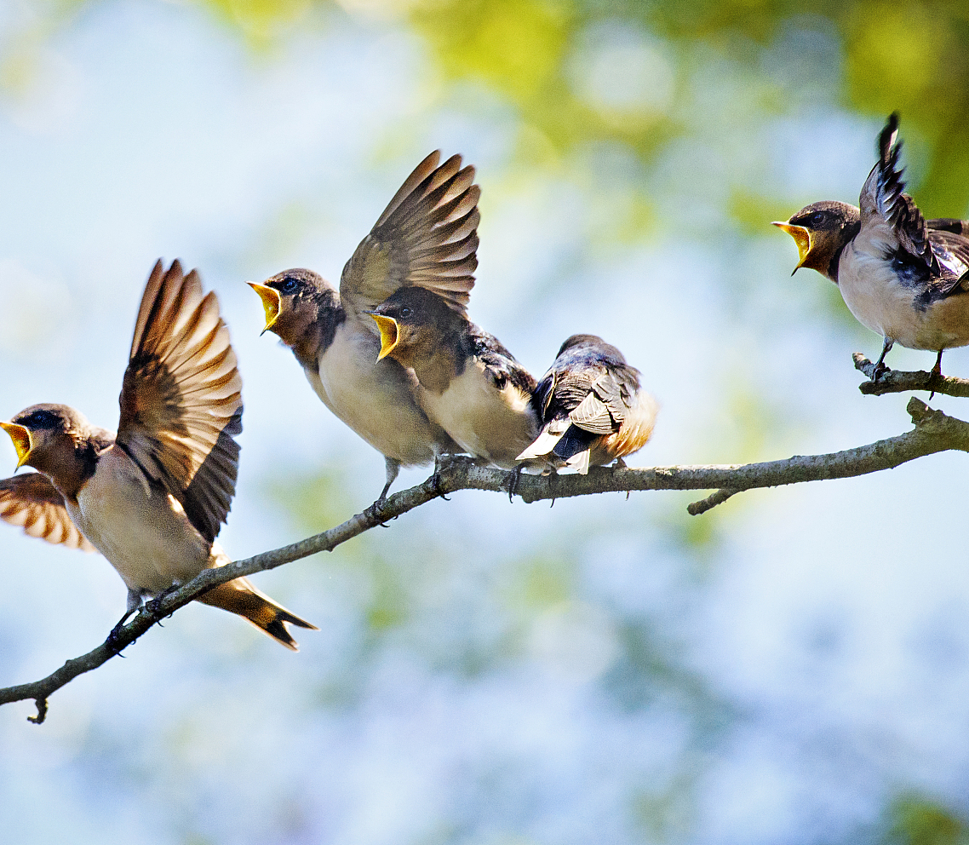
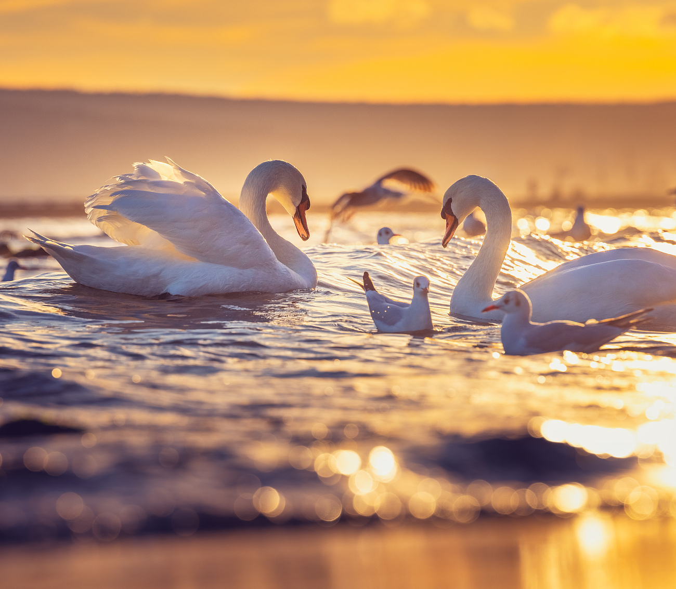
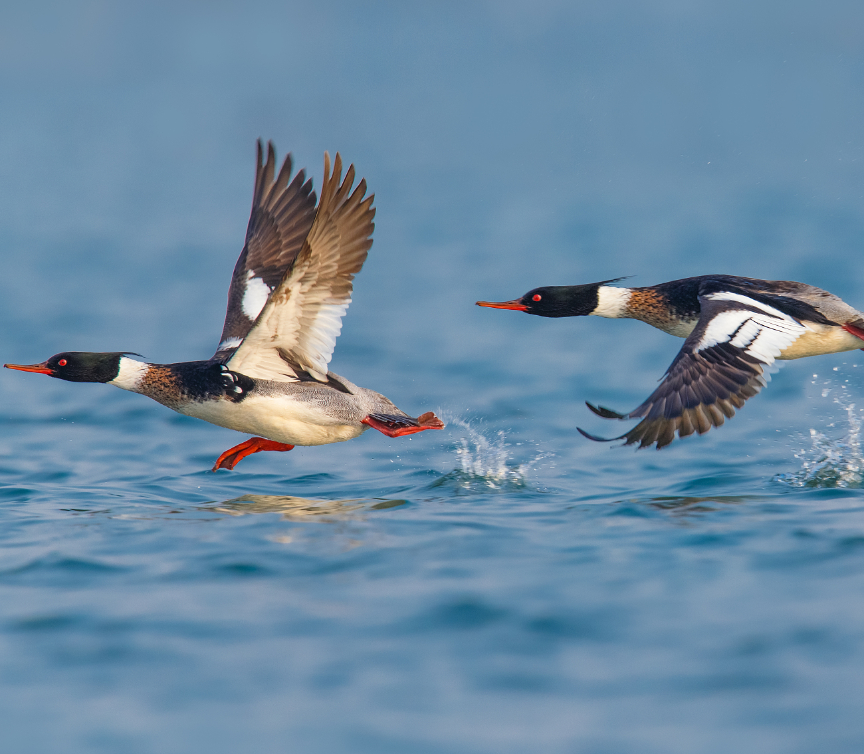
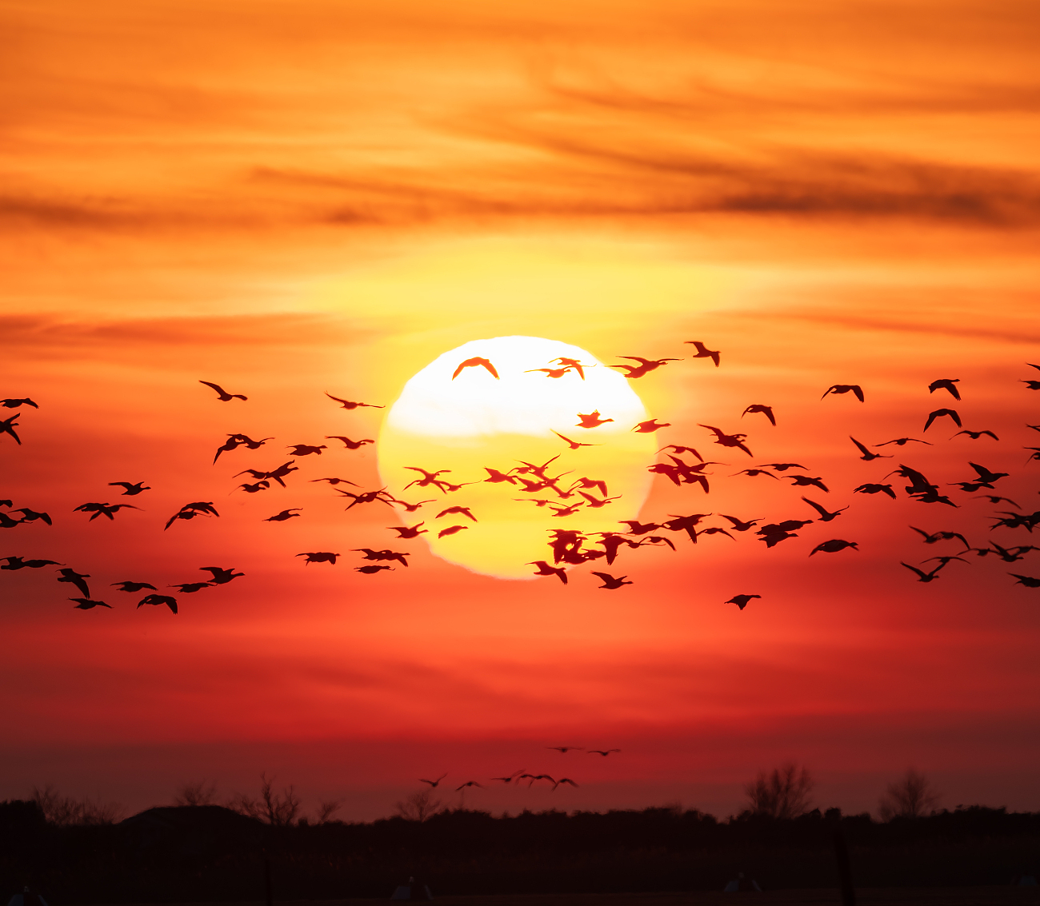
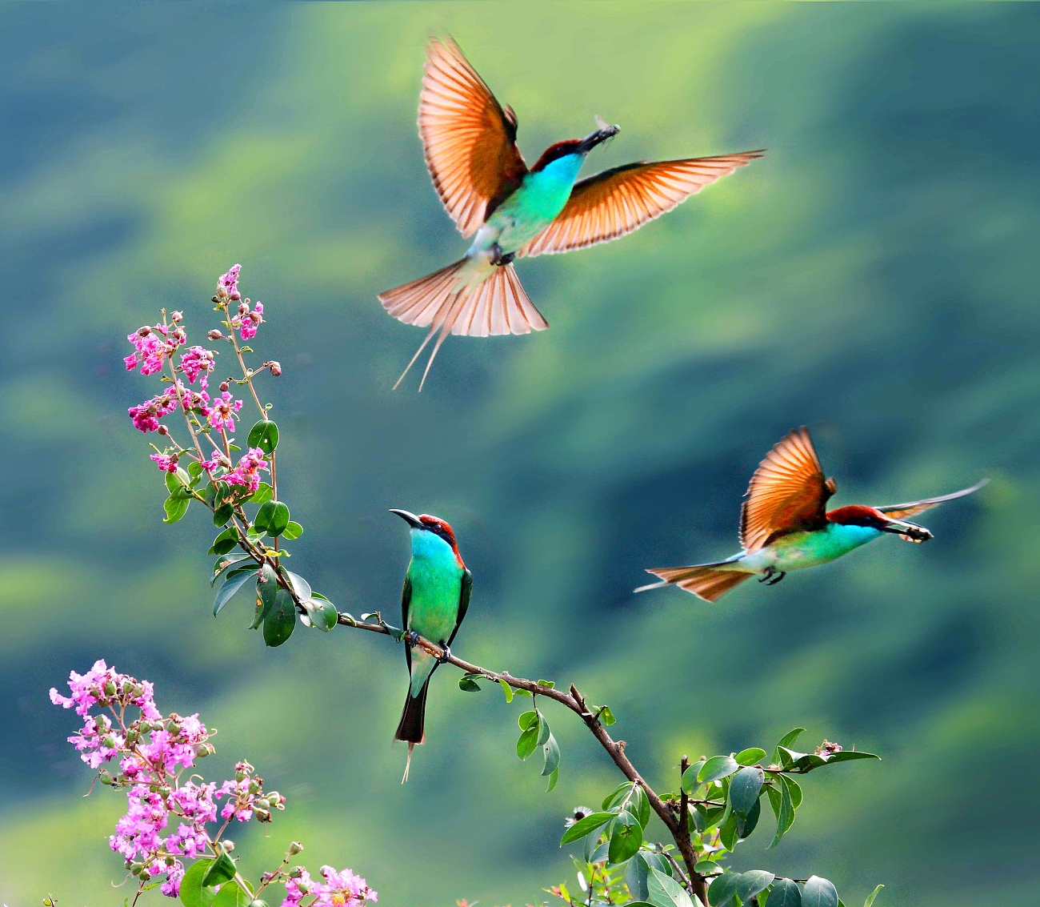
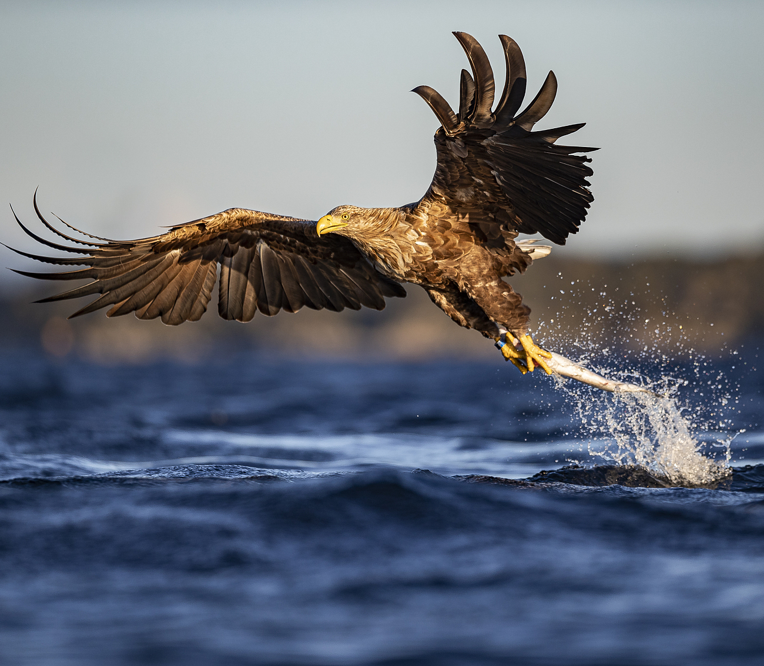
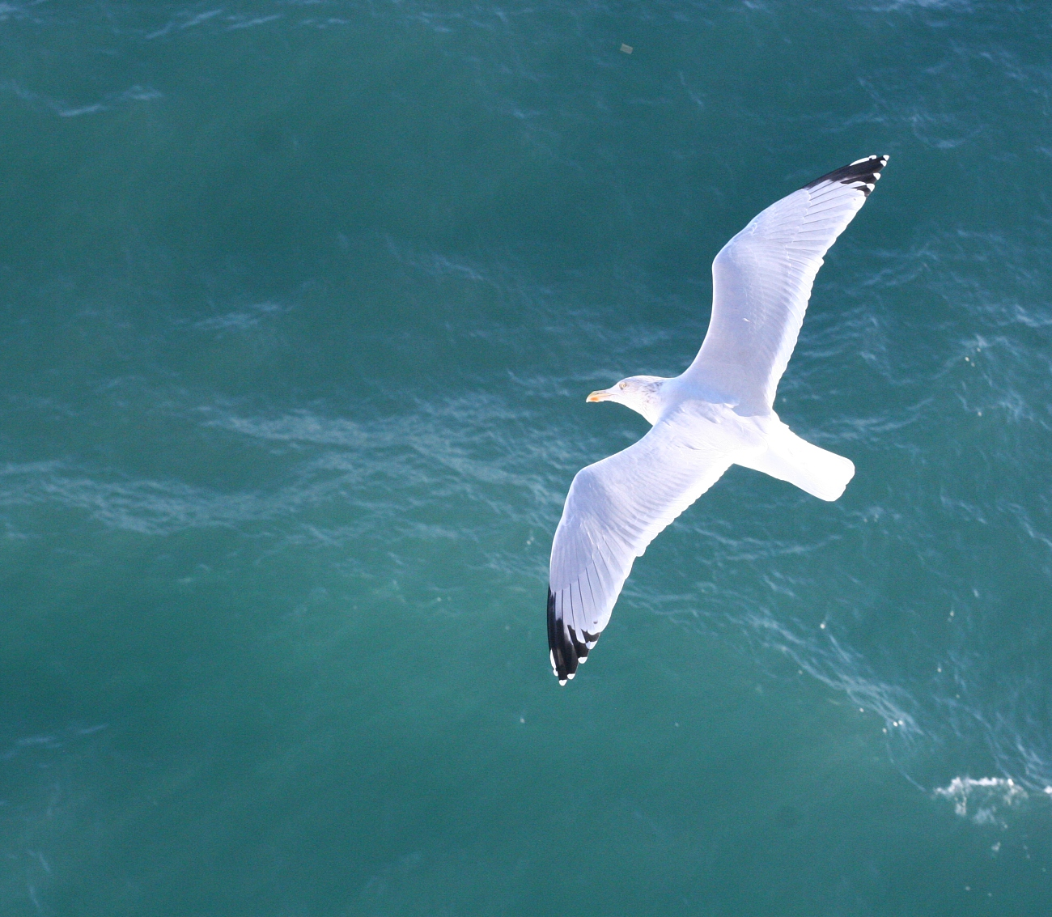
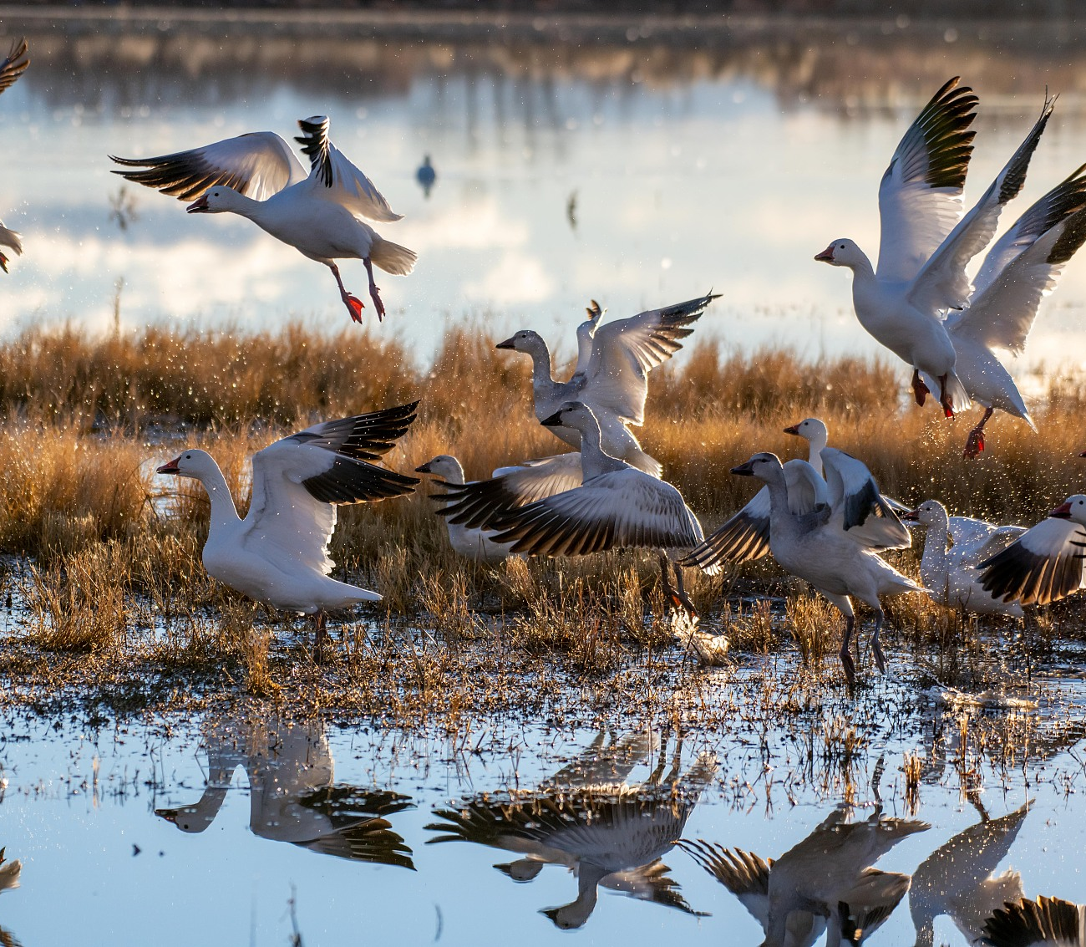
How do birds feel in the nature reserves?
happy
free
relaxed
peaceful
/ˈpiːsfl/宁静的

Slide 25
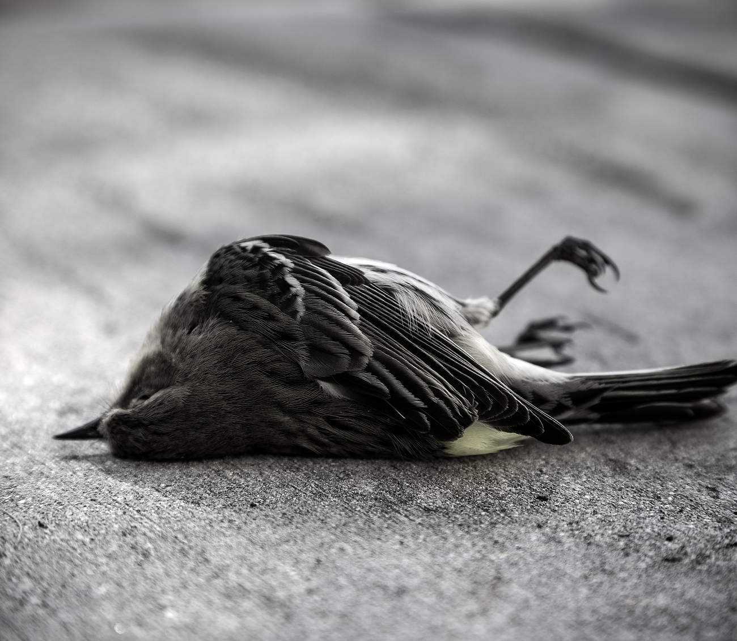
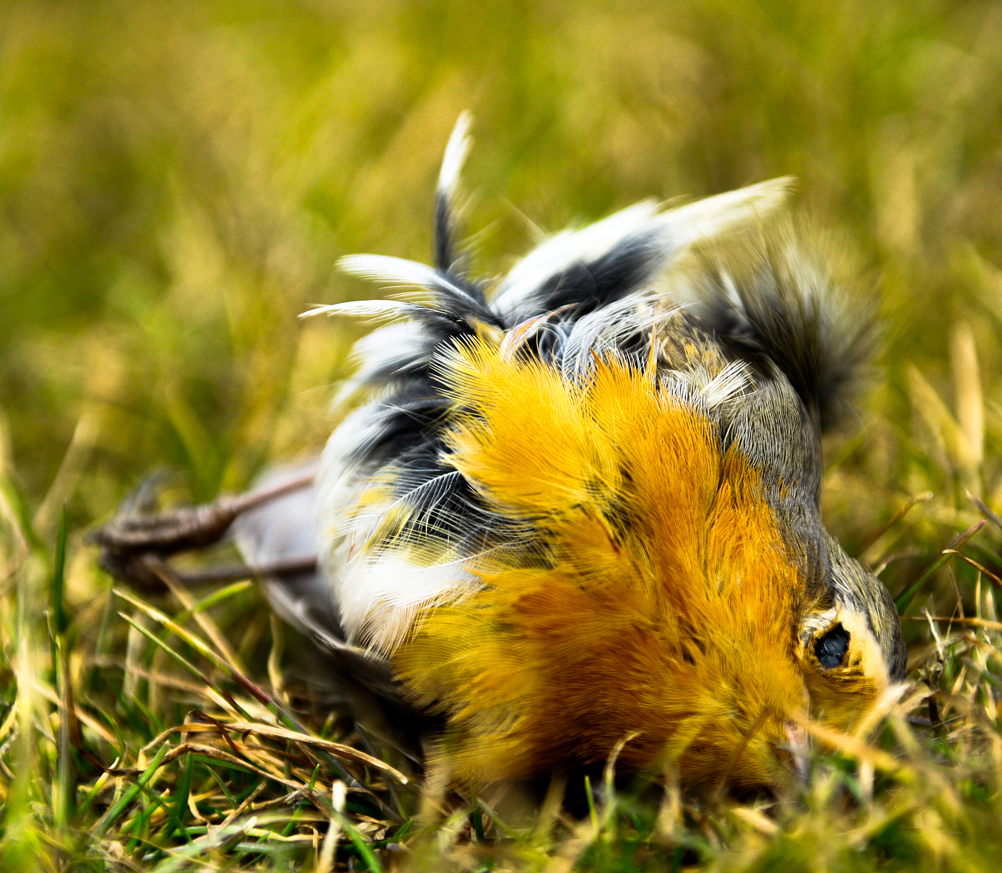
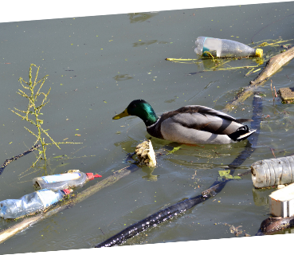
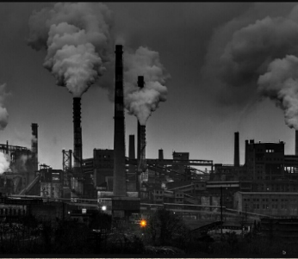
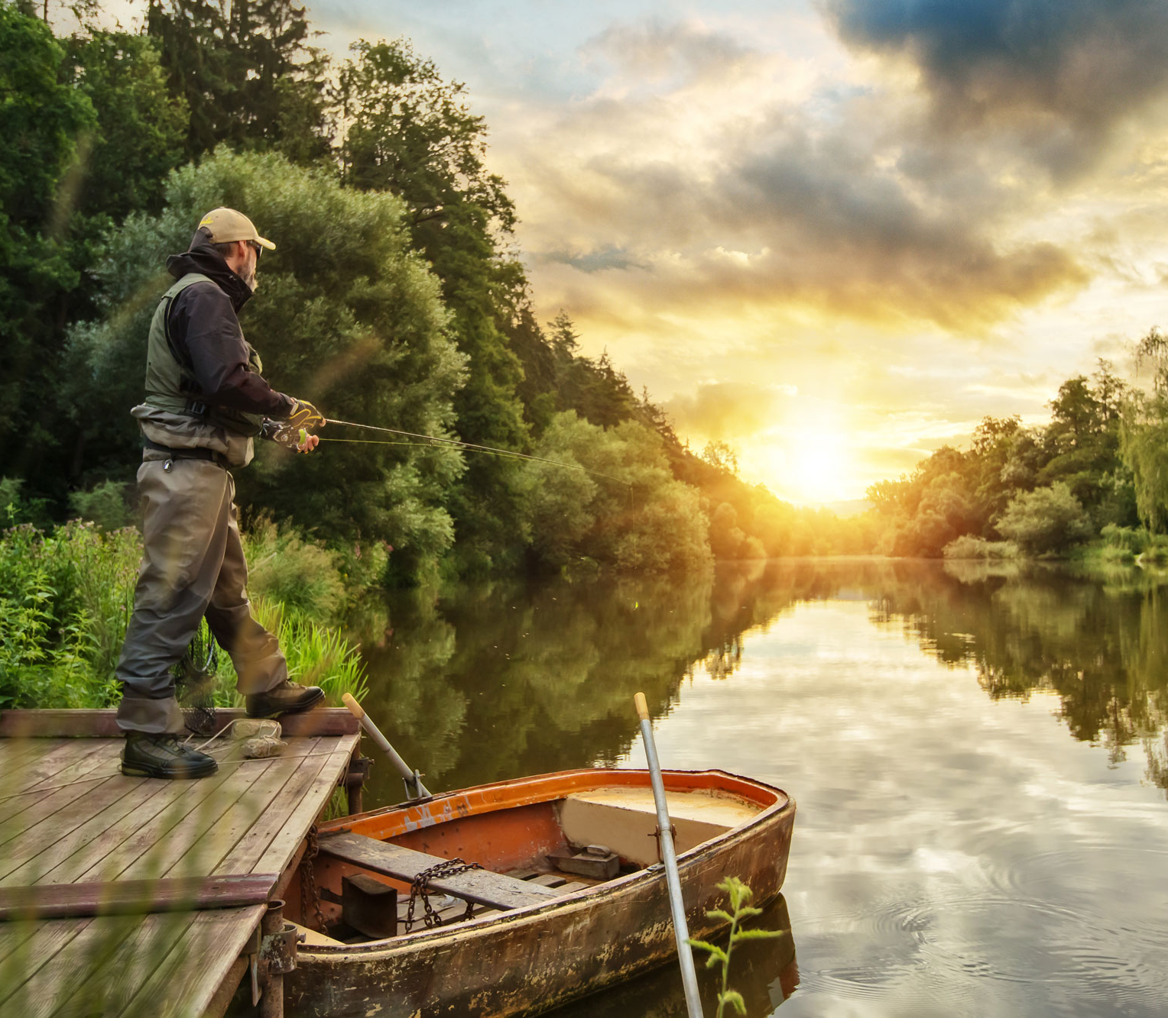
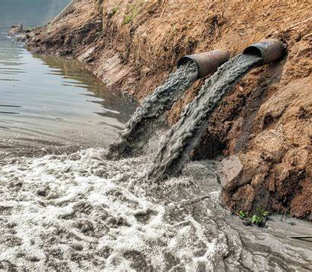
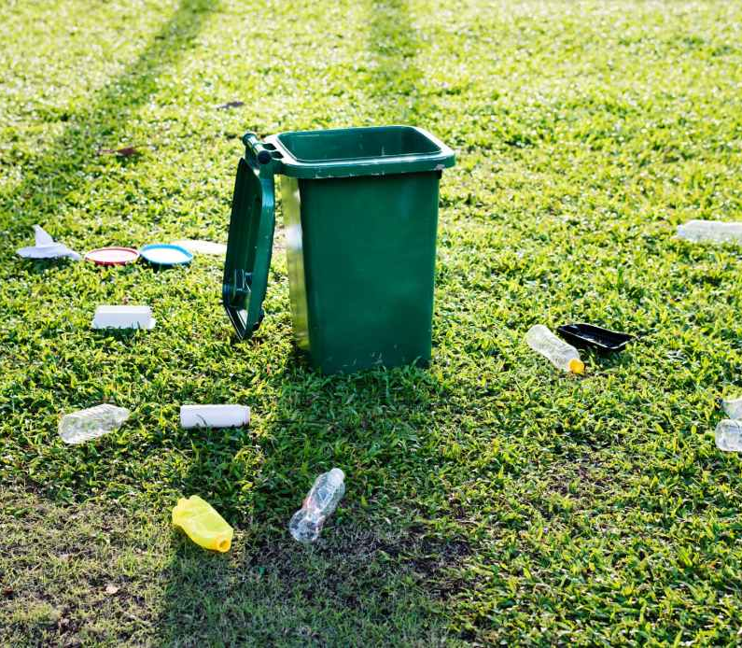
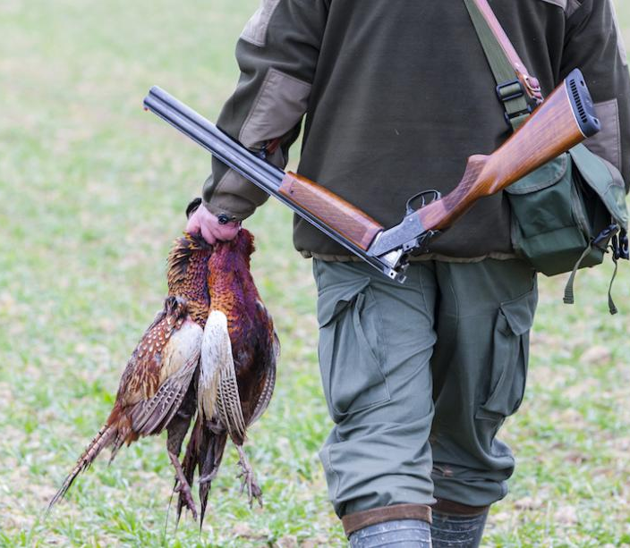
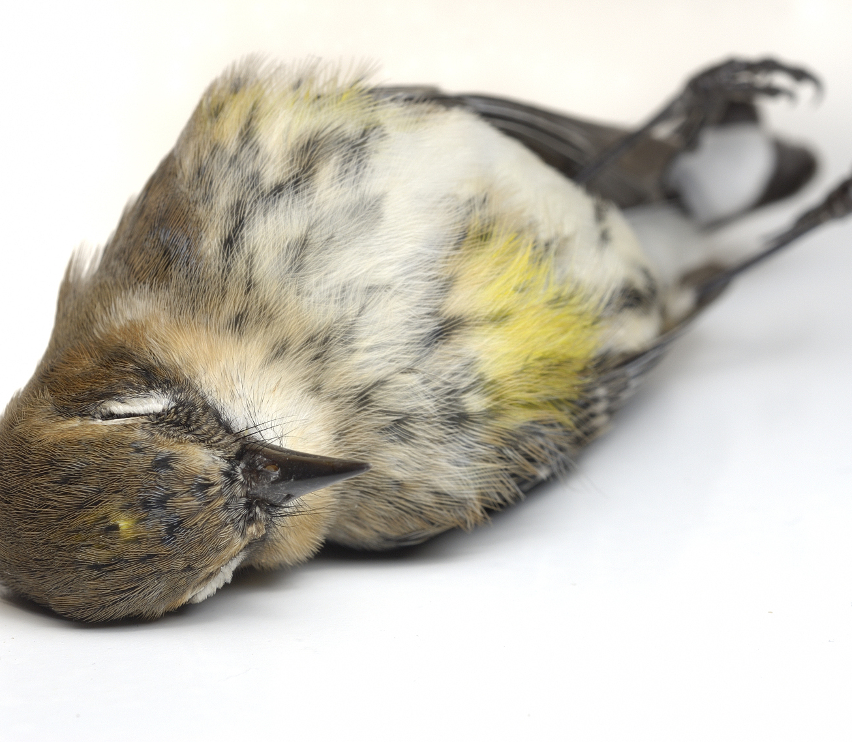
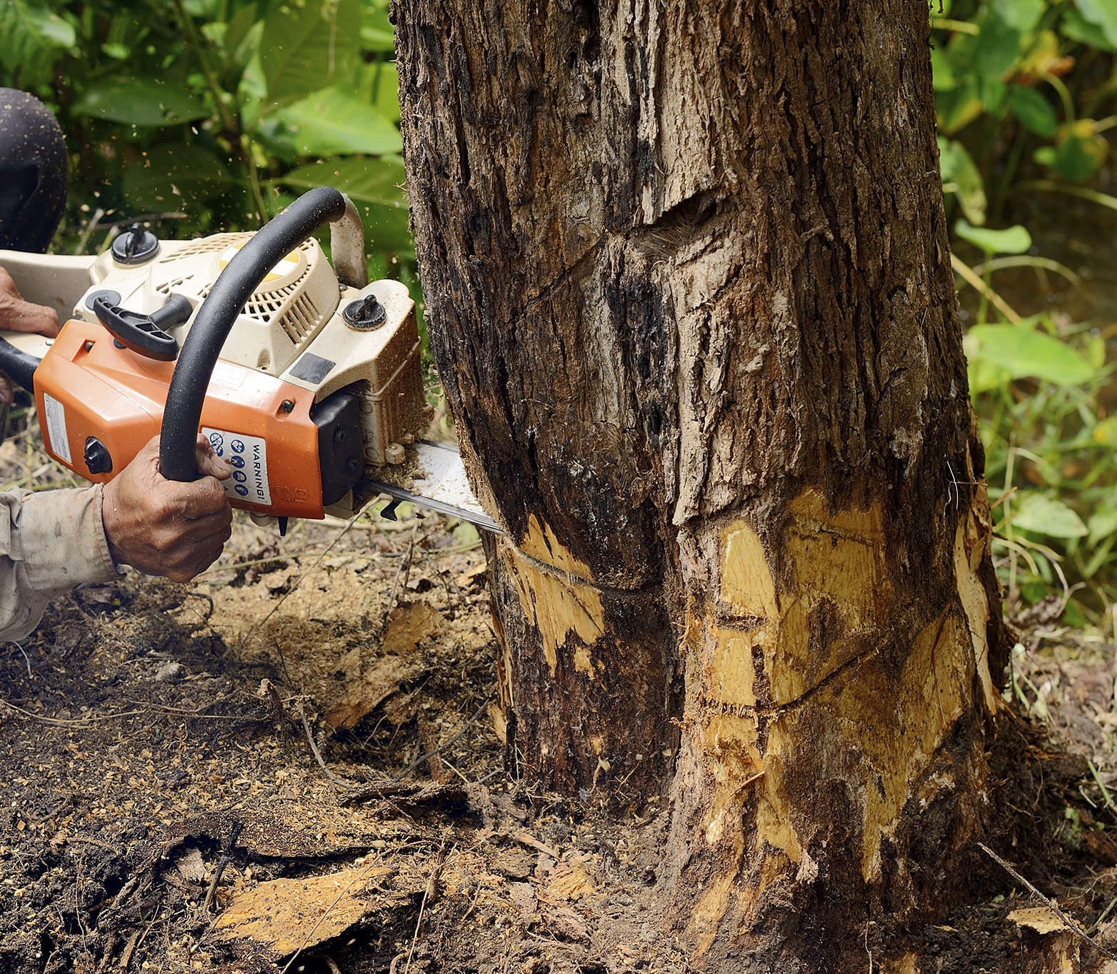
What serious problems do nature reserves face?
What can we do to save nature reserves?
stop hunting/fishing
plant more trees
make laws

Slide 26
Be a birdwatcher
Be a researcher
Be a speaker

Slide 27

Be a birdwatcher
Be a researcher
Be a speaker

Slide 28
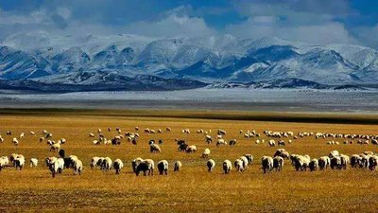
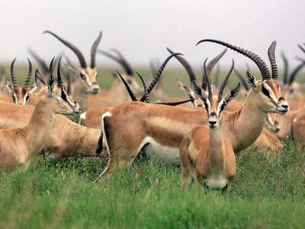
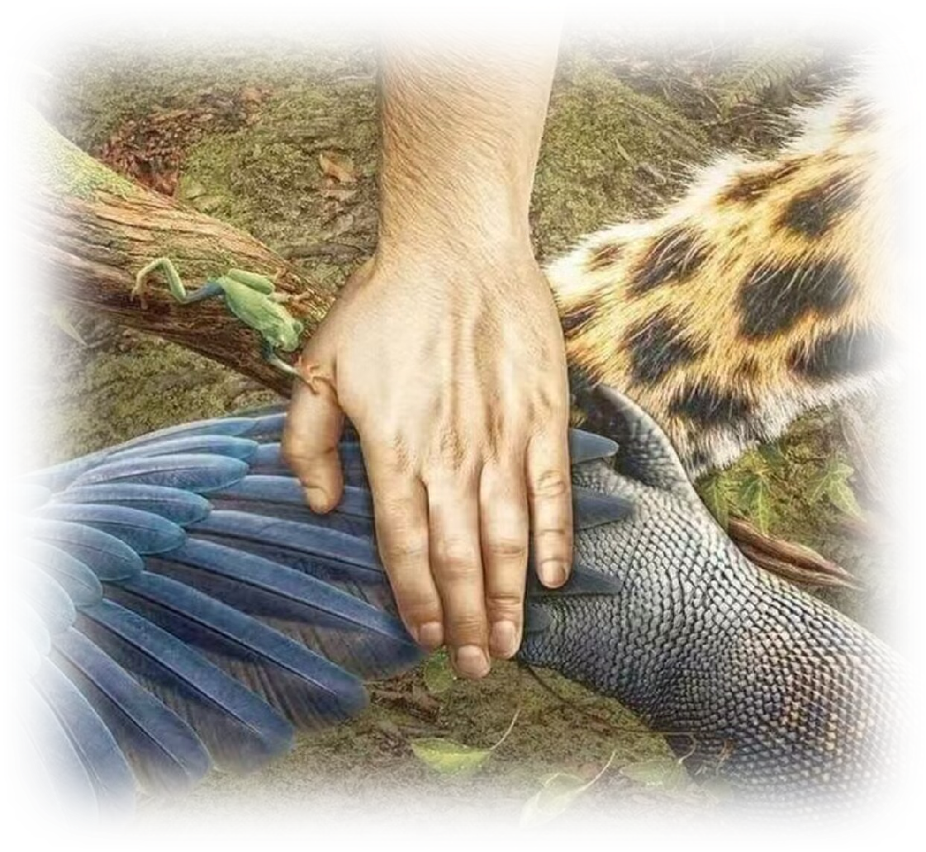
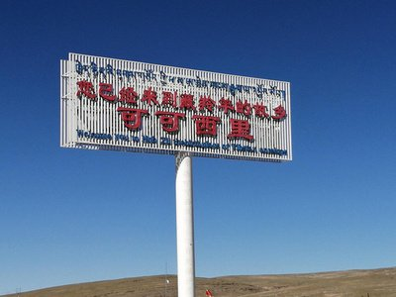
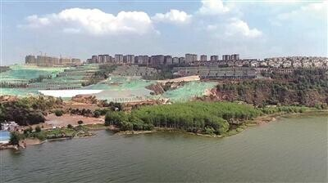
Task 3: Be a speaker——Speaking
Group work:
Discuss in groups of four to introduce Kekexili Nature Reserve.
/tɪˈbetn/ /'æntɪləʊp/
Tibetan antelope
cover an area of 45,000
square kilometres
less living areas
Chinese government
birdwatching society
tourists
less food
provide food and cover for wildlife

Slide 29
Task 3: Be a speaker——Speaking
Group work:
Discuss in groups of four to introduce Kekexili Nature Reserve.
Kekexili Nature Reserve is...
(Place, Land type, Living size)
Kekexili Nature Reserve is very important, because...
Let’s bring something with us. How about...?
Because...What else should we take?
Remember to bring...because...
Wetlands are important to humans. Let’s protect them together!
Student A:
Student B:
Student C:
Student D:
Together:

Slide 30
Be a birdwatcher
Be a researcher
Be a speaker

Slide 31

The final gift!

Slide 32

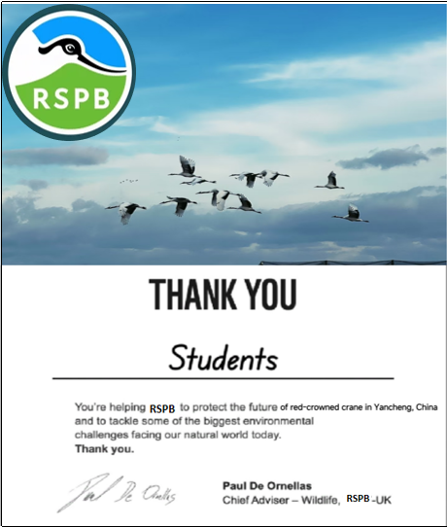
The final gift!

Slide 33
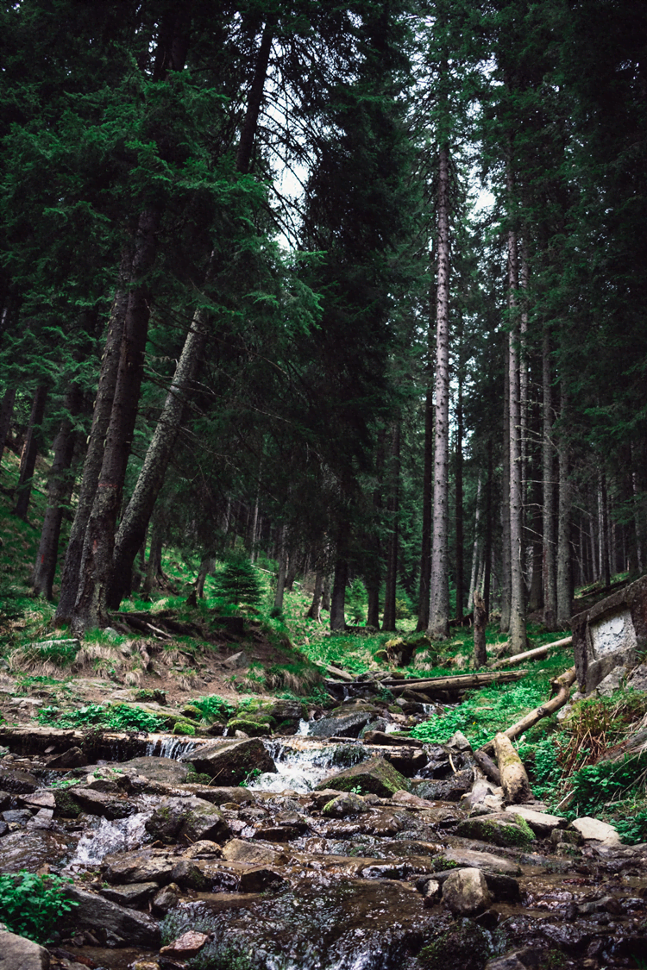
Learn to be a good birdwatcher !
Offer more help as a careful researcher.
Volunteer to speak for nature reserves
as a speaker!
Enjoy ourselves with nature reserves!

Slide 34


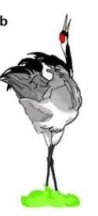



Let’s live together with love!
To speak
To research
To watch
英国皇家鸟类协会

Slide 35

Homework
You must
Finish your speech after class(50-80words): Kekexili Nature Reserve.
You can choose to
Search more informatiom about RSPB to learn more about bird protection.

