Slide 1
Unit 1 Task
My best friend

Slide 2
Review New Words
She has a s______ face.
quare

Slide 3
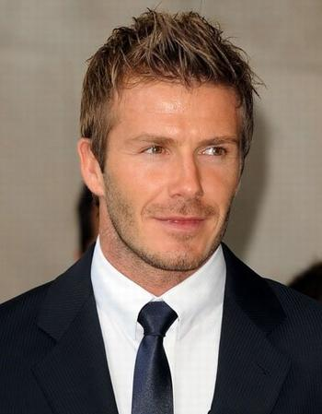
Review New Words
He looks h_________.
andsome

Slide 4
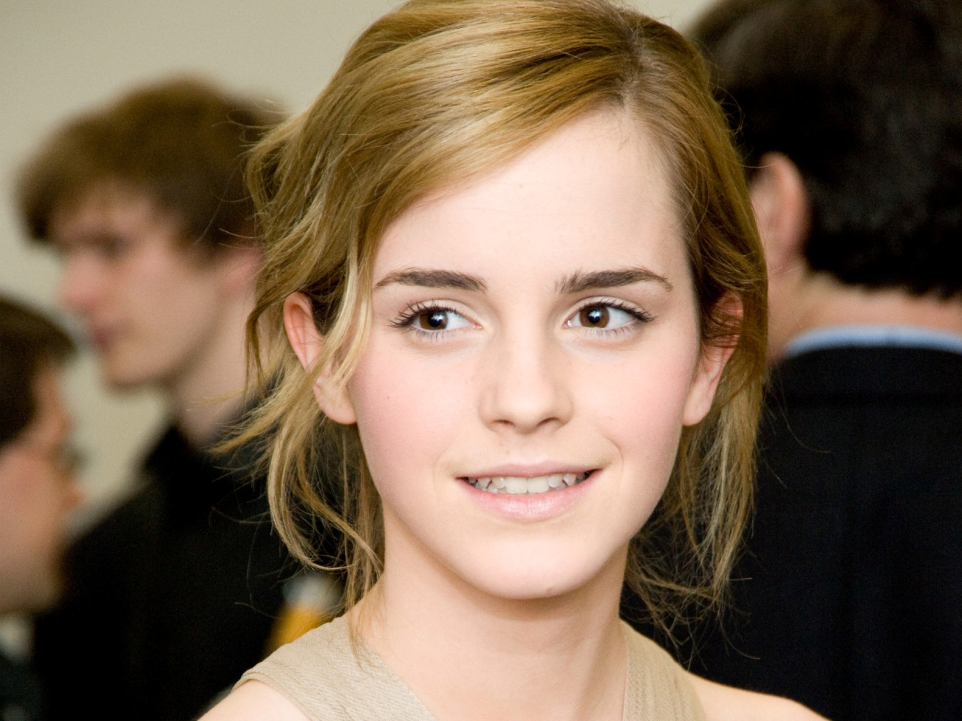
Review New Words
She always has a s______ on her face.
mile

Slide 5
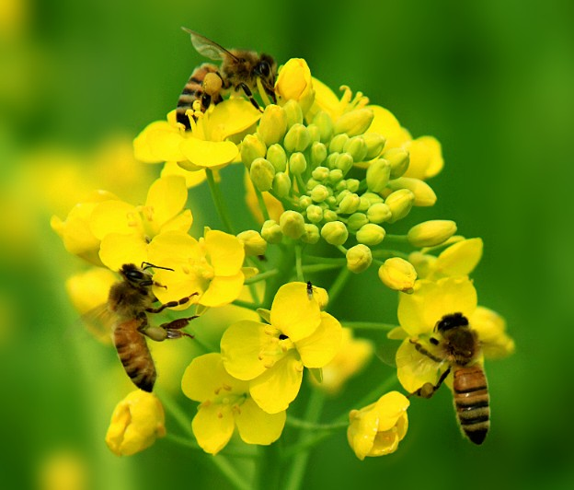
Review New Words
They are h___________.
ard-working

Slide 6
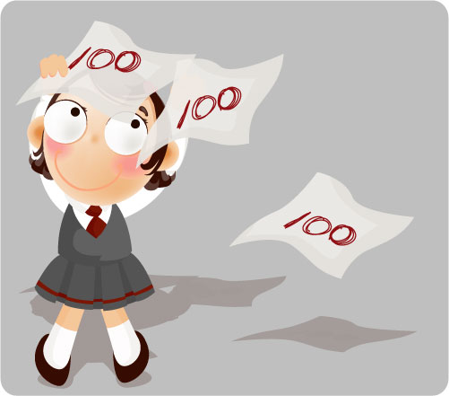
Review New Words
xcellent
All her lessons are e________.
excellent = very good
杰出的,极好的

Slide 7
Talk about your best friends with your partners by asking and answering some questions.
e.g. Who is your best friend?
My best friend is …
What’s he/she like?
He/She is …
What is his/her future plan?
He/She wants to…

Slide 8
What can we talk about when we talk about our friends?
Looks, personality, hobbies, future plans …

Slide 9
Task1:Look and learn
words about people’s looks
long, round, square, small
Face
Eyes
Nose
Hair
Looks
Personality
big, small,round,bright,smiling
big,small,long,short,straight
black,dark brown,long, short,straight
beautiful,pretty,good-looking, handsome,
lovely,cute,short,tall,fat,slim,smart,strong
clever,smart,polite,friendly,kind,
generous,hard-working,helpful,honest,
humorous,patient

Slide 10
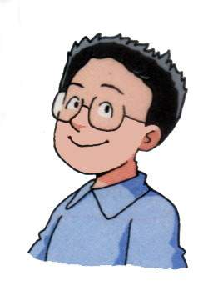
My best friend
Daniel is going to take part in the writing competition.

Slide 11
Task2:Listen and judge
1. Kate is Daniel’s friend.
2.kate first met Daniel five years ago.
3.Kate is tall and fat, she has a round face.
4.She is a friendly girl.
5.She wants to be a policewoman when she grows up.
( T )
( T )
slim
( F )
( T )
teacher
( F )

Slide 12
Task3: Read and complete
Face:
Eyes :
Nose:
Hair:
General appearance:
Personality:
Future plans:
a round face
bright smiling eyes
a small nose
long hair
tall, slim
friendly, helpful and patient
would like to be a teacher

Slide 13
The structure of the article.

Slide 14
Kate is both my neighbour and my best friend. I first met her five years ago.
(Part 1: say who your best friend is.)

Slide 15
Kate is tall and slim. She has long hair. She has a round face and a small nose. I like her bright, smiling eyes. They make her look really pretty and kind.
Kate is a friendly girl. She always has smile on her face and looks happy. she likes to help people. She helps me with my homework and she is patient. When I feel bored or unhappy, I often go to her. He will talk to me and tell me interesting things.
(Part 2: Describe her looks, personality, )

Slide 16
Kate wants to work with children. She would like to be a teacher when she grows up. I think she will make an excellent teacher.
(Part 3:say something about her plan)

Slide 17
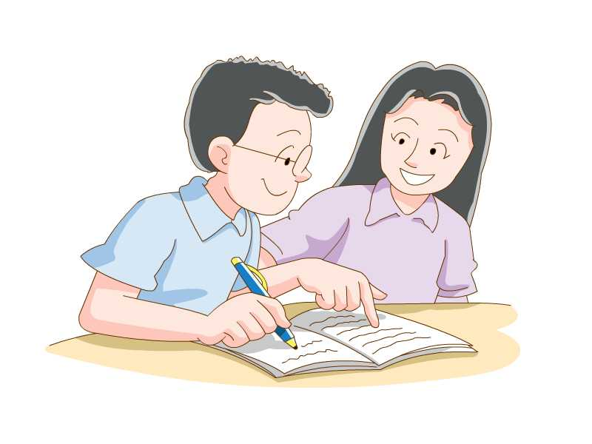
Read and conclude:
Structure
Daniel’s best friend
Kate is both my neighbor and my best friend.
I first met her five years ago.
Kate is tall and slim. She has long hair. She
has a round face and a small nose. I like her
bright, smiling eyes .They make her look really
pretty and kind .
Kate is a friendly girl. She always has a smile on her face and looks happy. She likes to help people. She helps me with my homework and is very patient. When I feel bored or unhappy, I often go to her. She will talk to me and tell me interesting things.
Kate wants to work with children. She would like to be a teacher when she grows up. I think she will make an excellent teacher.
Introduction
Kate’s looks
Main body
Kate’s personality
Kate’s future plans
Conclusion

Slide 18
Exercise
用所给词的适当形式填空：
1. Pan Changjiang is a very _________ (humour) person.
2. I’m the ______ (shy) student in our class.
3. She thinks she is a little ______ (fat) than last year.
humorous
shiest
fatter

Slide 19
4. He is a boy with ________ (smile) eyes.
5. I watched an _________ (excite) football match last night.
6. He is a p _________ man and
always explain(解释)things to me.
7. Yangzhou is one of _________
(popular)cities in China.
smiling
exciting
atient
the most popular

Slide 20
Read and recite the passage:
Kate 既是我的邻居又是我的好朋友. I第一次遇见她five years ago.
Kate is高而苗条. She 留着长发. She 圆脸and 小鼻子. I喜欢她明亮微笑的眼睛.They 使她看起来真的漂亮又和善.

Slide 21
Kate is一个友好的女孩. She always面带微笑and看起来开心. She喜欢帮助人. She always帮我家作and she 很耐心. When I 感到疲劳或不开心，I 常去找她. She 和我谈心and 给我讲有趣的事.
Kate 喜欢和孩子们一起工作. She想要当一名老师when she长大. I 相信she将是一名优秀的老师.

Slide 22
1.既是……又是……
2.有一个圆脸
3.明亮微笑的眼睛
4.面带笑脸
5.使她看起来
真的很漂亮和善良
6.成为一名杰出的老师
7.和某人工作
8.深棕色
both ……and……
has a round face
bright smiling eyes
has a smile on her face
make her look really
pretty and kind
make an excellent teacher
work with sb
dark brown

Slide 23
Exercise
假设你有一位叫海伦的好朋友。请根据以下信息以My best friend 为题，用英语写一篇介绍她的短文。
要点：1.方脸，明亮而笑眯眯的眼睛，短而黑的头发，漂亮的女孩。
2.诚实，与人为善，助人为乐，愿意与别人分享东西；
3.朋友多，学习刻苦；
4.各门功课都很好，是班上最好的学生之一；
5.她喜欢…,长大后想…
要求：1.短文应包括要点中所给信息，可做适当的发挥；
2. 行文连贯，书写规范；
3. 词数80个左右

Slide 24
My best friend
Helen is my best friend .She has a square face and bright and smiling eyes.She is a pretty girl with short and black hair.She is honest,kind and helpful.She is willing to share things with others.She has many friends and works very hard.She is good at all her subjects .She is one of the best students in her class.She likes singing and She would like to be a singer when she grows up.

Slide 25
Thank You!

