Slide 1
B1U4 Integrated Skills
Expressing your opinion about plastic surgery
By Wu Yeyun
Changzhou Wujin Luoyang Senior High School

Slide 2
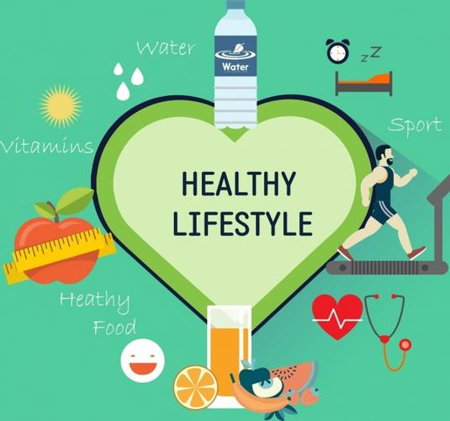
Warm-up
Questions:
Are you satisfied with your look?
What are you going to do to improve your look?
Have you thought about changing your face or body shape through operation?

Slide 3
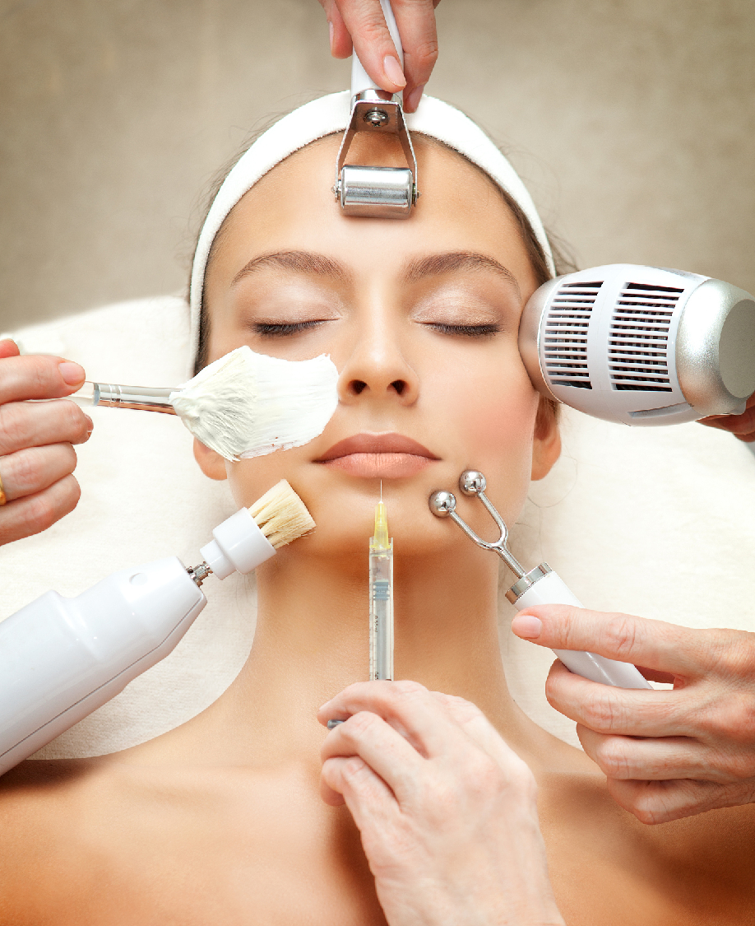
Lead-in
What do you know about plastic surgery?
the medical practice of changing the appearance of people’s faces or bodies, either to improve their appearance or to repair injuries
(From Longman Dictionary of Contemporary English)
Do you support or oppose plastic surgery?

Slide 4
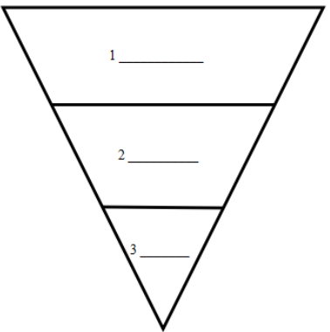
Be an insightful reader
What was the plastic surgery for?
Was it successful or not?
Plastic surgery helps man with burn marks
A man received plastic surgery at King’s Hospital last month to treat
burn marks he got one year ago.
“inverted pyramid” structure
Lead
Woman regrets plastic surgery
A woman who has recently had plastic surgery on her face now regrets the decision.
Body
Tail

Slide 5
Plastic surgery helps man with burn marks
1. What happened to John Wilson?
caught in a horrible campus fire
skin badly hurt
terrible burn marks
2. Why did John Wilson have the surgery?
to repair some of his burnt skin
to get rid of the terrible burn marks
to feel more confident about his appearance
3. Was he satisfied with the outcome?
very happy with the treatment
especially pleased with the face
can go out just like a normal guy

Slide 6
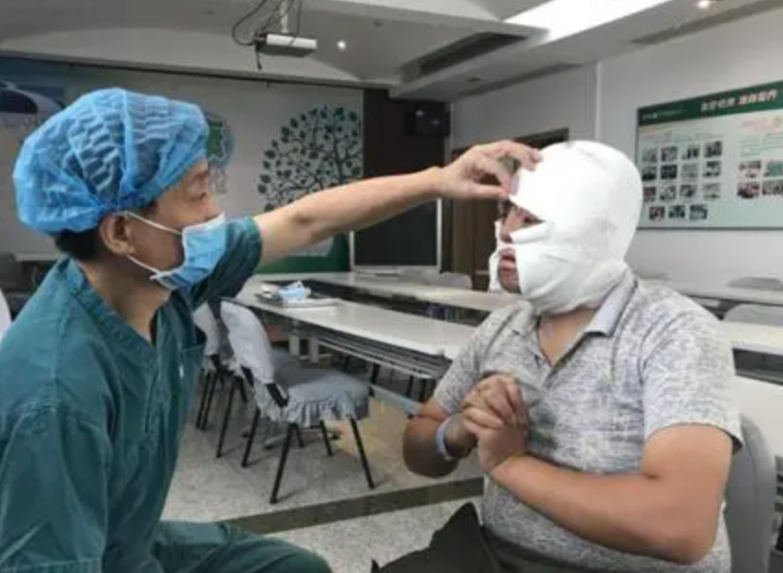
Summarize the case of John Wilson
With the help of plastic surgery, a man
With the help of plastic surgery, a man who was badly burnt in a campus fire successfully had some of his burnt skin repaired and terrible burn marks removed. He felt more confident about his appearance and could live a normal life again.
Have you changed your mind about plastic surgery?

Slide 7
Woman regrets plastic surgery
1. Why did Ella Edwards have the plastic surgery?
to become more beautiful
2. What problems did she suffer because of the surgery?
daily pain
couldn’t live a normal life
look unnatural (far from her expectation)
unable to make certain facial expressions
3. Was she satisfied with the result?
unhappy, anxious

Slide 8
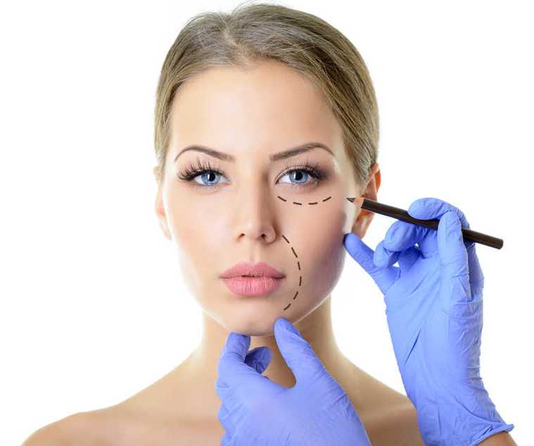
Summarize the case of Ella Edwards
Because of an unsuccessful plastic surgery, a woman
Because of an unsuccessful plastic surgery, a woman who wanted to be more beautiful ended up looking unnatural and unable to make certain facial expressions. She suffered from daily pain and might need to take painkillers for a long time. The result made her very anxious.
Have you changed your mind about plastic surgery?

Slide 9
Be a careful listener
Complete the news report about the plastic surgery industry
Results of recent research on plastic surgery
Every year,(1) of people decide to have plastic surgery to change their looks.
About(2) of all patients are men.
The average age of patients is(3) .
Experts believe the industry will(4) in the future.
Advantages of plastic surgery
It is the easiest way to help people improve their(5) .
It helps people(6) .
millions
one third
falling
continue to grow
appearance
build their self-confidence

Slide 10
Disadvantages of plastic surgery
It is very(7) .
It carries serious(8) . Patients may
(9) after failed plastic surgery operations or even die during operations.
The results of plastic surgery might be different from what people expect. This is especially true for(10) .
Advice on plastic surgery
Doctors advise against it for people(11) unless it is necessary.
Remember:(12) before you act.
expensive
health risks
suffer health problems
teenagers
under 18
think

Slide 11
What more do you know about plastic surgery after listening to the news report?
The plastic surgery industry is very popular now and will grow in the future.
More women have plastic surgery than men.
More and more young people have plastic surgery.
Plastic surgery have both advantages and disadvantages.
It is not advisable for teenagers.

Slide 12
Are you for or against plastic surgery?
Be a persuasive speaker
PRE structure
In general/On the whole, I think/believe/feel plastic surgery good.
t
Point
improve people’s appearance
build self-confidence
...
I know a person who...
Experts say...
Reasons
Experiences/Evidence
To be honest, I’m against plastic surgery
Expensive
Carry health risks
Results far from expectation
...
I read in a newspaper/ on the internet that...
Research shows...

Slide 13
Materials for reference

Slide 14
Be a critical thinker
News story 1: “Now I can go out just like a normal guy!”
How do you feel about being normal? What attitudes shall we hold towards our normal life?
News story 2: “I wanted to become more beautiful, but it hasn’t turned out well at all.”
What is the standard of being beautiful?

Slide 15
beautiful?
boring?

Slide 16
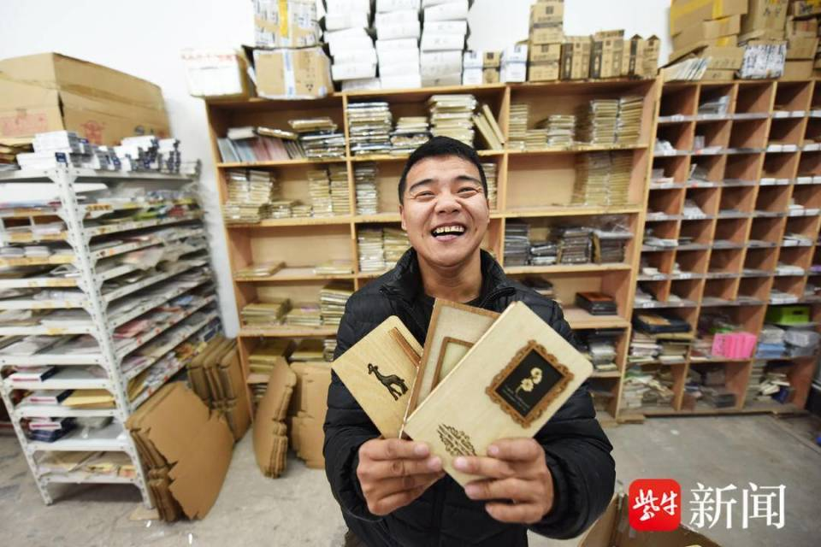
outer beauty?
inner beauty?

Slide 17
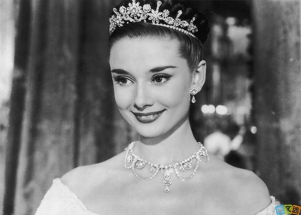
Appreciating
Beauty is being the best possible version of yourself on the inside and out.
—Audrey Hepburn

Slide 18
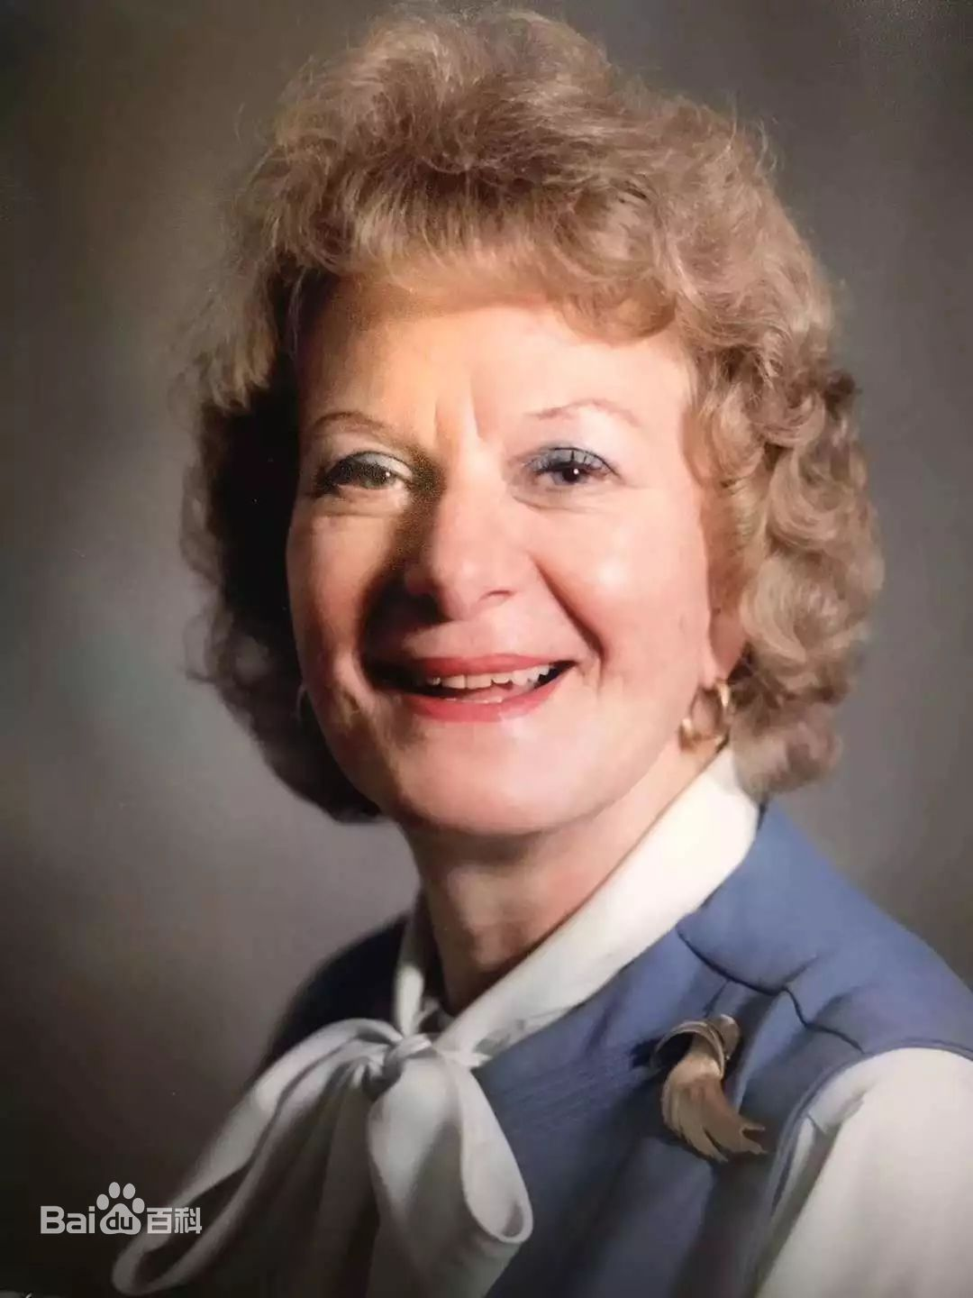
I Am Me (excerpt) Poem by Virginia Satir, world-famous psychologist
In all the world, there is no one else exactly like me,
Everything that comes out of me is authentically me,
Because I alone chose it--I own everything about me,
My body, my feelings, my mouth, my voice, all my actions.
......

Slide 19
Homework
Write an argument essay
假如你是李华，你们学校正在举行一次有关整形话题的征文。请你以 “My Views on Plastic Surgery”为题写一篇文章投稿。
内容包括：
你对整容的看法，支持还是反对；
给出支持或反对的理由，并适当添加个人经历或其它依据进行佐证。
注意词数：80词左右

Slide 20
Thanks for listening

