Slide 1
Unit 2 Be sporty, be healthy
Extended reading
Finding a balance: my tai chi experience
Presenter: Bian Xiaoyan
Jan.5, 2024

Slide 2
Lead-in
What’s your impression on tai chi?

Slide 3
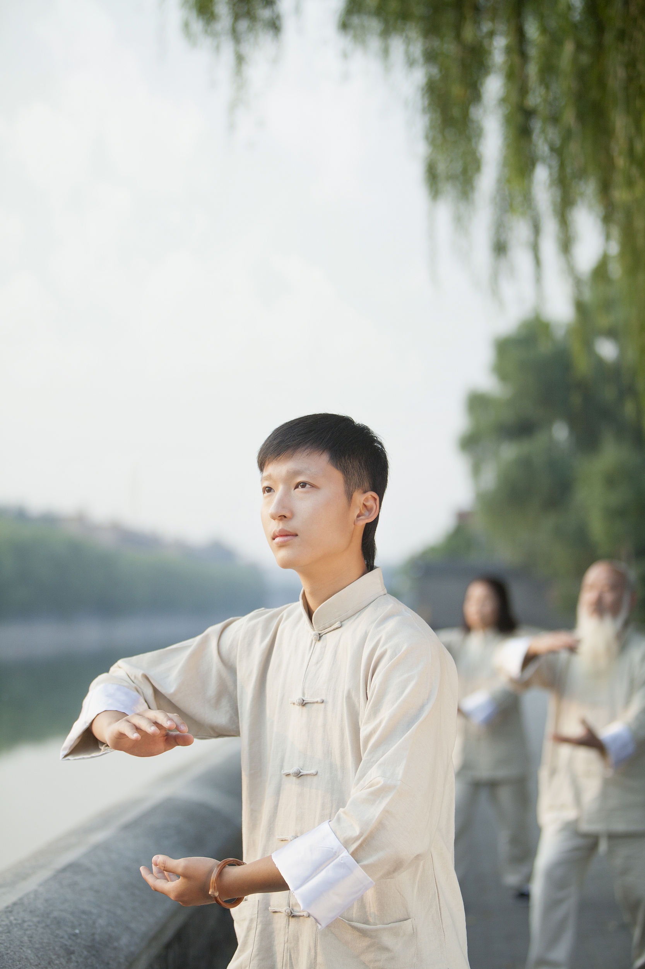
Make predictions
?
From the title and pictures, what will be talked about in the text?

Slide 4
Make predictions
?
How does the author find a balance in his tai chi experience?

Slide 5
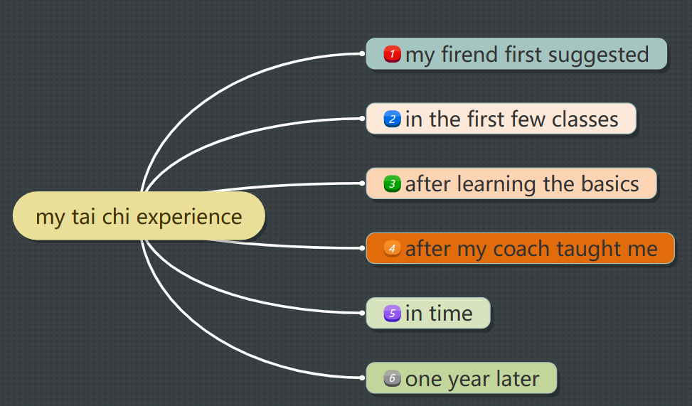
Read for understanding
How does the author develop the text?
A. In the time order B. In the space order

Slide 6
Read for understanding
What’s the structure of the text?
A
1
B
1
2
3
4
2
3
4
5
5
D
C
1
1
4
3
4
5
3
2
2
5

Slide 7
Read for understanding
Find out the main idea of each part.
_____________________ to the author’s experience of learning tai chi
General introduction
Part 1 ______
Part 2
________
Part 3 ______
(para. 1)
Beginning
History/Origin
Para. 2 ______________of tai chi
_______ about
the tai chi
experience
Details
Para.3 His own ________________________
(paras. 2–4)
learning experience and feelings
Body
Para.4___________ behind tai chi
Culture
(para. 5)
____________ from learning tai chi
Benefits
Ending

Slide 8
Read for understanding
According to the time order, how do the author’s feelings change? Supporting sentences.
my firend suggested
(para.1)
in the first few classes
(para.2)
after learning the basics
(para.3)
after my coach taught me
(para.3)
in time
(para.4)
one year later
(para.5)
time
hesitant
hesitated, I believed it was for old people

Slide 9
Read for understanding
According to the time order, how do the author’s feelings change? Supporting sentences. Why?
in the first few classes
(para.2)
my firend suggested
(para.1)
after learning the basics
(para.3)
after my coach taught me
(para.3)
in time
(para.4)
one year later
(para.5)
time
hesitant
fun and easy
the moves really caught my imaginatinon, with descriptive names:
white crane spreading its wings
golden rooster standing on one leg
origin of tai chi: Zhang Sanfeng
Chen Wangting

Slide 10
Read for understanding
According to the time order, how do the author’s feelings change? Supporting sentences. Why?
after learning
the basics
(para.3)
my firend suggested
(para.1)
in the first few classes
(para.2)
after my coach taught me
(para.3)
in time
(para.4)
one year later
(para.5)
time
hesitant
fun and
easy
bored &aching
bored and aching from doing the same moves again and again

Slide 11
Read for understanding
According to the time order, how do the author’s feelings change? Supporting sentences. Why?
after my coach taught me
(para.3)
my firend suggested
(para.1)
in the first few classes
(para.2)
after learning
the basics
(para.3)
in time
(para.4)
one year later
(para.5)
time
hesitant
fun and
easy
bored &aching
satisfied
I found to my satisfactiton that my balance and flexibility improved; my love for tai chi returned stronger than ever.

Slide 12
Read for understanding
Read for understanding
According to the time order, how do the author’s feelings change? Supporting sentences. Why?
one year later
(para.5)
my firend suggested
(para.1)
in the first few classes
(para.2)
after learning
the basics
(para.3)
after my coach taught me
(para.3)
in time
(para.4)
time
hesitant
fun and
easy
bored &aching
satisfied
fond; positive
Tai chi has a positive effect on my everyday life. I will continue to practise tai chi...
benefits
(para.5)

Slide 13
Read for understanding
Read for understanding
What are the benefits of practicing tai chi?
?
mental benefits
physical benefits
feel happier and more confident
sleep better
at night
benefits
(para.5)
relax in mind
feel energetic during the day
stay cool in stressful situations

Slide 14
Read for understanding
in time
(para.4)
my firend suggested
(para.1)
in the first few classes
(para.2)
after learning
the basics
(para.3)
after my coach taught me
(para.3)
one year later
(para.5)
time
hesitant
fun and
easy
bored &aching
satisfied
confident, positive
Benefit
explore/look into the ancient Chinese culture behind tai chi

Slide 15
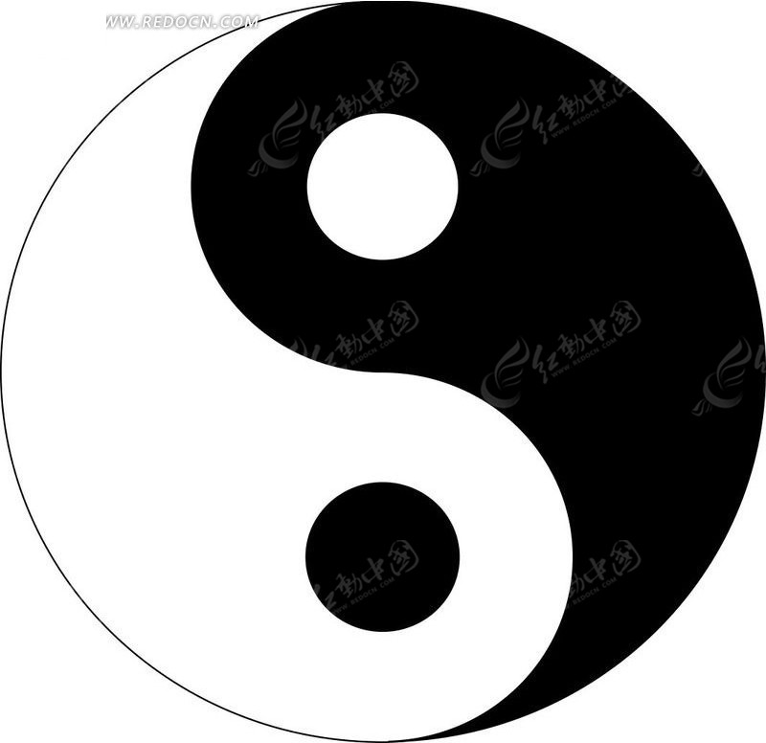
Read for understanding
para.4: What’s the ancient Chinese culture behind tai chi?
Tai chi is deeply rooted in the Chinese philosophy of yin and yang.
What is the relationship between yin and yang?
More examples.
Yin and yang are believed to form the unity of opposites. Neither can exist independent of the other. For example, there is no shadow without light.
More examples: failure & success; boys & girls; male and female; day & night...

Slide 16
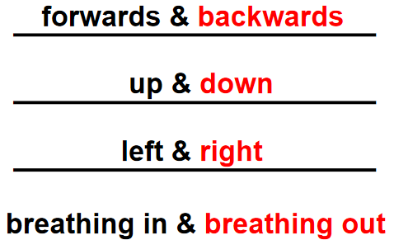
Read for understanding
How does tai chi maintain the balance of yin and yang?
The practice of tai chi aims to maintain the balance of yin and yang in the body through opposite movements.
Tai chi brings about a state of physical balance and mental peace.

Slide 17
Read for thinking
1. What does the balance refer to in the text?
physical
mental
I found that my balance and flexibility slowly improved.
Tai chi brings about a state of physical balance and mental peace. e.g. relax my mind; stay cool in stressful situations

Slide 18
Read for thinking
2. How can we keep a balance in our daily life?
E.g. study and play family and work
Be sporty, be healthy！
Yin and yang form a balanced world.
Live a balanced life = live a healthy life

Slide 19
Read for thinking
Group discussion:
Do you think tai chi will get more popular among teenagers? Why or why not?
I think tai chi will get more popular among teenagers because:
•be good for physical and mental health;
• brings about a state of physical and mental balance;
•broadens horizons and enriches knowledge on the ancient Chinese culture ...
I think tai chi will not get more popular among teenagers because:
• slow pace;
• takes much time;
• not practical ...

Slide 20
Read for writing
假定你是李华，你们学校正在开展各种社团活动。请你给你的朋友Tom写一封邮件，向他介绍太极，并邀请他一起参加太极俱乐部。内容包括：
1. 太极的历史及文化；
2. 练习太极对身心的好处。
注意：1. 词数80左右：
2. 可适当增加细节，以使行文连贯。

Slide 21
Read for writing
Dear Tom,
How’s everything going? I’m writing to ________________________________________.
Tai Chi, which is deeply rooted in _______________, enjoys great popularity. Aiming to _________________________________, it___________ ______________. I’m sure you will develop a great interest in this exercise.
Looking forward to your reply.
Yours,
Li Hua

Slide 22
Read for writing
Dear Tom,
How’s everything going? I’m writing to invite you to attend the Tai Chi Club held by our school.
Tai Chi, which is deeply rooted in the Chinese philosophy of yin and yang, enjoys great popularity. Aiming to maintain the balance in the body through opposite movements, it does good to both physical and mental health, which helps us sleep better, be more energetic and stay cool in stressful situations. I’m sure you will develop a great interest in this exercise.
Looking forward to your reply.
Yours,
Li Hua

Slide 23
Assessment time
5=Excellent 4=Good 3=Satisfactory 2=Fair 1=Improvement needed
How well can you: | Me
understand the author’s tai chi experience?
understand the Chinese culture rooted in tai chi?
understand the relationship of yin and yang?
maintain a balance in your daily life?

Slide 24
________________________________________________________________________________________________________________________________________________________________________________________________________________________________________________________________________________________________________________________________________________________________________
Homework
1.Polish your writing.
2.Learn and practice some tai chi moves.

Slide 25
Thanks!

