Slide 1
Unit 3
The Internet:
a world without frontiers

Slide 2
Lead-in
Presentation

Slide 3
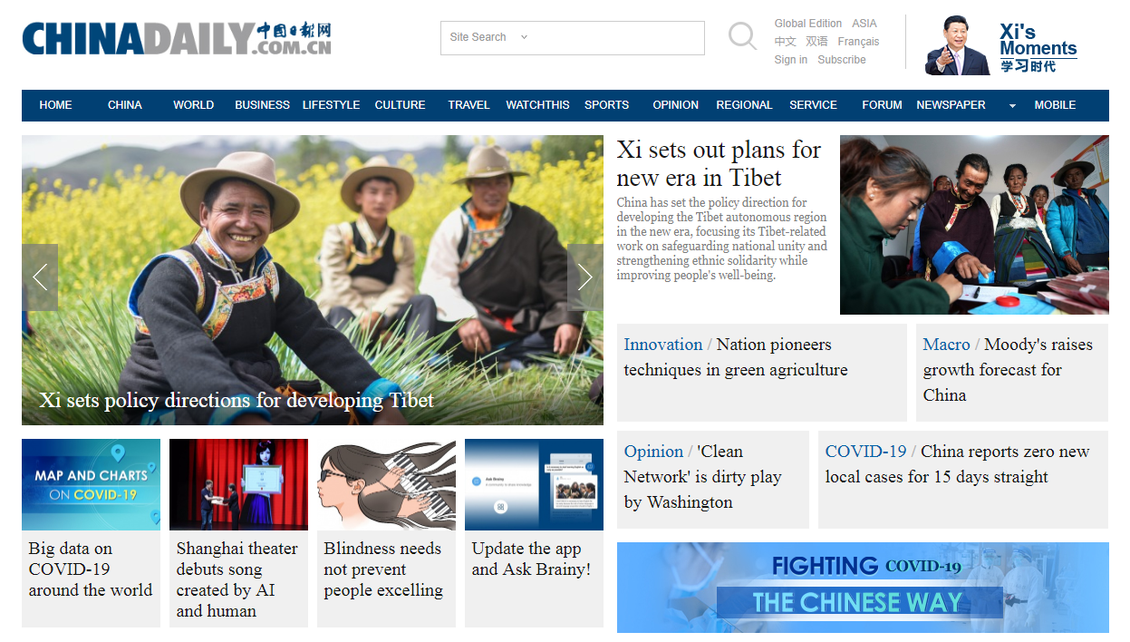
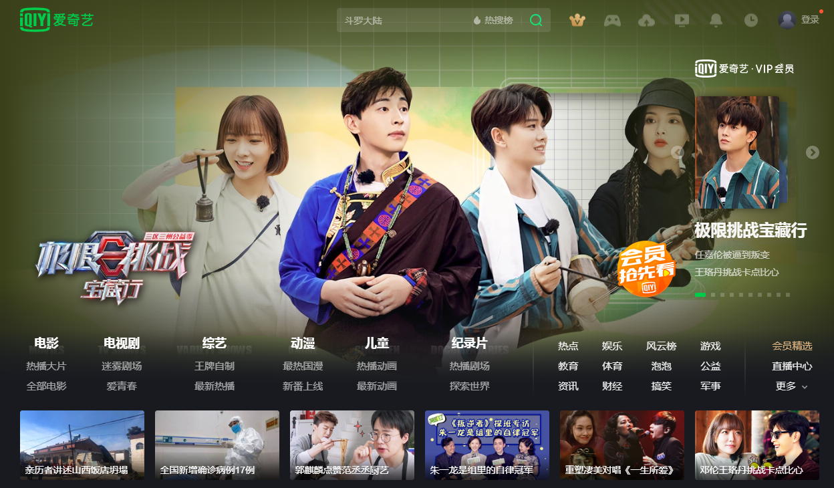
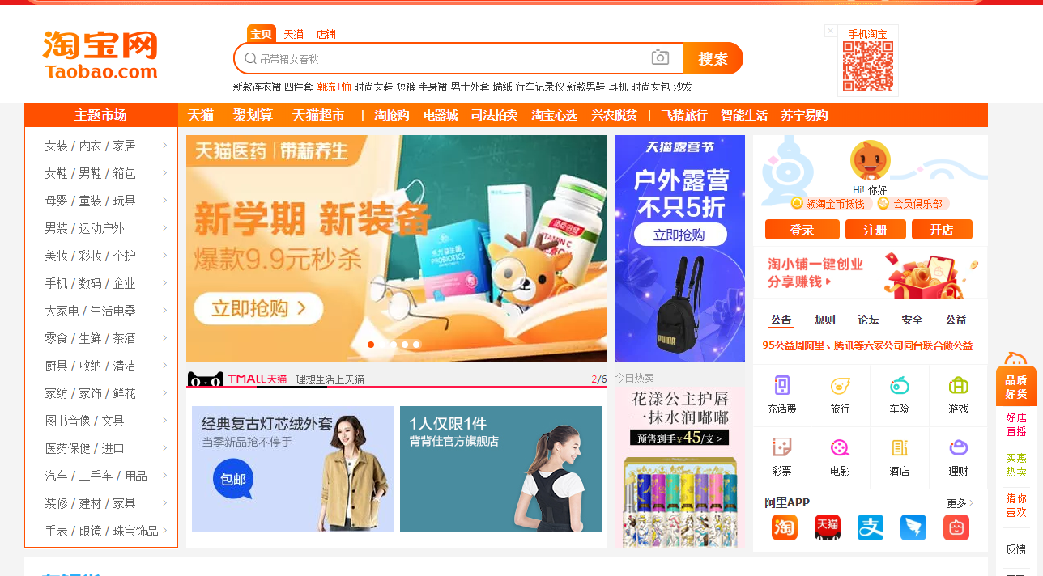
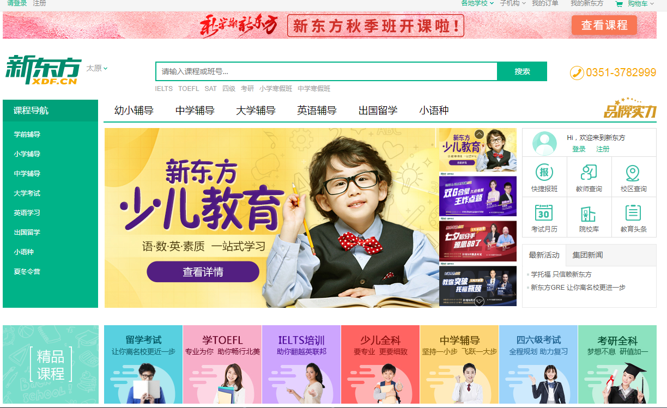
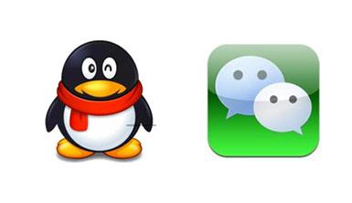
Lead-in
Presentation
When you are on the Internet, what do you usually do?
read the news
play internet games
watch films or TV plays
search for information
do shopping online
study on the internet
chat on the Internet

Slide 4
Fast reading
Read for the topic sentence
Para. 1
We can achieve almost anything online…
Para. 2
One of the greatest advantages of the Internet lies in the quick and easy access to a huge amount of information.
Para. 3
The Internet has also made our lives unbelievably convenient, with all sorts of goods and services provided ….
Para. 4
Above all else, the Internet helps us establish and maintain social ties.
Para. 5
However, while the Internet brings many valuable advantages, being connected has its problems.

Slide 5
Fast reading
Introduction
Para. 1: ______________
______________
______________
Main body
Paras. 2–4:
The Internet has many advantages.
Conclusion
Para. 5: ________________________
________________________
We can achieve almost anything online.
We should use the Internet properly and responsibly.
Advantage 1
____________________________________________________
Advantage 2
____________________________________________________
Advantage 3
_______________________________________
We have quick and easy access to a huge amount of information online.
E-commerce has made our lives unbelievably convenient.
The Internet helps us establish and maintain social ties.

Slide 6
Careful reading
Compare before and after the invention of the Internet
Access to information
You can talk from these aspects
1
2
Food
3
Shopping
4
Transportation
Aspects
5
Travel arrangements
6
Payments
7
Social life

Slide 7
Compare before and after the invention of the Internet
Access to information
before
Slow and inconvenient.
after
With the click of a mouse or the touch of a button, it is possible to find out almost anything we care to know.

Slide 8
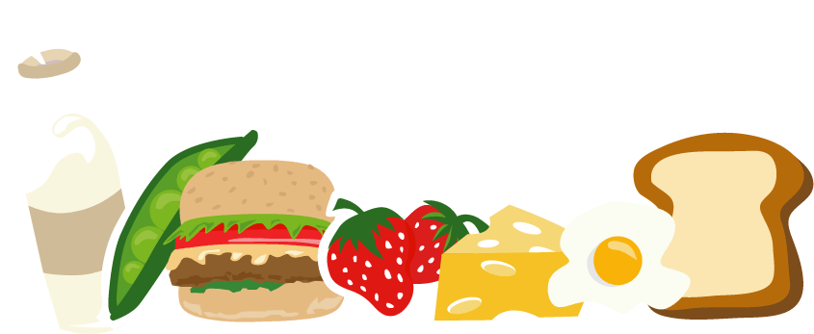
Compare before and after the invention of the Internet
Food
before
Go to the restaurant to have a meal.
after
Have food delivered to us by using food delivery apps and sites.

Slide 9
Compare before and after the invention of the Internet
Shopping
before
Search shop after shop for the perfect choice, for example, a pair of boots.
after
Compare styles and prices quickly and easily.

Slide 10
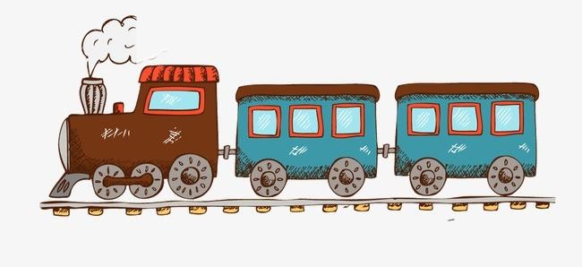
Compare before and after the invention of the Internet
Transportation
before
Wait hopelessly for a taxi in the cold rain.
after
Order a taxi on an app, sit back and relax indoors for a few warm minutes until the driver arrives.

Slide 11
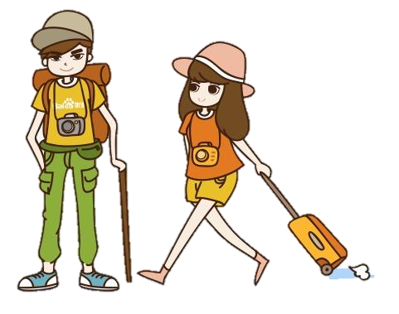
Travel arrangements
before
Go to the travel agency to make and book travel plans.
after
Make all the travel arrangements just in front of the computer.

Slide 12
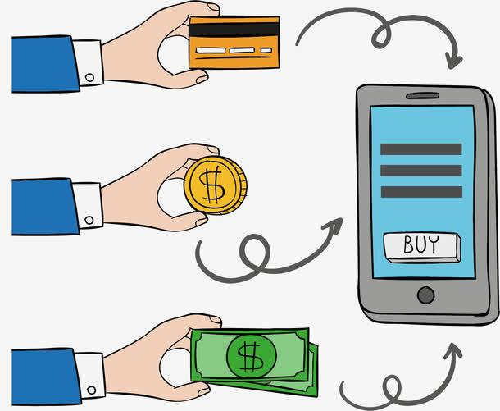
Payments
before
Pay using cash or cheques.
after
Almost everything can be paid on the smartphone.

Slide 13
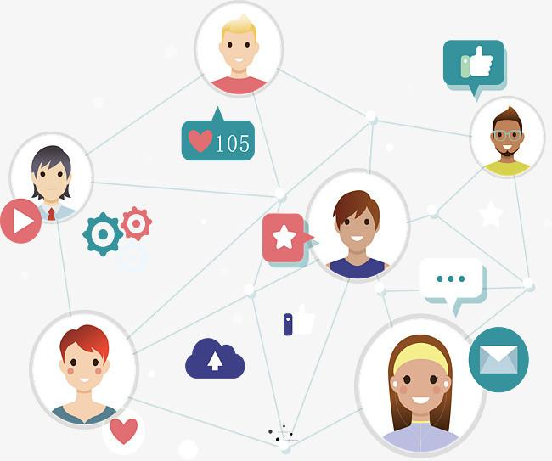
Social life
Physical distance often gets in the way because we have to go to meet up with someone else after arranging a time and place that is convenient for everyone.
before
after
There are endless ways to share our views or let someone know we care about them no matter where we are.

Slide 14
Discussion
The author mentions in the conclusion that the Internet has its problems. What do you think the problems are? Please discuss in your group.
(1) Personal information may be stolen.
(2) Surfing and playing games on the Internet can become addictive.
(3) Addiction to the Internet may lead to social isolation and depression.
(4) Internet viruses can infect and damage computers.
(5) We may not make sure the quality of the goods and the truth of the information.

Slide 15
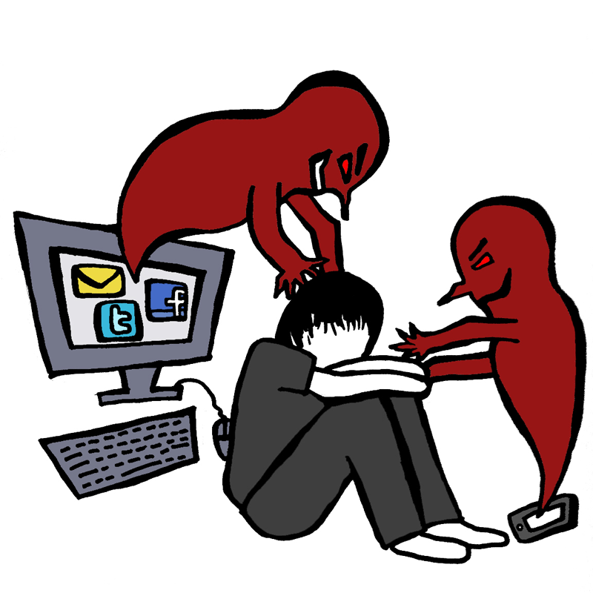
“However, the Internet also has its problems.”
The Internet is a double-edged sword. How can we use the Internet properly and responsibly?
Notes:
Everything is made possible with the Internet, no matter the good or the bad.
When we enjoy the benfits of it, we must recognize its down side.
Every one of us should know that the Internet is a double-edged sword.

Slide 16
Discussion(Group work)
Pay attention to our private
information security
Giving away personal information
Addiction to online games
Control our time spent on the Internet
Internet viruses can damage computers
Be aware of signs of online viruses
Hard to ensure the truth of the information online
Don’t easily trust the online information and
look for legal websites whenever possible
...

Slide 17
Writing
假如你是李华，请你为校刊“英语园地”投稿，谈谈使用网络的利弊及你的建议，要点包括：
1.互联网的优点；
2.互联网的缺点；
3.你的建议。
注意:词数80左右。
Dear Sir or Madam，
__________________________________________________________________
__________________________________________________________________
__________________________________________________________________
__________________________________________________________________
__________________________________________________________________
Yours，
Li Hua

Slide 18
Writing
Dear Sir or Madam,
I’m writing to tell you something important about the Internet. I think the Internet has both its advantages and disadvantages.
On one hand, the Internet is playing a more and more important role in our life. Just by clicking the buttons, we can work, study, chat online, play games, watch movies and so on. However, the Internet also has a negative effect on our life. Many people spend too much time surfing the Internet, which will waste much time and cause harm to our health. What’s worse, many teenagers are addicted to the Internet, which is becoming a social problem.
Therefore, we should make proper use of the Internet.
Yours,
Li Hua

Slide 19
Homework
1.Adjust（调整） the composition content properly
2.Sort out（整理）the related reading notes

Slide 20
Thank you

