Slide 1
Unit 3 Reading
The Internet:
a world without frontiers

Slide 2
Presentation

Slide 3
The Internet:
a world without frontiers

Slide 4
While-reading
Read the passage.
Work out the main idea of each paragraph.
underline key words and sentences
Notes:
Let’s have a quick look at the article.

Slide 5
While-reading
Work out the main idea and structure
Introduction
Achieve almost anything in the Internet which connects people across the world to a single shared community
Para. 1
Body
Be quickly and easily accessible to a huge amount of information
Para. 2
Para. 3
Give our lives unbelievably convenience provided by
e-commerce
Para. 4
Help us establish and maintain social ties
Conclusion
Be aware of the problems brought by being connected, and be careful to use the Internet properly and responsibly
Para. 5
Notes:
Have you got it?
Now, we have worked out the main idea and structure of this passage.
Let’s look at some details part by part.

Slide 6
3. Complete the mind map below.
Introduction Para. 1:
_________________
_________________
Main body Paras. 2–4:
The Internet has many advantages.
Conclusion Para. 5:
____________________
____________________
We can achieve almost anything online.
We should use the Internet properly and responsibly.
Advantage 1:
Advantage 2:
Advantage 3:
We have quick and easy access to a huge amount of information online.
The Internet helps us establish and maintain
social ties.
E-commerce has made our lives unbelievably
convenient.
Can we change the order of Para.2, Para.3 and Para.4?

Slide 7
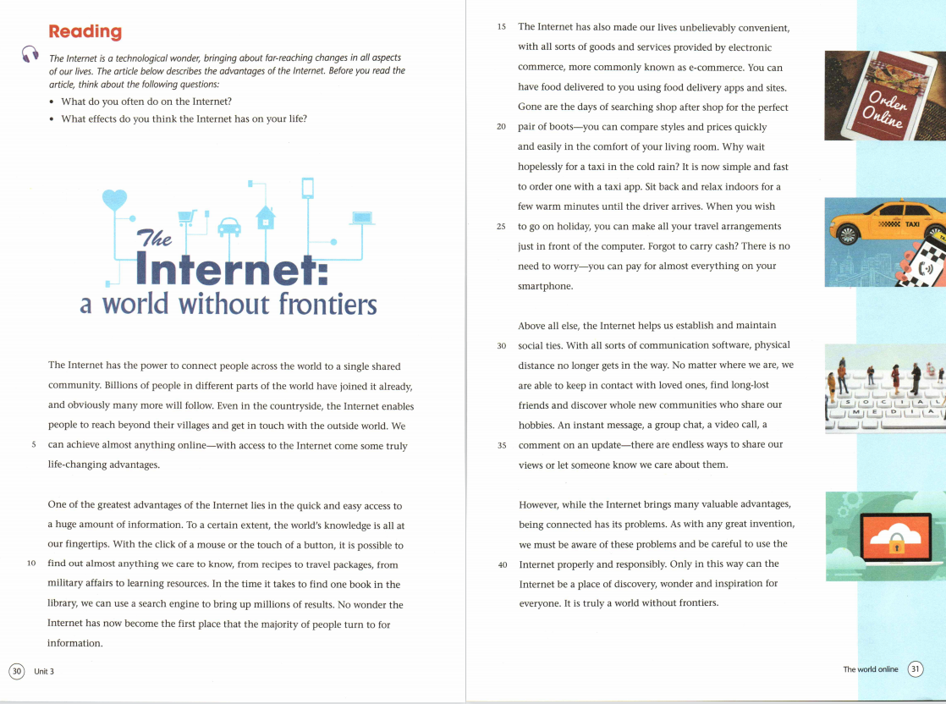
cohesive devices
Notes:
above all else: It tops all other advantages the author have said before
Cohesive devices are words or phrases that give signals to the reader that something important is about to happen.
Besides the structure, a good writing also needs some writing skills. Let’s appreciate the language together.

Slide 8
Careful reading
Compare before and after the invention of the Internet
1
Access to information
You can talk from these aspects
2
Food
3
Shopping
4
Transportation
Aspects
5
Travel arrangements
6
Payments
7
Social life

Slide 9
Compare before and after the invention of the Internet
Access to information
before
Slow and inconvenient.
after
With the click of a mouse or the touch of a button, it is possible to find out almost anything we care to know.

Slide 10
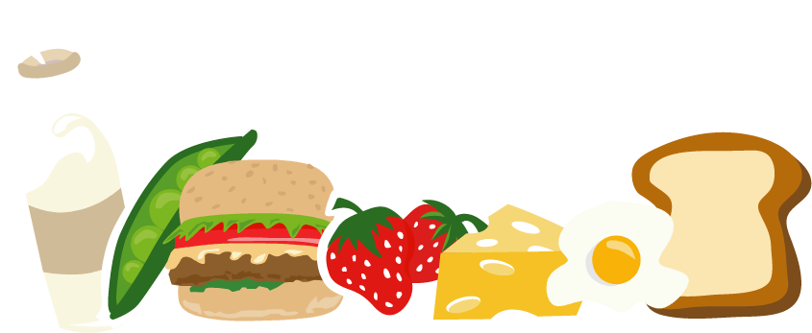
Compare before and after the invention of the Internet
Food
before
Go to the restaurant to have a meal.
after
Have food delivered to us by using food delivery apps and sites.

Slide 11
Compare before and after the invention of the Internet
Shopping
before
Search shop after shop for the perfect choice, for example, a pair of boots.
after
Compare styles and prices quickly and easily in the comfort of the living room.

Slide 12
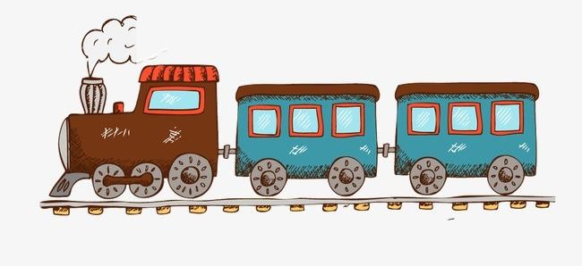
Compare before and after the invention of the Internet
Transportation
before
Wait hopelessly for a taxi in the cold rain.
after
Order a taxi on an app, sit back and relax indoors for a few warm minutes until the driver arrives.

Slide 13
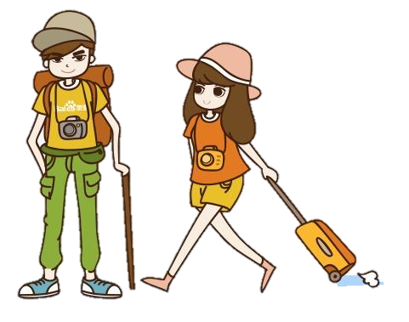
Travel arrangements
before
Go to the travel agency to make and book travel plans.
after
Make all the travel arrangements just in front of the computer.

Slide 14
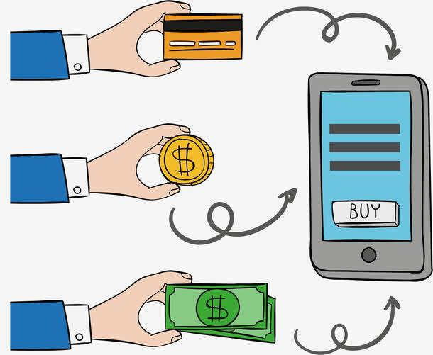
Payments
before
Pay using cash or cheques.
after
Almost everything can be paid on the smartphone.

Slide 15
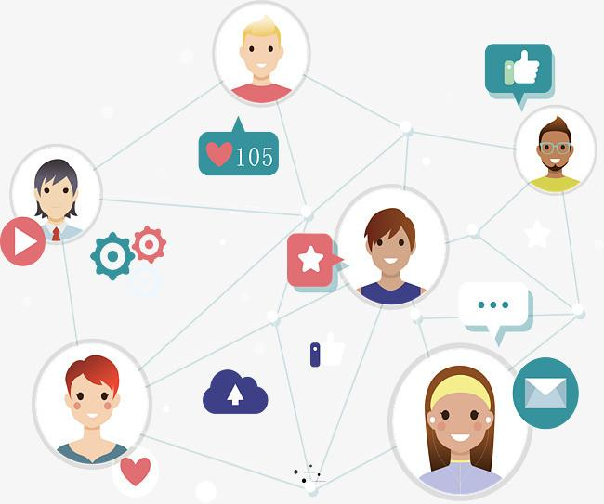
Social life
before
Physical distance often gets in the way.
after
There are endless ways to share our views or let someone know we care about them no matter where we are.

Slide 16
While-reading
Read Para.5, think about the questions below:
title
1. The last sentence of the essay and the _____ echo each other (前后呼应).
√
2. What is the author’s attitude towards the Internet?
A. Subjective. B. Objective.
C. Uncaring. D. Doubtful.
However, while the Internet brings many valuable advantages, being connected has its problems.

Slide 17
Discussion
The author mentions in the conclusion that the Internet has its problems. What do you think the problems are? Please discuss in your group.
Group work
(1) Personal information may be stolen.
(2) Surfing and playing games on the Internet can become addictive.
(3) Addiction to the Internet may lead to social isolation and depression.
(4) Internet viruses can infect and damage computers.
(5) We may not make sure the quality of the goods and the truth of the information.

Slide 18
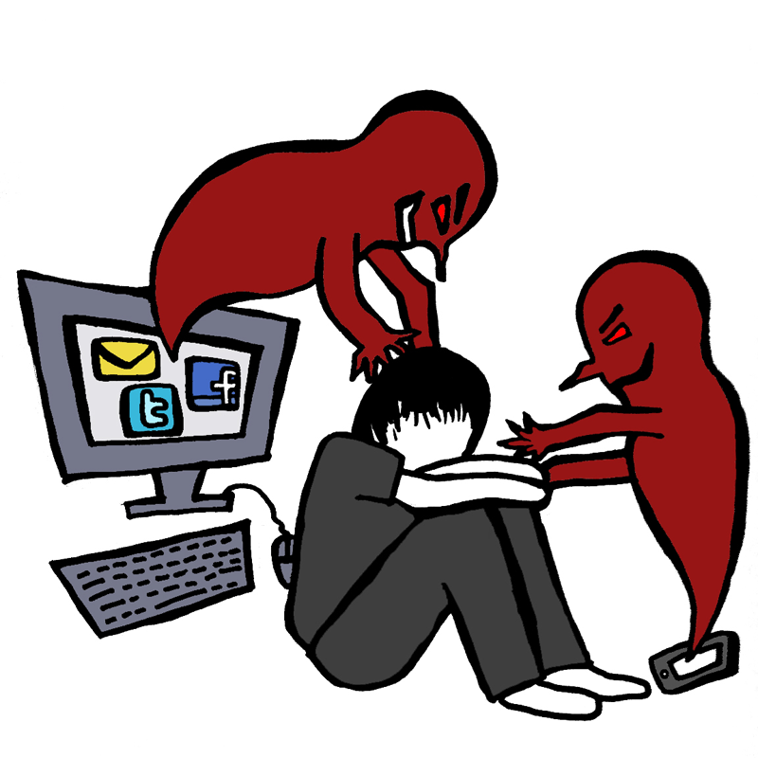
“However, the Internet also has its problems.”
The Internet is a problem.
The Internet is a double-edged sword.
Notes:
Everything is made possible with the Internet, no matter the good or the bad.
When we enjoy the benfits of it, we must recognize its down side.
Every one of us should know that the Internet is a double-edged sword.

Slide 19
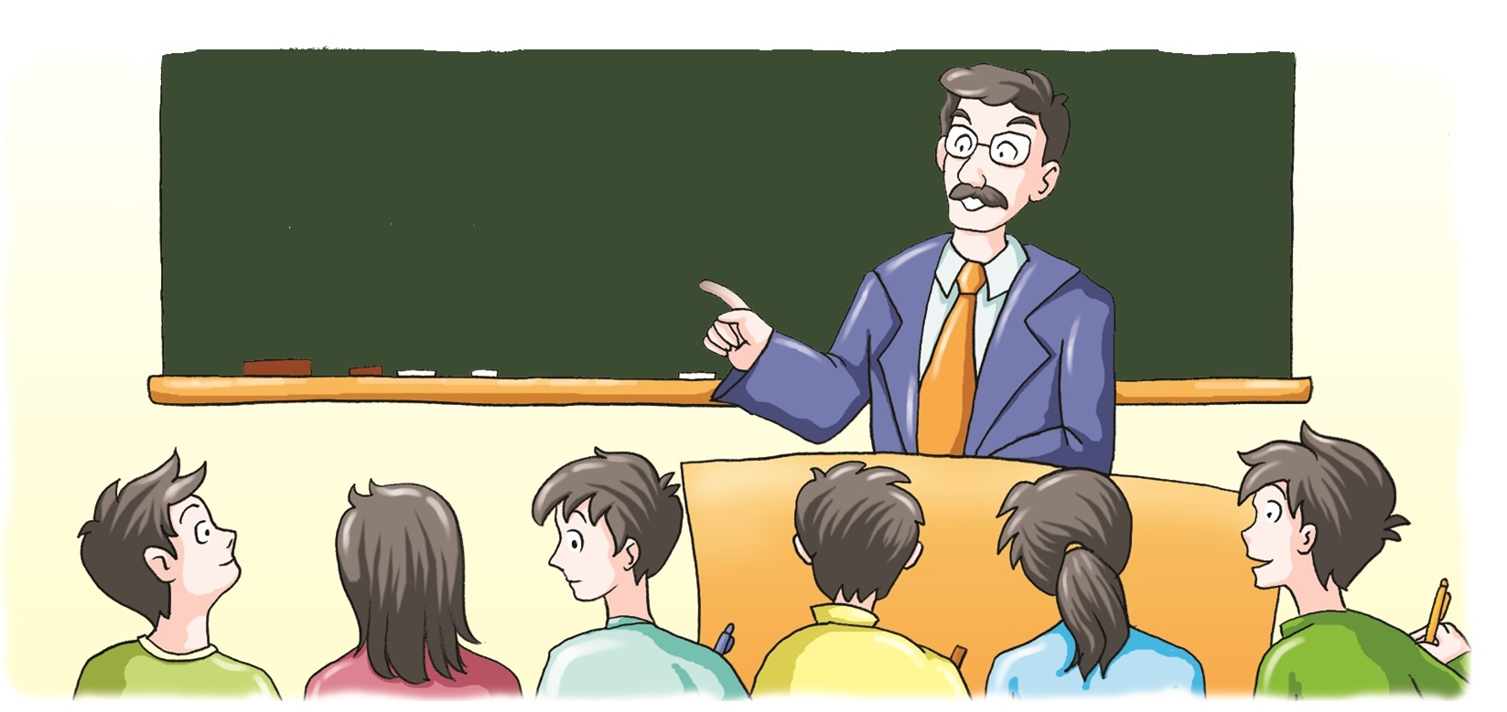
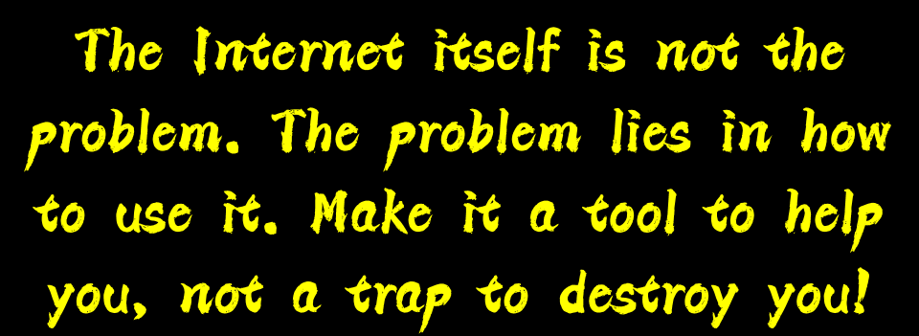
We should use the Internet properly and responsibly.

Slide 20
Writing
假如你是李华，请你为校刊“英语园地”写一封信，谈谈使用网络的利弊及你的建议，要点包括：
1.互联网的优点；
2.互联网的缺点；
3.你的建议。
注意:词数80左右。
Dear Sir or Madam，
__________________________________________________________________
__________________________________________________________________
__________________________________________________________________
__________________________________________________________________
__________________________________________________________________
Yours，
Li Hua

Slide 21
Thank you

