Slide 1
我们不乱扔

Slide 2
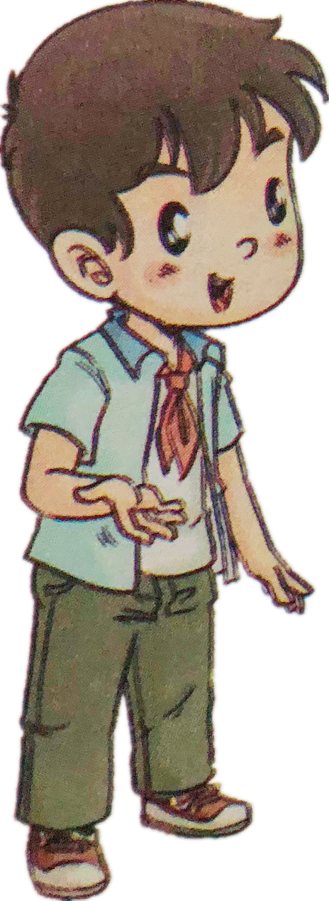
同学们好，我叫王勇
很高兴认识你们。

Slide 3
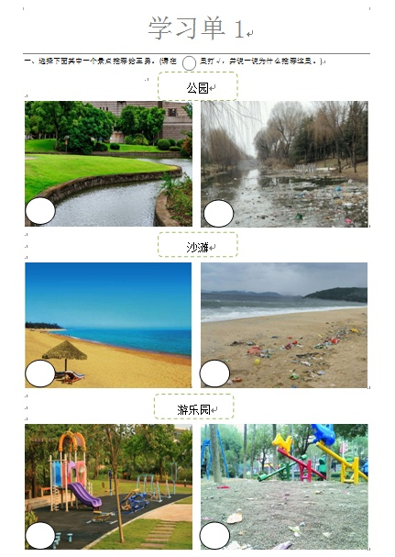
合作要求：
1. 勾一勾
√
2. 说一说
3. 选派代表

Slide 5
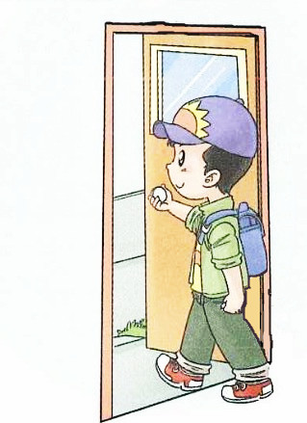

Slide 6
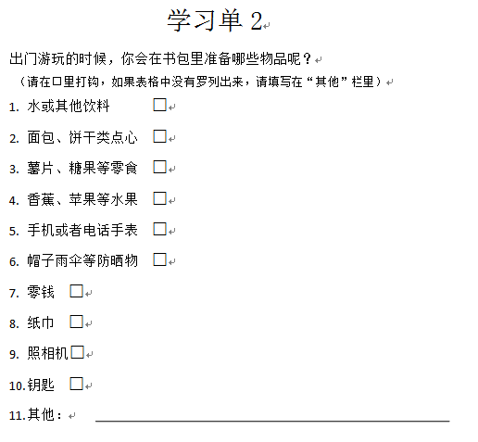
合作要求：
1. 说一说
2. 勾一勾
√

Slide 7
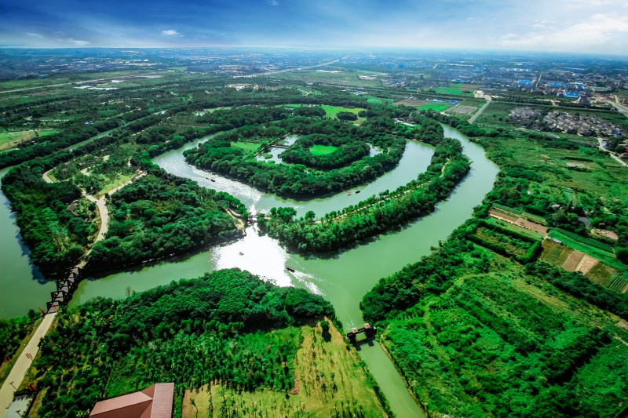
整洁优美的千年古城——淹城

Slide 8
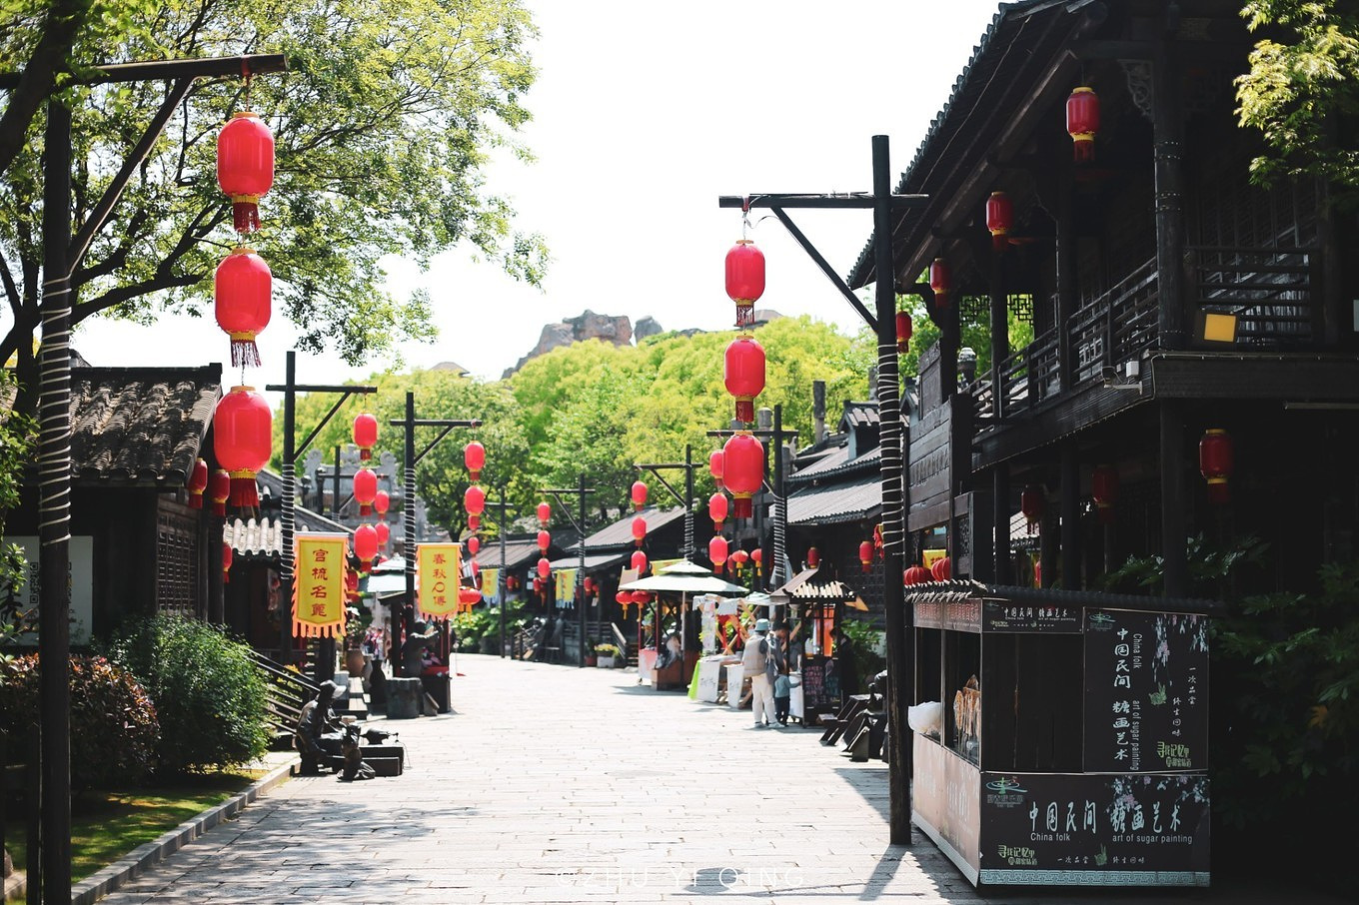
古色古香的建筑

Slide 9
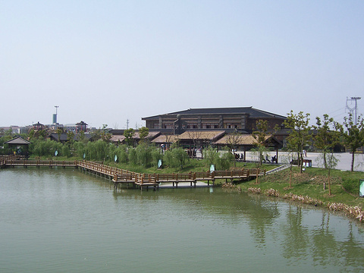
清澈如镜的景观湖

Slide 10
青青的草坪

Slide 11
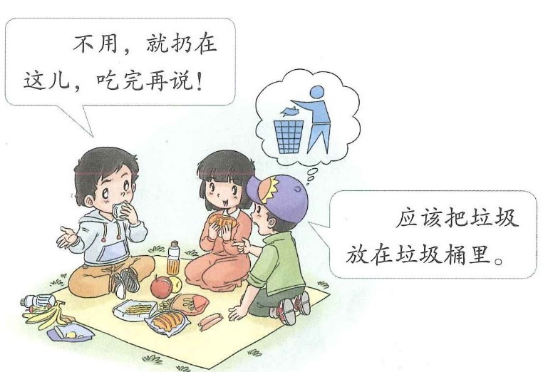
？
小刚你应该把垃圾放在垃圾桶里。

Slide 12
真心话
敢不敢

Slide 13
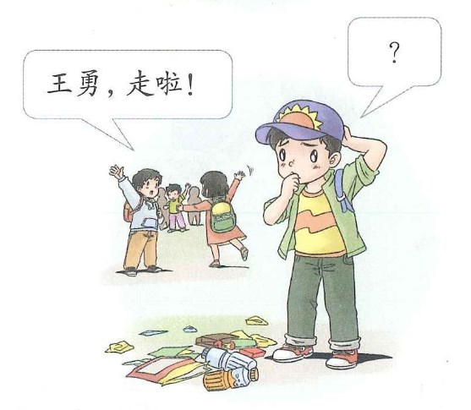

Slide 15
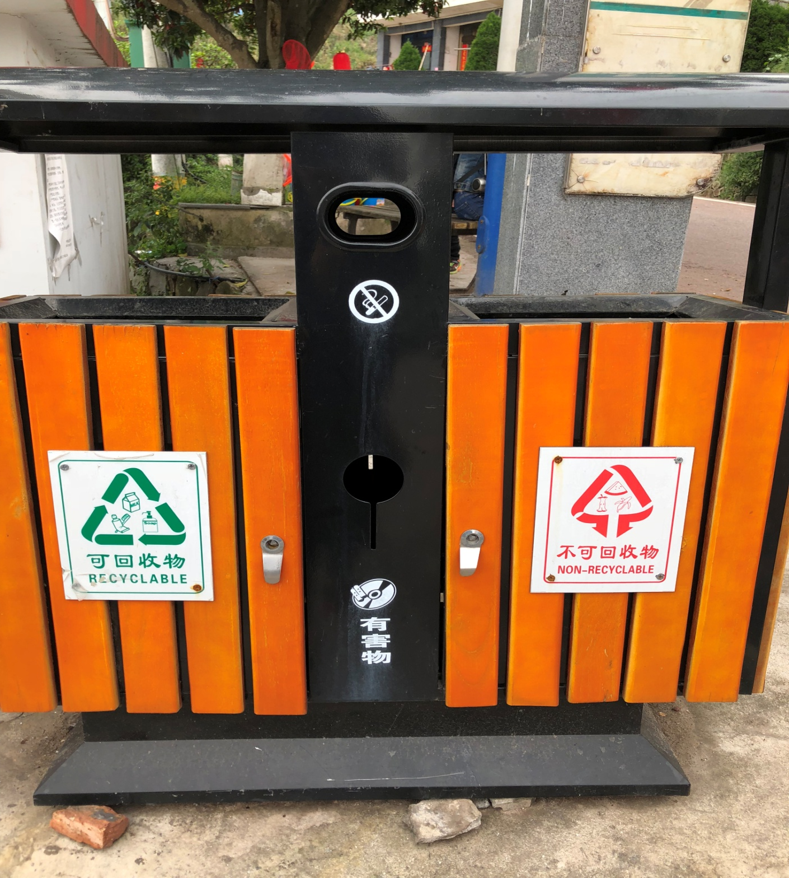
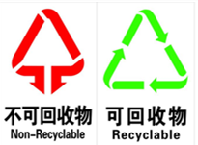

Slide 16
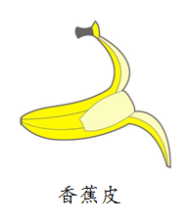
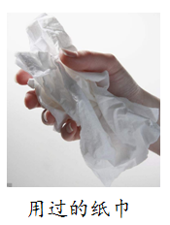
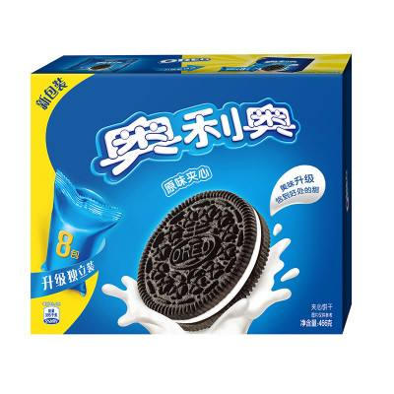
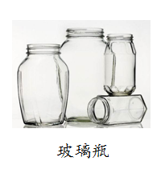
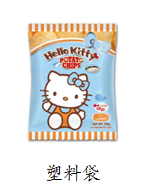
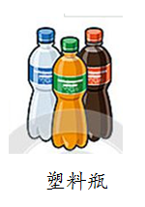
果皮、果核
纸盒

Slide 17
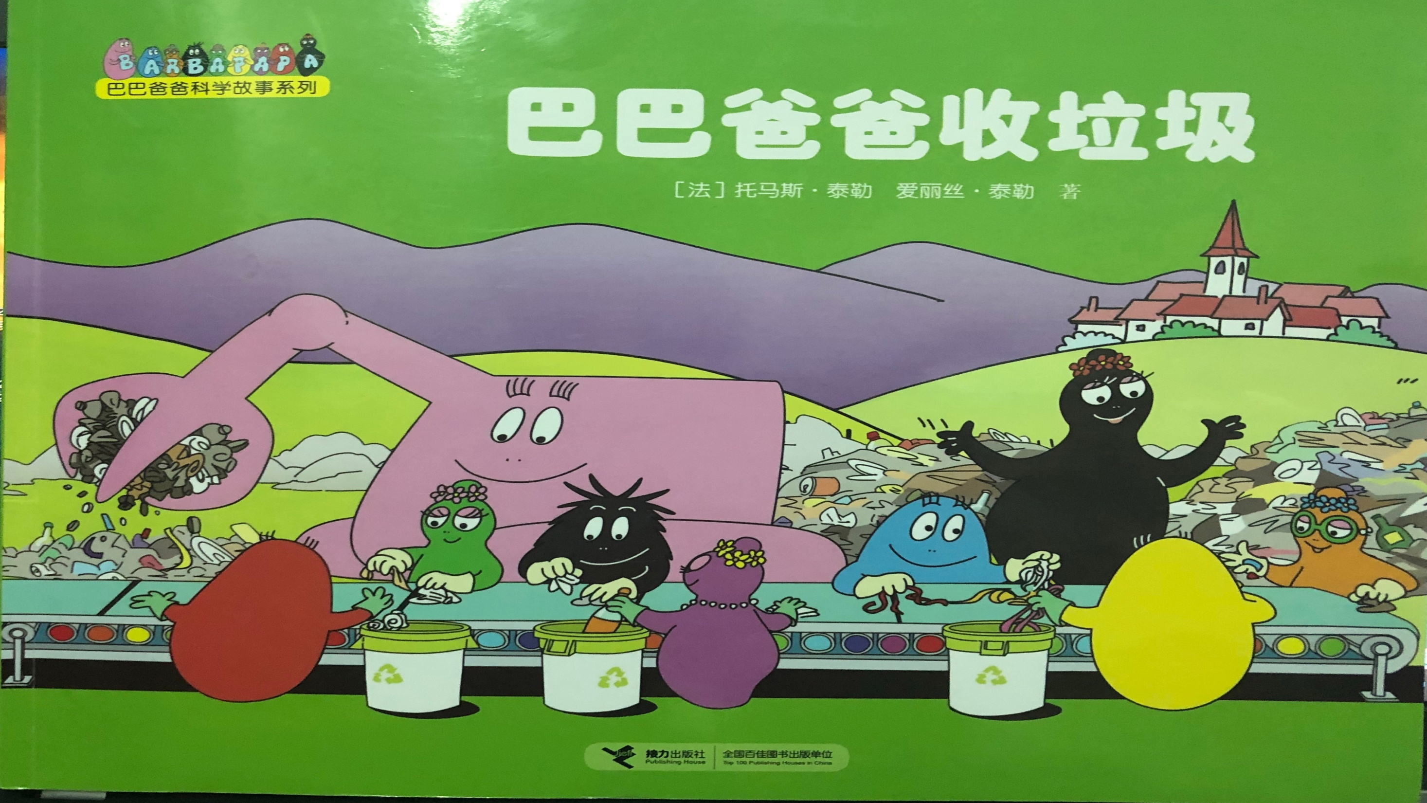

Slide 18
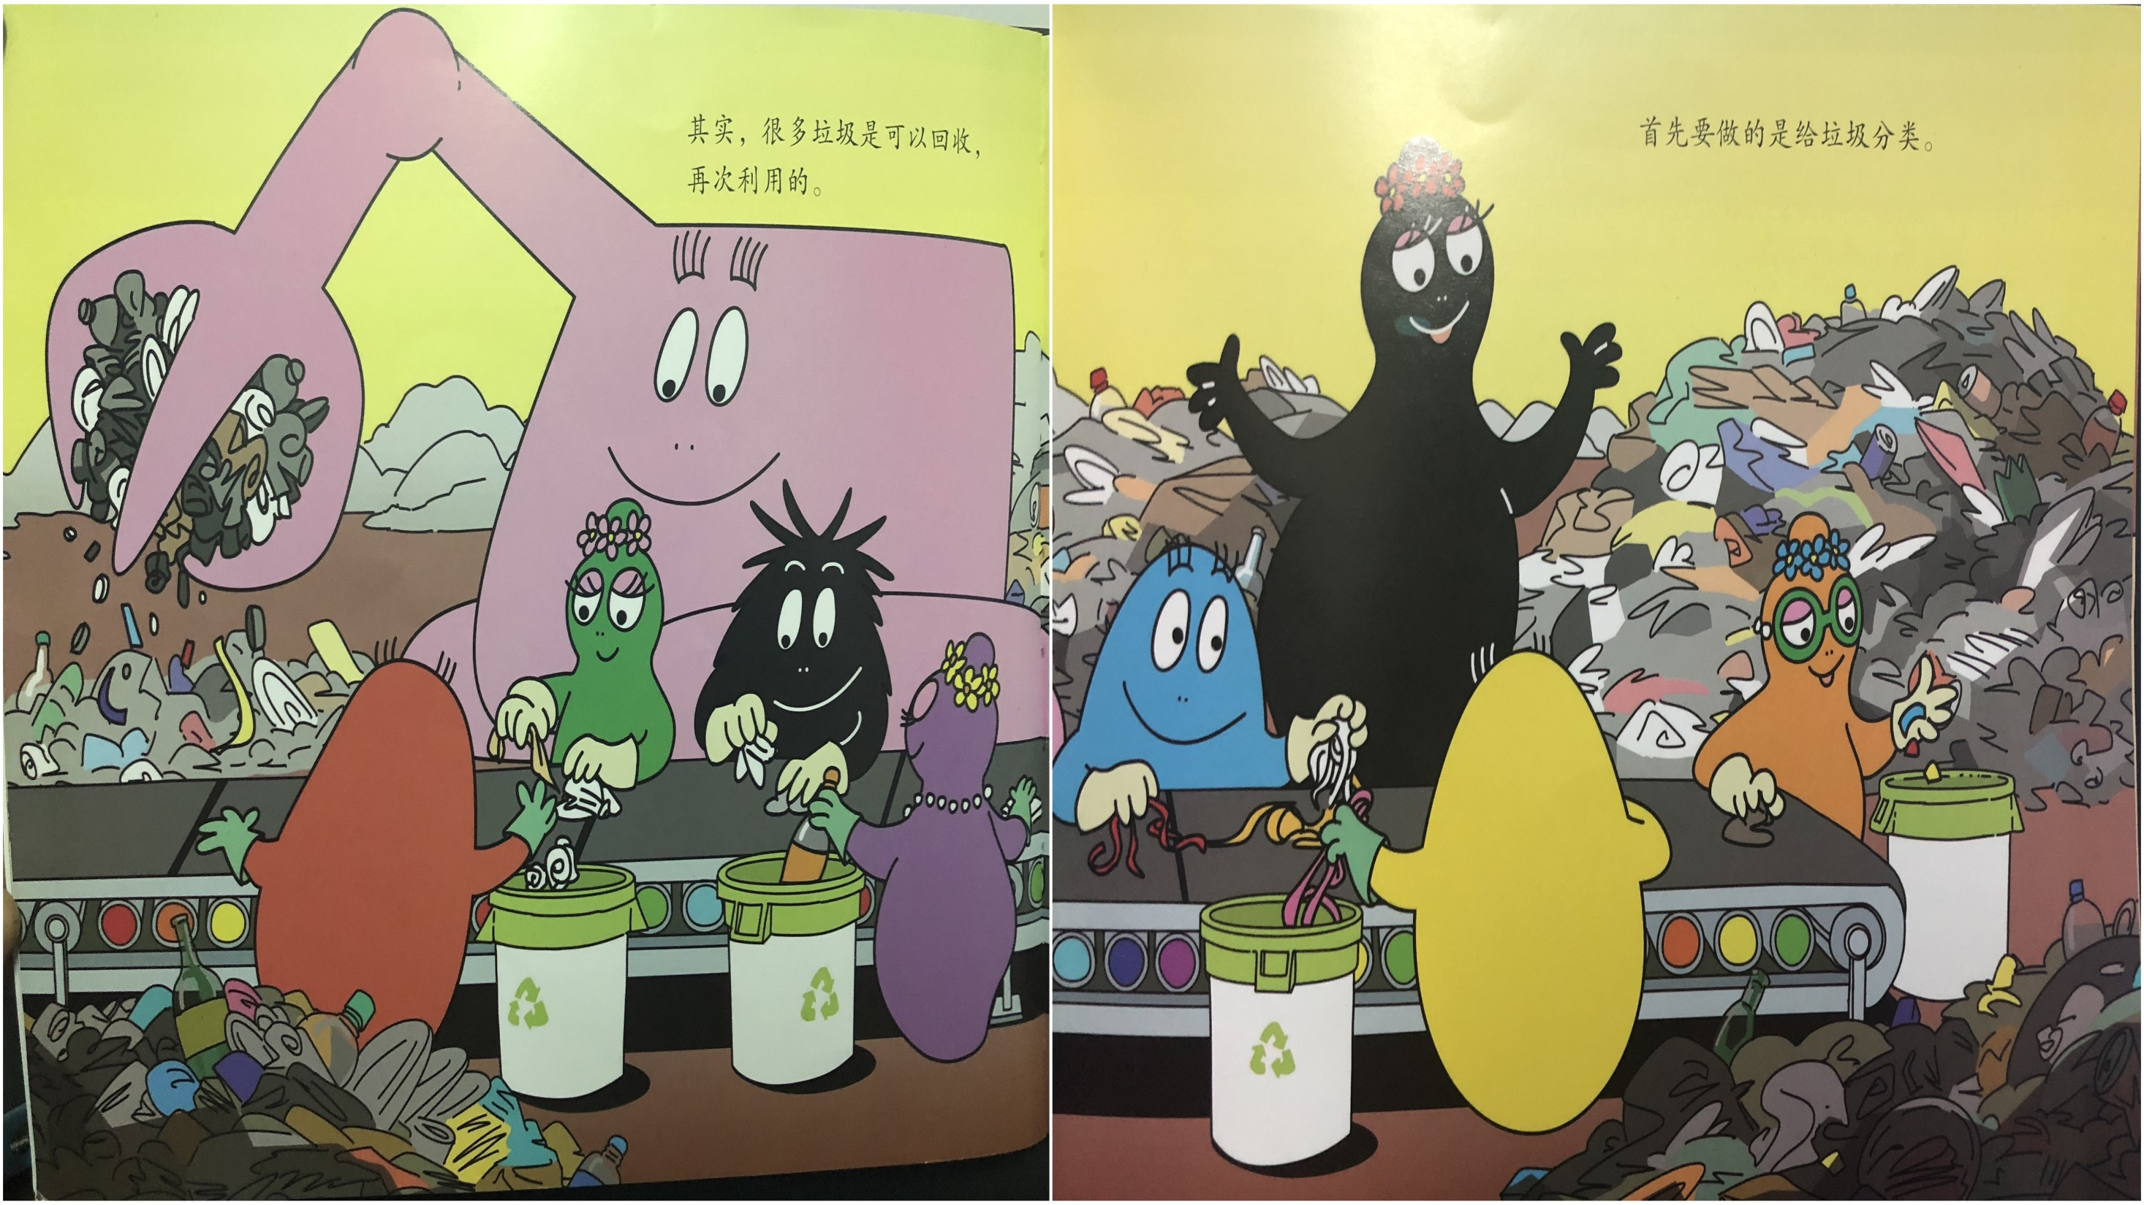
其实，生活中很多垃圾是可以回收再次利用的。
首先，我们要做的就是给垃圾分类。

Slide 19
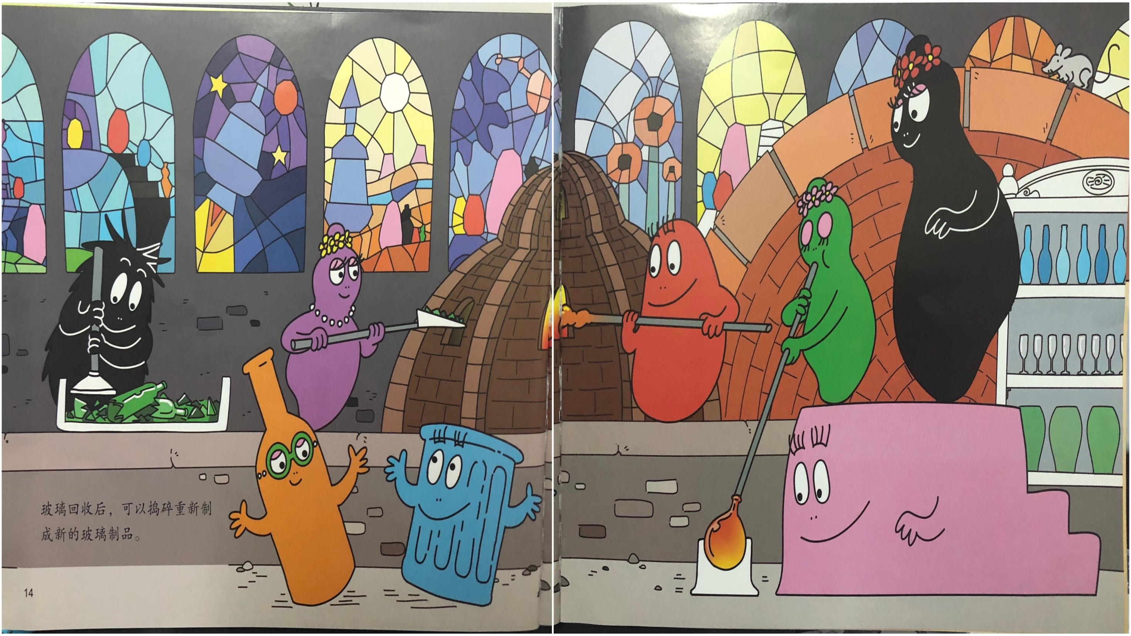
玻璃回收后，可以捣碎重新制成新的玻璃制品。

Slide 20
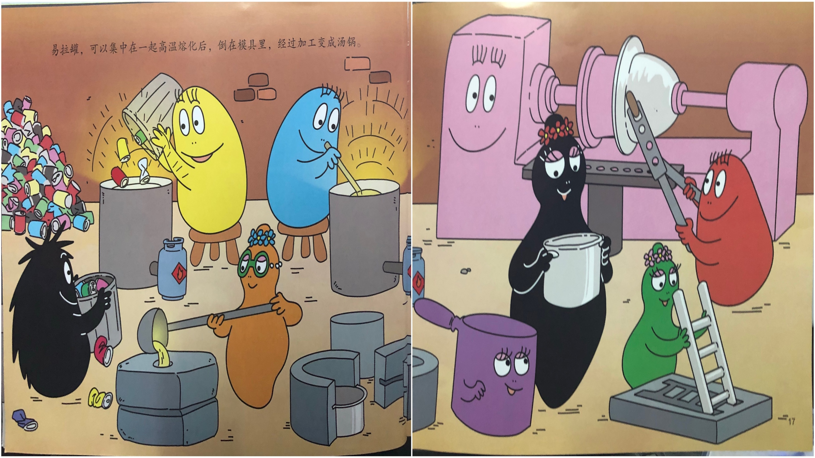
易拉罐可以集中在一起高温溶化后，倒在磨具里，经过加工变成汤锅。

Slide 21
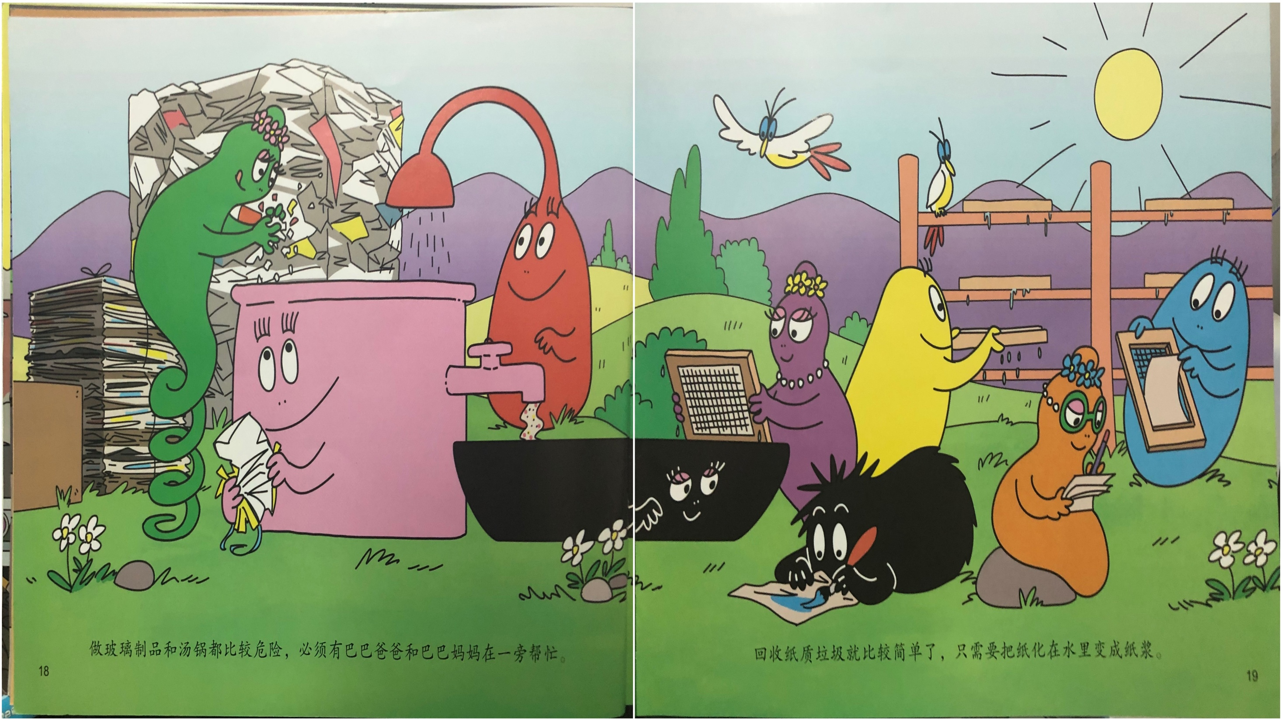

Slide 22
中国的《城市生活垃圾分类及其评价标准》
只要把纸张融化，变成纸浆又可以制成新的纸张了呢！

Slide 23
我们不乱扔
保护环境从你我做起
从身边的小事做起

Slide 24
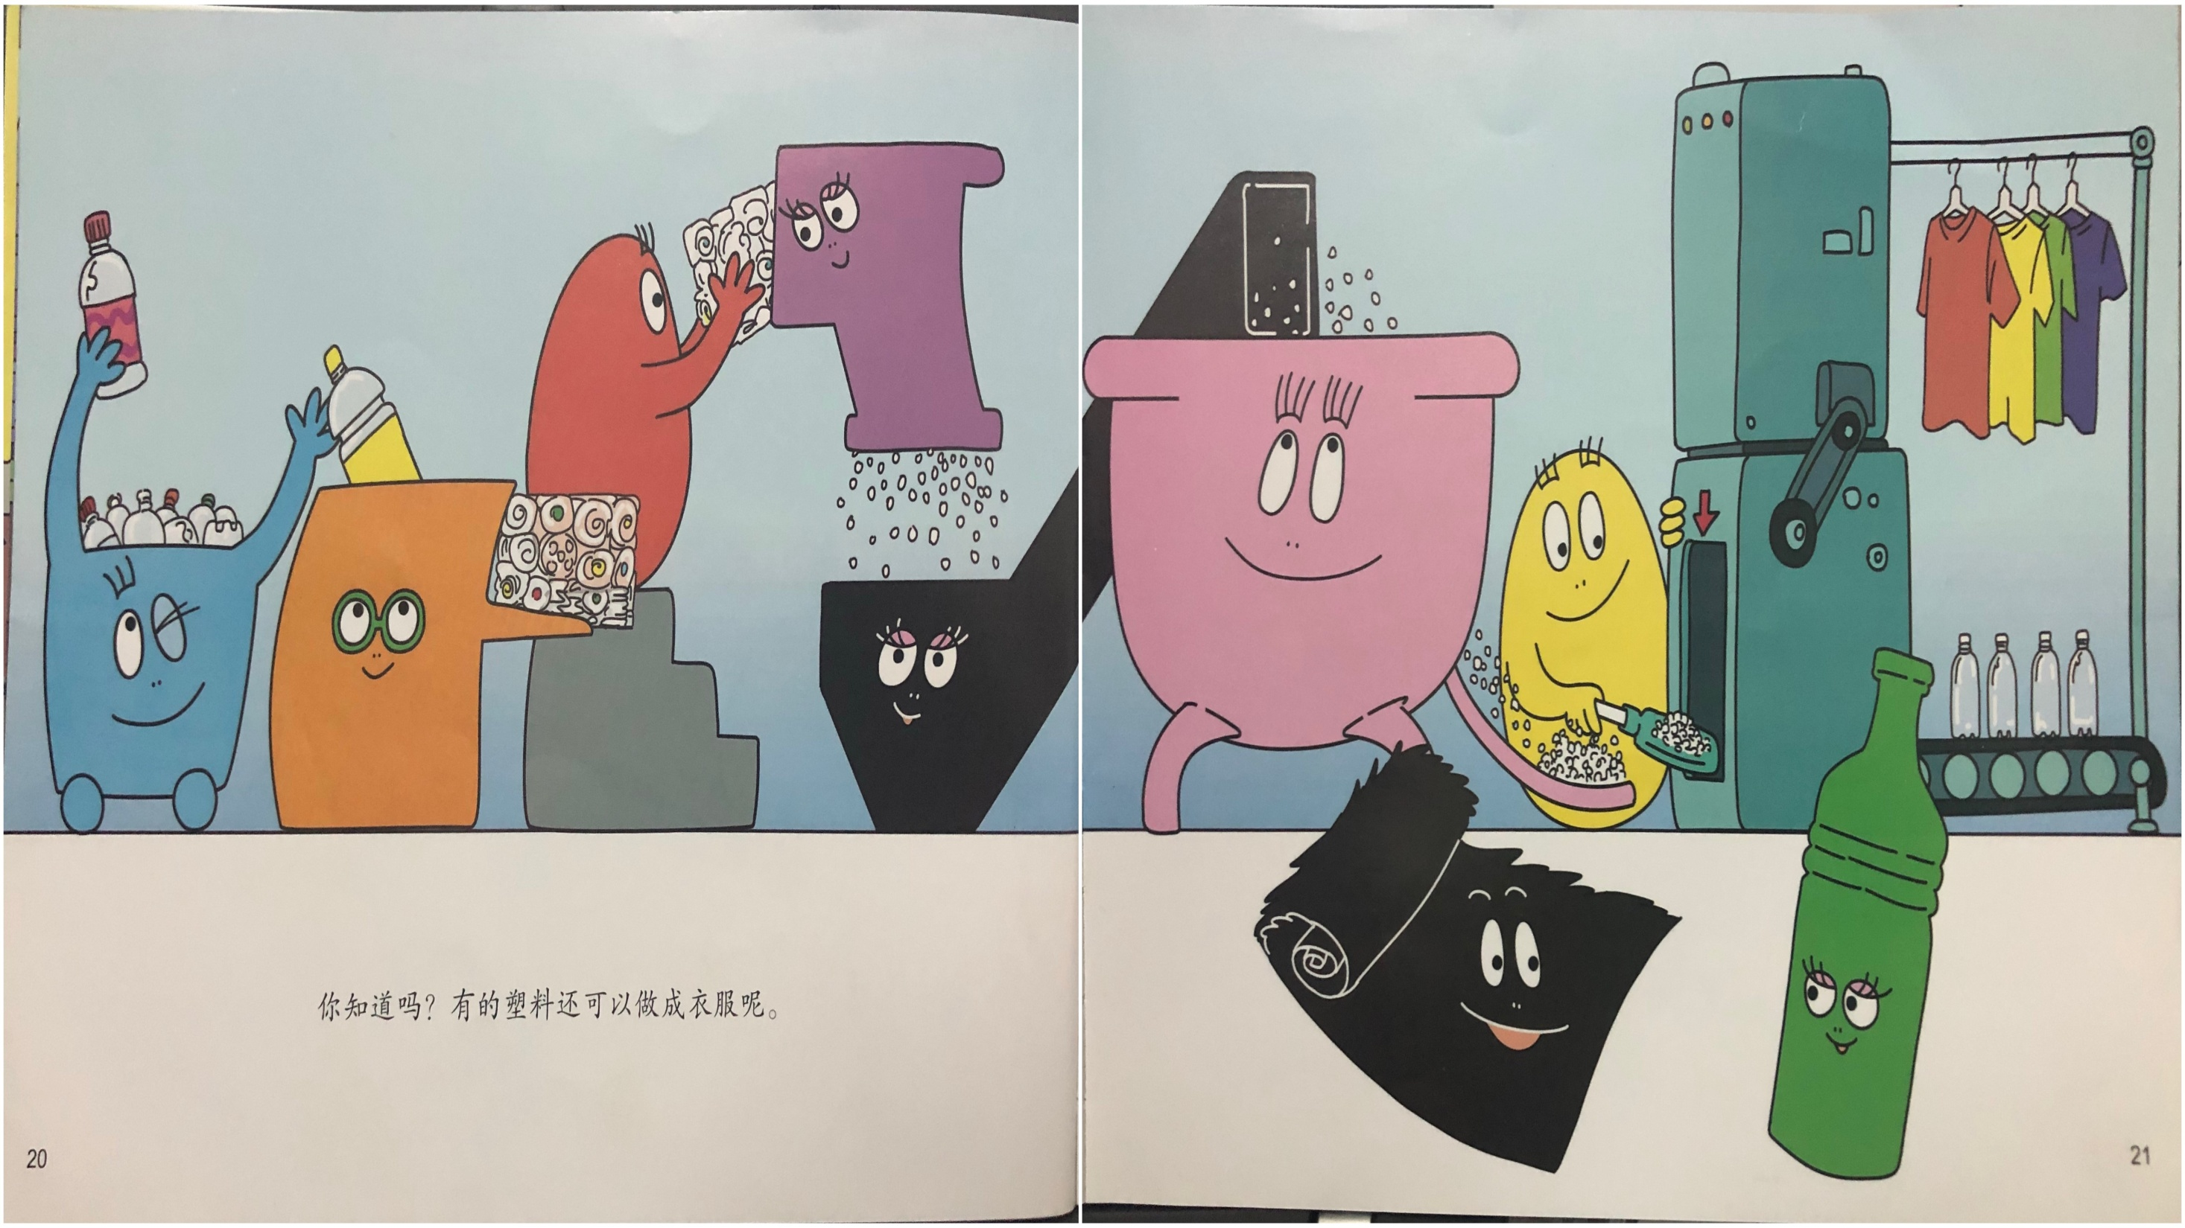
你知道有吗，有些塑料还可以制成衣服呢！

Slide 27
单击此处输入标题文本
单击此处输入标题
单击此处输入标题
If they throw stones at you, don’t throw back, use them to build your own foundation instead.
单击此处输入标题
If they throw stones at you, don’t throw back, use them to build your own foundation instead.
单击此处输入标题
If they throw stones at you, don’t throw back, use them to build your own foundation instead.
If they throw stones at you, don’t throw back, use them to build your own foundation instead.

Slide 28
单击此处输入标题文本
If they throw stones at you, don’t throw back, use them to build your own foundation instead.
单击此处输入标题
单击此处输入标题
If they throw stones at you, don’t throw back, use them to build your own foundation instead.
If they throw stones at you, don’t throw back, use them to build your own foundation instead.
单击此处输入标题
If they throw stones at you, don’t throw back, use them to build your own foundation instead.If they throw stones at you, don’t throw back, use them to build your own foundation instead.

Slide 29
02
工 作 完 成 情 况
When a cigarette falls in love with a match,it is destined to be hurt.When a cigarette falls in love with a match,it is destined to be hurt.

Slide 30
单击此处输入标题文本
输入标题
If they throw stones at you, don’t throw back, use them to build your own foundation instead.
单击此处输入标题文本
输入标题
If they throw stones at you, don’t throw back, use them to build your own foundation instead.
单击此处输入标题文本
输入标题
If they throw stones at you, don’t throw back, use them to build your own foundation instead.
单击此处输入标题文本

Slide 31
单击此处输入标题文本
单击此处输入标题
单击此处输入标题
单击此处输入标题
If they throw stones at you, don’t throw back, use them to build your own foundation instead.
If they throw stones at you, don’t throw back, use them to build your own foundation instead.
If they throw stones at you, don’t throw back, use them to build your own foundation instead.

Slide 32
单击此处输入标题文本
单击此处输入标题
If they throw stones at you, don’t throw back, use them to build your own foundation instead.
If they throw stones at you, don’t throw back, use them to build your own foundation instead.
单击此处输入标题
If they throw stones at you, don’t throw back, use them to build your own foundation instead.
If they throw stones at you, don’t throw back, use them to build your own foundation instead.
单击此处输入标题
If they throw stones at you, don’t throw back, use them to build your own foundation instead.
If they throw stones at you, don’t throw back, use them to build your own foundation instead.
单击此处输入标题
If they throw stones at you, don’t throw back, use them to build your own foundation instead.
If they throw stones at you, don’t throw back, use them to build your own foundation instead.

Slide 33
单击此处输入标题文本
单击此处输入标题
If they throw stones at you, don’t throw back, use them to build your own foundation instead.
单击此处输入标题
If they throw stones at you, don’t throw back, use them to build your own foundation instead.
单击此处输入标题
If they throw stones at you, don’t throw back, use them to build your own foundation instead.

Slide 34
03
工 作 完 成 情 况
When a cigarette falls in love with a match,it is destined to be hurt.When a cigarette falls in love with a match,it is destined to be hurt.

Slide 35
单击此处输入标题文本
01
单击此处输入标题
03
单击此处输入标题
If they throw stones at you, don’t throw back, use them to build your own foundation instead.
If they throw stones at you, don’t throw back, use them to build your own foundation instead.
单击此处输入标题
单击此处输入标题
02
If they throw stones at you, don’t throw back, use them to build your own foundation instead.
04
If they throw stones at you, don’t throw back, use them to build your own foundation instead.

Slide 36
单击此处输入标题文本
单击此处输入标题
If they throw stones at you, don’t throw back, use them to build your own foundation instead.
单击此处输入标题
单击此处输入标题
If they throw stones at you, don’t throw back, use them to build your own foundation instead.
If they throw stones at you, don’t throw back, use them to build your own foundation instead.

Slide 37
单击此处输入标题文本
单击此处输入标题
单击此处输入标题
单击此处输入标题
单击此处输入标题
If they throw stones at you, don’t throw back, use them to build your own foundation instead.
If they throw stones at you, don’t throw back, use them to build your own foundation instead.
If they throw stones at you, don’t throw back, use them to build your own foundation instead.
If they throw stones at you, don’t throw back, use them to build your own foundation instead.

Slide 38
单击此处输入标题文本
单击此处输入标题
If they throw stones at you, don’t throw back, use them to build your own foundation instead.If they throw stones at you, don’t throw back, use them to build your own foundation instead.
单击此处输入标题
If they throw stones at you, don’t throw back, use them to build your own foundation instead.If they throw stones at you, don’t throw back, use them to build your own foundation instead.
DREAM

Slide 39
单击此处输入标题文本
If they throw stones at you, don’t throw back, use them to build your own foundation instead.
If they throw stones at you, don’t throw back, use them to build your own foundation instead.
If they throw stones at you, don’t throw back, use them to build your own foundation instead.
If they throw stones at you, don’t throw back, use them to build your own foundation instead.

Slide 40
04
工 作 完 成 情 况
When a cigarette falls in love with a match,it is destined to be hurt.When a cigarette falls in love with a match,it is destined to be hurt.

Slide 41
单击此处输入标题文本
单击此处输入标题
单击此处输入标题
单击此处输入标题
单击此处输入标题
If they throw stones at you, don’t throw back, use them to build your own foundation instead.
If they throw stones at you, don’t throw back, use them to build your own foundation instead.
If they throw stones at you, don’t throw back, use them to build your own foundation instead.
If they throw stones at you, don’t throw back, use them to build your own foundation instead.

Slide 42
单击此处输入标题文本
单击此处输入标题
If they throw stones at you, don’t throw back, use them to build your own foundation instead.If they throw stones at you, don’t throw back, use them to build your own foundation instead.If they throw stones at you, don’t throw back, use them to build your own foundation instead.
If they throw stones at you, don’t throw back, use them to build your own foundation instead.
If they throw stones at you, don’t throw back, use them to build your own foundation instead.
If they throw stones at you, don’t throw back, use them to build your own foundation instead.
If they throw stones at you, don’t throw back, use them to build your own foundation instead.
If they throw stones at you, don’t throw back, use them to build your own foundation instead.
If they throw stones at you, don’t throw back, use them to build your own foundation instead.

Slide 43
单击此处输入标题文本
单击此处输入标题
单击此处输入标题
If they throw stones at you, don’t throw back, use them to build your own foundation instead.If they throw stones at you, don’t throw back, use them to build your own foundation instead.
If they throw stones at you, don’t throw back, use them to build your own foundation instead.If they throw stones at you, don’t throw back, use them to build your own foundation instead.

Slide 44
单击此处输入标题文本
A
B
C
D
E
单击此处输入标题
单击此处
输入标题
单击此处输入标题
单击此处输入标题
单击此处输入标题
单击此处输入标题文本
If they throw stones at you, don’t throw back, use them to build your own foundation instead.If they throw stones at you, don’t throw back, use them to build your own foundation instead.If they throw stones at you, don’t throw back, use them to build your own foundation instead.

Slide 45
THANK YOU
When a cigarette falls in love with a match,it is destined to be hurt.When a cigarette falls in love with a match,it is destined to be hurt.

Slide 46
更多精品PPT资源尽在—优品PPT！
www.ypppt.com
PPT模板下载：www.ypppt.com/moban/ 节日PPT模板：www.ypppt.com/jieri/
PPT背景图片：www.ypppt.com/beijing/ PPT图表下载：www.ypppt.com/tubiao/
PPT素材下载： www.ypppt.com/sucai/ PPT教程下载：www.ypppt.com/jiaocheng/
字体下载：http://www.ypppt.com/ziti/ 绘本故事PPT：http://www.ypppt.com/gushi/
Notes:
模板来自于 http://www.ypppt.com

