Slide 1
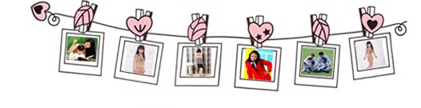
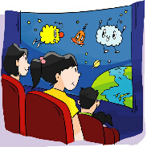
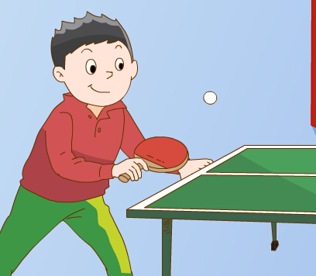
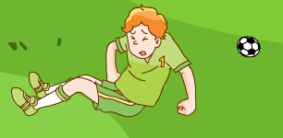
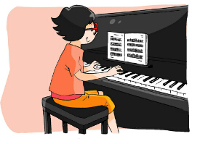
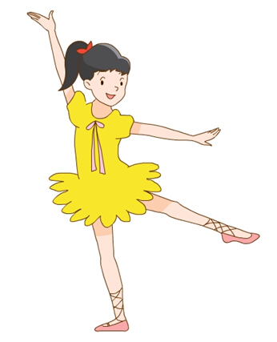

Unit4
Grammar&Fun time

Slide 2
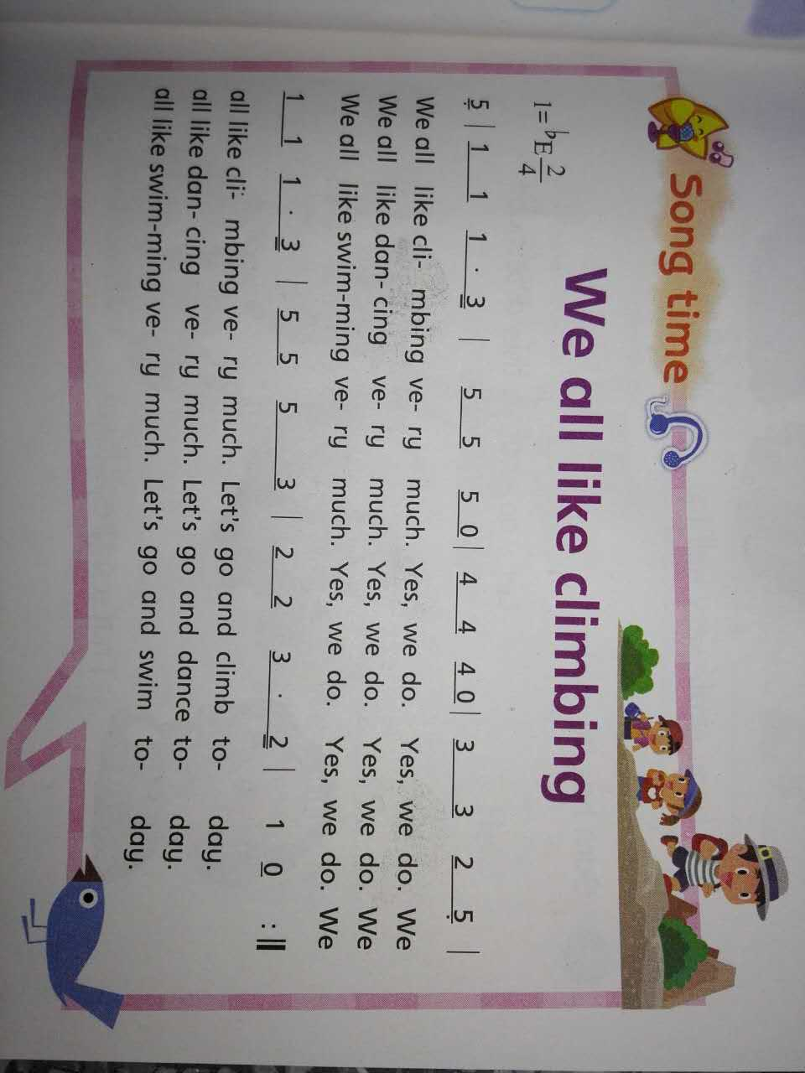



Slide 3
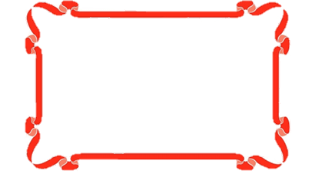
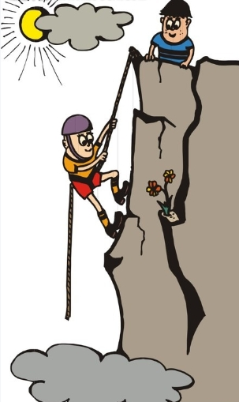
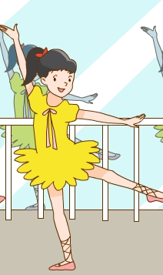
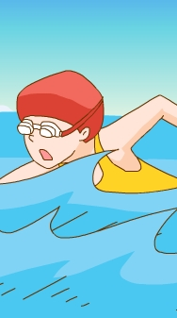
Let’s sing !
Q:What do they like doing?
climbing.
They like
dancing.
swimming.

Slide 4

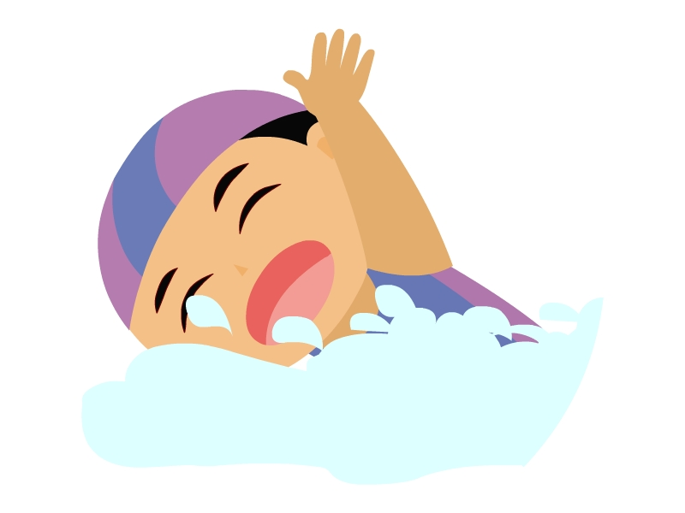
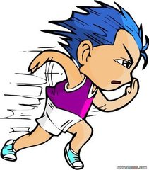
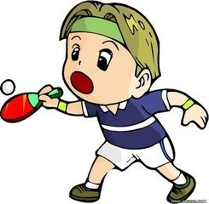
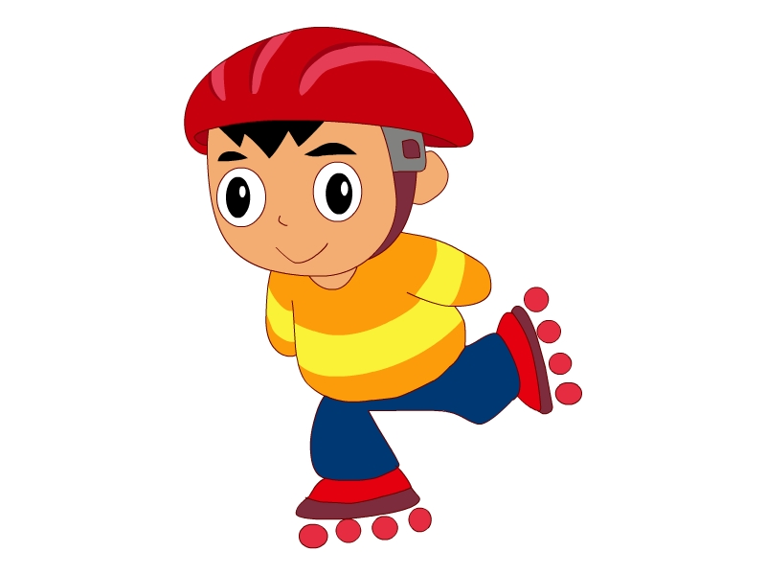
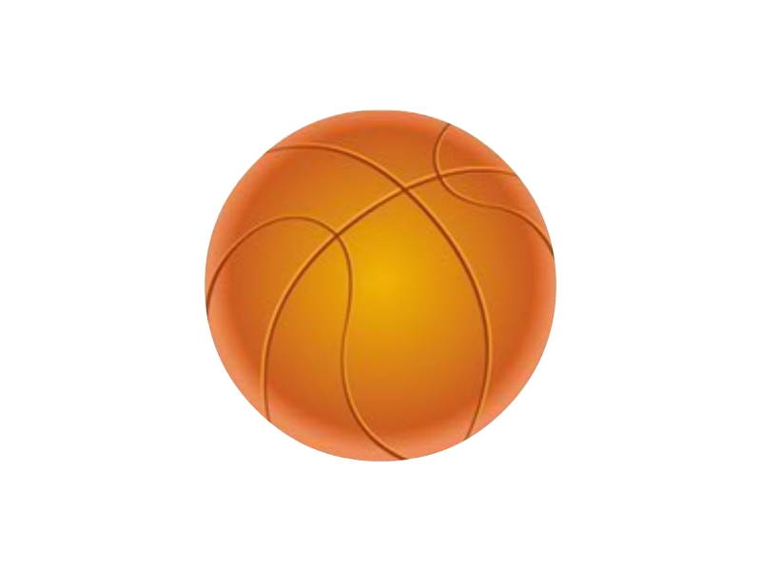
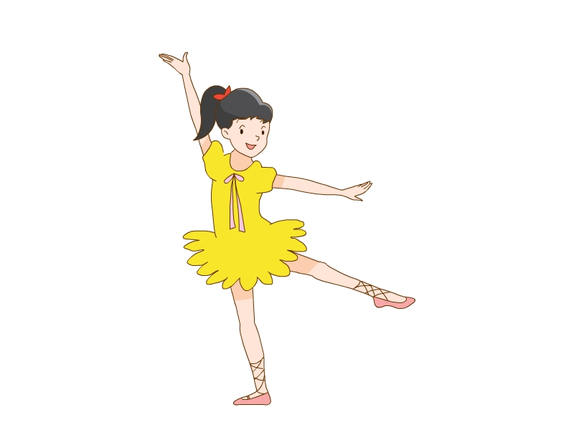
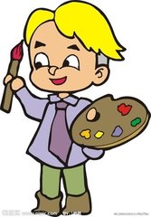
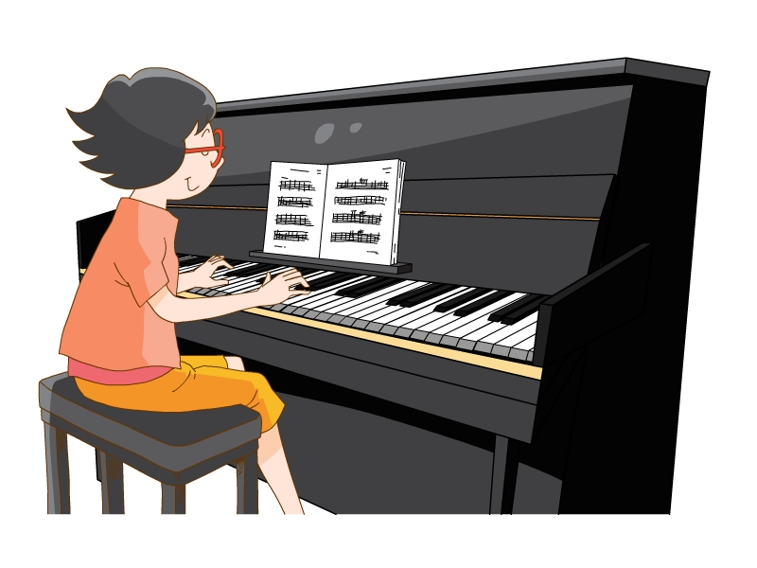
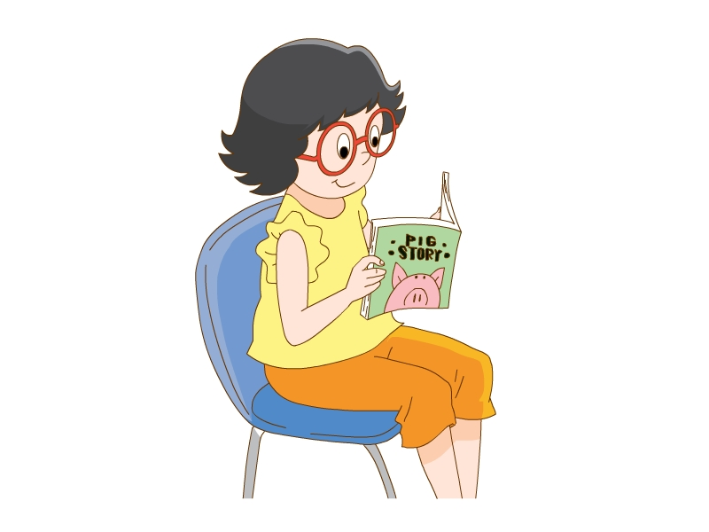
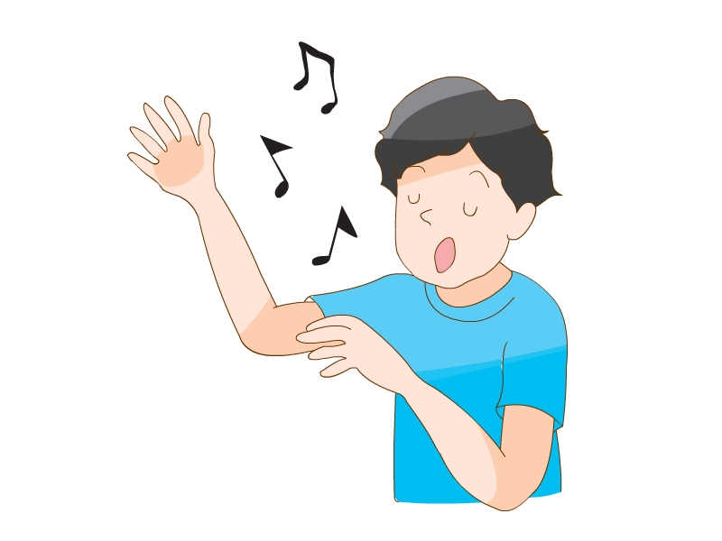
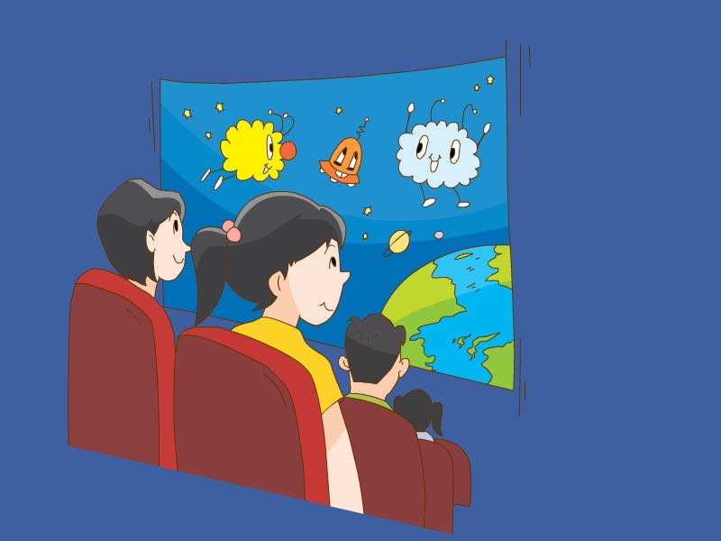
Let’s talk !
A: What do you like doing?
B: I like…ing.

Slide 5
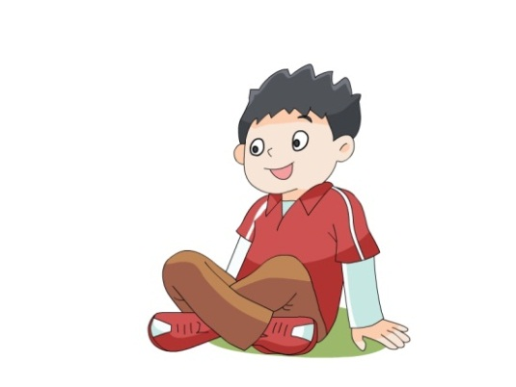
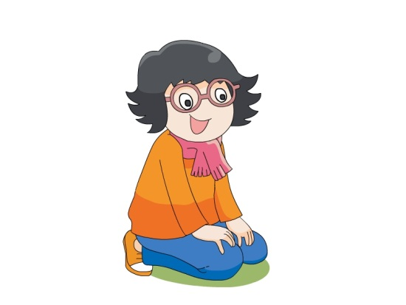
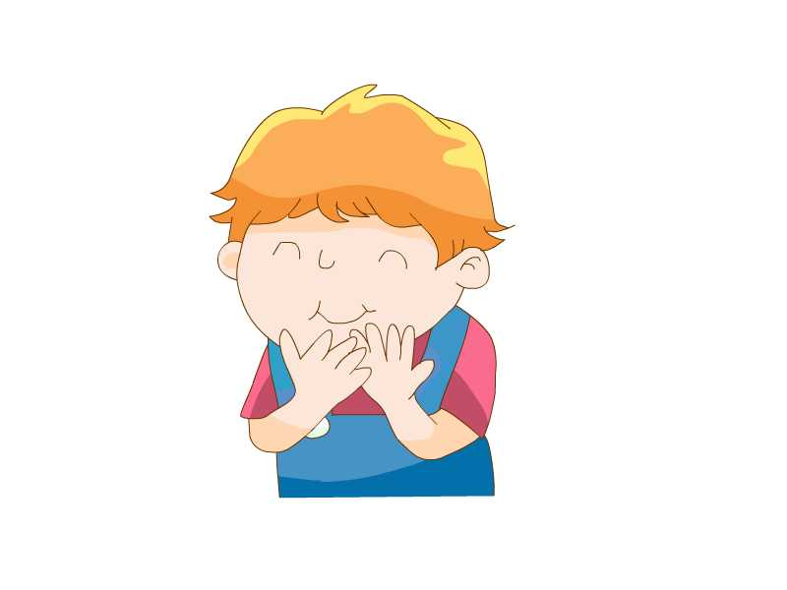
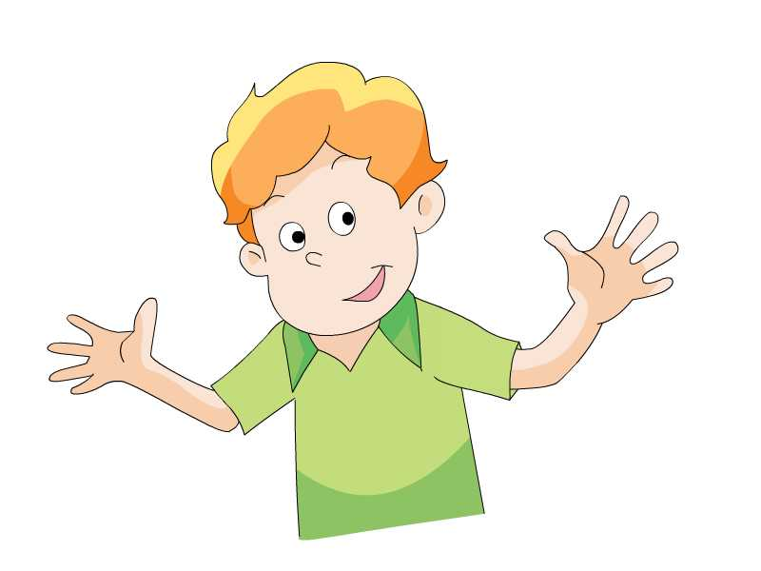
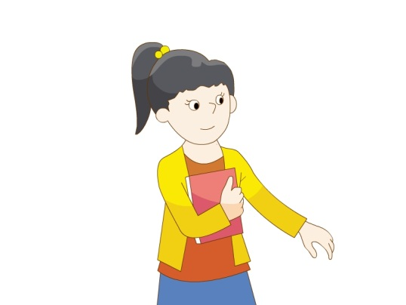
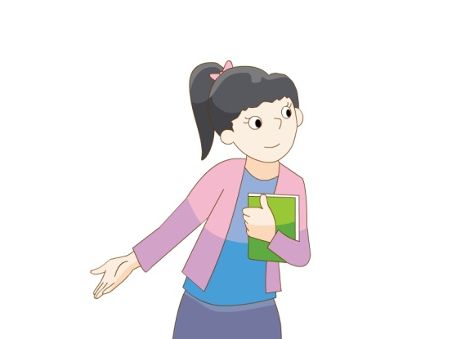
Let’s review !
What do they like doing?

Slide 6
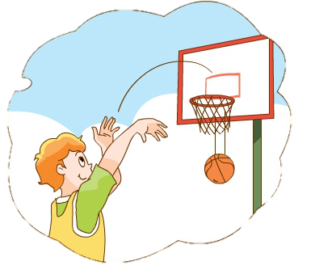
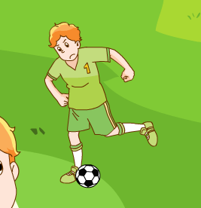
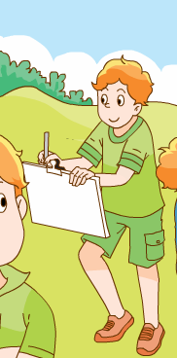
Let’s review !
-What Mike like doing?
does
-He likes________ ___________and ________.
playing basketball
football
He likes__________ too.
drawing

Slide 7

Let’s review !
-What Tim like doing?
does
-He likes___________.
drawing

Slide 8
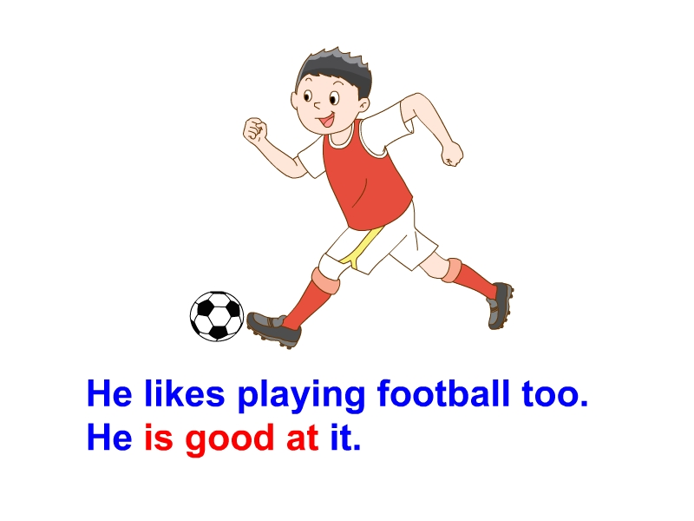
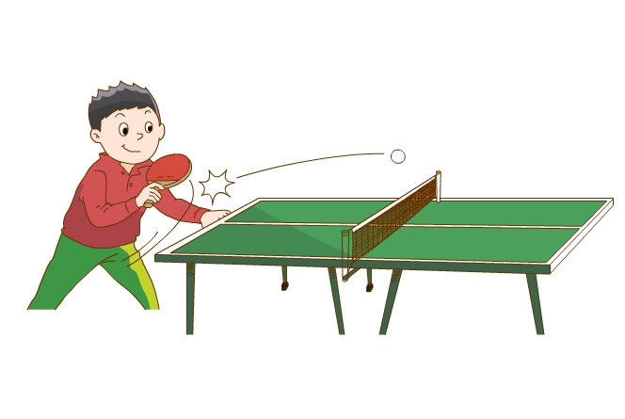
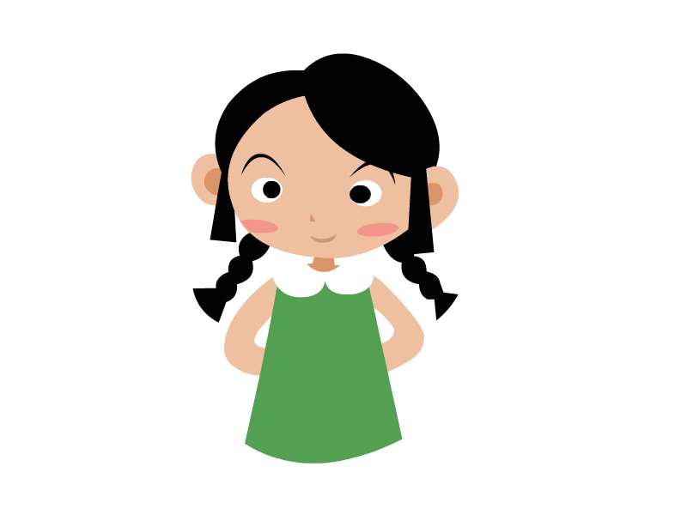
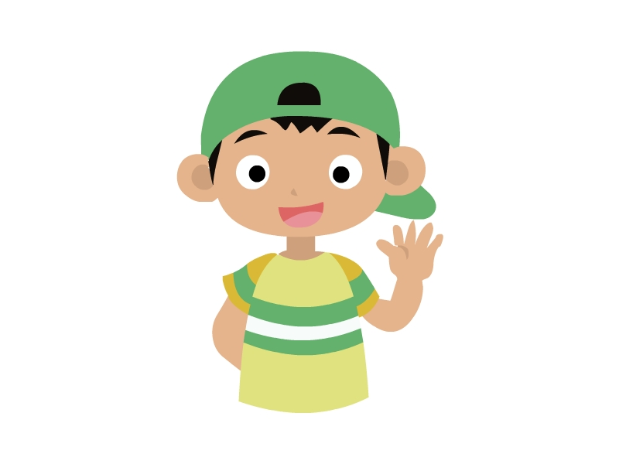
Let’s review !
-What_______Liu Tao _____________?
does
like doing
-He________ _________ _________.
likes
playing football
also
He ______likes _______ _____ ______.
playing table tennis

Slide 9

Let’s review !
-What_______Yang Ling ______________?
does
like doing
-She________ __________ ________.
likes
reading stories
also
playing the piano
She_______likes ________ _______ ______.

Slide 10

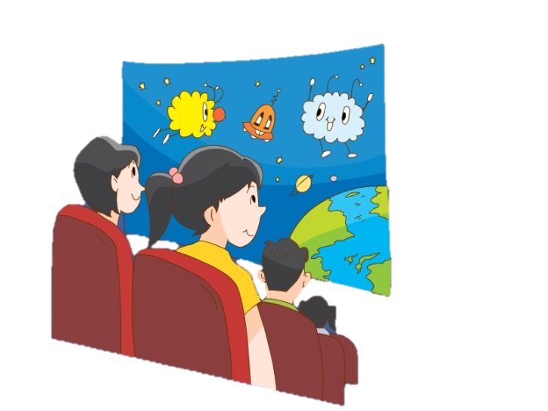
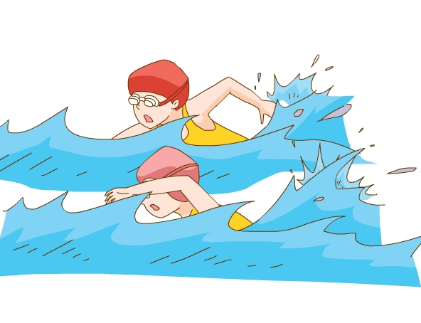
Let’s review !
和你的同桌问一问双胞胎们的爱好吧！
does
-What_______ Su Hai ____________?
like doing
-Su Hai_______ ________ and ___________
likes
dancing
swimming
-What_______ SuYang ____________?
does
like doing
likes
-Su Yang_______ __________ ________ and _____________.
watching films
swimming

Slide 11
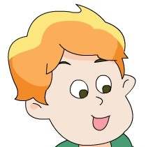

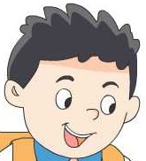
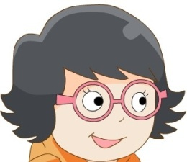
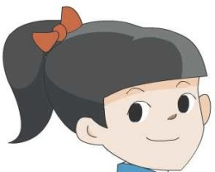
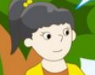
Let’s review !
一起读一读这些句子。
What does he like doing?
likes
playing basketball, football and drawing.
What does he like doing?
likes
drawing.
What does he like doing?
likes
playing football and table tennis.
你发现这些句子有什么地方相同吗？
What does she like doing?
likes
reading stories and playing the piano.
What does she like doing?
likes
dancing and swimming.
What does she like doing?
likes
watching films and swimming.

Slide 12
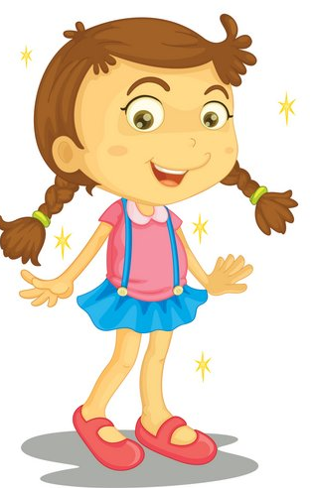








I can find
1
主语是he，she，it等第三人称单数时，
like后加S。
2
like后面的动词要用 ing形式。

Slide 13
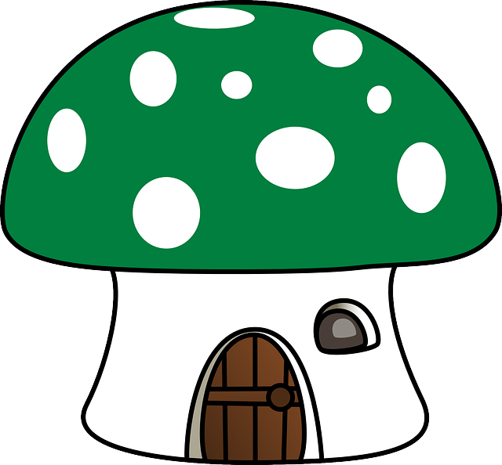
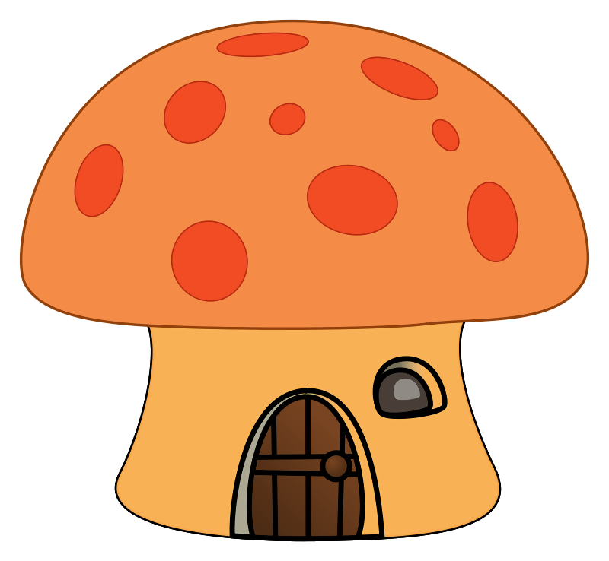
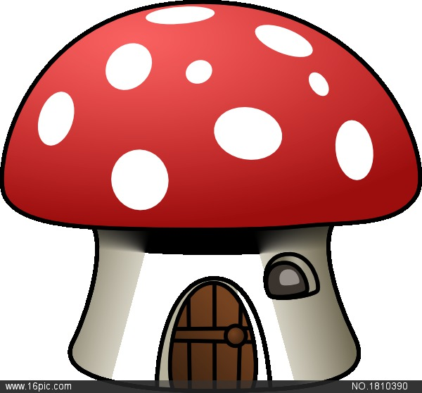
直接加ing
通常情况下
read
sit
run
draw drawing
have
sing singing
每所蘑菇房子中的动词如何加 ing？
dance
请把这些动词送回家
reading
play
playing
去e加ing
词尾是不发音e
双写尾字母加ing
最后一音节为重读闭音节
skate skating
swim swimming
dancing
running
having
sitting

Slide 14


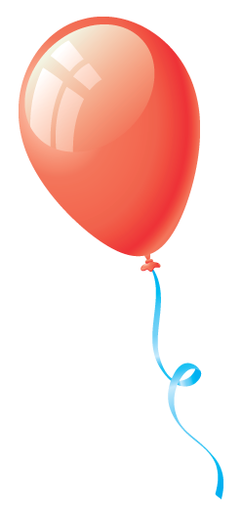
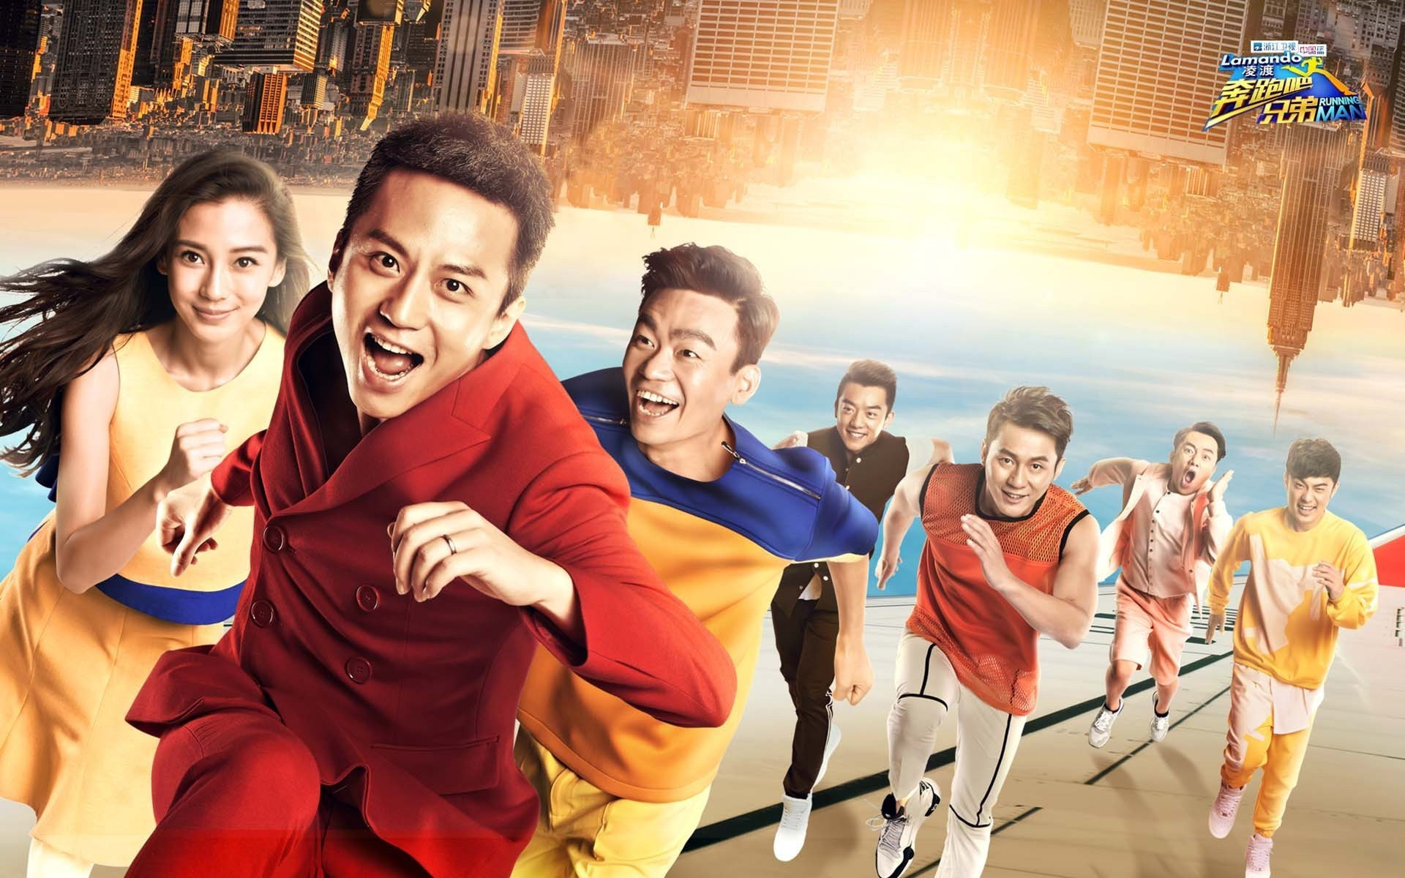
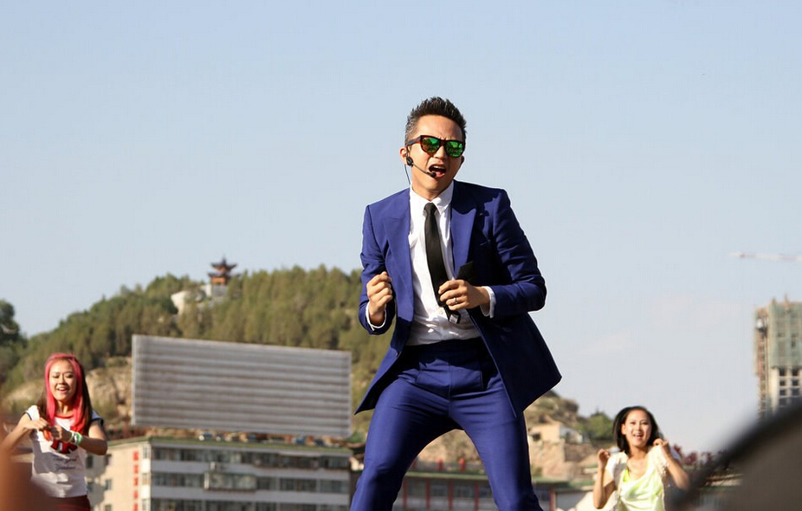
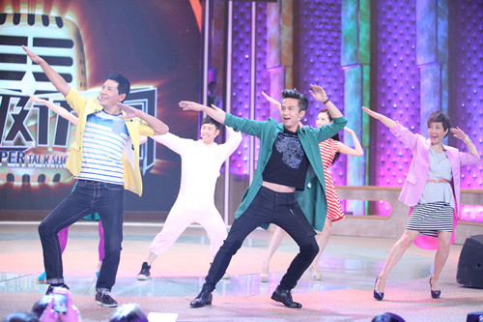

Running man
run
running
Running man
What does he like doing?
He likes ...ing.

Slide 15

What does he like doing?
He likes playing the piano.

Slide 16

What does he like doing?
He likes playing table tennis.

Slide 17


What does she like doing?
She likes dancing.

Slide 18

What does she like doing?
She likes drawing.

Slide 19

What do they like doing?
They like playing tennis.

Slide 20

What do they like doing?
They like playing basketball.

Slide 21



Work in pairs
a.
b.
c.
A: What does he/she like doing?
B: He/She likes …ing.
A: What do they like doing?
B: They like…ing.

Slide 22

Let’s read !

Slide 23

Summary time
助动词
主语
What | do | I | like | doing | ?
 |  | you
 |  | we
 |  | they
 | does | he
 |  | she
Tips: 当主语不是三单时，用助动词do;
当主语是三单时，用助动词does。

Slide 24

Summary time
主语
动词
I | like | playing football | .
You |  | playing basketball
We |  | watching films
They |  | swimming
He | likes | playing table tennis
She |  | reading stories
Tips: 当主语不是三单时，主语后动词用原型(like);
当主语是三单时，主语后动词要变成三单形式(likes)。

Slide 25
Summary time
1.当我想知道你喜欢做什么事时，可以怎样问与答？
What do you like doing? I like ……
2.当我想知道他或她喜欢做什么事时，可以怎样问与答？
What does he/she like doing?
He/She likes ……
3.当我想知道他们喜欢做什么事时，可以怎样问与答？
What do they like doing? They like ……

Slide 26
Let's talk
你知道小组内小伙伴的的爱好吗？让我们来问一问吧！
Rule:
1.四人一组完成调查
2.顺时针依次询问，完成P40表格
3.推选一人，完成小组展示
A
B
D
C
组
In our group, A likes...B likes...C likes...I like...

Slide 27


Do a survey
What do you like doing ,...?
I like...
In our group, A likes...B likes...C likes...I like...
A
B
D
C

Slide 28




Show Time

Slide 29

My Dad
Singing makes us happy.
歌唱让我们快乐。
Hobbies make
our life colourful.
爱好让我们的生活多姿多彩。
Dancing makes us beautiful.
舞蹈让我们美丽。
Reading makes us clever.
阅读让我们明智。

Slide 30

This is my dad.
What ____ he like___?
Let me tell you.

Slide 31

He is ____ ___ football.
He likes ______ football.

Slide 32


He ______ jumping and _____.

Slide 33


He also ____ ____ and eating.

Slide 34


He ____ many good friends.
They ____ singing and _____.

Slide 35

He’s really very good.
He loves me and
I love him forever.

Slide 36
My Dad

Slide 37
This is my dad.
What ____ he like_____?
Let me tell you.
does
doing

Slide 38
He is ____ ___ football.
He likes ______ football.
good
at
playing

Slide 39
running
He ______ jumping and _______.
likes

Slide 40
He also _____ ___ ___ and eating.
likes
swimming

Slide 41
He ____ many good friends.
They ___ singing and _____ .
has
like
dancing

Slide 42
He’s really very good.
He loves me and
I love him forever.

Slide 43



Homework
1.了解父母长辈的兴趣爱好，并用今天学到的句型与同学进行交流分享。
2.有兴趣的同学阅读绘本《My Mum》！

Slide 44

Goodbye!

