Slide 1
Unit 3 Holiday fun
(Grammar time & Fun time)

Slide 2
Guessing Time
四人一组，选择一个描述读一读，猜一猜Miss Huang国庆节去过哪里。比一比哪一组最快最准！
It is a must place to visit in Beijing. It’s very big. On a holiday, it is covered with fresh flowers. Miss Huang watched the flag-raising ceremony(升旗仪式) there.
It is a great wonder of the world. It’s very long. There is a saying “He who has never been there is not a true man.” Miss Huang climbed it up and took photos there.
Where did I go?
It’s a beautiful park in Beijing. Cixi used to(曾经) stay there in summer. There is a big lake in it. Miss Huang went boating there.
It was the palace. Now, it is a museum. Visitors will be excited to find some sites, parks, museums, and theatres in it. Miss Huang had a good time there.

Slide 3
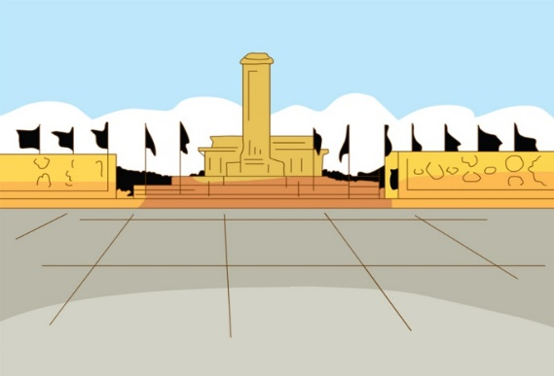
Guessing Time
Did you go to (the)…?
It is a must place to visit in Beijing. It’s very big. On a holiday, it is covered with fresh flowers. Miss Huang watched the flag-raising ceremony(升旗仪式) there.
Tian’anmen Square

Slide 4
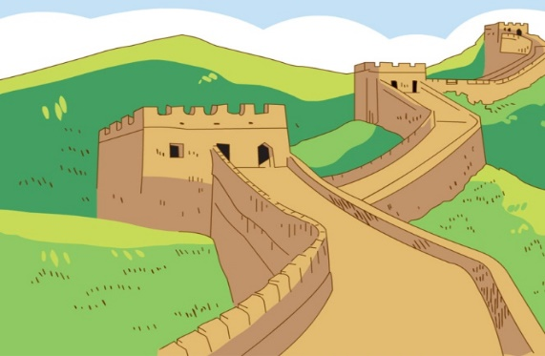
Guessing Time
Did you go to (the)…?
It is a great wonder of the world. It’s very long. There is a saying “He who has never been there is not a true man.” Miss Huang climbed it up and took photos there.
Great Wall

Slide 5
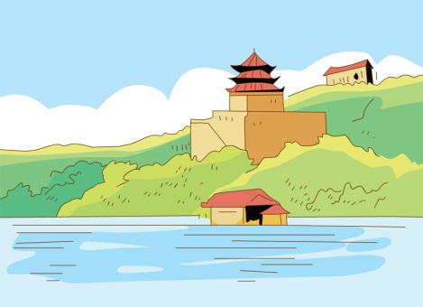
Guessing Time
Did you go to (the)…?
It’s a beautiful park in Beijing. Cixi used to(曾经) stay there in summer. There is a big lake in it. Miss Huang went boating there.
Summer Palace
cinema
apple

Slide 6
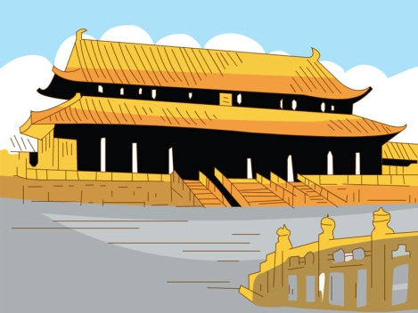
Guessing Time
Did you go to (the)…?
It was the palace. Now, it is a museum. Visitors will be excited to find some sites, parks, museums, and theatres in it. Miss Huang had a good time there.
Palace Museum
cinema
apple

Slide 7
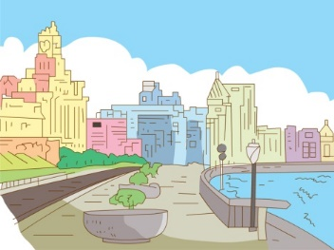
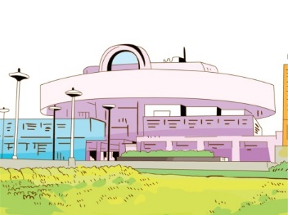
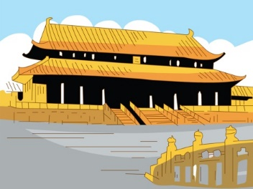
Bund
Shanghai Museum
Great Wall
Tian’anmen Square
Summer Palace
Palace Museum

Slide 8
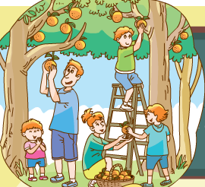
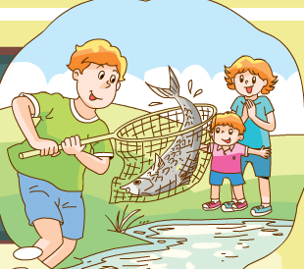
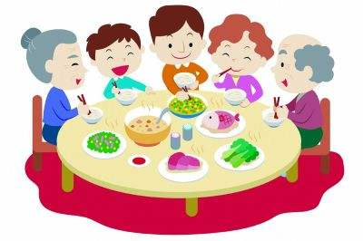
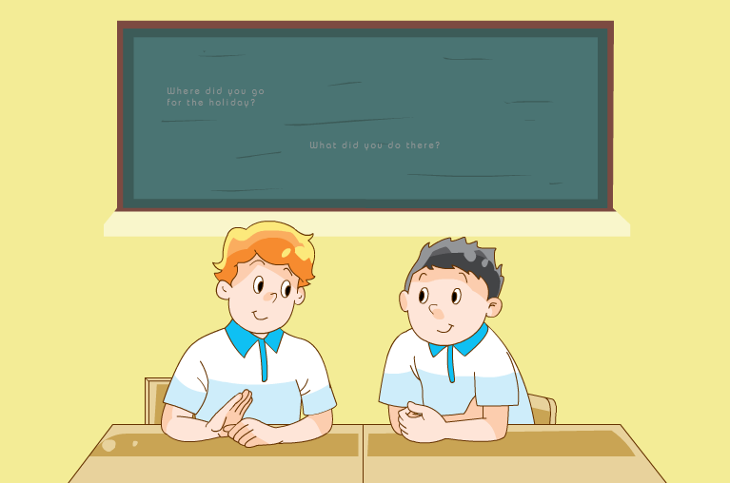
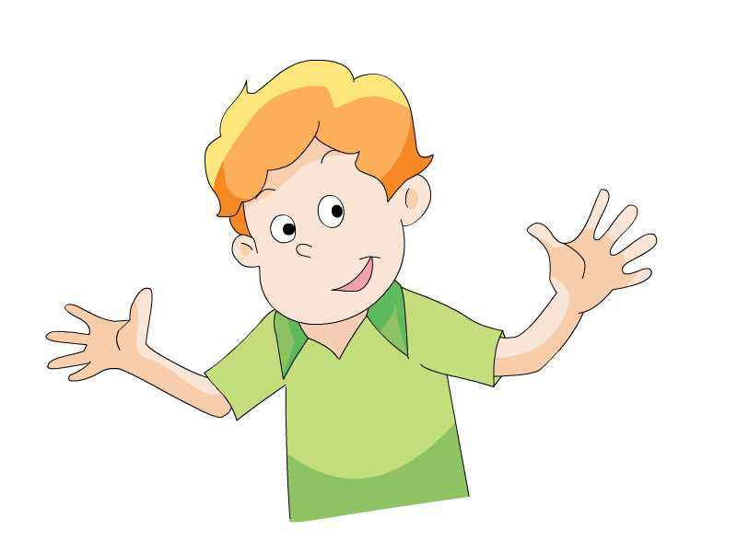
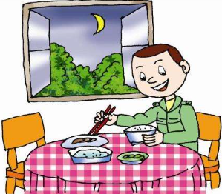
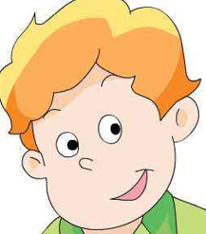
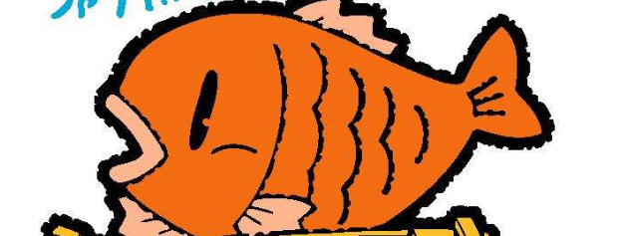
Talking Time
两人一组，根据图片和课文内容提问并回答。
比一比，谁提的问题多，谁回答得更准确。
Where…?
What…?
…
How…?
Did…?
You
You
…?

Slide 9
Talking Time
读一读，根据课文内容回答问题。
What did Liu Tao do for the holiday?
He visited Shanghai.
Where did Mike go for the holiday?
He went to a farm.
Why did Mike call Liu Tao?
Because he wanted to give him the fish.
How was Liu Tao’s holiday?
It was great fun.
Did Liu Tao go fishing?
No, he didn’t.

Slide 10
Grammar Time
Think and find
思考一下，找一找哪一句和其他句子不同。
What did Liu Tao do for the holiday?
Where did Mike go for the holiday?
How was Liu Tao’s holiday?
Why did Mike call Liu Tao?
Did Liu Tao go fishing?

Slide 11
Grammar Time
Think and discuss
思考并讨论，这两组句子有什么不同。
Wh-question
What did Liu Tao do for the holiday?
Where did Mike go for the holiday?
How was Liu Tao’s holiday?
Why did Mike call Liu Tao?
Yes-no question
Did Liu Tao go fishing?

Slide 12
Grammar Time
Think and discuss
思考并讨论
Wh-question
did
He visited Shanghai.
What did Liu Tao do for the holiday?
did
He went to a farm.
Where did Mike go for the holiday?
Why did Mike call Liu Tao?
Because he wanted to give him the fish.
did
Yes-no question
Did
Did Liu Tao go fishing?
No, he didn’t.
Grammar tip:
疑问构成有方法，疑问句中did加，
还有一点不能忘，后面动词用原样。

Slide 13
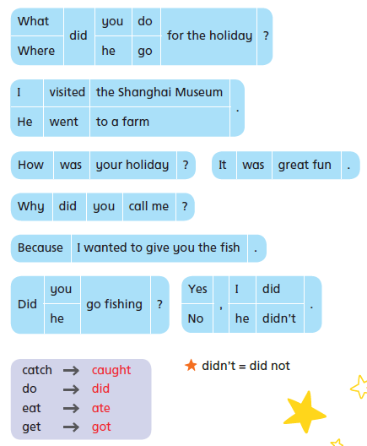
Grammar Time
Read in pairs
两人一组读一读

Slide 14
Grammar Time
catch caught
do did
eat ate
get got

Slide 15
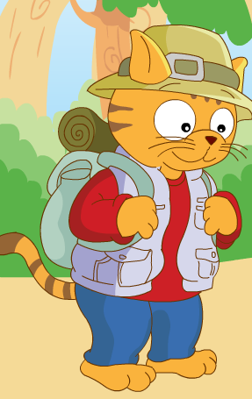
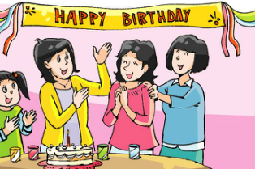
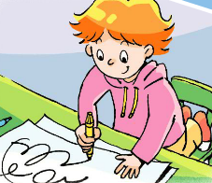
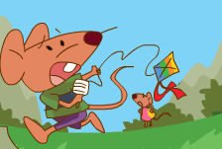
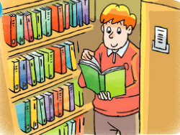
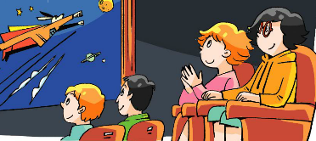
Grammar Time
20 seconds Non-stop talking
四人一组，20秒内轮流不停描述下面的图片，注意正确使用动词过去式。
4
On National Day holiday, …

Slide 16
Fun Time
Say a chant
Where did you go, Little Row?
I went to the zoo with Uncle Joe.
Did you see an animal show?
Yes, I did. How about you?
Amy
Row

Slide 17
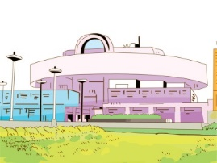
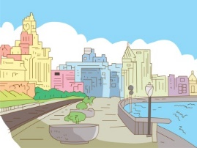
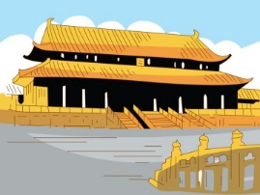
Fun Time
Look, imagine and act
eat Beijing ducks
吃北京烤鸭
see the beautiful night 看美丽的夜景
see the culture relics 看文物
两人一组，观察图片，扮演Row和Amy，展开想象，进行对话。
How was your National Day holiday?
It was …
Where did you go?
I went…
What did you do?
I…
Did you…?
Yes, I did./ No, I didn’t.

Slide 18
Sharing Time
Talk about your travel experiences
四人一组，晒一晒自己的旅游照片。其他人轮流提问。
Where …?
What …?
…
When…?
How …?
…?
You
You

Slide 19
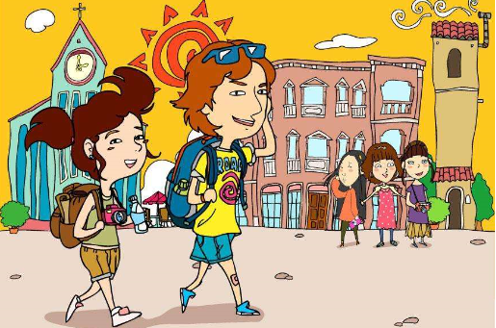
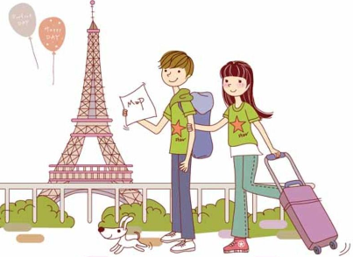
Sharing Time
Make our holiday albums
1.在卡纸上粘贴自己的照片，并填写信息
2.四人一组，制作旅游影集。
Last…, I went to… with…
I saw/ ate…
It was interesting/…
Last…, I went to… with…
I bought/ visited…
It was unforgettable/…

Slide 20
Homework
用所学语言试着和更多的同伴谈论旅行经历，并把你们的对话写下来。
2. 找一找你感兴趣的名胜古迹。至少记住
其中两个。下节课交流。

Slide 21
Thank you!

