Slide 2
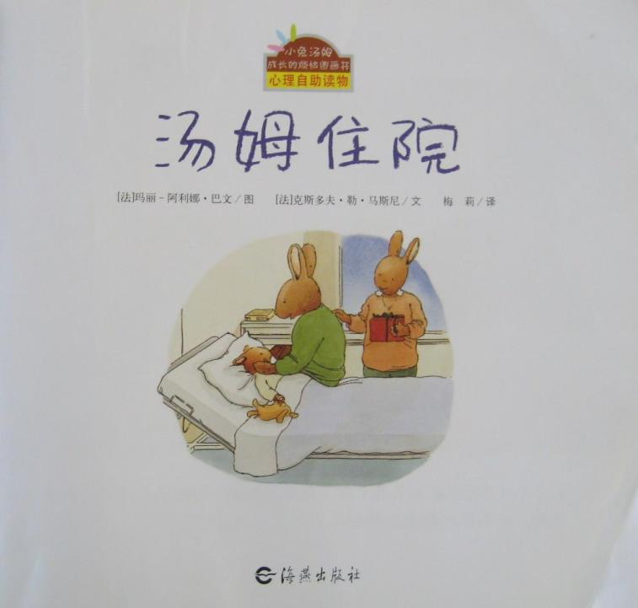

Slide 3
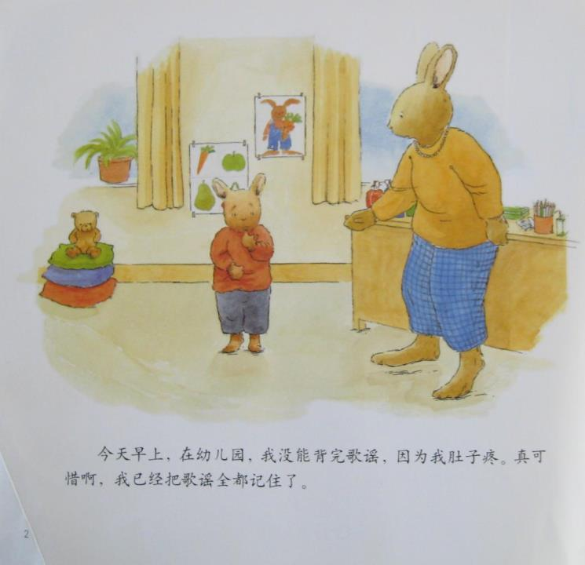

Slide 4
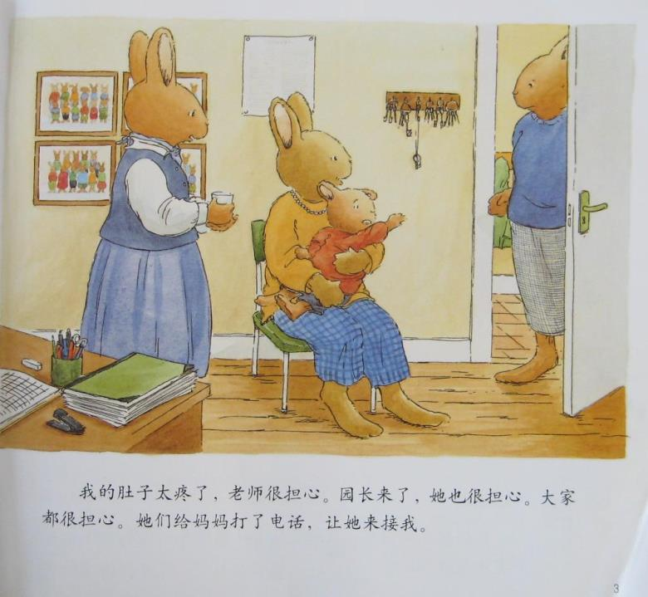

Slide 5
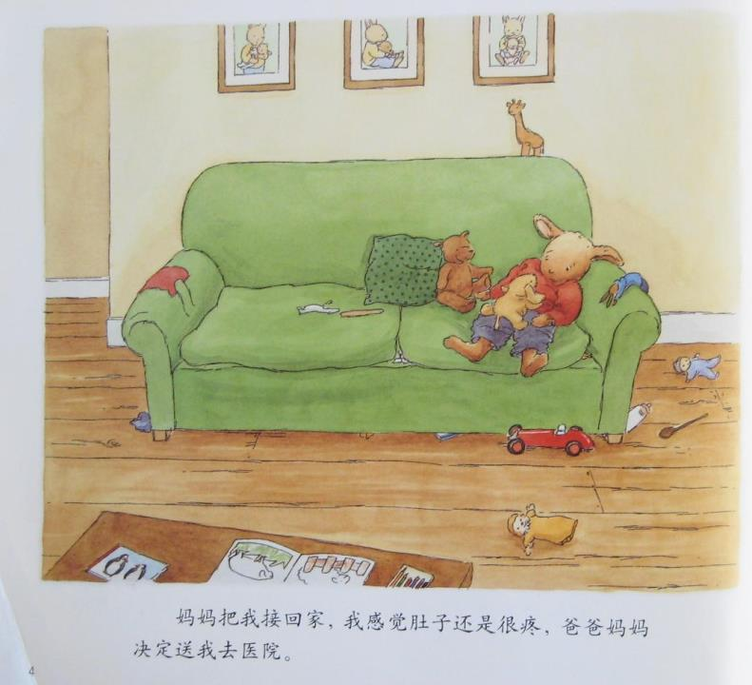
PPT模板：www.1ppt.com/moban/ PPT素材：www.1ppt.com/sucai/
PPT背景：www.1ppt.com/beijing/ PPT图表：www.1ppt.com/tubiao/
PPT下载：www.1ppt.com/xiazai/ PPT教程： www.1ppt.com/powerpoint/
资料下载：www.1ppt.com/ziliao/ 范文下载：www.1ppt.com/fanwen/
试卷下载：www.1ppt.com/shiti/ 教案下载：www.1ppt.com/jiaoan/
PPT论坛：www.1ppt.cn PPT课件：www.1ppt.com/kejian/
语文课件：www.1ppt.com/kejian/yuwen/ 数学课件：www.1ppt.com/kejian/shuxue/
英语课件：www.1ppt.com/kejian/yingyu/ 美术课件：www.1ppt.com/kejian/meishu/
科学课件：www.1ppt.com/kejian/kexue/ 物理课件：www.1ppt.com/kejian/wuli/
化学课件：www.1ppt.com/kejian/huaxue/ 生物课件：www.1ppt.com/kejian/shengwu/
地理课件：www.1ppt.com/kejian/dili/ 历史课件：www.1ppt.com/kejian/lishi/

Slide 6
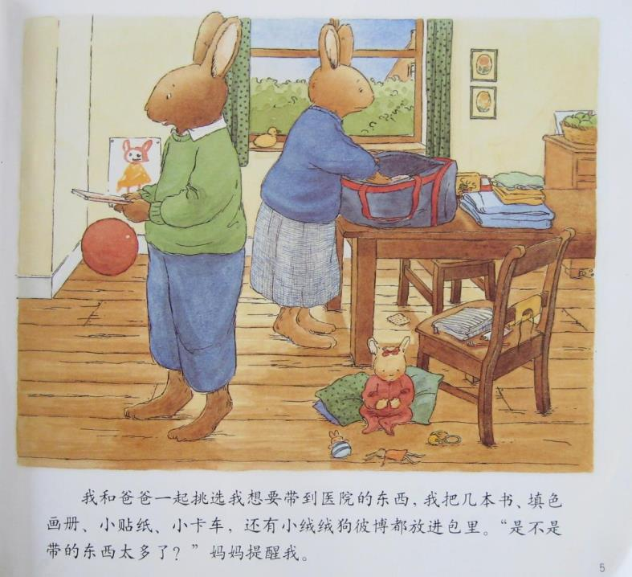

Slide 7
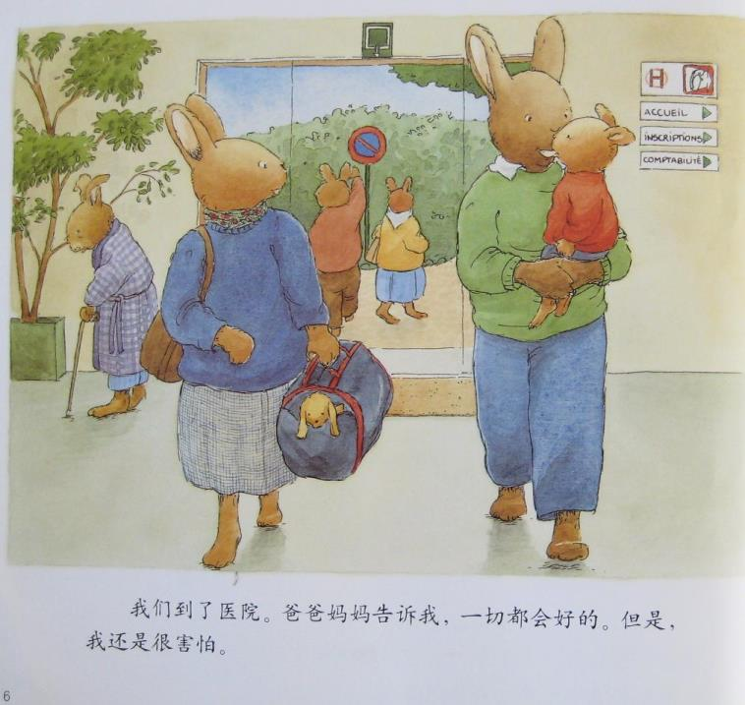

Slide 8
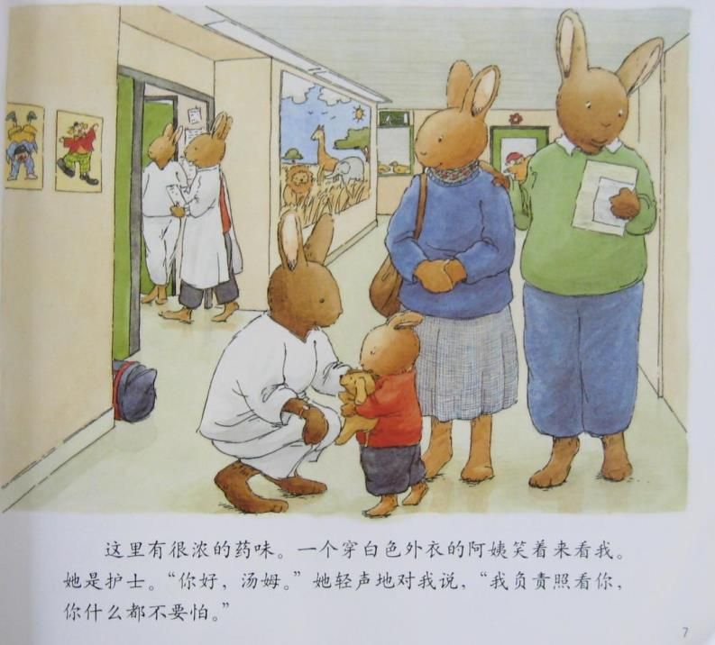

Slide 9
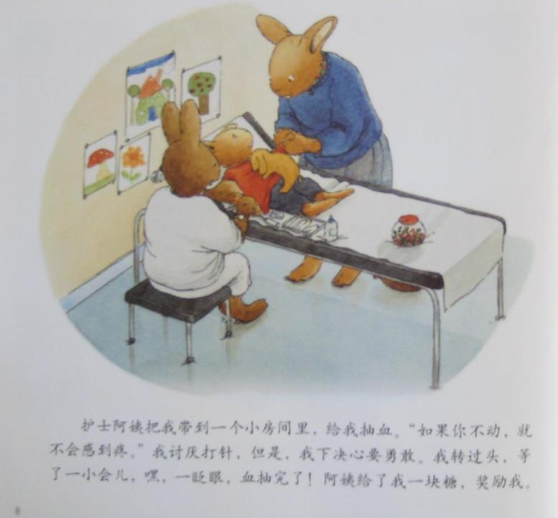

Slide 10
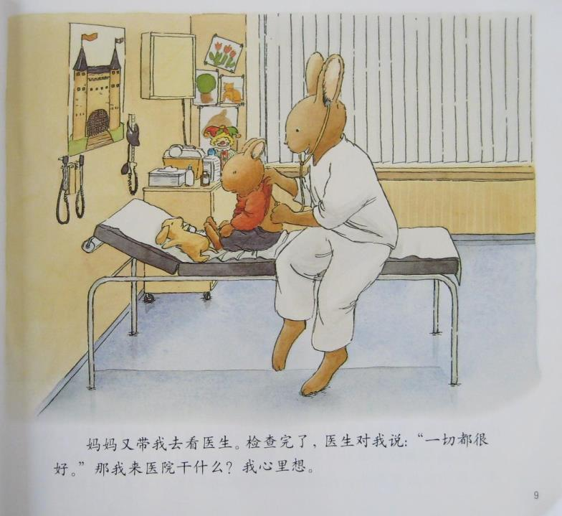

Slide 11
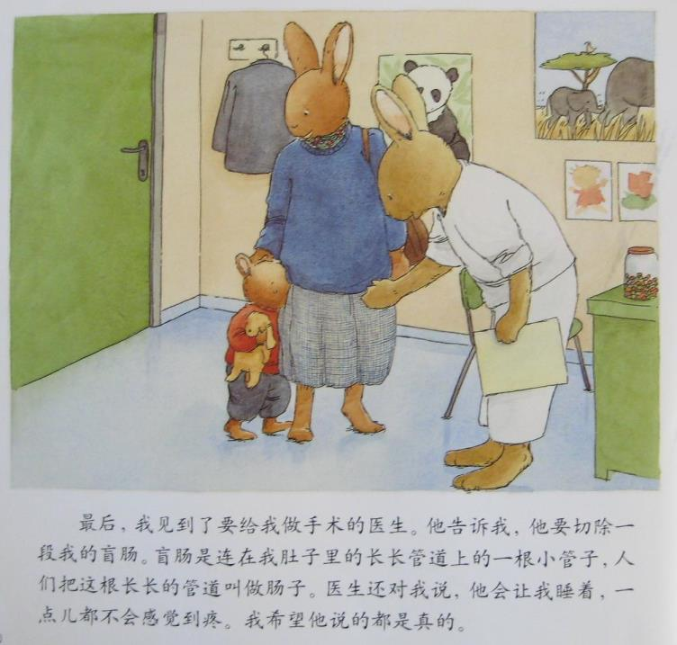

Slide 12
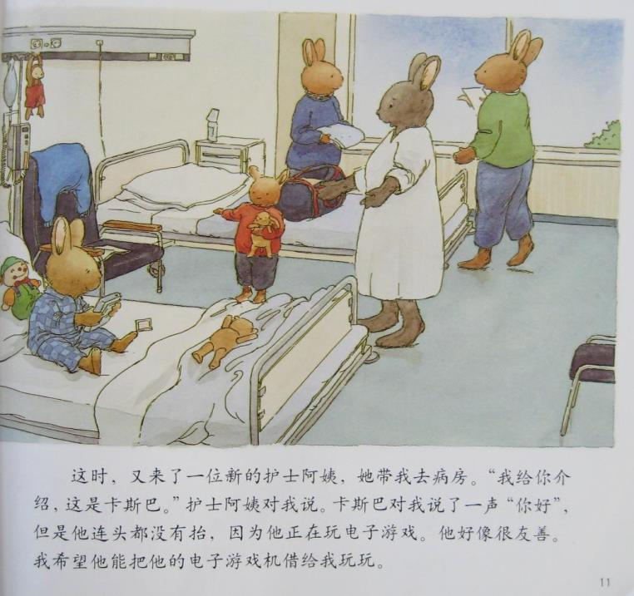

Slide 13
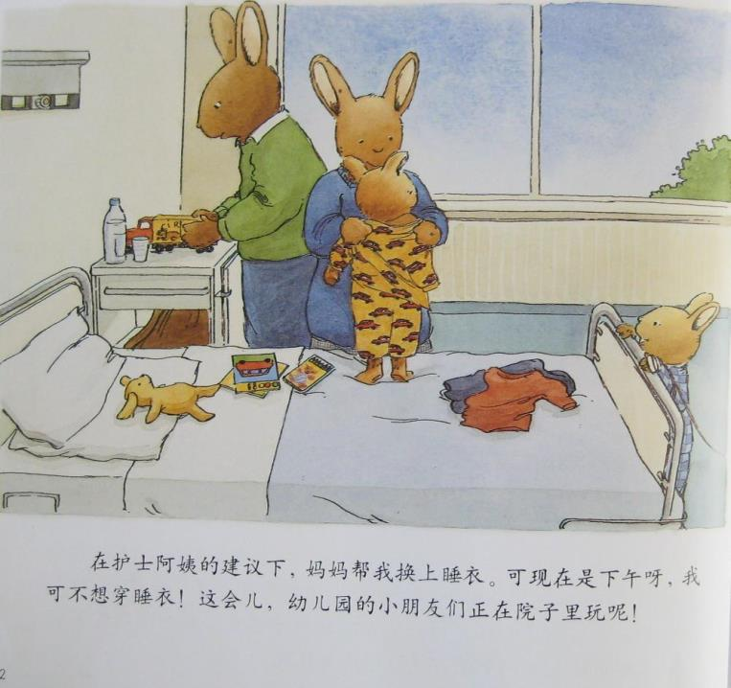

Slide 14
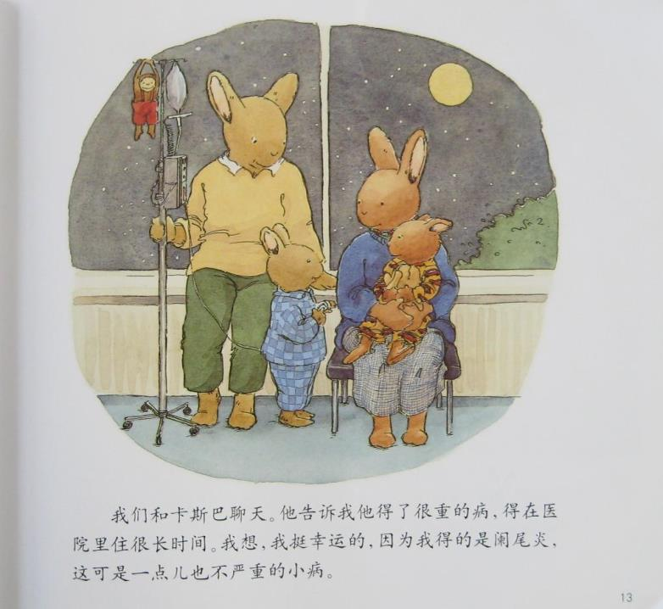

Slide 15
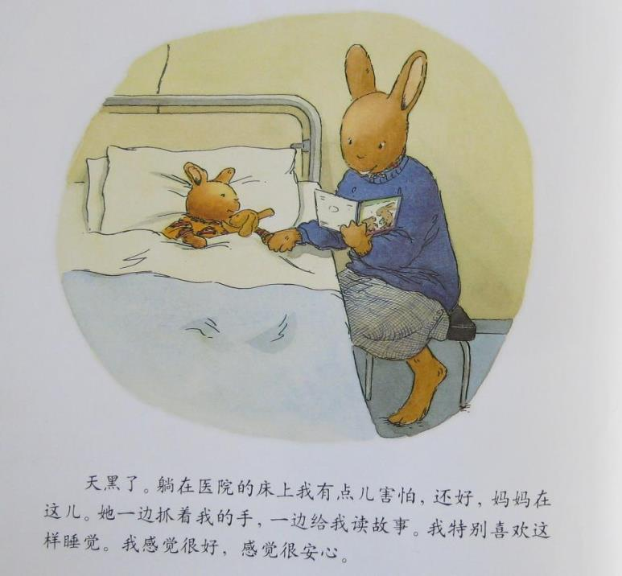

Slide 16
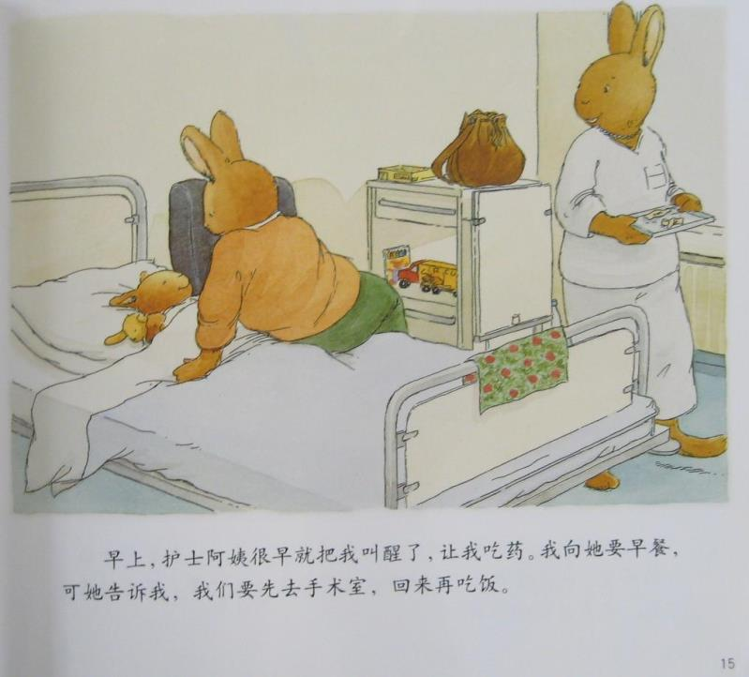

Slide 17
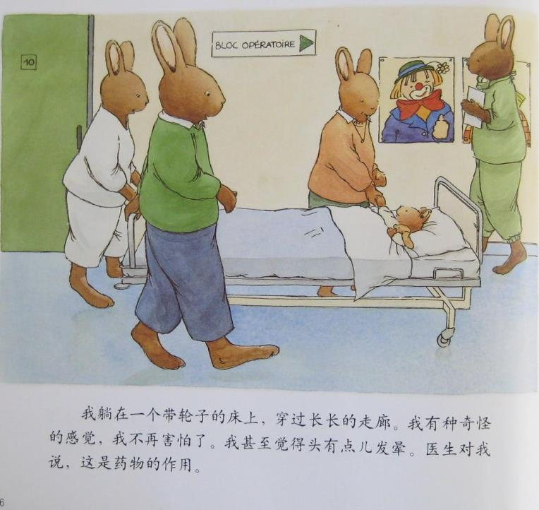

Slide 18
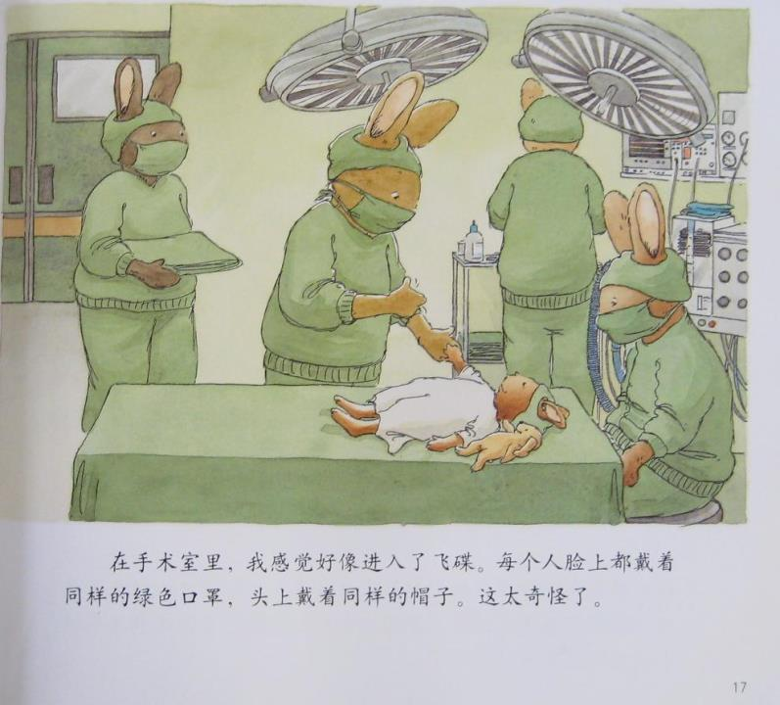

Slide 19
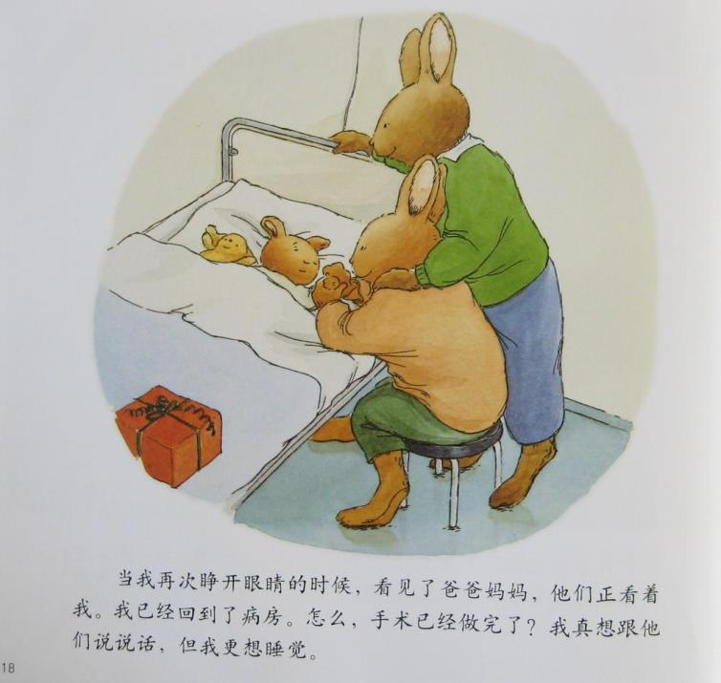

Slide 20
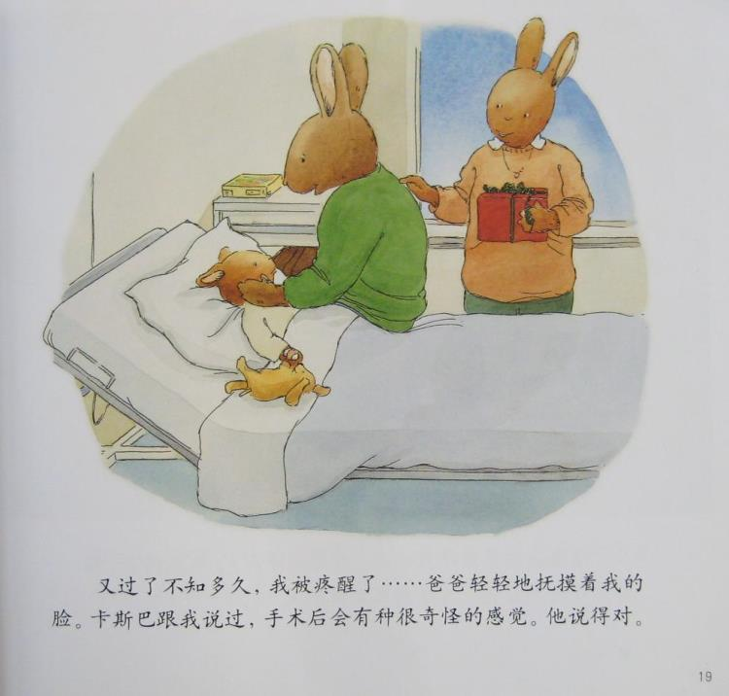

Slide 21
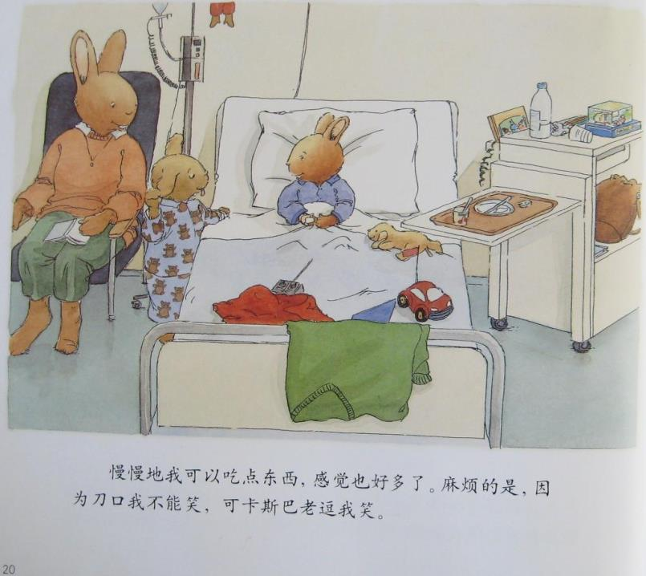

Slide 22
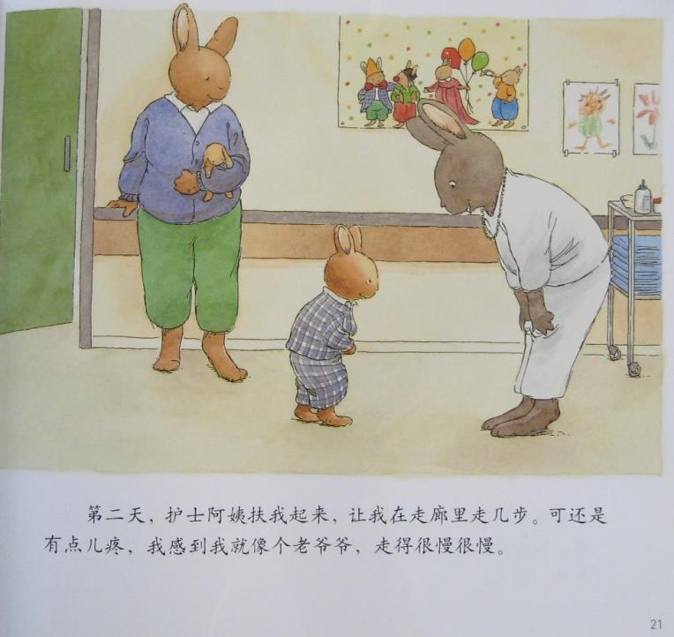

Slide 23
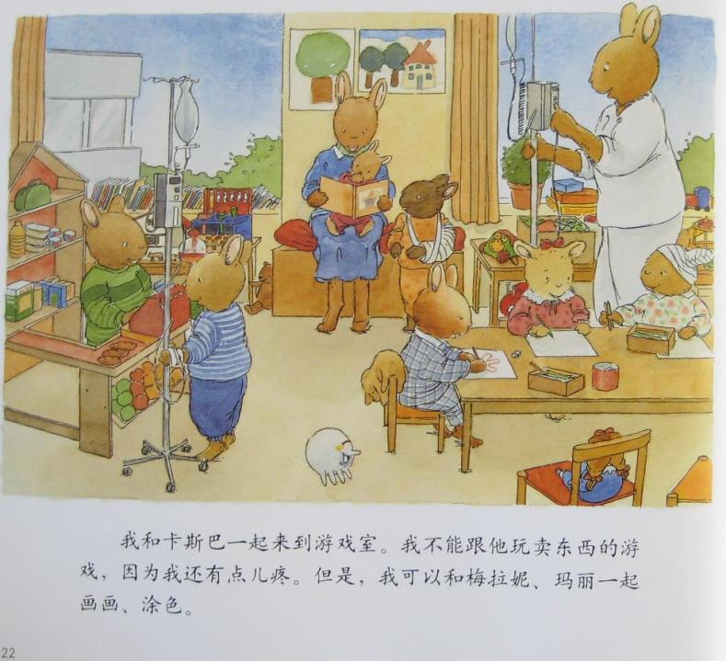

Slide 24
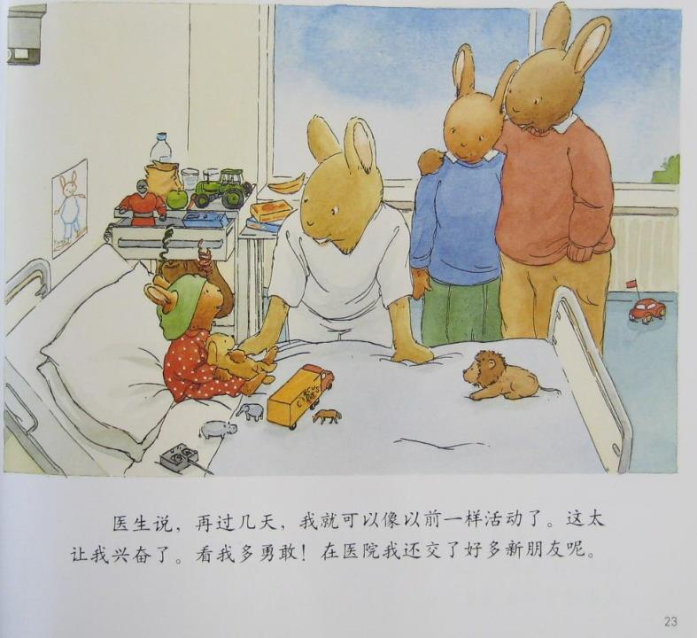

Slide 25
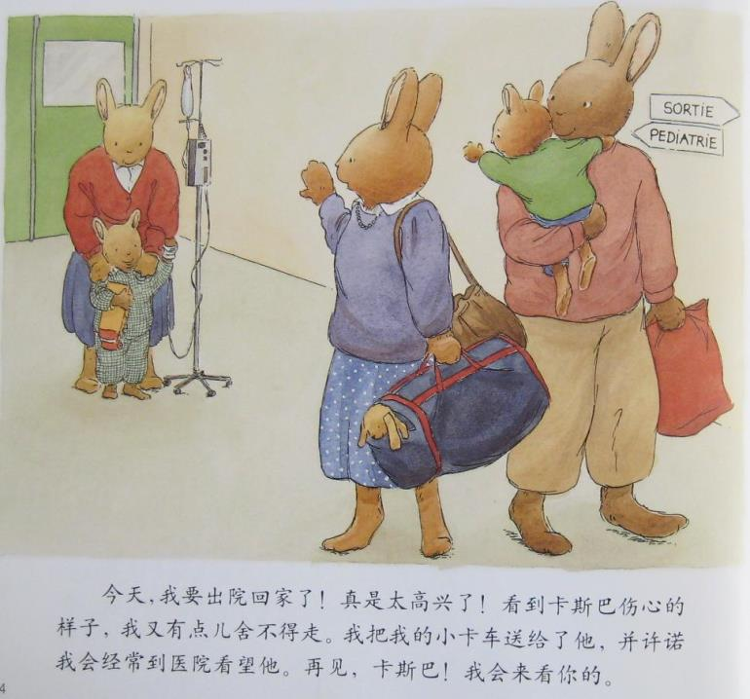

Slide 26
