Slide 1
Enjoy a song
What is the song about?
It’s about jobs(工作).
https://b23.tv/z4UY93q

Slide 2
(Grammar&Fun time)

Slide 3
Fun facts
about jobs!

Slide 4
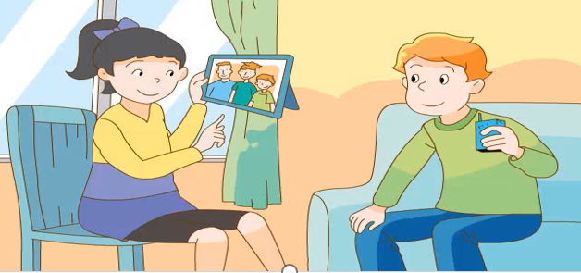
Fun fact 1
同桌选择一人的职业进行问答。
A: What does Mike’s father do?
A: What does...do?
B: ...is/are...He/She...(s/es)...
Who
What
B: He is a teacher. He teaches English.

Slide 5
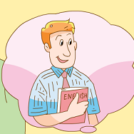
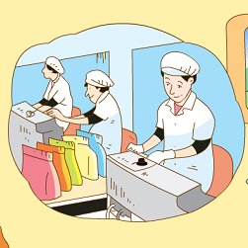
Fun fact 1
Who
What
a teacher
teaches English
a writer
writes stories
a doctor
helps sick people
a worker
makes sweets

Slide 6
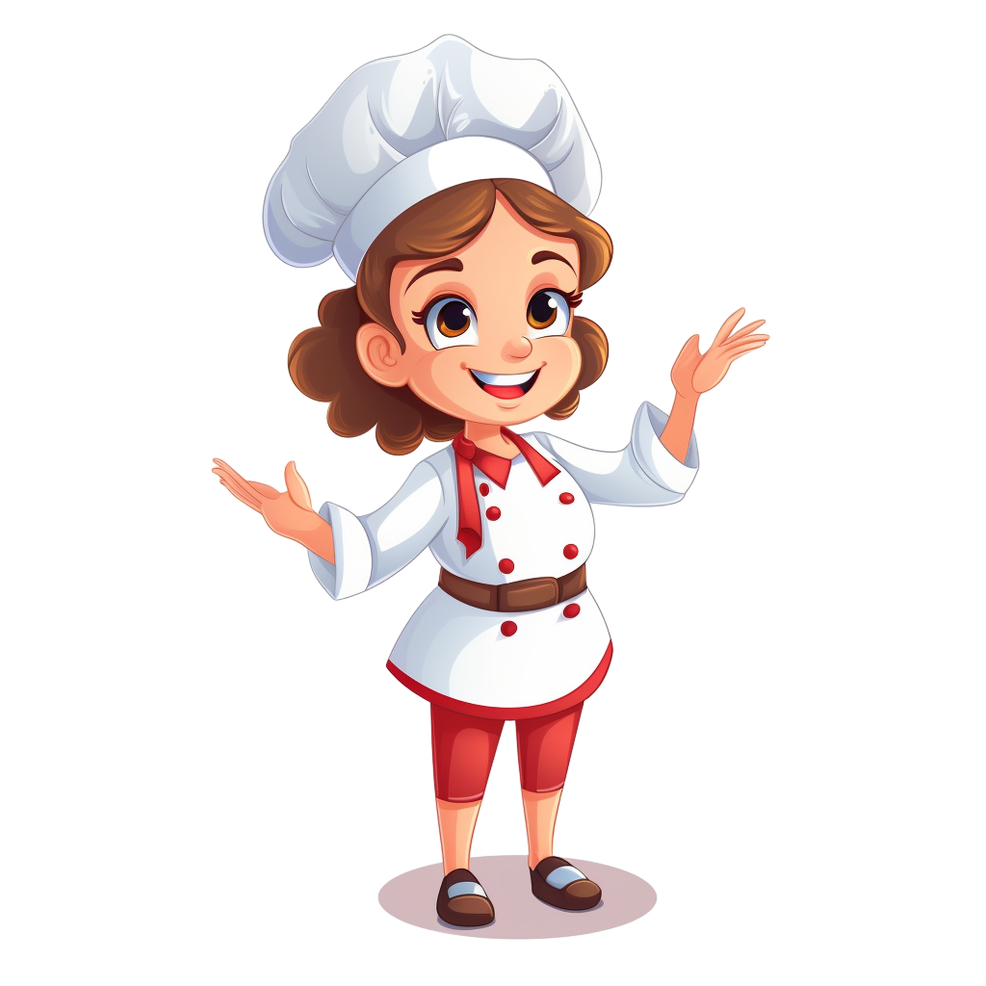
What do they do?
Know more jobs
Tip：圈画让我们更好找到答案哦！
读句子选出合适的职业.
A.driver
B.cook
C.worker
D.nurse
policewoman
E.farmer
F.policeman
cooker 厨具
E.
farmer
1.This woman works on the farm. She’s a _____________.
C.
worker
2.This man repairs(修理) the machine(机器). He’s a _____________.
F.
policeman
3.This man catches(抓住) bad people. He’s a ________________.
4.This woman helps sick people and doctors. She’s a __________.
D.
nurse
B.
cook
cooker？
5.This woman cooks nice food . She’s a _____________.
driver
6.This woman drives a car for work. She’s a _____________.
A.

Slide 7
How to classify these jobs?
怎么将这些职业词进行分类？
Fun fact 1
What do you find?
nurse
driver
policeman
cook
teacher
worker
farmer
writer
driver
policeman
fireman
policewoman
nurse
cook
doctor
teacher
writer
fireman
doctor
farmer
worker
policewoman

Slide 8
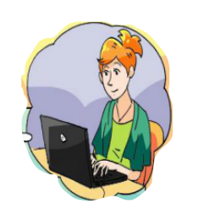
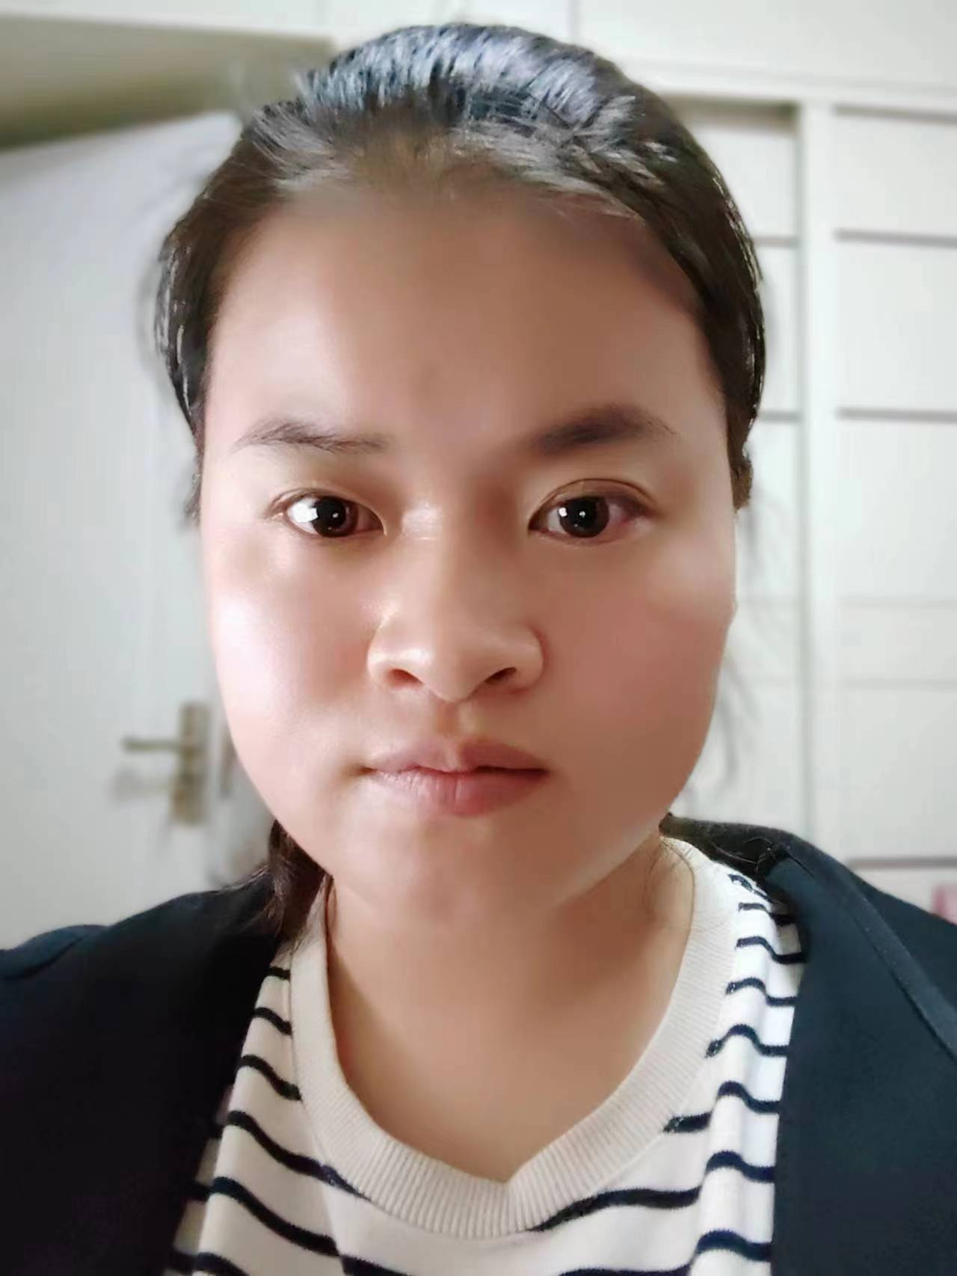
Fun fact 2
你能询问这些人的职业吗？
What does Mike’s mother do?
She’s a writer. She writes stories.
She works at home.
What does Su Hai’s father do?
He’s a doctor. He helps sick people.
What do you do?
I’m a teacher. I teach English.

Slide 9
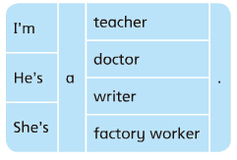
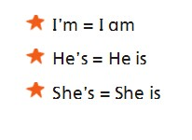
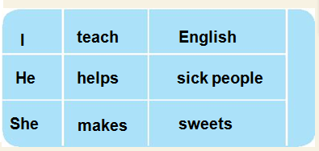
Grammar time
take notes:记笔记是个学习的好方法！
请把这些词圈在书上51页。！
两人小组，朗读对话。
do
you
四人小组讨论：
当我们谈论职业时，
要注意什么？
your father
What
do
?
does
his mother
her mother
询问职业时，用 .
回答时，用 .
He/She人称后，动词+ .
do/does
help —— helps
make—— makes
take——takes
write——writes
teach ——teaches
am/is/are
s/es
s
陈述句中，当主语是第三人称单数时，动词要用其第三人称单数形式。
writes stories.
s
s

Slide 10
What do they usually do?
陈述句中，当主语是第三人称单数时，动词要用其第三人称单数形式。
用所给动词适当形式完成句子。
He/She
 | What
Who
has
works
He/She=
A farmer
______ (have) a farm and ______(work) on the farm.
A fireman
puts
_______(put) out（熄灭） fire.
A policeman
works
_______(work) in the police office(警局）.
helps
A nurse
______(help) sick people and doctors.
A cook
cooks
______(cook) nice food.
A driver
drives
______(drive) a car for work.
A teacher
teaches
________(teach) English.

Slide 11
Grammar points
动词第三人称单数形式变化规则：
1.一般情况下，动词后面直接加-s，如：
make—makes，help—helps，write-writes
2.以o、s、x、ch、sh结尾的动词，在后面加-es，如：
teach—teaches, watch—waches，go-goes
3. 结尾以辅音字母+y的动词，要把y变为i加-es，如：
fly—flies, cry—cries
4. 特殊变化 have-has

Slide 12
More job contents
He
She
It
I
We
You
They
Who | What
have
work
Lily and Sam
has
works
They=
A farmer
______(have) a farm and_______(work) on the farm.
She
+
He
=They
puts
Lily and Sam’s father
______(put) out（熄灭） fire.
A fireman
works
Their dog
_______(work) in the police office(警局）.
A policeman
We
helps
A nurse
______(help) sick people and doctors.
His friends
cooks
A cook
______(cook) nice food.
A driver
drives
Our sister
______(drive) a car for work.
Your teacher
teaches
A teacher
________(teach) English.

Slide 13
More job contents
He
She
It
I
We
You
They
Who | What
have
work
They=
Lily and Sam
_____（have) a farm and ______(work) on the farm.
puts
______(put) out（熄灭） fire.
He=
Lily and Sam’s father
Their dog
_______(work) in the police office(警局）.
We
______(help) sick people and doctors.
His friends
______(cook) nice food.
Our sister
______(drive) a car for work.
Your teacher
________(teach) English.

Slide 14
More job contents
He
She
It
I
We
You
They
Who | What
Tip: 要注意圈画哦！
have
work
They=
Lily and Sam
_____（have) a farm and ______(work) on the farm.
puts
______(put) out（熄灭） fire.
He=
Lily and Sam’s father
works
It=
Their dog
_______(work) in the police office(警局）.
We
______(help) sick people and doctors.
His friends
______(cook) nice food.
Our sister
______(drive) a car for work.
Your teacher
________(teach) English.

Slide 15
More job contents
He
She
It
I
We
You
They
Who | What
have
work
They=
Lily and Sam
_____（have) a farm and ______(work) on the farm.
puts
______(put) out（熄灭） fire.
He=
Lily and Sam’s father
works
It=
Their dog
_______(work) in the police office(警局）.
help
We
______(help) sick people and doctors.
His friends
______(cook) nice food.
Our sister
______(drive) a car for work.
Your teacher
________(teach) English.

Slide 16
More job contents
He
She
It
I
We
You
They
Who | What
have
work
They=
Lily and Sam
_____（have) a farm and ______(work) on the farm.
puts
______(put) out（熄灭） fire.
He=
Lily and Sam’s father
works
It=
Their dog
_______(work) in the police office(警局）.
help
We
______(help) sick people and doctors.
His friends
cook
They=
______(cook) nice food.
Our sister
______(drive) a car for work.
Your teacher
________(teach) English.

Slide 17
More job contents
He
She
It
I
We
You
They
Who | What
have
work
They=
Lily and Sam
_____（have) a farm and ______(work) on the farm.
puts
______(put) out（熄灭） fire.
He=
Lily and Sam’s father
works
It=
Their dog
_______(work) in the police office(警局）.
help
We
______(help) sick people and doctors.
They=
His friends
cook
______(cook) nice food.
She=
Our sister
drives
______(drive) a car for work.
Your teacher
________(teach) English.

Slide 18
He
She
It
I
We
You
They
More job contents
第三人称单数（动词三单）
其他（动词原型）
Who | What
have
work
They=
Lily and Sam
_____（have) a farm and ______(work) on the farm.
puts
______(put) out（熄灭） fire.
He=
Lily and Sam’s father
works
It=
Their dog
_______(work) in the police office(警局）.
help
We
______(help) sick people and doctors.
They=
His friends
cook
______(cook) nice food.
She=
Our sister
drives
______(drive) a car for work.
Your teacher
teaches
He/She=
________(teach) English.

Slide 19
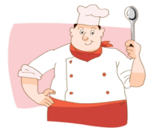
Chant time
What does he do?
He’s a cook.
He cooks nice food.
He’s very good.
Notes:
缺真实人物环节;You know how to talk about jobs very well. Let’s play a card game to challenge.

Slide 20
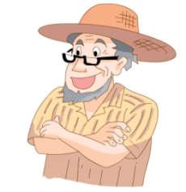
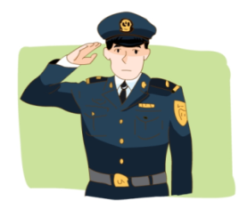
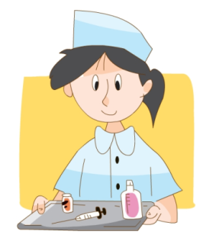
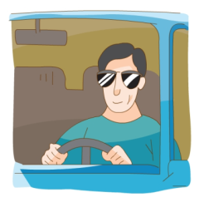
Chant time
四人小组，选择喜爱的职业，创编诗歌。
What does he/she do?
He’s/She’s a _____.
He/She _______.
He’s/She’s very ____!
nice
…
good
cool
great
Notes:
8

Slide 21
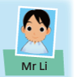
Job cards
Notes:
You chant very well about jobs. Let’s play a game about jobs.

Slide 22
Job cards

Slide 23
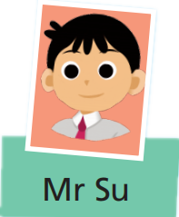
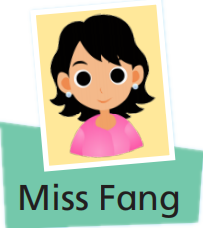
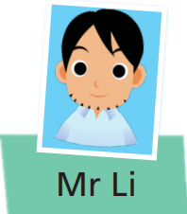
两人问答玩卡片，汇报时只选择其中两人的职业问答展示。
Job cards
A: What do/does...do?
B: ...is/are...He/She/They...(e/es)...

Slide 24
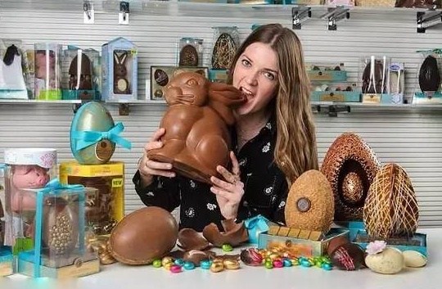
Sharing time
There are different jobs around us.
Notes:
People do different jobs around us.

Slide 25
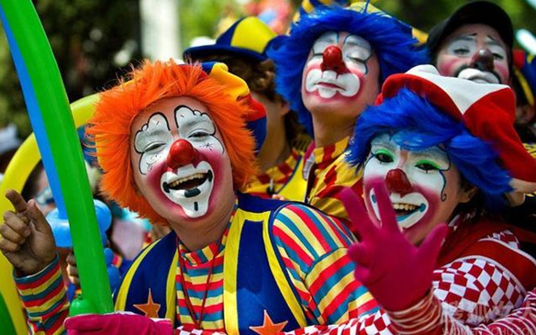
Some jobs are interesting(有趣).

Slide 26
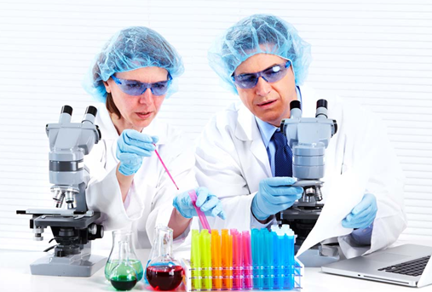
Some jobs are great!

Slide 27
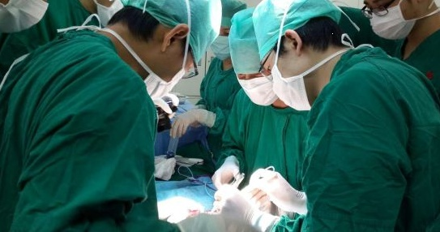

Slide 28
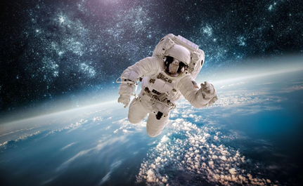
Some jobs are challengeable.
Notes:
Some jobs are challengeable.

Slide 29
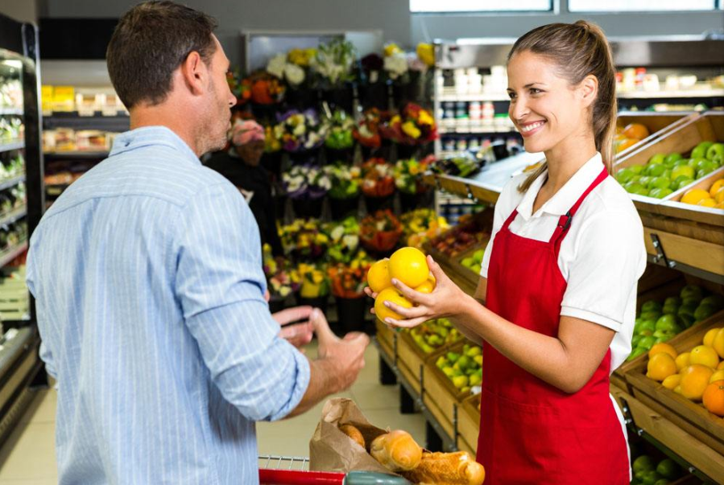
Some jobs look simple(简单) and normal(平凡).

Slide 30
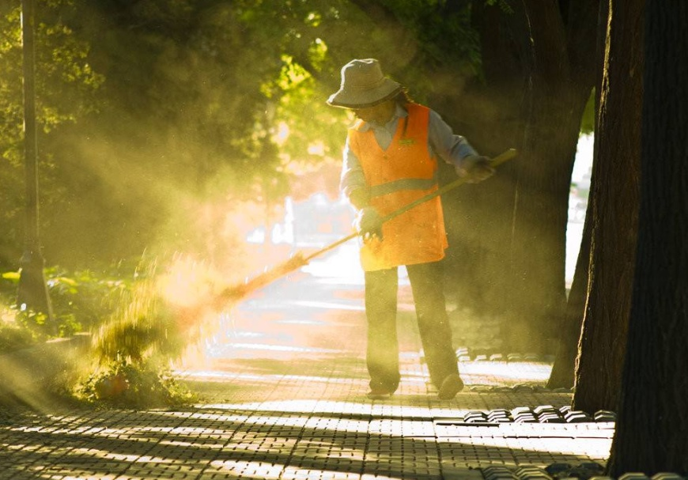
They take care(关心) about us.
Notes:
But they do take care about us.

Slide 31
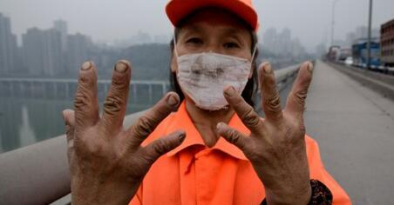
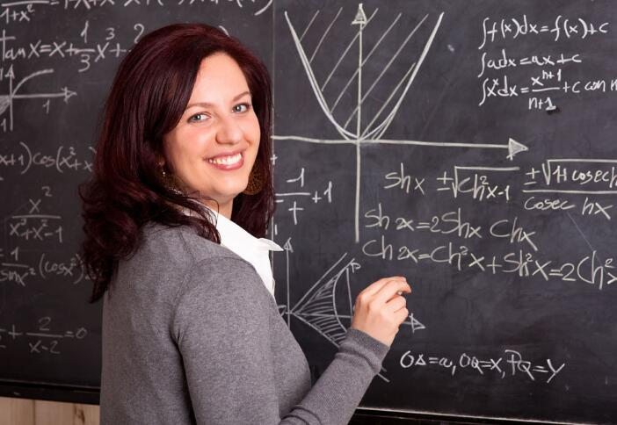
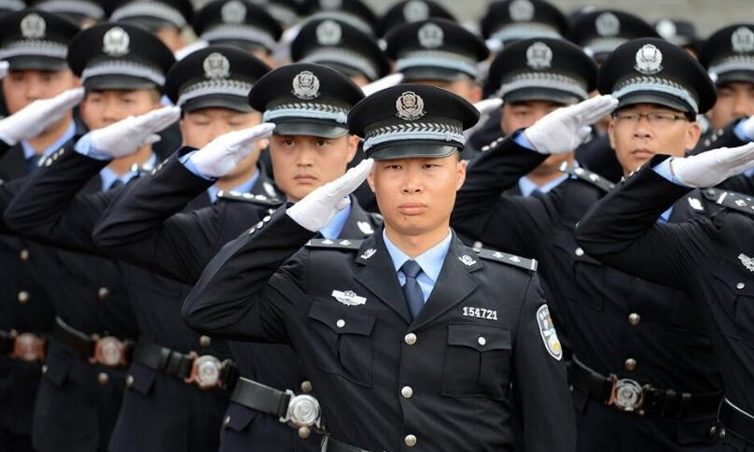
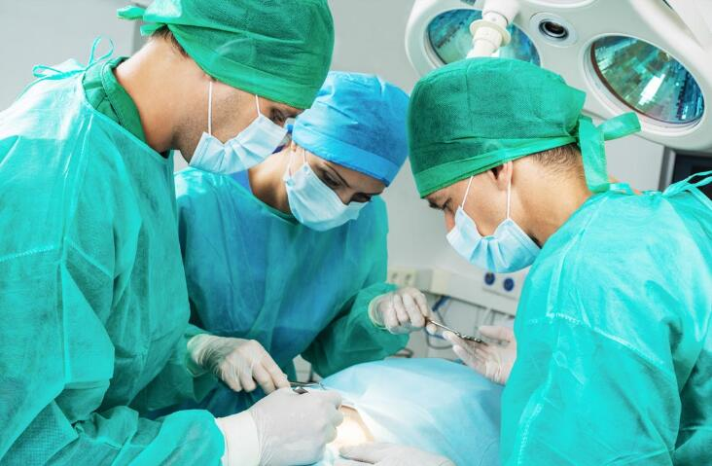
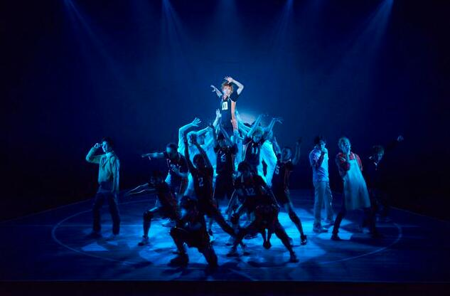
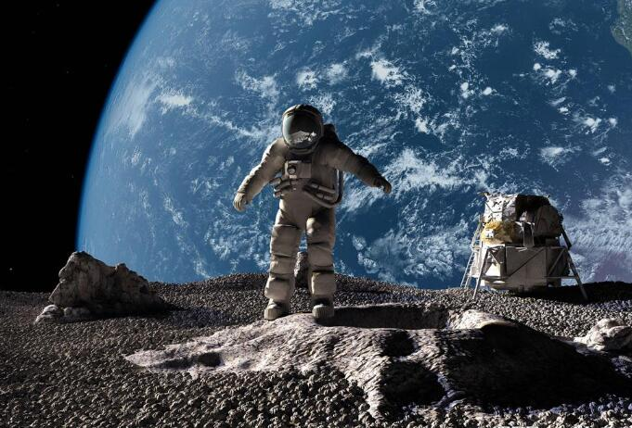
All the jobs are meaningful!
所有的工作都有意义！
They deserve our respect！
他们值得我们尊重！

Slide 32
Homework
Must do
I know these jobs
My parents’ jobs
_______ _________ ________ _______ _________ ________
_______ _________ ________
_______ ________ ________
My father is _____________. He________________________.
My mother is_____________.
She_______________________.
I think they are_________.
Choose to do
Job card

