Slide 1
Book 5 Unit 1 Reading
@

Slide 2
Learning aims
1. Review the structure of news reports;
2. Identify the differences between the two news reports;
3. Understand the reasons for the differences between news reports and the ways to be a critical reader;
4. Make comments on news reports critically.

Slide 3
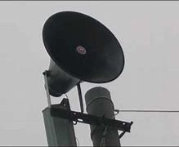
How can we get the latest news updates?
Should we believe everything we read in a news report?

Slide 4
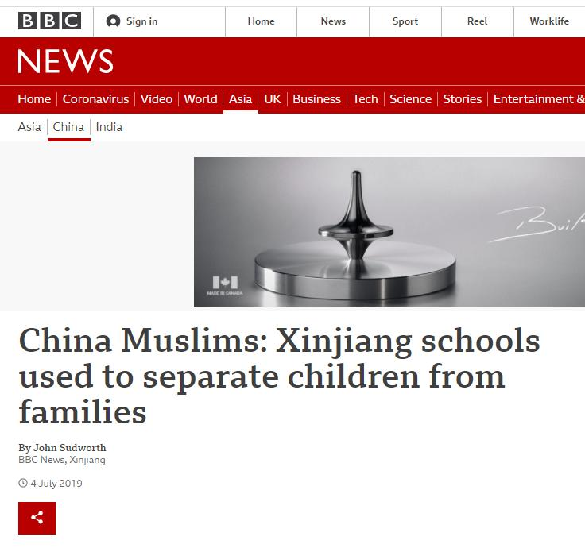
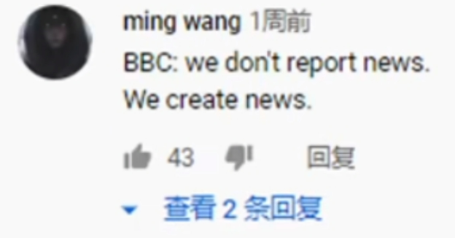
British Broadcast Corporation
报道指出，中国政府把新疆少数民族儿童送进寄宿制学校，“强迫”其与父母分离。

Slide 5
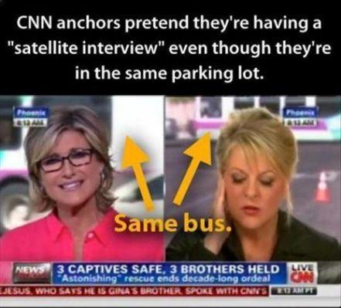
Cable News Network

Slide 6
?

Slide 7
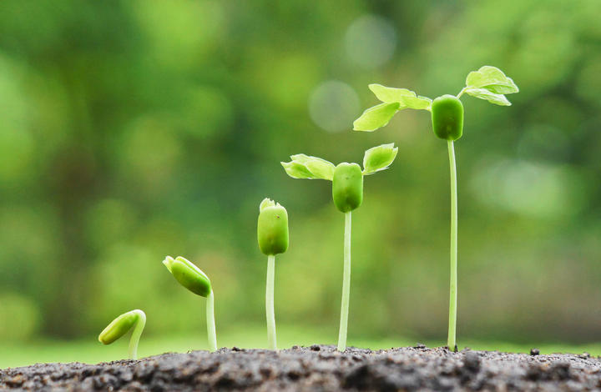
Read two news reports

Slide 8
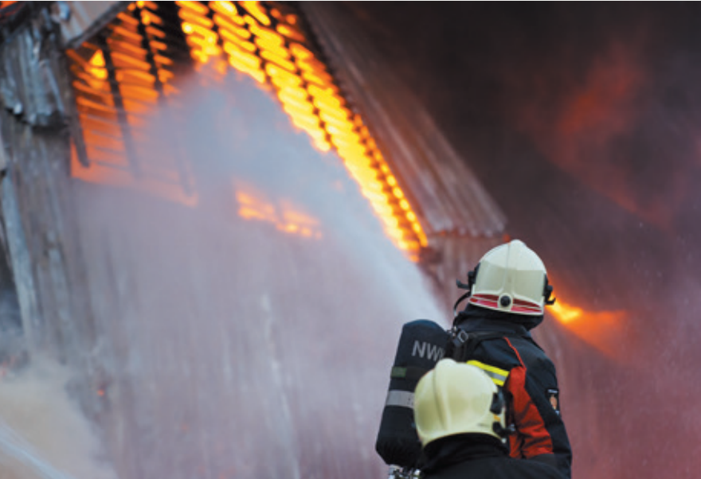
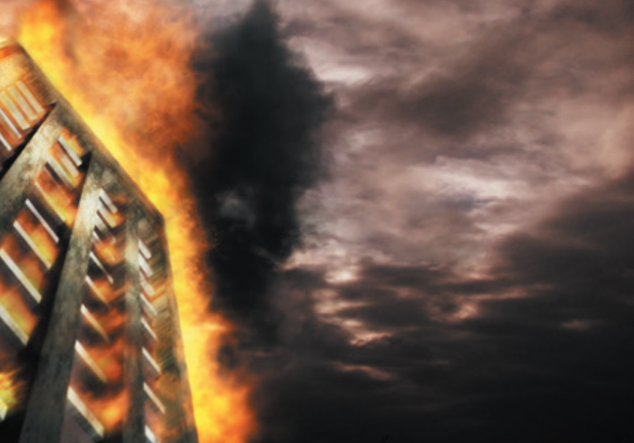
Do the two news reports report the same thing?
Differences?
headline
Firefighters put out tower block fire
Deadly fire in tower block causes serious damage
the Henderson Tower

Slide 9
Firefighters put out tower block fire
Structure of news reports?
Deadly fire in tower block causes serious damage
1
The lead
1
sentence:______
sentence:______
Detailed information about the event
2-6
2-6
sentences:________
sentences:________
Different priorities
Rescue efforts
Background or supporting information
Deaths and injuries
7
7-8
sentence:________
sentences:________

Slide 10
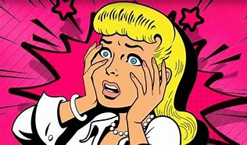
Would you like to imitate her voice?
模仿
What is the function of this part?
个人叙述
1. It is meant to provide a personal account of how serious the fire was.
2. It is meant to add to the authenticity of the report.
真实性

Slide 11
 | Time | Place | Deaths and injuries | Rescue efforts | Cause
News report 1 | Sunday night | Henderson Tower | (1) __________ _________________________________ | (2) _________ ________________________________________________
News report 2 |  |  | 4 confirmed dead and dozens of people injured |  | (3) _______ ______________________________
The number of death could reach 5
Fire engines and ambulances reached …
Firefighters …
How long?
9:45
9:30-9:45-11:00
About one hour and fifteen minutes
A dropped cigarette end on a carpet of the 8th floor
We should not rush to the conclusion that one of the news reports gives false information.
Different factual details

Slide 12
Different stages
Different approaches
They may choose to present the minimum, the maximum or something in between in their news reports.
What may different journalists do when an estimate of a number is given?

Slide 13
Differences
Different priorities
Different factual details
Different approaches
Different stages
When
How
Differences between news reports may depend on
__________and___________ the news reports are written.

Slide 14
Reading for structure
Read the article

Slide 15
Why
reasons
News reports usually
comes with
Part 1: Para. .
1
differences.
Reading news reports critically
Differences between news reports may depend on
Part 2: Paras._____.
2-3
how and when the news reports are written.
We can
in many ways.
Part 3: Para. ___.
become critical news
4
readers
How

Slide 16
Read for details
Reading comprehension

Slide 17
Detailed-reading
Reading news reports critically
Why do news reports differ from or even contradict each other? | (4) ______________________________________. News reports may be written at different stages of an event. (5) ______________________________________ _________________________________________.
Journalists may have different priorities
Journalists may approach information they get from research or interviews differently

Slide 18
Detailed-reading
Reading news reports critically
How can we be critical news readers? | Read different news reports on the same event written from various perspectives and at different stages. (6) ______________________________________ ________________________________________ _________________________________________.
Be critical about the information we receive and remember not to blindly trust what we have read

Slide 19
Different priorities
Read more than one report.
Different factual details
Rush to the conclusion?
Check.
Different stages
Judge.
Different approaches
with discrimination
How to be a critical news reader?

Slide 20
Discussion

Slide 21
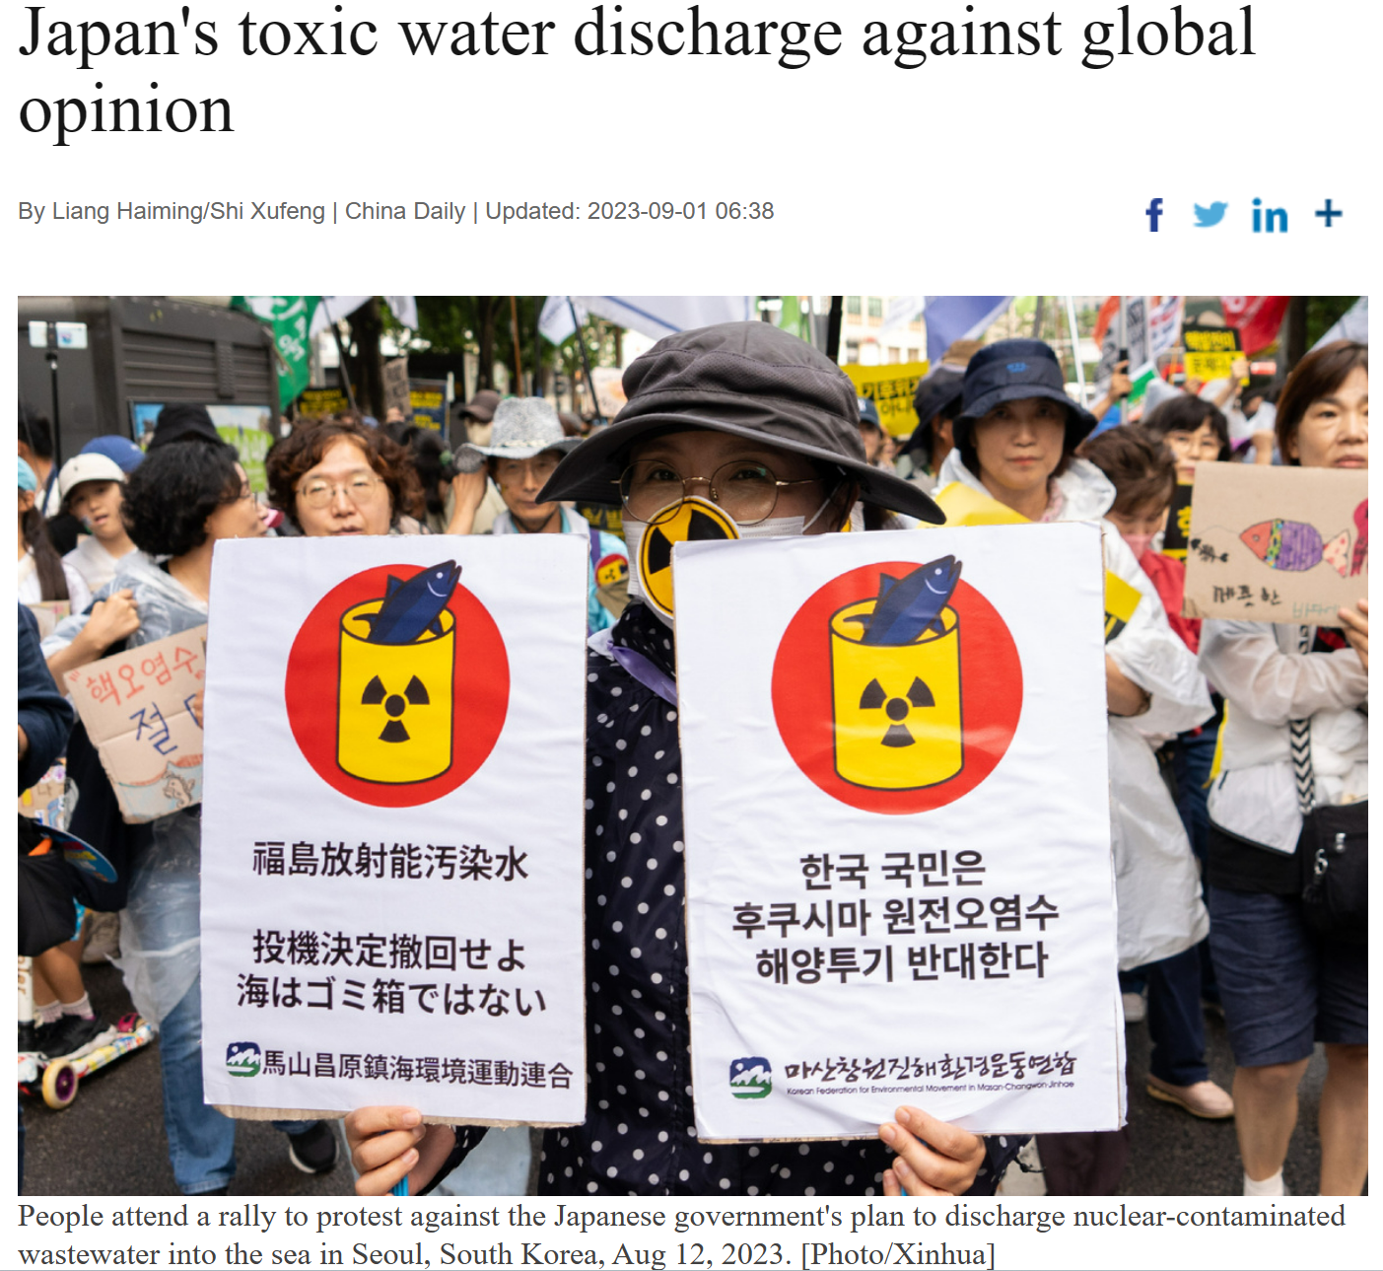
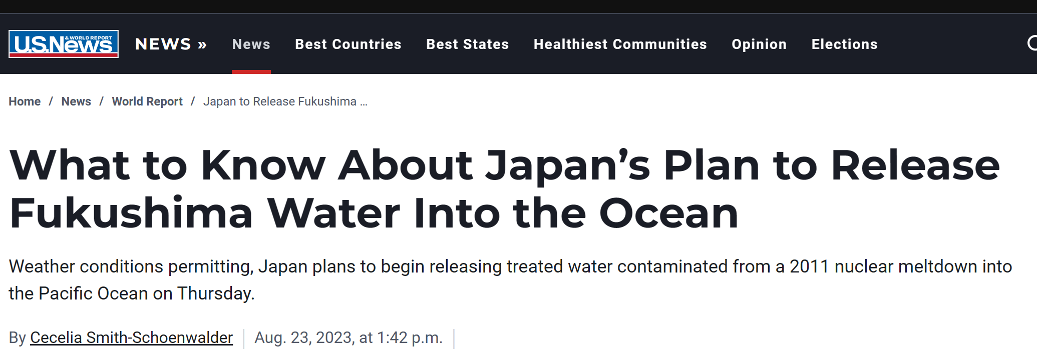
微不足道的

Slide 22
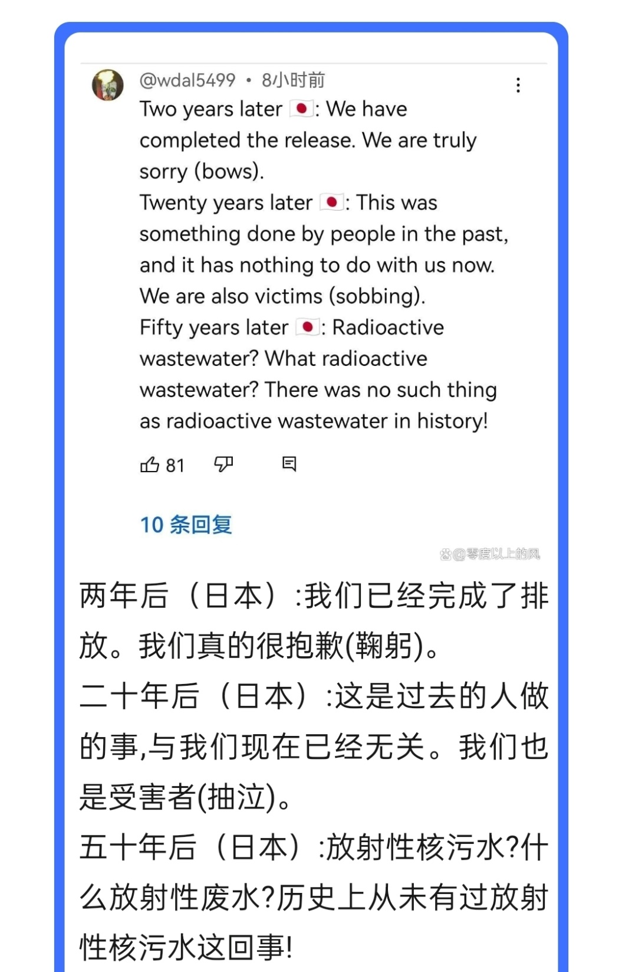
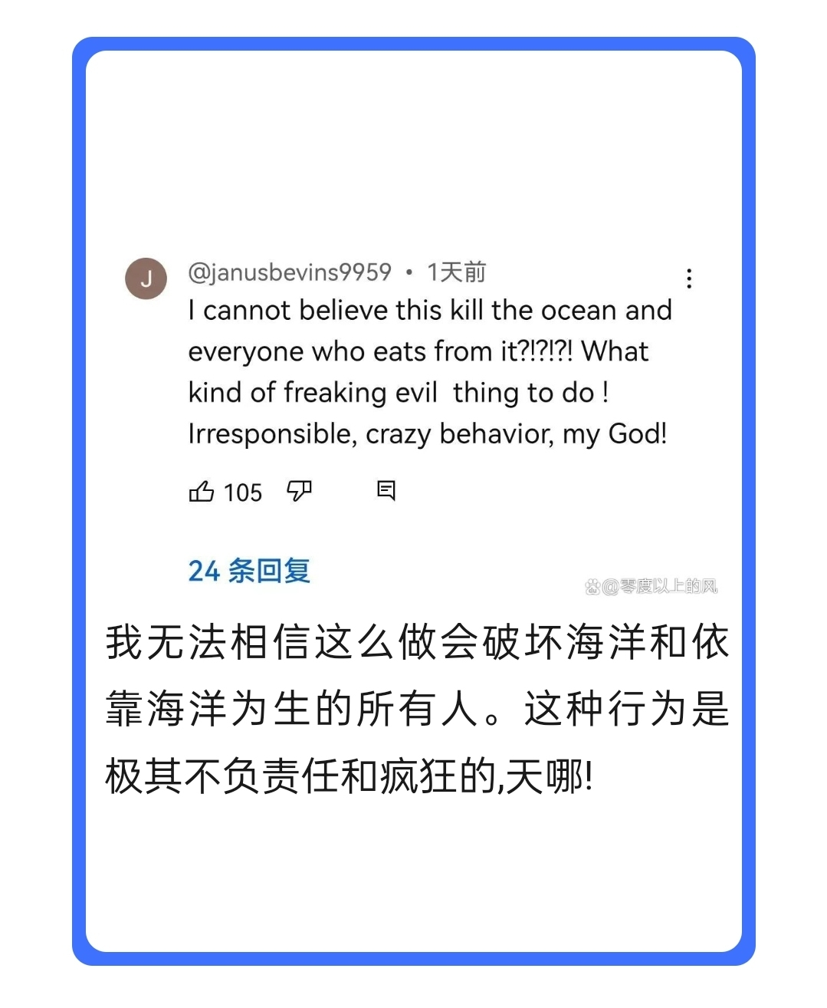
Can you make comments critically on the news reports?

Slide 23
Summary

Slide 24
Seeing is believing.
Be a critical news reader. Don’t be a keyboard warrior！

Slide 25
Homework
假设校报最近在就“面对假新闻，我们该如何保持清醒”这个话题征求学生意见，请你向校报编辑投稿，谈谈你的看法。
要求：1. 内容要点：目前现状，识别假新闻意义，你的建议。
2. 字数：80词。
Dear editor, _____________________________________________________________________________________________________________________________________________________________________________________________________________________________________________________________________________________________________________________________________________________________________________________________________________________________________________________________________________________________________________________________________________

