Slide 1
Unit 5 Amazing things
Task

Slide 2
Phrases
它的长脖子
生活在陆地上
几乎不吃/什么也不吃
在寒冷的冬天
在干燥的地方
嗅觉好
不喝水生活很长一段时间
感谢你的帮助。
知道…感到惊讶
需要保持我们的房子干净
its long neck
live on the ground
eat little/ nothing
in cold winter
in dry places
smell things well
live without water for a long time
Thanks for your help.
be surprised to know
need to keep our house clean

Slide 3
11. 不再，再也不
12. 更加了解
13. 听说
14. 骑车环游80多个国家
15. 读到
16. 另一天
17. 用一只手写字
18. 用另一只手画画
19. 同时
20. 用粉笔画三维画
not…any more
know/ learn more about
hear of
travel around over 80 countries by bicycle
read about
the other day
write with one hand
draw with the other hand
at the same time
draw 3-D pictures with chalk

Slide 4
不再，再也不 not ... any more
1. 我不再是个孩子了。
I ________ a child ___________.
2. Suzy不再害怕动物了。
Suzy __________________________________.
3. 他不再担心他自己了。
He _______________________________________.
am not
any more
isn’t afraid of animals any more
doesn’t worry about himself any more

Slide 5
The world is full of amazing things.

Slide 16
Do you know any amazing things about animals?
The world is full of amazing things.

Slide 17
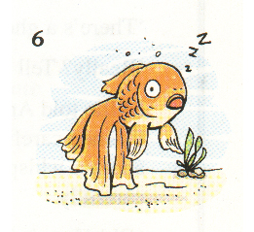
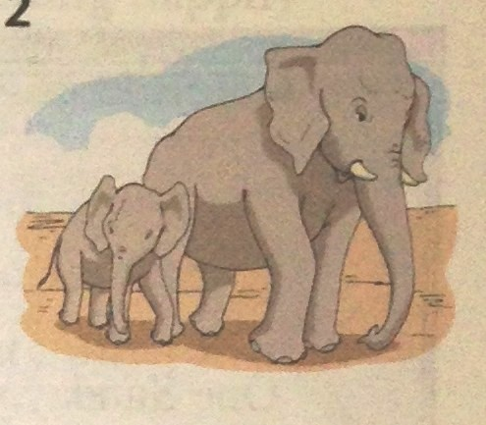
Fish sleep
_______________________
with their eyes open.
Goldfish can only remember things for 3 seconds(秒).
no bones
There are_________ in
the back of elephants’
__________- only fat.
feet
They walk on tiptoe(脚趾尖).

Slide 18
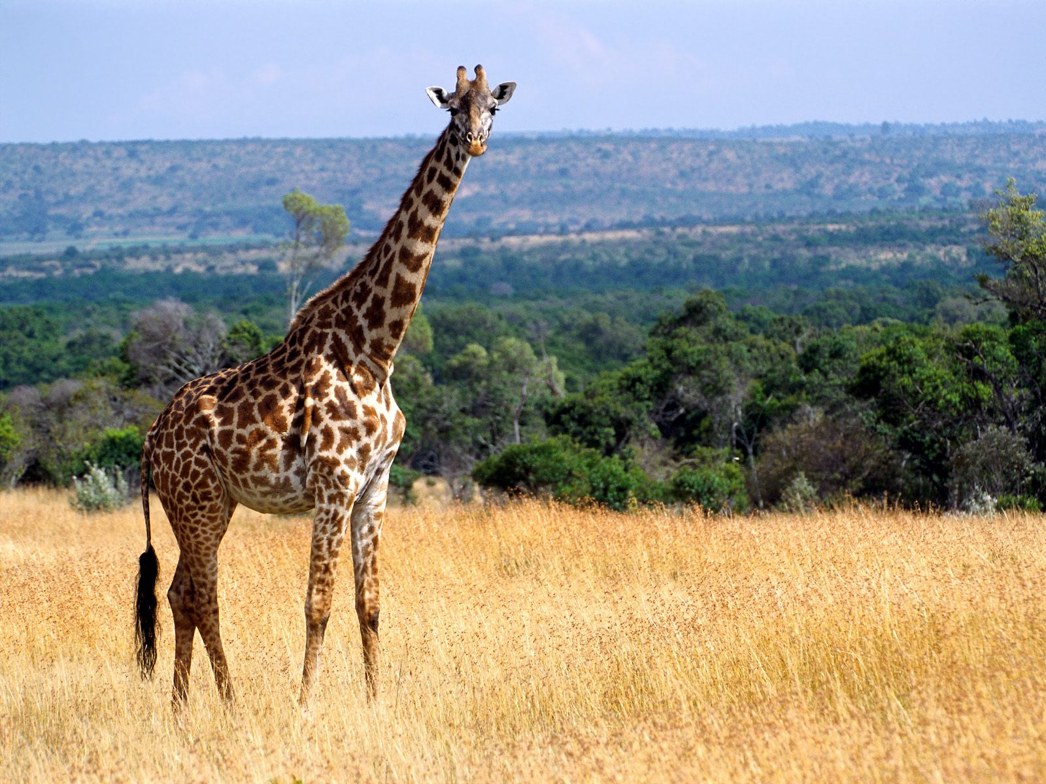
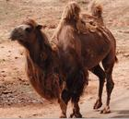
7 bones
A giraffe has only________ in its
long neck.
without water
Camels can live__________________
for a long time.
Each of their eyes has 3 eyelids.
眼皮

Slide 19
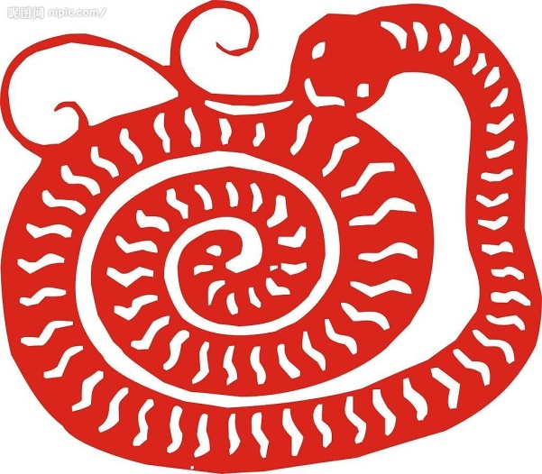
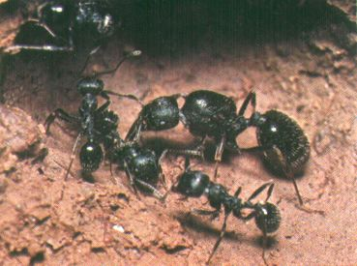
A snake eats ______________
for months in cold winter.
little or nothing
smell things well.
Ants can_________________
They can smell things as well as
dogs.

Slide 20
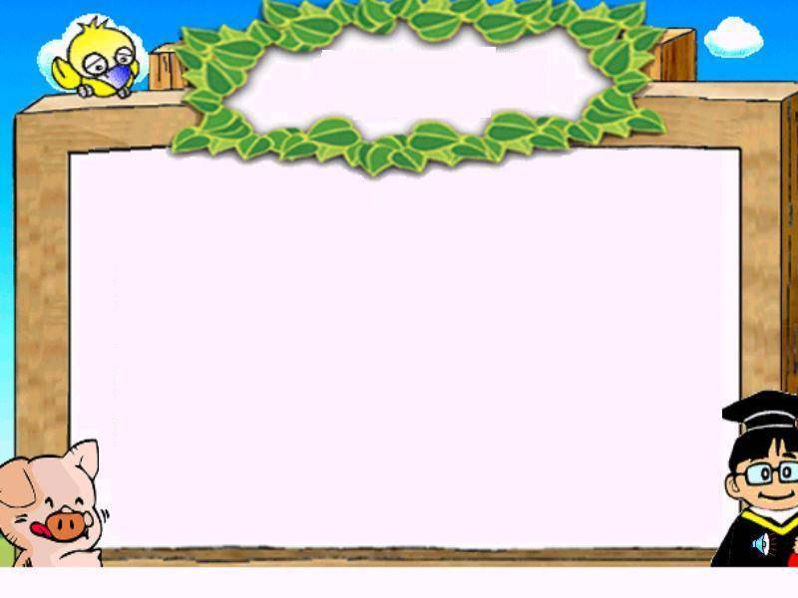
Amazing people
A young man travelled _______________________________.
A man can write _______________________________.
An artist _________________________.
Our eyes _________________________, but our nose and ears ______________.
around over 80 countries by bicycle
with one hand and draw with the other one at....
can draw 3-D pictures with chalk.
are the same size from birth
never stop growing

Slide 21
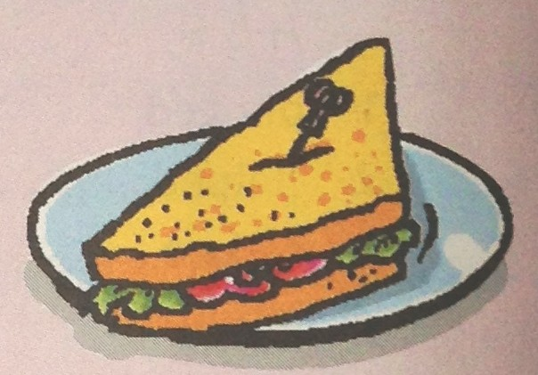
More amazing things
Do you know the story of sandwiches?
sandwich
put meat between
two pieces of bread

Slide 22
The story of sandwiches
My name is John Montagu, the Fourth
Earl of Sandwich(三明治伯爵）. I like playing cards very much. And I do not want to stop to eat. So I put meat between two pieces of bread. Others want to eat the same food. Later it becomes popular. People name the food after me.
1.What does John Montagu like?
2.Why does he put meat between two pieces of bread?
3.Do others like this kind of food?
4.Who does the food get its name from?
He likes playing cards very much.
Because he doesn’t want to stop to eat.
Yes, they do.
John Montagu.

Slide 23
1.got its name from a man called John Montagu,
the Fourth Earl of Sandwich
2.loved playing cards very much
3.did not want to stop for meals
4.put meat between two pieces of bread
5.others wanted to eat the same food
6.later became popular all over the world
Notes
Sample passage P67
We live in a wonderful world with a lot of amazing things.
Many people like sandwiches, but do you know anything about this kind of food?
Sandwich got its name from a man called John Montagu, the Fourth Earl of Sandwich. The man loved playing cards with his friends very much. He did not want to stop for meals, so he put meat between two pieces of bread. Soon others wanted to eat the same food, so they asked for a “sandwich”.
Later the food became popular all over the world. Isn’t that amazing?
Introduction
Body（1-5小点）
Conclusion（第6小点）

Slide 24
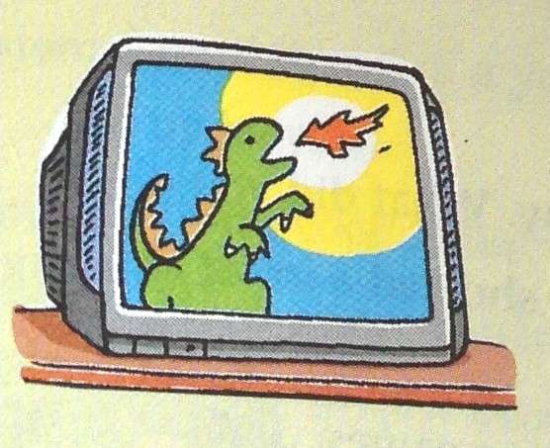
1. the first TV show in the UK in 1926
2. by 1935, about 2,000 TVs in use（投入使用）
3. in China, in 1987, about 29 TVs per 100 families, but now most families have at least one TV
4. now TVs can be as large as 152 inches
Notes
TV
We live in a wonderful world with a lot of amazing things.
Many people like … , but do you know anything about … ?
watching TV
TV
Introduction
The first TV show was in the UK in 1926. There were about 2,000 TVs in use by 1935. In China, there were about 29 TVs per 100 families in 1987. But now most families have at least one TV. And now TVs can be as large as 152 inches.
Body
Now TVs
… become popular all over the world. Isn’t that amazing?
Conclusion

Slide 25
Language points
1. play cards 打牌
play的宾语如果是体育类活动, 不能用冠词the; 如果是乐器类宾语, 则必须加上冠词the。
打篮球
打排球
踢足球
打网球
打棒球
打羽毛球
play basketball
弹钢琴
拉小提琴
弹吉他
play the piano
play volleyball
play the violin
play football
play the guitar
play tennis
play baseball
play badminton

Slide 26
2. as…as 翻译为“像……一样”，中间必须接形容词或者副词的原形。否定形式是 not as … as 或者not so … as。
我的书包和你的一样新。
我的书包不如你的新。
Lucy和她妹妹跑得一样快。
我们的教室是他们的两倍大。
My schoolbag is as ____ as yours.
new
as/so as
My schoolbag isn’t ____ new ___ yours.
Lucy runs ____ fast ____ her sister.
as as
Our classroom is ___________________.
twice larger than theirs
twice as large as theirs

Slide 27
Important phrases
1. 一个叫做John的人
2. 停下来吃饭
3. 吃一样的食物
4. 全世界
5. 每100个家庭
6. 像……一样大
7. 在两片面包之间
8. 非常喜欢打牌
9. 在使用中
10. 至少一台电视
a man called John
stop to have meals
eat the same food
all over the world
per 100 families
as large as
between two pieces of bread
love playing cards very much
be in use
at least one TV

Slide 28
How to
write an article about
amazing things?

Slide 29
Amazing things
We live in wonderful world
with a lot of amazing things.
Many people like …,
but do you know
anything about … ?
…
…
…
Notes
1…. 2….
3….
Isn’t that amazing?

Slide 30
Writing Time
Write about an amazing thing for a writing competition.
Choose a kind of animal and talk about some amazing things about it. Then write an article.

Slide 31
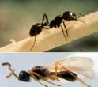
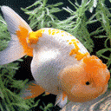
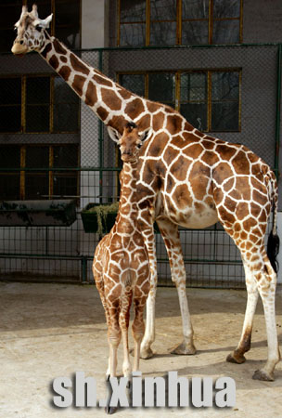
Amazing animals

Slide 32
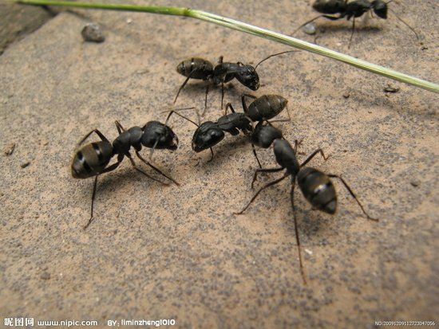
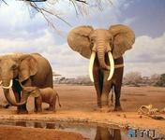
1. colourful
2. never make any noise(噪音)
3. have no eyelids(眼皮)
4. sleep with eyes open
5. only remember things for 3 seconds(秒)
don’t know what happened to them 3 seconds ago
Goldfish
1. very small and weak
2. very hard-working
3. like working together
4. have good smell(嗅觉)
5. can smell things as well as dogs
Ants
1. the biggest animals on land(陆地上)
2. have large ears like open fans
3. no bones in the back of their feet
4. can live for 60-70 years
5. walk on tiptoe(脚趾尖)
6. move(移动) quietly
Elephants

Slide 33
The world is full of amazing things. Just enjoy your every day and love the happy life!

Slide 34
Homework
Finish the exercises on P61 in
Learn English With You.
2. Review this lesson and prepare
for a dictation.

Slide 35
1.没有水生活很长一段时间 2.害怕动物
3.数月吃得很少或几乎不吃 4.嗅觉好
5.需要保持我们的房子干净 6.惊讶地知道
7.用一只手写字 另一只手同时画画 8.投入使用
9.用粉笔画立体图片 10.听说过一个年轻人
11.住在陆地上，树上或水中
12.在两片面包之间放肉 13.全世界变得流行
14.住在一个有许多惊人事件的精彩世界里
15.喜欢吃三明治 16.骑车环游80多个国家
17.在它的长脖子里只有七根骨头。
understand write won wear wake

