Slide 1
Good manners
Xiaohe Middle School Qi Shanshan

Slide 2
Lead in
Beauty opens your eyes,
intelligence opens your mind,
but good manners will open your heart.

Slide 3
Good manners at school
Good manners at school
In class
After class
Listen carefully in class.
Take notes in class.
Don’t talk in class.
Don’t eat in class.
Don’t sleep in class.
…
Say “Hi” to your classmates.
Chat with each other politely.
Don’t make too much noise.
Don’t play tricks on others.
Don’t push others.
…

Slide 5
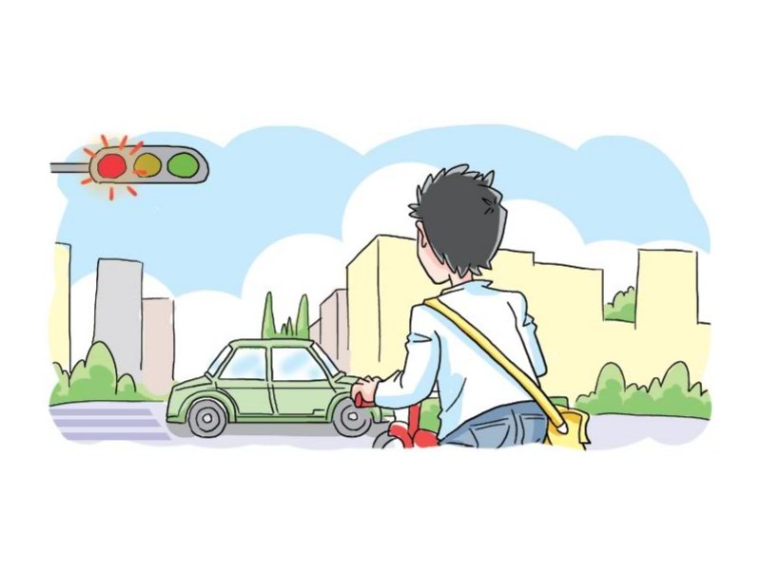
Ask and answer
What should the boy do when he crosses the road?
He should obey traffic rules.
遵守交通规则

Slide 6
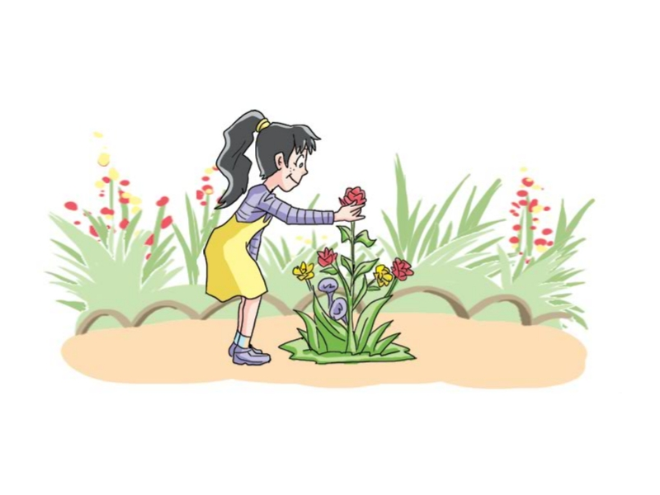
Ask and answer
What is the girl doing?
She is picking flowers in the park.
摘花

Slide 7
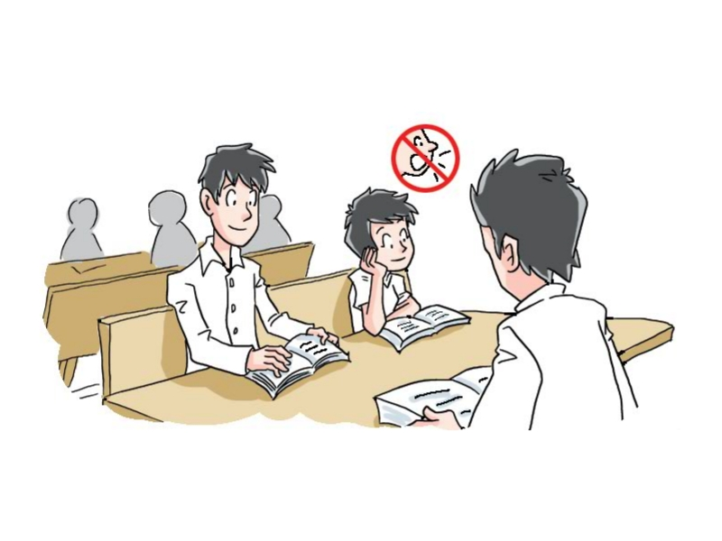
Ask and answer
What should we do in the library?
We should keep quiet in the library.

Slide 8
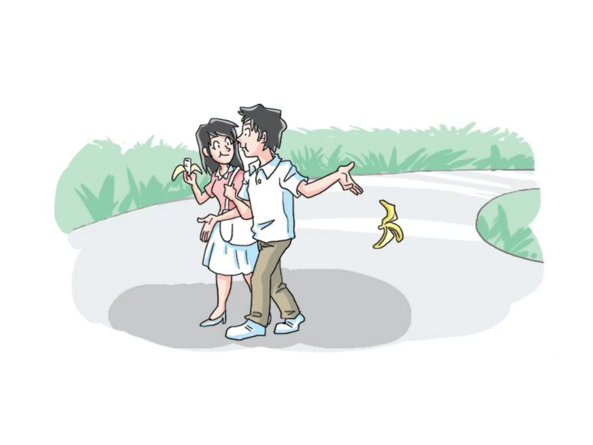
Ask and answer
What are the boy and the girl doing?
They are dropping litter everywhere.
到处扔垃圾

Slide 9
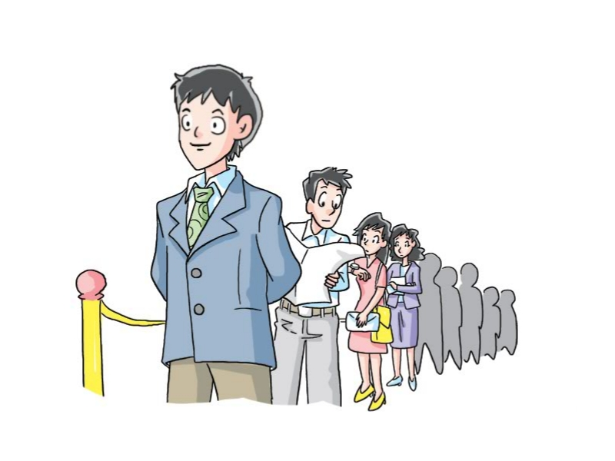
Ask and answer
What is the man doing?
He is queuing for his turn.
依次排队

Slide 10
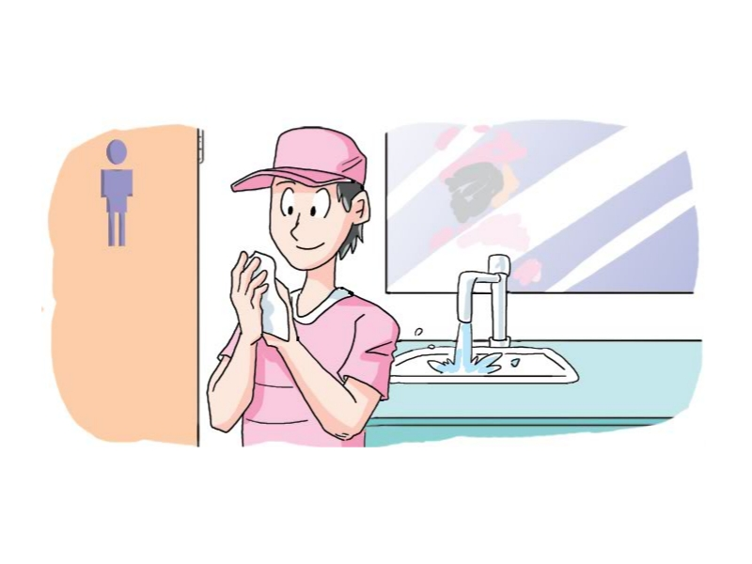
Ask and answer
What did the boy do?
He left the tap running.
让水龙头一直开着

Slide 11
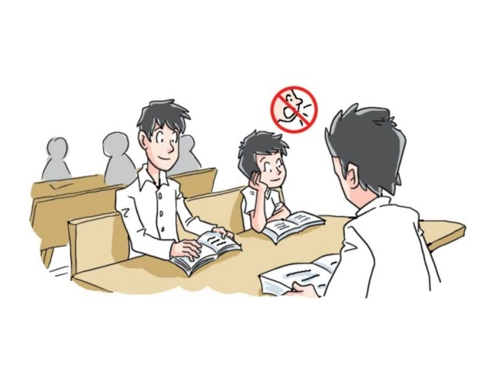
Practice (Part A on Page65)
a drop litter everywhere b leave the tap running
c keep quiet in the library d pick flowers in the park
e obey traffic rules f queue for your turn
e
d
c
a
f
b

Slide 12
1
4
2
5
Who is doing right and who is doing wrong?
3
6

Slide 13
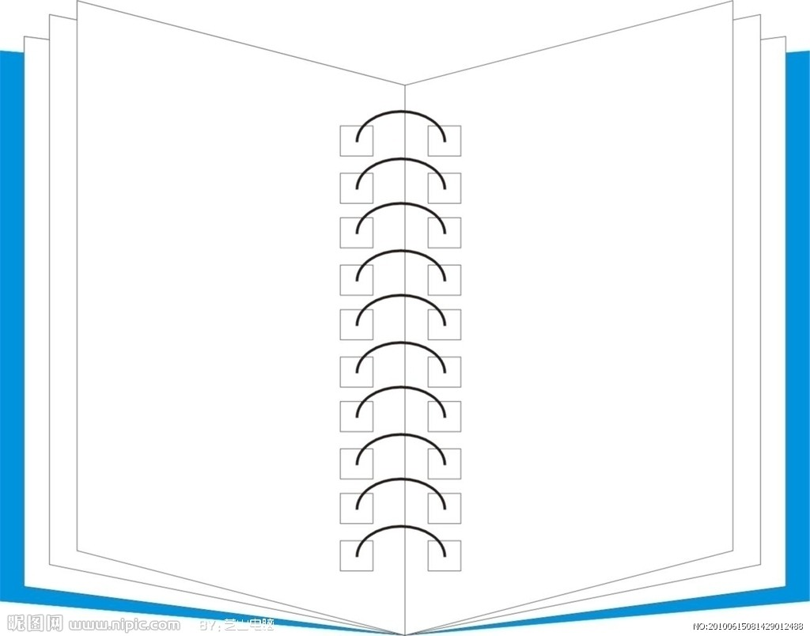
Summary
Bad Manners
Good Manners
keep quiet in the library
obey traffic rules
queue for our turn
drop litter everywhere
leave the tap running
pick flowers in the park
We shouldn’t...
We should...

Slide 14
Discussion
What else should we do in public?
What else shouldn’t we do in public?

Slide 15
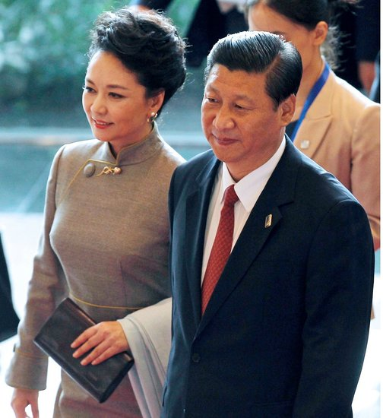
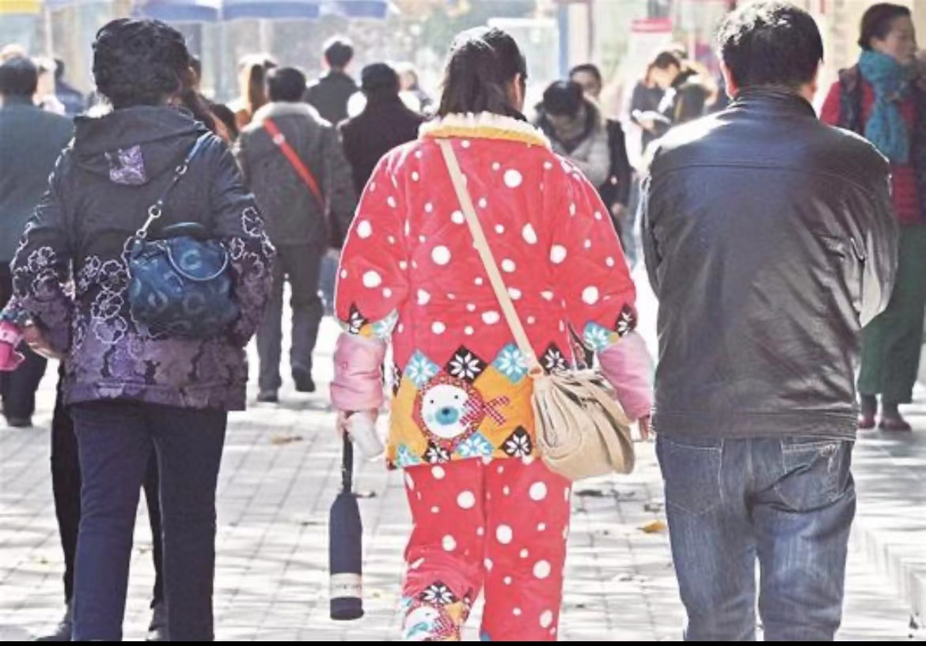
We should dress properly in public.

Slide 16
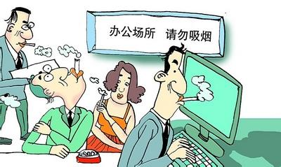
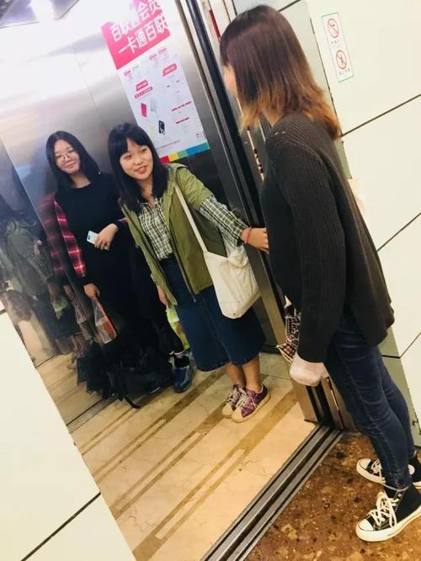
We shouldn’t smoke in public.
We should hold the door open when somebody else wants to get into the lift.

Slide 17
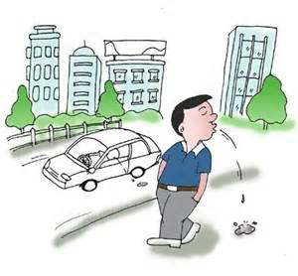
We shouldn’t spit (吐痰) everywhere.
We shouldn’t carve (雕刻)our names when visiting places of interest.

Slide 18
Listen and practice (Part B on Page65)
Amy and her cousin Shirley are discussing what they should and should not do in the library.
Read the conversation.

Slide 19
Practice: Manners in the library
We should | ______ ______
 | _____ the library ______
 | _____ _____ the books after reading
We shouldn’t | chat or _____ in the library
 | _____ _____ everywhere
 | _____ in the books
keep quiet
Good manners
keep clean
put back
eat
Bad manners
drop litter
write

Slide 20
Think and practise
A: Can we …?
B: I’m afraid not. We should …
A: Anything else?
B: Don’t ... Always ...
A: I see. Can we …?
B: No, we can’t … there. A: Can we …?
B: No, we shouldn’t …, and we …
a. In the places of interest
b. In the classroom
c. In the cinema
d. In the meeting room
e. In the shopping mall
f. While talking to others
g. While driving
h. While having a dinner
While taking a bus/plane…
…

Slide 21
Read and answer
What is the passage mainly about？
A. An experience in the restaurant
B. The importance of Chinese table
manners
C. Some examples of Chinese table
manners

Slide 22
Read and answer
Why does the author introduce the topic by using his own experience?
How does the writer introduce the topic?
Yesterday I had a dinner with several friends, it was too terrible. One of my friends was so rude on the table, he was talking and talking all over the meal, even though his mouth was full of food, he still couldn't stop his talking…I could see his slobber was spill out! To all of the plate! Oh, I could take it anymore..
A. To let us know that bad manners will bring others trouble.
B. To prove that manners are very important.

Slide 23
First
Seating arrangement
Chinese table manners
Second
Chopsticks using
Third
Drinking rules

Slide 24
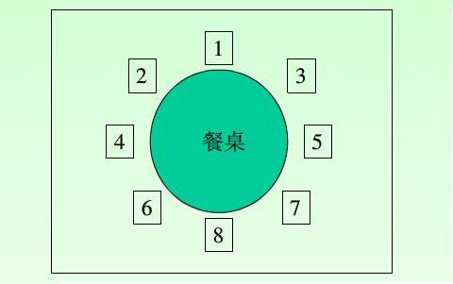
Settting arrangement
First, seating is very important. Seating arrangement is very complexed(复杂), the best seat is for the honour guest or the old in the family. And the seat is usually face to south. The host usually sits the opposite of them.
host
S
honour
guest
N
honour
guest
N
E
host
honour
guest
host
S
W

Slide 25
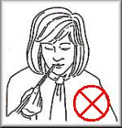
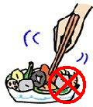
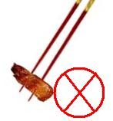
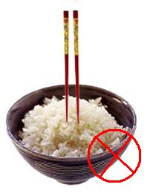
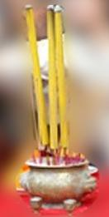
Chopsticks using
Second, how to use chopsticks matters a lot. Don't stick your chopsticks upright in the rice bowl when you are eating. Instead, you should lay them on your dish. I remember when I was a child ,my mom was not pleased when I played with chopsticks before having the dinner.

Slide 26
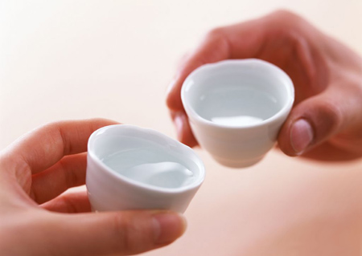
Drinking rules
Third, the drinking time has many rules too. How to toast, how to drink, and how much you drink once time, it has it’s own meaning. When elder people toast to you, you must stand up and finish at once, of course , with both of your hands. Moreover, when you are knocking glasses with a person who is older than you, the top of the glass must be lower than his. This behavior shows respect to the old.
Show time

Slide 27
Chinese table manners has became a kind of culture. Everyone need to know some thing about the manners on the table, especially the young people. Good manners mean good behavior on Chinese table.

Slide 29
We shouldn’t...
1. laugh at others
2. swear to others
3. shout loudly
4. imitate the actions and languages of others
5. keep staring at others

Slide 30
We should...
As the parents
As the boy
1. Teach the boy patiently
2. Be kind to others
3. Tell the child not to laugh
at others
4. Ask the boy to say sorry to
the girl
5. Become a role mode
6. ...
1. Say sorry to the girl
2. Respect others
3. Obey the table manners
4. ...

Slide 31
Don’t mind about what other people think of you! Be confident, believe in yourself!

Slide 32
八礼四仪
仪表之礼 仪式之礼
言谈之礼 待人之礼
行走之礼 观赏之礼
游览之礼 餐饮之礼

Slide 33
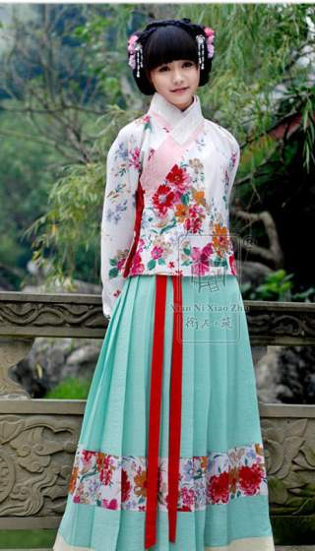
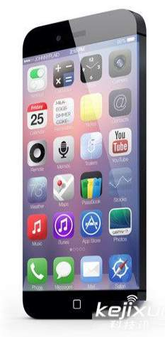
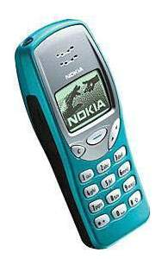
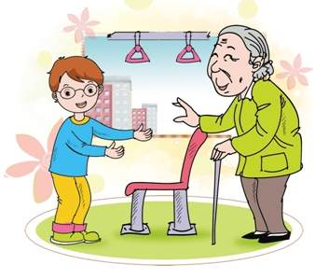
Let’s remember
Beautiful clothes may be out of fashion soon.
Modern electronics will be out of fashion too.
But……
Good manners will never be out of fashion!

