Slide 1
Unit 6
Integrated skills
Wang Lu

Slide 2
It has many colours and shapes.
It is a good choice for outdoor activities.
It is usually very light and can fly high.

Slide 3
Free talk:
How often do you fly kites?
Where do you usually fly kites?
Who often goes with you?
What does your kite look like?

Slide 4
Task A1 Listen to the conversation and write the students’ names under their kites.
Millie
Simon
Amy
Daniel

Slide 5
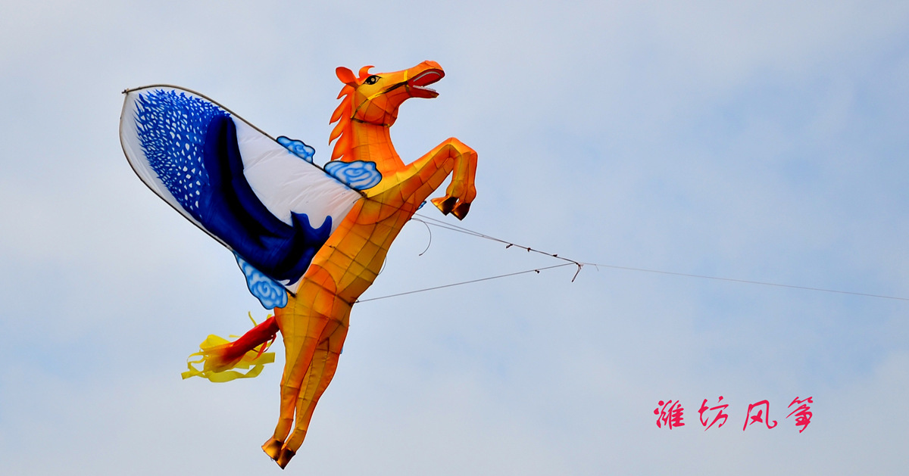
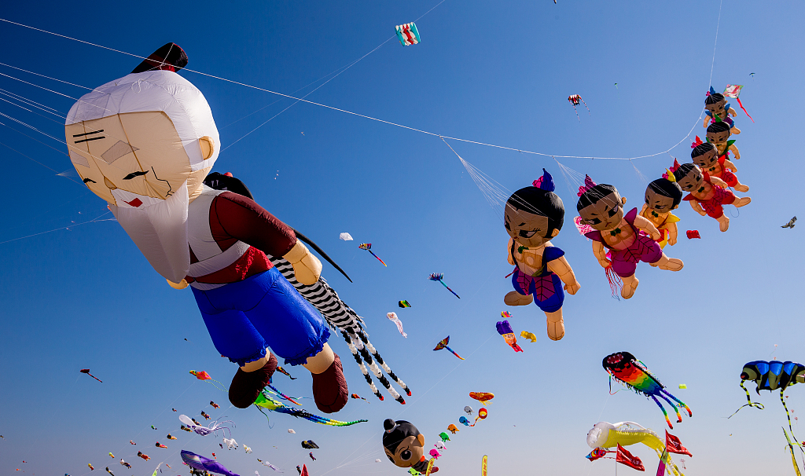
Weifang International Kites Festival

Slide 6
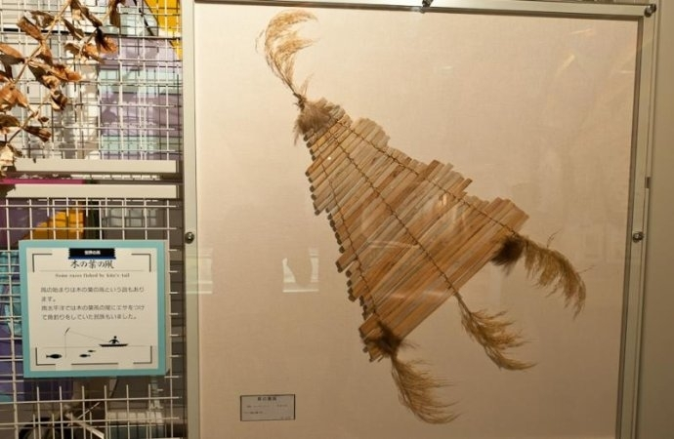
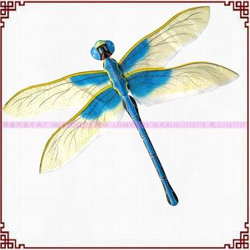
Have you wondered -
What can we use to make kites?
Who made the first kite ?
Who told the people in the West about kites?
Let’s get to know more...

Slide 7
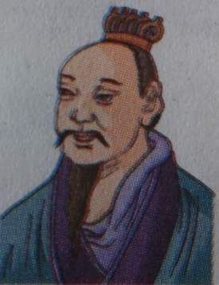
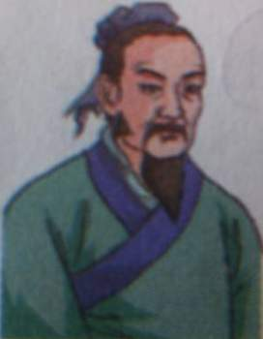
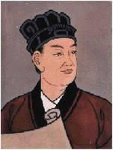
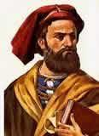
Famous people in history
Mozi
Lu Ban
Cai Lun
Marco Polo

Slide 8
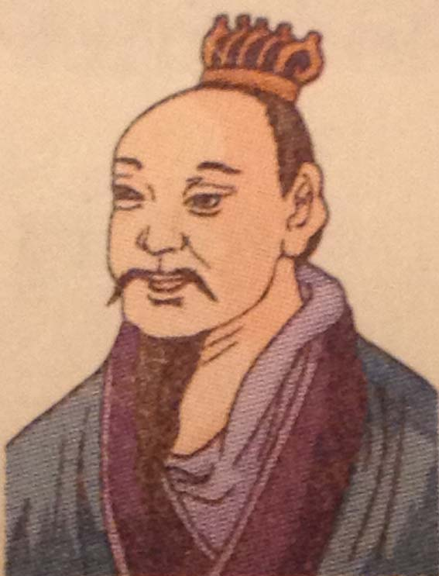
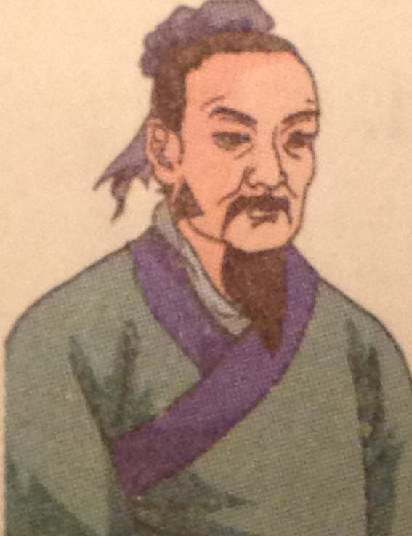
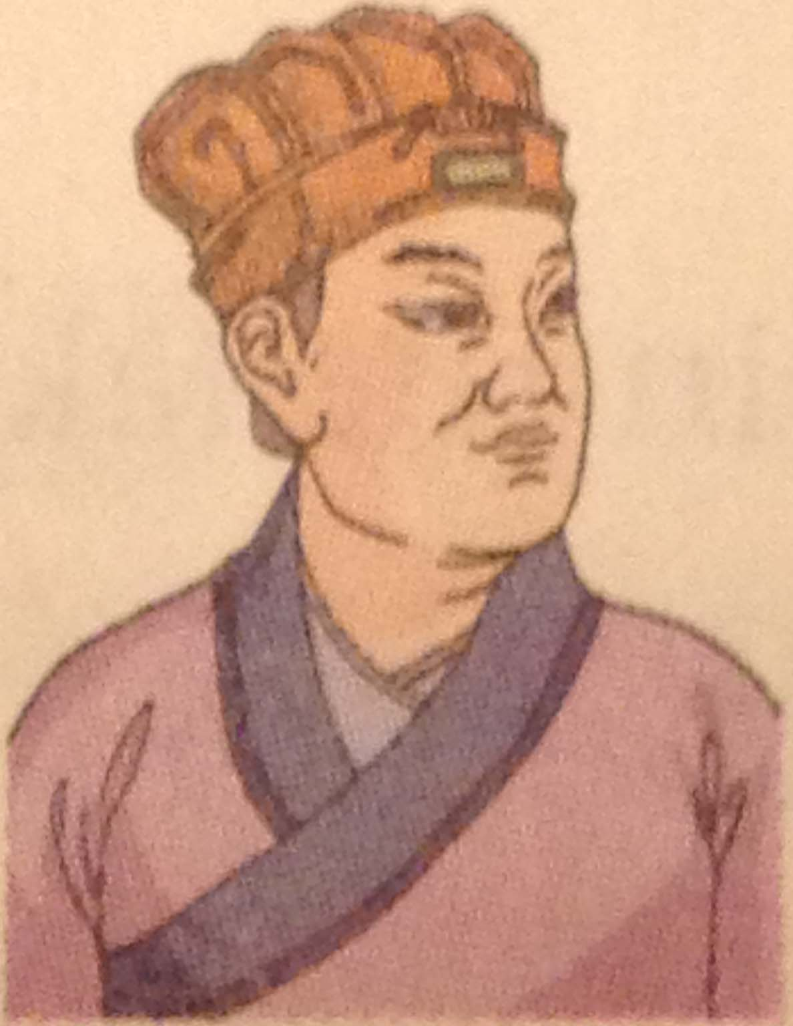
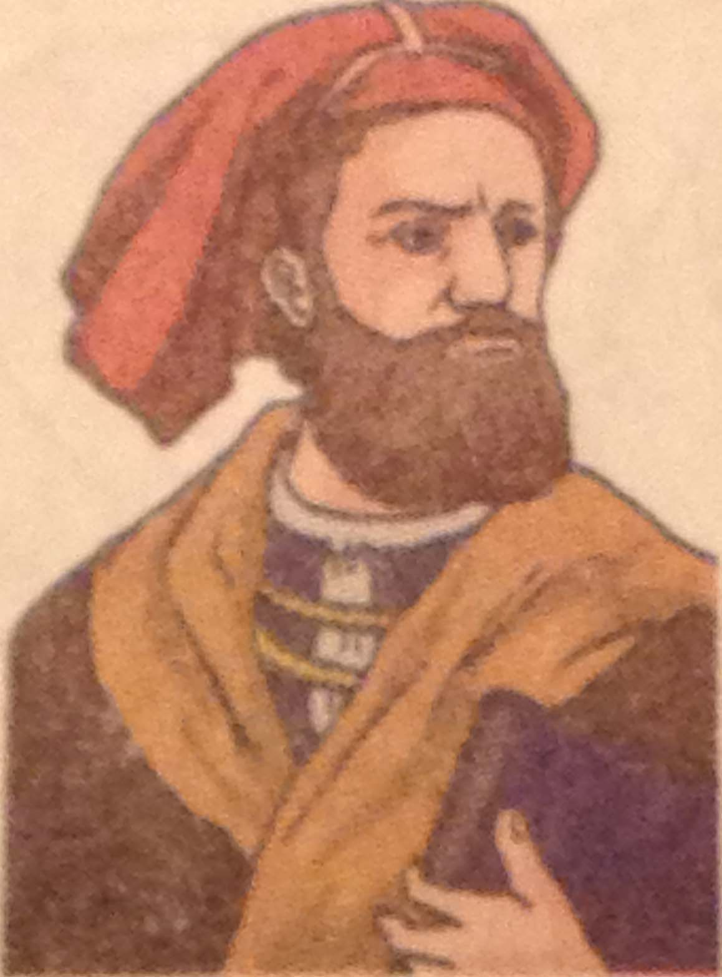
Task A2 Listen and match.
The history of kites
Mozi
⊙ told people in the West all about kites
⊙found a new way to make paper
⊙used bamboo to make kites
⊙made a bird out of wood
Lu Ban
Cai Lun
Tip: Find out the key words/关键词 first.
Marco Polo

Slide 9
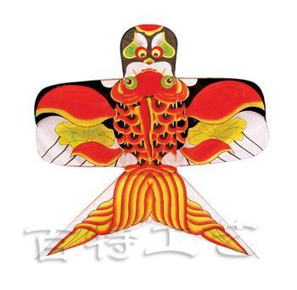
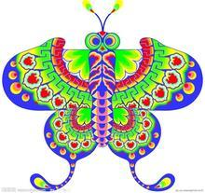
Task A3 Listen and fill in the blanks.
Kites have a long history in China.The Chinese began to make kites over(1)______years ago. In the Warring States period,
a famous man, (2) ______, made a bird out of(3) ______. That was the first kite in history. His student (4) ______ used bamboo to make kites. In the Eastern Han dynasty,
(5) ______ found a new way to make paper, and then people began to use paper to make kites. In the (6)______century, an Italian man called (7) ________ visited China. He told
people in the (8) ______ all about kites. In the Ming and Qing dynasties, kite flying became a very popular (9)______ activity. Weifang, a city in Shandong Province, has become famous for making (10) ______ from then on.
Tip: While listening for detailed information,
write down parts of the words first.
2,000
['pɪəriəd]
Mozi
wood
Lu Ban
['dɪnəsti]
Cai Lun
13th
['sentʃəri]
Marco Polo
West
outdoor
kites

Slide 10
Task: Speak up
Who?
When?
What?

Slide 11
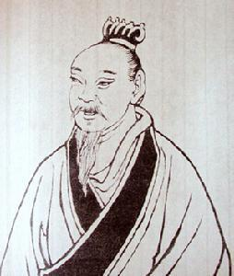
This is ...
He lived in ...
He made...

Slide 12
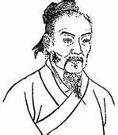
This is ...
He lived in ...
His teacher was ...
He used ...

Slide 13
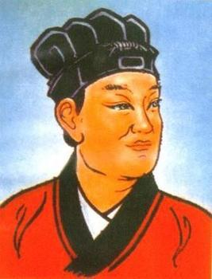
This is ...
He lived in the ...
He found ...And then...

Slide 14
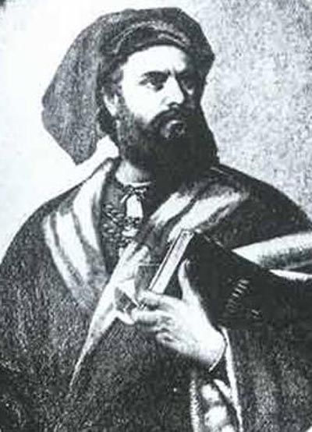
This is ... from ...
In the 13th century, he visited...
He told ...

Slide 15
It is a city in ……
It becomes famous for……
Weifang潍坊

Slide 17
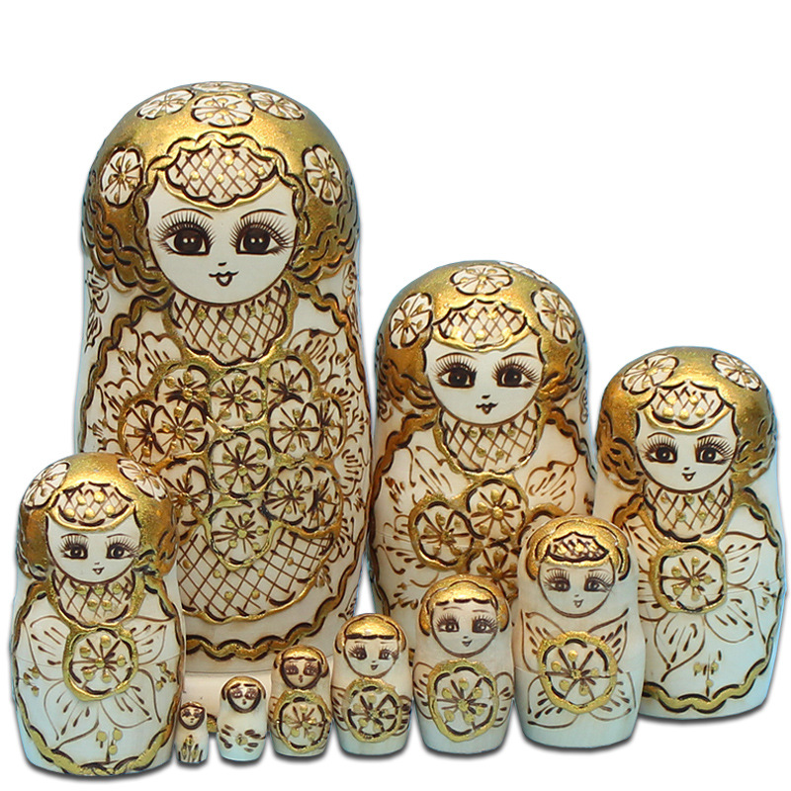
Russia
俄罗斯
Matryoshka doll
套娃

Slide 18
Skimming
Questions：
1. Where does the writer come from? How do you know?
2. What are matryoshka dolls made of?
3. Why does the writer love matryoshkas?

Slide 19
Scanning Para. 2
What is the secret of matryoshkas?
Fun facts：
* dolls range from big to small
* twist it, open and see a smaller one inside
* five to ten different dolls inside

Slide 20
Deep thinking Para. 5-6
Though doll designs have changed a lot over 100 years, what does matryoshka dolls mean to Russians?

Slide 21
Works of Art

Slide 22
Group work
As you are in the student exchange program, you are planning to give your Russian friend a kite,
you are expected to:
a. use typical Chinese and Russian elements (pics attached)
b. write a brief description (shape, color, materials, elements)
c. present in groups

Slide 23
Oral presentation：
Student A: Hello, everyone! Our kite looks like ____. The colours used are ____ because ____.
Student B：The materials(材质) used are ____, as(因为)____.
Student C: We pick ____ (element A ) because it ____.
Student D: We also pick ____ (element B) because it ____.

Slide 24
Think about :
Why are Works of Art popular all over the world?

Slide 25
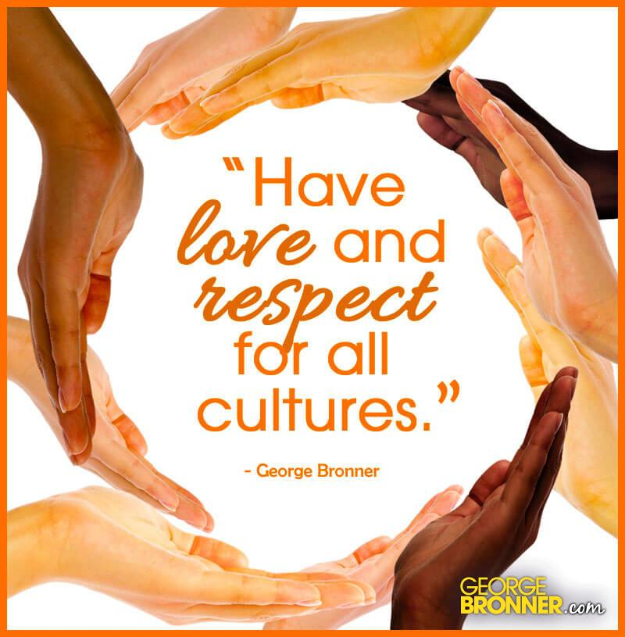

Slide 26
Homework
Required：
Design a kite and display in the class.
Encouraged：
Write a summary of what you have learnt in the lesson.

Slide 27
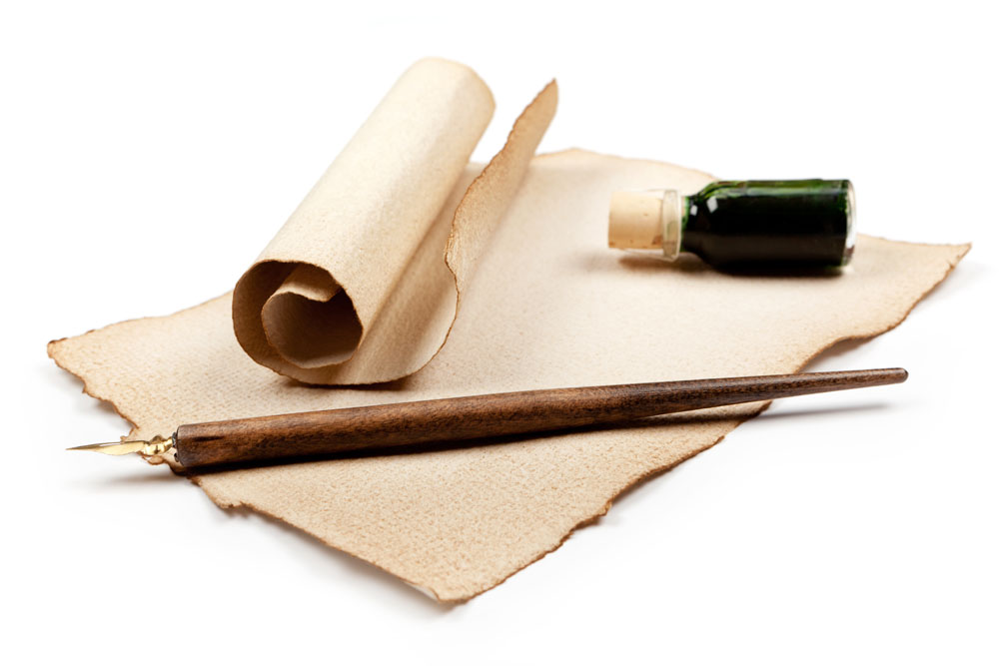
Thank you !

