Slide 2
Unit 5 Amazing things
Reading

Slide 3
Lead-in
a ghost
[ɡəʊst]

Slide 4
Lead-in
1. Are there any ghosts in the world?
2. Are you afraid of ghosts?
3. Do you like reading ghost stories?

Slide 5
Predict (预测) before reading
What can you know from the picture and the title (标题)?
What might happen (发生) in the story?

Slide 6
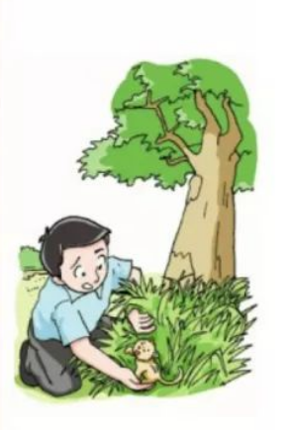
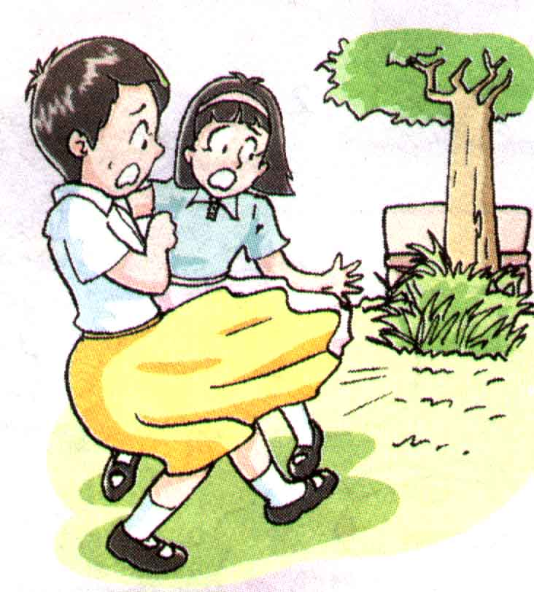
Fast reading
Read the story quickly and answer the questions.
Millie, Amy and Andy
one Sunday morning
Who
When
They met a “ghost”.
What happened

Slide 7
Main ideas
Read the story again,and match the main ideas.
Part 1 Line 1--- Line 7
Part 2 Line 8--- Line 13
Part 3 Line 14--- Line 16
A: Andy helped them
find out the ghost.
B: They took the little cat
to the animal center.
C: Millie and Amy heard
the ghost in the park

Slide 8
Careful reading
Read Line 1-Line 2.
When did it happen? | Where did it happen? | Who was there? | What did they do？ | How did they feel?
One Sunday
morning
At Sunshine
Park
Millie and
Amy
Sat down under
a big tree
Relaxed
What happened later?
afraid ？
relaxed(放松的)?

Slide 9
Careful reading
Read Line 3-Line 7.
When did it happen? | Where did it happen? | Who was there? | What did they do？ | How did they feel?
a whisper from
1.Heard_______________
______________________
Later
At Sunshine
Park
Millie and
Amy
the bushes behind the tree
very afraid
2.________________but
______________
Turned around
saw nothing
3. They ___________
quickly
left the park

Slide 10
Read Line 3-Line 7.
A
Suddenly, they heard a whisper from the bushes behind the tree.
They turned around but saw nothing. “Is anybody there?” Millie
asked. Nobody replied.“That's strange,” the two girls were very
afraid. They left the park quickly.
B
C
What does “that” refer to?(that 指什么)
Where did they go?

Slide 11
Careful reading
Read Line 7-Line 9.
1. Where did it happen?
On their way home.
2. Who was there?
Millie, Amy and Andy.
3. What did they do？
Millie told Andy everything.
4. How did Millie feel?
She was still afraid.

Slide 12
Read Line 7-Line 9.
On their way home, they met Andy.
“What happened?” Andy asked.
“There is a ghost in the park ” Millie said.Then she told Andy everything.
Did Andy go to the park to find it out?
Can you read it with emotion?
(有感情地朗读)
Which sentence（句子） shows that Millie was still afraid?
!

Slide 13
Careful reading
Read Line 9-Line 13.
Millie and Amy ____ Andy on the way and told him _______. He wanted to help them, so he went back to the park. He ______ carefully. At last, he found a little cat in the bushes. It was very ____.
met
everything
searched
weak

Slide 14
Read Line 9-Line 13.
“What's it?” Andy wondered. He went to the park ,
stood beside the tree and listened carefully.
Then he heard the whisper! He searched the bushes.
“Here it is,” Andy said to himself. He found a little cat
in the bushes. It was very weak. When it miaowed,
it sounded like a whisper.
How did Andy find out the ghost ?
Why did they mistake(误认为) a little cat for a ghost?

Slide 15
Read Line 9-Line 13.
Did Andy go to the park with anybody or alone(独自) ?
“What's it?” Andy wondered. He went to the park ,
stood beside the tree and listened carefully.
Then he heard the whisper He searched the bushes.
“Here it is,” Andy said to himself. he found a little cat
in the bushes. It was very weak. When it miaoed,
it sounded like a whisper.
!
How did he feel when he heard the whisper?
He was not afraid and wanted to find out the truth.

Slide 16
Read Line 9-Line 13.
When did it happen? | Where did it happen? | Who was there? | What did he do？ | How did he feel?
Next | In the park |  |  | Andy felt ________
not afraid
He found out the
________
Andy
ghost
and ...
Where did they take
the little cat to?

Slide 17
Careful reading
Read Line 14-Line 16.
When did it happen? | Who was there? | What did they do？ | How did Millie and Amy feel?
At last |  |  | Millie and Amy felt ________
Millie、
Amy
and Andy
They took it to
______________
surprised
the animal center

Slide 18
Read Line 14-Line 16.
“This is the ghost in the park,” Andy said.
Millie and Amy were very surprised— it was a little cat
Later that day, they took the little cat to the animal center.
!
Which sentence（句子） shows that they were surprised?

Slide 19
Read Line 14-Line 16.
“This is the ghost in the park,” Andy said.
Millie and Amy were very surprised— it was a little cat!
Later that day, they took the little cat to the animal center.
We should be kind to the animals, never hurt or kill them.
Why did they take it to the animal center?
What can we learn from them?What do you think of them?
Because it was very ________ (weak / strong),
and the animal center can take good care of it.
weak

Slide 20
Discuss
How did they feel at first? Then? At last?
 | Millie and Amy | Andy
At first
Then
At last
Afraid
Very afraid
Surprised

Slide 21
Discuss:Can we change the title into “The cat in the park”?
cat
The “ghost” makes the article more attractive(有吸引力的).

Slide 22
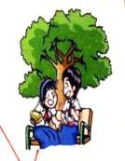
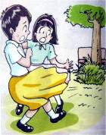
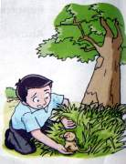
Retell: Please retell the story according to the following words.
First, ____________________________________.
went → sat→ heard
turned → saw → asked → replied → were afraid → left
Next, __________________________________________.
met→ asked → said → told → wondered → went
Then, ____________________________________.
Afterwards, __________________________________________.
stood → listened → heard →searched →said → found
Finally, ____________________________________________.
maiowed → sounded → picked → went → were surprised → took

Slide 23
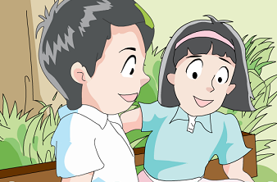
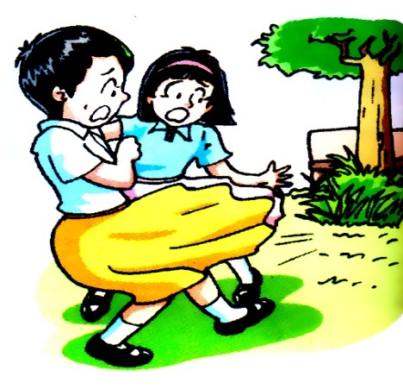
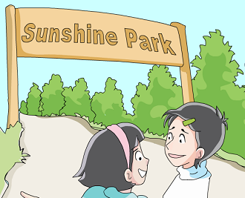
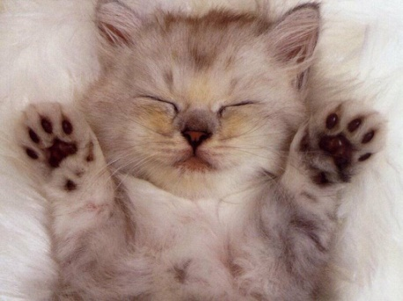
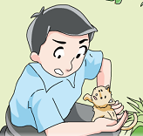
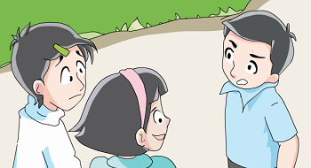
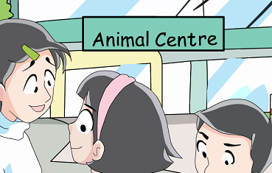
Act it out
heard
went to
sat
left
was weak
found
met Andy
took---to

Slide 24
What can you learn from the article(文章)？
There is no ghost in the world.
Try to be a brave(勇敢的) person.
We should love animals and be kind to everyone.

Slide 25
Homework.
Write a short article about one of your amazing experiences.(经历)

Slide 26
Thank you for listening !

