Slide 1

Role Models
By Cao Dan
Feilong Middle School

Slide 2
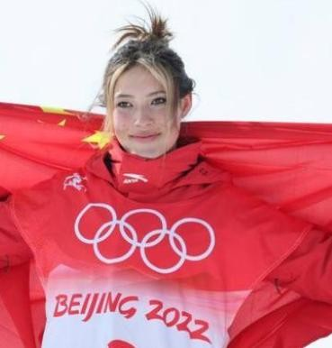
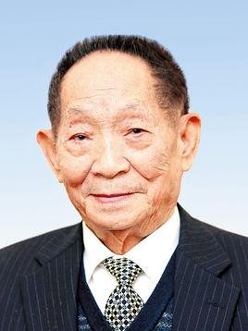
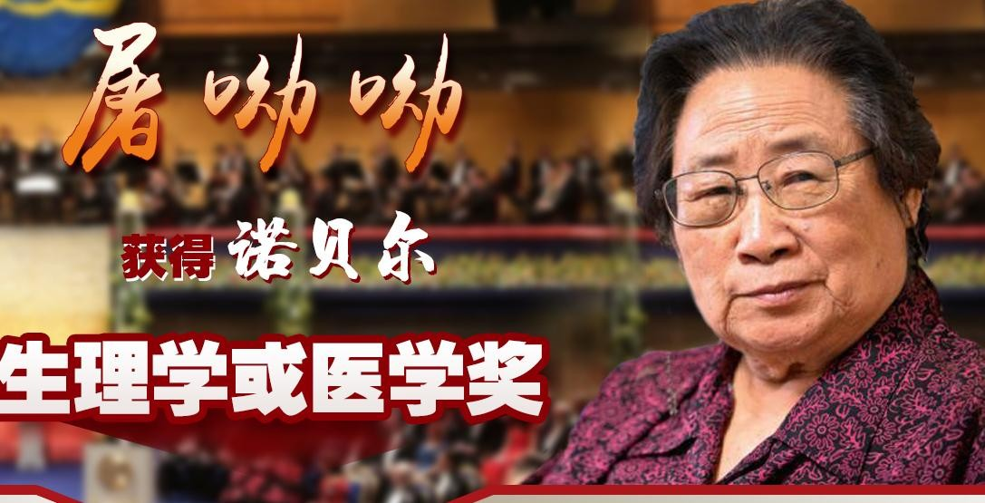
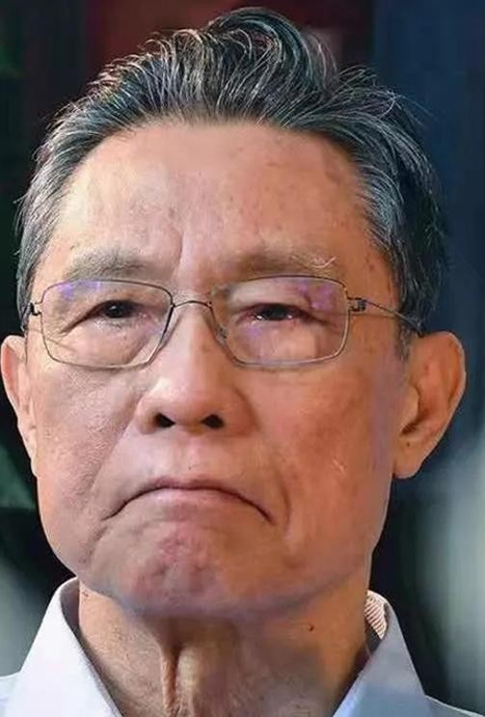
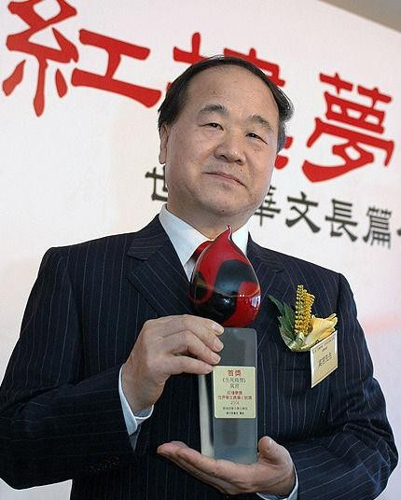
Role Models

Slide 3
Read for information
Passage1& Passage2& Passage3
 | Figure (人物） | Identity（身份） | Deeds（事迹）
Passage 1
Passage 2
Passage 3
1. develop a new type of hybrid rice plant
Yuan Longping
a rice scientist
2. solve the problem of hunger for people around the world
1. devote herself to a common job during her lifetime
2. show passion and love for life
a 90-year-old woman
Irene Astbury
a disabled swimmer
1. compete and win several medals in Paralympic Games
2. try her best to help people with disability
Victoria Arlen

Slide 4
Read for information
Passage1& Passage2& Passage3
 | Figure(人物） | Identity（身份） | Deeds（事迹）
Passage 1 | Yuan Longping | a rice scientist | 1. develop a new type of bybrid rice plant 2. solve the problem of hunger for people around the world
Passage 2 | Irene Astbury | a 90-year-old woman | 1. devote herself to a common job during her lifetime 2. show passion and love for life
Passage 3 | Victoria Arlen | a disabled swimmer | 1. compete and win several medals in Paralympic Games 2. try her best to help people with disability
Tip 1(content): Identity, achievements, deeds and qualities should be included.

Slide 5
Read for language
eg: I work not because I have to, but because I want to.
Yuan Longping spent all his life on the research and development of better rice plants.
Yuan Longping devoted all his life to the research ......
He solved the problem of hunger for people not only in China but also in many other countries.

Slide 6
Read for language
A 90-year-old has been awarded “Women of The Year” for being Britain’s oldest full-time employee.
Her years of hard work have finally been acknowledged after....
Doctors said she would be in a wheelchair for the rest of her life, but she didn’t let this get her down.
“Face it; Hug it; Beat it; Overcome it.” This saying helps her fight against illness.

Slide 7
Read for language
Passage1& Passage2& Passage3
Function | Expression
Describing achievements | He is considered... He solved ... for people not only in China but also in ... Her years of ...have finally been acknowledged(认可) after...
Showing qualities | I work not because I have to, but because I want to. Yuan Longping spent ... on .... Doctors said ......, but she didn’t let this get her down. “Face it; Hug it;....” This ... helps her fight against illness.
Tip 2(language): Beautiful phrases and sentence patterns should
be used as much as possible.

Slide 8
Read for structure
Passage1& Passage2& Passage3
Structure
Content
Introduction
impressive deeds
Main body
comment(评价)/ influence
Conclusion
general information
Tip 3(structure): The structure should be clear.

Slide 9
Read for writing
我校正在组织 “My Role Model”为话题的作文比赛, 请写一篇短文参赛。 1. 介绍榜样人物（基本信息、事迹、贡献、品格等） 2. 榜样人物对你的影响 3. 词数100词左右
Structure | Content | Language
Part.1 | general information | be considered/acknowledged/awarded...
Part. 2 | impressive deeds | He devoted...to.../He spent...on... He ...not only...but also... I work not...but...
Part. 3 | comment influence | learn from.../ encourage...to... be inspired(激励) by...

Slide 10

Read for writing
Use the checklist to help you evaluate your partner’s writing
Is the structure clear?（ ）
Is the language beautiful?（ ）
Does the writer tell an impressive story of the role model’s life?（ ）
Does the writer show role model’s qualities by telling the story?（ ）
Does the writer use the language that we learned today?（ ）

Slide 11
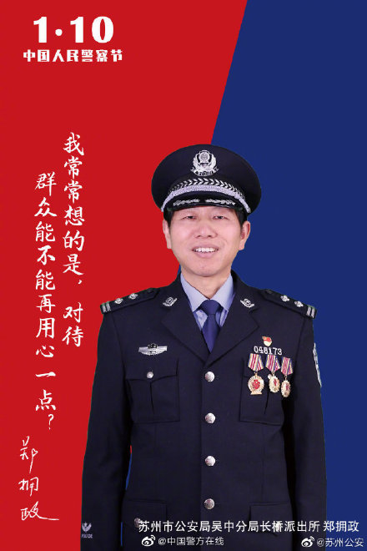
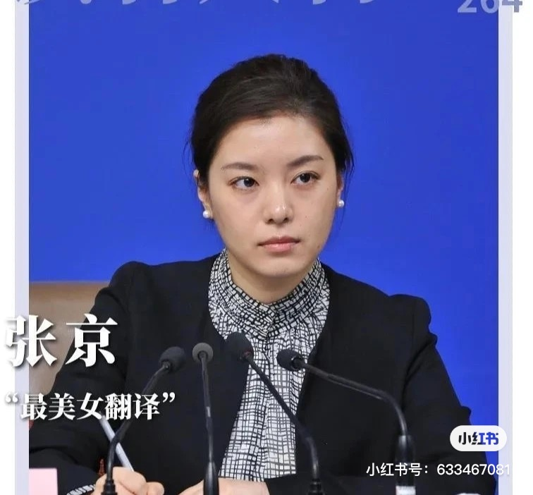
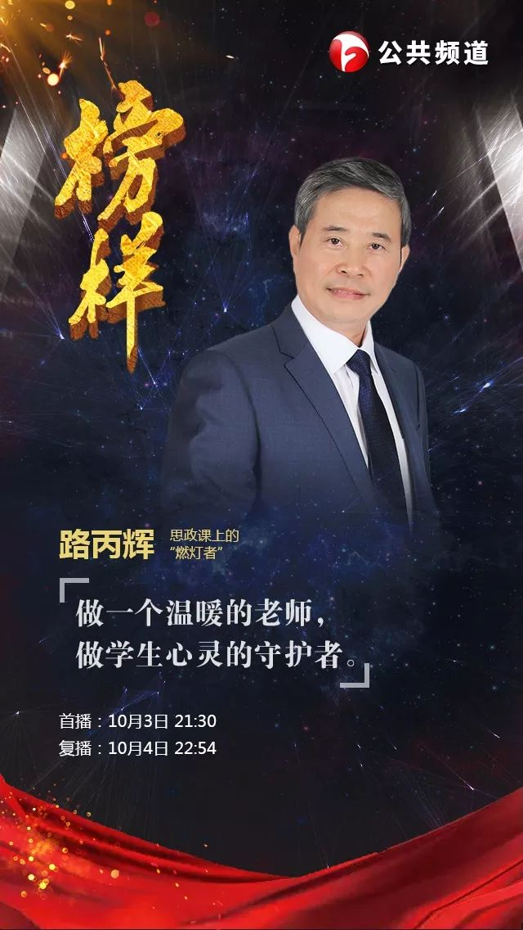
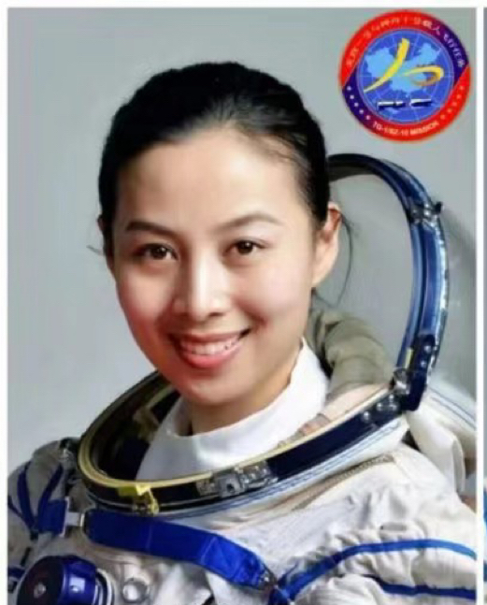
Summary
No matter who we are,
no matter how old we are,
no matter what job we take,
as long as we are skillful in a certain field,
as long as we can influence others positively,
we can be a role model.

Slide 12
Homework
1. Polish(改进) your writing according to the checklist.
2. Share your role model with classmates after class.

