Slide 1
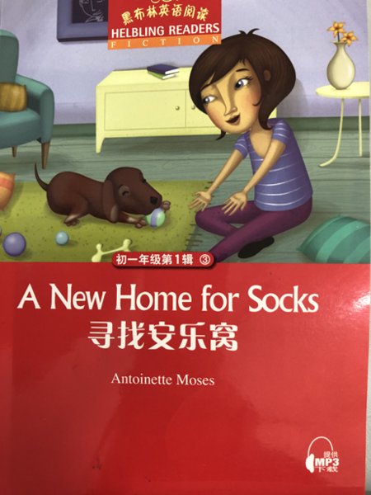
A New Home for Socks
Binjiang Middle School Song Di
2023.5.16

Slide 2
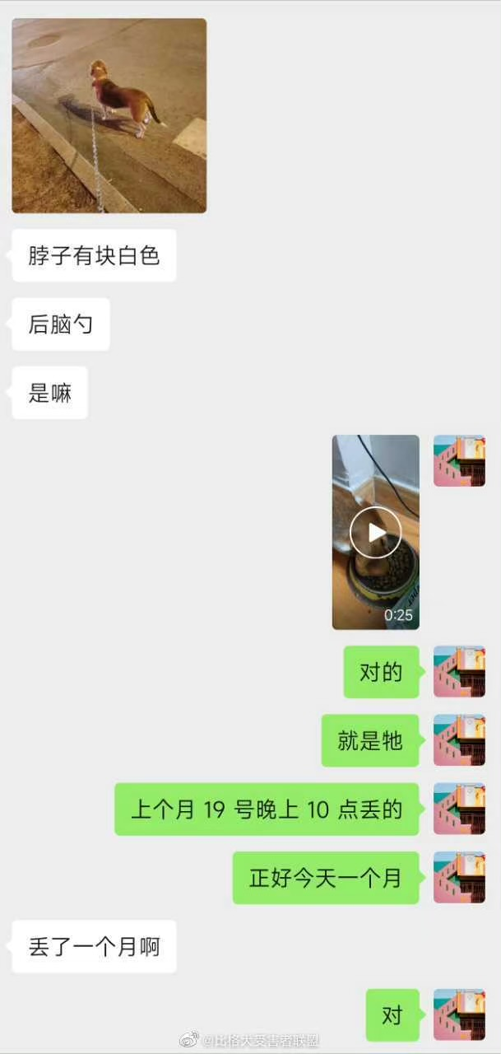
Lead in

Slide 3
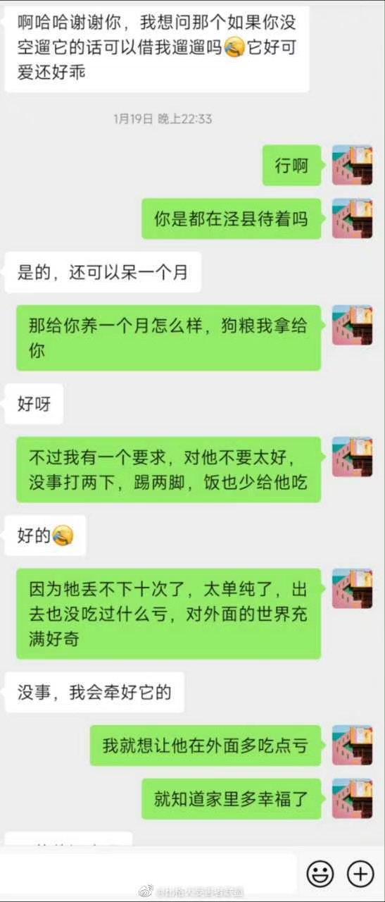
Lead in

Slide 4
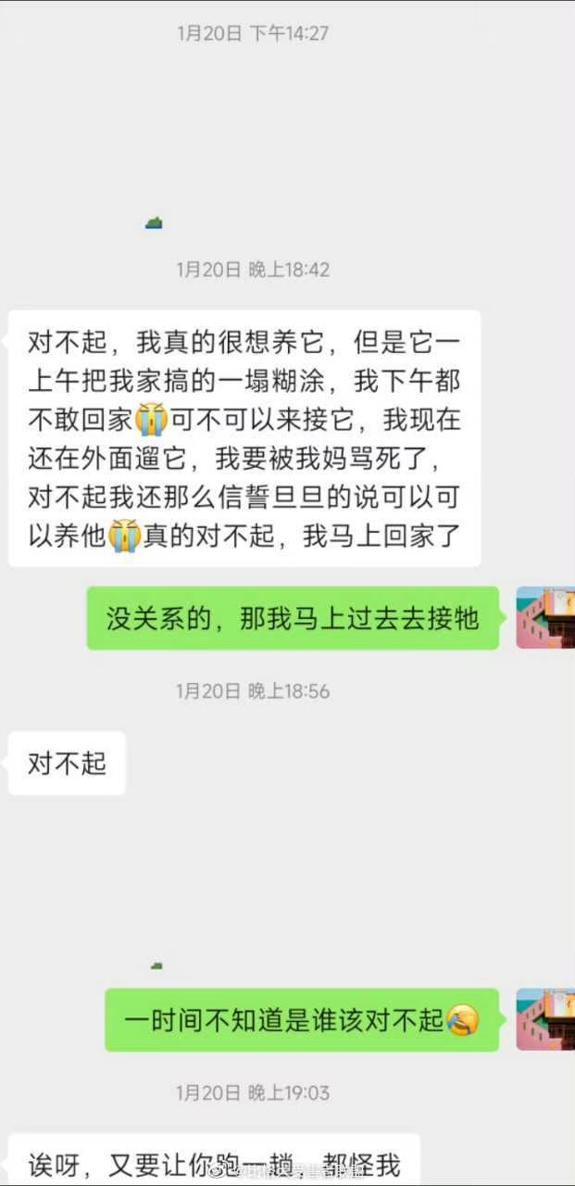
Lead in

Slide 5
Main ideas of each part
Beginning
(Chapter1-2)
Development
(Chapter3-8)
Climax
(Chapter9-14)
Ending
(Chapter15)

Slide 6
Beginning(p13-16)
The Coopers have just moved from _______ to ________ because Mr Cooper has to _______________. But Penny feels __________ because she _____________________________.
Now it’s time for Penny to say goodbye to ____________________.

Slide 7
Appreciation
Penny and her friends often play with Holly. Sometimes they throw sticks into the lake and Holly brings them back. Then she makes everyone wet. Penny and her friends laugh at Holly. (P14)
life in the village
in sharp contrast(鲜明对比)
Penny is on her own. She is often on her own. She's on her own at school and she's on her own at home. Penny often feels lonely. (P13)
life in the city
own

Slide 8
Beginning(P13-16)
Compare
A Different Life
living conditions
friendship
parents
small
big
a lake, hills, woods
a park
live in the house, a big garden
live in the apartment,
empty, small
own a dog, have many friendly friends
often on her own;
have no dog/friends
father works at a factory
father out of work
mother at home
mother works
happy
sad
life in the village
life in the city

Slide 9
Development(p18-35)
Penny finds a homeless dog in ______________ and she __________________. She knows that she can’t __________ because ________________. So she wants to ask others for help.
Lucy, an old lady, agrees to take Socks home but Socks _________________. Then, Penny persuades（说服） Jane, who is another dog owner, to adopt（收养） Socks. But _________________. Next, Penny takes Socks to ______________ but ___________.
At last, Penny ______________________________.

Slide 10
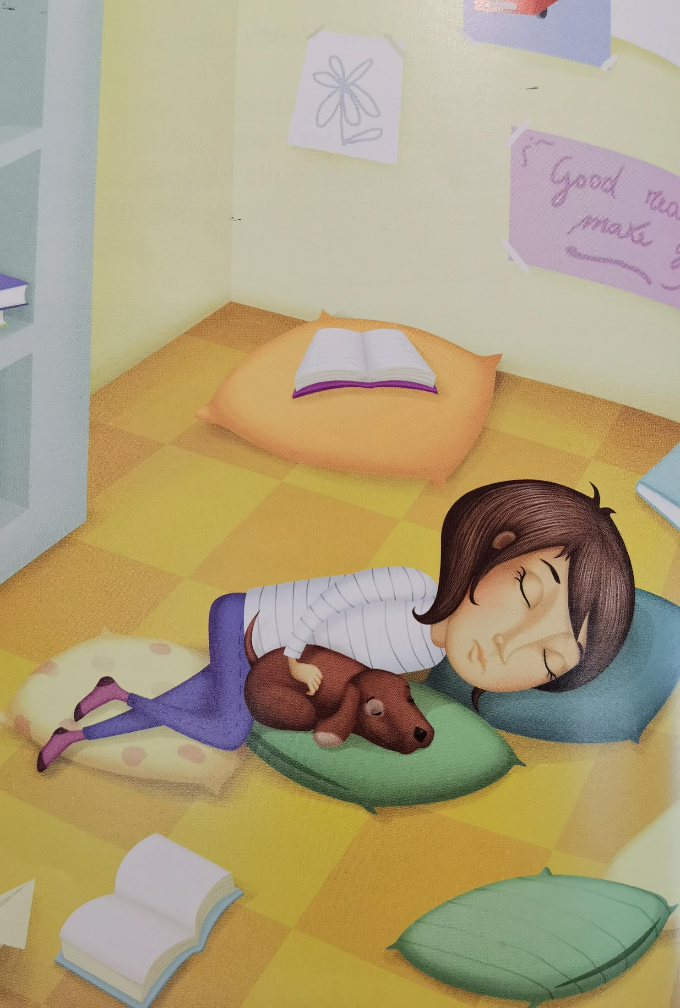
Development (P18-35)
Q: What causes(导致 ) the “missing” of Penny?
miss her old friends
dislike the city
like the village
be in a big trouble
(P35)
look for an ideal home for Socks
look for an ideal
home for herself
in the village
in the city

Slide 11
Climax(p36-55)
Mr and Mrs Cooper find their daughter is missing. The headteacher says that maybe the missing of the girl has something to do with(与…有关) ___________ but her parents __________. Then, the police ask the journalists to show a piece of news about the missing girl on TV. After hearing of the news, _____________ call the police at once and ________________.
Penny gets into a ___________ in the village and the owner ___________________. At night, they _______________.
With the help of the _____________, the police find Penny finally. And _______________ takes her home.

Slide 12
Helping hands
Headteacher:Because there is a dog in the school eating my students’ trainers and now one of my students is missing. I wonder if there is a connection.(P38)
Sara: Penny doesn’t have any friends. I like Penny.(P40)
Sara’s mother: Sara’s mother is thinking about Mrs Cooper. Maybe she needs a friend, too.(P53)
Jane and Lucy: They immediately call the police and tell them about Penny and Socks.(P43)
The cafe owner: The man gives her some dog biscuits for Socks and he also gives her a piece of cake and an apple.(P49)

Slide 13
Ending(p56-59)
Everyone is happy to see Penny come back. Penny’s parents tell her __________________ and in turn(相应地), Penny tells her parents ___________________.
Other students’ parents ______________________. Sara’s mother agrees ____________________ and Penny is quite happy because she manages to(成功) find ________________.

Slide 14
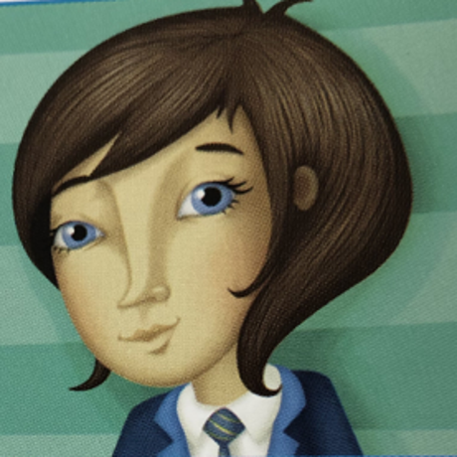
Ending (P56-59)
After Penny comes back, what does she and her parents say and do to each other?
Ending
in the village
in the city
Beginning
Development
Climax

Slide 15
What causes(导致) the “missing” of Penny?(P56-57)
Penny sees the police cars and she is frightened.
“It's OK,” says her mother. “The police are here because you are missing. You are not in trouble.”
“I'm so sorry,” cries Penny. She understands now how worried her parents are.
“Don't go off on your own again!” says her father. “And always keep your phone on. We were very worried.”
“I'm very sorry,” says Penny. And they all hug each other.
“We are a family,” says her mother. “We must talk about everything together as a family. We love you,” she tells her daughter. “And we worry about you.”
“I love you, too,” says Penny.
“And we're so sorry,” say her parents.
“Why are you sorry?” Penny asks them.
“Because you feel lonely and you don't want to tell us. And you find a puppy and you can't tell us,” they say.
It's OK
I'm so sorry
We were very worried.
I'm very sorry
they all hug each other
We love you
we worry about you
I love you, too
we're so sorry
Because you feel lonely and you don't want to tell us. And you find a puppy and you can't tell us

Slide 16
Comment on the main character
What do you think of Penny?
kind
have a heart full of love
independent
shy
reckless(鲁莽的)
strong-willed（意志坚定的）
stubborn（固执的）
...

Slide 17
Discussion
Before adopting(收养) Socks, what should Penny think about?
parents’ support
space
time
money
neighbors
enough preparation
...

Slide 18
Group work
Share your poem writing
Share and evaluate(评价) your poem writing.
(contents内容,form形式, rhyme, the choice of words, the figure of speech修辞, emotion情感...)

Slide 19
Homework
Choice A: Continue to write the story
Q1: Will Socks like his new home?
Q2: Will Penny get used to the life in the city?
Q3: Will her father get a new job?
Q4: ...?
Choice B: Write an article about your pet
Q1: Do you have a pet?
Q2: What does it look like? What is it like?
Q3: How do you look after it?
Q4: Do you have fun playing with it?
Q5: Do you have problems getting along with it?

Slide 20
Title: A New Home for Socks
Q: Who has a new home in this book?
A house is where we live
while a home is where the soul inhabits(栖息).

