Slide 1
Unit 1 Honesty and responsibility
Extended reading

Slide 2
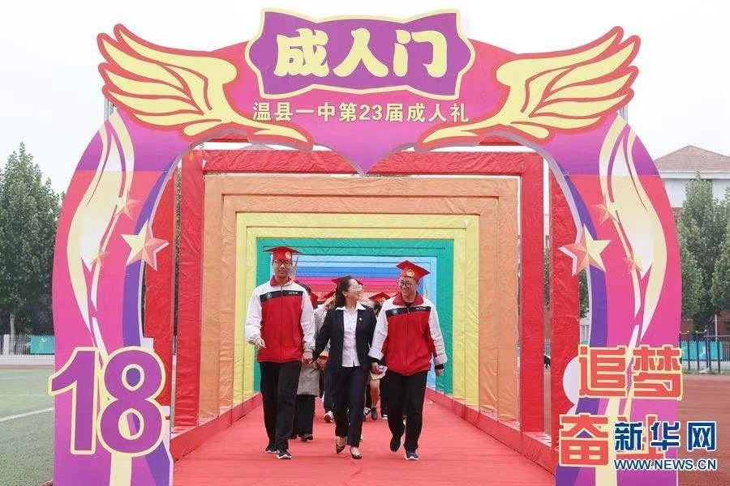
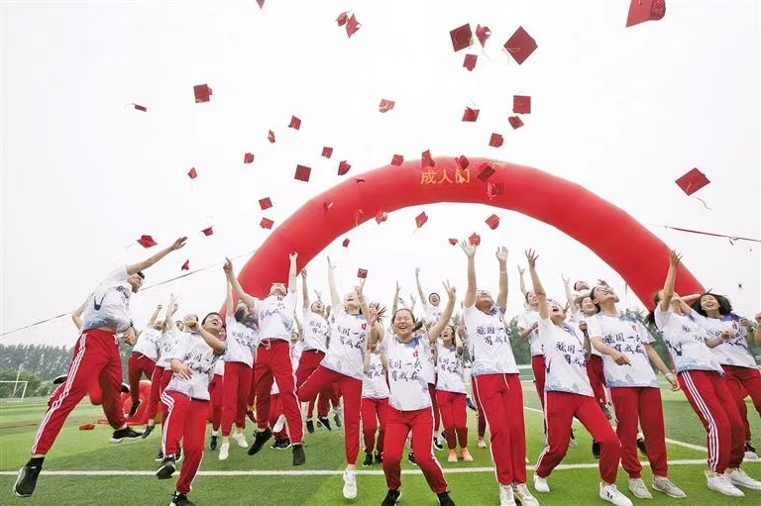
Lead-in
What ceremony do students attend when they turn 18?
What does that mean?
A coming-of-age ceremony

Slide 3
Lead-in
How do you feel about becoming an adult? Why?
I feel because .
I am no longer...
I am more...
I have changed from...to...
I used to ..., but now...
I have learnt...

Slide 4
Extended reading
Taking responsibility

Slide 5
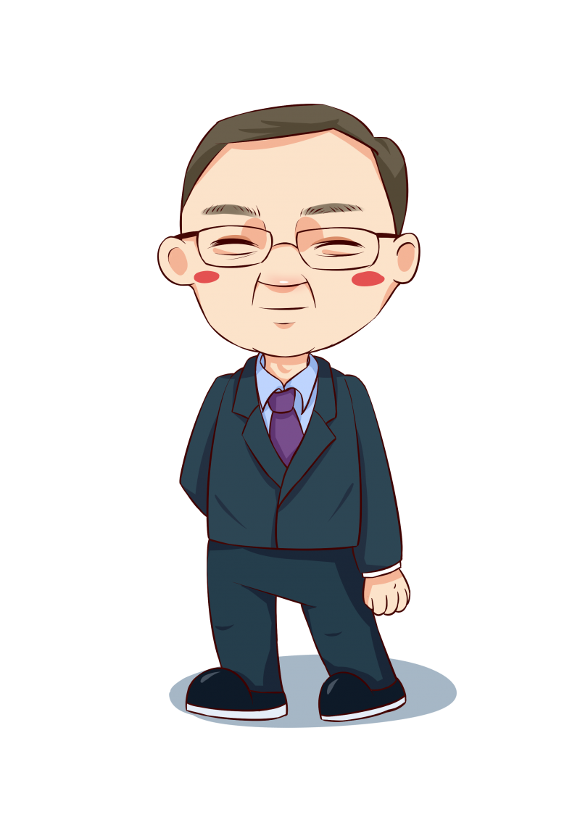
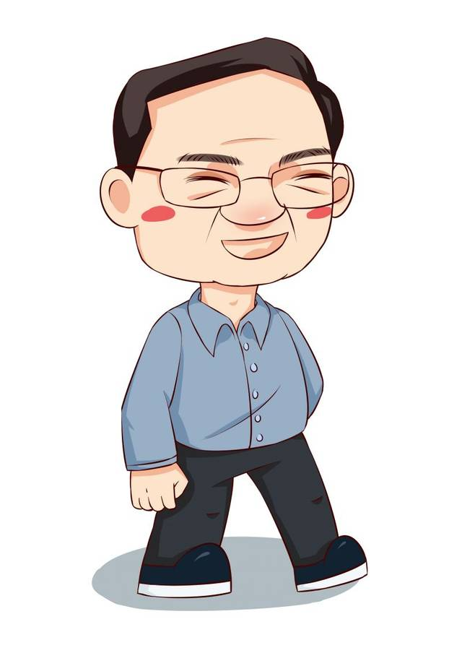
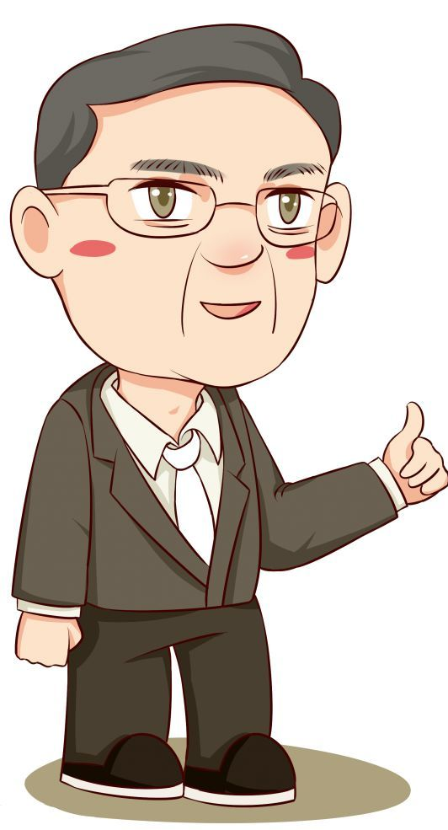
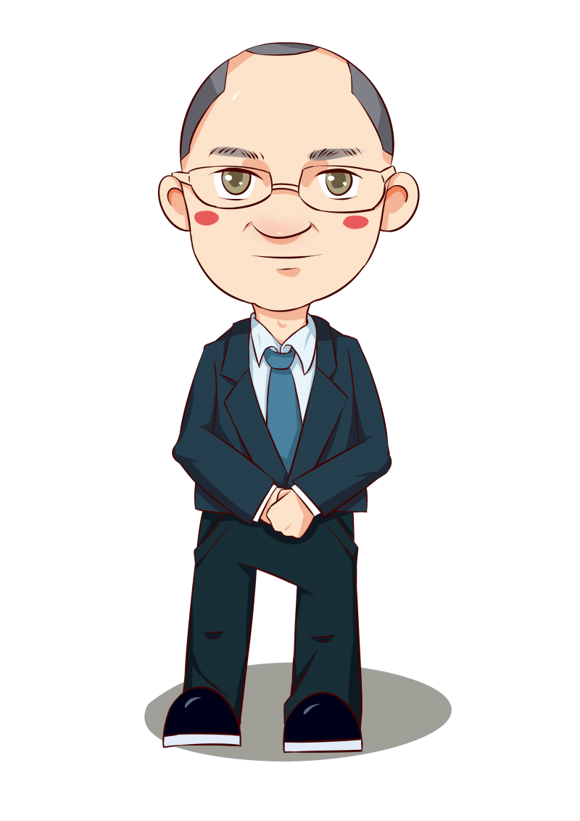
Structure
Para.1 _______________________________
Part 1 (Para.1-2)
introduction
greeting
Para.2 _______________________________
topic/ theme
Para.3 the _______________ of responsibility
importance
Part 2 (Para.3-5)
main body
Para.4 responsibility and _________________
personal development
Para.5 responsibility and _________________
betterment of society
Part 3 (Para.6)
____________
conclusion

Slide 6
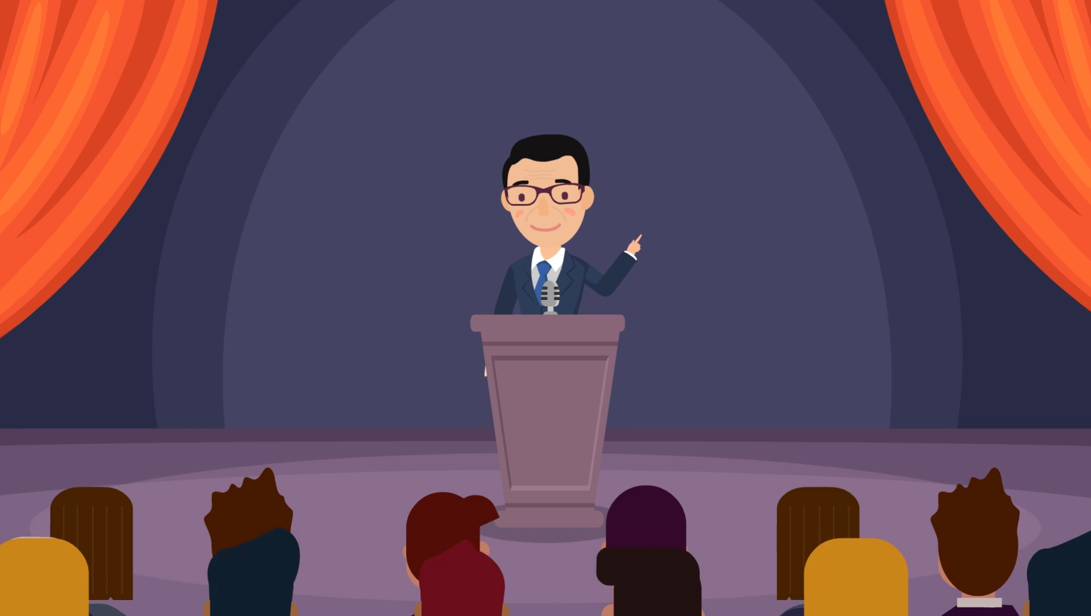
careful reading
Which is the right attitude to responsibility suggested by principal according to Para.3?
A. a weight troubling us
B. an investment in success
C. an anchor of a ship
D. a reason for careless behavior
“Hopefully, you have learnt to treat responsibility not as a weight that burdens you, but rather as a foundation which will support your future development.”
Tip：“Hopefully” is used to express one’s opinion.

Slide 7
careful reading
Taking responsibility for oneself can lead to personal development . Please match the practice with the virtue below according to Para.4.
Instead of being quick to blame others, analyse the problem, and if it is indeed your own fault, be ready to admit your mistake and then correct it.
determination
Always give your best in whatever you set out to do, however difficult that might be.
integrity
Be honest by saying what you mean and by meaning what you say.
courage

Slide 8
careful reading
From Para. 5, one can make a contribution to the betterment of society by ___________________, What influence does assuming responsibility for one’s actions have on society?
doing little things
It is important for the betterment of society. The little things a person does can make a difference to society and also inspire other people around them to follow suit

Slide 9
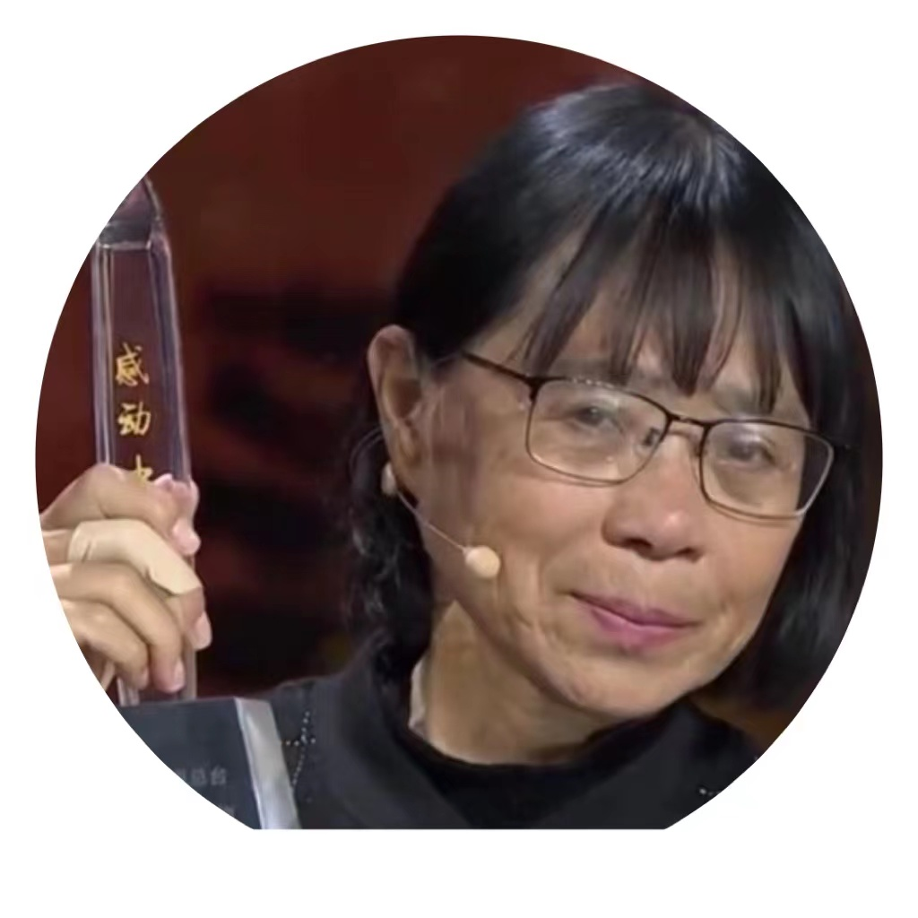
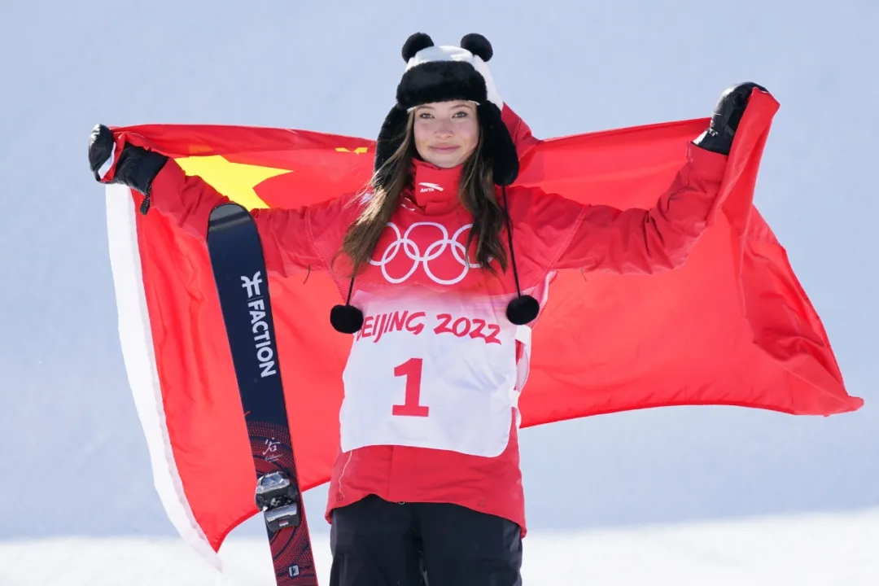
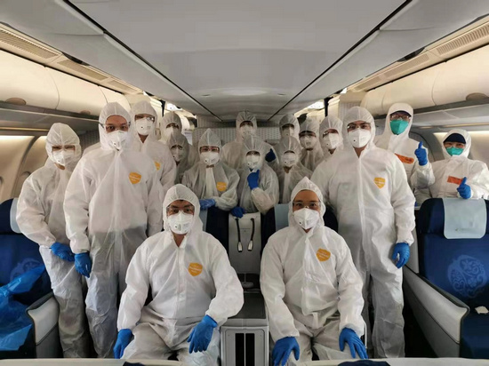
PEOPLE WHO MOVED YOU
Talk about a role model who left a deep impression in your heart
Who is he/she? (classmates/friends/parents/celebrities…)
What responsibilities does he/she take?
How does he/she take responsibilities?

Slide 10
Discussion
As a responsible person, who should we take responsibility for and what could we do?
What is the relationship between taking responsibility for yourself and taking responsibility for society?
be made up of
in turn

Slide 11
Writing
Sense of Responsibility
Whether it is for the home, the country or the world, we should 高度重视责任. It is tradition for us to take care of our parents. 我们非常感谢他们在我们成长过程中给予我们的爱. When they are old, it’s our duty to see that they are well cared for.
作为忠诚的中国公民，我们应该对国家有强烈的责任感. We should study and work hard to make our country strong.
Finally, we must remember that we have responsibility for the world. It is important that 我们必须学会与世界其他国家和平相处，保护我们的环境.

Slide 12
Writing
Sense of Responsibility
Whether it is for the home, the country or the world, we should place a high value on responsibility.
It is tradition for us to take care of our parents. We owe them a great deal for the love they give us while we are growing up. When they are old, it’s our duty to see that they are well cared for.
As loyal Chinese citizens, we should have a strong sense of responsibility for our country. We should study and work hard to make our country strong.
Finally, we must remember that we have responsibility for the world. It is important that we learn to live in peace with the other nations of the world and to protect our environment.

Slide 13
Design
To live a life of honesty and integrity is a responsibility of every decent person.

Slide 14
Thank you !

