Slide 1
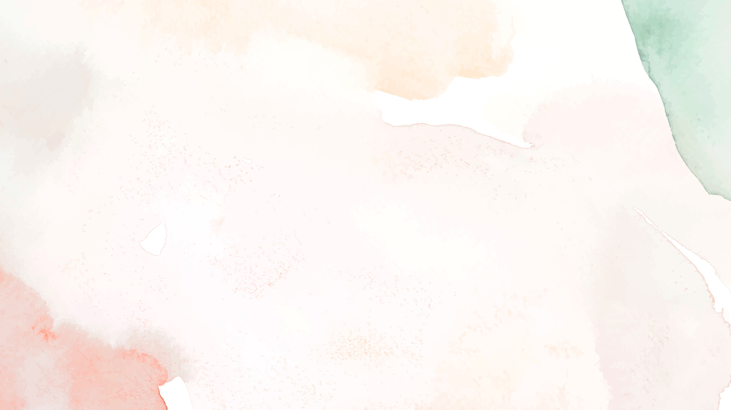
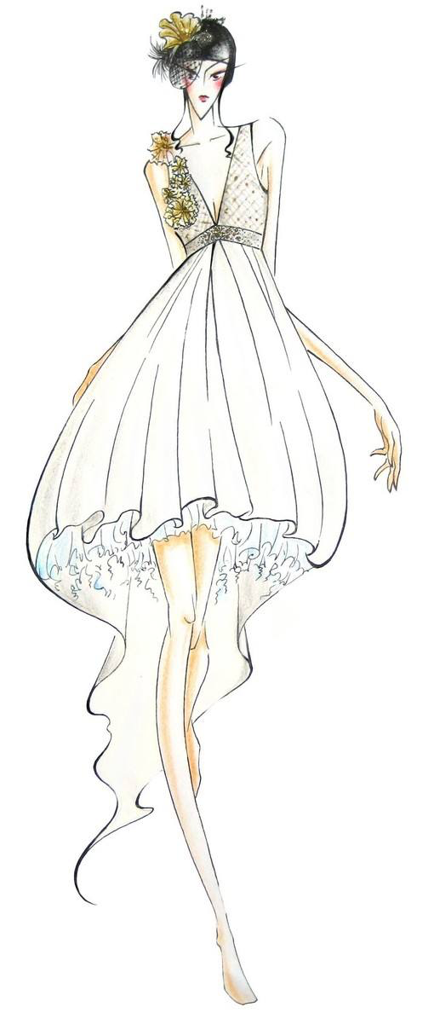
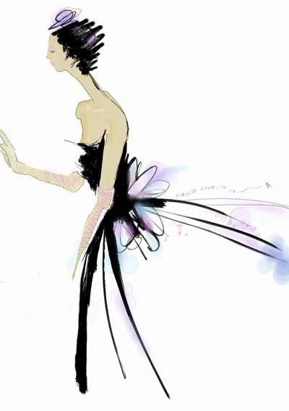
Unit8 fashion
Reading
Qian Fangliang

Slide 2
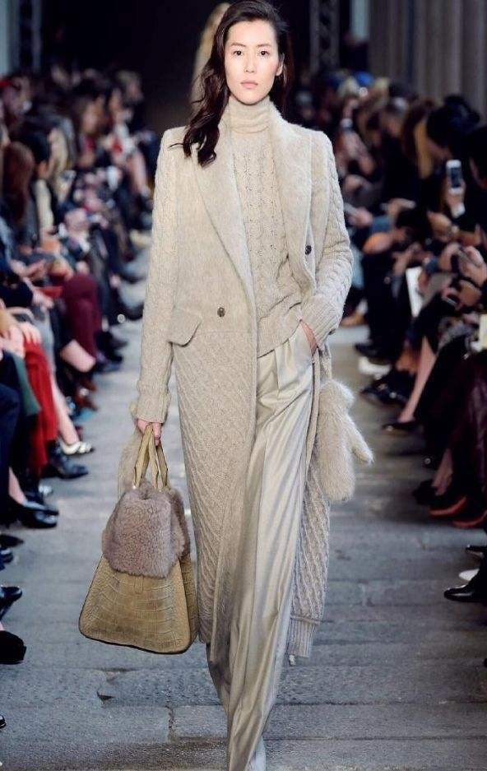
Free talk
What kind of clothes do you see?
coat, dress, trousers, shoes…
What do you think of the clothes?
Beautiful，pretty，cool，fashionable(时髦的)…
Liu Wen is one of most popular models among young people.
流行的
模特

Slide 3
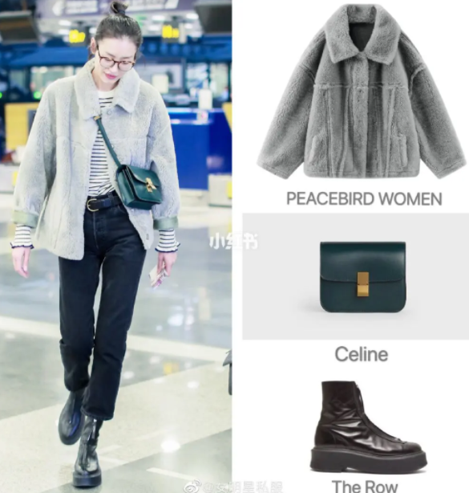
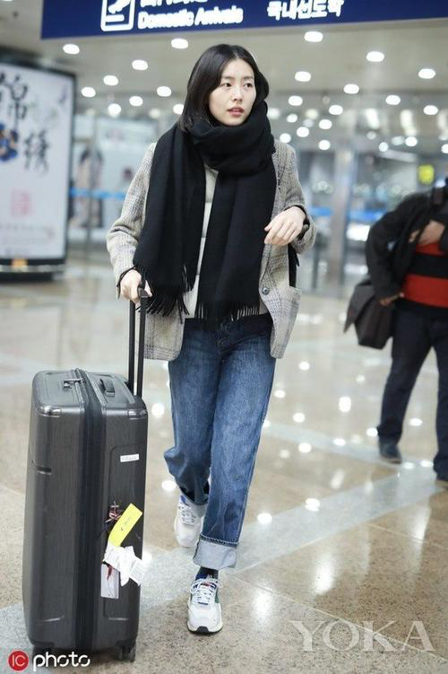
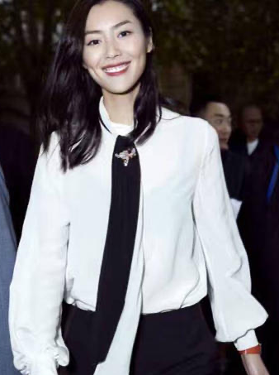
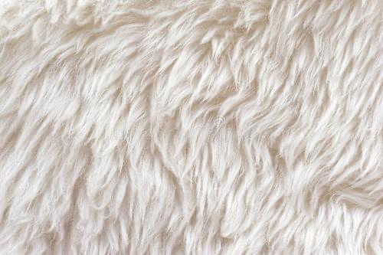
Preview
/ska:f / n. 围巾
a scarf
pl. scarves
jeans
/dʒ i:n z/ n.牛仔裤
a pair of jeans
trainers
a pair of
/treinəs/n.运动鞋
a pair of leather boots
a silk
blouse
['leðə] [buːts]
皮的 靴子
丝绸
be made of
由…制成
a pair of cotton trousers
棉质
a wool coat

Slide 4
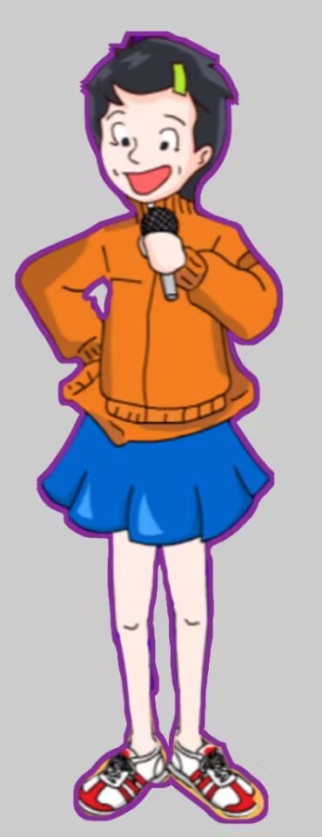
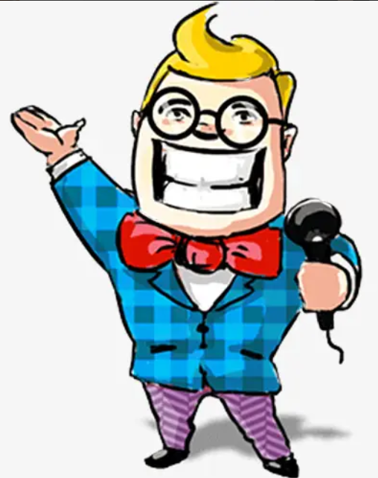
Good afternoon, ladies and gentlemen.
Welcome to our fashion show!
host
hostess

Slide 5
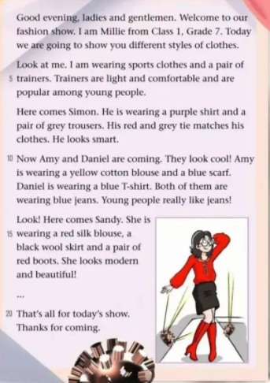
Pre-reading
The passage is a ________.
A. news report (新闻报道)
B. diary
C. script (主持稿)
D. letter
C
Spoken English or written English?
Tips：read the begining and ending to find out the type of the writing.

Slide 6
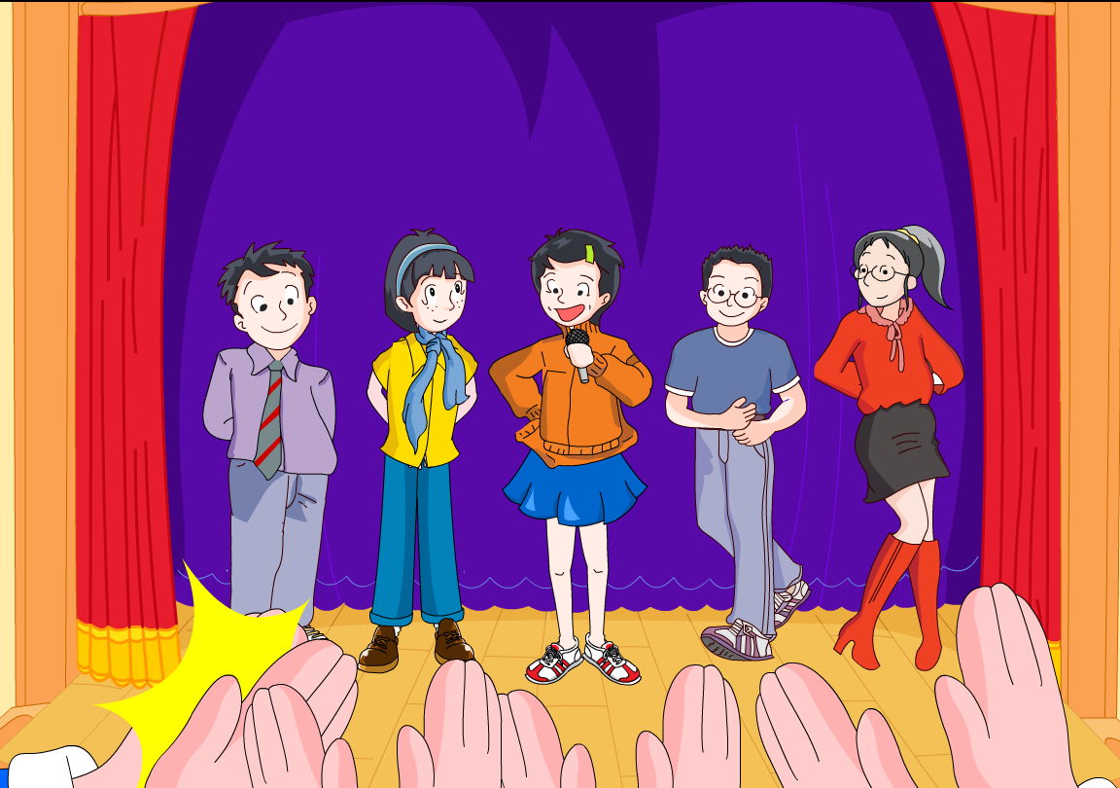
Fast-reading
Who are the models in the fashion show?
C A B D E
designers(设计师)
The order of show is _______________.
①Different clothes
colors+materials
②How they looks
B
D
A
Amy
Daniel
E
Simon
Sandy
C
Millie
Tips:Skim the first paragraph and the first sentence of each paragraph for general infromation.

Slide 7
Careful-reading
Introduce the models
What does Millie show on the catwalk(T台)?
Clothes
sports clothes
Millie is wearing ______________and a pair of ________.
Trainers are very ____ and __________. They are ________ among young people.
sports clothes
trainers
light
comfortable
Looks
popular
a pair of light and comfortable trainers

Slide 8
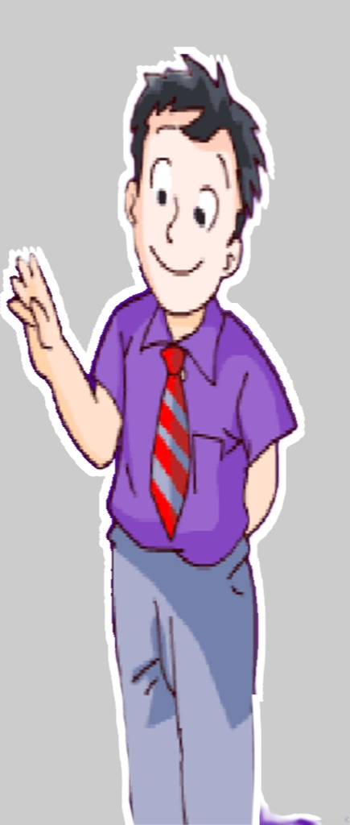
Careful-reading
Introduce the models
What does Simon show on the catwalk?
Color | Clothes | Looks
purple
shirt
grey
trousers
smart
red and grey
tie
The tie matches his clothes.
=They are a good match.

Slide 9
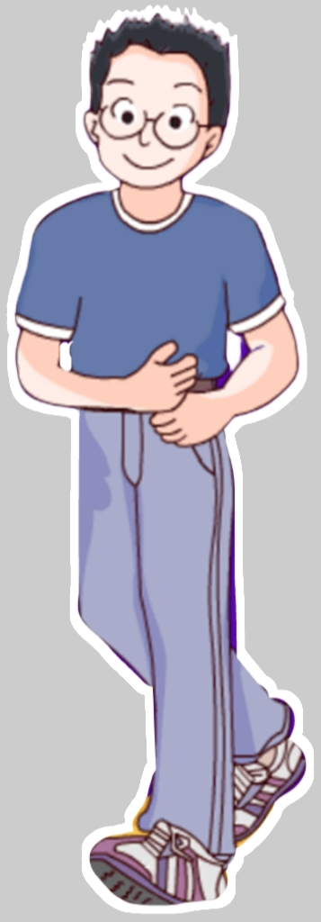
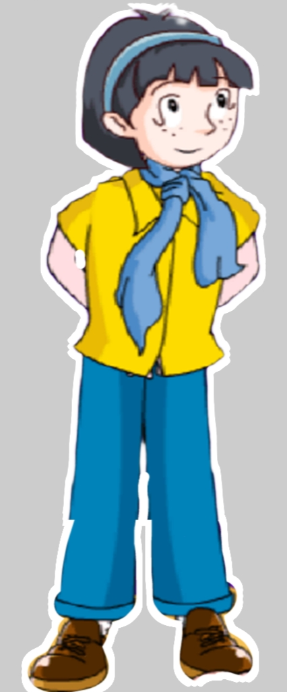
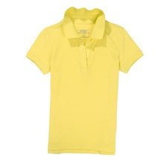
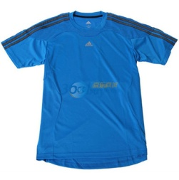
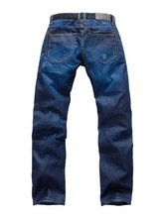
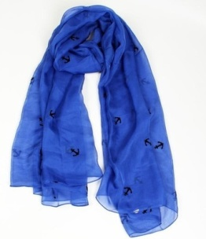
Careful-reading
Introduce the models
What do Daniel&Amy show on the catwalk?
C
Clothes
A
B
Both Daniel and Amy are wearing blue jeans.
Looks
They look cool. Young people really like jeans.
E
D

Slide 10
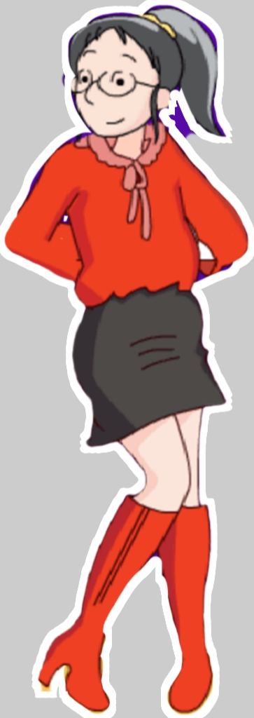
Careful-reading
Introduce the models
What does Sandy show on the catwalk?
Read and tell ”T or F”
1. Sandy is wearing a red cotton blouse.
2. Sandy is wearing a black wool skirt.
3.Sandy looks modern and beautiful.
F
Clothes
color+ material
silk
T
Looks
T
Tips: the order of adj.（形容词顺序）
shape+color+material
eg. a small black wool skirt
a big red silk blouse

Slide 11
They show different styles of clothes.

Slide 12
Post-reading
To be a fashion designer
Group work
Try to have a class fashion show
A fashion show
Rules:
1. Discuss in groups of four .
2. Choose one host/hostess and three models .
3.Models design and paint their clothes, then
describe the clothes.
Clothes
color+ material
Name
+
+
Looks

Slide 13
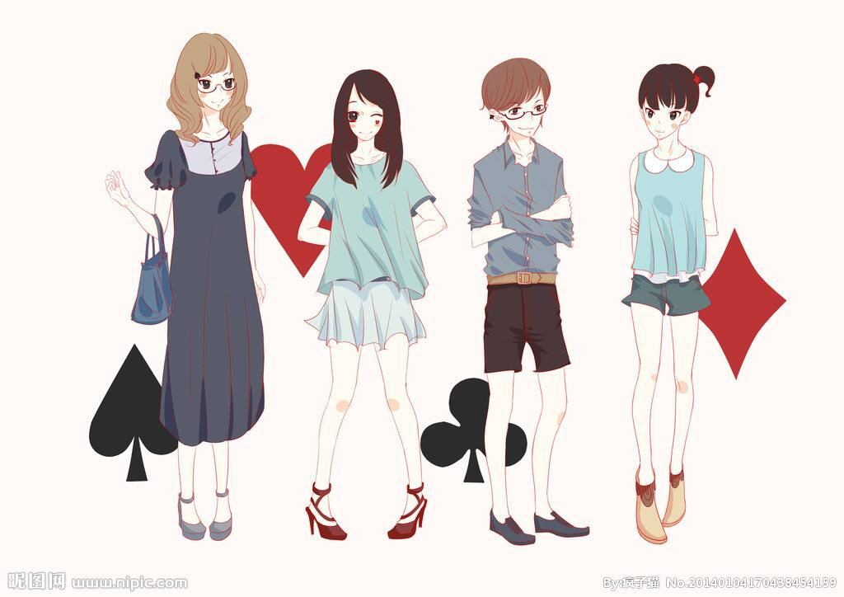
Post-reading
To be a fashion designer
Group work
Host: Good afternoon, ladies and gentlemen.
Welcome to .... I’m ... from ….
Today we are going to show you....
Here comes ....
Model1: Hi , I’m …. I’m wearing …
My … is made of… and … is made of …
I like my clothes because....
Do you think I look…?
Host: Look! ...is coming.
Model2:……
Model3:……
Host: That's all for our show. Thanks for coming.

Slide 14
Model1: Hi , I’m …. I’m wearing …
My … is made of… and … is made of …I like my clothes because....
Do you think I look…?
Host：Good afternoon, ladies and gentlemen.
Welcome to .... I’m ... from ….Today we are going to show you....Here comes ..../That’s all for...
Model2：...
Model3：...
host
model

Slide 15
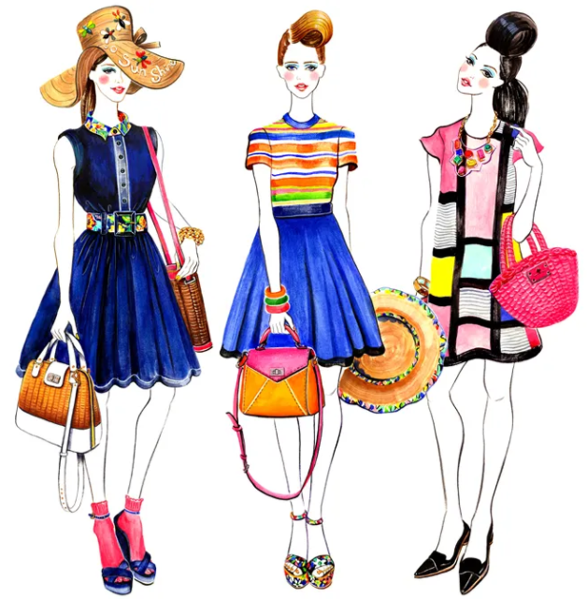
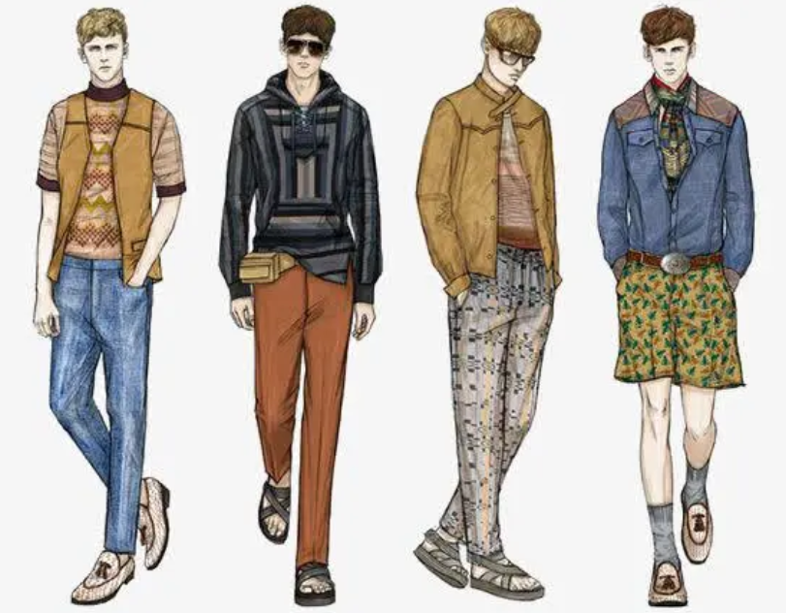
Further-reading
Can we wear clothes like these at school? Why？

Slide 16
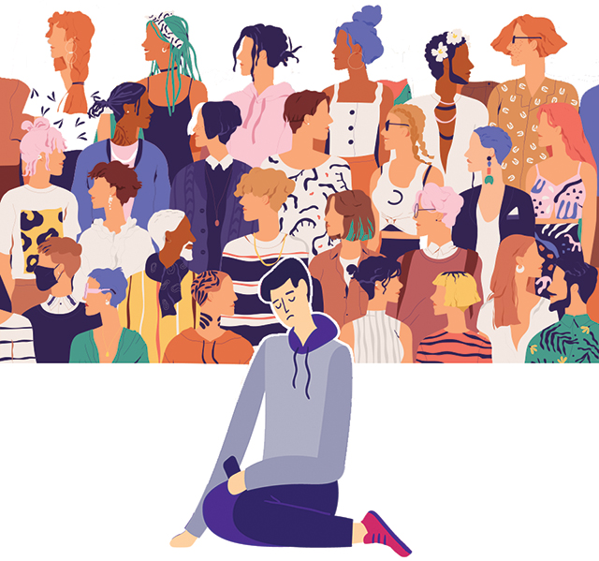
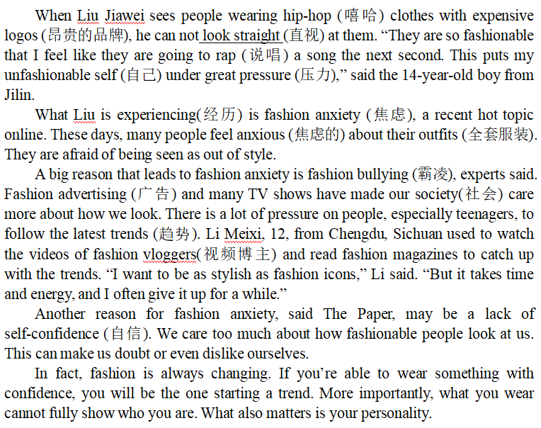
Further-reading
A
The passage is a ________.
A. news report (新闻报道)
B. diary
C. script (主持稿)
D. letter
焦虑的
①
Para 1-2
Fashion is not everthing.
②
③
Para 3-4
What is fashion anxiety?
④
⑤
Why is there
fashion anxiety?
Para 5

Slide 17
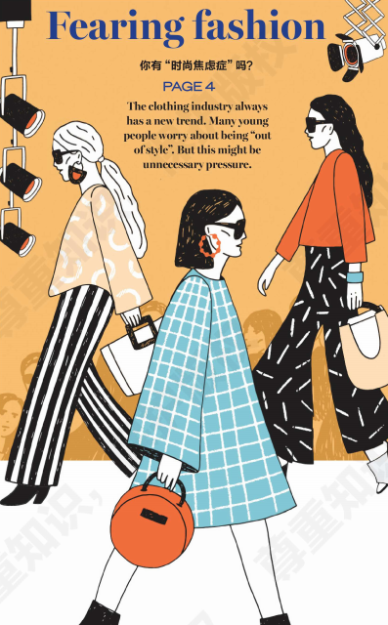
Careful-reading
Read para1-2 and choose.
1.How does the writer begin the article?
(1)by showing an attitude(态度)
(2)by giving an example
(3)by listing some numbers
(4)by telling a story
√
2.Why does the writer begin with the example?
*To lead in(引入) the topic.
*To echo(呼应) with the title.
*To catch readers' eyes.
Fashion anxiety?

Slide 18
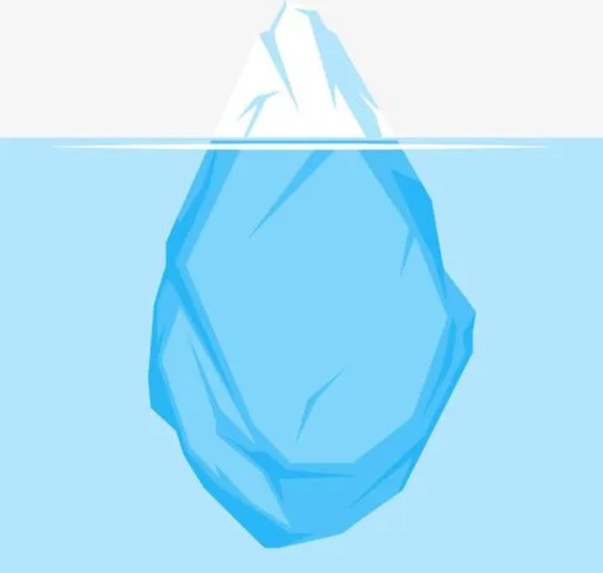
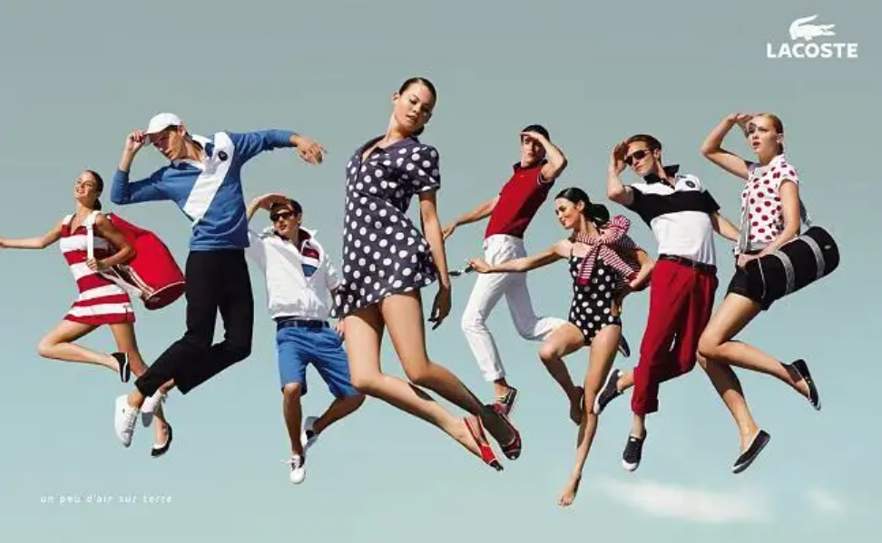
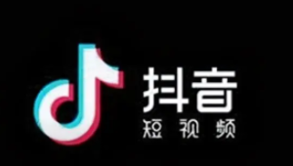
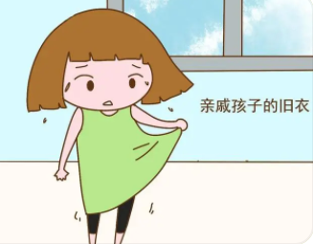
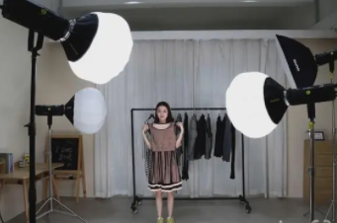
Careful-reading
Read para3-4 and answer.
Why do students have fashion anxiety?
fashion anxiety
advertisements
fashion bullying
short videos
a lack of self-confidence
...
clothing shows

Slide 19
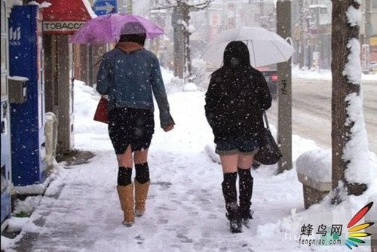
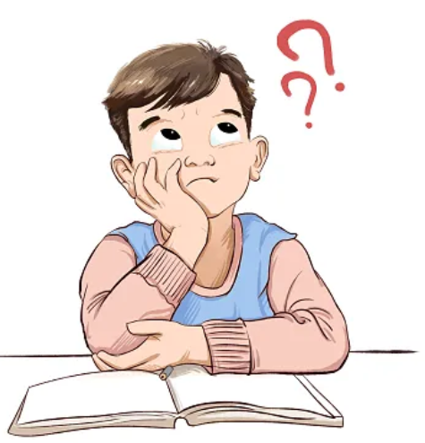
Careful-reading
Read para5 and answer.
What does the writer think of fashion?
Are they fashionable？
Are they suitable(适合) for us?
What’s your own idea about fashion?

Slide 20
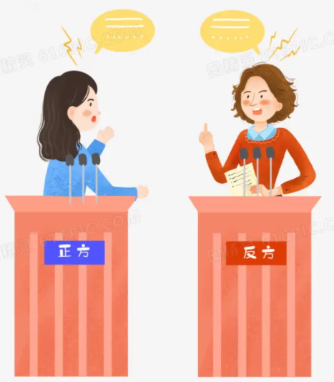
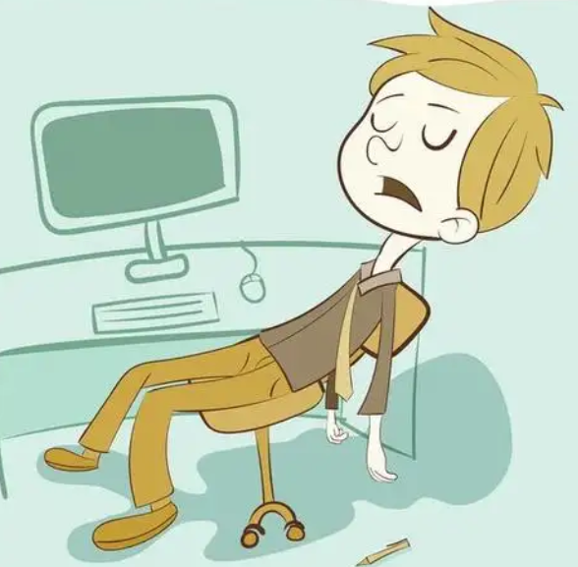
Group work
Further-discussion
Should we follow the fashion at school?
S1: We _______(should/shouldn’t) follow the fashion at school.
S2: Because ...
time
money
energy
study

Slide 21
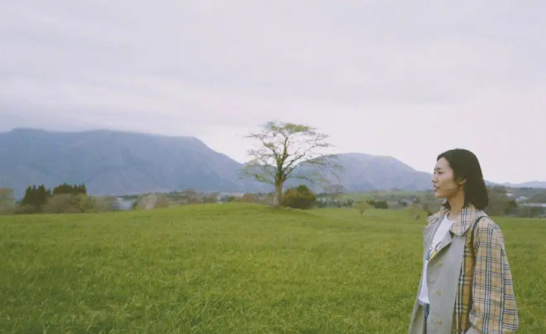
True fashion is not a kind of appearance(外表),but an inner(内在). Only inner beauty is the true fashion.
So, do not blindly(盲目) follow trends(潮流).
Just be yourself!

Slide 22
Homework
Suppose you are going to a fashion show in Paris.Write a short passage about what you see in the show.

Slide 23
Thank you!

Slide 24
outer beauty
unhappy
colors
materials
uncomfotable
Fashion
anxiety
clothes
fashion bullying
looks
feelings
non- confidence
inner beauty

