Slide 1
True grit is the mother of success
—— Gu Jingyun
Xue Jia Middle school

Slide 3
hard work
good looks
gift(天赋)
___?___ is the mother of success
failure
IQ
physical health

Slide 4
True grit(坚毅) is the mother of success
What
Why
How

Slide 5
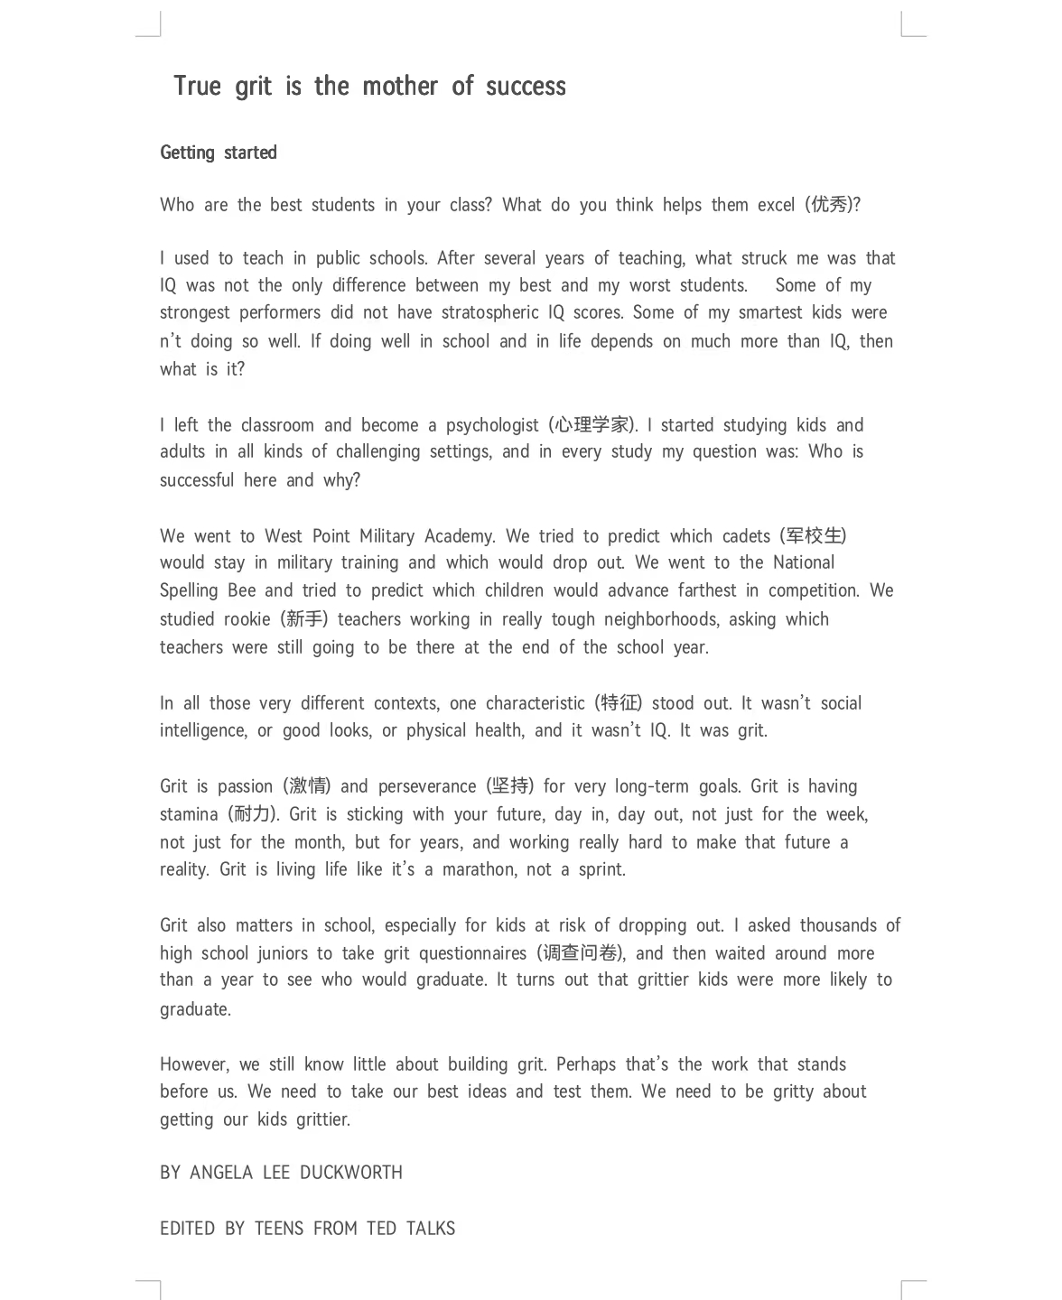
P1
P2
P3
What is grit
P4
P5
How the research is made
P6
How to build grit
P7
How grit matters in school

Slide 6
How the research is made:
Para1-Para3
Tip1 关键词定位
1.What did the writer learn from her years of teaching?
A. Teaching was less interesting than doing research
B. Students’ performances depend on their IQs
C. Education was more challenging than she expected
D. Students’ success didn’t necessarily relate to their IQs
2. What does the word predict in paragraph 3mean?
冥想 B. 预测 C. 想象 D. 归纳
Tip2
联系前后，一一代入

Slide 7
Read after the video
Grit is passion (激情) and perseverance (坚持) for very long-term goals. Grit is having stamina (耐力). Grit is sticking with your future, day in, day out, not just for the week, not just for the month, but for years, and working really hard to make that future a reality. Grit is living life like it’s a marathon, not a sprint.

Slide 8
What is grit:
Para4-5
Grit is passion (激情) and perseverance (坚持) for very long-term goals. Grit is having stamina (耐力). Grit is sticking with your future, day in, day out, not just for the week, not just for the month, but for years, and working really hard to make that future a reality. Grit is living life like it’s a marathon, not a sprint.
Definition(定义)
1.Which is the one with grit?
A. Simon promises to improve his skills and has kept practicing for 6 hours today.
B. Sandy is full of energy and always wins the first in race
C. Amy has run for half an hour every weekend for 5 years
D. Andrew is clever enough to finish all the homework without spending much time
Examples（举例解释）

Slide 9
How grit works:
Para6
Grit also matters in school, especially for kids at risk of dropping out. I asked thousands of high school juniors to take grit questionnaires (调查问卷), and then waited around more than a year to see who would graduate. It turns out that grittier kids were more likely to graduate.
1. Can we cut out(删掉) paragraph 6? Why?
To test whether the result
is right and give a convictive(有说服力的) example
Tips:
2. To make a research we should make sure of _______________ samples(样本) and wait_______________ time
scientific and objective(客观的)
a large number of
enough long

Slide 10
How to build grit:
Para7
1.How can we understand the
last sentence?
A. The team has difficulty taking actions to be gritty
B. The kids will work hard to become gritty
C. The writer will also have to carry on with the research with great grit
However, we still know not much about building grit. Perhaps that’s the work that stands before us. We need to take our best ideas and test them. We need to be gritty about getting our kids grittier.
2.what’s the purpose of the speech?
To prepare students for their future lives B. To help teachers find smart kids
C. To inspire us to learn psychology. D. To explain the power of grit

Slide 11
The mind map
a ______ in public school at first
teacher
a __________ later
psychologist
Study question:__________________________
Who is successful here and why
West Point Military Academy
National Spelling Bee
Tough neighbourhoods
stay
advance farthest
Which teachers
remained
Whether to ______in military
training or __________
Which children____________
drop out
grit
__________ matters most
Mind:?
Action?
passion
perseverance
stamina
_______
__________

Slide 12
The precondition(前提)of building strong grit is :
Growth mindset
You must believe that you can improve your ability through hard work.

Slide 13
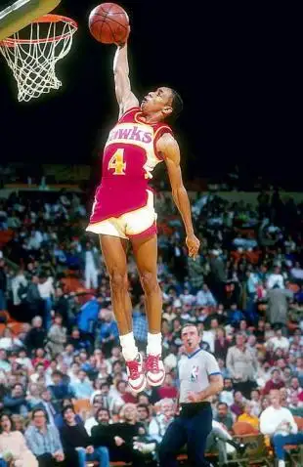
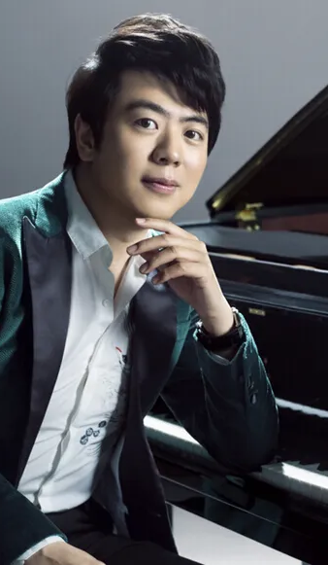
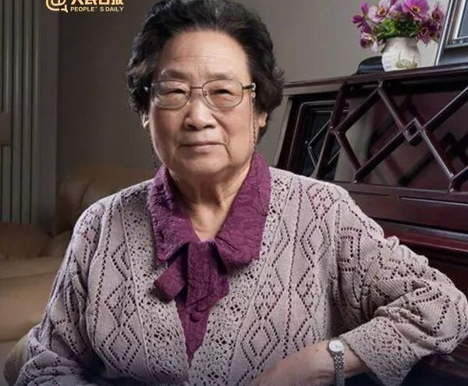
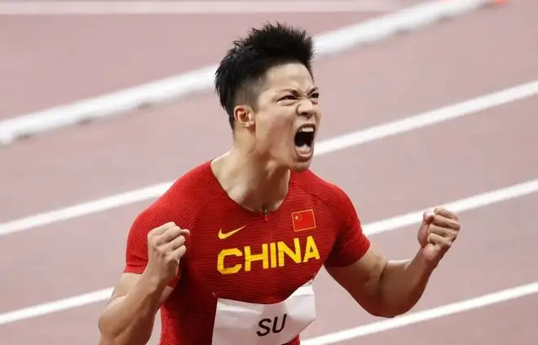
Athlete
Musician
Scientist
Athlete
Athlete
Great men in different fields

Slide 14
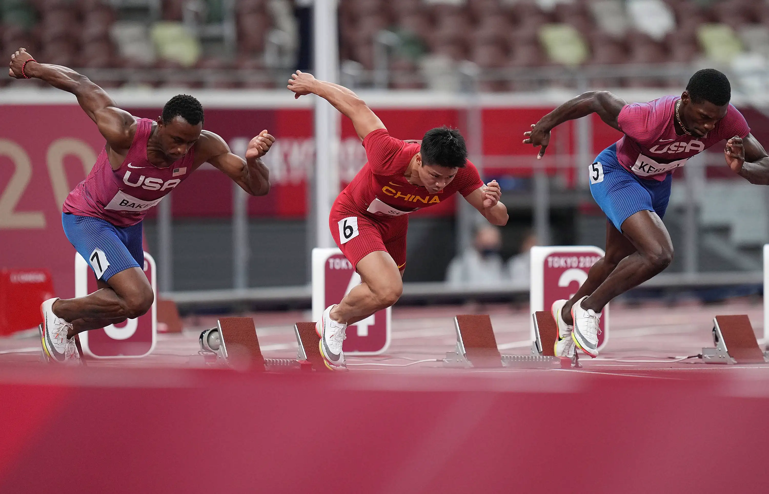
Scan and find the information
‘Known as the fastest Chinese man, Su Bingtian made history and brought an unforgettable moment for the world in the summer of 2021.
How did Su Bingtian
build grit ?
But the way to success was never easy for Su. Because of an injury (受伤), Su had to stop running for several years. He even planned to retire (退役) in 2017. But the call to challenge himself brought Su back to the track (跑道). To increase his strength, Su trained even harder than before. He realized that finishing the semifinal in less than 10 seconds would earn him the chance to enter the final competition. To encourage himself, Su set a personal goal of 9.89 seconds. He even made the number his personal password for his phone and computer. Luckily, his efforts paid off.’

Slide 15
How he built grit:
1. have the call to________________
2. set _______________ 9.89 seconds
3. __________________ to increase his strength
4. make the number 9.89 his _______________________________
_____________________________
challenge himself
a personal goal of
Be full of passion
Set a proper goal
Su Bingtian
Train even harder than before
Train hard enough
Have daily reminder
personal password for his phone and computer
Build grit

Slide 16
Use grit to solve your problem:
A: I want to improve my ……….., but I have no idea.
B: Take it easy, grit is the key to success.
A: How to be gritty?
B: First you should have a growth mindset. You must believe…………
A：I see, I think I will be confident of myself.
B: Then you should set……….
A: Ok, I want to ………(具体目标)
B: You must also work hard enough.
A: I plan to ………..…………..and…………（具体行动）
B: what’s more, often remind yourself of your goal and try your best.
A: Thanks, I will let you know if I make it.

Slide 17
have learnt
Since this term, we 1_________(learn) about many great men, 2___________Spud Web and Anne Frank. Because of the 3________(high), Sup Web met many difficulties and Anne Frank died from the war. But both of them had great grit and they never gave up 4___________ (realize) what they want.
Grit is 5___________ (value) to all of us. It is _________, perseverance and ____________(毅力的定义). 6___________ we want to build grit, we should first have a growth mindset. it means we must believe that our abilities can 7______________(change) through our hard work.
And we must take actions to try to build our grit. First, we should _____________________. Second, we should set __________________ and then ________________________.Besides, we should often remind ourselves of our goal and keep 8_________ on mind.
As for me, I have made up my mind 9.________(improve) myself in _________________. I think I can challenge 10_________(me). i set a goal of /that_______________________(具体目标). I plan to _______ _________________________________________________________(具体的措施) and compete with my classmates to see whether we can achieve it.
like
height
realizing
valuable
passion
stamina
If
be changed
have passion
a proper goal
hard enough
it
to improve
myself

Slide 18
Always trust yourself
set a proper goal
keep practicing day in , day out
give yourself encouragement
With strong grit, you can achieve whatever you want

Slide 19
Homework:
1. share the passage with classmates
2. watch the complete video and borrow the books about the grit to read

