Slide 1

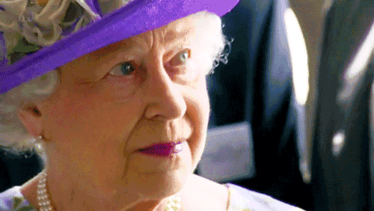
Discussion
What happened to her recently?
Do you know her?
Do you like her?
Why?
Do you feel sad?
Why?
Queen Elizabeth II

Slide 2





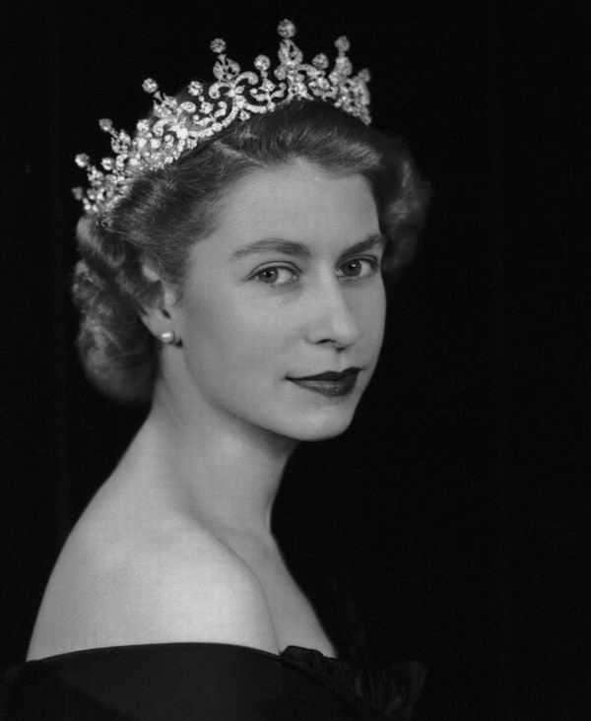


A loss felt
around the world
Teacher：Siyue Zhu

Slide 3

Contents
1.A video about Queen
2.Queen passed away
3.Queen’s visit to China
4.Queen’s Corgis
5.UK pounds with
Queen’s face

Slide 4
Let’s watch a Video

Slide 5


Questions
1、How many children does the queen have?
2、Who will be the next king?
3、Do you think she is a great queen? Why?

Slide 6
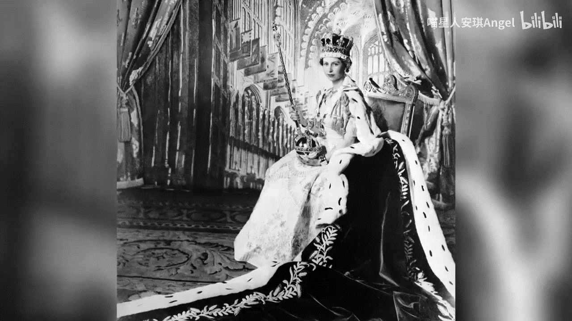

Slide 7
Questions
1、How many children does the queen have?
2、Who will be the next king?
3、Do you think she is a great queen? Why?
Four
Her son Charles
Yes, because…

Slide 8
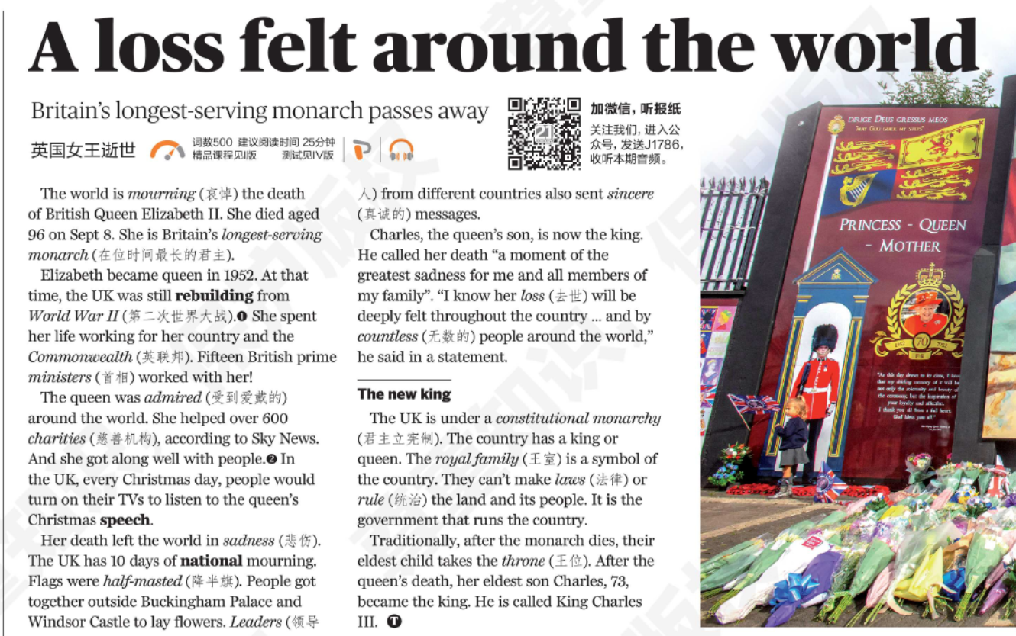
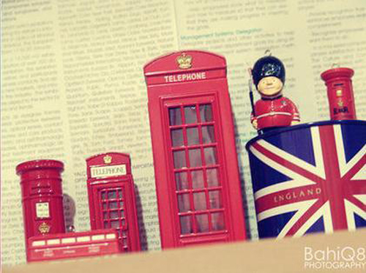
Learning tips
Prediction
What can you know from the title?

Slide 9
Learning tips
Prediction
1、What does loss mean?
2、Why it is a loss?
3、Why it is a loss felt around the world?

Slide 10
Learning tips
Vocabulary
longest-serving monarch
minister
首相
在位时间最长的君主
Loss/death
去世
countless
无数的
half-masted
降半旗
admired
受到爱戴的

Slide 11
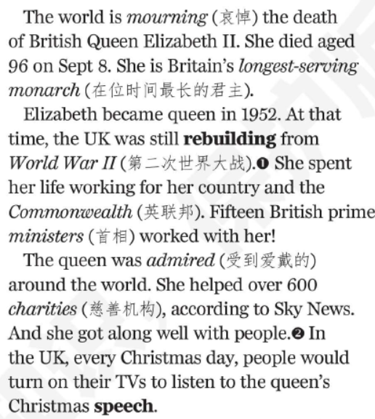

Read Paragraph 1-3 and answer the following questions
1、How old is she when she passed away?
96
2、Can you guess the meaning of “rebuilding”?
Build again
3、Do you know anything about the Commonwealth?
4、Was queen admired around the world? Why?
Yes
5、How do people show their respect to the queen?

Slide 12



Commonwealth
The commonwealth is made up of 53 countries around the world and they have the same queen or king!
Canada
Australia

Slide 13
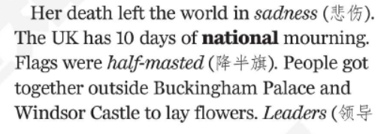

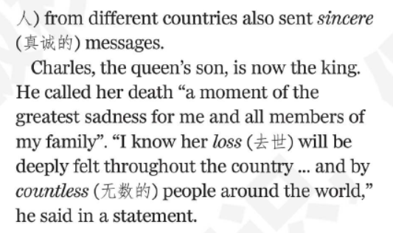
Read Paragraph 4-5 and tell if sentences are True or False
1、The UK has half a month of national mourning.
F
2、People lay flowers before her homes.
T
3、Charles thinks Queen’s death has nothing to do with the people around the world.
F

Slide 14
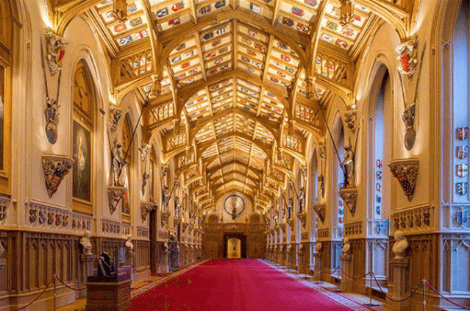
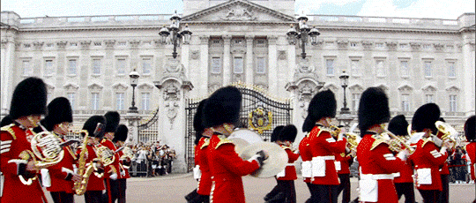
Queen’s homes
Buckingham Palace
Windsor Castle

Slide 15
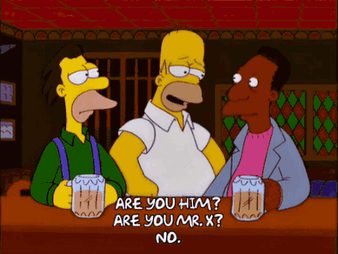
Make a dialogue about Queen Elizabeth II
A: Do you know that Queen passed away?
B: Yes, of course!
A: Do you want to live in her big houses?
B:__________________________________________
A: Why?
B:__________________________________________
A: Do you feel sad about her death?
B:__________________________________________
A: Why you feel/don’t feel sad about
her death?
B:__________________________________________

Slide 16
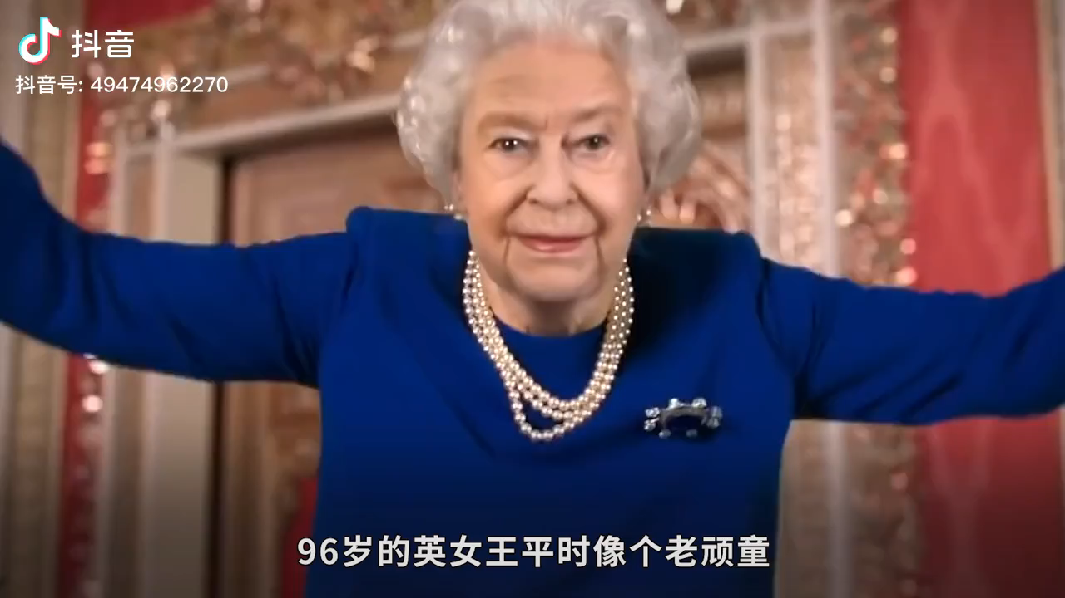
Interesting Facts

Slide 17
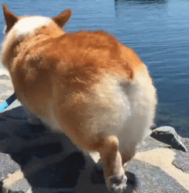
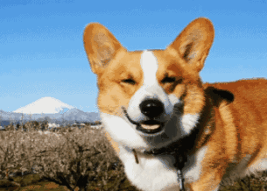
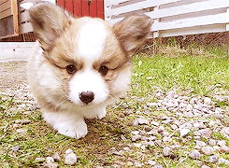
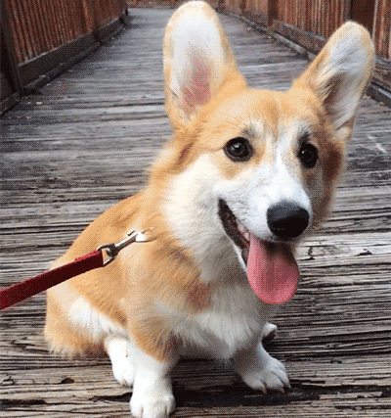
What kind of animal did she like most?
Corgi!
Corgi!
Corgi!
Corgi!

Slide 18
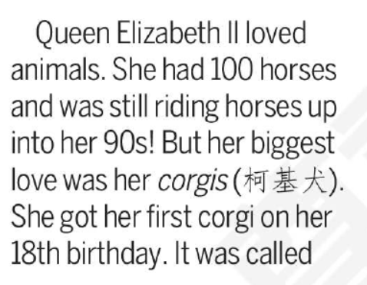
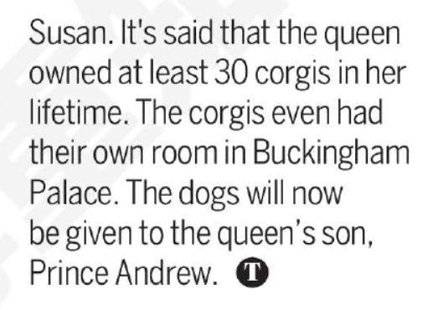
Read the paragraph about Corgis and fill in the form
Animals
Horse & Corgi
First Corgi
18th
birthday
Her name
Susan
How many
At least 30
Future Master
Prince Andrew

Slide 19
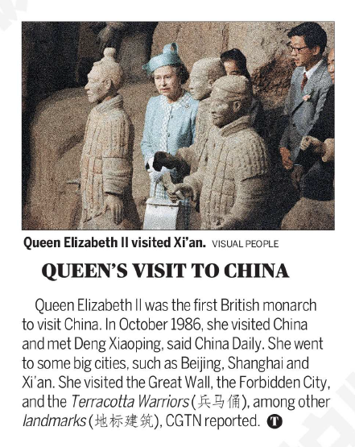
Read the paragraph and match
Beijing Shanghai
Xi’an
Who
Forbidden City
Terracotta Warriors
City
Landmark
Deng Xiaoping

Slide 20
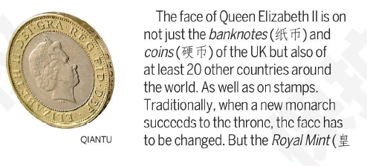
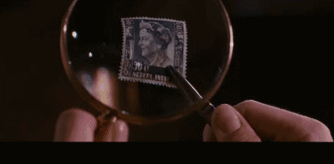
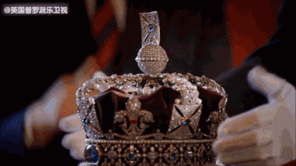
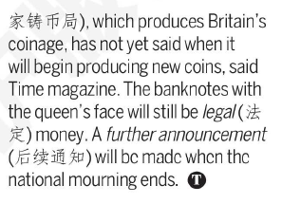
Read the paragraph and guess the meaning and translate the sentences
stamp
throne
Traditionally, when a new monarch succeeds to the throne, the face has to be changed.

Slide 21
Group work: If you are the queen what you will do for the students?
food
study
school life
travelling for three days with classmates every term
have a PE lesson everyday
two students in one dorm
watch a movie every week
have a school basketball
game
every term
……….
you will have 30 minutes for breakfast
you will have a small shop on campus
you can eat snacks after class
…….
20 students in one classroom
everyone has a computer
school finishes at 5:00 p.m.
talk freely in class
Less homework
……
happy
relaxed
If I am a queen, I will let the students have 30 minutes to have breakfast. For example, the students can drink some milk or coffee and choose the food that they like and they can talk with their classmates about the interesting things at school. Because we only have 5 minutes to eat and we can’t talk now. I feel very unhappy and fast. I even have the food in my mouth on my way back to the classroom. I want to be happy and healthy so I will do this for my students. (50words)

Slide 22
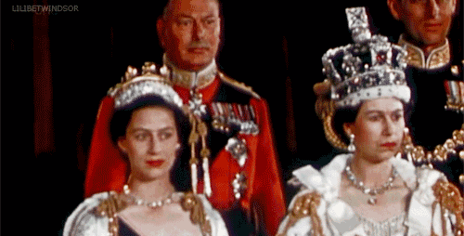
Be a good leader
He who would wear his crown must bear his weight!

Slide 23
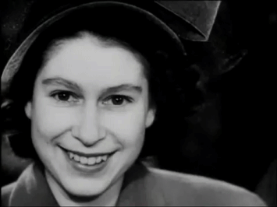
R.I.P Thank you!

